Slide 1
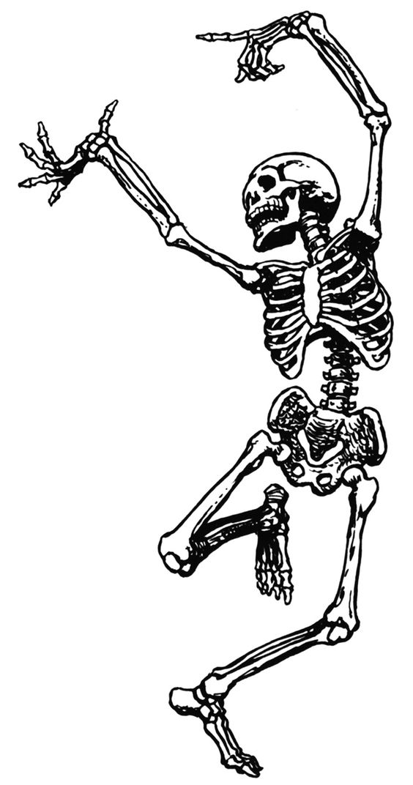
Radiology of the Brainstem and Cerebellum
Second Lecture
Color index Important
Doctor’s note Extra explanation
Team 437 Radiology
Neuropsychiatry Block
Lecture objectives:
1- Identify radiological anatomy of brainstem and cerebellum.
2- compare CT and MRI imaging of brainstem and cerebellum.
3- Recognize the imaging findings in common diseases involving brain stem and cerebellum.

Slide 2
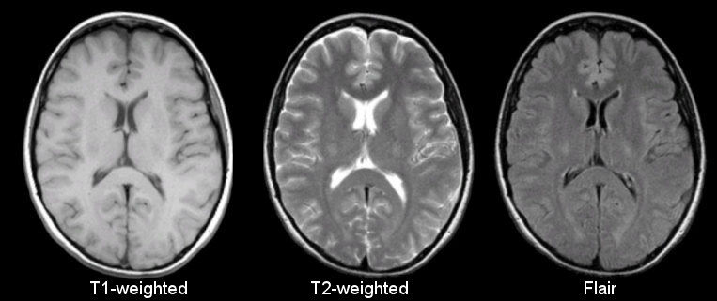
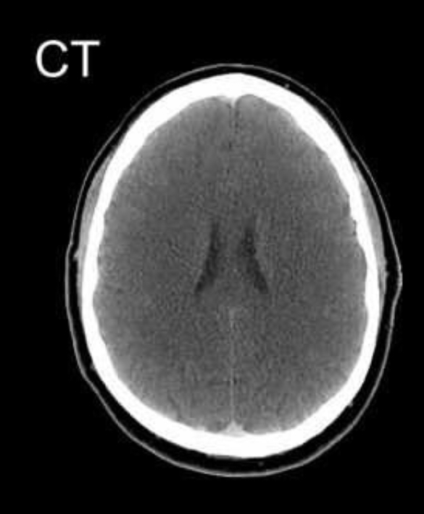
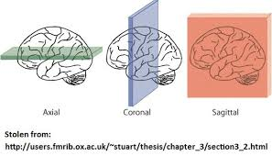
Extra information
MRI:
The differences between MRI sequences :
Tissue | T1-Weighted | T2-Weighted | Flair
CSF | Dark | Bright | Dark
white matter | Light | Dark Gray | Dark Gray
cortex | Gray | Light Gray | Light Gray
Inflammation (infection, demyelination) | Dark | Bright | Bright
how to differentiate between T1 and T2 sequences?
In general, T1- and T2-weighted images can be easily differentiated by looking at the CSF, CSF is dark on T1-weighted imaging and bright on T2-weighted imaging
how to differentiate between a CT scan and MRI ?
We can use the appearance of bone as a reference CT scan : bright , MRI : dark
Anatomical planes :
Some terms that are used in describing abnormalities :
In MRI : In CT scan:
hypointense/dark hypodense /dark
hyperintense/bright hyperdense/bright

Slide 3
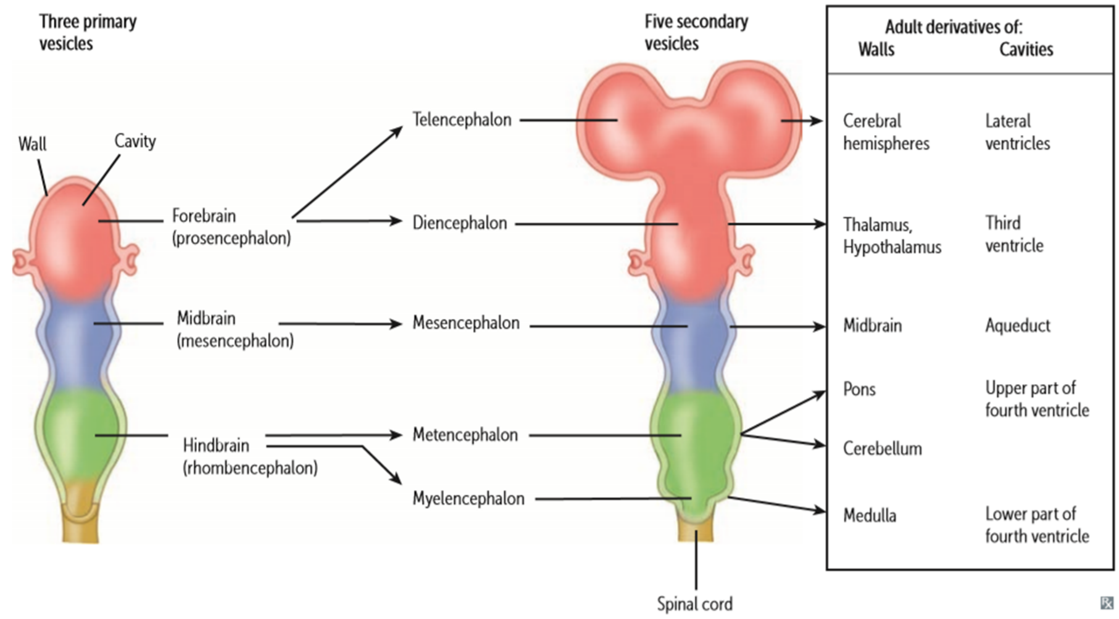
Brain divisions:
The three major divisions of the brain:
1- Prosencephalon: Forebrain
Diencephalon: thalamus , hypothalamus
Telencephalon: cerebrum
2- Mesencephalon: Midbrain
3- Rhombencephalon: Hindbrain
Metencephalon: Pons and Cerebellum
Myelencephalon: Medulla Oblongata

Slide 4
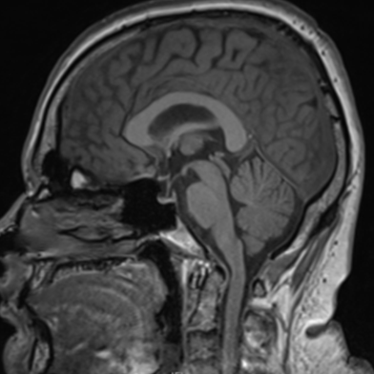
MRI T1WI*
Brain stem:
-Three parts from superior to inferior:
1-Midbrain
2-Pons
3-Medulla oblongata
-It connects cerebral hemisphere
with spinal cord.
1
2
3
*MRI T1 Weighted: the CSF is dark.

Slide 5
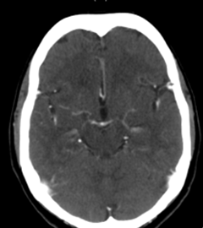
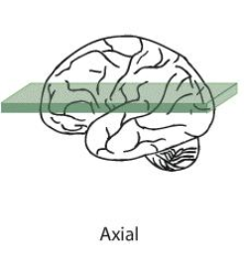
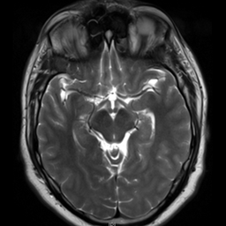
Midbrain:
Radiological features of the midbrain:
-At the level of circle of willis. (The major blood supply to brain)
-Anteriorly two cerebral peduncles separated by interpeduncular fossa.
-posteriorly four rounded prominences (superior and inferior Colliculi).*
MRI T2WI (CSF appears white, so it’s T2)
CT
*Together they are called the Quadrigeminal plate
Midbrain

Slide 6
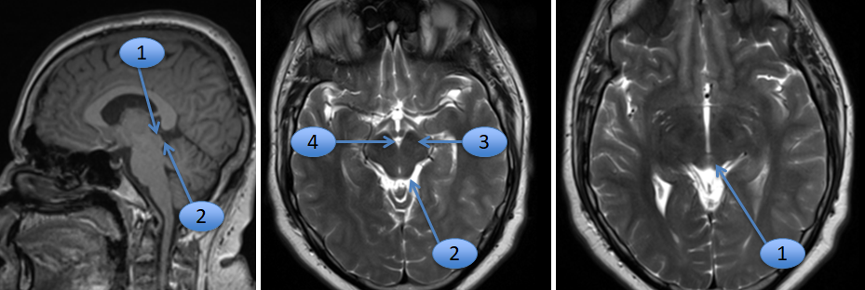
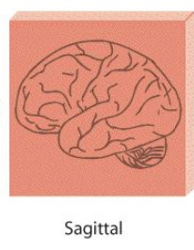
Midbrain:
1- Superior colliculus
2- Inferior colliculus
3- Cerebral peduncle
4- Interpeduncular cistern
-MRI views:
T1: Dark fluid
T2: White or Bright fluid
MRI T1WI
MRI T2WI
Sagittal
Axial

Slide 7
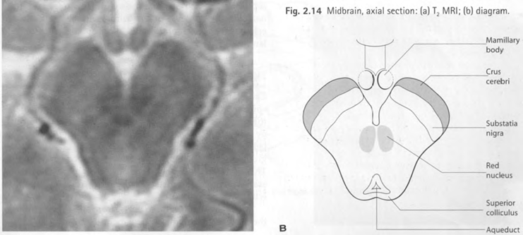
Midbrain:
Internal features:
-Substantia nigra separates crus cerebri ventrally from tegmentum posteriorly* -Red nuclei are dorsal to substantia nigra at the level of superior colliculi.
-Both of Red nuclei and substantia nigra appear dark in MRI T2 because they contain iron.
*

Slide 8
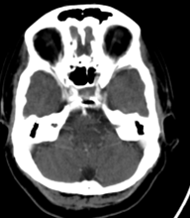
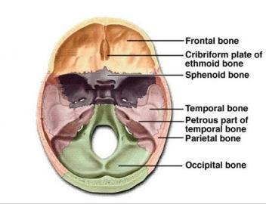
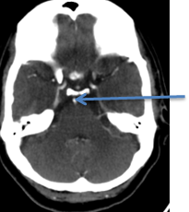
Pons:
CT+
Petrous bone
Radiological features:
-The bulbous anterior part consists
mainly of fibers continuous on each
side with middle cerebellar peduncle.
-Basilar artery lies in groove anteriorly.
-Posterior surface of the pons forms
the upper part of the floor of the 4th
ventricle.
-Bony anterior relation:
clivus centrally and petrous temporal
bones laterally.
Basilar Artery

Slide 9
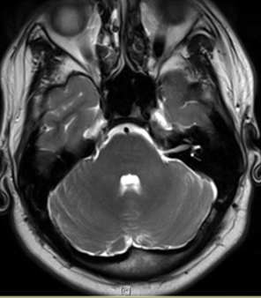
Pons:
P- Pons
1- 4th ventricle*
2- Basilar artery
3- Middle cerebellar peduncle
*White because there’s fluid and T2WI makes fluid appear whitish
MRI Axial T2WI
MRI Sagittal T1WI
2
P
P
3
1

Slide 10
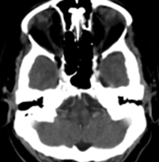
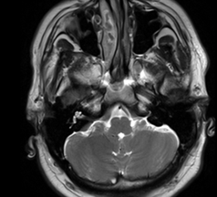
Medulla Oblongata:
radiological features:
CT + MRI axial T2WI
MRI imaging of the medulla gives superior
images to CT due to lack of bony artifact.
The ventral median fissure is seen anteriorly
with the pyramid laterally.
The 4th ventricle is seen posteriorly.
Medulla

Slide 11
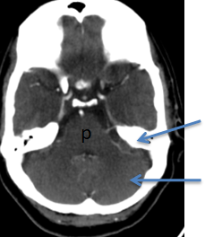
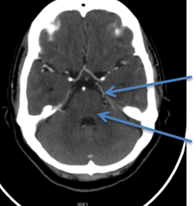
Cerebellum:
-Cerebellum is connected to the brainstem by three pairs of cerebellar peduncles:
Superior..........connected to the midbrain
Middle.............connected to the pons
Inferior..............connected to medulla oblongata
CT+
Radiological Features:
-On axial CT & MRI the cerebellum is separated from the Pons by the 4th ventricle and is connected to the Pons on each side by the middle cerebellar peduncle, it is bounded anteriorly by petrous temporal bone.
Petrous bone
Cerebellum
-On higher slices it is separated from the temporal and occipital lobes anterolaterally by tentorial margins, tentorium can be seen on contrast enhanced studies owing to the contained superior petrosal sinus
Tentorium
Middle cerebellar peduncle

Slide 12
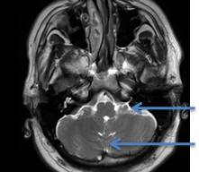
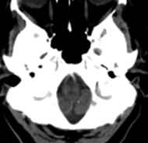
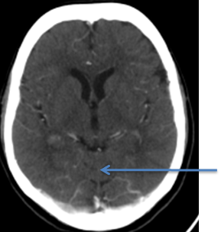
Cerebellum:
MRI Axial T2 WI
-Two cerebellar hemisphere with midline vermis. -Flocculus is a small ventral portion of the hemisphere.
flocculus
vermis
Axial CT
MRI Sagittal T1 WI
-Tonsils are the most anterior inferior part of the
hemispheres that lie close to the midline.
tonsil
-The superior vermis can be seen between occipital
lobes on section through the thalamus.
tonsil
CT+
Superior vermis

Slide 13
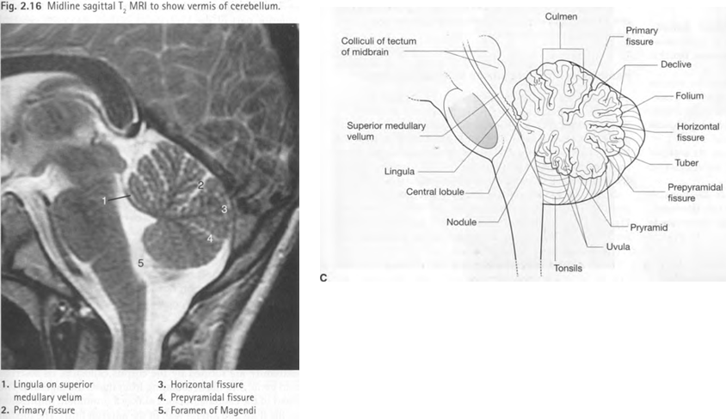
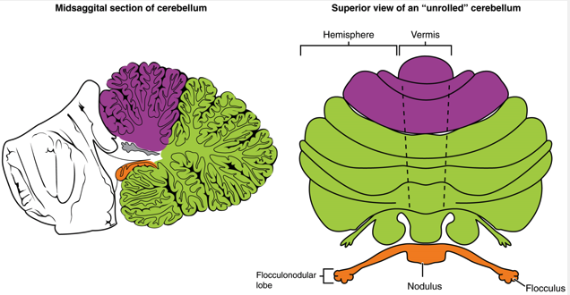
Cerebellar Vermis:
-Most important fissures are the Primary and Horizontal fissures.
-Cerebellar vermis is only visible through the midline
-The cerebellar vermis has 3 Fissures and 9 Lobules

Slide 14
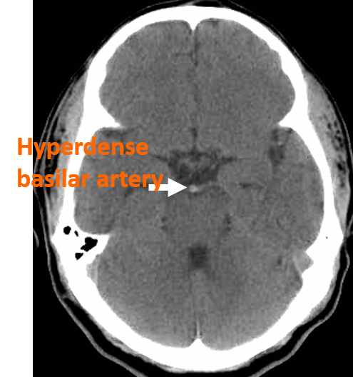
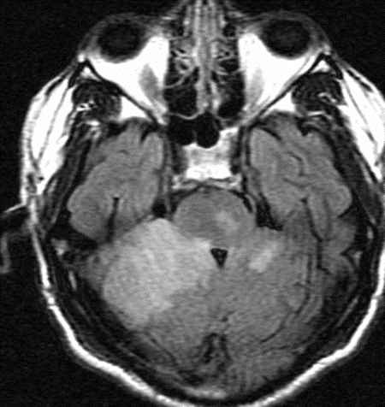
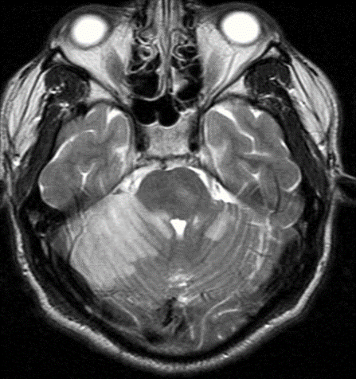
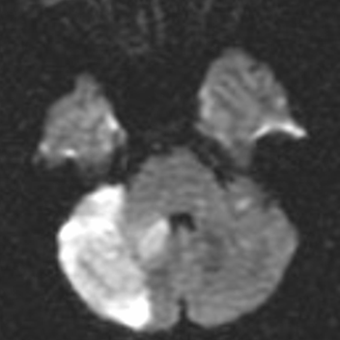
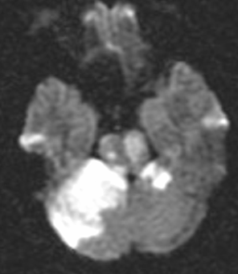
Common diseases of brainstem and cerebellum:
1-Acute infarction due to basilar artery thrombosis
-MRI is better in detecting infarctions than CT
CT*
MRI axial flair
MRI axial T2 WI
*Normally vessels don’t appear bright,
The bright appearance indicates a thrombus
Diffusion sequence
-Diffusion- Weighted MRI is very sensitive in detecting infractions very early, that’s why it’s very important in such cases.
-The infarcted tissue appears very white

Slide 15
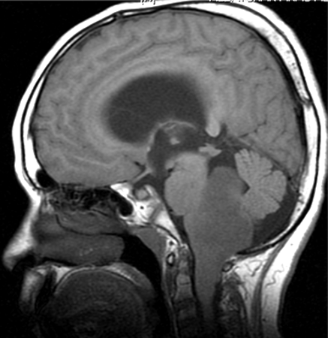
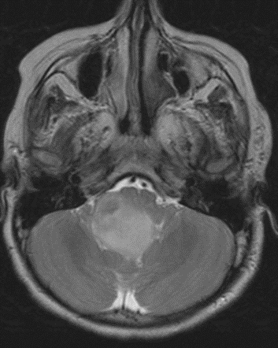
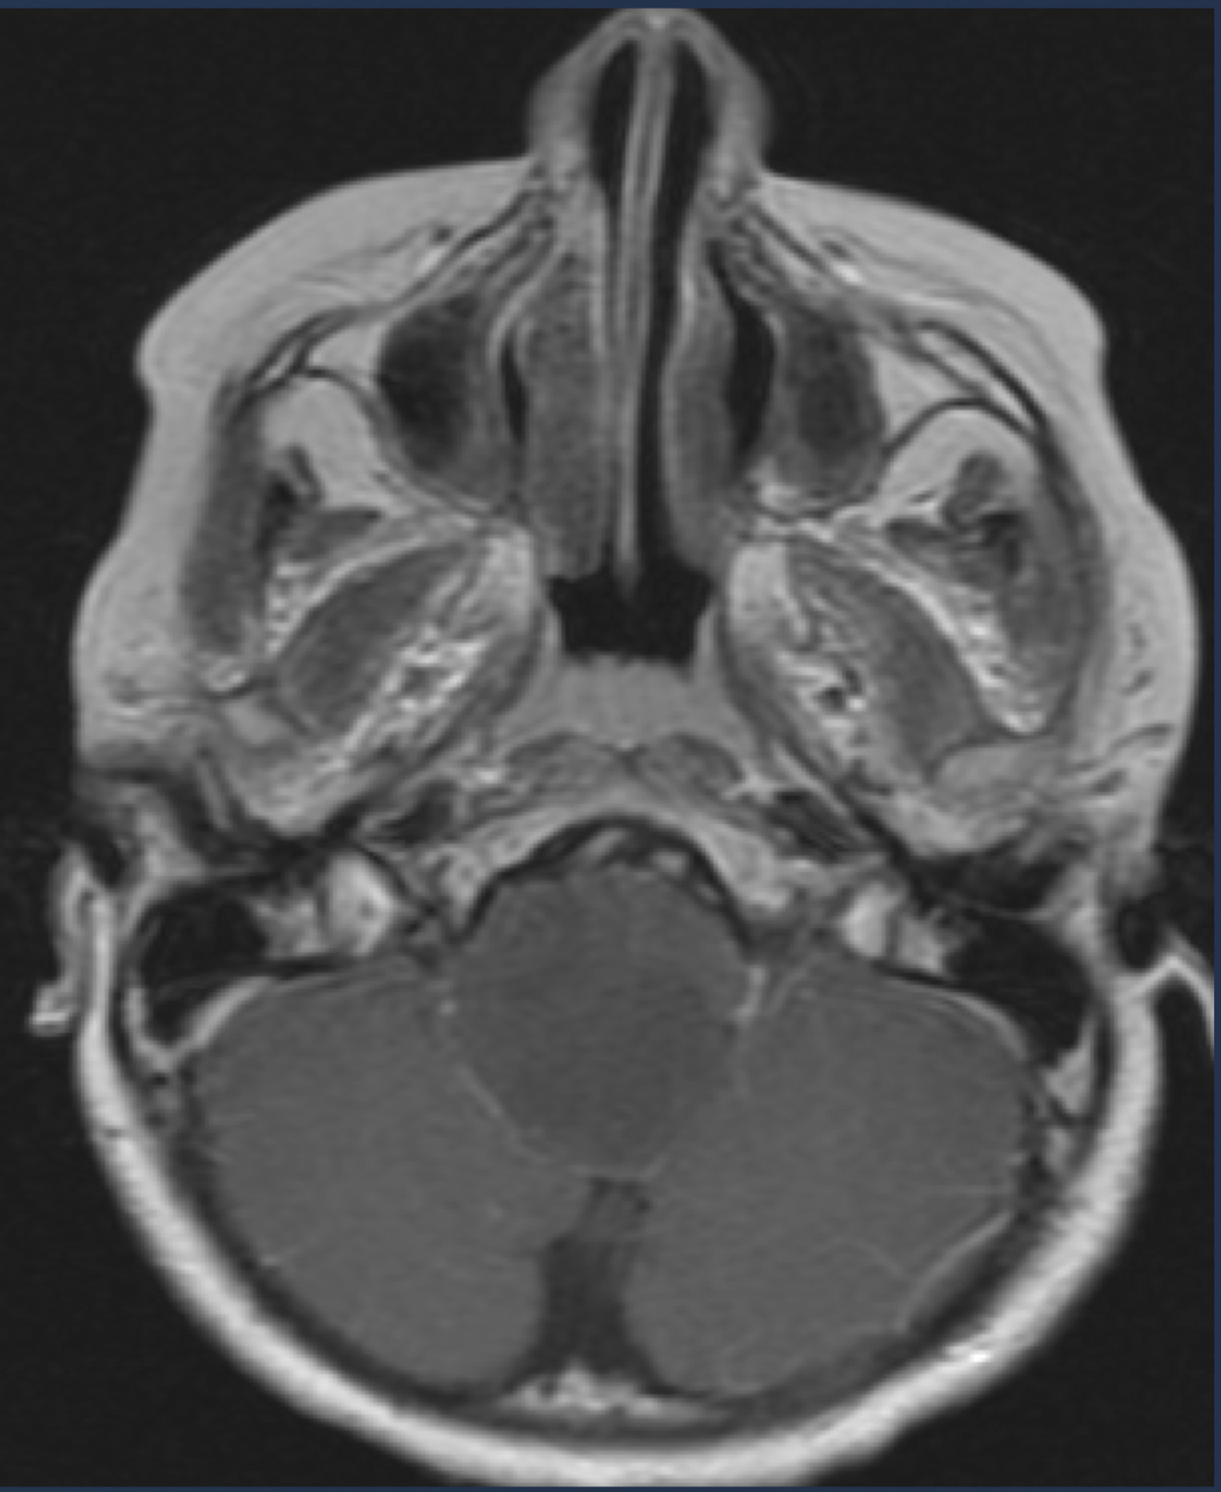
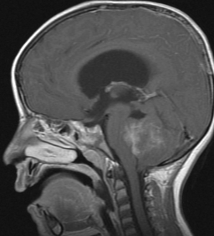
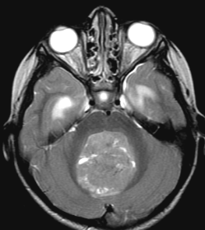
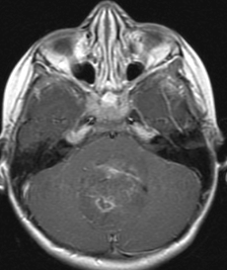
2. Brainstem Glioma
-The Tumor is arising from the posterior part of the Medulla Oblongata
the mass is compressing the 4th ventricle
-Obstruction of the 4th ventricle leads to hydrocephalus
Sagittal MRI T1 WI
axial MRI T2 WI
axial MRI T1 WI contrast
3. Medulloblastoma
-The Tumor is arising from the Cerebellum and part of the 4th Ventricle.
Sagittal MRI T1WI contrast
Axial MRI T2 WI
Axial MRI T1 WI contrast
-Because the 4th ventricle is obstructed the lateral ventricle is dilated
-Common in pediatric patients

Slide 16
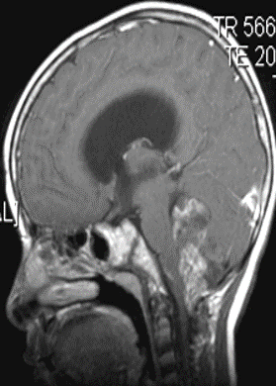
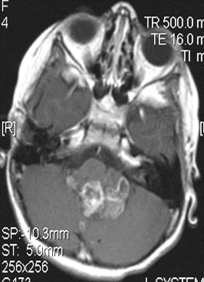
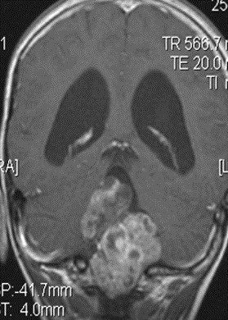
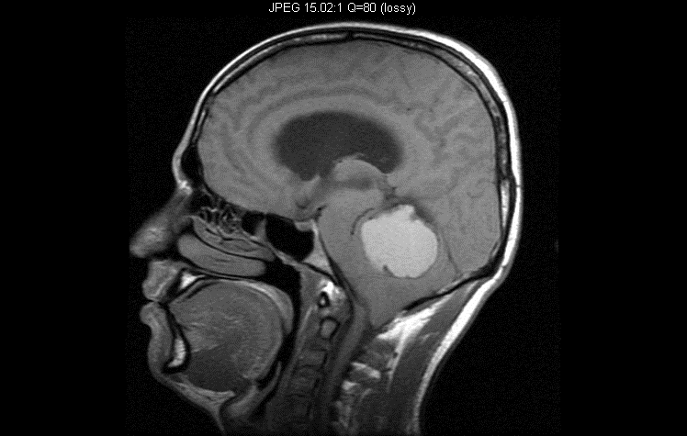
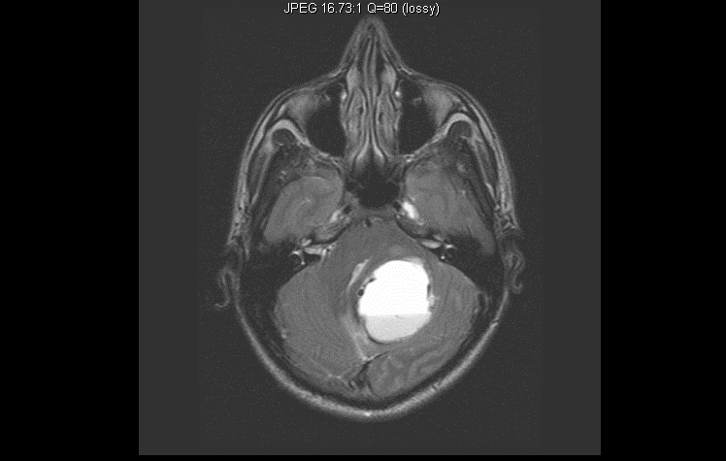
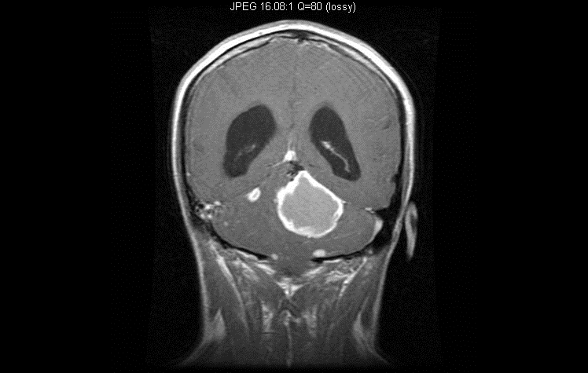
4. Hemangioblastoma
3-Ependymoma
-Within the 4th ventricle , the tumor extends through the outlet foramina beyond the 4th ventricle into the foramen of magendie “characteristic for Ependymoma”
Sagittal MRI T1 WI contrast
axial MRI T1 WI contrast
Coronal MRI T1 WI contrast
-Multiple small other lesions appear only with contrast
Sagittal MRI T1 WI
Axial MRI T2 WI
Coronal MRI T1 WI contrast
-Vascular tumor.
-The mass is bright on T1
-Not within the 4th ventricle
-The mass is within the cerebellar hemispheres

Slide 17
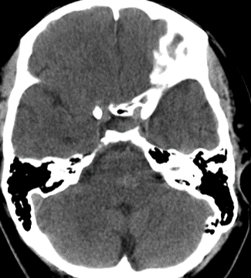
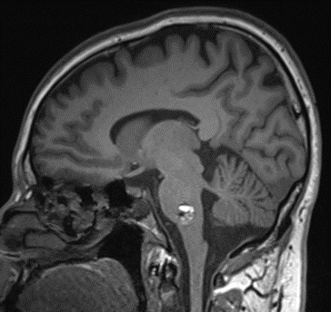
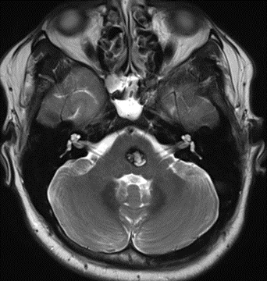
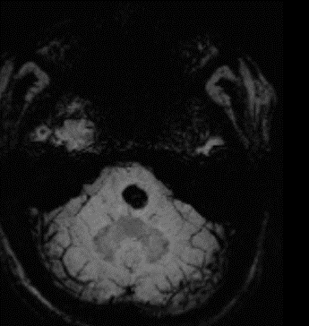
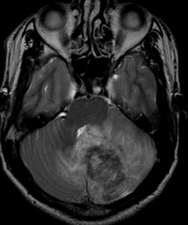
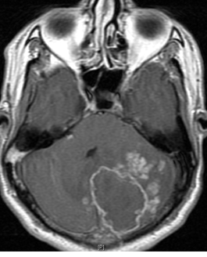
5. Cavernous Angioma
*MRI SWI:
Good to detect hemorrhage and calcification
- Cavernous Angioma is a Vascular malformation, here we can see it in the central part of Pons.
-Benign tumor
CT
Sagittal MRI T1 WI
Axial MRI T2 WI
Axial MRI SWI*
6. Cerebellar tuberculosis
Axial MRI T2 WI
Axial MRI T1 Contrast
-Affecting the Left side of Cerebellum.
-Tiny nodules around the mass indicate an infection
-Extensive edema

Slide 18
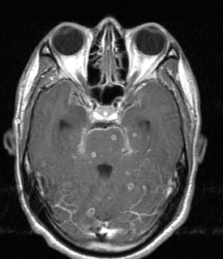
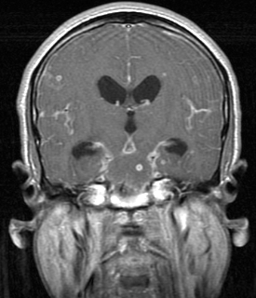
7. TB meningitis with multiple tuberculomas
-Affecting the left side of the Pons.
Axial MRI T1 Contrast
Coronal MRI
-Thickening of the Dura in.

Slide 19
MCQs:
Q2: the MRI in the second picture is showing Brain stem glioma .. from which part is it arising from ? A)) pons B)) cerebellum. C))medulla D))midbrain
Q1:The MRI is showing Medulloblastoma.. from which part is it is arising from ?
A)) pons B)) cerebellum. C))medulla D))midbrain
Q3: the MRI in the picture is showing Cerebellar tuberculosis .. from which part is it arising from ? A))right cerebellar B))middle cerebellar C))left cerebellar
Q4 : the arrow of number 1 is showing ..
A))lateral ventricle B)) inferior colliculus C))superior colliculus
1 B. 2 C. 3 C. 4 C.

Slide 20
Thank you for checking our work
Team Leaders:
Faisal Alqusaiyer Aljoharah Alshunaifi
Team members:
Afnan Almustafa Adel alzahrani Rawan Alrehaili Abdullah alsergani Abeer Alabduljabbar Abdulmalik alsharhan
Contact us on:
@Radiology437
Radiology437@gmail.com

