Slide 1
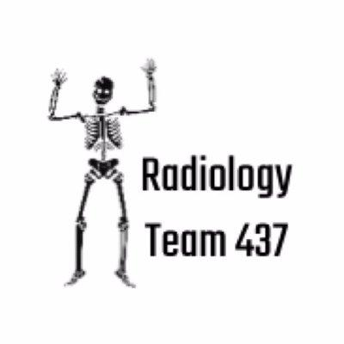
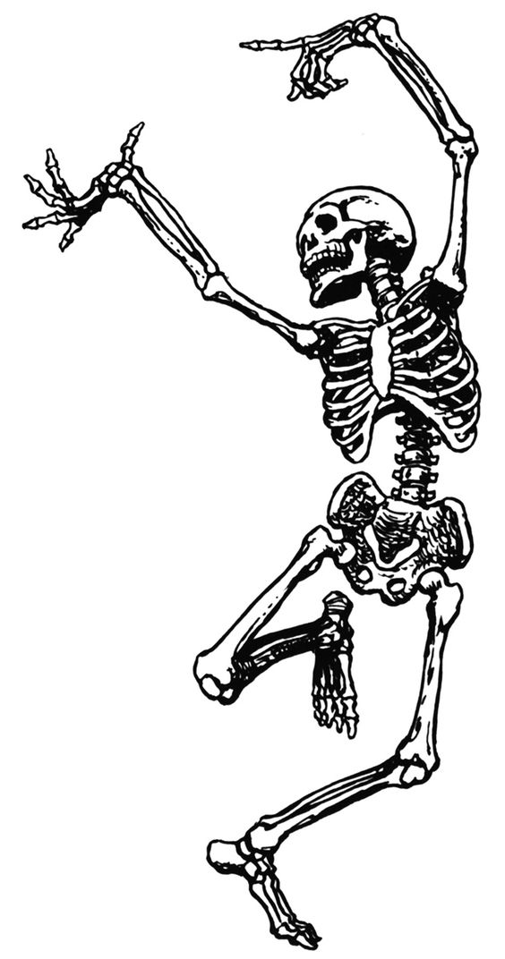
Radiology of the Spinal Cord
First Lecture
Color index Important
Doctor’s note Extra explanation
Team 437 Radiology
Neuropsychiatry Block
Lecture objectives:
1- Anatomy of spinal cord .
2- Anatomy of vertebral column.
3-Identify,and distinguish between common types of radiographic Images
4- You should also be able to recognize some radiological presentation of spinal cord diseases.

Slide 3
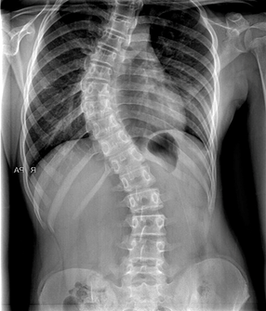
X-RAYS:
Characteristics:
-Often the first diagnostic imaging test
-Small dose of radiation to visualize the bony parts
-X-ray can detect:
Spinal alignment and curvature
Spinal instability-with flexion and extension views
Congenital (birth) defects of spinal column
Fracture caused by trauma
Moderate osteoporosis (loss of calcium from the bone)
Infections Not always
Tumors Not always
-X-ray image of a person who suffers from Scoliosis

Slide 4
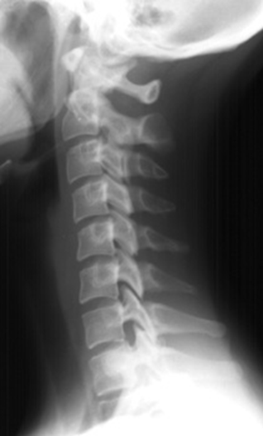
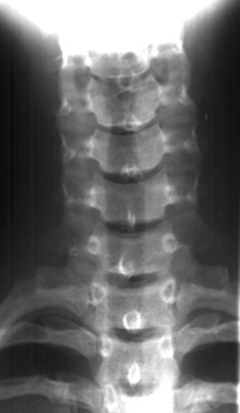
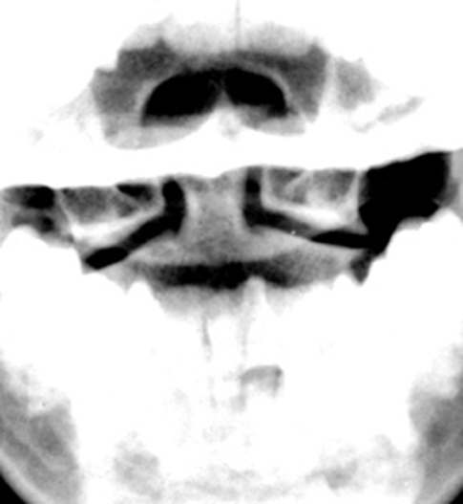
Lateral view
Anteroposterior (frontal view)
Open mouth view
C1
C1
C2

Slide 5
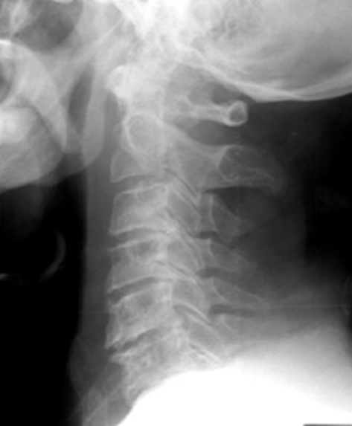
Is this film an adequate(acceptable) lateral film?
It’s not an adequate film because the 7th cervical vertebra is not seen in the image.

Slide 6
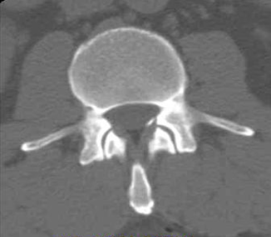
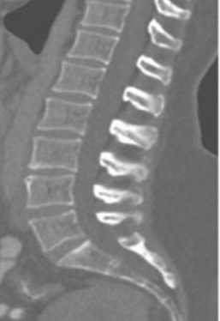
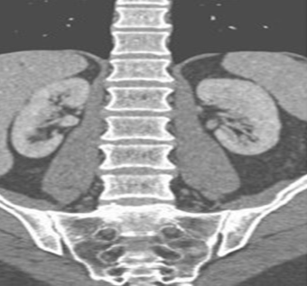
Computerized Tomography (CT SCAN):
-Uses radiation
-Obtain 2-D images (can be processed to 3-D images)
-Entire spine can be imaged within a few minutes
-Detailed information regarding bony structures
-Limited information about spinal cord & soft tissues

Slide 7
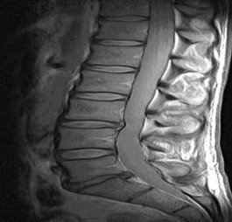
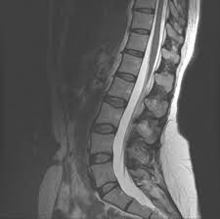
Magnetic Resonance Imaging (MRI):
T1 Weighted
-Gold standard of imaging for spinal cord disorders
-No radiation
-Can identify abnormalities of bone, soft tissues and spinal cord
-Claustrophobic(fear of small places) patients, uncooperative and children may need sedation or general anesthesia
-Contraindications include implanted devices e.g. cardiac pacemakers and electromagnetic devices
T2 Weighted
*CSF
*Cerebrospinal fluid appears white when taken by the T2 MRI method, while the T1 method makes the CSF appear darker.

Slide 8
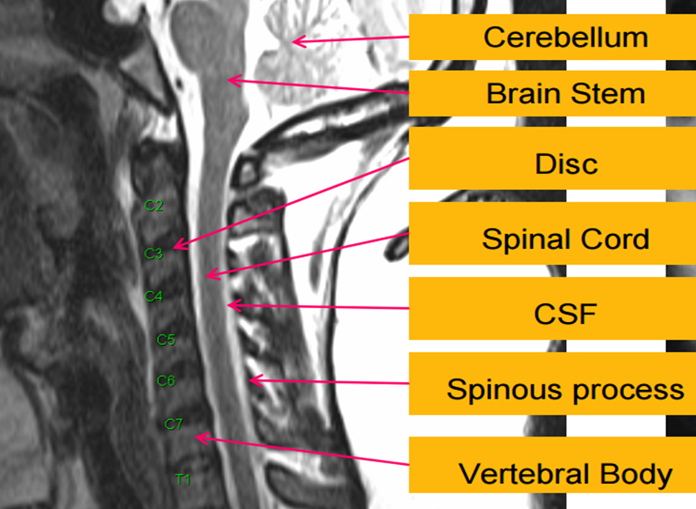
-It’s MRI T2, because the fluid is white

Slide 9
 | Indications (Usage) | Advantages | Disadvantages
X-ray | Trauma Intraoperative localization (in the middle of a surgery) | Inexpensive Widely available Quick Portable | Radiation exposure Difficulty in interpretation High rate of false-positive findings
CT | Trauma | Visualization of bony structures Widely available Quick | Less useful at visualizing soft tissue structures Radiation exposure Expensive
MRI | Patients with “red flags”case radiculopathy Tumor Myelopathy(injury to spinal cord) | Visualization of soft tissue structures (relationship of discs to nerves) No radiation exposure | Contraindications: presence of Ferromagnetic implants. cardiac pacemakers, intracranial clips, Claustrophobia(fear of small spaces Not widely available Expensive
-Red flag case = patient with dangerous symptoms

Slide 10
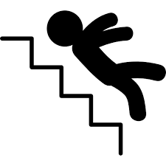
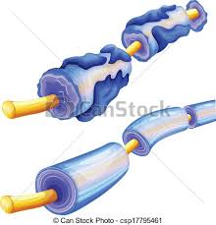
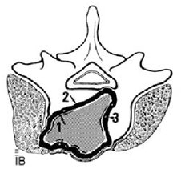
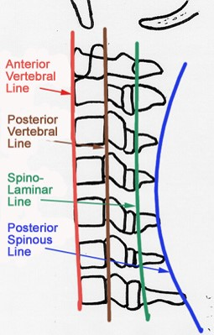
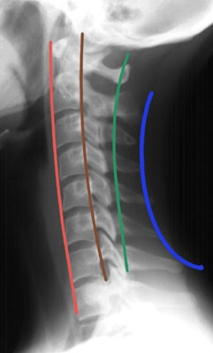
Abnormalities Of Spinal Cord:
Trauma
Congenital
demyelination
Tumors
Trauma
Usually the first series of images to be ordered by the physician Plain Radiographs (x-rays).
If fractures, or other bony defects are suspected CT images can provide very detailed information.
When soft tissue injury is suspected MRI is usually the imaging technology of choice.
.
Important
Accesses for parallel lines (imaginary lines):
1- Anterior vertebral line
2- Posterior vertebral line
3- Spinolaminar line
4- Posterior spinous line
Any malalignment should be considered as an evidence of injury.

Slide 11
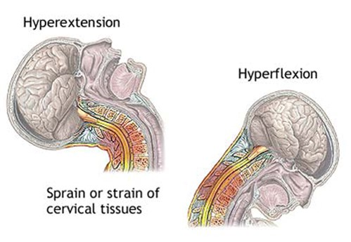
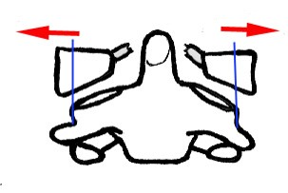
Mechanism Of Injury
For trauma there is several mechanism of injury Here is some examples:
Hyperextension:
a sudden backward acceleration of the skull creating extreme extension of cervical spines ,a common example is like hanging, or when the head hits the dashboard of the car in a car accidents.
Hyperflexion:
excessive flexion of the neck like when diving in shallow water ,could cause paraplegia
Compression Fracture
Type of imaging in All pictures listed below is X-ray
When you get a caudally directed force on your head (like when something heavy falls on yours head).
Normal open mouth view
Lateral mass splitting,
displacement more than 2ml

Slide 12
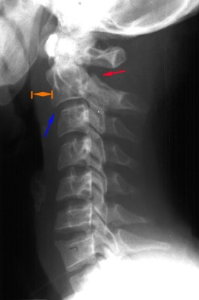
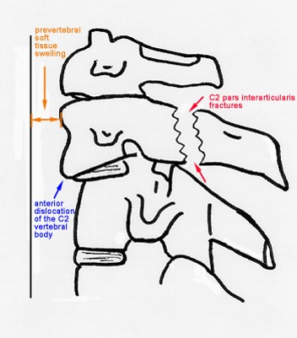
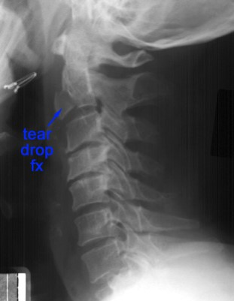
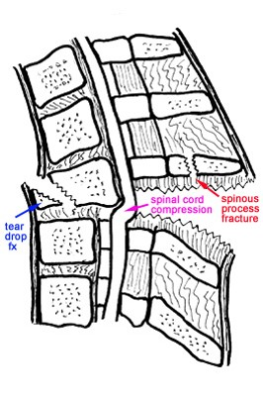
Type of imaging in All pictures listed below is X-ray
Hangman's Fracture (result of hyperextension)
A fracture which involves the pars interarticularis of C2 on both sides, and a dislocation of C2 , its a result of hyperextension and distraction
Normal lateral view
Hyperflexion
*
*The distance between spinal processes is wide
Normal lateral view
A tear drop fracture in the anterior margin of the vertebral body

Slide 13
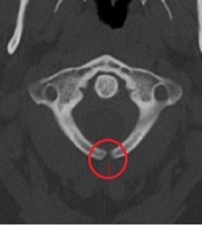
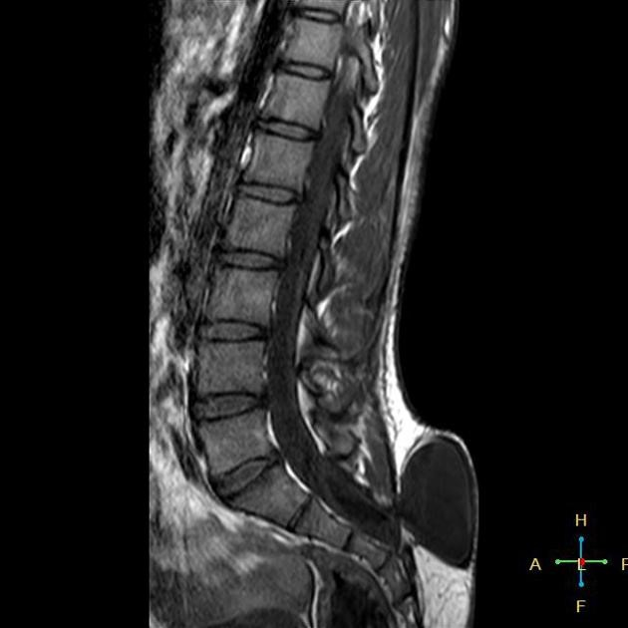
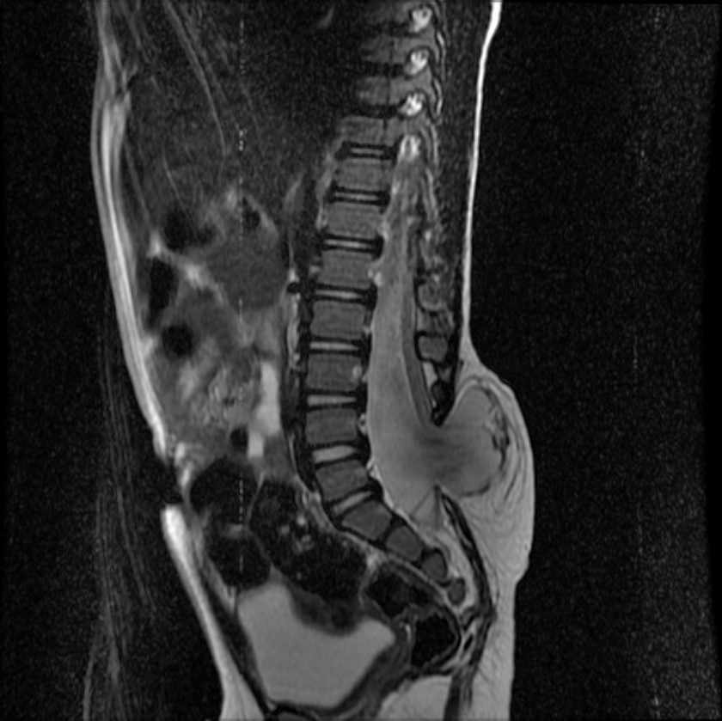
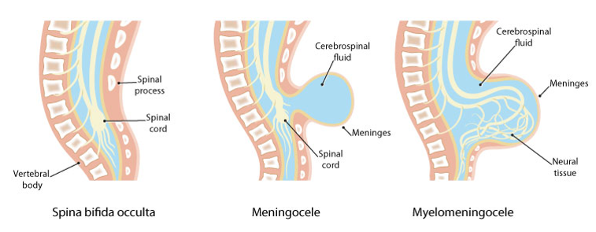
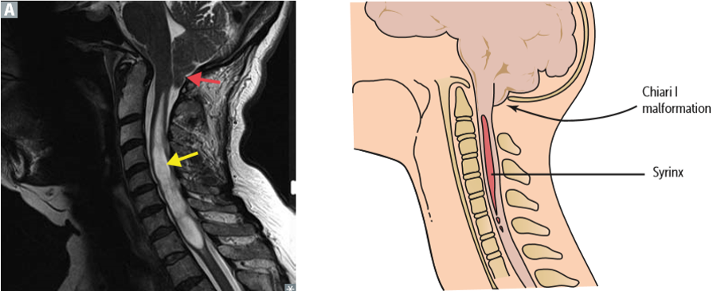
Syringomyelia
Congenital defects
Spina bifida
-Its when a pregnant mother has deficiency of folic acid then the babies neural tube gets defected. for more information about the disease .
A
B
C
b) meningocele,
MRI T1 WI
c) meningomyelocele
MRI T2 WI.
a)Spina bifida occulta.,
CT scan
-it is the development of a fluid-filled cyst within the spinal cord.

Slide 14
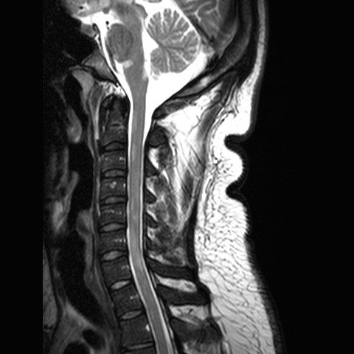
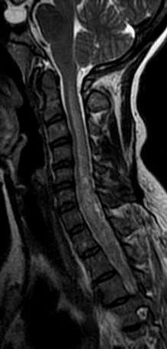
demyelination
Multiple Sclerosis
Multiple sclerosis (MS) is a relatively commonly acquired chronic relapsing demyelinating disease involving the CNS.
Characteristically disseminated not only in space but also in time.
Transverse Myelitis
-Spinal cord is swollen.
inflamed cord of uncertain cause
Viral infections
Immune reactions
Idiopathic
Myelopathy progressing over hours to weeks.

Slide 15
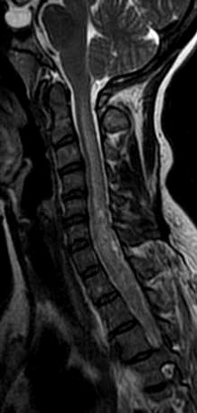
Multiple Sclerosis VS Transverse Myelitis
Multiple sclerosis lesions in spinal cord | Transverse myelitis lesions in spinal cord
More likely multiple, focal and peripherally located | -
Don’t cover the entire section on axial images. | Extend over >3 vertebral body heights on axial images.
Often < 2 vertebral body heights on sagittal images | Often > 4 vertebral body heights on sagittal images
Usually associated with brain lesions | no brain lesions
Are disseminated in time and space. | -

Slide 16
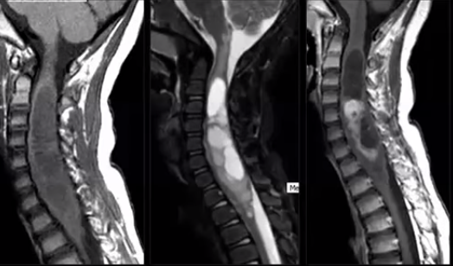
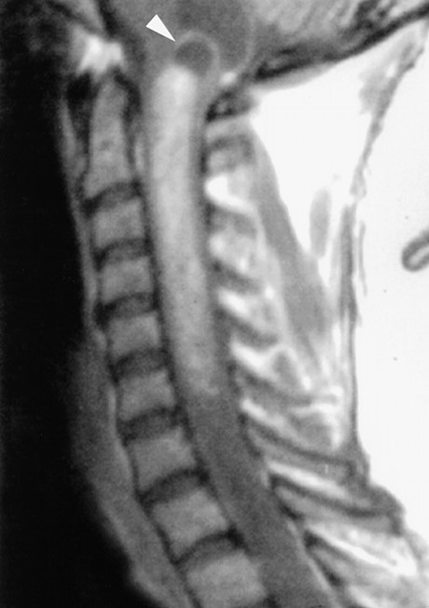
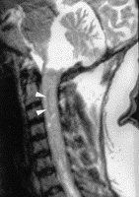
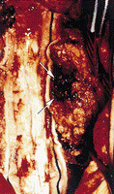
Tumors
Classification of TUMORS
-Intramedullary lesions: its location is determined within the cord
-Extramedullary lesions: May be related to nerve roots and may extend into the foramen (e.g. schwannomas and neurofibromas) or may have a broad dural attachment (e.g. meningiomas).
Astrocytoma
Ependymoma
-Intramedullary tumor
-Intramedullary tumor
-There’s a chance of bleeding

Slide 17
MCQs:
1-Technology that can Obtain 2-D images (can be processed to 3-D images).
A- X-RAY B-MRI
C- CT SCAN D- ULTRASound
2-is a relatively common acquired chronic relapsing demyelinating disease involving the CNS
A-Multiple Sclerosis B-Ependymoma
C-Astrocytoma D-Transverse Myelitis
3-inflamed cord of uncertain cause
A-Multiple Sclerosis B-Ependymoma
C-Astrocytoma D-Transverse Myelitis
4-When soft tissue injury is suspected, ___is usually the imaging Modality of choice.
A- MRI B- XRAY
C- CT SCAN D- ULTRASOUND
Answers:
1- C
2- A
3- D
4- A

Slide 18
Thank you for checking our work
Team Leaders:
Faisal Alqusaiyer Aljoharah Alshunaifi
Team members:
Afnan Almustafa Adel alzahrani Rawan Alrehaili Abdullah alsergani Abeer Alabduljabbar Saad alhaddab
Contact us on:
@Radiology437
Radiology437@gmail.com

