Slide 1
Biochemical Aspects of
Digestion of Lipids
Dr. Sumbul Fatma
Clinical Chemistry Unit
Department of Pathology

Slide 2
Objectives
By the end of this lecture the Second Year students will be able to:
Understand the process of digestion of dietary lipids including, the organs involved, the enzymes required, and the end products.
Study the synthesis, secretion and fate of chylomicron
Understand the clinical manifestations of diseases that involve defective lipid digestion and/or absorption (indigestion and malabsorption syndrome)

Slide 3
Overview
Dietary lipid: organs and enzymes
Lipid digestion in the stomach and intestine
Lipid degradation by the pancreatic enzymes
Pancreatic insufficiency
Control of lipid digestion
Lipid absorption, re-synthesis and secretion
Lipid malabsorption
Use of dietary lipid by the tissues

Slide 4
Dietary lipids
Dietary lipids intake is ~81 g/day
Triacylglycerol is >90%
The remainder includes:
  Cholesterol
  Cholesterol ester
  Phospholipids
  Glycolipids
  Free fatty acids

Slide 5
Dietary lipids: Organs and Enzymes
Stomach
  Lingual lipase
  Gastric lipase
Small intestine
  Lipase / C0-lipase
  Cholesterol esterase
  Phospholipase A₂
  Lysophospholipase

Slide 6
Lipids digestion in the stomach
Catalyzed by an acid-stable lipase (lingual lipase)
Triacyglycerols (TAGs) are hydrolyzed by the lipases secreted:
  Under the tongue and gastric mucosa
Acid lipases are important for lipid (milk fat) digestion in neonates and patients with pancreatic insufficiency

Slide 7
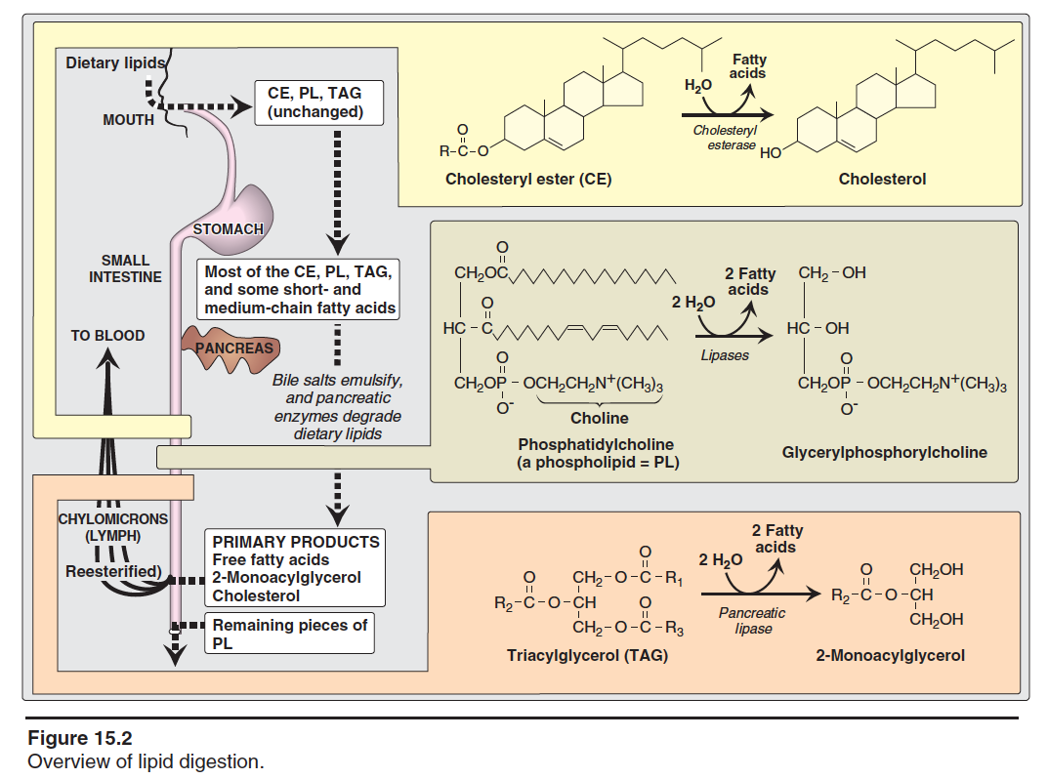

Slide 8
Lipid digestion in the small intestine
Emulsification:
Occurs in the duodenum
Increases surface area of lipid droplets
To maximize the effect of digestive enzymes
Two mechanisms:
    1. Detergent properties of bile salts in the bile
    Bile salts emulsify dietary lipid particles
    2. Mechanical mixing by peristalsis

Slide 9
Lipid degradation by pancreatic enzymes
TAG degradation:
Performed by pancreatic lipase, colipase
Removes fatty acids at C1 and C3
Leaving 2-monoacyglycerol and free fatty acids (FFAs)
Cholesteryl ester degradation:
Hydrolyzed by cholesterol esterase
Produces cholesterol + FFAs

Slide 10
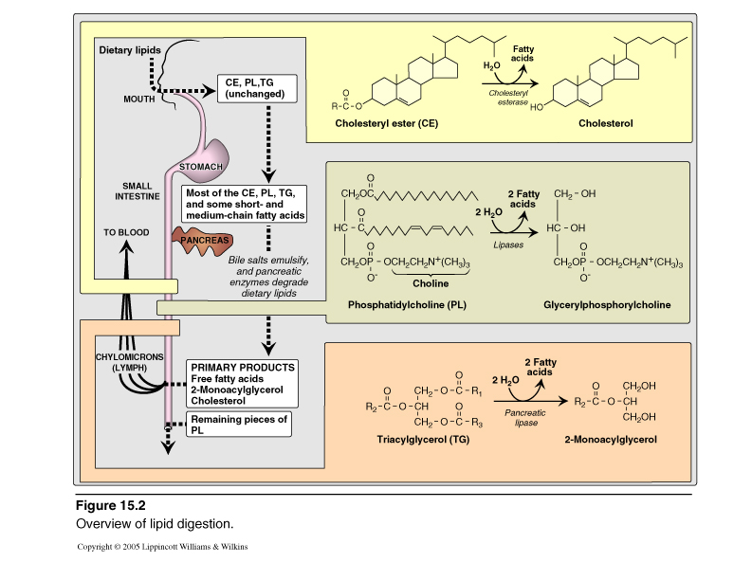
Digestion of TAG by Pancreatic Lipase
& Colipase
Pancreatic lipase :
Found in high conc. in pancreatic secretion (2-3% of total proteins)
Inhibited by Orlistat, an antiobesity drug

Slide 11
Digestion of Cholesterol Ester by Cholesterol Esterase

Slide 12
Digestion of Phospholipids (PL)by Phospholipase A2 & Lysophospholipase
H₂O
Fatty acid
PL
Lysophospholipid
Phosphophlipase A2
H₂O
Fatty acid
Lysophospholipid
Glycerolphosphoryl
base
Lysophosphophlipase
Excreted in the feces, degraded or absorbed

Slide 13
+
Esterase

Slide 14
Pancreatic insufficiency in cystic fibrosis (CF)
CF is due to genetic mutations in CFTR (transmembrane conductance regulator protein)
Functions as chloride channel on epithelium
Defective CFTR causes:
  Decreased secretion of chloride
  Increased reabsorption of sodium and water
Decreased hydration in pancreas thickens the pancreatic secretions
Pancreatic enzymes are unable to reach the intestine
Treatment: enzyme and fat-soluble vitamin supplementation

Slide 15
Control of lipid digestion
Controlled by hormones:
Cholecystokinin (CKK)
  Acts on gallbladder to release bile
  Acts on pancreas to release enzymes
  Decreases gastric motility (slow release of gastric contents)
Secretin
  Low pH stimulates its secretion
  Acts on pancreas and liver to release bicarbonate
  Neutralizes the pH of the contents before entering the small intestine

Slide 16
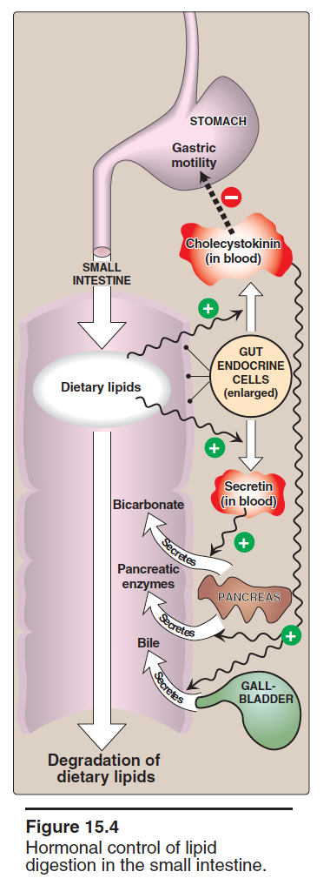

Slide 17
Lipid absorption by enterocytes
Products of lipid digestion (FFAs, free cholesterol, 2-monoacylglycerol) combine with bile salts and fat-soluble vitamins
They form mixed micelles (disk-shaped particles)
Absorbed by brush border membrane of enterocytes
Short and medium chain length fatty acids are absorbed directly

Slide 18
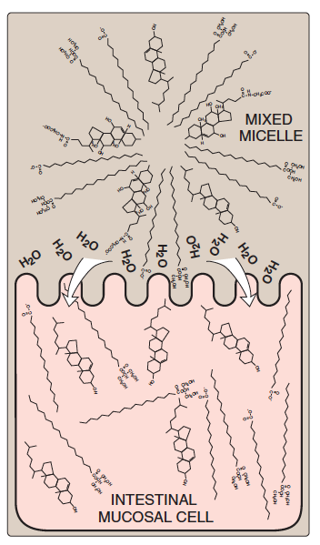
Mixed micelles are hydrophobic inside
and hydrophilic outside

Slide 19
Resynthesis of TAG / Cholesteryl esters
Digested lipids absorbed by enterocytes migrate to endoplasmic reticulum for complex lipid biosynthesis
Fatty acids → activated to acyl CoA form
2-Monoacyglycerols → TAGs

Slide 20
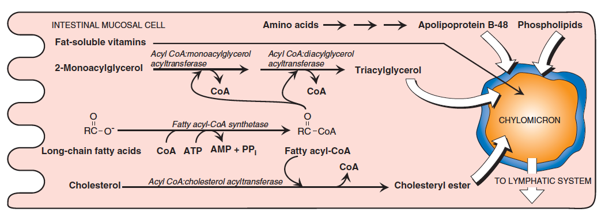

Slide 21
Assembly of chylomicrons by enterocytes
Newly synthesized TAG and cholesterol ester are packaged as lipid droplets surrounded by thin layer of:
  Apolipoprotein B-48 (apo B-48)
  Phospholipids
  Free cholesterol

Slide 22
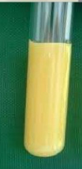
Secretion of chylomicrons by enterocytes
By exocytosis into lymphatic vessels around villi of small intestine (lacteals) which enter into systemic circulation
Serum becomes milky after a fatty meal

Slide 23
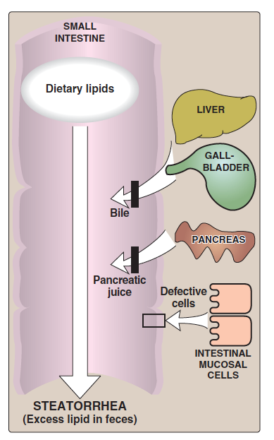
Lipid malabsorption
Increased excretion of lipids, fat-soluble vitamins and essential FAs in the feces
Due to defects in lipid digestion or absorption
Can be caused by CF or shortened bowel

Slide 24
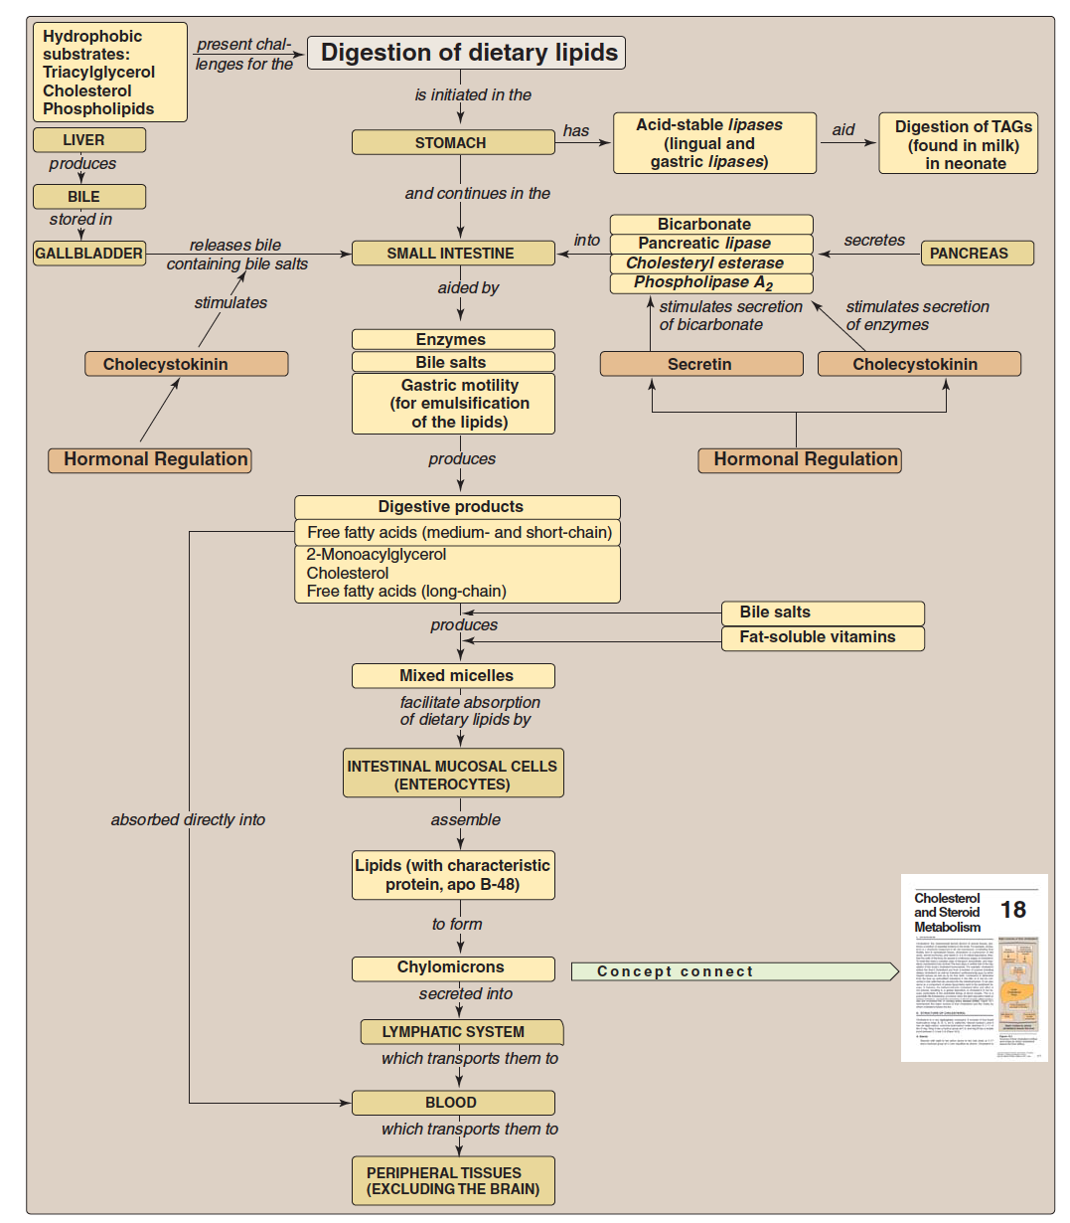
Key concepts for digestion and absorption of dietary lipids

Slide 25
Take home message
Lipid digestion begins in stomach
Emulsification of lipids occurs in duodenum, helped by peristalsis and bile salts
Intestinal digestion of lipids by pancreatic enzymes
Lipid absorption by mixed micelles
Re-synthesis of TAGs, cholesterol ester and PLs inside the intestinal mucosal cells
Assembly and secretion of chylomicrons into lymphatic lacteals and then into systemic circulation

Slide 26
References
Lippincott’s Illustrated Reviews, Biochemistry, 5th edition, Denise R. Ferrier, Lippincott Williams & Wilkins, USA.
Chapter 15: pages 173-180

