Slide 1
HEMOLYTIC ANEMIAS
Dr. Fatma S. Al-Qahtani
ASSOCIATE PROFESSOR
CONSULTANT HAEMATOLOGIST
DEPARTMENT OF PATHOLOGY

Slide 2
LEARNING OBJECTIVES
To be able to define haemolysis and hemolytic anemia.
To be able to classify hemolytic anemias into congenital and acquired types, and to know the etiological factors in each division.
To understand the difference between intravascular and extravascular haemolysis, and to recognize the laboratory features of each.
To appreciate some major examples of congenital disorders resulting in hemolysis like HS and G6PD deficiency.
To understand the role of autoantibodies in the production of hemolytic anemias and to know the types of disease with which they are associated
To understand some causes of non-immune acquired hemolytic anemias.

Slide 3
HEMOLYTIC ANAEMIAS
Hemolysis: is a state with a short of the lifespan of a mature red blood cell.
- IF hemolysis is not marked and can be compensated;
- increased red cell output from the marrow.
- stimulated by erythropoietin.
- will be sufficient.
- IF hemolysis is marked and can not be compensated;
- more marked reductions in red cell lifespan.
- say to 5-10 days from the usual 120 days.
- will result in hemolytic anemia.
Hemolytic anemia: is a shorten in life span of RBC that can not be overcome by ability of bone marrow production.

Slide 4
INTRA vs. EXTRAVASCULAR HEMOLYSIS
In the majority of hemolytic anemias, the macrophages in the spleen, liver and bone marrow remove red cells from the circulation by phagocytosis. This is termed extravascular haemolysis.
By contrast, in intravascular haemolysis, the red cells are caused to rupture and release their hemoglobin (Hb) directly into the circulation.
The intra/extravascular site of red cell destruction may give clues to the underlying etiology of the haemolysis.

Slide 5
Laboratory Evidence of Hemolysis
A rise in the unconjugated bilirubin concentration in the plasma.
Lactate dehydrogenase, an enzyme present in red cells, more with intra,.
Reduction of serum haptoglobin, molecule binds to free Hb, intra,.
Free hem can bind to albumin to form methemalbumin.
Free Hb in the urine: hemoglobinuria, intra, (note the difference from hematuria, which describes the presence of intact red cells in the urine).
Increased reticulocyte count. The number of reticulocytes in the blood is expressed either as a percentage of the total number of red cells or as an absolute number per liter of blood; in normal adults, the percentage is in the range of 0.5-3.0% and the absolute count is 20-100x10⁹/L. Increase in the absolute reticulocyte count is an indication of increased erythropoietic activity.

Slide 6
Laboratory Evidence of Hemolysis; cont’d…
As haemolysis will also increase the marrow’s demand for folic acid, macrocytosis, high MCV, may also develop secondary to folate deficiency.
Polychromasia, a bluish discoloration of RBC, due to reticulocytosis.
Generally extravascular haemolysis is associated with spherocytosis on the peripheral blood film. Intravascular haemolysis is characterized by red cell fragmentation (schistocytes).
If examination of the bone marrow is undertaken, there will be evidence of increased erythropoiesis. Marrows showing erythroid hyperplasia are also hypercellular, due to the replacement of fat cells by erythroid precursors. (Figure).

Slide 7
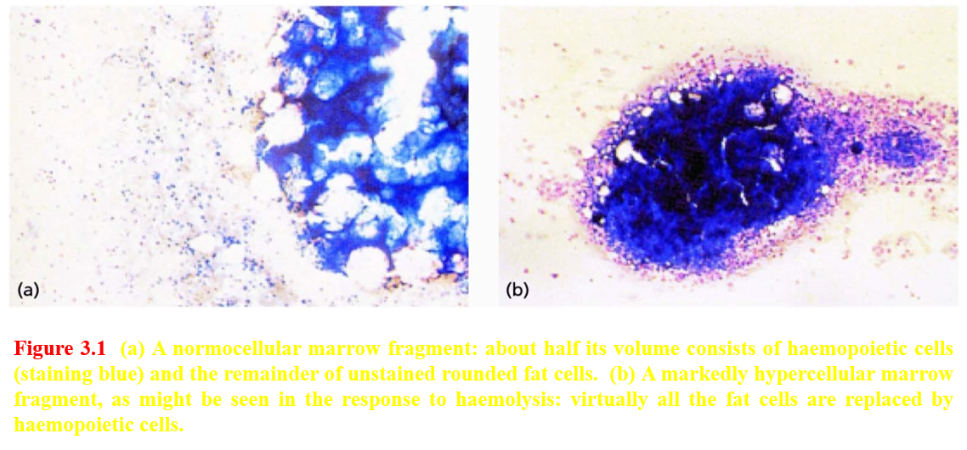

Slide 9
Clinical features of hemolysis
Pallor, and jaundice secondary to the elevated bilirubin levels.
Splenomegaly may be seen.
Long-term complications of chronic hemolysis; expansion of erythropoiesis in the marrow cavities, thinning of cortical bone, bone deformities (e.g. frontal and parietal bossing) and, very occasionally, pathological fractures.
Pigment gallstones are seen commonly.
Risk of episodes of pure red cell aplasia especially with parvovirus B19.

Slide 10
Classification of Hemolytic Anemias
Classified simply as either I] congenital or II] acquired.
With the congenital causes, the underlying defect is typically intrinsic to the red cell itself, affecting the red cell
A) membrane,
B) its enzymes or,
C) its hemoglobin.
Acquired causes, are typically due to defects extrinsic, outside the red cell (except PNH), and can be divided into those with an immune basis and those without.

Slide 12
1] Congenital Hemolytic Anemias A) Red Cell Membrane “Membranopathy”
The red cells undergo significant deformations while traversing the circulation. Thus, flexible red cell cytoskeleton is essential.
Key components of the cytoskeleton include α and β spectrins, actin and protein 4.1, while connections linking the cytoskeleton to the overlying red cell phospholipid bilayer include band 3, Rh-associated glycoprotein and glycophorin C (see Figure).
Defects in any of these proteins can jeopardize the integrity of the red cell and shorten its lifespan.

Slide 13
Hereditary spherocytosis (HS)
The most common membranopathy is hereditary spherocytosis (HS) with ~ 60% related to Ankyrin gene. Loss of Ankyrin then leads to secondary reductions in spectrin and protein 4.1 leading to a spheroid shape, vertical.
Destroyed by splenic macrophages, extravascular hemolysis, with 20% of all HS have mild disease. The majority of patients have moderate disease characterized by a Hb concentration of 8-11g/dl, while a small percentage have severe disease requiring intermittent or even regular transfusions
Complications of the chronic hemolysis in HS include the development of pigment gallstones. Aplastic crises may occur secondary to parvovirus B19. Megaloblastic anemia is occasionally found.

Slide 15
Hereditary spherocytosis (HS): Diagnosis and management
The Diagnosis of HS:
Family history, mild jaundice, pallor and splenomegaly.
Laboratory findings (anemia, reticulocytosis and elevated plasma bilirubin).
Presence of spherocytes on the peripheral blood film.
Special Tests: The eosin-5-maleamide (EMA) binding test (definitive evidence) by flow cytometry. The red cell membrane proteins’ genes, by molecular testing. Protein electrophoresis on a denaturing polyacrylamide gel.
Some Treatment of Significant HS:
Folic acid supplementation.
Splenectomy (children with severe disease), which increases the risk of significant infection, encapsulated organisms. This risk is especially marked in children under the age of 5. Administration of pneumococcal and meningococcal vaccine and Haemophilus influenzae type b vaccine (splenectomy preoperative preparation). Prophylactic penicillin V is advised lifelong (post splenectomy).

Slide 16
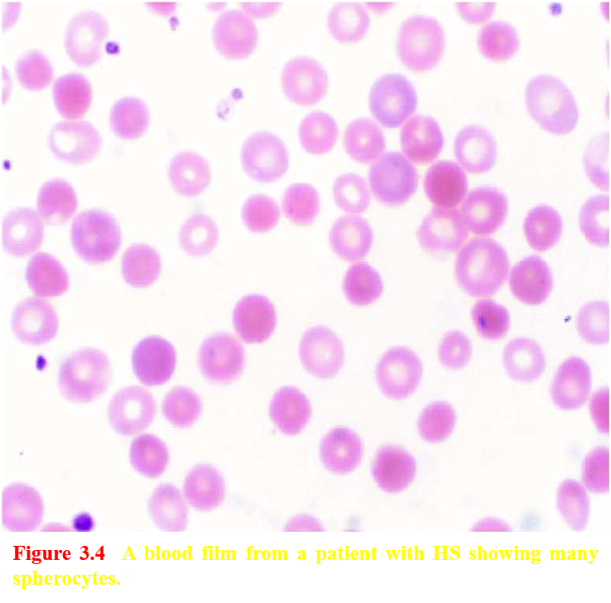

Slide 17
Hereditary Elliptocytosis (HE) and Hereditary Pyropoikilocytosis (HPP)
Hereditary elliptocytosis (HE) is also a relatively common condition, with many cases showing defects in α spectrin, horizontal interaction.
Most patients are clinically asymptomatic, some will have a chronic symptomatic hemolytic anemia.
All show the very characteristic elongated red cell shape on peripheral blood films (Figure).
Severe disturbance of the multimerization of spectrin with a severe hemolytic anemia from infancy and a bizarre peripheral blood morphology, including microspherocytes and poikilocytes. Such patients are described as having hereditary pyropoikilocytosis.

Slide 18
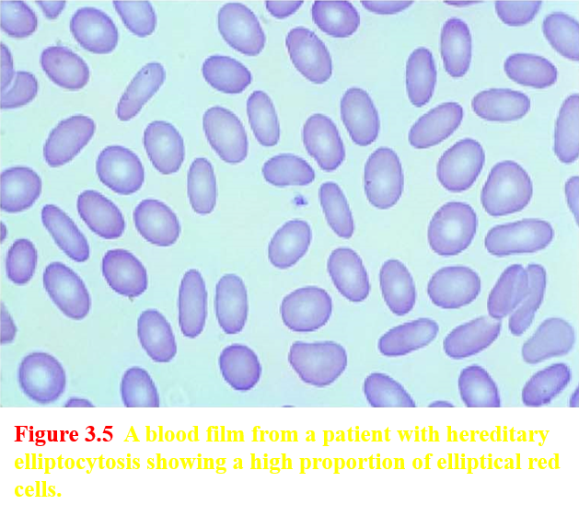

Slide 19
I] Congenital Hemolytic Anemias 2) Red Cell Enzyme “Enzymopathy”
Hemolytic anemias may also result from congenital abnormalities of the enzymes required for energy transfer in glucose metabolism.
The red cell needs a continuous supply of energy for the maintenance of membrane flexibility and cell shape, the regulation of sodium and potassium pumps, and the maintenance of Hb in the reduced ferrous form which protects from an oxidative stress.

Slide 20
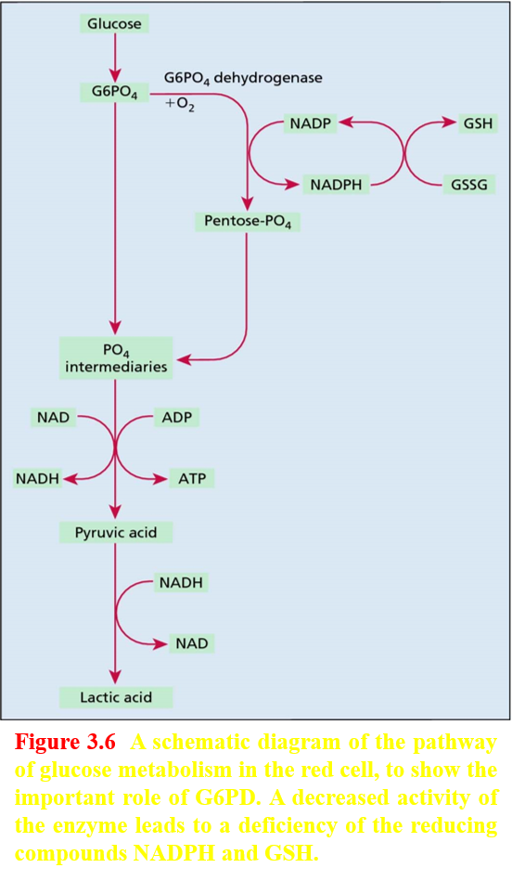

Slide 21
Glucose-6-Phosphate Dehydrogenase Deficiency
Deficiency of glucose-6-phosphate dehydrogenase (G6PD), the first enzyme of the hexose monophosphate/pentose-phosphate shunt, will prevent the normal generation of NADPH, with subsequent erythrocyte sensitivity to oxidative stress. Various mutations in the G6PD gene on the X chromosome results in this disorders with a male predominance.
When the red cell is exposed to oxidants, e.g. some medications, Hb is converted to methemoglobin and denatured. Denatured Hb then precipitates forming inclusions in the red cell (termed Heinz bodies and detected by supravital staining, as in Figure). Splenic macrophages, extra, remove Heinz bodies; the resulting inclusion-free cells display unstained areas at their periphery (‘bite’ cells, seen in Figure). Screening tests and assays for detecting G6PD deficiency are available.

Slide 22
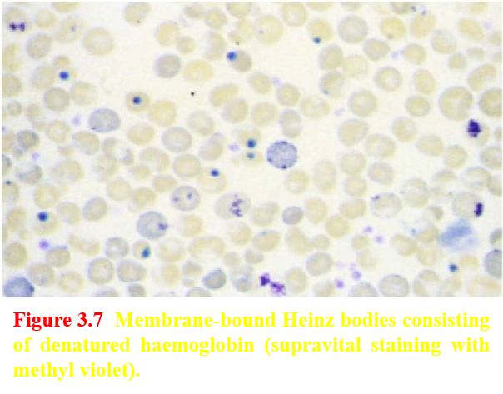
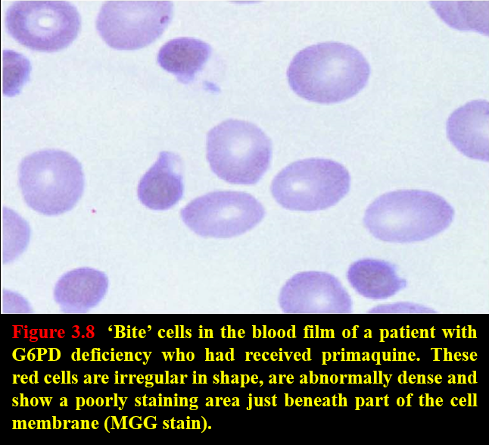

Slide 23
Glucose-6-Phosphate Dehydrogenase Deficiency
Hemolysis begins 1-3 days post exposure to the oxidative stressor, with anemia being maximal about 7-10 days after exposure. Patient may report dark urine due to hemoglobinuria, intravascular.
Favism: a syndrome in which an acute hemolytic anemia occurs after the ingestion of the broad bean (Vicia fava) in individuals with a deficiency of G6PD (commonly of the Mediterranean type), usually affects children; severe anemia develops rapidly and is often accompanied by hemoglobinuria.
Treatment generally focuses on the avoidance of oxidative precipitants to hemolysis. In many cases, hemolysis is self limiting. In children, rehydration is needed to avoid acute kidney injury. Packed red cell transfusion may be required in cases of severe hemolysis.

Slide 24
I] Congenital Hemolytic Anemias 2) Red Cell Enzyme “Enzymopathy”
Pyruvate kinase deficiency is another relatively common example.
There is usually a chronic hemolytic anemia and some patients may benefit from splenectomy.

Slide 25
I] Congenital Hemolytic Anemias 3) Red Cell Hemoglobin “Hemoglobinopathy”
Defects in the structure of Hb. Structural variants of the globin chains may affect the lifespan of the red cell, with sickle cell anemia being the best-described example.
A tendency of the HbS variant to polymerize under conditions of low oxygen tension leads to distortion of the erythrocyte in the well-recognized sickle shape.

Slide 26
II] Acquired Hemolytic Anemias
In the acquired hemolytic anemias, red cells may be destroyed either by immunological or by non-immunological mechanisms.

Slide 27
II] Acquired Hemolytic Anemias
A) Immunological Causes
Antigens on the surface of red cells react with antibodies and might complement activation.
IgG-coated red cells interact with the Fc receptors on macrophages in the spleen, and are then either completely or partially phagocytosed (extra). When the phagocytosis is partial, the damaged cell will return to the circulation as a spherocyte. Sometimes, membrane attack complex (C5-C9), complement, leading to intravascular hemolysis.
The immune hemolytic anemias may be due to autoantibodies; that is, antibodies formed against one or more antigenic constituents of the individual’s own tissues. These include autoimmune hemolytic anemia (AIHA) and some drug-related hemolytic anemias.
It is also possible to develop alloimmune hemolytic anemia, consequent on the production of antibodies against red cells from another individual, as in hemolytic transfusion reactions and hemolytic disease of the newborn.

Slide 28
Autoimmune Hemolytic Anemias
II] Acquired Hemolytic Anemias
A) Immunological Causes
‘Warm’ autoantibodies react best with the red cell antigen at 37ºC and are usually of IgG subtype.
‘Cold’ antibodies react best at temperatures below 32ºC (usually below 15ºC) and, since they are usually of IgM subtype, are capable of agglutinating red cells.

Slide 29
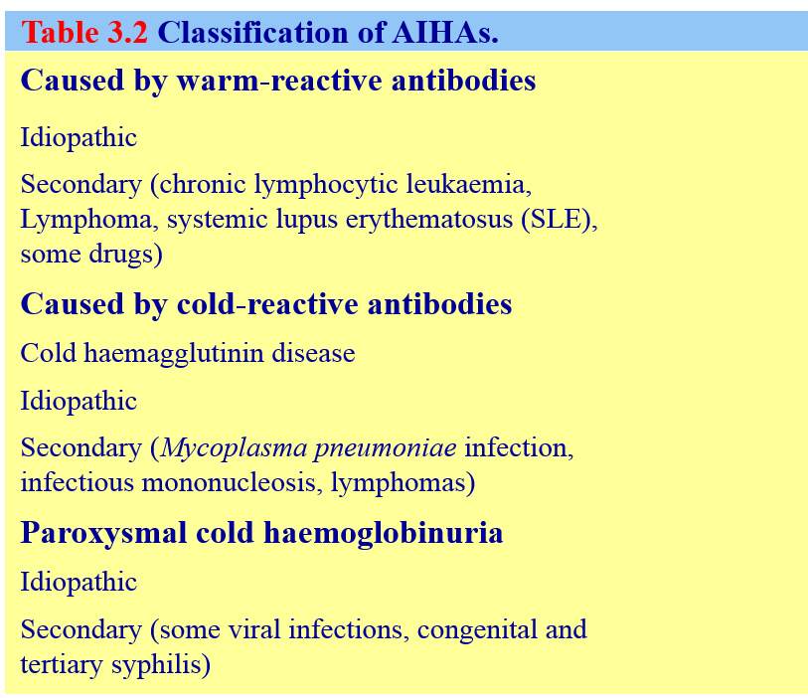

Slide 30
Warm AIHA
In idiopathic warm AIHA, hemolysis dominates the clinical picture and no evidence can be found of any other disease. In secondary AIHA, the hemolysis linked with a primary disease like; chronic lymphocytic leukemia (CLL) or systemic lupus erythematosus (SLE).
The antibody-coated red cells undergo partial or complete phagocytosis in the spleen and by the Kupffer cells of the liver. There may be partial activation of the complement cascade.
Findings like; anemia, spherocytosis, reticulocytosis and rare nucleated red cells in the peripheral blood. The critical diagnostic investigation is the direct antiglobulin test (DAT).
Hemolysis can be limited by treatment with prednisolone. If reduction in hemolysis is not maintained when the dose of steroids is lowered, splenectomy or alternative immunosuppressive therapy should be considered. The anti-CD20 monoclonal antibody rituximab, as well as immunosuppressants such as azathioprine or cyclophosphamide.

Slide 31
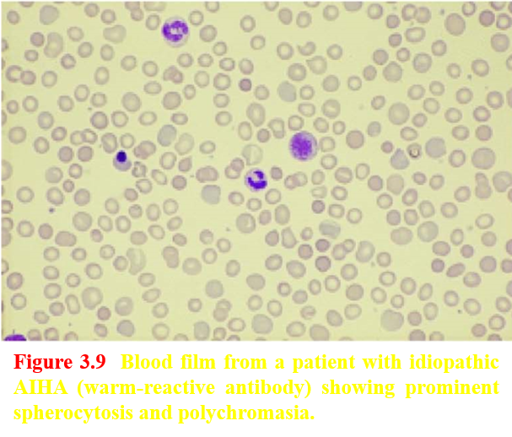

Slide 32
Cold Hemagglutinin Disease (CHAD)
Cold antibodies bind to the red cell surface in the cooler superficial blood vessels of the peripheries. IgM subtype, pentameric structure, permits direct agglutination of red cells coated with antibody; they are therefore sometimes termed cold agglutinins.
Symptoms due to cold AIHA are worse during cold weather. Exposure to cold provokes acrocyanosis. The direct activation of the complement system leads to red cells lysis and, consequently, to hemoglobinemia and hemoglobinuria (intra).
Chronic idiopathic CHAD is managed initially simply by keeping the patient warm. Treatment with rituximab may be effective.
Other causes of hemolytic anemia with an immune element include:
1) Paroxysmal nocturnal hemoglobinuria (PNH);
2) Paroxysmal cold hemoglobinuria;
3) Drug-related hemolytic anemias.

Slide 33
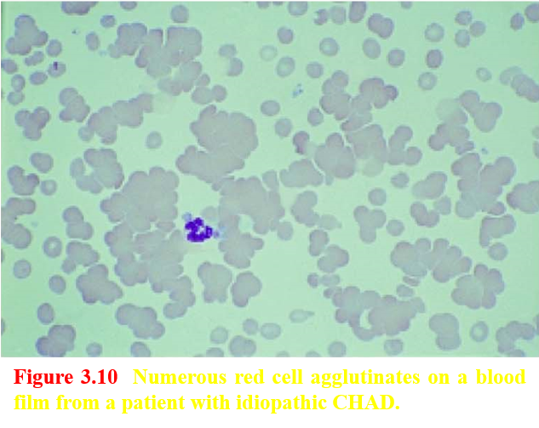

Slide 34
II] Acquired Hemolytic Anemias B) Non-immune hemolytic anemias Mechanical Damage to Red Cells
Several of the mechanical causes of acquired non-immune hemolytic anemia are summarized in Table. Red cells are mechanically damaged when they impact upon abnormal surfaces.
In disseminated intravascular coagulation (DIC) inappropriate activation of the coagulation cascade produces fibrin strands which are thought to cause mechanical destruction of red cells. Such damage usually results in the presence of red cell fragments (schistocytes) in the blood film.

Slide 35
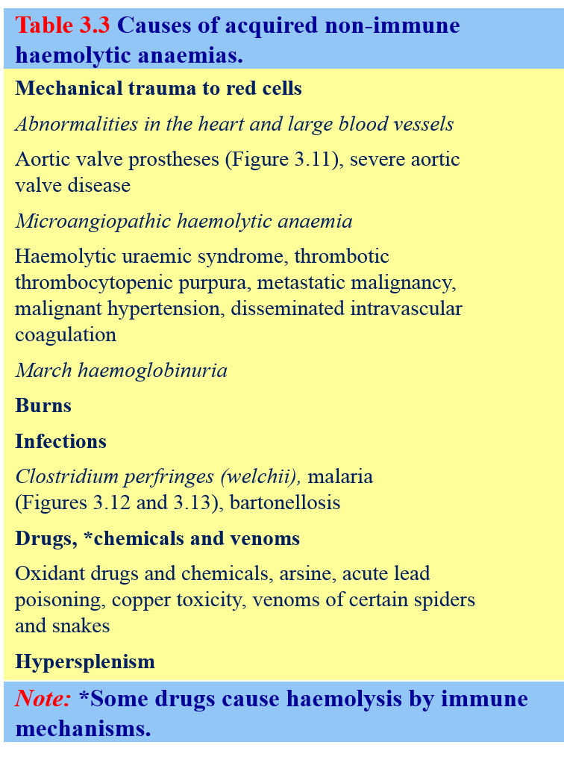

Slide 36
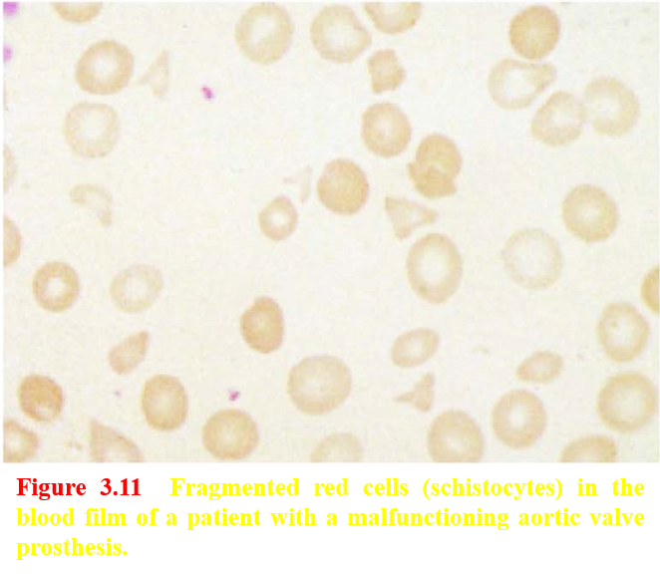

Slide 37
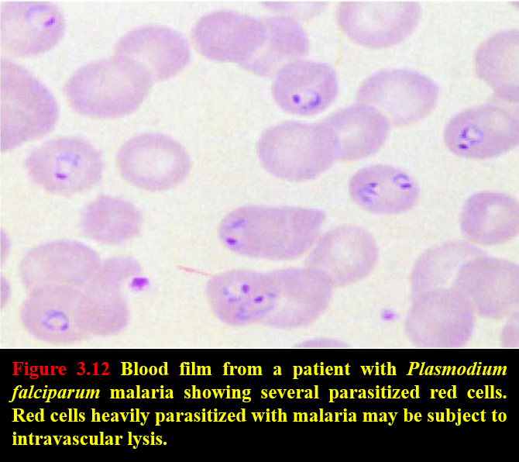

Slide 39
II] Acquired Hemolytic Anemias B) Non-immune hemolytic anemias Some Drugs
While immune mechanisms of drug-induced haemolysis are well described, there are also non-immune mechanisms by which the red cell lifespan may be shortened. Chemicals, such as benzene, toluene and saponin, which are fat solvents, act on the red cell membrane directly and disrupt its lipid components, inducing hemolysis.

Slide 40
Hypersplenism
Hypersplenism results in the reduction in the lifespan of red cells, granulocytes and platelets that may be found in patients with splenomegaly due to any cause.
The cytopenias found in patients with enlarged spleens are also partly caused by increased pooling of blood cells within the spleen and might be treated with a splenectomy.

Slide 41
Q1) Which ONE of the following is TRUE about glucose-6-phosphate dehydrogenase (G6PD) deficiency?
A) It is NOT a cause of neonatal jaundice.
B) It protects against malaria.
C) It commonly presents as a chronic hemolytic anemia.
D) Carrier females have approximately 10% G6PD levels.

Slide 42
Q2) Spherocytosis in the blood film is a feature of which ONE of the following?
A) Thalassemia major.
B) Reticulocytosis.
C) Glucose‐6‐phosphate dehydrogenase (G6PD) deficiency.
D) Autoimmune hemolytic anemia.

Slide 43
Q3) Which ONE of the following is an only cause of intravascular hemolysis?
A) Glucose‐6‐phosphate dehydrogenase (G6PD) deficiency.
B) Rhesus incompatibility.
C) Red cell fragmentation syndrome.
D) Hereditary spherocytosis.

Slide 44
Q4) Which ONE of these statements is TRUE regarding hereditary spherocytosis?
A) It is caused by an inherited defect in hemoglobin.
B) It is more common in males.
C) It can be treated by splenectomy.
D) It is more frequent in southern Europe

Slide 45
Q5) Which ONE of the following is TRUE about autoimmune hemolytic anemia?
A) It is associated with pernicious anemia.
B) Hemolytic anemia is minimal.
C) It may complicate B‐cell chronic lymphocytic leukemia.
D) It is associated with a positive indirect antiglobulin test.

Slide 46
Thank You!!!

