Slide 1
Transfusion and
Cross-Matching
BY:
DR. FATMA AL-QAHTANI

Slide 2
LEARNING OBJECTIVES
To identify the key elements in the current blood bank services.
To appreciate the implemented measurements and standards for obtaining the highest quality in the blood bank services.
To have a general idea about the donation process and main blood components.
To understand the inheritance and significance of the ABO system.
To understand the nature and significance of the Rh blood group system.
To understand the cross-matching process, including the antiglobulin test.
To have an overview about main hazards of blood transfusion.

Slide 3
Blood Bank Units
Traditionally, two parts:
  1) Donation services: donor area, component separation, infectious testing, ABO typing and RhD screening, inventory.
  2) Transfusion services: inventory, Patient (recipient) ABO grouping, RhD and antibody identification screening, cross-match, component issuing.
Currently in the major hospital, there is a apheresis unit (donation, therapeutic or prophylaxis).
In many tertiary hospitals, stem cell unit, cord blood unit and tissue banking.

Slide 4
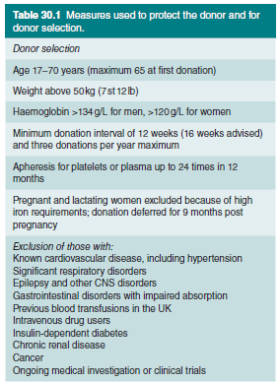
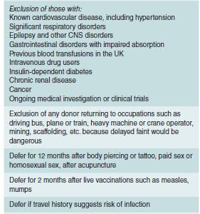













Drugs

Slide 5
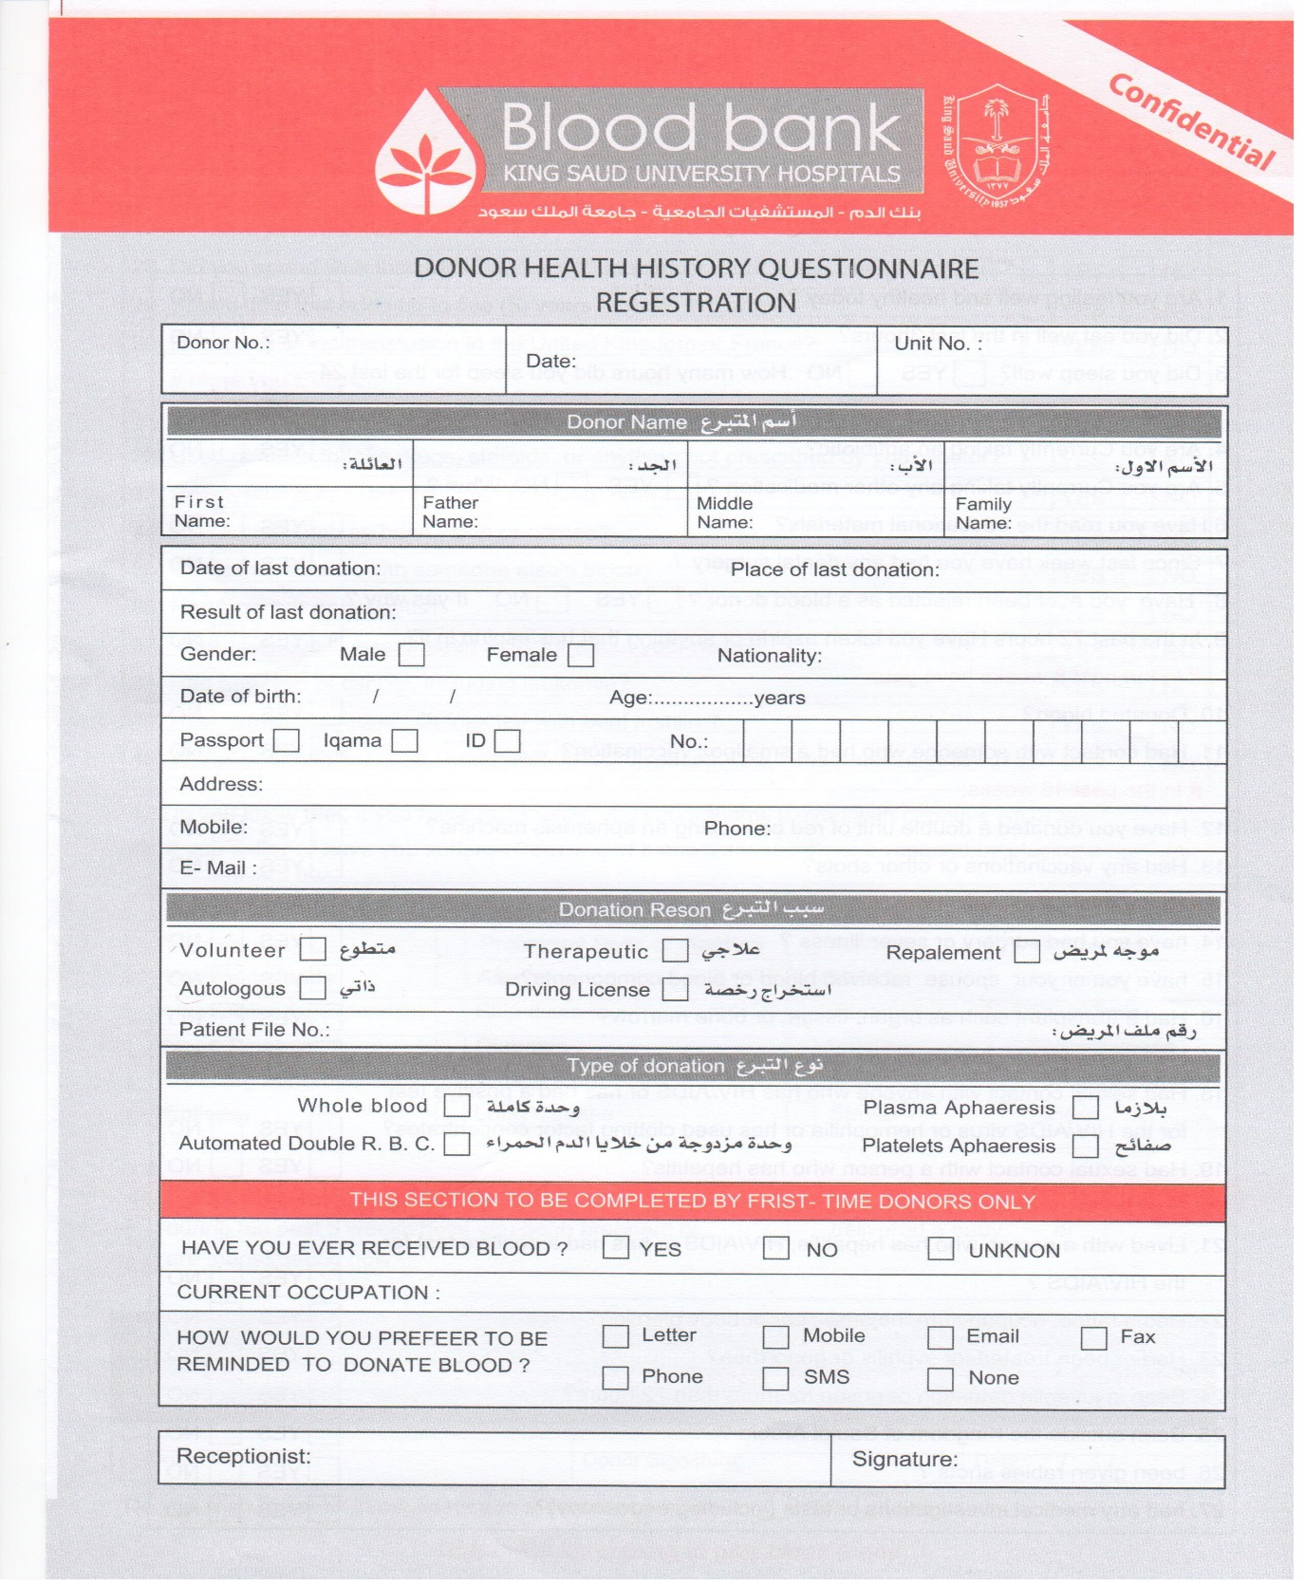

Powerful tool for screening
Identify high risk behaviors.
Some issues can only be ruled out by systemic questionnaire.

Slide 6
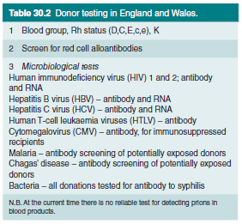


Infectious Testing
Extra testing (not in all cases); Sickle cell &G6PD level.

Slide 7
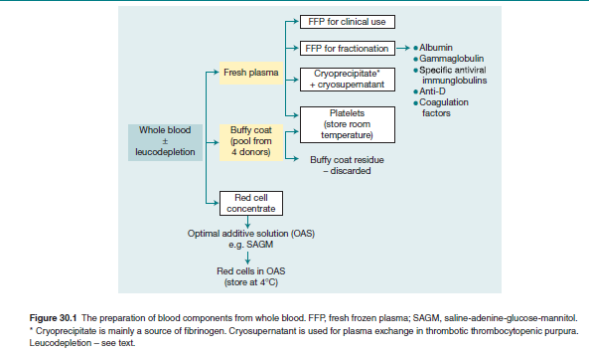
Component Separation

Slide 8
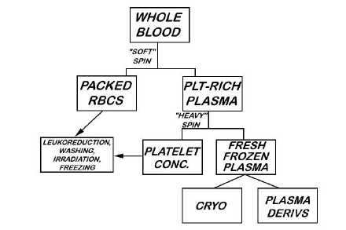

Slide 9


Slide 10


Slide 11
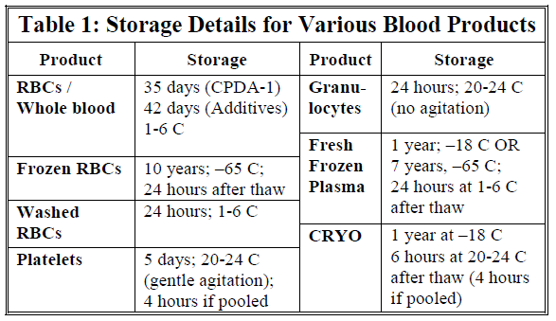
Component Storage

Slide 12
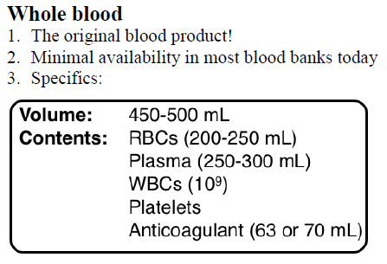
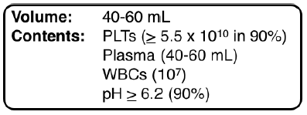
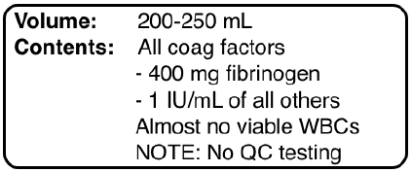
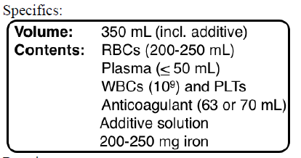
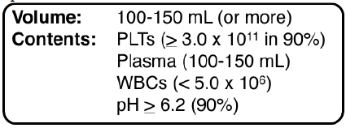
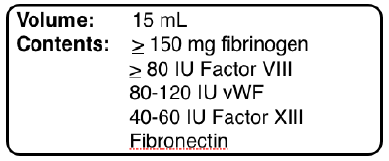





























Whole blood donor (5-6 pooled)
Fresh Frozen Plasma (FFP)
Packed RBC unit
Single donor (apheresis) adult dose
Cryoprecipitate
Without leukoreduction

Slide 13
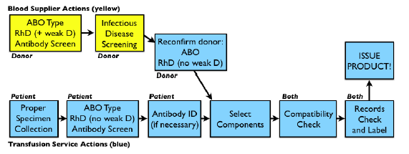
II] Transfusion Unit

Slide 14
Blood Groups
One of the main problems in the transfusion of blood is the avoidance of immunological reactions resulting from the differences between donor and recipient red cells.
When the red cells of a donor are transfused into a recipient who lacks these antigens, they may induce an immunological response.
There are at least 30 major blood group systems (e.g. the ABO group, Rh group).

Slide 15
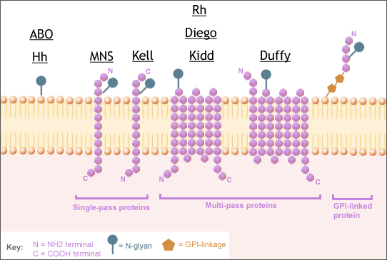

Blood Groups

Slide 16
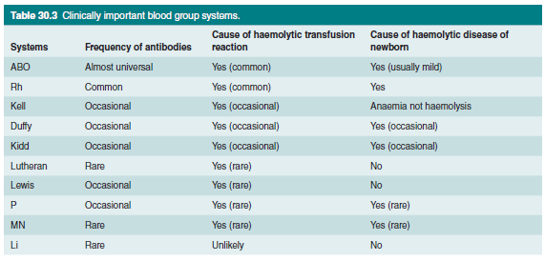











Slide 17
ABO system
Practically all red cells have the H antigen, a carbohydrate group attached mainly to proteins on the cell membrane (FUT1, Ch19q).
This H antigen is the basis for the ABO blood groups.
The ABO locus is encoded on chromosome 9q, where one of three possible alleles may be found.
The A allele encodes for a glycosyltransferase, which modifies the H antigen by adding N-acetylgalactosamine to it (thus forming the A antigen).

Slide 18
cont’d…
The B allele of the ABO locus encodes an alternative glycosyltransferase that links galactose to the H antigen (thus converting it to the B antigen).
The O allele, by contrast, encodes no functional enzyme at all, such that the H antigen remains unmodified.
Hemolytic reactions will occur immediately in the event of incompatible transfusion, and may be fatal.

Slide 19
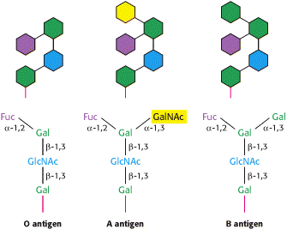
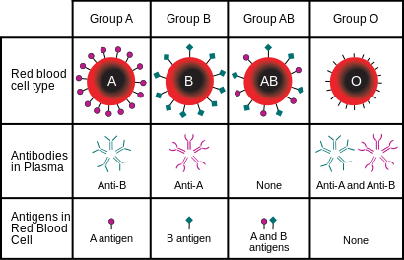

Slide 20
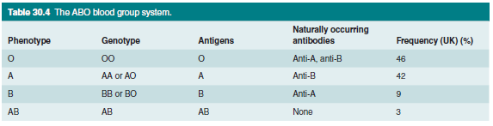
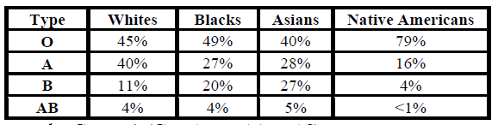





Slide 21
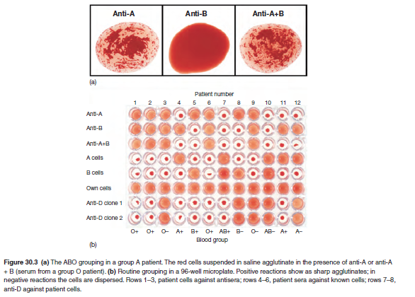
Forward grouping
Backward grouping
RhD grouping

Slide 22
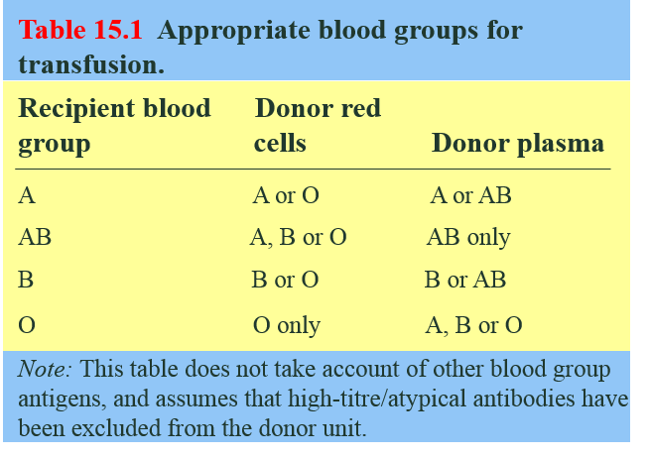

Slide 23
Rh system
The Rh system is also of great importance and can cause problems with both transfusion and pregnancy. The inheritance of the Rh blood group system is slightly more complex than that of the ABO system.
Two separate genetic loci on chromosome 1 encode for a total of five antigens.
The first locus, RHD, has alleles D or d; D encodes a transmembrane protein featuring the D antigen, while the allele d encodes a variant that does not bear this antigen.
RHCE is an adjacent locus that encodes a transmembrane ion channel bearing the antigens C (or its variant, c) and E (or its variant, e). Alleles at this locus may be described as CE, Ce, cE and ce, denoting the set of antigens they encode.
A complete description of the Rh haplotype for a patient will include alleles at both RHD and RHCE loci. The commonest haplotypes are DCe, dce and DcE.

Slide 24
cont’d…
The D antigen is the most clinically important of the Rh group antigens, due to its high immunogenicity.
An RhD-negative person (e.g. dce/dce) has over a 50% chance of developing anti-D antibodies after the transfusion of one unit of RhD-positive blood: it is therefore important that RhD-negative patients receive RhD-negative blood.
Note that unlike the ABO system, Rh antibodies are not naturally occurring; they must be raised by exposure of an antigen-negative individual to the appropriate antigen, either through transfusion of incompatible blood or through pregnancy.
After the exposure, IgG antibodies come to predominate, and hemolysis is generally extravascular (major cause of HDFN/HDN).

Slide 25
Management of mother and child
Women who are negative for RhD are given routine antenatal anti-D prophylaxis at 28 weeks, 34 weeks and within 72 hours of delivery.
This involves an intramuscular injection of anti-D immunoglobulin, which prevents active immunization in the case of red cell transfer across the placenta.
Any potentially sensitizing event is also treated with additional anti-D administration: such events include abdominal trauma, threatened abortion, or any spontaneous abortion after 12 weeks.

Slide 26
Other blood group systems
Other blood group antibodies, which are sometimes a problem during blood transfusion, include the following:
  anti-K (Kell system),
  anti-Fyª (Duffy system),
  anti-Jkª (Kidd system) and
  anti-S (part of the MNSs blood group system).
These antigens are relatively poorly immunogenic.
Their potency in stimulating antibody production is 10-1000 times less than that of RhD.
Consequently, these antigens may not need be routinely assessed prior to transfusion.

Slide 27
Compatibility
The purpose of cross-matching blood before transfusion is to ensure that there is no antibody present in the recipient’s plasma that will react with any antigen on the donor’s cells (major cross-match, IAT).
The basic technique for detecting such antibodies relies on their ability to agglutinate red cells that bear the appropriate antigen.

Slide 28
Antiglobulin test
Its purpose is to detect antibodies to red cell surface, either bound to the red cell surface or free in the serum.
The antiglobulin test can be used in two ways:
  First, the direct antiglobulin test (DAT), used in the diagnosis of autoimmune hemolytic anemia. it can be used to detect antibody already on the patient’s cells in vivo. Red cells are washed to remove the free IgG in the plasma, which would otherwise react with and neutralize the antiglobulin. After washing, anti-human globin is added and, if the red cells are coated with antibody, agglutination takes place.

Slide 29
cont’d…
Second, the indirect antiglobulin test (IAT), the test can be used to detect the presence of antibody in serum, as in the cross-matching of blood for transfusion. In this case, serum from the patient who requires transfusion is incubated with donor red cells. Any antibody present in the recipient’s serum that has specificity for antigens on the donor’s cells will interact with those cells. After washing, addition of anti-human globulin will bring about red cell agglutination.

Slide 30
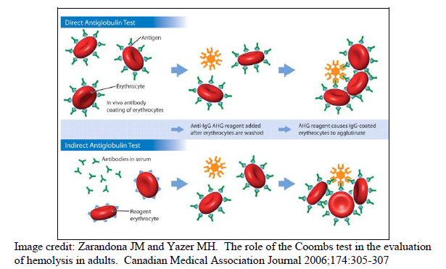

Slide 31
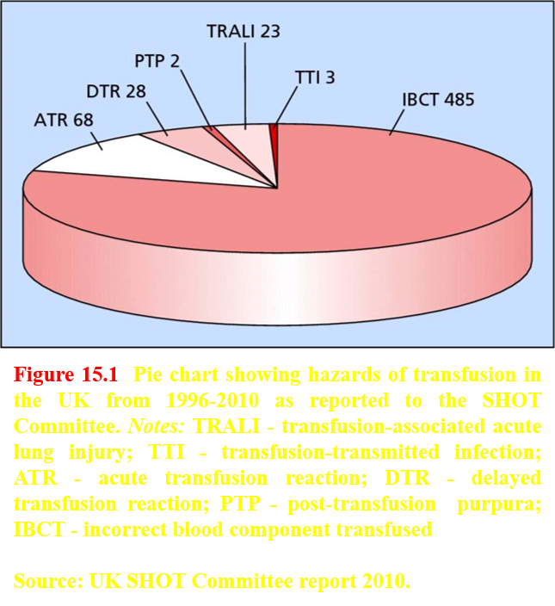
Hazards of blood transfusion:
the Serious Hazards of Transfusion (SHOT) Committee, between 1996 and 2010.

Slide 32
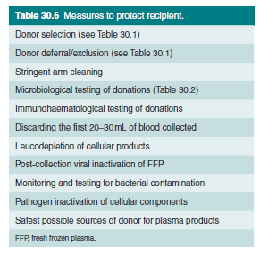

Slide 33
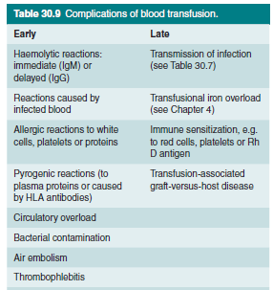
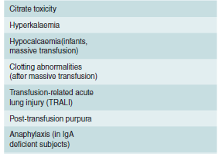
Early
Important Slide
Solution: irradiation

Slide 34
Management of Transfusion Reactions
The first action is always to stop the transfusion and clarify that the correct patient’s details are on the component being transfused.
Any suspicion of ABO incompatibility should lead to the institution of circulatory support with IV fluids, careful monitoring of pulse, blood pressure and urine output, and supportive management of any developing DIC.
The component bag should be returned to the transfusion laboratory with a fresh cross-match sample from the patient.
Samples should also be sent to assess for intravascular hemolysis - including a full blood count, serum haptoglobin, and hemoglobinuria.
It is important to ensure that the possibility of bacterially contaminated units has been addressed through taking blood cultures.

Slide 35
cont’d…
If necessary, broad-spectrum antibiotics may be commenced empirically after cultures have been drawn.
Severe allergic reaction should be treated initially by stopping the transfusion and returning the unit to the laboratory.
Chlorpheniramine may help, but severe reactions are likely to require oxygen and nebulized salbutamol, plus intramuscular adrenaline in the case of circulatory collapse.
With mild fevers only, simple interventions may suffice (e.g. giving an antipyretic and slowing the transfusion); similarly, if a mild allergic reaction is evident (e.g. urticaria), chlorpheniramine followed by a slower reinstatement of the transfusion may help.
Appropriate investigations include a full blood count, a direct antiglobulin test, serum bilirubin and assessment of renal function.

Slide 36
Massive transfusion
Patients with acute hemorrhage (i.e. loss of red cells and plasma) may need to be transfused with large quantities of packed red cells.
Massive transfusion has been defined as the replacement of one blood volume over 24 hours, or as the replacement of 50% of circulating volume in 3 hours.
With the transfusion of many units of packed red cells, the patient may become deficient in key plasma components such as clotting factors and may also become thrombocytopenic (even in the absence of DIC).
The administration of one unit of FFP per unit of red cells may be effective in replacing clotting factors. Fibrinogen and platelets should also be replaced, with 2 pools of cryoprecipitate and 1 adult dose of platelets per 6-8 units of packed red cells.

Slide 37
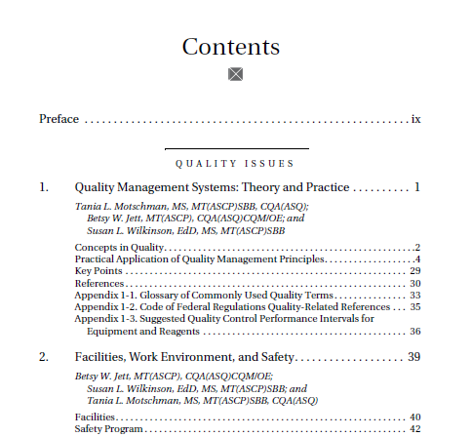

Always Quality First;

Slide 38
Conclusion:
The main goal of blood bank services is to provide a safe blood component in timely and cost-effectiveness manners.
Different key dedicated areas in the blood bank serve in harmony to achieve the main goal.
Always, there is a risk in transfusion. All implemented standards goal to minimize the risk.
Always, maintain the quality!

Slide 39
Example MCQs
Q1) Which one of the following services is under the transfusion/cross-match services of the blood bank?
  A) Collection of whole blood unit.
  B) Reconfirmation of donor blood group.
  C) Component separation.
  D) Infectious agents testing.

Slide 40
Example MCQs
Q2) Which one of the following potential complications of the blood transfusion is an acute/early complication?
  A) TRALI.
  B) GvHD.
  C) Allo-antibodies/immue sensitization.
  D) Iron overload.

Slide 41
Example MCQs
Q3) Which one of the following step is critical for reducing the frequency of GvHD?
  A) Washing the transfused unit.
  B) Stop the transfusion when you suspect a chronic GvHD.
  C) Irradiation prior to transfusion.
  D) Transfuse only fresh unit (<7 days).

Slide 42
Example MCQs
Q4) Which ONE of the following statements is TRUE about the indirect antiglobulin test?
  A) It may detect complement on the surface of red cells.
  B) It is positive in hemolytic disease of the newborn because of Rh incompatibility.
  C) It detects agglutination of antibody-coated red cells.
  D) It is used for cross-matching recipient and donor blood.

Slide 43
Example MCQs
Q5) Which ONE of these infectious agents is usually identified by high risk behavior and NOT routinely tested for in blood products?
  A) Hepatitis C antibody.
  B) Hepatitis B.
  C) Gonorrhoea.
  D) HIV.

Slide 44
Thank You!!!

