Slide 1
Approach to Bleeding Disorders DR. FATMA AL-QAHTANI ASSOCIATE PROFESSOR CONSULTANT HAEMATOPATHOLOGIST DEPARTMENT OF PATHOLOGY

Slide 2
LEARNING OBJECTIVES
To know the function of platelets
To learn about different types of inherited and aquired platelet quantitative and qualitative defects.
To know about the diseases associated with (i) a failure of platelet production and (ii) a shortened platelet lifespan.
To know the main sequence of events in the coagulation pathways
To understand normal fibrinolysis and the principles of fibrinolytic therapy
To know the principles of different coagulation tests.

Slide 3
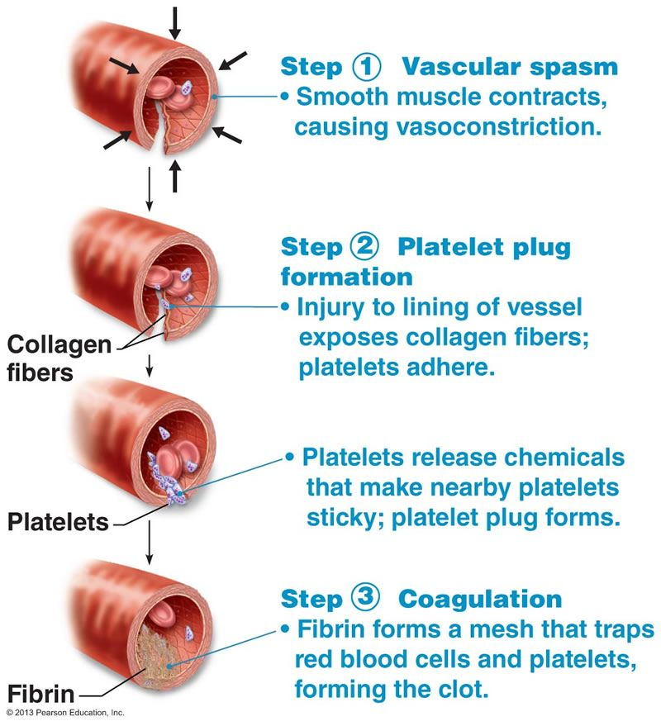
3 Steps of normal hemostasis

Slide 4
Classification of haemostatic defects
Bleeding arise from defects in one of the three processes:
Thrombocytopenia (a low platelet count) (the commonest cause)
Abnormal platelet function.
A defect in the clotting mechanism (the second commonest cause)
clotting defects usually present with bleeding into deep tissues (muscles or joints).
Platelet defects usually present with mucocutaneous bleeding.

Slide 5
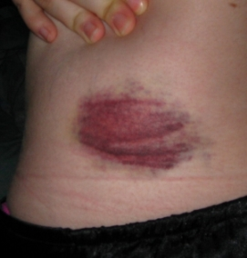
Petechiae
Ecchymoses

Slide 6
Platelet structure

Slide 7
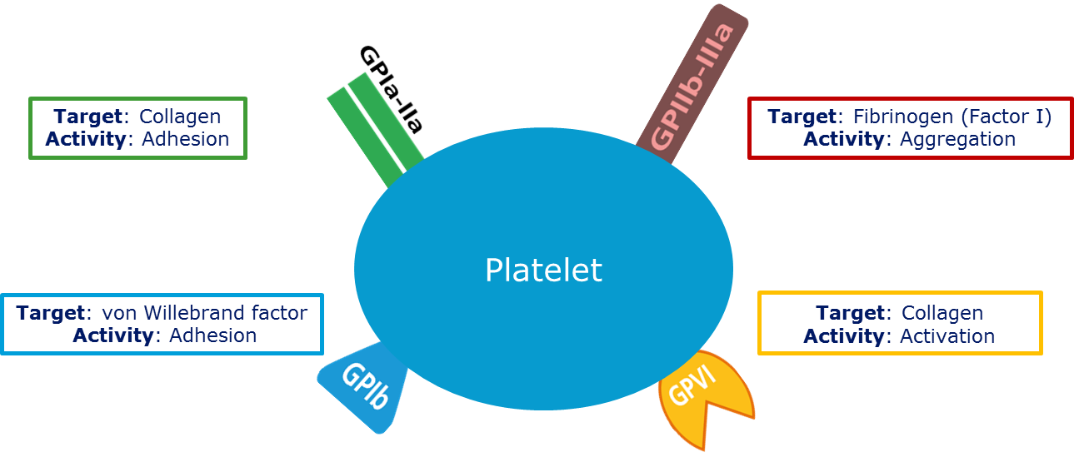
The plasma membrane of a platelet contains glycoproteins (GPs) that are important in the interaction of platelets with subendothelial connective tissue and other platelets.
GP Ia and VI, which bind to collagen
GP Ib, which binds to von Willebrand factor (VWF)
and GP IIb/IIIa, which binds to fibrinogen.

Slide 8
Platelets
Formed in the bone marrow by the fragmentation of megakaryocyte cytoplasm.
Their concentration in normal blood is 150-450 X 10⁹/L.
The lifespan of the platelet around 10 days.

Slide 9
Tests of platelet function
Bleeding time
Old method not used in routine practice.
It is estimated by making small wounds in the skin of the forearm after applying a blood pressure cuff to the upper arm and inflating it to 40mmHg; the average time that elapses until bleeding ceases is then measured.

Slide 10
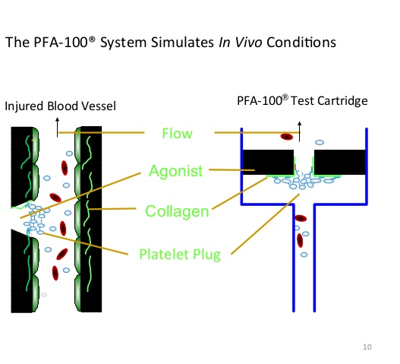
PFA-100
The bleeding time has largely been replaced by an in vitro estimation of primary haemostasis using a machine called a PFA-100.

Slide 11
Platelet aggregation studies
The most common is light transmission aggregometry.
The aggregation of platelets is studied following the addition of substances such ADP, epinephrine, arachidonate, collagen and ristocetin to platelet-rich plasma.
Aggregation causes an increase in the light transmitted through the sample and the test is performed using special equipment capable of continuously recording light transmission.

Slide 13
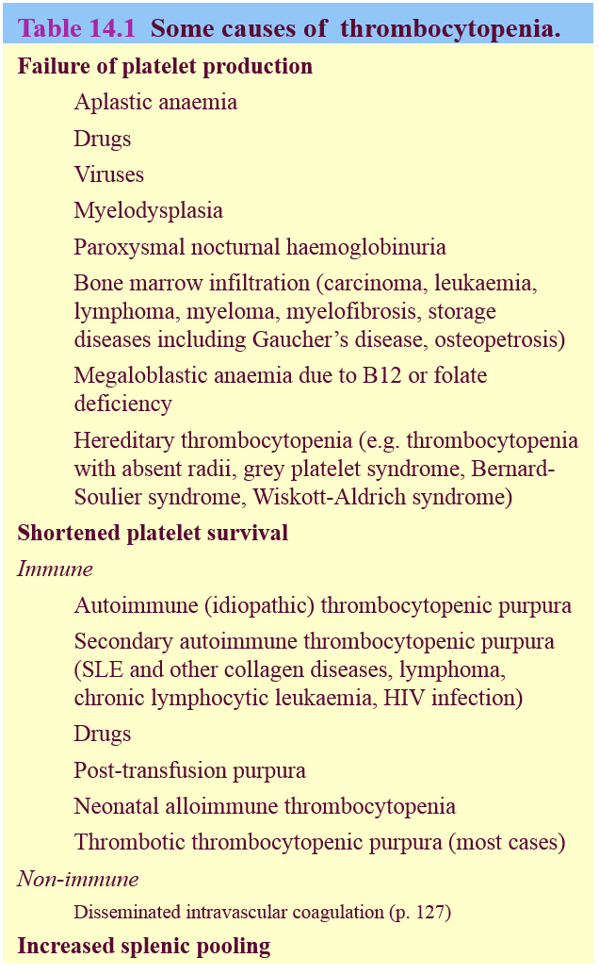
Thrombocytopenia
Low platelet count

Slide 14
Immune thrombocytopenic purpura (ITP)
ITP is characterized by thrombocytopenia and mucocutaneous bleeding .
Acute or Chronic form.
Acute ITP
Most common before the age of 10 years but can affect any age
Commonly prceeded by viral infection (e.g. upper respiratory tract infection, chicken pox, measles).
Platelet counts are often less than 20 X 10⁹/L.
in most pateints has a self-limiting course of 2-4 weeks.
In approximately 20% it becomes chronic (lasts more than 6 months).
The mortality is low, the main danger being intracranial bleeding.

Slide 15
ITP
Chronic ITP
This occurs mainly in the age period 15-50 years
Higher incidence in women than in men. Platelet counts are usually between 20 and 80 X 10⁹/L.
Spontaneous cures are rare and the disease is characterized by relapses and remissions.

Slide 16
Diagnosis
Children with the appropriate clinical features, acute thrombocytopenia with large platelets (high MPV) and an otherwise normal blood count (i.e. no evidence of acute leukaemia).
In ITP, bone marrow megakaryocytes are normal or increased in number (up to four- or eightfold) and increased in size.
An absence or reduction of megakaryocytes rules out the disease.

Slide 17
Treatment
Acute ITP
Over 80% of patients recover without any treatment.
Corticosteroids are widely used
High dose of intravenous immunoglobulin (Ig) cause a rapid increase in the platelet count
Chronic ITP
Treatment is usually not needed in patients with platelet counts above 30-50 X 10⁹/L who have no significant spontaneous bleeding.
High-dose corticosteroid therapy increases the platelet count to more than 50 X 10⁹/L
Splenectomy, thrombopoietin receptor agonists, and rituximab are reserved for refractory cases.

Slide 18
Thrombotic thrombocytopenic purpura (TTP)
In healthy individuals a VWF-cleaving protease (ADAMTS 13) VWF.
In the absence of the protease (Inherited or acquired), ultra-large VWF multimers are released that lead to platelet aggregation and the disease known as ‘thrombotic thrombocytopenic purpura’ (TTP).
This is a serious illness characterized by widespread arteriolar platelet thrombi leading to fragmentation of red cells (schistocytes), thrombocytopenia, neurological symptoms and renal impairment.
Coagulation tests are NORMAL.
Treatment is by plasma exchange.
Platelet transfusion is CONTRAINDICATED.
HUS (hemolytic uremic syndrome) is a similar condition affecting children after infection by Escherichia coli or Shigella dysenteriae and treated conservatively.

Slide 19
Increased splenic pooling
A normal spleen contains within its microcirculation about 30% of all the blood platelets.
The splenic platelet pool increases with increasing splenic size, so that in patients with moderate to massive splenomegaly it may account for 50-90% of all blood platelets, thus causing thrombocytopenia.

Slide 20
Abnormalities of platelet function (Acquired)
Causes:
Drugs (aspirin and other antiplatelet drugs).
Chronic myeloproliferative disorders
Myelodysplastic syndromes
Paraproteinaemias (e.g. myeloma or Waldenström’s macroglobulinaemia)
Uraemia.

Slide 21
Inherited platelet disorders:
Glanzmann’s disease:
Rare but severe platelet disorder caused by a lack of glycoprotein IIb/IIIa receptors.
Autosomal recessive
Platelets are normal in morphology and number.
Bernard-Soulier disease:
Caused by a lack of glycoprotein Ib receptors.
Autosomal recessive.
Platelets are larger than normal and usually the platelet count is reduced.
Storage pool diseases:
These are inherited group of diseses resulting in defective platelet granules.

Slide 22
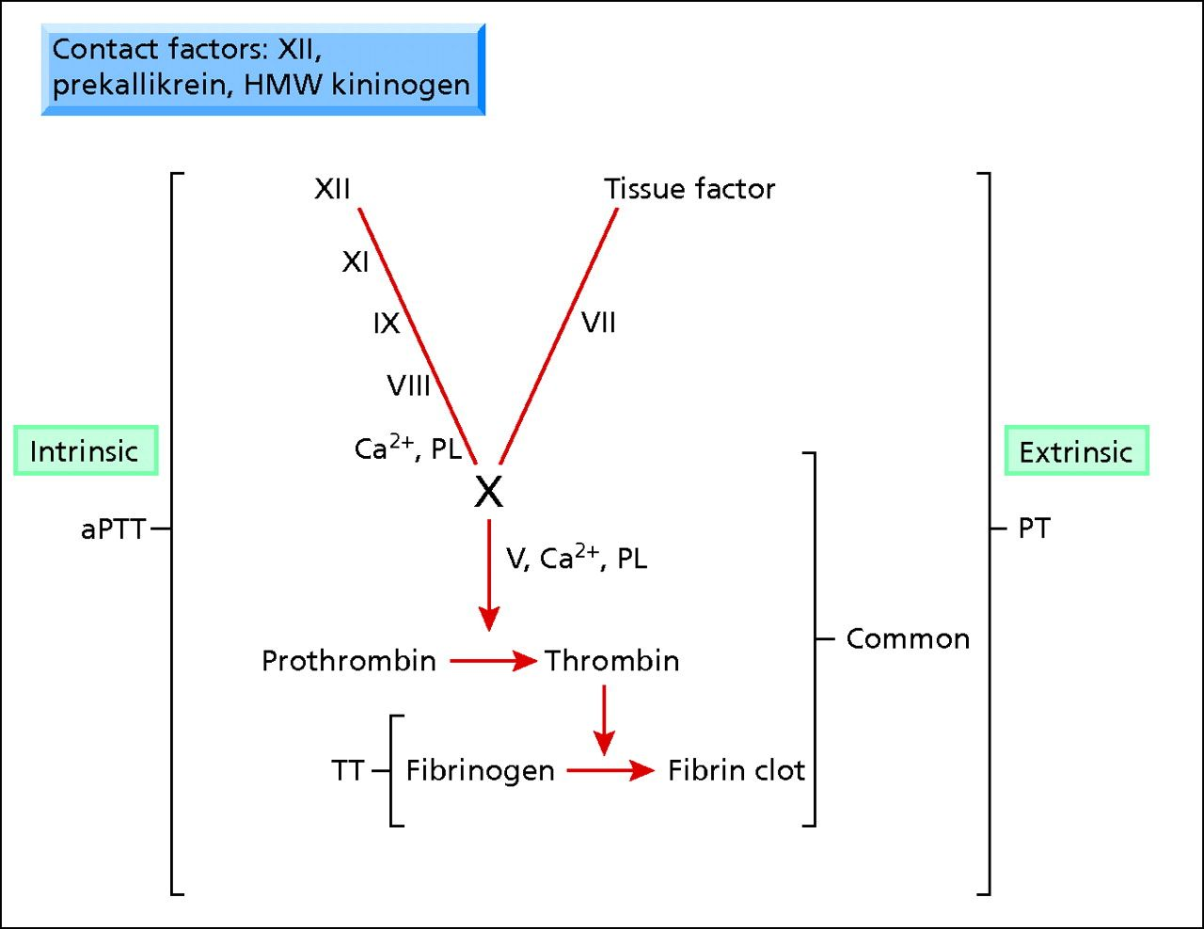
Coagulation cascade

Slide 24
The fibrinolytic mechanism
After haemostasis has been achieved, the body has a mechanism for the enzymatic lysis of clots. The dissolution of the fibrin into fibrin-degradation products (FDPs) is carried out by the proteolytic plasma enzyme plasmin. Plasmin is present in the plasma in an inactive form.
D‐dimer is a measurement of fibrin degradation products

Slide 25
D-dimer
D-dimers are raised in thrombosis. It has a high negative predictive value. D-dimers are raised in a variety of clinical situations and so have a low positive predictive value for thrombosis.
They can be raised in: • Pregnancy • Malignancy • Infection • DIC • Vaso-occlusive sickle cell crisis • Surgery • Burns • Liver disease • Snake bites • Atrial fibrillation • Renal failure • Cardiac failure • Venous thromboembolic disease [VTED] • Aortic dissection

Slide 28
Coagulation tests
PT(INR),APTT.
Fibrinogen.
D-Dimer.
Factors Assay.
Mixing study.
VWF test

Slide 31
Test | Patient | Reference Range
Hb | 7.6 g/dL | 11.5-13.5g/dL
WCC | 11.9 x 10⁹/L | 4 -11 x 10⁹/L
Platelets | 10 x 10⁹/L | 150 - 400 x 10⁹/L
PT | 13s | 11-14s
APTT | 35.6s | 23-35s
Fibrinogen | 2.1g/L | 1.5-4.0g/L
A 30-year-old woman is admitted through A & E with a 2 days history of easy bruising, upon admission she had convulsion.

Slide 32
. The LDH is elevated at 2389 U/dL . The creatinine is raised at 389 µmol/mL . A blood film is shown

Slide 33
What is the diagnosis? Are there any additional tests you would request?

Slide 34
What is the treatment in this disorder?
Test | Patient | Reference Range
ADAMTS13 Activity | <5% | 66-126%
ADAMTS13 Inhibitor Assay | 28 AU/mL | <11 AU/mL

