Slide 1
PRACTICAL HAEMOGLOBINOPATHIES
DR. FATMA S. AL-QAHTANI
ASSOCIATE PROFESSOR
CONSULTANT HAEMATOPATHOLOGIST
DEPARTMENT OF PATHOLOGY

Slide 2
Golden Rules to Evaluate Hemoglobin Electrophoresis
1) You must know the CBC results (RBC count, Hb, MCV, MCH, RDW & Plt).
2) Peripheral blood film might be useful (target, sickle, pencil, rhomboidal, golf).
3) different methods has its own issues (gel: alkaline or acid, HPLC & capillary electrophoresis)
4) Family history and molecular tests are critical in difficult cases and to confirm the diagnosis.
5) As a physician, do not under estimate the medical history and clinical examination.

Slide 6
Pencil cell

Slide 8
Golden Rules to Evaluate Hemoglobin Electrophoresis
6) Are all normal hemoglobin variants present? And if present, are they in normal amount?
7) Beta thalassemia trait has a higher Hb A2 (>3.6) & beta thalassemia major has a very high Hb F (>80%).
8) Is there any abnormal Hb? What is the percentage?
9) Sickle cell trait has 35% - 45% Hb S. If it is >45%, it is a sickle cell disease (when high Hb A2 then likely S/beta thal).
10) Alpha thalassemia reduced other abnormal Hb level.

Slide 9
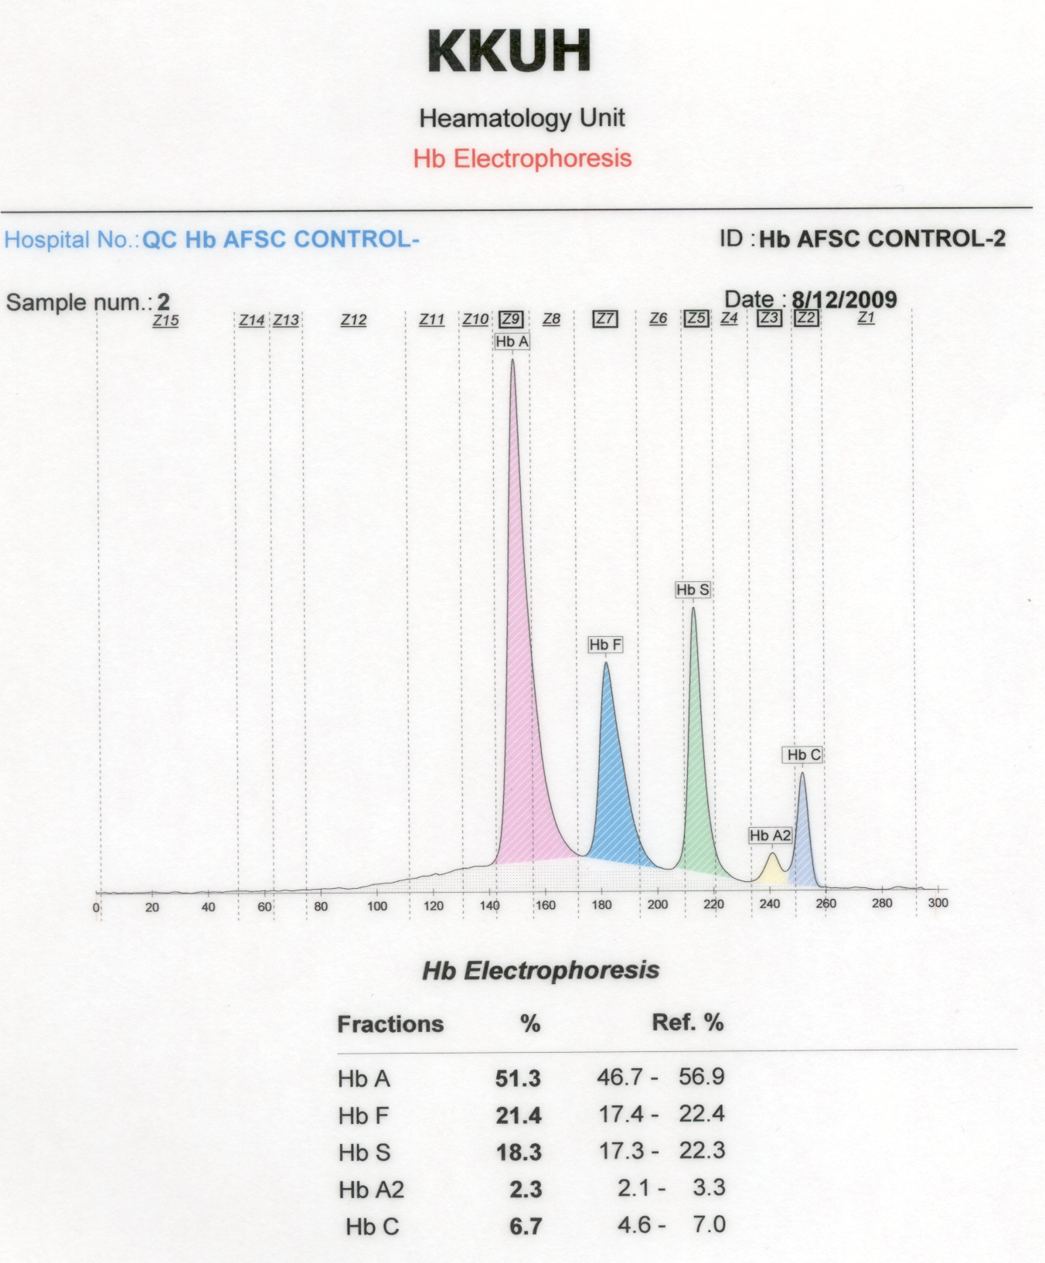
This a QC to ensure accurate results of Hb Electrophoresis

Slide 10
RBC= 4.8 (N).
Hb= 14 (N).
MCV= 83 (N).
MCH= 29 (N).
RDW= 14 (N).
Plt= 230 (N).
This is a normal Hb pattern.

Slide 11
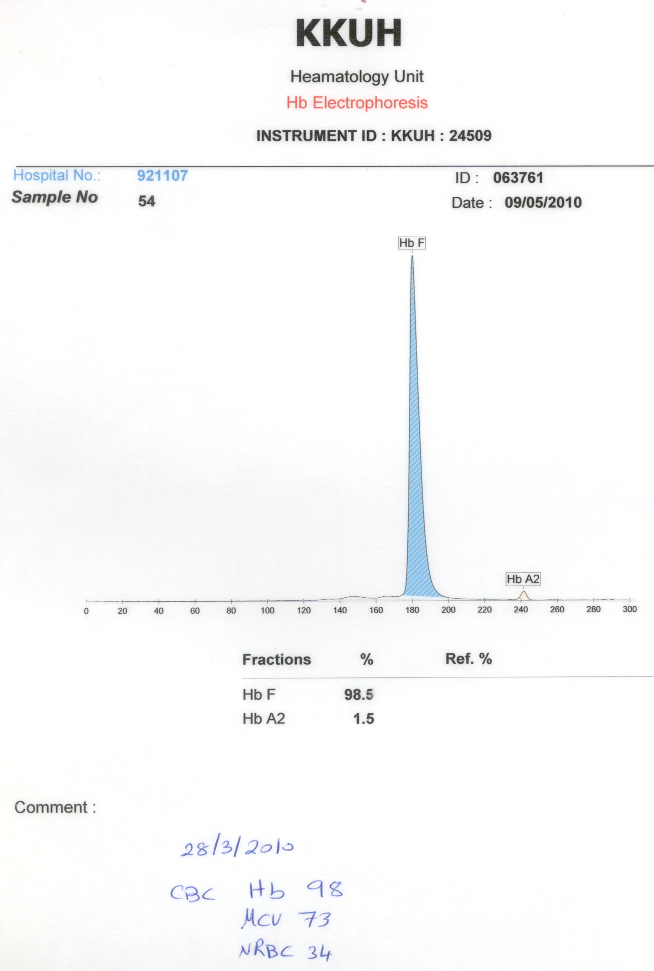
Beta thalassemia major (B0/B0).
There is NO Hb A.

Slide 12
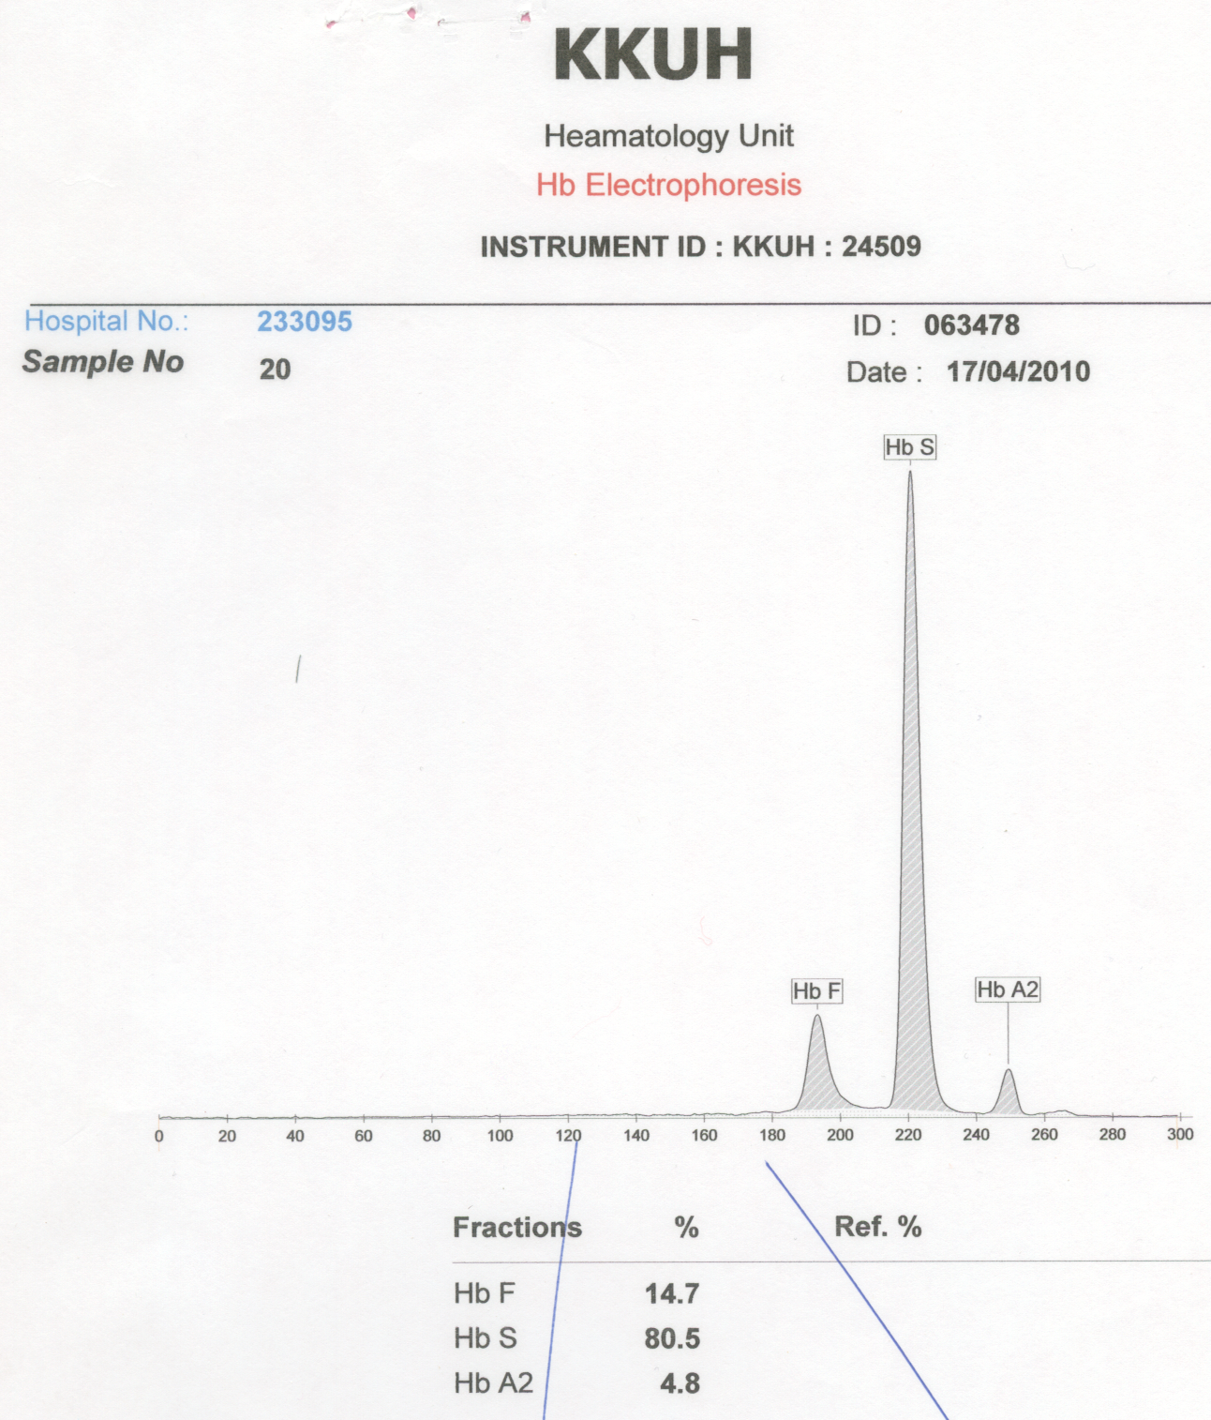
RBC= 2.8 (L).
Hb= 7.2 (L).
MCV= 72 (L).
MCH= 22 (L).
RDW= 16 (H).
Plt= 340 (N).
Sickle cell disease, likely (S/beta0) + HPFH.
PBF might show target & NRBCs.

Slide 13
RBC= 2.8 (L).
Hb= 7.2 (L).
MCV= 83 (N).
MCH= 29 (N).
RDW= 16 (H).
Plt= 340 (N).
Sickle cell disease, likely (S/S). Pt likely on Hydroxyurea (HU, elevated Hb F).

Slide 14
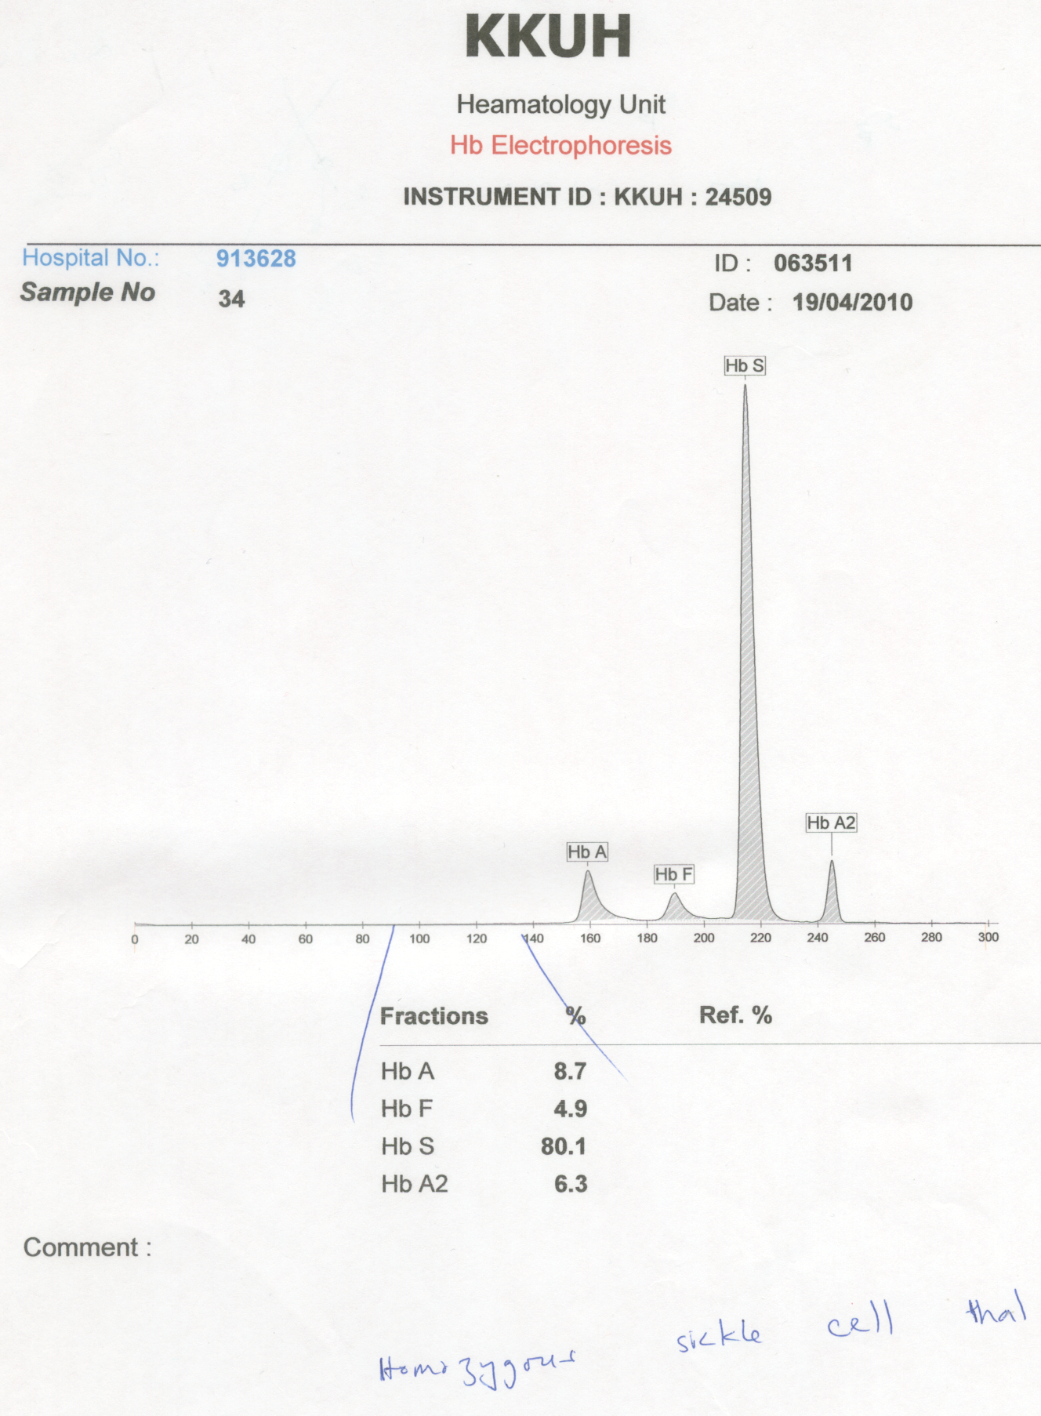
RBC= 2.8 (L).
Hb= 7.2 (L).
MCV= 72 (L).
MCH= 22 (L).
RDW= 16 (H).
Plt= 340 (N).
Sickle cell disease, likely (S/beta thal).
Pt has blood Tx + HU and PBF might show target & NRBCs.

Slide 15
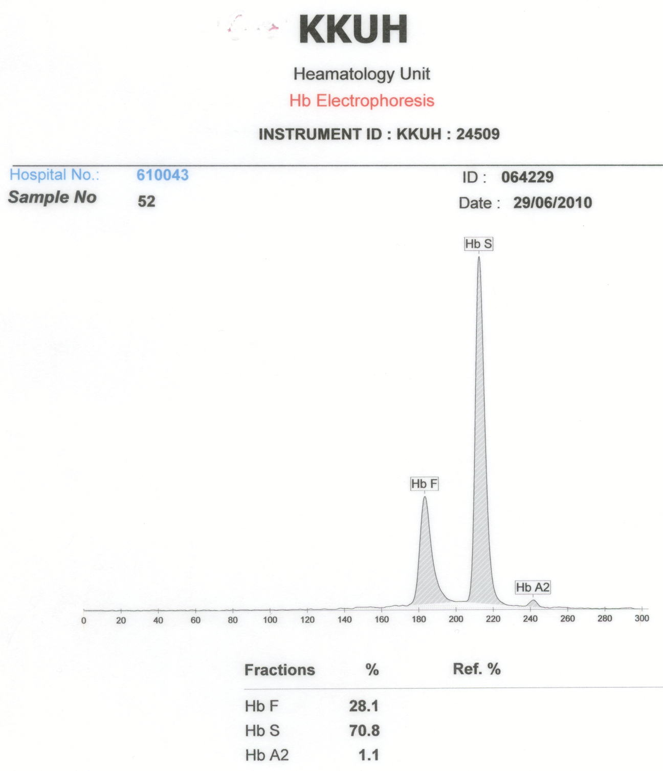
Sickle cell disease, (S/S) + HPFH & alpha thalassemia (low MCV, MCH & Hb A2). High Hb F might protect from crisis. Confirm by family & molecular .
RBC= 2.8 (L).
Hb= 7.2 (L).
MCV= 72 (L).
MCH= 22 (L).
RDW= 16 (H).
Plt= 340 (N).

Slide 16
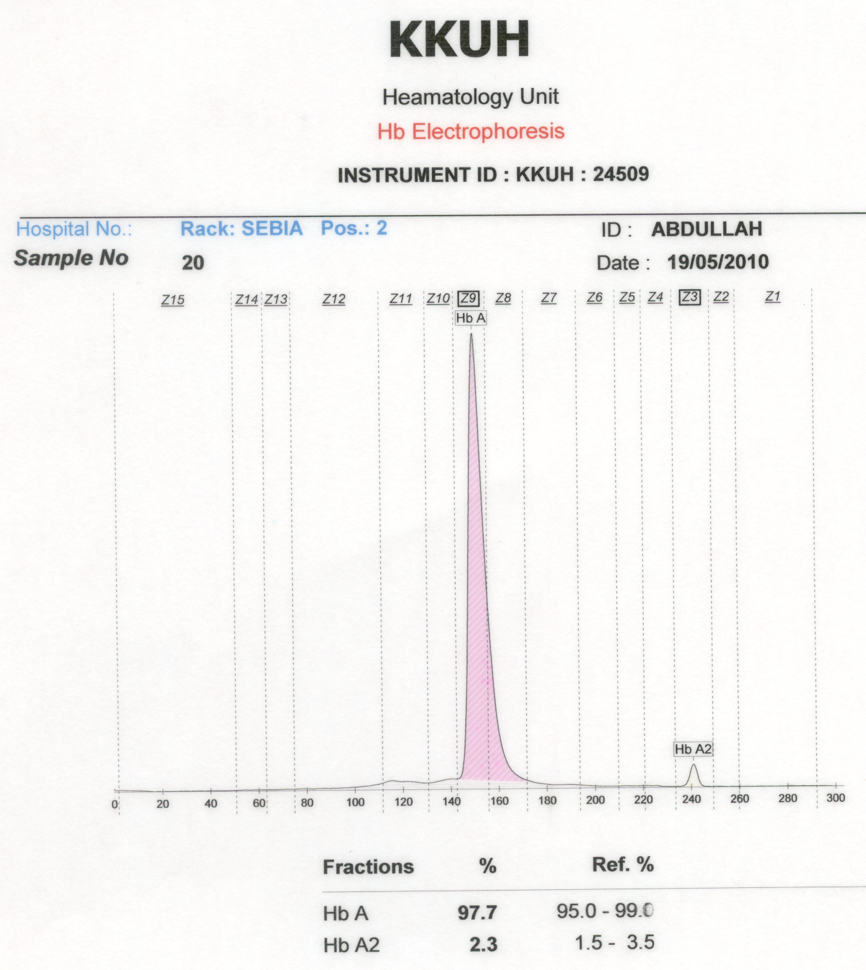
RBC= 4.8 (N).
Hb= 14 (N).
MCV= 67 (L).
MCH= 23 (L).
RDW= 13 (N).
Plt= 230 (N).
Normal Hemoglobin pattern but likely alpha thalassemia trait.
Family and molecular studies to confirm.

Slide 17
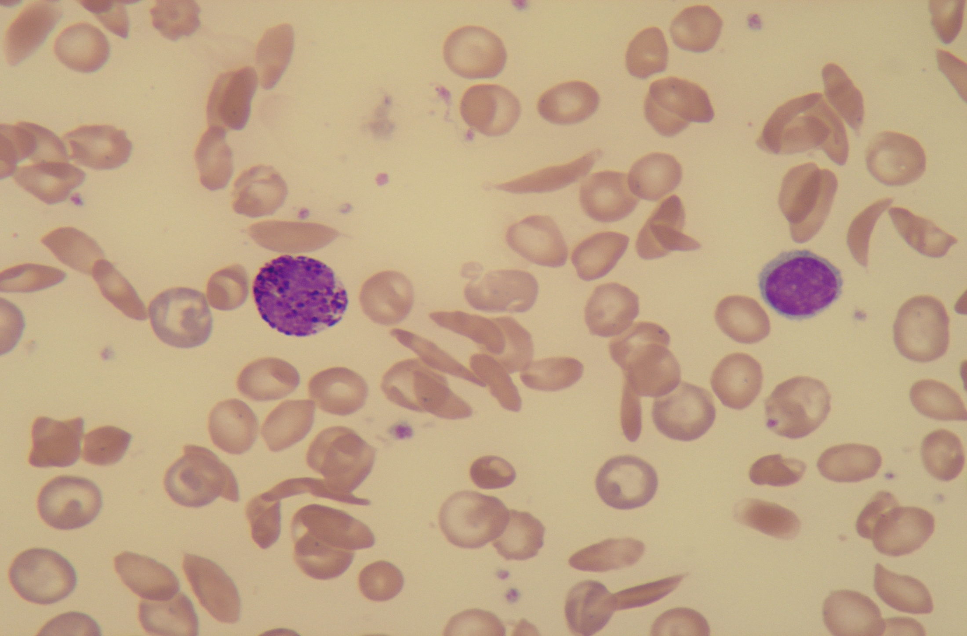
Frequent sickle cells seen with few target cells.
If Hb A2 is normal with low MCV & MCH, this SCD with likely alpha thalassemia trait.

Slide 18
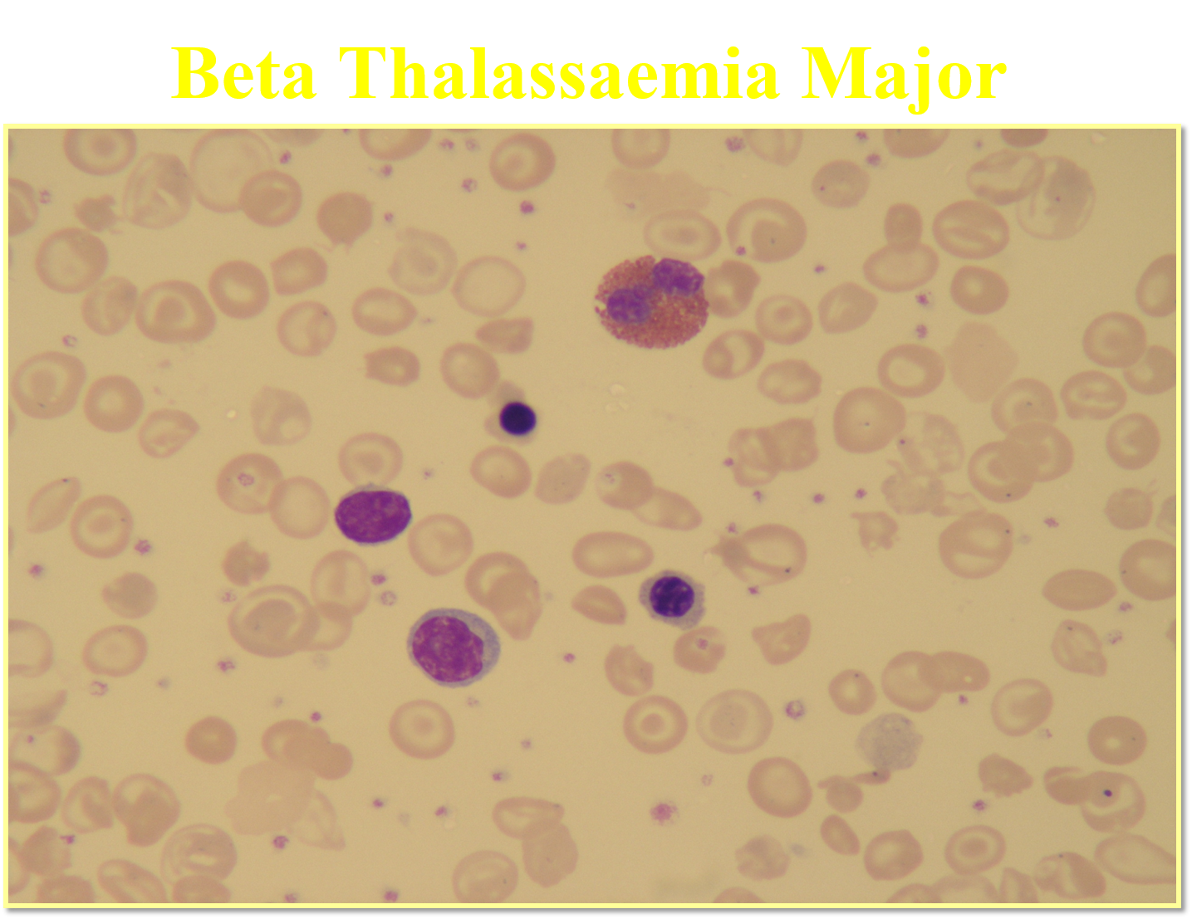
Microcytic RBCs.
Hypochromic RBCs.
Many target cells.
Frequent NRBCs.
WBCs (2 lymphocytes and eosinophil).
IF Hb F is ~ 95%, this is beta thalassemia major. If NO Hb A, then, (B0/B0).

Slide 19
RBC= 4.8 (N).
Hb= 14 (N).
MCV= 67 (L).
MCH= 23 (L).
RDW= 13 (N).
Plt= 230 (N).
Sickle cell trait with likely alpha thalassemia.
Family and molecular studies to confirm.

Slide 20
RBC= 2.8 (L).
Hb= 7.2 (L).
MCV= 82 (N).
MCH= 27 (N).
RDW= 16 (H).
Plt= 340 (N).
- Sickle cell disease, (S/S) + HPFH.
- (normal MCV, MCH & Hb A2). High Hb F might protect from crisis.
- Confirm by family & molecular .

Slide 21
Normal results even with slight elevated Hb A2 (NOT beta thalassemia trait).
Family and molecular studies to confirm.

Slide 22
Thank you

