Slide 1
BILIARY PASSAGES & PANCREAS
Objectives:
The student should be able to identify & describe the histological features of:
Intrahepatic biliary passages.
Extrahepatic bile ducts.
Gall bladder.
Exocrine pancreas.

Slide 2
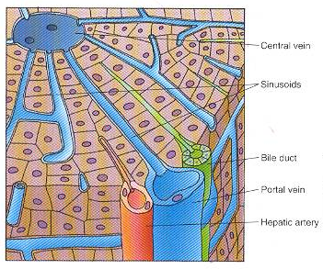
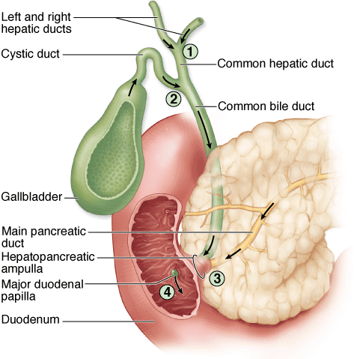
Biliary Passages
Intrahepatic passages:
1- Bile canaliculi.
2- Bile ductules (canals of Hering).
3- Interlobular bile ducts.
Extrahepatic passages:
4- Right & left Hepatic ducts.
5- Common hepatic duct.
6- Common bile duct.

Slide 3
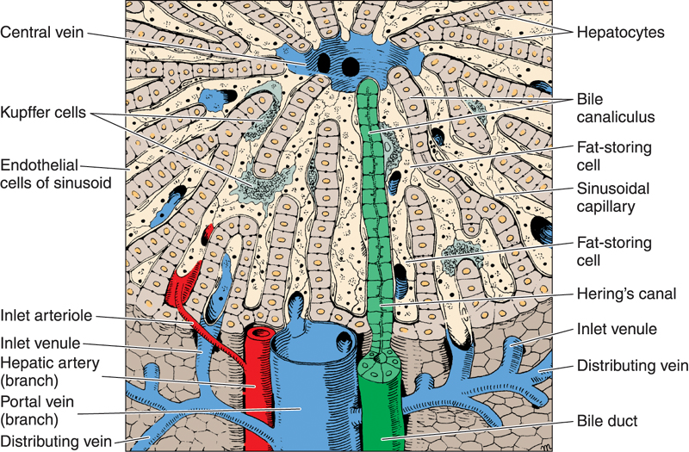
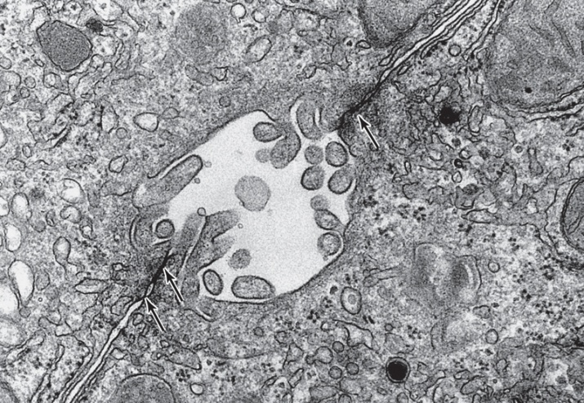
Bile Canaliculi
Narrow channels located between hepatocytes, limited only by the cell membranes of 2 hepatocytes.
They are the first portions of the bile duct system.
Microvilli project from the hepatocyte into the bile canaliculi, thus increasing the surface area.
Tight junctions between the cell membranes of the 2 hepatocytes prevent leakage of bile.

Slide 4
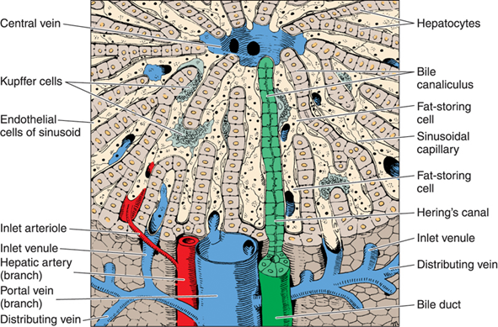
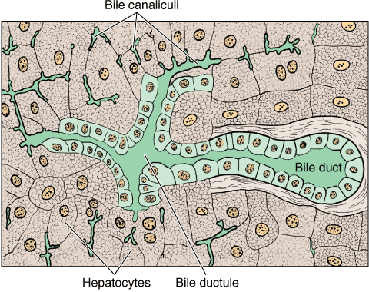
Bile Ductules (Canals of Hering)
Near the peripheral portal areas, bile canaliculi empty into bile ductules composed of cuboidal epithelial cells called cholangiocytes.
After a short distance, these ductules collect and end in the interlobular bile ducts in the portal areas.

Slide 5
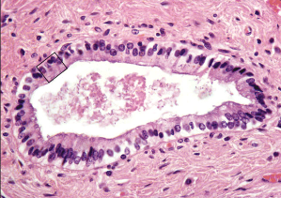
Interlobular Bile Ducts
Are in the portal areas.
Lined by simple cuboidal epithelium (becomes simple columnar epithelium near the porta hepatis).
Interlobular bile ducts merge to form larger ducts, which eventually unite to form the right and left hepatic ducts.

Slide 6
Common Hepatic Duct
Formed by union of the right & left hepatic ducts. It joins the cystic duct, arising from the gallbladder, forming the common bile duct.
Similar in structure to the wall of gall bladder and other extrahepatic bile ducts.
Mucosa:
  Epithelium: Simple columnar.
  Lamina propria.
Muscularis: bundles of smooth muscle fibers in all directions.
Adventitia.

Slide 7
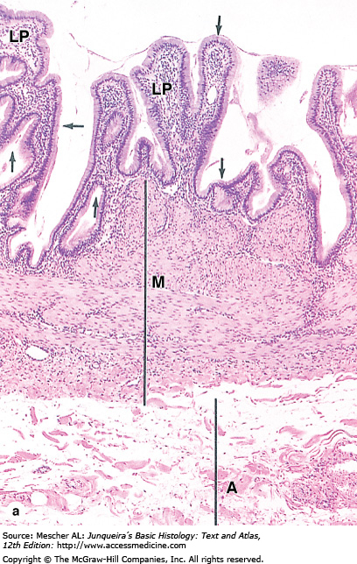
Gall Bladder
A saclike structure that stores, concentrates and releases bile. Its wall is formed of:
Mucosa: highly folded.
  Simple columnar epithelium.
  Lamina propria: contains mucous glands in the neck of gall bladder.
Muscularis: bundles of smooth muscle fibers oriented in all directions.
Serosa or adventitia.

Slide 8
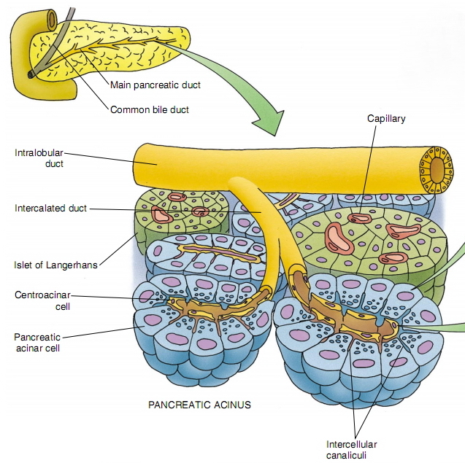
PANCREAS
Stroma: capsule, septa & reticular fibers.
Parenchyma: Pancreas is a mixed gland:
  Exocrine part (acini & ducts): produces digestive pancreatic enzymes.
  Endocrine part (islets of Langerhans): produces hormones.

Slide 9
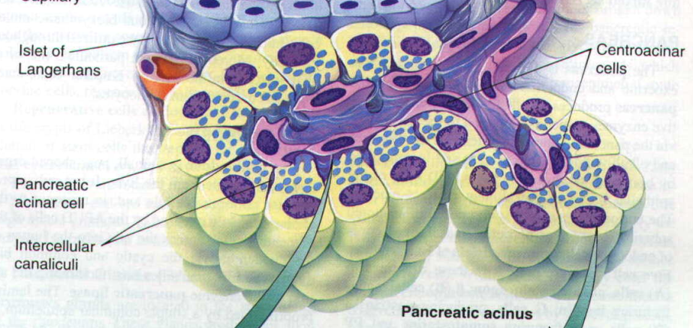
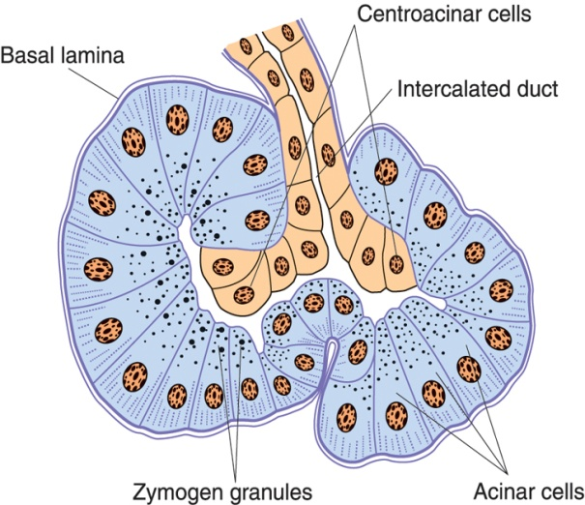
Exocrine Pancreas
Pancreatic Acini:
They are serous acini: secreting a thin fluid rich in digestive pancreatic enzymes.
Centroacinar cells:
Their nuclei appear in the center of the acini. They represent the beginning of the ducts.
No myoepithelial cells around the acini.

Slide 10
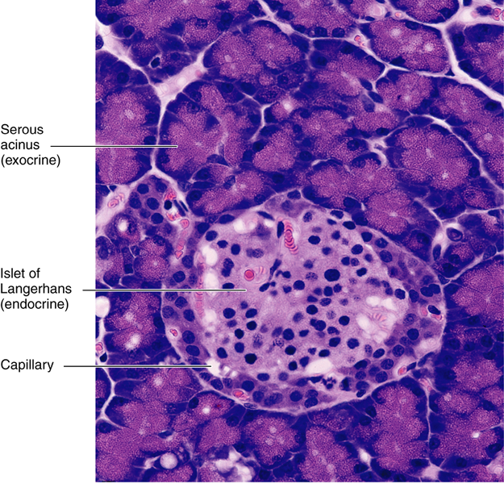
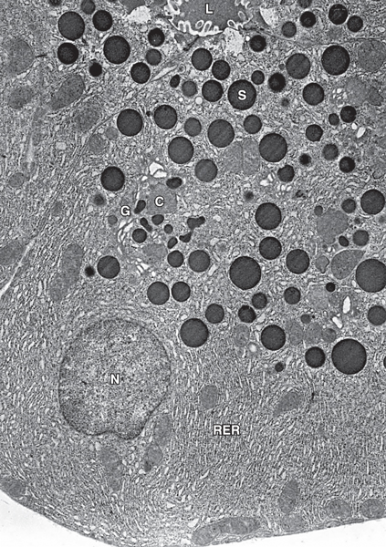
Exocrine Pancreas
Pancreatic Acinar Cells:
Pyramidal in shape.
Nuclei are basal.
Cytoplasm:
  Basal part basophilic (due to abundant rER).
  Apical part acidophilic (due to secretory granules).

Slide 11
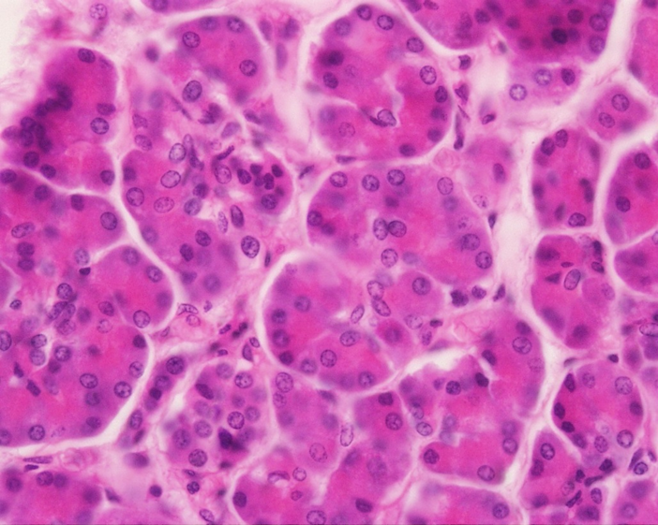
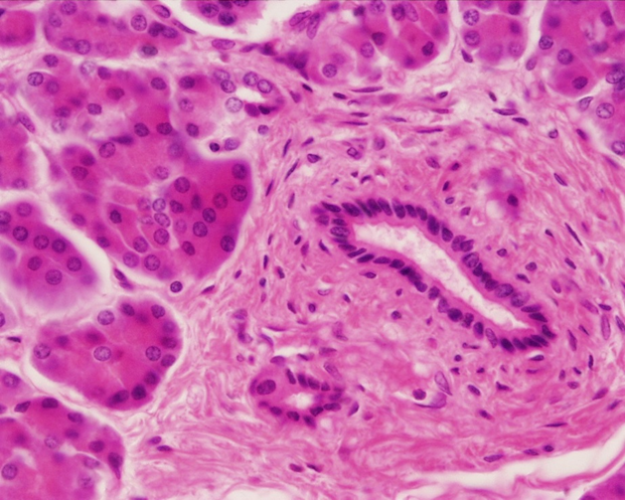
Exocrine Pancreas
Duct System:
Centroacinar cells.
Intercalated ducts (low cuboidal).
Intralobular ducts (NOT prominent).
Interlobular ducts.
Main pancreatic duct.

Slide 12
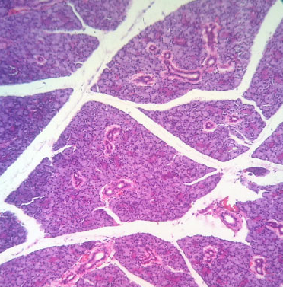
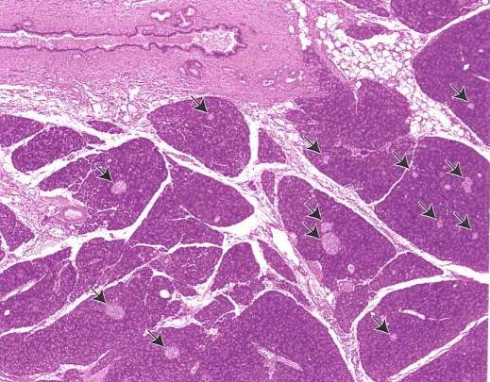
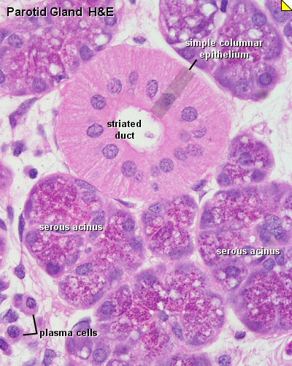
Parotid gland
Pancreas

Slide 13
Best Wishes

