Slide 1
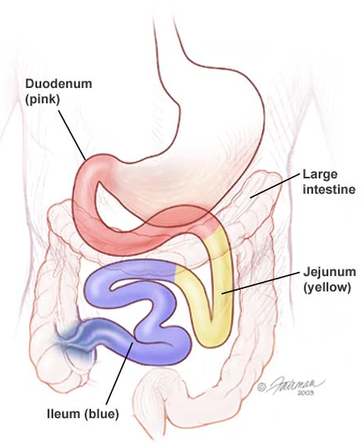
SMALL INTESTINE
Objectives:
By the end of this lecture,
The student should describe the microscopic
structure of the three regions of the small intestine:
1- Duodenum.
2- Jejunum.
3- Ileum.
Notes:
Plicae circulares: transverse folds of mucosa and submucosa.
Villi: Finger like projections of lamina propria that is covered with epithelium.
Microvilli: projections from the apical surface of epithelial cells.
Crypts of Lieberkuhn: invaginations of epithelium into the lamina propria between the villi to form glands.

Slide 2
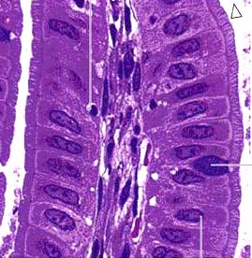
SMALL INTESTINE
To increase surface area the mucosa has:
Plicae circulares
(circular folds):
Permanent folds of the mucosa and submucosa.
Villi.
Intestinal crypts (crypts of Lieberkühn).
Microvilli (Brush border).
Notes:
Plicae circulares: transverse folds of mucosa and submucosa.
Villi: Finger like projections of lamina propria that is covered with epithelium.
Microvilli: projections from the apical surface of epithelial cells.
Crypts of Lieberkuhn: invaginations of epithelium into the lamina propria between the villi to form glands.

Slide 3
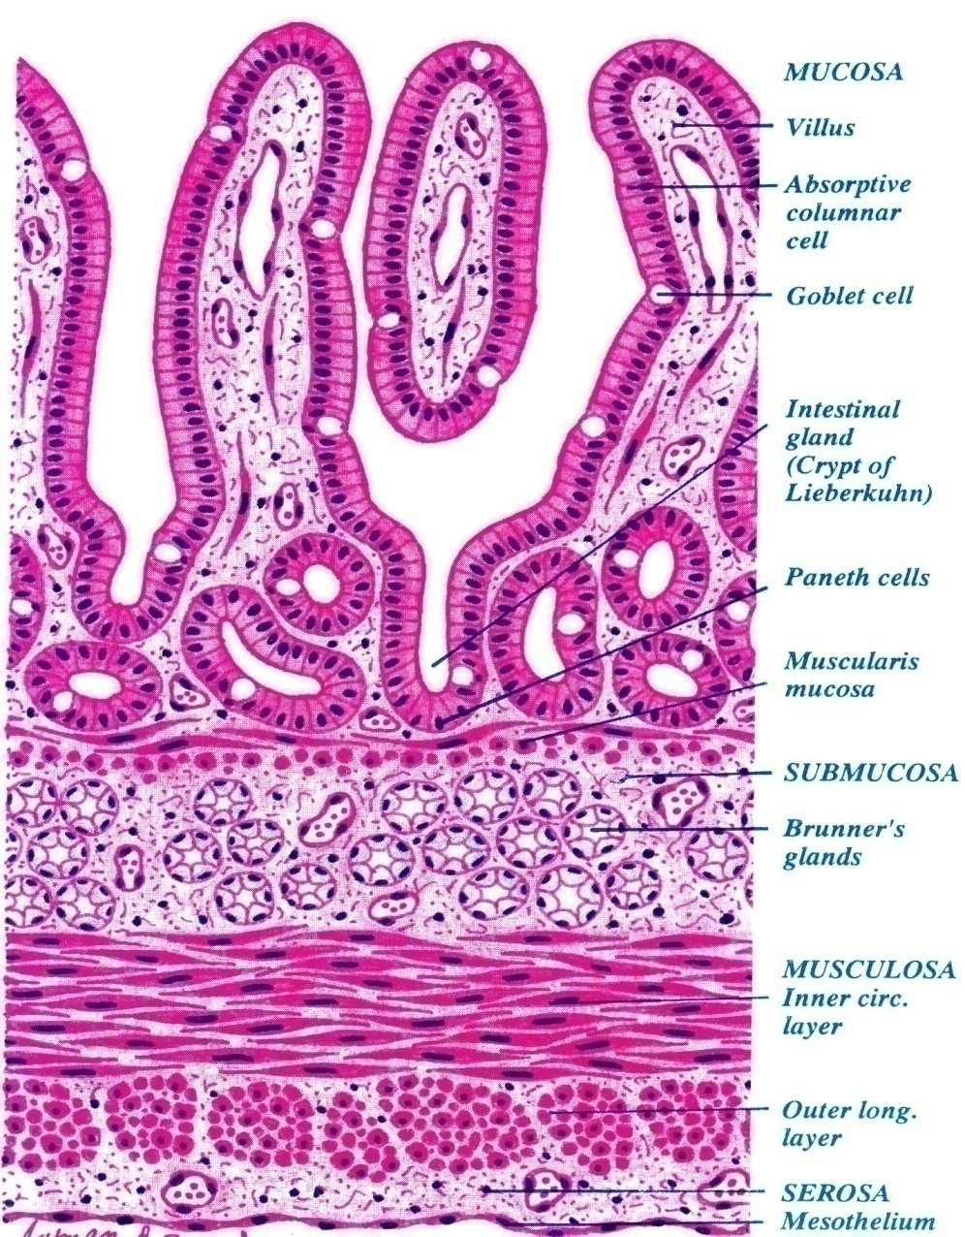
Duodenum
1- Mucosa:
Shows villi and crypts.
A- Epithelium: simple columnar epithelium with goblet cells.
B- Lamina propria: Loose areolar C.T.
C- Muscularis mucosae: 2 layers of smooth muscle cells.

Slide 4
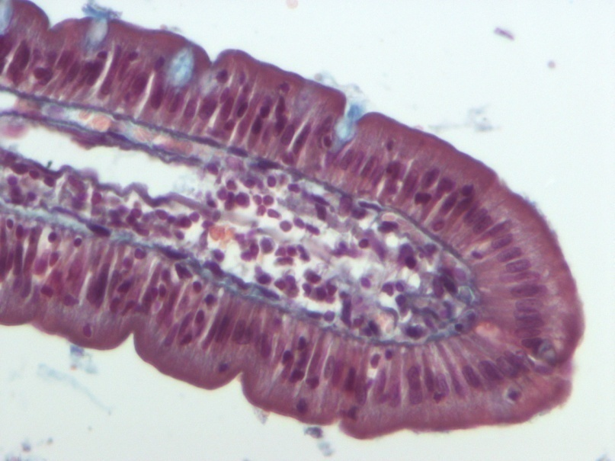
Intestinal villi
Each Villus is a finger-like projection of small intestinal mucosa and it is formed of:
I- Central core of loose areolar C.T. containing:
Lymphocytes.
Plasma cells.
Fibroblasts.
Smooth muscle cells.
Capillary loops.
Lacteal (blindly ending lymphatic channels).
II- Villus-covering epithelium.

Slide 5
Cells Covering the Villi
1- Surface columnar absorptive cells: They have brush border (microvilli). They are covered with thick glycocalx that has digestive enzymes. They have Junction complex (tight, adhering and desmosome junctions).
2- Goblet cells: Increase toward the ileum.
3- Enteroendocrine (EE) cells (DNES cells).

Slide 6
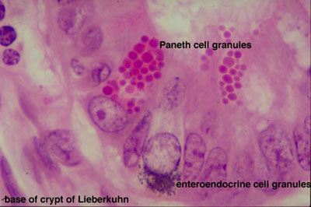
Intestinal Glands (Crypts)
Simple tubular glands that open between villi.
Composed of 5 cell types:
1. Columnar absorptive cells.
Goblet cells: secrete mucus.
Enteroendocrine (EE) (DNES) cells: secrete hormones.
4. Paneth cells: secrete Lysozyme (antibacterial).
are found in the base of the crypts.
Stem cells: are regenerative cells.
are found in the base of the crypts.

Slide 7
Columnar Absorptive cells
Paneth cell

Slide 8
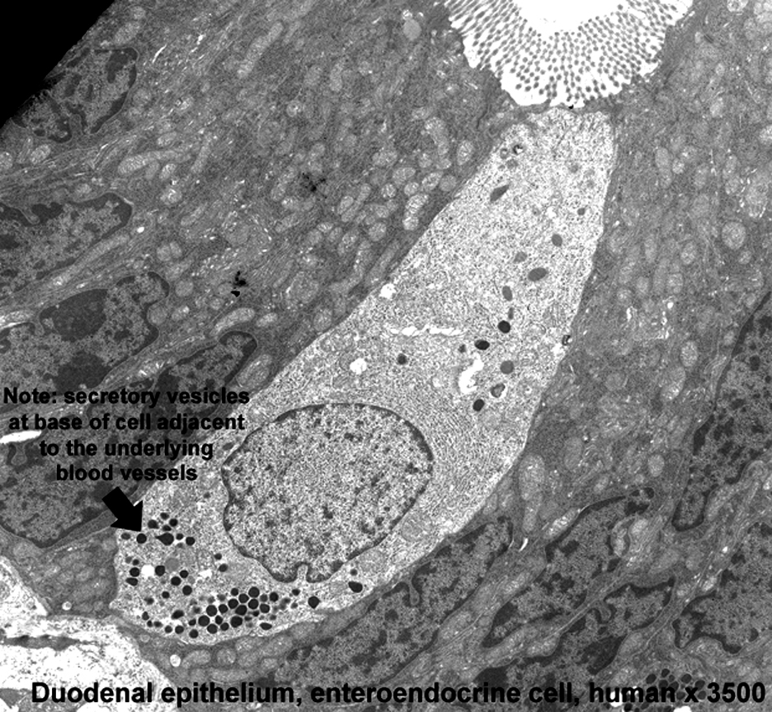
EE (DNES) cells
EE cells:
EC cells: secrete endorphin and serotonin.
S cells: secrete secretin.
D cells: secrete somatostatin.
A cells: secrete glucagon.
Mo cells: secrete motilin.
CCK-PZ cells: secrete cholecystokinin (pancreozymin)

Slide 9
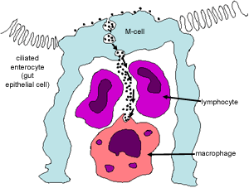
M Cells (Microfold cells)
They are mainly found within the intestinal epithelium overlying lymphatic nodules of lamina propria.
Each is a dome-shaped cell (or specialized squamous cell) with a basal concavity that contains intraepithelial lymphocytes and macrophages.
They phagocytose and transport antigens present in the intestinal lumen to the underlying lymphoid tissue cells to initiate the immune response to these antigens leading to the secretion of IgA.

Slide 10
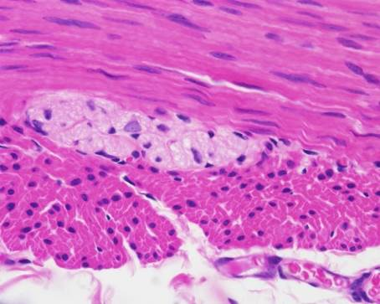
Duodenum
2. Submucosa:
Connective tissue containing blood vessels & nerves.
Contains Brunner’s glands (secrete mucus).
3. Muscularis Externa:
2 smooth muscle layers:
Inner circular layer.
Outer longitudinal layer.
4. Serosa or Adventitia:
Duodenum is invested by a serosa or adventitia.

Slide 11
Duodenum

Slide 12
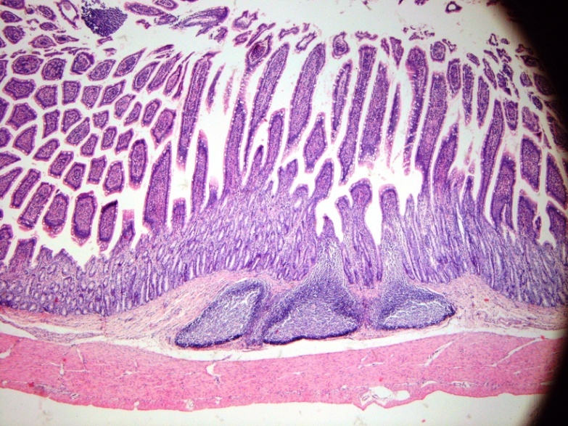
Regional differences of small intestine
Duodenum: Its submucosa has Brunner’s glands.
It is invested by serosa or adventitia
Jejunum: has neither Brunner’s glands nor Peyer’s patches.
Jejunum is invested by serosa.
Ileum: Its lamina propria, opposite the attachment of the mesentery, has lymphoid nodules (Peyer's patches) that extend to the submucosa.
Ileum is invested by serosa.
Notes:
12

Slide 13
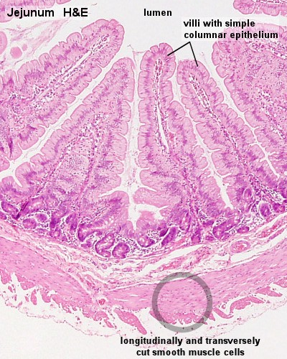
Jejunum

