Slide 1
LARGE INTESTINE
Objectives:
By the end of this lecture the student should be able to:
Identify the histological structure of the 4 layers of colon.
Identify the histological structure of the 4 layers of appendix.

Slide 2
Large Intestine
It is divided anatomically into:
Appendix,
Cecum,
Colon (ascending, transverse, descending & sigmoid),
Rectum, and
Anal canal.

Slide 3
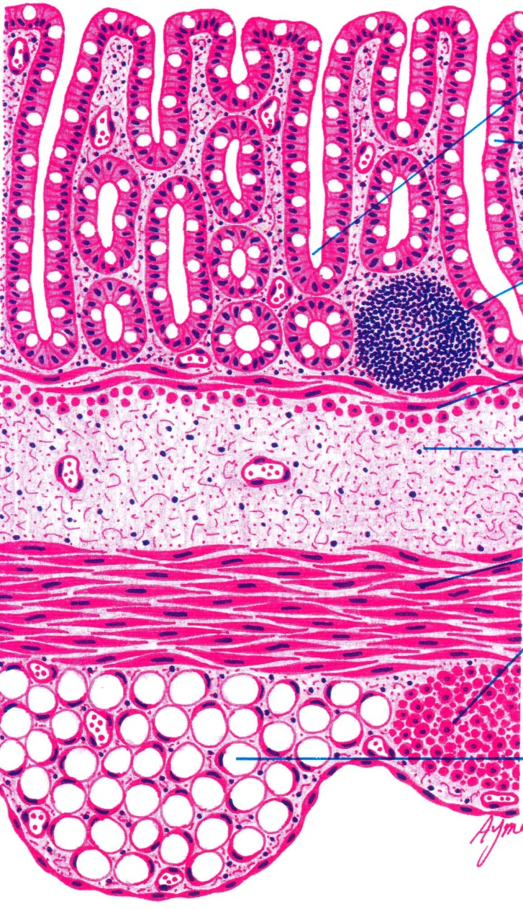
Colon
Mucosa:
Shows only crypts (NO villi)
Epithelium: simple columnar epithelium with numerous goblet cells.
Lamina propria: Connective tissue containing numerous crypts. Cells of the crypts are the same as in small intestine but NO Paneth cells. Lymphatic nodules (solitary): frequent.
Muscularis mucosae: 2 layers of smooth muscle.

Slide 4
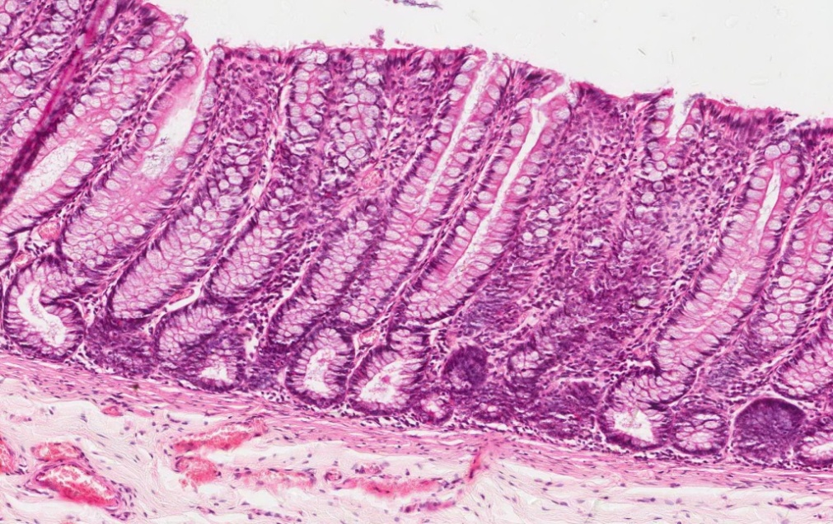
Mucosa of Colon

Slide 5
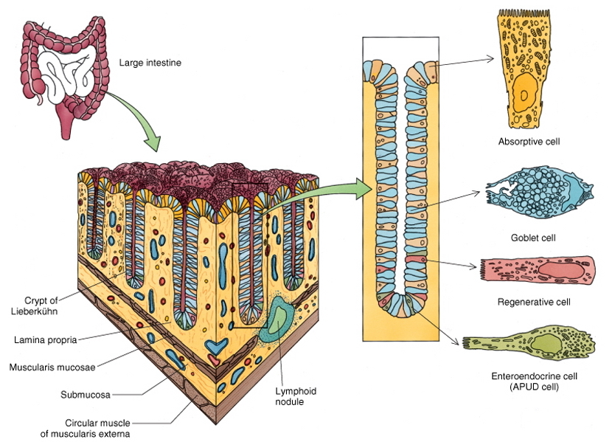
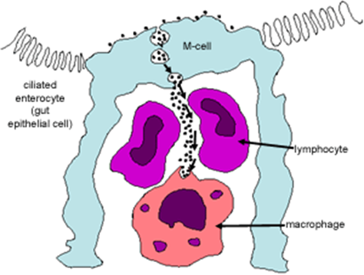
Intestinal Crypts of Colon
Cells lining the crypts are:
1. Surface columnar absorptive cells.
2. Goblet cells.
3. Enteroendocrine cells.
4. Stem cells.
5. M-cells.

Slide 6
Colon
Submucosa:
NO glands.
Meissner’s nerve plexus.
Muscularis Externa:
Inner circular & outer longitudinal smooth muscle layers.
The longitudinal layer is not continuous but in the form of 3 longitudinal ribbons or bands (teniae coli).
Auerbach’s nerve plexus.
Serosa:
C.T. covered by mesothelium.
Has fat-filled pouches (pendulous masses) called appendices epiploicae.

Slide 8
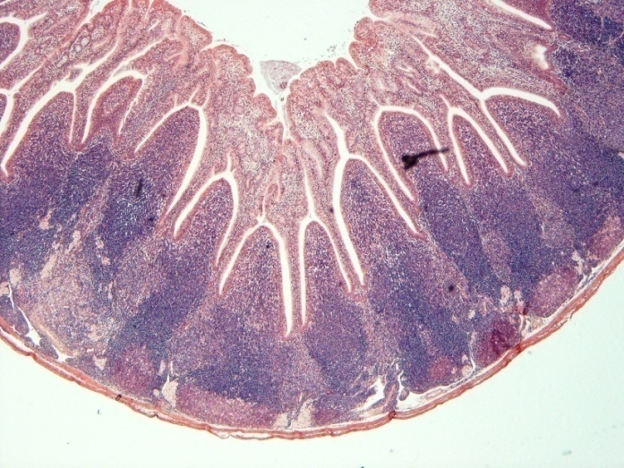
Vermiform Appendix
Similar to the colon, but with much smaller diameter, shallow crypts, more lymphoid nodules (aggregated lymphoid nodules, all around, in lamina propria and extending into submucosa), Few goblet cells and more EE (DNES) cells.
Cells lining the crypts are:
1. Surface columnar absorptive cells.
2. Goblet cells.
3. Enteroendocrine cells.
4. Stem cells.
5. M-cells.
Muscularis mucosae:
Not continuous.
Muscularis externa:
No teniae coli. It is invested by serosa.

Slide 9
Thank You

