Slide 1
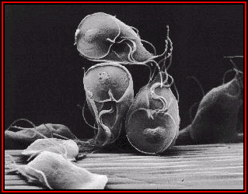
Intestinal`
Protozoa
Dr: MONA BADR

Slide 2
CLASSIFICATION OF PARASITES
PROTOZOA | HELMINTHS
Unicellular Single cell for all functions | Multicellular Specialized cells
1:Aoebae: move by pseudopodia. 2:Flagellates: move by flagella. 3:Ciliates: move by cilia 4:Apicomplexa(Sporozoa) tissue parasites | Round worms (Nematodes): - elongated, cylindrical, unsegmented. Flat worms : - Trematodes: leaf-like, unsegmented. - Cestodes: tape-like, segmented.

Slide 3
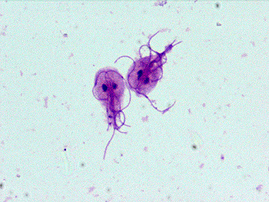
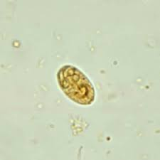
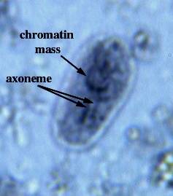
Giardia Lamblia
Giardia cyst
(light microscope)
INFECTIVE STAGE
Trophozoite
Cyct

Slide 4
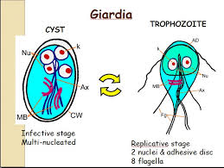
Giardiasis is transmitted via the fecal- oral route with the ingestion of CYST(the infective stage).
These cysts can stay infectious in the environment for more than 3 months
These cysts can resist the stomach acidity.
After ingestion of the cysts and then cysts pass the stomach acidity , ex-cystation take place in small intestine to produce TROPHOZOITE
Trophozoite can multiply by binary fission and responsible for causing the disease : diarrhea ,vomiting ,excessive gas and loss of appetite especially in children.

Slide 5
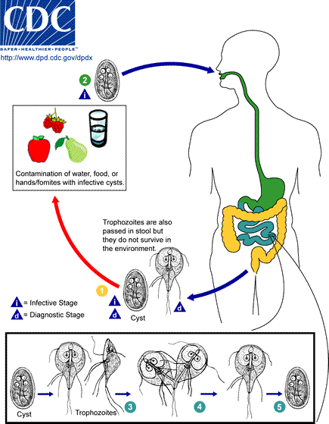
Giardia lamblia :
Life cycle

Slide 6
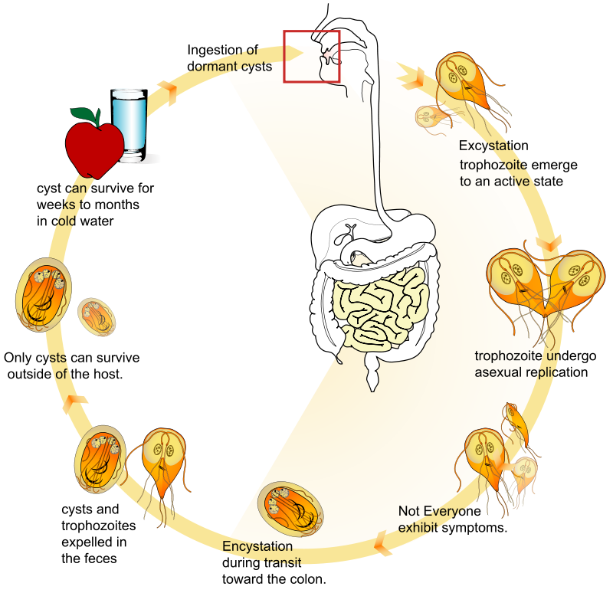
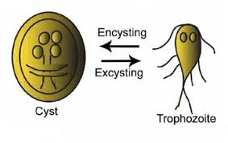
Infective stage only CYST
Diagnostic stage cyst and trophozoite in stool

Slide 7
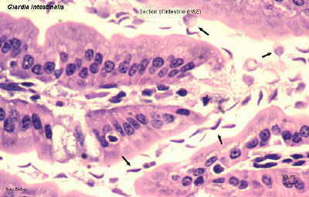
Giardia trophozoites in tissue section
Seen by duodenal aspirate

Slide 8
Giadriasis: Clinical Picture.
The parasite mostly asymptomatic or can produce a wide range of gastrointestinal symptoms especially in children. .
Symptomatic Infections:
  Typical picture: IP 1-2 wks followed by diarrhea ,vomiting &flatulence for about 6 wks,
  Atypical : Severe diarrhoea , malabsorption especially in children and cholecystitis.

Slide 9
Giardiasis: Laboratory diagnosis
Stools examination :
  Microscopy for cysts or trophozoits
  Detection of Giardia antigens in stools
Examination of duodenal biopsy : trophozoites

Slide 10
Giardiasis: Chemotherapy
Drug of choice: Metronidazole

Slide 11
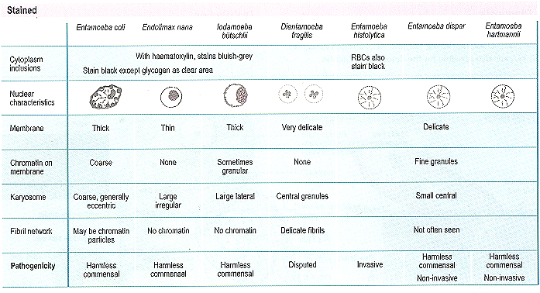
Intestinal Amoebae

Slide 12
ENTAMOEBA HISTOLYTICA…
500 million people are infected. 100,000 deaths per year. Worldwide distribution but is seen more often in tropical countries with poor sanitary conditions. It is a waterborne infection.
There are 6 species of Entamoeba:
E.histolytica
E.dispar
E.hartmanni
E.coli
E.gingivalis
E.polecki

Slide 13
E. histolytica vs E. dispar
Entamoeba histolytica : Amoebae that are pathogenic and invasive.
E. dispar : The nonpathogenic ,non invasive form .
The 2 amoebae can’t be distinguish by microscopic
observation.

Slide 14
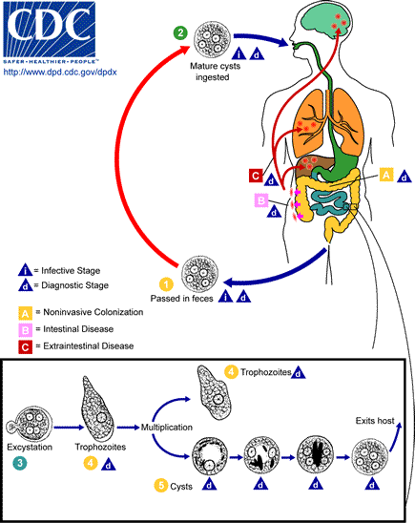
Entamoeba histolytica

Slide 15
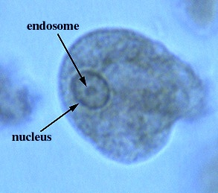
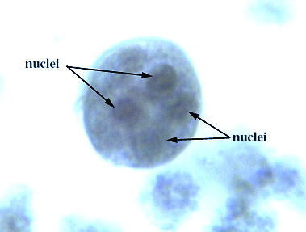
Entamoeba histolytica
Trophozoite: vegetative stage, must encyst to survive in the environment. It is a fragile structure.
Cyst: infective stage. Resist the harsh conditions of the environment.

Slide 16

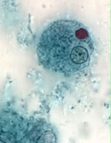
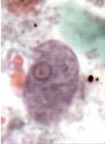
E. histolytica cyst
E. histolytica trophozoite
The infective stage is the cyst but we can detect both in the stool cysts &trophozoites

Slide 17
Entamoeba histolytica
Mode of infection (faecal-oral route)
    Water, food
    Flies can act as vector..
    Can be sexually transmitted person -to -person contacts
    Not a zoonosis

Slide 18
Entamoeba histolytica
The infective dose can be as little as 1 cyst.
The incubation period can be from few days to few weeks depending on the infective dose. IF the TROPHOZOITE is ingested it is disintegrates in the stomach without producing infection.
Excystation occurs in the lower region of the small intestine and then production of 8 small amoebae which enter the large intestine and may :(1)invade the tissue,
(2) live in the lumen of large intestine without invasion ,or (3) encyst (become cysts and pass in the stool).
Only the Cysts can survive in the environment for weeks at appropriate temperature and humidity after excreted from stool of infected patients.

Slide 19
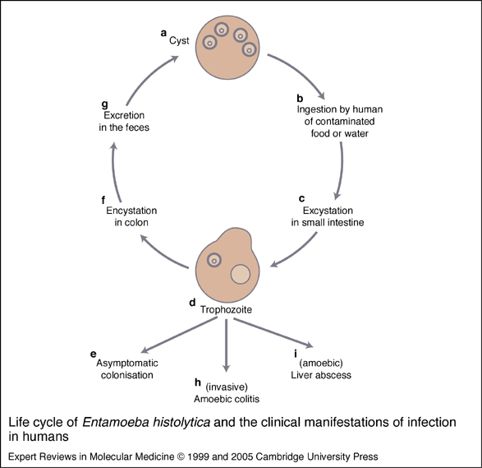

Slide 20
Entamoeba histolytica
Intsetinal amoebiasis (Acute amoebic dysentry) :
Trophozoite has the ability to hydrolyze host tissues with their active enzymes present on the surface membrane of the trophozoite ( causing ulcer and tissue perforation), also trophozoite has the ability to ingest blood cells.
The presenting symptom is diarrhea which is accompanied by blood ,mucus and some times tenesmus.
As a complication ,severe intestinal hemorrhage or rarely perforation may occur ,lesions are found in cecum ,appendix or colon.
They may heal. If perforation of the colon occurs, this may lead to peritonitis that can lead to death.
Amoeboma :Granulomatous mass obstructing the bowel.

Slide 21
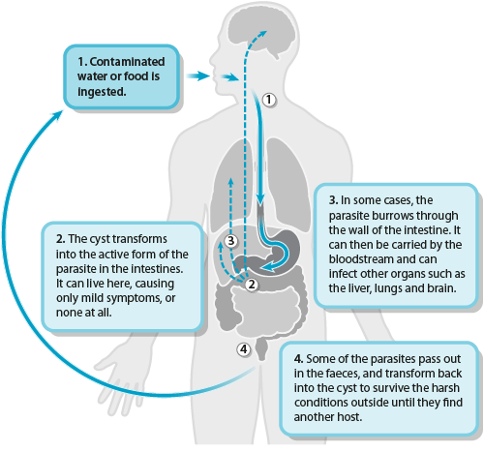
Entamoeba histolytica
cysts
Trophozoites
Both cysts and trophozoites

Slide 22
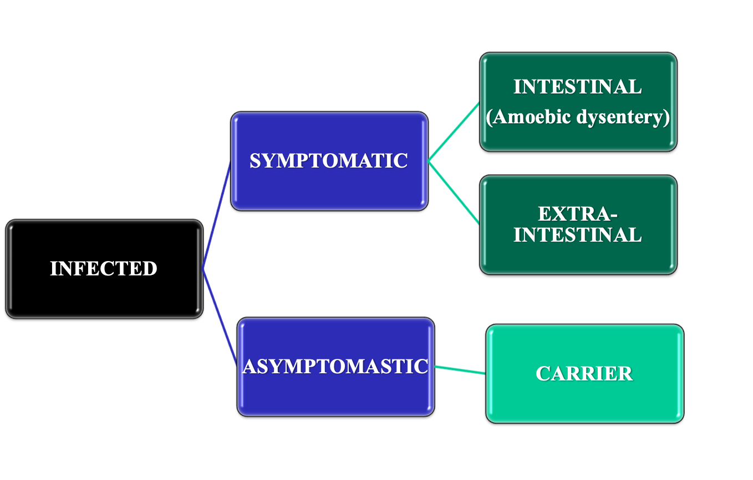
THE CLINICAL OUTCOMES OF INFECTION WITH
Entamoeba histolytica

Slide 23
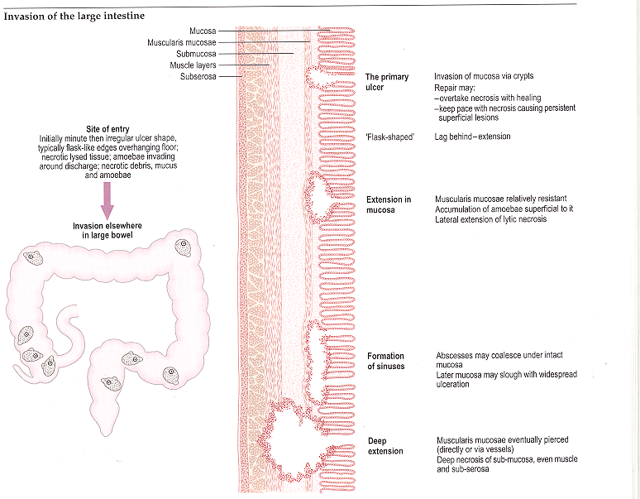
PATHOLOGY:Intsetinal amoebiasis :

Slide 24
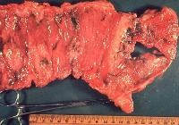
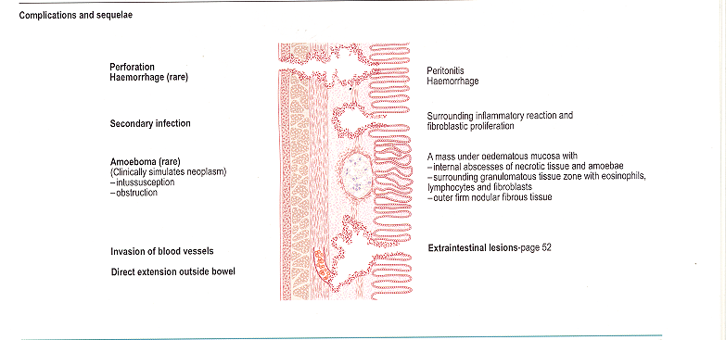
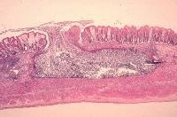
PATHOLOGY : Intsetinal amoebiasis
Complications
Intestinal perforation
Flask shape ulcer in large intestine

Slide 25
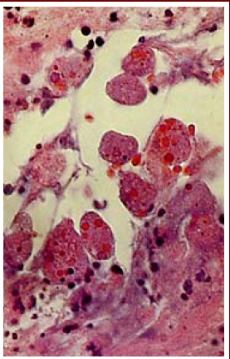
PATHOLOGY
Intsetinal amoebiasis :
E. Histolytica in mucosa.
Numerous trophozoites can be seen with ingested erythrocytes.

Slide 26
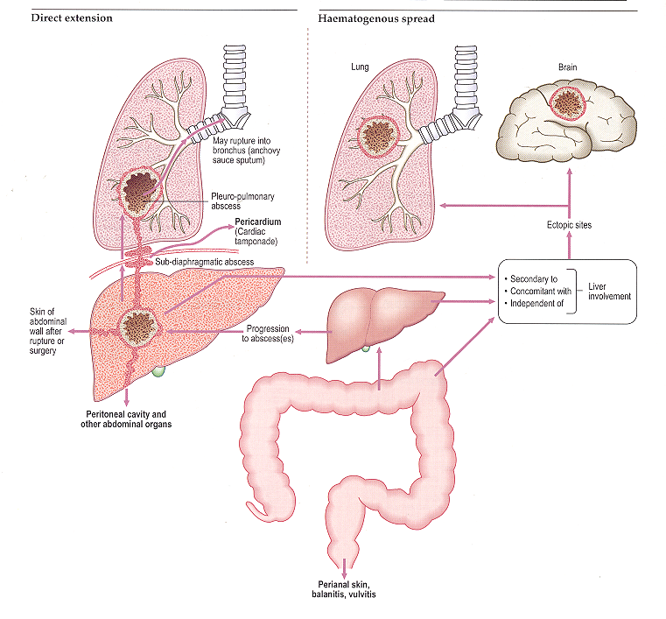

PATHOLOGY: Extra-intsetinal amoebiasis :

Slide 27
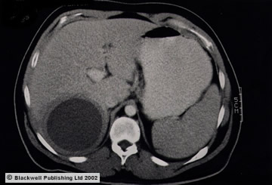
A 30-year-old male experienced diarrhea for two weeks with fever of 39° C, nausea, vomiting, malaise and right upper abdominal pain. Physical examination revealed hepatomegaly 6 cm below the right costal margin. CT scan showed a single hypodense mass in the rigth lobe of 7.8 x 5.2 cm, round, with well defined borders. Serology was positive for Enamoeba histolytica at 1/512.
Amebic liver abscess was diagnosed.

Slide 28
Laboratory Diagnosis of Amoebiasis
Intestinal :
  Stools examination :
    Wet mount ( cysts and trophozoites)
    Concentration methods ( only cysts)
  Serology ( mainly for invasive infections): IHA , ELISA
Extra-intestinal:
  Serology: IHA , ELISA
  Microscopy of tissues or fluids

Slide 29
Main Drugs for Treatment of Amoebiasis
Intestinal :
  Symptomatic(cysts and trophozoites): Metronidazole
Extra-intestinal:
  Metronidazole

Slide 30
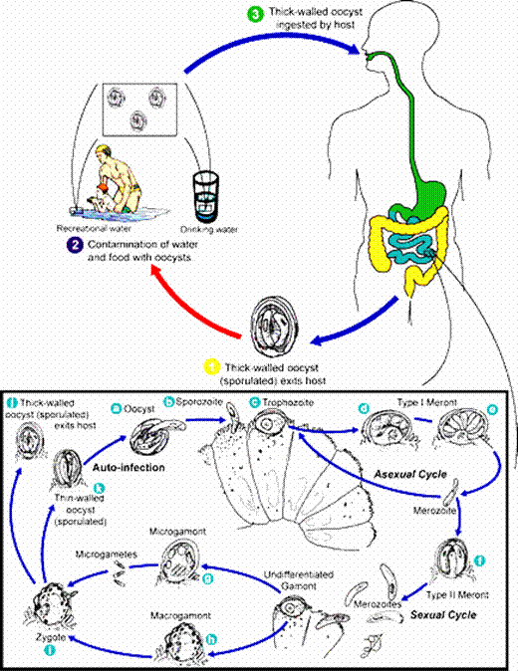
Cryptosporidium Parvum
Infection is caused by ingestion of sporulated oocysts transmitted by the faecal-oral rout
Infection is generally self-limiting in immunocompetent people. In immunocompromised patients, such as those with AIDS or those undergoing immunosuppressive therapy, infection may not be self-limiting, leading to dehydration and, in severe cases, death

Slide 31
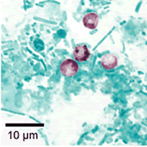
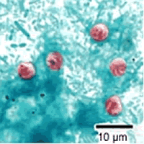
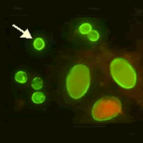
Cryptosporidium Diagnosis
Cryptosporidium , safranin Ziehl-Neelsen
Cryptosporidium oocyst in feces by stain acid-fast stain
Crypto-Gardia FAT

Slide 32
Cryptosporidiosis Treatment& prevention
The most effective way to prevent the spread of C. parvum is to avoid contact with contaminated feces. Avoiding this contact, especially with young children, Hygiene is the most effective way to combat this difficult-to-prevent parasite
Self-limited in immunocompetent patients
In AIDS patients : paromomycin

