Slide 1
VIRAL GASTROENTERITIS
(GI T Block , Microbiology : 2018 )
Dr.Malak M. El-Hazmi
Associate professor & Consultant Microbiologist College of Medicine & King Saud University Medical City

Slide 2
OBJECTIVES
Definition
Viral etiology of GE ( Structures )
Epidemiology
Clinical Features
Lab diagnosis
Treatment &Prevention (Vaccine)
Rotavirus , Adenovirus , caliciviruses & Astrovirus .

Slide 3
GASTROENTERITIS
Definition
Causes
Infectious
Noninfectious

Slide 4
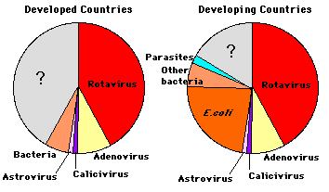
Viruses associated with gastroenteritis
Etiologic agents in severe diarrheal illnesses requiring H of infants & young children
Other viruses;
Coronaviruses , Adenoviruses & Enteroviruses….

Slide 5
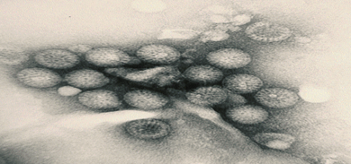
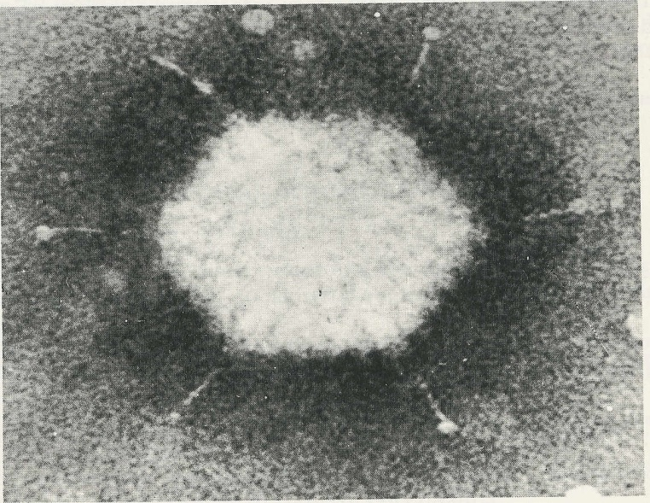
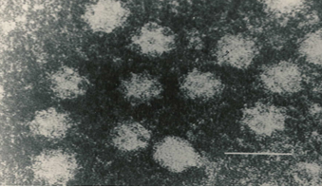
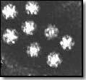
Electron micrographs
VGE
Adenovirus
Rotavirus
Calicivirus
Astrovirus

Slide 6
VIRAL GASTROENTERITIS
Virus Genome Important Morphological features
Rotavirus ds RNA Double-Shelled With
11 Segments Wheel-Like Structure.
Adenovirus ds DNA Classical Icosahedron with
40,41 types fibers.
Calicivirus ss RNA(+) Cup-Like depression on its surface .
Astrovirus ss RNA(+) 5 or 6-Pointed Star on its surface .

Slide 7
Epidemiology
VGE
Distribution ; Worldwide
in poor hygiene, overcrowding, and poverty
Age ; Infants & young>>Older children
Transmission ; Faecal-oral route
Season ; Winter months
Endemic inf ; Gp A rota & adeno 40,41
Epidemic inf ; Norovirus

Slide 8
Clinical Features
VGE
IP ;Short
Symptoms:
D, V, Fever & abdominal cramps
Dehydration Life threatening
Winter vomiting disease:
Vomiting > Diarrhoea
Calicivirus

Slide 9
Lab diagnosis
VGE
Cell culture: [c/c]
Fastidious growing poorly not used
Electron microscopy: [EM]
Catch all tech
Many disadvantages not used
Specific test:
ELISA for detection of viral ags in stool
[rota , adeno , astro & caliciviruses]

Slide 10
Management
VGE
Treatment:
Rehydration
Prevention:
Sanitation & hygiene measures
No vaccines except for rotavirus

Slide 11
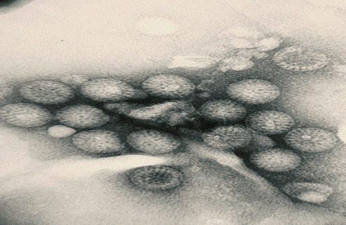

Slide 12
ROTAVIRUS
Family:
Reoviridae [Respiratory& Enteric Orphan]
Description:
11 segments dsRNA
Double-layered icosahedral
Nonenveloped
~ 70 nm
RNA – dependent RNA polymerase
7 groups [A-G]----- GpA →most common

Slide 13
Epidemiology
Rota
Spread:
Faecal-oral route
Age: all age groups
Symptomatic inf ;
6 -24 ms.
Peak ; Winter months
Inf ; Endemic

Slide 14
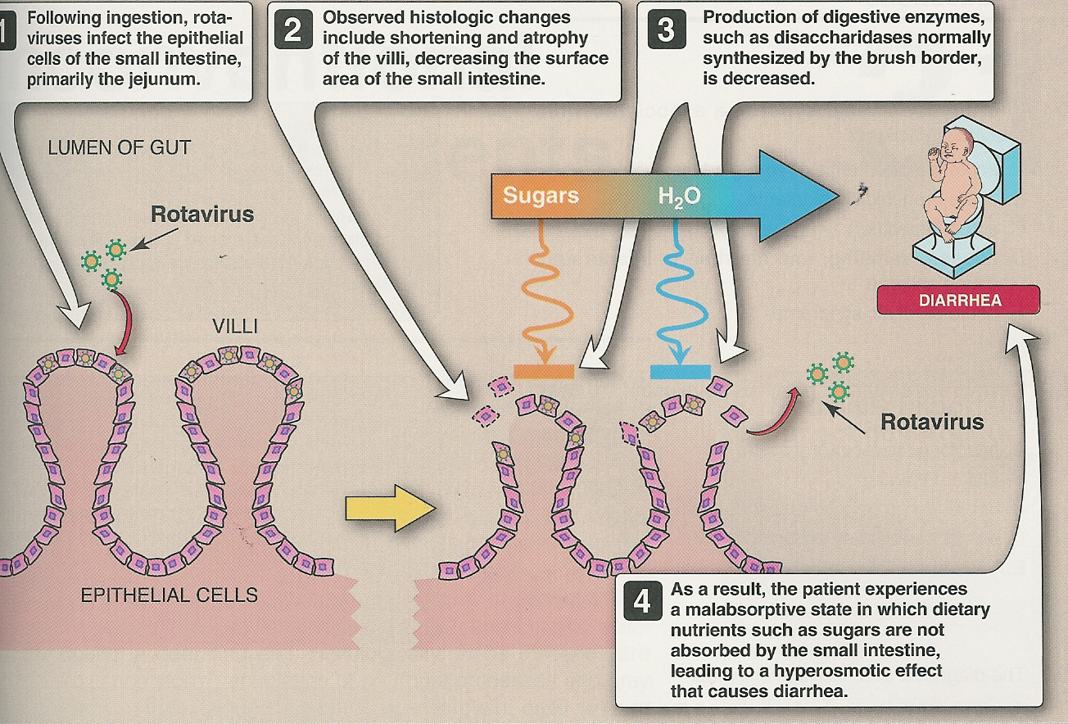
Pathogenesis
Rota

Slide 15
Clinical features
Rota
Intestinal inf:
Infants & young children
gastroenteritis or infantile GE
IP = 1-2 ds
Watery, nonbloody D,V & F
Dehydration
Outcomes Vary
In developed count. Mortality is low
In developing count. Mortality is sig.
~1/2 of all GE cases Admission
Deaths reported

Slide 16
Clinical features
Rota
Intestinal inf:
Infants & young children GE
Older children+ adults asymptomatic
Immuno ed hosts chronic D
Extra-intestinal inf:
Encephalitis small n.

Slide 17
Diagnosis
Rota
Sample; stool
Immunoassay Most used
ELISA , ICT& latex agglutination
EM
Gel electrophoresis
RT.PCR
Cell culture
Immunochromatography Tech.

Slide 18
Management
Rota
Treatment:
Rehydration
Prevention:
Sanitation & hygiene measures
Vaccine; LAV, oral
Rotarix
RotaTeq*

Slide 19
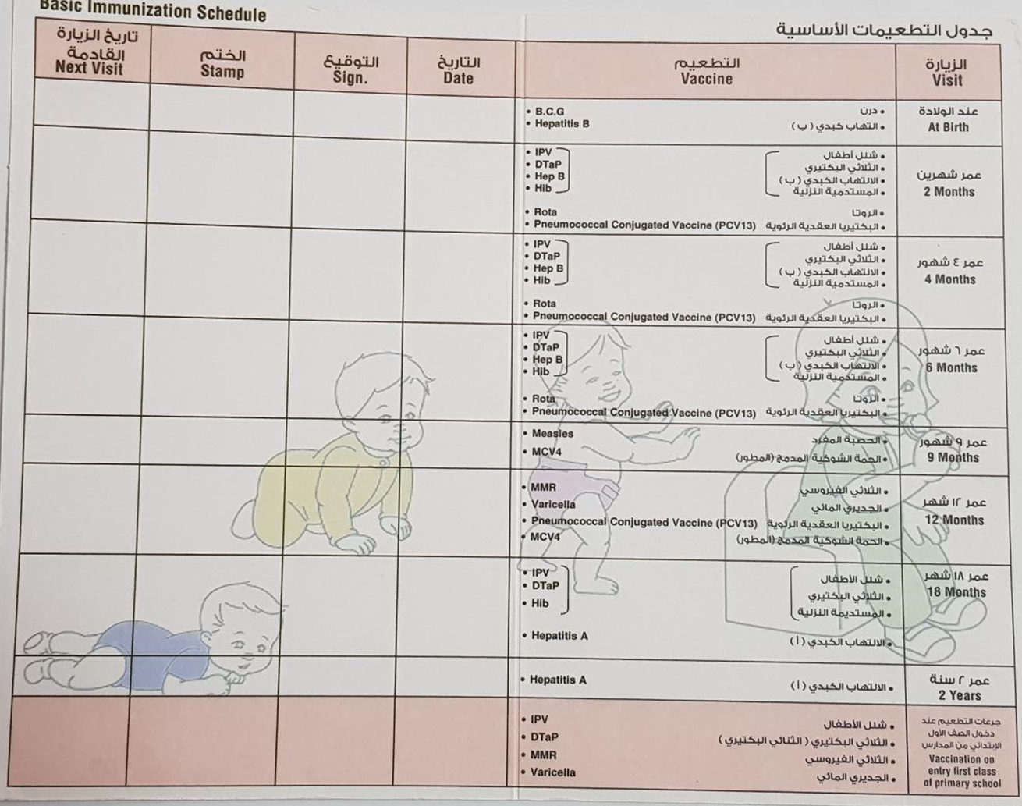

Slide 20
Rotavirus
Structure
Epidemiology
Clinical Features
Lab diagnosis
Treatment
Prevention (Vaccine)

Slide 22
ENTERIC ADENOVIRUSES
Family: Adenoviridae
Description:
Nonenveloped, icosahedral , dsDNA
Only V with a fiber protruding from each of
the vertices of the capsid
Fiber Attachment
Type-specific ag

Slide 23
ENTERIC ADENOVIRUSES
Classification:
Adenoviruses 7 subgenera[A-G]
> 50 serotypes
Grow in C/C
Enteric adenoviruses Subgenus F . 40&41serotypes . Fastidious

Slide 24
ENTERIC ADENOVIRUSES
Clinical feature:
Longer IP
Less severe than rotavirus
Prolonged illness
Diagnosis:
Ag detection in stool by
ELISA
Immunochromatography Tech.

Slide 25
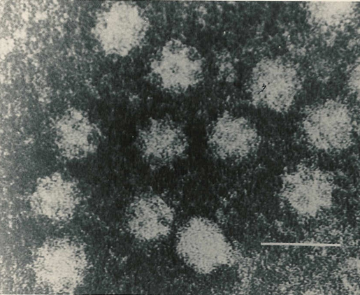

Slide 26
Caliciviruses
Family ; Caliciviridae [Calyx =cup]
Description :
Nonenveloped
ssRNA,+ve polarity
Icosahedral capsid
Two morphologic types
Typical caliciviruses (Sapoviruses)
Small Rounded Structured Viruses . (Noroviruses)

Slide 27
NOROVIRUS
Epidemiology
Faecal-oral route [water, shellfish]
Outbreaks of GE in schools, camps &cruise
All age gps
Clinical features
Children vomiting [projectile]
Adults diarrhea
Diagnosis
Viral Ag in stool by ELISA

Slide 29
Astroviruses
Family; Astroviridae [astro= a star]
Description:
Nonenveloped
ssRNA,+ve polarity
Icosahedral capsid

Slide 30
Astroviruses
Clinical features;
Mild GE
Outbreak of diarrhea <5 ys
Lab. Diagnosis;
Ag detection in stool by ELISA

Slide 31
عن أبي هريره رضي الله عنه
أن رسول الله صلي الله عليه وسلم قال:
{ كلمتان خفيفتان على اللسان , ثقيلتان في الميزان حبيبتان إلي الرحمن :
سبحان الله وبحمده ,
سبحان الله العظيم }

Slide 32
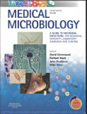
Reference books &the relevant page numbers
Notes on Medical Microbiology
By ; Morag C. Timbury, A. Christine McCartney, Bishan Thakker and Katherine N. Ward
(2002)
Pages; 338 - 344
Medical Microbiology.
By: David Greenwood ,Richard Slack,
John Peutherer and Mike Barer.
17th Edition, 2007.
Pages;545-551,565-571

