Slide 1

The Trematodes
DR MONA BADR

Slide 2
PROTOZOA | HELMINTHS
Unicellular Single cell for all functions | Multicellular Specialized cells
1:Aoebae: move by pseudopodia. 2:Flagellates: move by flagella. 3:Ciliates: move by cilia 4:Apicomplexa(Sporozoa) tissue parasites | Round worms (Nematodes): - elongated, cylindrical, unsegmented. Flat worms : - Trematodes: leaf-like, unsegmented. - Cestodes: tape-like, segmented.
CLASSIFICATION OF PARASITES

Slide 3
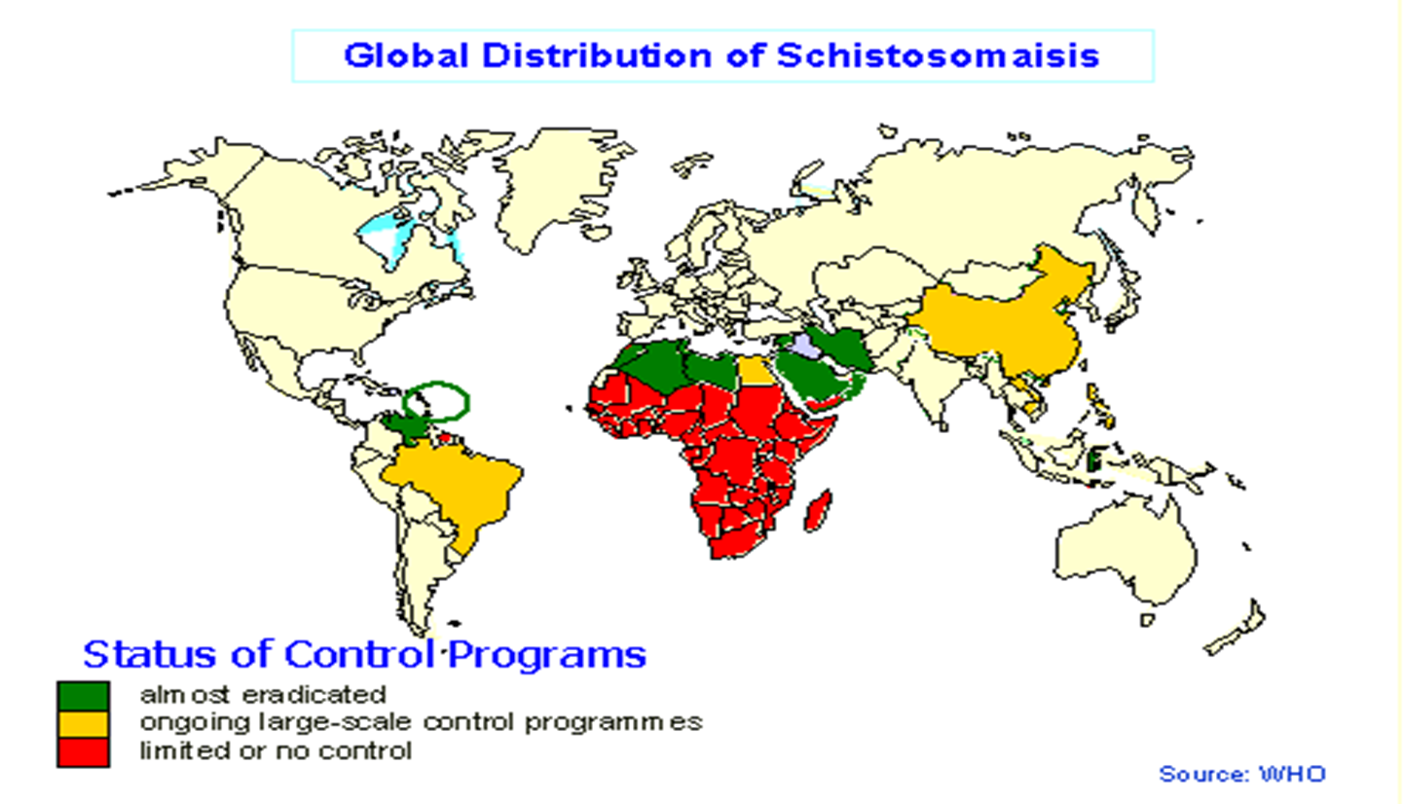

Blood Flukes
Schistosoma spp

Slide 4



Slide 5
Schistosoma
A genus of trematodes, Schistosoma, commonly known as blood-flukes, are parasitic flatworms responsible for a highly significant group of infections in humans termed schistosomiasis. Schistosomiasis is considered by the World Health Organization as the second most socioeconomically devastating parasitic disease, (after malaria), with hundreds of millions infected worldwide.
Adult flatworms parasitize blood capillaries of either the 1-mesenteries( Schistosoma mansoni ) 2-plexus of the bladder (Schistosoma haematobium), depending on the infecting species

Slide 6
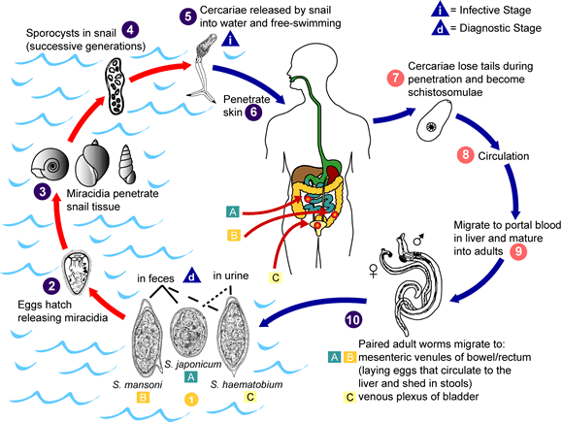
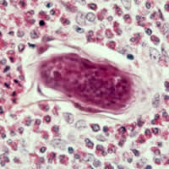

Slide 7
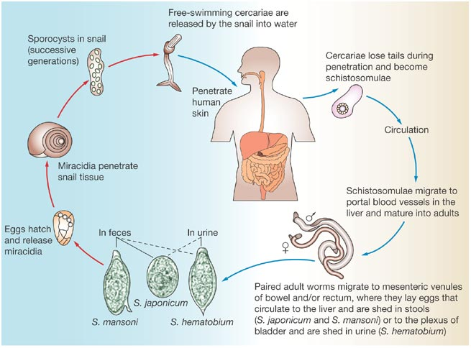
Schistosoma spp
CERCARIA IS THE INFECTIVE STAGE.
Cercaria emerge from snail in the water and penetrate the skin of the human.
The cercaria is transformed into a schistosomulae inside the host tissues.
The schistosomulae first enters the systemic circulation and then finds its way into 1- the portal circulation (S.mansoni &Sjaponicum) worms mature in the mesenteric veins of the portal circulation 2-,S.haematobium worms generally remain in the systemic circulation and mature in the blood vessels of the vesical and venous plexus.
THE EGG IS THE DIAGNOSTIC STAGE .The eggs of S.mansoni &S.japonicum are passed mainly in stool and S.haematobium passed mainly in the urine.
MAN is the DEFENITIVE HOST .
SNAILS is the INTERMEDIATE HOST.
.

Slide 8
PATHOLOGY:
The EGG is the main cause of pathology in schistosomiasis . Many eggs become stranded in the tissues or are carried by the blood stream to other organs mainly the LIVER. The host reaction to the eggs may vary from small granulomas to extensive fibrosis .The extent of damage is generally related to the number of eggs present in the tissues.

Slide 9
After the eggs of the human-infected with S.mansoni & S.japonicum are passed in the feces into the water 0r the eggs are passed during micturition from host infected with S.haematobium .
the miracidium hatches out of the egg and searches for a suitable freshwater snail to act as an intermediate host . In the snail the miracidium develops to cercaria. From a single miracidium result a few thousand cercaria, every one of which is capable of infecting a human
Cercaria emerge from snail in the water and penetrate the skin of the human .The cercaria is transformed into a schisosomula inside the host tissue.
The schistosomulae first enters the systemic circulation and then finds its way into the portal circulation (S.mansoni &Sjaponicum) worms mature in the mesenteric veins of the portal circulation ,S.haematobium worms generally remain in the systemic circulation and mature in the blood vessels of the vesical plexus.

Slide 10
The cercaria emerge from the snail during daylight and they actively seeking out their final host. When they recognize human skin and become schistosomula,
Each schistosomule spends a few days in the skin and then enters the circulation starting at the dermal lymphatic and venles, they feed on blood.
The schistosomule migrates to the lung and then moves via circulation through the left side of the heart then it develops into a sexually mature adult and the pair migrate to the mesenteric veins (S.mansoni &S.japonicum) or to urinary bladder veins (S.haematobium).
The female fluke (S.haematobium) lays as many as 30 eggs per day which migrate to the lumen of the urinary bladder and ureters
Each female of (S.mansoni & S.japonicum) layes 300 eggs a day the eggs move into the lumen of the host's intestines and are released into the environment with the feces .

Slide 11
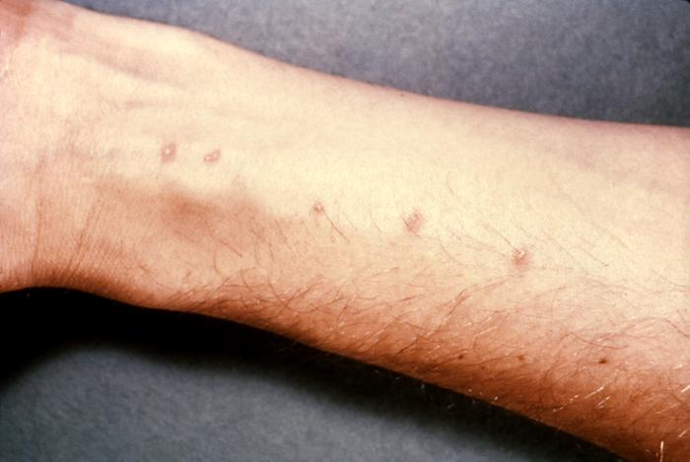
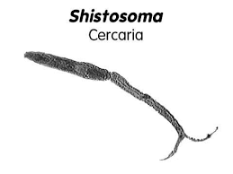
Schistosome dermatitis, or "swimmers itch” occurs when skin is penetrated by a free-swimming, fork-tailed infective cercaria. The dermatitis often develops 24 hours after exposure and last for 2 to 3 days and then spontaneously disappears.

Slide 12
Pathogenicity of Schistosomiasis
1-Cercarial dermatitis: at the site of entry of cercaria.
2-Toxic Metabolites: liberated during the growth of schistosomulae in the circulation veins, may cause anaphylactic reaction ,fever ,urticarial rashes and eosinophilia.
3-Terminal spined eggs : may erode blood vessels and cause hemorrhages. Schistosome eggs, deposited in the tissues, act as foreign protein ,cause irritation leading to cell infiltration and connective tissue hyperplasia ,egg granuloma around each egg (cell mediated immunity) .

Slide 13
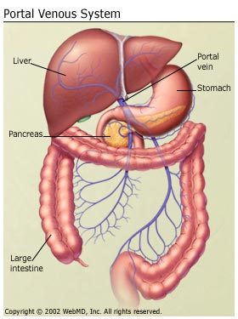
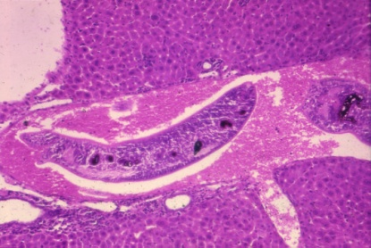
Developing schistosome in liver:
S. mansoni &S. japonicum located mainly in mesenteric vein and its branches, the worm discharges EGGS ,the eggs travel in 2 directions : 1- some eggs find their way into the lumen of the bowel and appear in the feces . 2- other flow with blood stream in the portal circulation and enter the LIVER. Most of these eggs are trapped in the liver and give rise to pathology as ,fibrosis of the liver caused from eggs settled in the liver may produce portal hypertension ,which may lead to hepatomegaly ,splenomegaly, esophageal varices ,hemorrhoids and ascites.

Slide 14
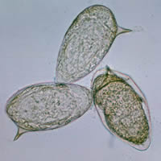
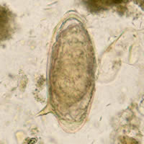
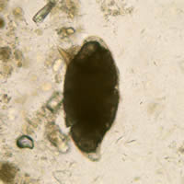
Eggs of Schistosoma mansoni with lateral spine

Slide 15
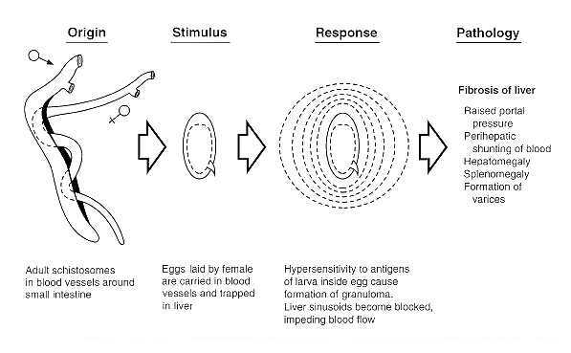
Schistosoma mansoni

Slide 16
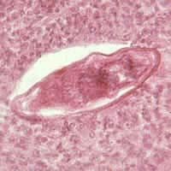
Eggs of Schistosoma mansoni in the liver and cellular reaction.

Slide 17
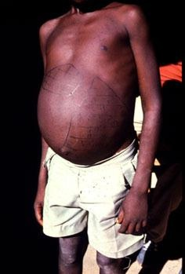
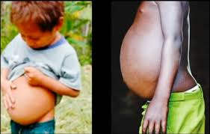
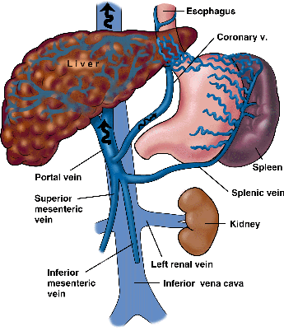
Hepatomegally and slenomegally wih ascites.
Portal hypertension in chronic schistosomiasis

Slide 18
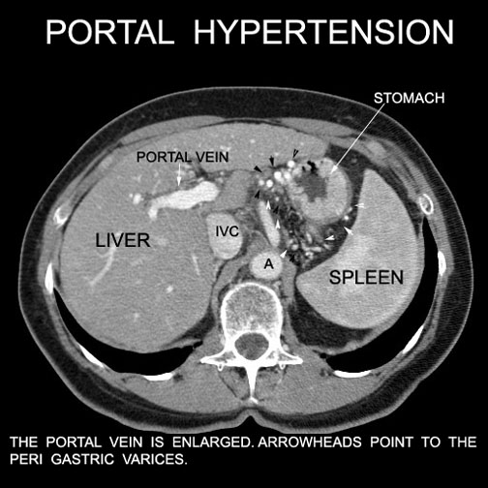

Slide 19
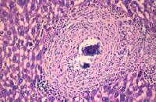
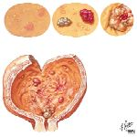
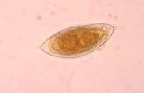
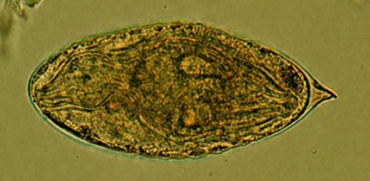
S. haematobium : the worm is located in the vesical venous plexus surrounding the urinary bladder .Many eggs are trapped in the wall of the bladder where they may give rise to calcification and granuloma formation .Constriction of the orifice of the ureter may produce kidney damage , hydronephrosis and cancer of the bladder.
Egg of S. haematobium

Slide 20
Pathology of Schistosomiasis
Schistosoma haematobium
Causes urinary schistosomiasis
  PREPATENT PERIOD 10-12 wks
  EGG DEPOSITION AND EXTRUSION:
    painless haematuria
    Inflammation of bladder and burning micturition
    CNS involvement (rare)
  TISSUE PROLIFERATION AND REPAIR:
    Fibrosis , papillomata in the bladder and lower ureter leading to obstructive uropathy.
    Periportal fibrosis
    Lung and CNS involvement
Schistosoma mansoni
Causes intestinal schistosomiasis
  PREPATENT PERIOD 5-7 wks
  EGG DEPOSITION AND EXTRUSION:
    dysentery (blood and mucus in stools),
    hepatomegaly splenomegaly
    CNS involvement (rare)
  TISSUE PROLIFERATION AND REPAIR:Fibrosis ,
    Papillomata in intestine,
    Pperiportal fibrosis,hematemesis
    Lung and CNS involvement.

Slide 21
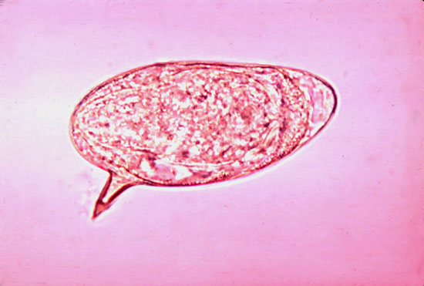
Diagnosis of Schistosomiasis
Schistosoma haematobium
Microscopical:
  Examination of urine
Immunological
  Serological tests CFT ,ELIZA
Indirect:
  Radiological
  Cystoscopy
Intradermal test :
With cercarial antigen cause allergic reaction.
Schistosoma mansoni
Microscopical:
  Examination of stools
Immunological
  Serological tests CFT,ELIZA.
Indirect:
  Radiological
  endoscopy
Intradermal test :
With cercarial antigen cause allergic reaction.

Slide 22
Egg of S. haematobium
Egg of S. mansoni

Slide 23

Drug of choice for schistosomiasis is
Praziquantel

Slide 24
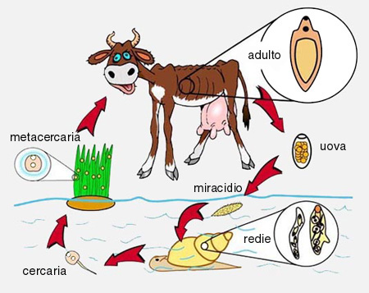
Life cycle of Fasciola hepatica
LIVER FLUKE
How is Fasciola hepatica transmitted to man?
By ingestion of raw, fresh –water vegetation contaminated with the METACERCARIA.
METACERCARIA ,excyst in the duodenum ,migrate through intestinal wall to the liver and settle in the biliary tract,
Then grow into adult worm
And liberate eggs in bile , throw bile eggs reach the intestine and then passed in stool.

Slide 25
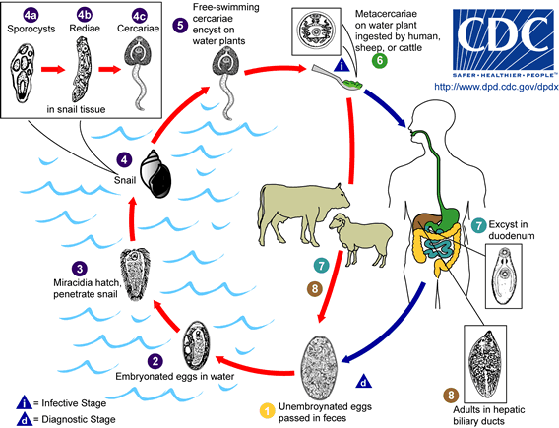
Life-cycle of Fasciola hepatica
DEFENITIVE HOST
Sheep ,cattle ,goat and MAN.
INTERMEDIATE HOST: SNAILS.
INFECTIVE STAGE: METACERCARIA
ingested with contaminated grasses.
.DIAGNOSTIC STAGE:
EGGS PASS IN STOOL OR IN THE DUODENAL ASPIRATE

Slide 26
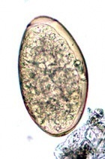
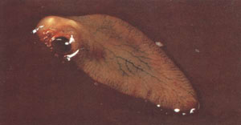
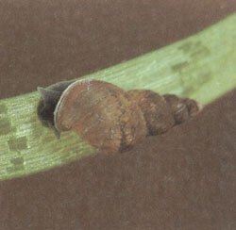
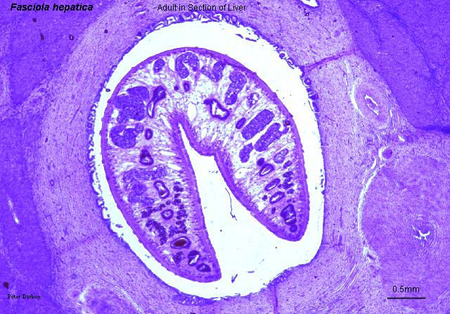
Snail intermediate host of :
Fasciola hepatica
Egg of Fasciola hepatica can be seen in true patient's stool or in false infection.
Fasciola hepatica worm in the definitive host
Fasciola hepatica in bile duct

Slide 27
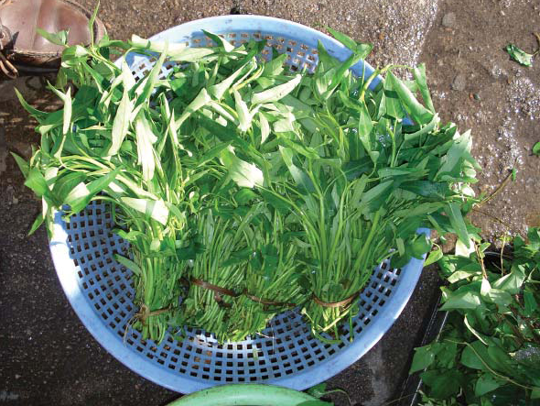
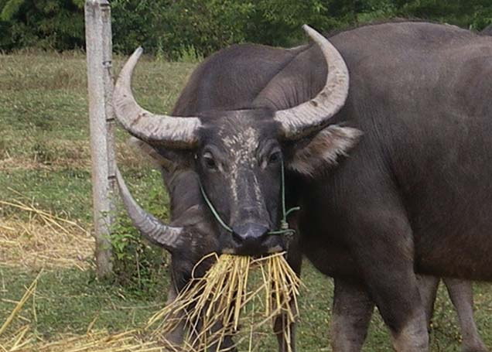
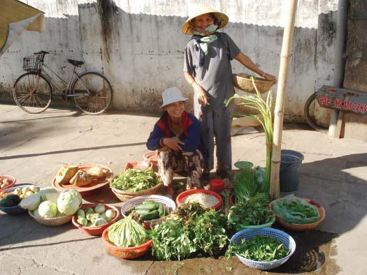
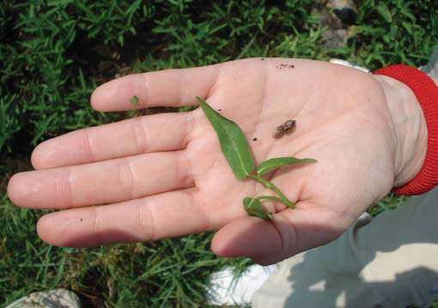
Watercress , one means of transmission of fascioliasis
Snail intermediate host of :
Fasciola hepatica

Slide 28
Fasciola hepatica
Pathology and clinical picture :
  True infection : occur when man ingests water plant (watercress) contaminated with METACERCARIA , the adult worm can causes mainly biliary colic with biliary obstruction, jaundice, generalised abdominal pain ,cholecystitis and cholithiasis.
  False infection is when eggs are eaten in infected animal liver and passed in stools.
Diagnosis: eggs in stools or duodenal aspirate.
Serological Test :CFT and skin test are also used.
Treatment: Triclabendazole.

Slide 29
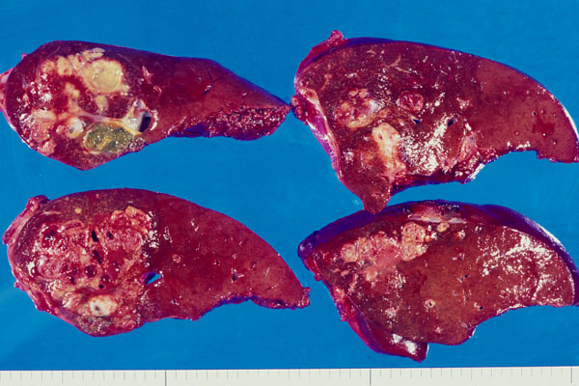
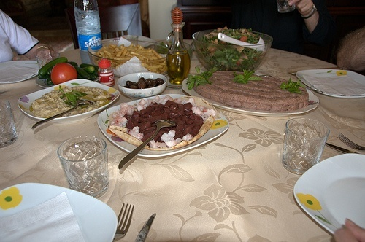
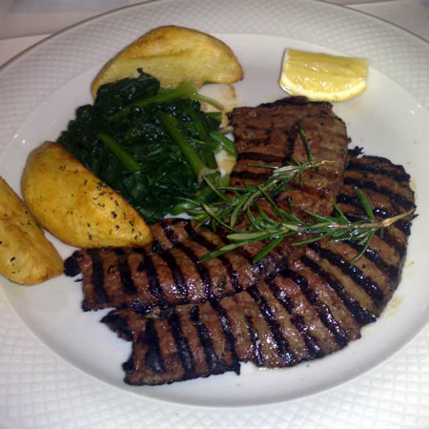
Fasciola hepatica: false infection will not lead to liver infection only we can detect eggs in stool after eating rot cattle liver infected with Fasciola Hepatica so we can find the eggs in stool but patient is not infected.
Sheep liver infected with Fasciola hepatica

Slide 30
TREATMENT Triclabendazole is the drug of choice to treat fascioliasis and is on the WHO list of essential medicines.
The correct dosage is calculated based on the person’s weight (10 mg/kg) and the tablets are given at one time.

