Slide 1
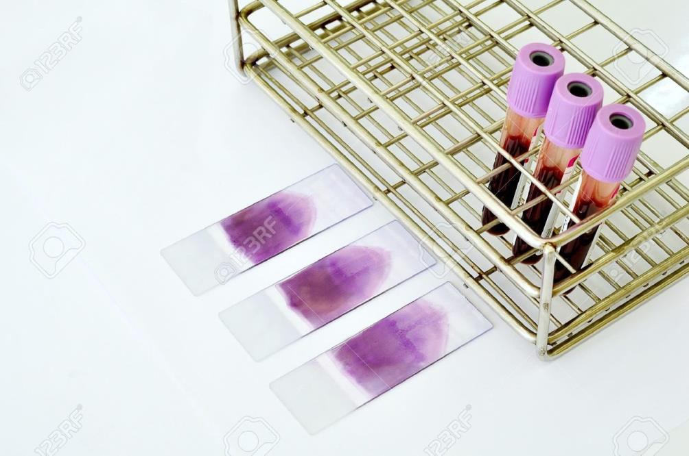
BLOOD AND TISSUE PARASITES
Microbiology Practical Class

Slide 2
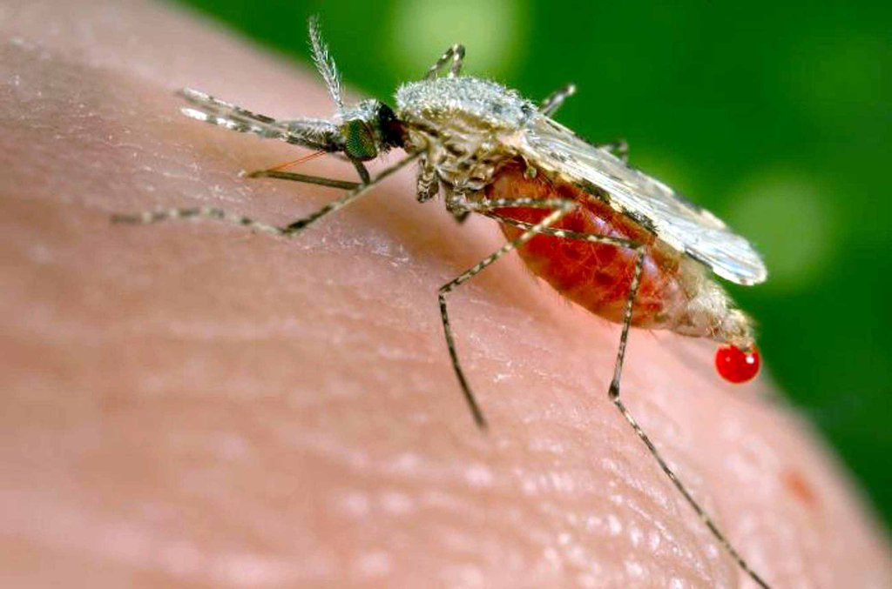
MALARIA
Anopheles Mosquito

Slide 3
LABORATORY DIAGNOSIS OF MALARIA
Malaria Can Be Diagnosed Commonly By:
1- MICROSCOPY (LIGHT MICROSCOPE):
Uses a blood smear to identify whether parasites are present in the patient’s blood.
Thick film: for screening
Thin film: for different spices identification
2 - RAPID DIAGNOSTIC TESTS (RDTs):
RDTs are quick tests for screening that use a drop of blood from the finger tip to identify whether parasites are present in the patient or no.
3- SEROLOGY
4- PCR

Slide 4
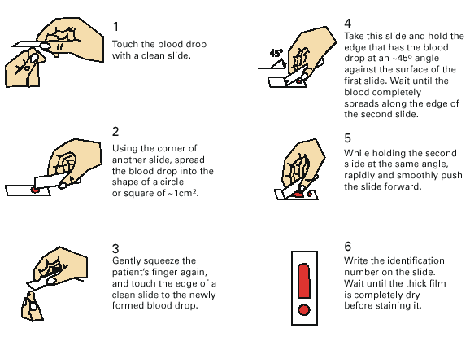
LABORATORY DIAGNOSIS OF MALARIA
LIGHTMICROSCOPY
1- Preparing blood film (Thick & Thin)

Slide 5
LABORATORY DIAGNOSIS
LIGHTMICROSCOPY
2- Video showing Preparing of Thin and Thick blood film
https://youtu.be/aEAXYJ7XaCg

Slide 6
LABORATORY DIAGNOSIS
LIGHTMICROSCOPY
3- Interpreting Thick and Thin Films
THIN FILM
fixed RBCs, single layer
smaller volume
good for species identification
requires more time to read
THICK FILM
lysed RBCs
larger volume
good screening test
positive or negative

Slide 7
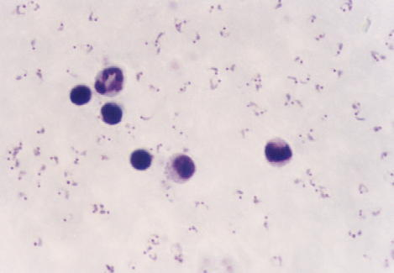
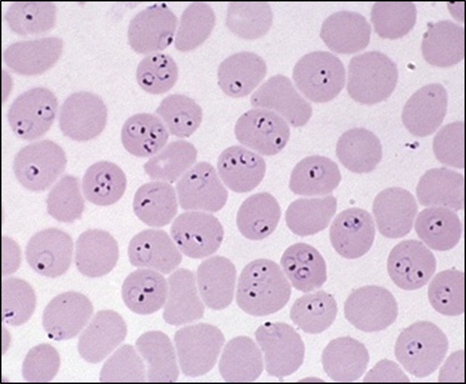
LABORATORY DIAGNOSIS
LIGHTMICROSCOPY
4- Microscopic image for Thick film VS Thin film
Plasmodium falciparum
Plasmodium falciparum
(Ring stage in thin smear)

Slide 8
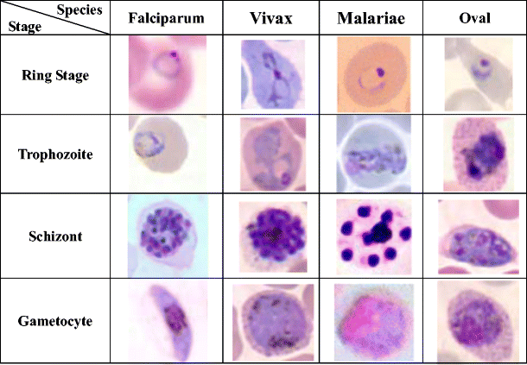
LABORATORY DIAGNOSIS
LIGHTMICROSCOPY
5- Species of Malaria (Plasmodium Spices) is identified by its characteristic microscopic appearance:

Slide 9
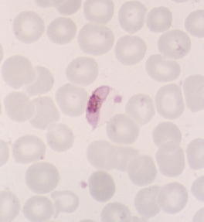
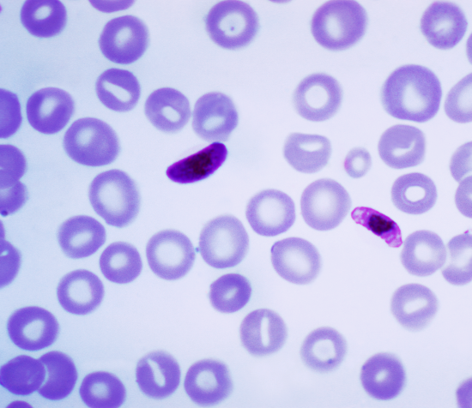
LABORATORY DIAGNOSIS
LIGHTMICROSCOPY
Plasmodium falciparum
Gametocyte stage in thin smear
(characteristic banana-shaped or crescent –shaped gametocyte stage in thin smear)

Slide 10
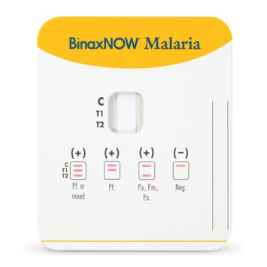
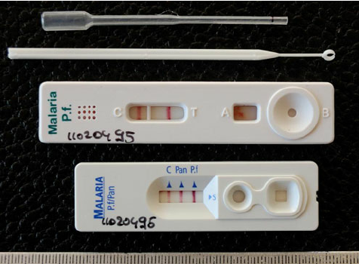
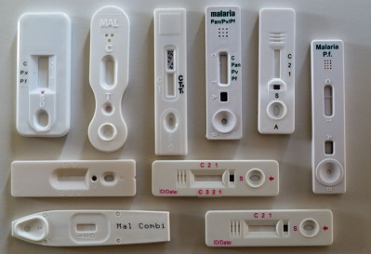
LABORATORY DIAGNOSIS
RAPID DIAGNOSTIC TESTS (RDTS)
1- The RADTs Test ( for screening)

Slide 11
LABORATORY DIAGNOSIS OF MALARIA
LIGHTMICROSCOPY
3- RADTs Result
Negative
Positive

Slide 12
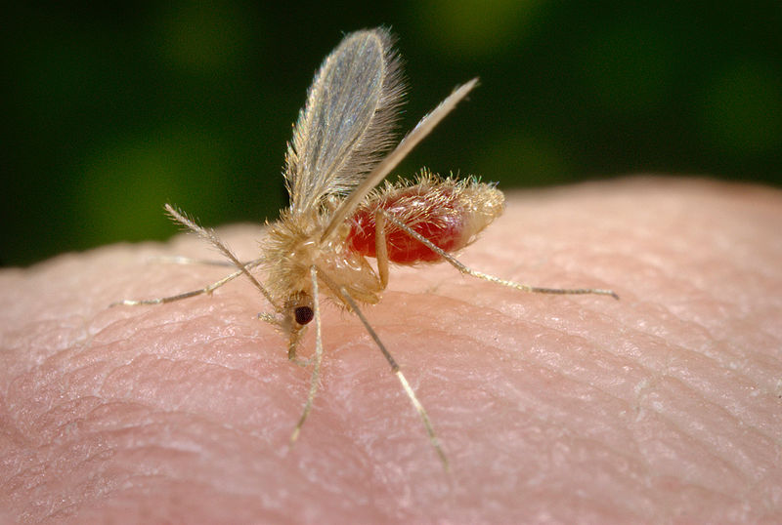
LEISHMANIA
Sand Fly

Slide 13
LABORATORY DIAGNOSIS OF LEISHMANIA
Leishmania Can be Diagnosed Commonly By:
Microscopy (Light Microscope)
Culture in NNN Medium
Used Samples:
Bone Marrow aspirate
Splenic aspirate
Lymph node
Biopsy

Slide 14
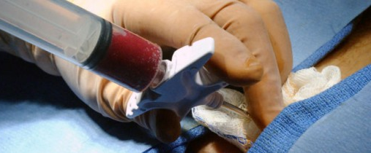
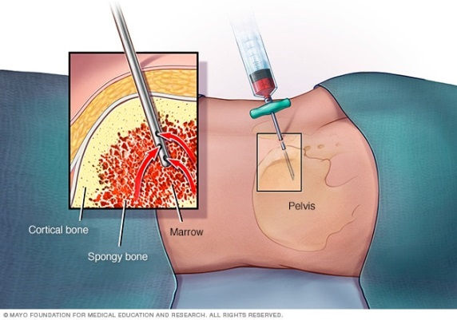
LABORATORY DIAGNOSIS OF LEISHMANIA
Bone marrow aspiration

Slide 15
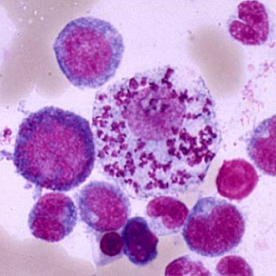
LABORATORY DIAGNOSIS OF LEISHMANIA
Bone marrow aspirate
(Amastigotes)

Slide 16
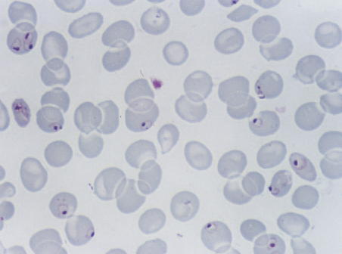
Case1:
A 25 year-old male from India, who came 3 months ago was admitted in KKUH with a history of severe anaemia and intermittent high grade fever for the last two months not responding to antibiotics.
WHAT IS THE DIAGNOSIS?
Malaria or Plasmodium Falciparum
Mention other way for diagnosis?
RADTs, Serology or PCR

Slide 17
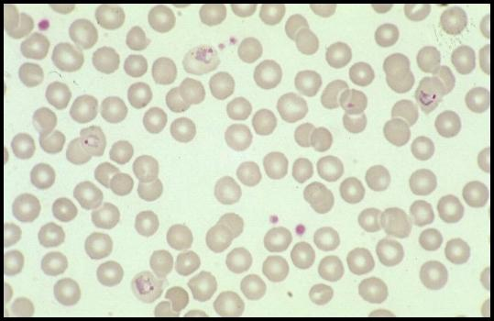
Case2:
A businessman who makes frequent trips to Thailand , presents with intermittent fever.
WHAT IS THE DIAGNOSIS?
Malaria or Plasmodium spices

Slide 18
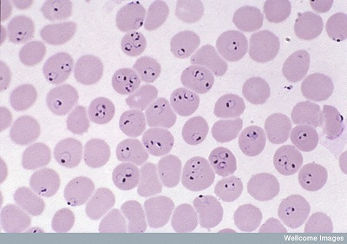
Case3:
A student in KSU who returned three weeks from vacation in Africa , he developed intermittent fever last week and lost consciousness a short time ago.
WHAT IS THE DIAGNOSIS?
Malaria
WHAT IS THE PATHOGEN?
Plasmodium falciparum

Slide 19
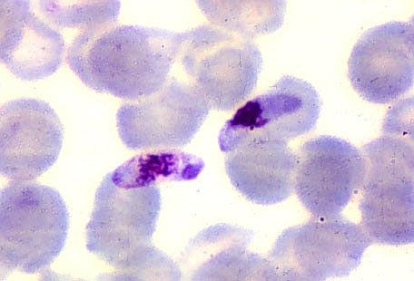
Case4:
The patient was then treated with schizontocidal antimalarial drugs, a follow-up blood film is shown .
NAME THE PARASITE?
Plasmodium falciparum
IN WHAT STAGE ?
Gametocyte stage

Slide 20
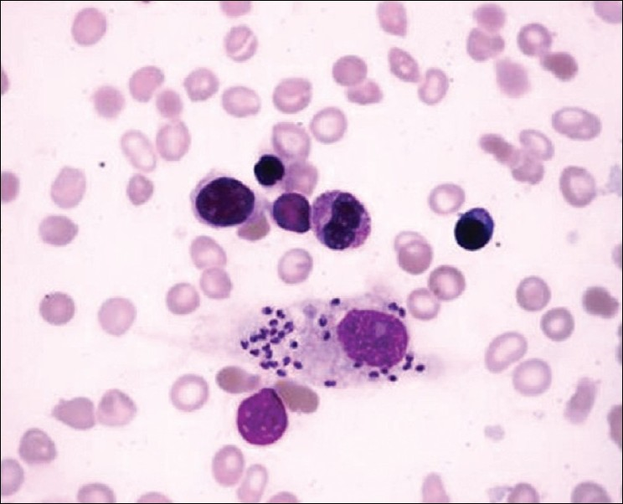
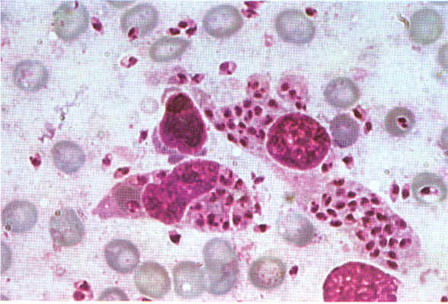
Case 5 :
A 7 year old child presented with anemia , hepatospenomegaly and fever. Not responding to antimalarials and antibiotics . Bone marrow aspirate smear is shown:
WHAT IS THE DIAGNOSIS?
Viseral Leishmania
IDENTIFY THE PARASITE STAGE ?
Amastigote Stage

