Slide 1
Gastrointestinal Diseases
GNT BLOCK
Pathology, 2018
Dr. Maha Arafah

Slide 2
8 LECTURES GIT+5 LECTURES LIVER, PANCREAS, GB
Gastro-esophageal reflux disease
Peptic Ulcer Disease
Acute and chronic pancreatitis
Diarrhea
Patholgy of liver cirrhosis
Malabsorption
Complication of liver cirrhosis
Colonic polyps and carcinoma-1
Cancer of the liver and pancreas
Colonic polyps and carcinoma-2
Inflammatory bowel disease-2
Gallstones and cholecystitis
Inflammatory bowel disease-1

Slide 3

Page 593 -597

Slide 4
Gastro-esophageal reflux disease
OBJECTIVES
Describe the following aspects of reflux esophagitis:
  Definition
  Pathogenesis
  Clinical features
  Pathology (gross and microscopic features)
  Complications
Describe the following aspects of Barrett esophagus:
  Definition
  Main cause
  Pathology (gross and microscopic features)
  Complications (dysplasia and adenocarcinoma)

Slide 5
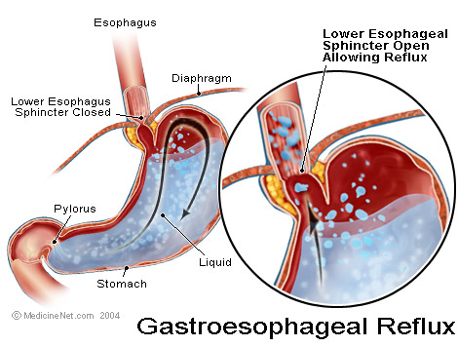
Definition
Reflux Esophagitis
American College of Gastroenterology (ACG)
  Symptoms OR mucosal damage produced by the abnormal reflux of gastric contents into the esophagus
  Often chronic and relapsing
  May see complications of GERD in patients who lack typical symptoms

Slide 6
Gastroesophageal Reflux Disease (GERD)
Reflux Esophagitis
Gastroesophageal reflux is a normal physiologic phenomenon experienced intermittently by most people, particularly after a meal.
Gastroesophageal reflux disease (GERD) occurs when the amount of gastric juice that refluxes into the esophagus exceeds the normal limit, causing symptoms with or without associated esophageal mucosal injury.

Slide 7
Physiologic vs Pathologic
Reflux Esophagitis
Physiologic GERD
  Postprandial
  Short lived
  Asymptomatic
  No nocturnal symptomes
Pathologic GERD
  Symptoms
  Mucosal injury
  Nocturnal symptomes
Notes:
--distinction between normal and GERD is blurred because some degree of reflux is physiologic is all folks
Physiologic—postprandially, short lived, asymptomatic, not during sleep
Pathologic—symptoms or mucosal injury and often with nocturnal symptoms

Slide 8
Reflux Esophagitis
Esophagitis is rarely caused by agents other than reflux
Acute esophagitis may be caused by:
  Infective agents:
  Bacterial infection is very rare, but fungal infection (mainly by Candida albicans) is common
  Viral infections of the esophagus (particularly by herpes simplex and cytomegalovirus) are seen in AIDS patient
or
Physical agents:
irradiation and by ingestion of caustic agent

Slide 9
Epidemiology of GERD
Reflux Esophagitis
About 44% of the US adult population have heartburn at least once a month
14% of Americans have symptoms weekly
7% have symptoms daily

Slide 10
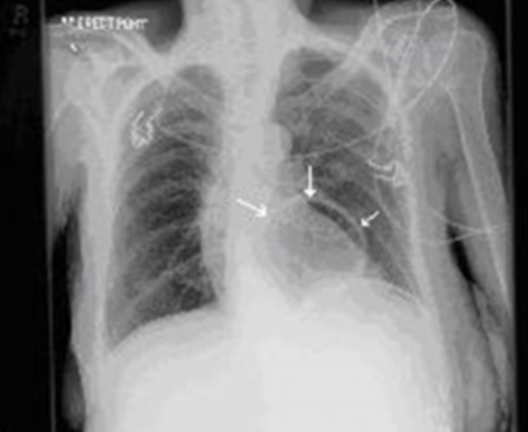
Epidemiology of GERD
Reflux Esophagitis
Approximately 80% of pregnant women have GERD.
Hiatal hernia present in ~70% of people with GERD.
Risk factors
  Smoking, alcohol
  Caffeine, fatty foods, chocolate
  Pregnancy, obesity
  Hiatal hernia
Herniation of a portion of the stomach into the lower thorax

Slide 11
GERD
Pathophysiology
Reflux Esophagitis
Abnormal lower esophageal sphincter
or
Increase abdominal pressure

Slide 12
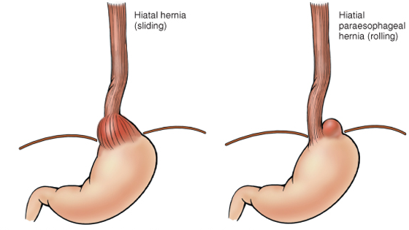
GERD
Pathophysiology
Reflux Esophagitis
Abnormal lower esophageal sphincter
Functional (frequent transient LES relaxation)
Mechanical (hypotensive LES)
Foods (eg, coffee, alcohol, smoking)
Medications (eg, calcium channel blockers),
Location .......... hiatal hernia
or
B. Increase abdominal pressure
The most common cause of (GERD).
decrease the pressure of the LES.
Obesity
Pregnancy
Increased gastric volume

Slide 13
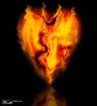
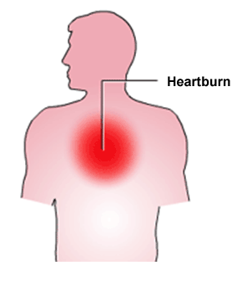
Clinical Manisfestations
Reflux Esophagitis
Most common symptoms
  Heartburn—retrosternal burning discomfort
  Regurgitation—effortless return of gastric contents into the pharynx without nausea, retching, or abdominal contractions
Atypical symptoms….coughing, chest pain, and wheezing.
Notes:
--gerd related chest pain may mimic angina—squeezing/burning, substernal, radiates to back, neck, jaw, arms. Minutes to hours. After meals, awakens patient from sleep, exacerbated by emotional stress
--water brash—hypersalivation—heartburn and regurg of sour fluid or tasteless saliva into mouth
--globus—lump in throat irrespective of swallowing
--odynophagia—esophageal ulcer
--nausea—infrequent
--hrt burn 70-85%//regurg 60%//dysphagi 15-20%//angina 33%//asthma 15-20%

Slide 14
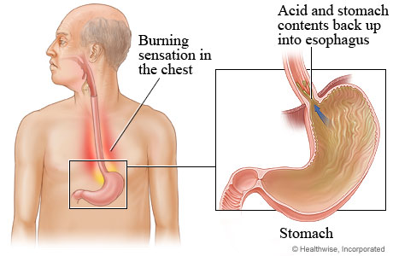
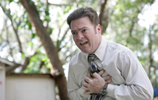
Reflux Esophagitis
  Clinical features of reflux esophagitis

Slide 15
Diagnostic Evaluation
Reflux Esophagitis
  If classic symptoms of heartburn and regurgitation exist, the diagnosis of GERD can be made clinically and treatment can be initiated
Notes:
--heartburn +/- regurgitation high specificity, low sensitivity

Slide 16
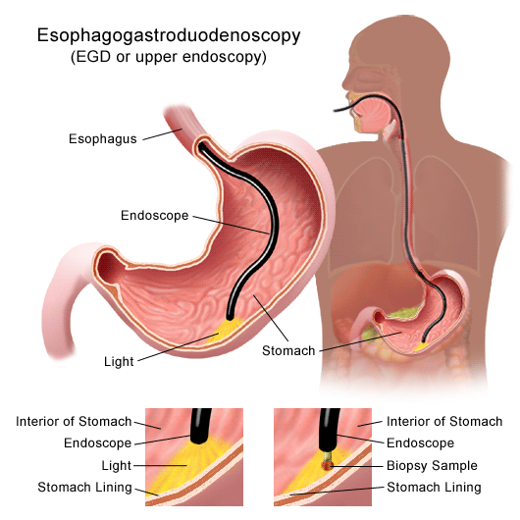
Esophagogastrodudenoscopy
Reflux Esophagitis
Endoscopy (with biopsy if needed)
  In patients with unusual signs/ symptoms
  Those who fail a medication trial
  Those who require long-term treatment
Notes:
--if trial of med did not work or if alarm symptoms or long term 5yrs need egd 1a evidence—dysphagia/early satiety/gi bleed/odynophagia/vomiting/wt loss/anemia
--50-70% of patient’s with gerd will have a neg egd.

Slide 17
pH
Reflux Esophagitis
24-hour pH monitoring
  Accepted standard for establishing or excluding presence of GERD for those patients who do not have mucosal changes
  Trans-nasal catheter or a wireless capsule shaped device
Notes:
--Transnasal catheter or a wireless capsule shaped device affixed to distal esophagus
--cather positioned 5cm above manometrically defined upper limit of les
--capsul attached 6cm proximal to endoscopically defined squamocolumnar jxn
--if mucosal changes—have dx and do not need 24hph.

Slide 18
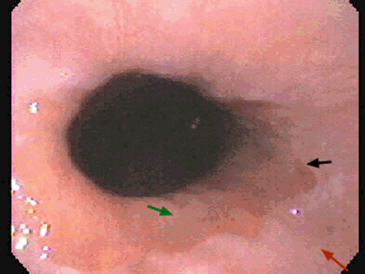
Morphology
Reflux Esophagitis
Simple hyperemia

Slide 19
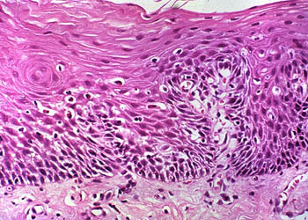
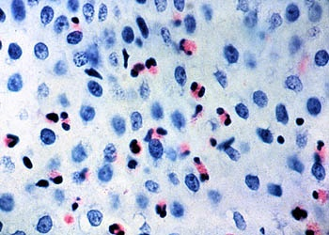
Morphology of GERD
Reflux Esophagitis
Eosinophils and neutrophils
basal zone hyperplasia,
Elongation of lamina propria papillae

Slide 20
Treatment
Reflux Esophagitis
H 2 receptor Blockers
Proton pump inhibitors
Antireflux surgery
Notes:
Once established h&p dx and no alarm symptoms can proceed with dx/therapeutic trial of tx.

Slide 21
Complications
Reflux Esophagitis
Erosive esophagitis
Stricture
Barrett’s esophagus
Notes:
--dysphagia, odynophagia, early satiety, gi bleed, anemia, vomit, wt loss

Slide 22
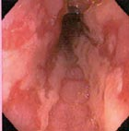
Complications
Reflux Esophagitis
Erosive esophagitis
  Responsible for 40-60% of GERD symptoms
  Severity of symptoms often fail to match severity of erosive esophagitis
  Red mucosa with erosions
Notes:
--black arrow squamo-columnar jxn—Z-line
--Z-line has undulating smooth contours
--green arrow—gastric columnar epithelium above round black sphincter
--red arow—pink white esophageal squamous epithelium
--ulcerations in 2-7%

Slide 23
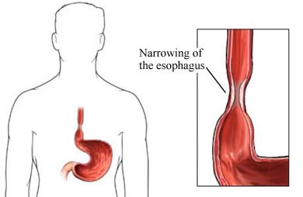
Complications
Reflux Esophagitis
Esophageal stricture
  Result of healing of erosive esophagitis
  May need dilation
Notes:
4-20% of patients

Slide 24
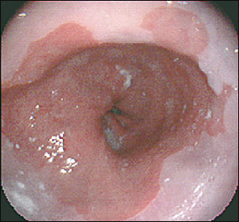
Complications
Reflux Esophagitis
8-15%
Barrett’s Esophagus
Definition:
  Intestinal metaplasia of the esophagus
Notes:
--1950—Norman Barrett
--10-15%
--black arrow squamo-columnar jxn—Z-line
--Z-line has undulating smooth contours
--green arrow—gastric columnar epithelium above round black sphincter
--red arow—pink white esophageal squamous epithelium
--RFs—male, smoker, age, obese

Slide 25
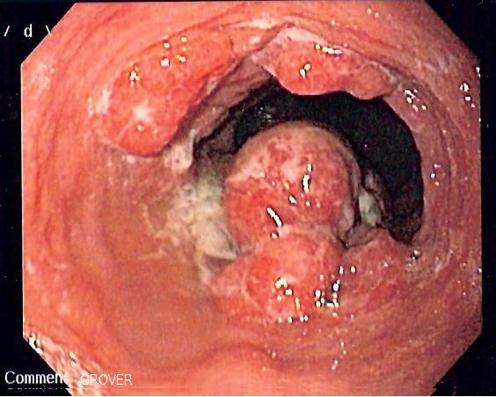
  Main cause (Pathopysiology)
Barrett esophagus
Barrett esophagus
Barrett’s Esophagus
  Acid damages lining of esophagus and causes chronic esophagitis
  Damaged area heals in a metaplastic process and abnormal columnar cells replace squamous cells
  Associated with the development of adenocarcinoma
  Many patients with Barrett’s are asymptomatic
Notes:
Adenoca with barretts 0.5%/yr--------without barretts 0.07%/yr

Slide 26
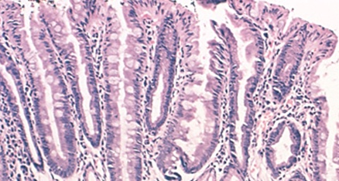
Morphology
Barrett esophagus
Barrett's esophagus is marked by the presence of columnar epithelia in the lower esophagus, replacing the normal squamous cell epithelium
Endoscopic image of Barrett's esophagus: An area of red mucosa

Slide 27
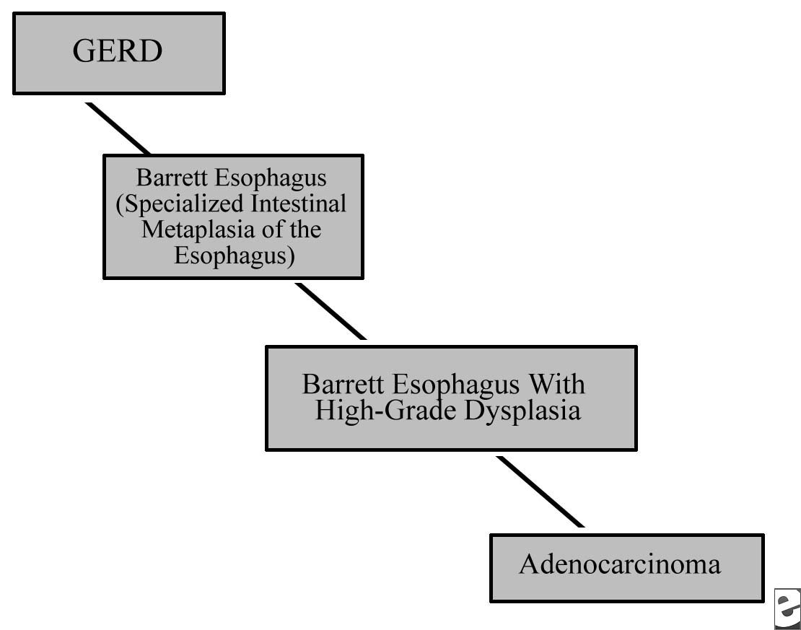
Summary
Barrett esophagus

Slide 28
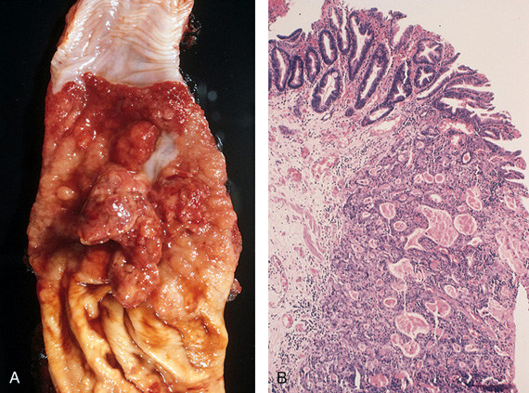
Barrett esophagus
Complications: Dysplasia and adenocarcinoma

Slide 29
The most common malignant tumors of the esophagus are squamous carcinomas and adenocarcinomas
The prognosis for both types of carcinoma is poor

Slide 30
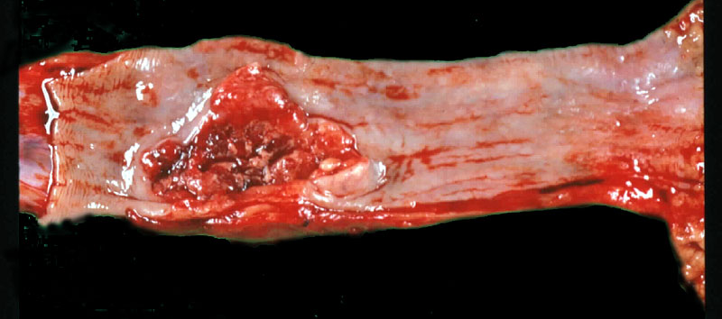
Squamous carcinomas
are most common in the middle and lower esophagus. They mostly develop in men who are heavy alcohol drinkers or heavy smokers, and may be preceded by epithelial dysplastic change.
Not related to GERD

Slide 32
Case scenario: A man with retrosternal pain
A 57-year-old presents with a history of a retrosternal burning sensation, particularly after large meals, and often on retiring to bed at night. Treatment with antacids has had little effect and he has been referred by his GP for endoscopy.
Upper gastrointestinal tract endoscopy reveals reddening of the lower esophageal mucosa from the level of the gastroesophageal junction to a point 32 cm from the incisors. There is no evidence of a hiatus hernia. The proximal border of the reddened area is irregular, and this area is biopsied. The biopsy shows gastric and intestinal-type glandular mucosa.

Slide 33
1. What is the likely cause of the symptoms?
The symptoms of ‘heartburn’ are suggestive of gastroesophageal reflux disease (GERD), with or without the presence of a hiatus hernia.
Other important causes of retrosternal pain should not be overlooked, including cardiovascular causes, especially myocardial ischaemia, as well as other rarer causes including pneumothorax and musculoskeletal pain.

Slide 34
2. What is the final diagnosis?
The endoscopic and biopsy appearances confirm a Barrett’s oesophagus. This is a metaplastic process which develops as a result of persistent reflux of gastric contents into the esophagus, the normal squamous mucosa being replaced by glandular mucosa of gastric or intestinal type

Slide 35
3. What further information do you require from the biopsy report?
It is important to look for dysplastic change in the biopsy which may herald the development of adenocarcinoma.

Slide 36
4. What are the major causes of reflux esophagitis?
Reflux of gastric contents is the major cause of reflux esophagitis. Many factors play a role:
(a) the presence of a sliding hiatal hernia is the most common
(b) heavy alcohol use
(c) heavy tobacco use
(d) increased gastric volume
(e) decreased efficacy of LES
(f) pregnancy
(g) CNS depressants
(h) hypothyroidism

Slide 37
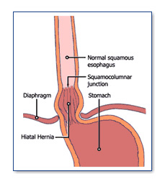

Slide 38
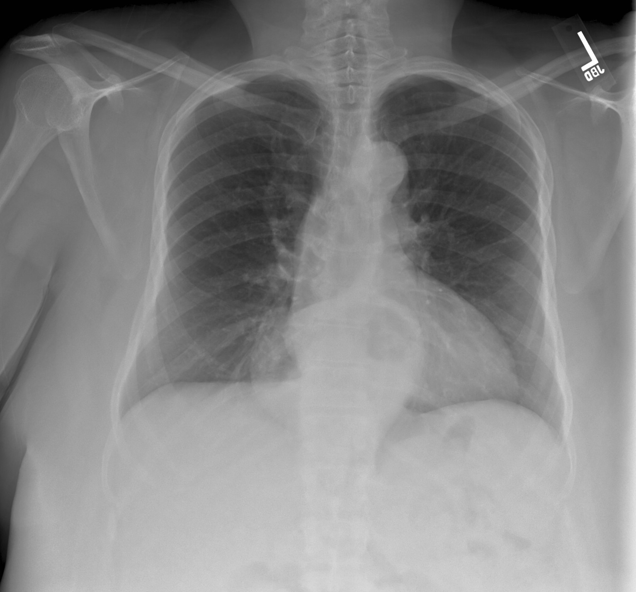
hiatus hernia
An X-ray film of the chest shows a retrocardiac, gas-filled structure.

Slide 39
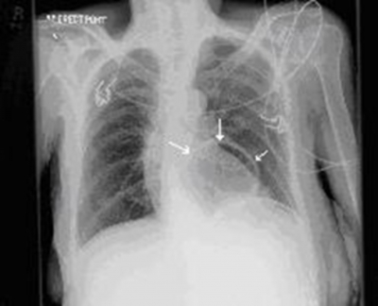
CT scan of the abdomen with contrast was done which showed marked distention and distortion of the stomach with herniation of a portion of the stomach into the lower thorax, representing a combination of hernia through the esophageal hiatus hernia

Slide 40
5. What are other causes of esophagitis?
Ingestion of irritants (eg, alcohol, corrosive acids); infections in immunosuppressed hosts by fungi (eg, Candida) or viruses (eg, CMV, herpes); uremia; radiation therapy; graft-versus-host disease; and cytotoxic anticancer therapy.

Slide 41
  6. What are the gross and microscopic features of reflux esophagitis?

Slide 42
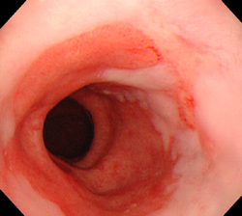
Gross featurs:
Simple hyperemia
Erosion
Ulceration
Stricture
Development of Barrett esophagus
Development of mass: adenocarcinoma

Slide 43
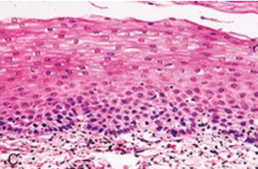
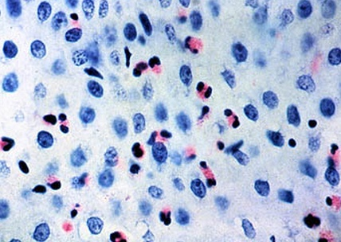
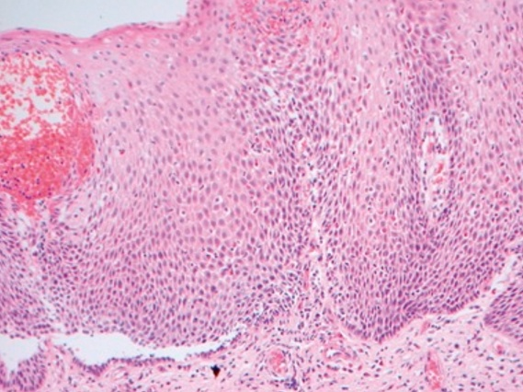
Microscopic features of reflux esophagitis
1. basal zone hyperplasia,
2. Eosinophils and neutrophils
3. Elongation of lamina propria papillae

Slide 44
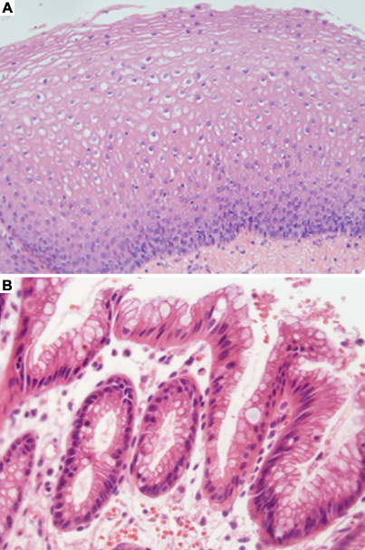
Barrett esophagus without dysplasia

Slide 45
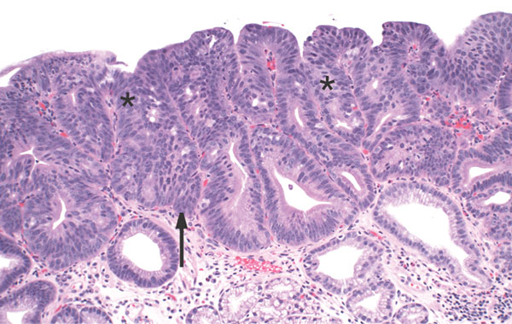
Barrett esophagus with dysplasia

Slide 46
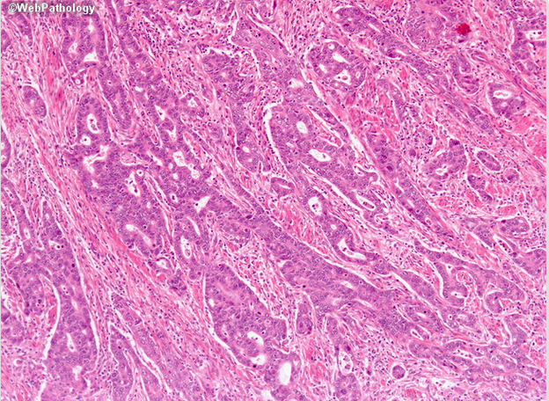
Adenocarcinoma in Barrett Esophagus

Slide 47
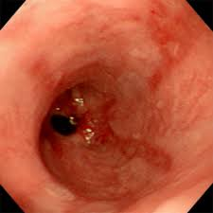
Mass , need biopsy
adenocarcinoma

Slide 48
7. What are the major complications of reflux esophagitis?
The potential complications of severe reflux esophagitis are (a) ulcer; (b) bleeding; (c) development of stricture; (d) development of Barrett esophagus and adenocarcinoma.

Slide 49
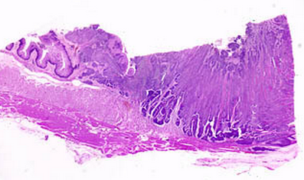
-development of Barrett esophagus and adenocarcinoma
complications of reflux esophagitis

Slide 50
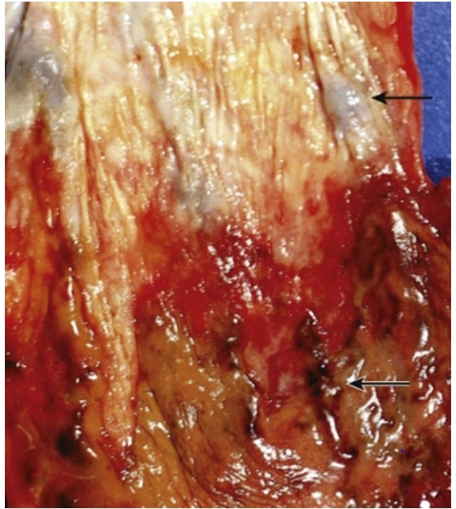
linear-oriented dilated and tortuous veins (arrows) in the submucosa of the distal esophagus
Esophageal varices

