Slide 1
GNB Pathology lecture 2018
Pathology and mechanisms of malabsorption
Dr. Maha Arafah
Dr. Ahmed Al Humaidi

Slide 2
Objectives
Upon completion of this lecture the students will:
Understand that the malabsorption is caused by either abnormal digestion or small intestinal mucosal disease
Know that malabsorption can affect many organ systems ( alimentary tract, hematopoietic system, musculoskeletal system, endocrine system, epidermis, nervous system)
Know the following aspects of celiac disease:
a. definition
b. pathogenesis
c. clinical features
d. pathology (gross and microscopic features)
e. complications (T-cell lymphoma and GI tract carcinoma)
Know the cause and types of Lactose intolerance

Slide 3
Definition of malabsorption
Malabsorption Syndrome
Inability of the intestine to absorb nutrients adequately into the blood stream
Impairment can be of single or multiple nutrients depending on the abnormality

Slide 4
Physiology
Causes of malabsorption
The main purpose of the gastrointestinal tract is to digests and absorbs nutrients (fat, carbohydrate, and protein), micronutrients (vitamins and trace minerals), water, minerals and electrolytes.

Slide 5
Mechanisms and Causes of Malabsorption Syndrome
Causes of malabsorption
1. Inadequate digestion
2. Deficient bile salt
3. Primary mucosal abnormalities
4. Inadequate small intestine
5. Lymphatic obstruction

Slide 6
Mechanisms and Causes of Malabsorption Syndrome
Causes of malabsorption
Inadequate digestion
Postgastrectomy
Deficiency of pancreatic lipase
Chronic pancreatitis
Cystic fibrosis
Pancreatic resection
Zollinger-Ellison syndrome
Deficient bile salt
Obstructive jaundice
Bacterial overgrowth
Stasis in blind loops, diverticula
Fistulas
Hypomotility states (diabetes)
Terminal ileal resection
Crohns' disease
Precipitation of bile salts (neomycin)
Primary mucosal abnormalities
Celiac disease
Tropical sprue
Whipple's disease
Amyloidosis
Radiation enteritis
Abetalipoproteinemia
Giardiasis
Inadequate small intestine
Intestinal resection
Crohn's disease
Mesenteric vascular disease with infarction
Jejunoileal bypass
Lymphatic obstruction
Intestinal lymphangiectasia
Malignant lymphoma
Macroglobulinemia
Many causes

Slide 7
Pathophysiology
Causes of malabsorption
Inadequate digestion
Or
=
Malabsorption
Small intestine abnormalities

Slide 8
Pathophysiology
Causes of malabsorption
Inadequate digestion
Postgastrectomy
Stomach
Pancreas
Deficiency of pancreatic lipase
Chronic pancreatitis
Cystic fibrosis
Pancreatic resection
Bile
Small intestine abnormalities
Obstructive jaundice
Terminal ileal resection
mucosa
Inadequate small intestine
Lymphatic obstruction

Slide 9
Pathophysiology
Causes of malabsorption
Inadequate digestion
Stomach
Pancrease
Bile
Celiac disease
Tropical sprue
Whipple's disease
Giardiasis
Small intestine abnormalities
mucosa
Intestinal resection
Crohn's disease
Inadequate small intestine
Lymphatic obstruction
Intestinal lymphangiectasia
Malignant lymphoma

Slide 10
Malabsorption Syndrome Clinical features
Know that malabsorption can affect many organ systems
1. There is increased fecal excretion of fat (steatorrhea) and the systemic effects of deficiency of vitamins, minerals, protein and carbohydrates.
Steatorrhea is passage of soft, yellowish, greasy stools containing an increased amount of fat
2. Growth retardation and failure to thrive in children
3. Weight loss despite increased oral intake of nutrients

Slide 11
Systemic effects of the malabsorption syndromes
Know that malabsorption can affect many organ systems
Weight loss and anorexia
Abdominal distension and borborygmi (increased bowel sounds)
Diarrhoea (loose, bulky stools)
Steatorrhoea—malabsorption of fat, producing pale, foul-smelling stools that characteristically float in water
Muscle wasting

Slide 12
Malabsorption Syndrome Clinical features
Know that malabsorption can affect many organ systems
Depend on the deficient nutrient
Protein
Swelling or oedema
B₁₂, folic acid and iron deficiency
Anaemias
(fatigue and weakness)
vitamin D, calcium
Muscle cramp
Osteomalacia and osteoporosis
vitamin K and other coagulation factor
Bleeding tendencies

Slide 13
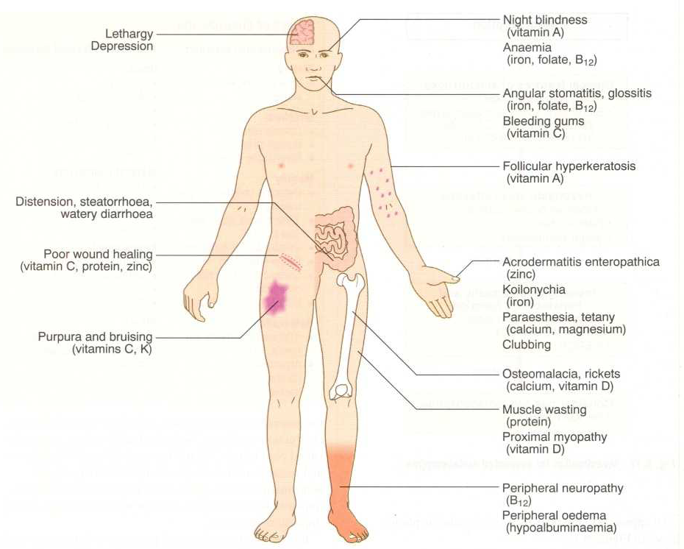
Know that malabsorption can affect many organ systems
Clinical features

Slide 14
Diagnosis
Diagnosis of malabsorption
There is no specific test for malabsorption.
Investigation is guided by symptoms and signs.
Fecal fat study to diagnose steatorrhoea
Blood tests
3. Endoscopy
Biopsy of small bowel

Slide 15
Malabsorption Syndrome Celiac disease
Celiac disease
An immune reaction to gliadin fraction of the wheat protein gluten
Usually diagnosed in childhood – mid adult.
Patients have raised antibodies to gluten autoantibodies
Highly specific association with class II HLA-DQ2 or HLA-DQ8 alleles.

Slide 16
Celiac disease
a 33-amino acid peptide resistant to degradation by gastric, pancreatic, and small intestinal proteases

Slide 17
Clinical features Celiac disease
Celiac disease
Typical presentation GI symptoms that characteristically appear at age 9-24 months.
Symptoms begin at various times after the introduction of foods that contain gluten.
A relationship between the age of onset and the type of presentation;
Infants and toddlers….GI symptoms and failure to thrive
Childhood…………………minor GI symptoms, inadequate rate of weight gain,
Young adults……………anemia is the most common form of presentation.
Adults and elderly…...GI symptoms are more prevalent

Slide 18
Endoscopy
Celiac disease
Normal
Celiac disease

Slide 19
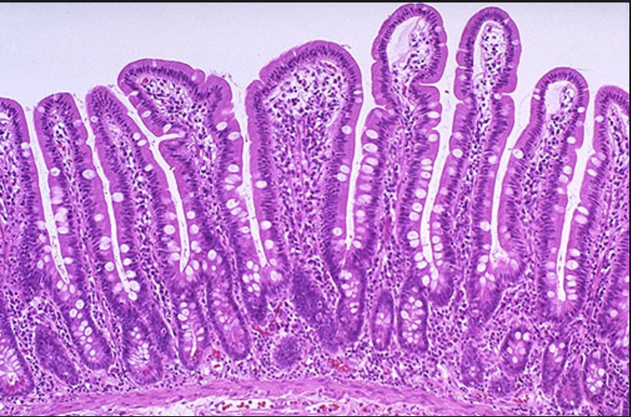
Celiac disease
Celiac Disease
Histology
Mucosa is flattened with marked villous atrophy.
Increased intraepithelial lymphocytosis
Crypt elongation
Subtotal villous atrophy
Normal
Total villous atrophy

Slide 20
Celiac Disease
Celiac disease
Diagnosis
Clinical documentations of malabsorption.
Stool ………. Fat
Serology is +ve for IgA to tissue transglutaminase or IgG to deamidated gliadin or anti-endomysial antibodies
Small intestine biopsy demonstrate villous atrophy.
Improvement of symptom and mucosal histology on gluten withdrawal from diet.
wheat, barley, flour
Other grains, such as rice and corn flour, do not have such an effect.

Slide 21
Celiac Disease
Celiac disease
Complications
Osteopenia , osteoporosis
Infertility in women
Short stature, delayed puberty, anemia,
Malignancies: [intestinal T-cell lymphoma]
10 to 15% risk of developing GI lymphoma.

Slide 22
Lactose Intolerance
Lactose Intolerance

Slide 23
Lactose Intolerance Pathophysiology
Lactose Intolerance
lactase
Lactose
glucose + galactose
At the brush border of enterocytes
Lactose Intolerance
Low or absent activity of the enzyme lactase

Slide 24
Lactose Intolerance causes
Lactose Intolerance
Inherited lactase deficiency
Congenital lactase deficiency
Childhood-onset and adult-onset lactase deficiency
extremely rare
common
Genetically programmed progressive loss of the activity of the small intestinal enzyme lactase.
Gastroenteritis: Infectious diarrhea, particularly viral gastroenteritis in younger children, may damage the intestinal mucosa enough to reduce the quantity of the lactase enzyme
Acquired lactase deficiency
Transient
Secondary lactase deficiency due to intestinal mucosal injury by an infectious, allergic, or inflammatory process

Slide 25
Clinical
Lactose Intolerance
Bloating, abdominal discomfort, and flatulence
……………1 hour to a few hours after ingestion of milk products

Slide 26
Lactose Intolerance

Slide 27
Lactose Intolerance Diagnosis
Lactose Intolerance
Lactose Intolerance
Empirical treatment with a lactose-free diet, which results in resolution of symptoms;
Hydrogen breath test

Slide 28
Hydrogen breath test .
Lactose Intolerance
An oral dose of lactose is administered
The sole source of H₂ is bacterial fermentation;
Unabsorbed lactose makes its way to colonic bacteria, resulting in excess breath H₂.
Increased exhaled H₂ after lactose ingestion suggests lactose malabsorption.

Slide 29
Lactose Intolerance
A 3-week trial of a diet that is free of milk and milk products is a satisfactory trial to diagnose lactose intolerance

Slide 30
Lactose Intolerance summary
Lactose Intolerance
Deficiency/absence of the enzyme lactase in the brush border of the intestinal mucosa → maldigestion and malabsorption of lactose
Unabsorbed lactose draws water in the intestinal lumen
In the colon, lactose is metabolized by bacteria to organic acid, CO2 and H2; acid is an irritant and exerts an osmotic effect
Causes diarrhea, gaseousness, bloating and abdominal cramps

Slide 32
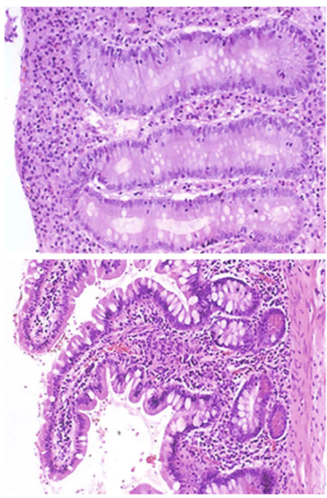
Questions
A 33-year-old man with a 5-year history of chronic diarrhea has recently lost 6 kg and become chronically fatigued. A biopsy specimen of his jejunum (top) is compared with a normal jejunal biopsy specimen. After a change in diet, he improves.

Slide 33
Q1. What is your diagnosis?
Q2. What serologic tests can aid in diagnosis?
Q3. What was the dietary change?
Q4. What skin condition can accompany this disease?
The flattening with atrophy of the villi, the loss of goblet cells, and the chronic inflammation are features of celiac disease (nontropical sprue or gluten-sensitive enteropathy).
Testing for antiendomysial antibodies (directed against transglutaminase in epithelial cells), antigliadin antibodies, and antireticulin antibodies may be helpful.
Gluten (found in wheat, rye, or barley flour) contains the gliadin protein that binds to epithelial cells; cytotoxic T cell injury directed against gliadin-modified cells leads to cell loss. The removal of gluten (gliadin) from the diet removes the antigenic stimulus to the T cells, and the epithelium is eventually restored.
Dermatitis herpetiformis, with sub-basilar skin blistering and associated IgA deposition, may occur with this condition.

Slide 34
Question
A 23-year-old woman from Hong Kong who is living in Zurich has had bouts of explosive, watery diarrhea with abdominal bloating since her arrival 6 months ago. Her stool has no occult blood, ova, parasites, or bacterial pathogens. Her laboratory findings are shown.

Slide 35
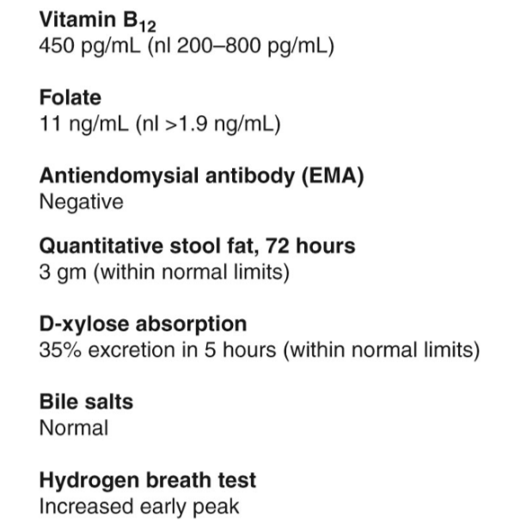

Slide 36
1. What is your diagnosis?
lactase deficiency. Disaccharidases are secreted from apical enterocytes, with infants expressing more than adults. Europeans typically have more lactase expression than Asians do.
2. What is the pathogenesis?
When disaccharides are not absorbed, gut bacteria have increasing substrate to ferment, which produces hydrogen that is absorbed and exhaled. It is the bacterial overgrowth and osmotic diarrhea that cause the unpleasant symptoms.
3. How can this be treated?
Avoiding foods containing lactose sugar include dairy products will reduce the symptoms.

Slide 37
