Slide 1
GNB Pathology 2018
MalignantTumors of Intestine
Dr. Maha Arafah
Dr. Ahmed Al Humaidi

Slide 2
Objectives:
Colon cancer:
Describe the epidemiology of colon cancer.
Compare the pathology (gross and microscopic features) and clinical features of right-sided colonic adenocarcinoma and left-sided colorectal adenocarcinoma.
Describe the relationship between prognosis and the various stages of cancer of the colon and rectum as noted in the TNM (tumor-nodes-metastasis) classification and staging system.
Describe the relationship between carcinoembryonic antigen (CEA) and recurrence following resection of the primary tumor.
Mention the significant of carcinoid tumor and its features

Slide 3
Tumors of the small and large intestines
Carcinoma
Carcinoid tumor
Lymphoma

Slide 4
Adenocarcinoma of the colon is the most common malignancy of the GI tract and is a major cause of morbidity and mortality worldwide.

Slide 5
The small intestine accounts for 75% of the overall length of the GI tract, is an uncommon site for benign and malignant tumors.
Among malignant small intestinal tumors, adenocarcinomas and well-differentiated neuroendocrine (carcinoid) tumors have roughly equal incidence, followed by lymphomas and sarcomas.

Slide 6
Malignant Tumors of Large Intestine
Adenocarcinoma
Adenocarcinoma of the colon is the most common malignancy of the GI tract and is a major cause of morbidity and mortality worldwide.
Constitutes 98% of all cancers in the large intestine.
incidence peaks at 60 to 70 years of age
Notes:
14

Slide 7
Malignant Tumors of Large Intestine
Adenocarcinoma
Predisposing factors
IBD, adenomas, polyposis syndrome.
Diet appears to play an important role in the risk for colon cancer:
- Low fibre diet.
High fat content.
Alcohol
- Reduced intake of vit A, C & E.
It is theorized that reduced fiber content leads to decreased stool bulk and altered composition of the intestinal microbiota. This change may increase synthesis of potentially toxic oxidative by-products of bacterial metabolism, which would be expected to remain in contact with the colonic mucosa for longer periods of time as a result of reduced stool bulk. High fat intake also enhances hepatic synthesis of cholesterol and bile acids, which can be converted into carcinogens by intestinal bacteria.
Notes:
14

Slide 8
Several epidemiologic studies suggest that aspirin or other NSAIDs have a protective effect. This is consistent with studies showing that some NSAIDs cause polyp regression in FAP patients in whom the rectum was left in place after colectomy.

Slide 9
Adenocarcinoma of Large Intestine
Carcinogenesis
Two pathogenetically distinct pathways for the development of colon cancer, both seem to result from accumulation of multiple mutations:
1- The APC/B-catenin pathway ( 85 % )
2- The DNA mismatch repair genes pathway

Slide 10
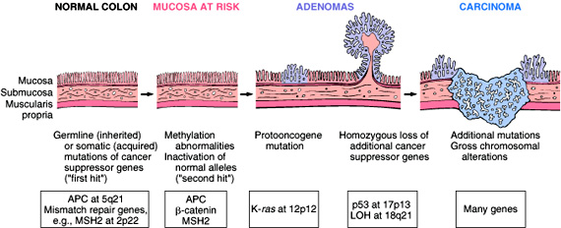
Adenocarcinoma of Large Intestine
Carcinogenesis
1- The APC/B-catenin pathway ( 85 % )
chromosomal instability that results in stepwise accumulation of mutations in a series of oncogenes and tumor suppressor genes.
adenoma-carcinoma sequence

Slide 11
Familial Adenomatous Polyposis
Hereditary mutation of the APC gene is the cause of familial adenomatous polyposis (FAP), where affected individuals carry an almost 100% risk of developing colon cancer by age 40 years.

Slide 12
Malignant Tumors of Large Intestine Adenocarcinoma
Carcinogenesis
2- The DNA mismatch repair genes pathway
(These are referred to as MSI high, or MSI-H, tumors:)
10% to 15% of sporadic cases.
There is accumulation of mutations
Five DNA mismatch repair genes (MSH2, MSH6, MLH1, PMS1, AND PMS2)
give rise to the hereditary non polyposis colon carcinoma (HNPCC) syndrome.

Slide 13
Hereditary non polyposis colon carcinoma syndrome (Defects in mismatch repair genes_
This result in microsatellite instability and permit accumulation of mutations in numerous genes.
If these mutations affect genes involved in cell survival and proliferation, cancer may develop.
It progress from normal to sessile serrated adenomas to adenocarcinoma
May produce abundant mucin that accumulates within the intestinal wall, and these carry a poor prognosis

Slide 14
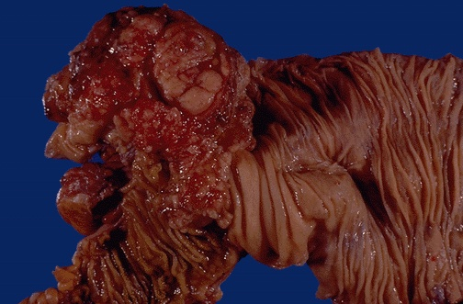
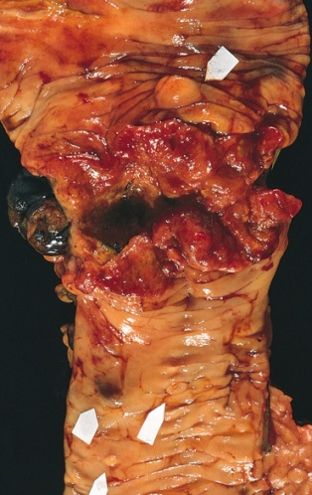
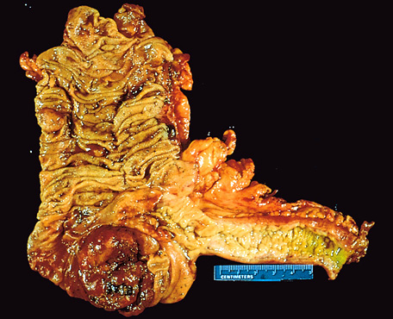
Colorectal Carcinoma
Morphology
70% are in the rectum, rectosigmoid and sigmoid colon.
Left-sided carcinomas tend to be annular, encircling lesions with early symptoms of obstruction.
Right-sided carcinomas tend to grow as polypoid, fungating masses, obstruction is uncommon.
Right-sided
Left-sided
Notes:
16

Slide 15
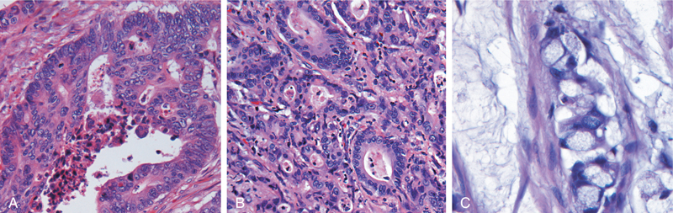
Colorectal Carcinoma Morphology
Adenocarcinoma
Mucinous adenocarcinoma secret abundant mucin that may dissect through cleavage planes in the wall.

Slide 16
Signs and symptoms
If located closer to the anus: change in bowel habit, feeling of incomplete defecation, PR bleeding
A tumor that is large enough to fill the entire lumen of the bowel may cause bowel obstruction
Right-sided lesions are more likely to bleed while left-sided tumors are usually detected later and could present with bowel obstruction.

Slide 17
Colorectal Carcinoma
Serum levels of carcinoembryonic antigen (CEA) are related to tumor size and extent of spread. They are helpful in monitoring for recurrence of tumor after resection.

Slide 18
TNM Staging of Colon Cancers is used for staging

Slide 21
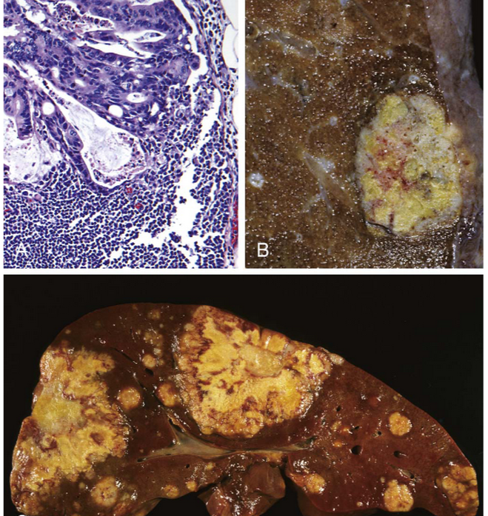

Slide 22
Colorectal Carcinoma
The most important prognostic factors are depth of invasion and the presence or absence of lymph node metastases and distant metastasis.

Slide 24
Malignant Small Intestinal Neoplasms
In descending order of frequency:
Carcinoid
Adenocarcinomas
Lymphomas
Leiomyosarcomas.
Notes:
20

Slide 25
Small Intestinal Neoplasms
Carcinoid Tumors
Neoplasms arising from endocrine cells found along the length of GIT mucosa.
The peak incidence: sixth decade, but they may appear at any age.
They compose less than 2% of colorectal malignancies
almost half of small intestinal malignant tumors:
60 to 80% appendix and terminal ileum
10 to 20% rectum.
Notes:
21

Slide 26
Carcinoid Tumors Behavior
Aggressive behavior correlates with:
Site of origin:
Appendiceal and rectal carcinoids infrequently metastasize, even though they may show extensive local spread
90% of ileal, gastric, and colonic carcinoids that have penetrated halfway through the muscle wall have spread to lymph nodes and distant sites at the time of diagnosis, especially those larger than 2 cm in diameter.
Depth of local penetration
Size of the tumor

Slide 27
Small Intestinal Neoplasms
Carcinoid Tumors
Morphology
A solid, yellow-tan appearance
The cells are monotonously similar, having a scant, pink granular cytoplasm and a round-to-oval stippled nucleus.
Ultrastructral features: neurosecretory electron dense bodies in the cytoplasm
Notes:
21

Slide 28
Small Intestinal Neoplasms
Carcinoid Tumor
Clinical features
Asymptomatic
May cause obstruction, intussusception or bleeding.
May elaborate hormones: Zollinger-Ellison, Cushing’s carcinoid or other syndromes.
Notes:
22

Slide 29
Small Intestinal Neoplasms
Carcinoid tumor
Carcinoid syndrome
1% of carcinoid tumor & in 20% of those of widespread metastasis
Paroxymal flushing, episodes of asthma-like wheezing, right-sided heart failure, attacks of watery diarrhea, abdominal pain,
The principal chemical mediator is serotonin
The syndrome is classically associated with ileal carcinoids with hepatic metastases.
Notes:
23

Slide 30
Clinical findings
Due to serotonin and other bioactive compounds (e.g., histamine, bradykinin)
Flushing of the skin (75%–90% of cases)
Due to vasodilation; may be triggered by emotion, alcohol, other foods
Diarrhea (>70% of cases)
Increased bowel motility from serotonin
Intermittent wheezing and dyspnea (25% of cases)
Due to bronchospasm
Facial telangiectasia
Tricuspid regurgitation and pulmonary stenosis
Serotonin increases collagen production in the valves.

Slide 31
Serotonin and diarrhea
Patients with carcinoid syndrome often suffer from diarrhea, which has both a secretory and a motor component. The secretory component of carcinoid diarrhea is attributable to excessive serotonergic stimulation of submucosal secretomotor neurons; the motor component includes faster small bowel and colon transit and an exaggerated tonic response of the colon to ingestion of a meal

Slide 32
Small Intestinal Neoplasms
Lymphoma
Most often low-grade lymphomas arising in mucosal-associated lymphoid tissue (MALT) lymphoma or high-grade non-Hodgkin's lymphomas of B cell type.
May occur in any part of the intestine;
The ileocecal region is a favored site for Burkitt's lymphoma.

Slide 34
A
B
Neurosecretory electron dense bodies
Occult blood in stool
Worst prognosis
Intussusception
Excess extracellular mucin
Serotonin
Round and uniform nuclei
Carcinoembryonic antigen
Annular lesions
Polypoid, exophytic masses
Sessile serrated adenomas
Right-sided adenocarcinomas
Left-sided adenocarcinomas
Carcinoid Tumor

Slide 35
A
B
FAP
MSH2
APC
MSH6
K-RAS
MLH1
P53
PMS1
DCC
PMS2
HNPCC
The APC/B-catenin pathway
The DNA mismatch repair genes pathway

Slide 36
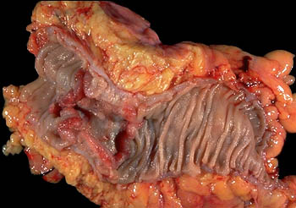
Left colon, carcinoma - Gross, mucosal surface
This specimen from the left colon shows an annular, encircling, and constricting cancer. The margins of the cancer are heaped-up and firm, and the mid-region is ulcerated.
Left-sided colon cancers come to attention by producing occult bleeding and changes in bowel habits (i.e., constipation and cramping in the left lower quadrant).

Slide 37
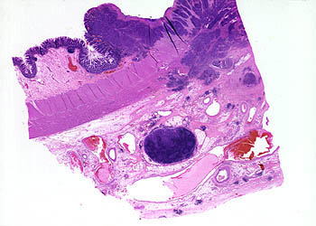
The carcinoma is composed of irregular glands infiltrating the muscularis propria, serosa, and mesentery. The TNM classification is based on the extent of invasion, number of lymph nodes involved, and extent of metastatic involvement. The deeper tumor extends into the muscularis propria, and as lymph nodes become involved, the prognosis worsens.
T—extent of invasion
N—number of lymph nodes involved
M—extent of metastatic involvement

Slide 38
Assuming this patient did not have lymph node metastasis, what stage is this carcinoma? The TNM stage for the current case would be T3N0MX.
T3—extends through the muscularis propria
N0—no lymph node involvement
MX—extent of metastatic involvement unknown

Slide 39
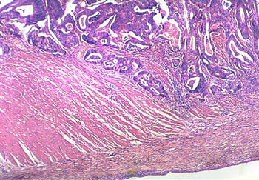
malignant glands of an adenocarcinoma of the colon infiltrating the muscularis propria.
What is the mode of spread of this cancer? Colonic carcinomas spread by local extension to adjacent structures. The favored sites of metastases are regional lymph nodes, liver, lungs, and bones.

Slide 40
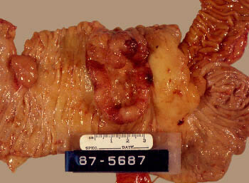
Cecal adenocarcinoma
Tumors in the proximal colon tend to grow as polypoid, fungating, ulcerating masses. Obstruction is uncommon. About 25% of colon carcinomas are located in the cecum or ascending colon. Note the adjacent pedunculated adenomatous polyp. Most colon cancers develop from adenomatous polyps (the adenoma-carcinoma sequence).
Cecal and right colon cancers most often come to clinical attention by the appearance of fatigue, weakness, and iron-deficiency anemia.

Slide 42
Diverticulosis

