Slide 1
Digestive system block-
Practical 2
GNT Block
2018
Pathology Practical

Slide 2
Large intestine
Gross and histopathology

Slide 3
Crohn’s disease

Slide 4
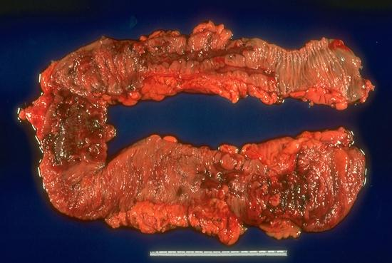
Notes:
Here the inflammation has produced large, irregularly shaped to rake-like ulcers that are separated from each other by mucosa that appears close to normal.

Slide 5
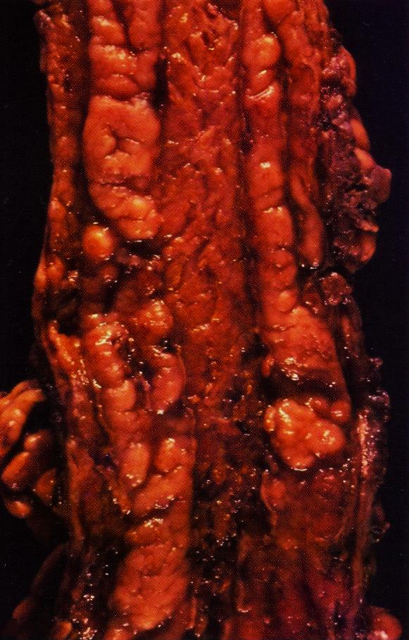
Crohn,’s disease
Linear mucosal ulcers and thickened intestinal wall.

Slide 6
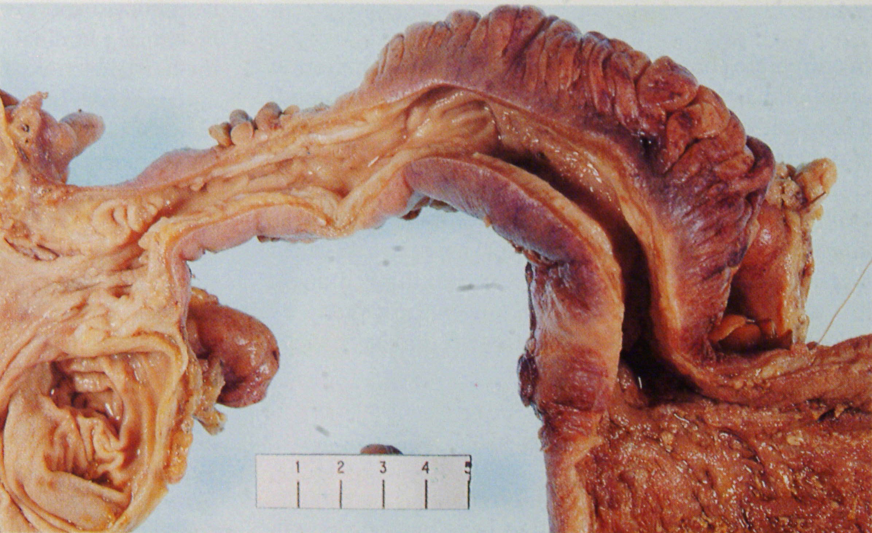
Crohns disease alternating normal and ulcerating mucosa

Slide 7
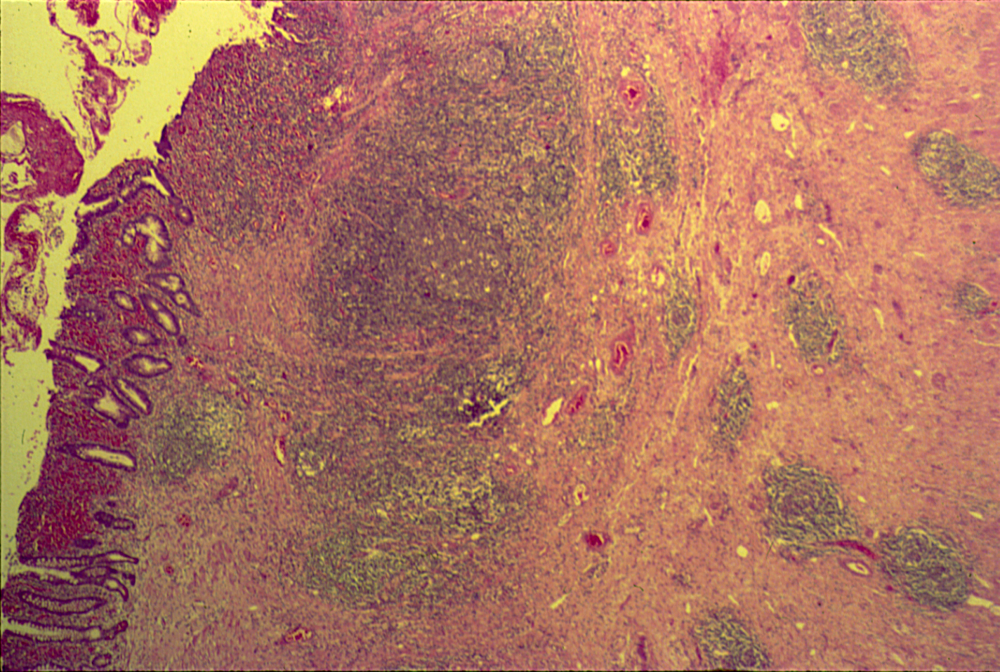
CROHN’S DISEASE (LARGE BOWEL) transmural chronic inflammatory cell infiltrate, lymphoid aggregates and mild fibrosis.

Slide 8
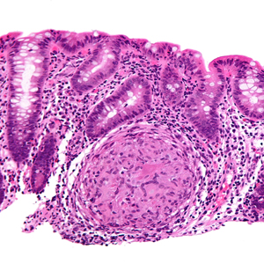
granuloma

Slide 9
Crohn’s disease of the intestine:
Section of large bowel shows alternating normal and ulcerating mucosa:
All layers of intestinal wall show transmural chronic inflammatory cell infiltrate, lymphoid aggregates and mild fibrosis.
Subserosa contains few epithelioid granulomas.

Slide 10
Ulcerative colitis

Slide 11
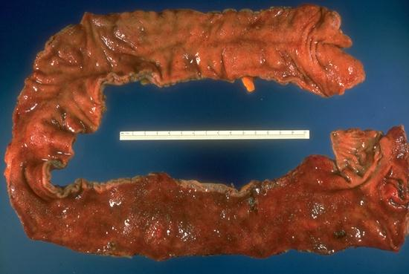
The entire colon is abnormal, and the usual transverse rugal folds have been almost completely effaced.
Notes:
The entire colon is abnormal, and the usual transverse rugal folds have been almost completely effaced.

Slide 12
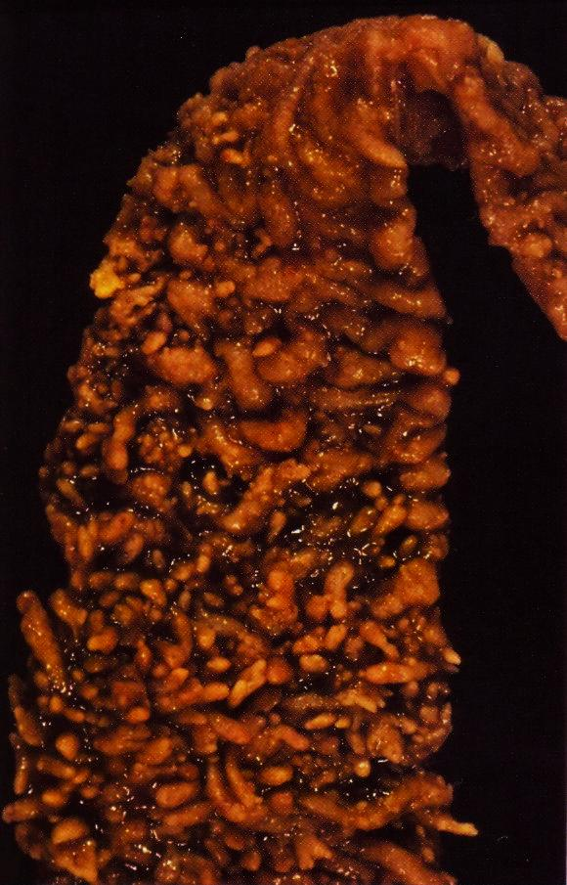
Inflammatory pseudopolyp
Notes:
Inflammatory pseudopolyp

Slide 13
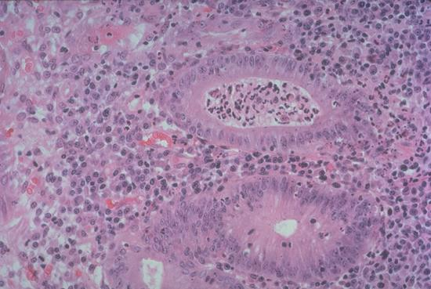
Crypt abscess

Slide 14
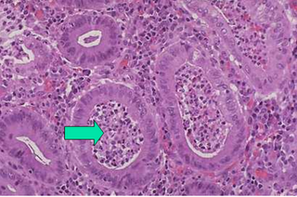

Slide 15
Ulcerative colitis:
Section of large bowel wall show a few relatively superficial ulcers lined by acute inflammatory exudate. Marked oedema and vascular congestion are seen in lamina propria.
The mucosa adjacent to the ulcers contains several crypt abscesses and there is evidence of goblet cells depletion in many glands.
No granulomas or glandular dysplasia are noted.

Slide 16
Adenomatous polyp of rectum / colon

Slide 17
Organ: Colon Dx: adenoma

Slide 18
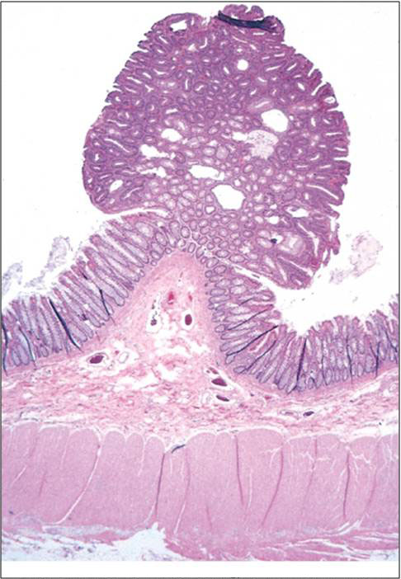
Colonic polyp.

Slide 19

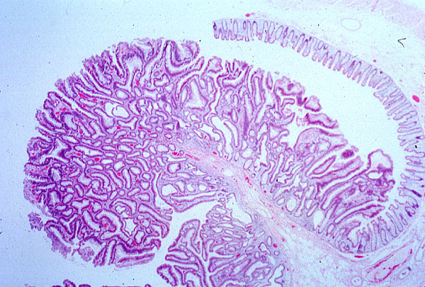
Tubular adenoma, colon

Slide 20
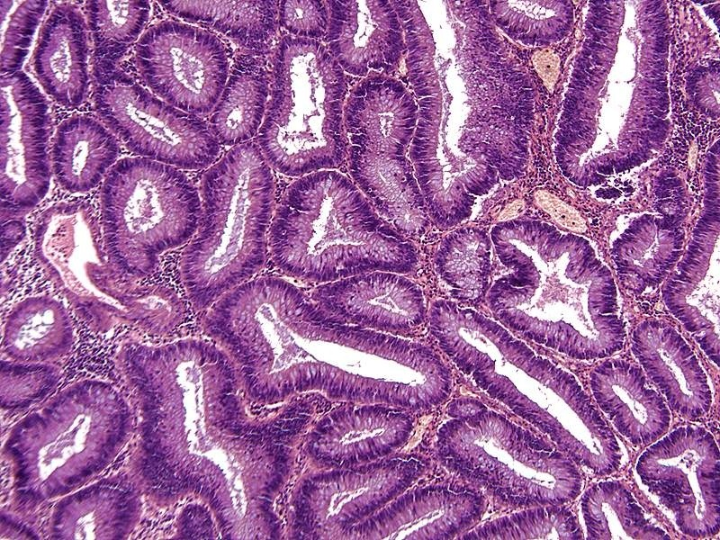
ADENOMATOUS POLYP (TUBULAR)
Notes:
TUBULAR adenoma, note how all the epithelial (glandular) cells look the same.

Slide 21
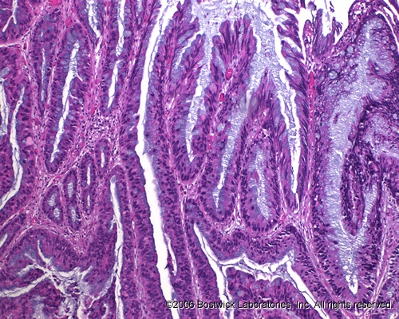
ADENOMATOUS POLYP (VILLOUS)
Notes:
Villous adenomas behave more aggressively than tubular adenomas. They have a HIGHER rate of developing into frank adenocarcinomas than the “tubular” patterns.

Slide 22
familial adenomatous polyposis

Slide 23
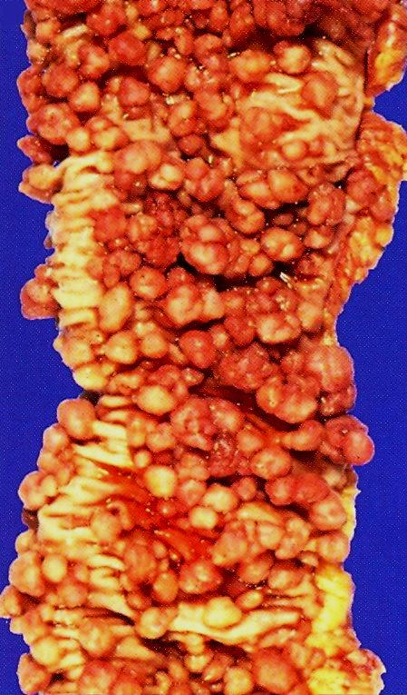
Notes:
It is caused by mutations of the adenomatous polyposis coli , or APC gene .

Slide 24
Colon carcinoma

Slide 25
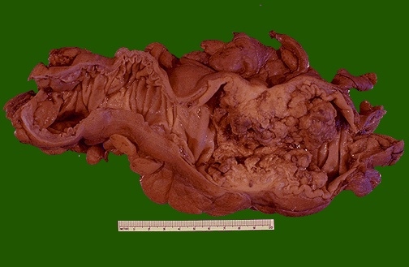
Organ: Colon Dx: adenocarcinoma

Slide 26
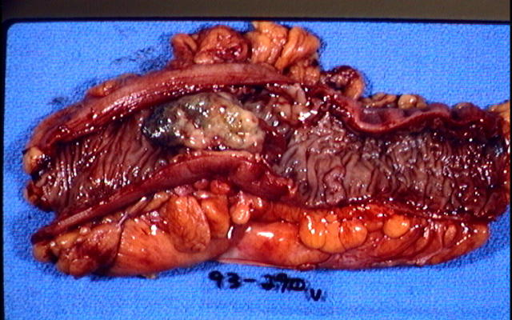

Slide 27


Slide 28
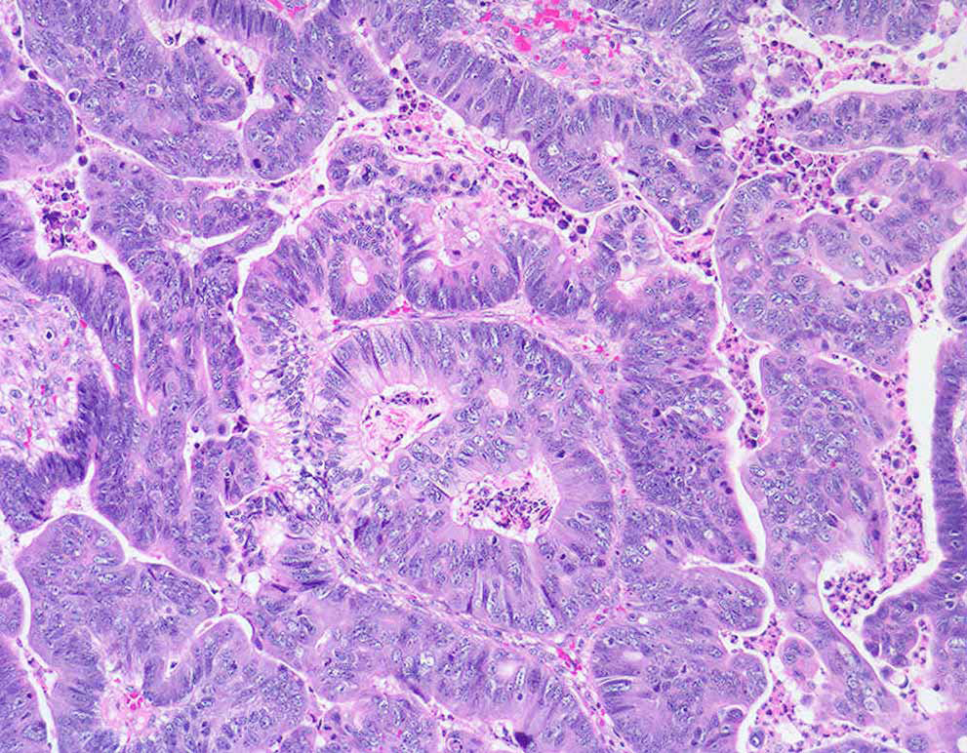

Slide 29


Slide 30
Adenocarcinoma of the large intestine:
Section of large intestine shows:
A tumour mass at one end, and a normal mucosa on the other side:
Tumour consists of crowded irregular malignant acini separated by thin fibrovascular stroma.
The acini are lined by one or several layers of neoplastic cells with papillary projection showing pleomorphism, hyperchromatism and few mitoses.
Muscle coat is invaded by neoplastc glands.

