Slide 1
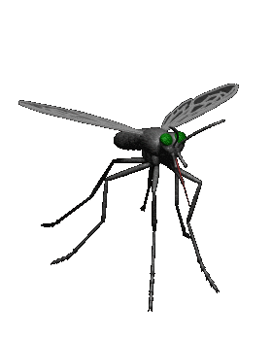
Antiprotozoal /Antimalarial drugs
Dr. Osama
Dr. Aliah

Slide 2
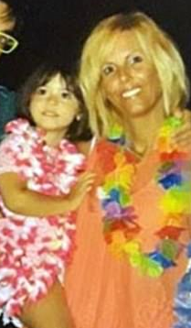
Mysterious & puzzling case of malaria
Sofia Zago died of cerebral malaria after developing a fever & slipping into a coma last September in north Italy
Sofia had NOT travelled to any at-risk countries
World Health Organization declared Italy free of malaria in 1970
Sofia did NOT have blood transfusion recently

Slide 3

How did sofia contract malaria?
Could it be transmitted from immigrants?
Malaria is not transmitted from person to person
Could climate change to blame for the first-home grown case in 50 years ?
With global climate change, the potential for the reappearance of malaria in countries where it was previously eradicated exists, but is relatively small.
Could a re-used needle at the hospital where she was treated to blame?
Could the disease-carrying mosquitoes arrived by plane in people’s suitcases?

Slide 4
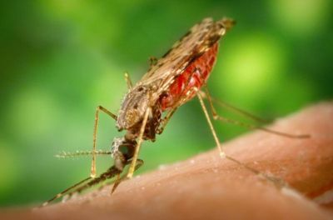
Antimalarial drugs
ilos
Classify the main antimalarial drugs depending on their goal of therapy
Detail the pharmacokinetics & dynamics of main drugs used to treat attack or prevent relapses
State the WHO therapeutic strategy for treatment
Hint on the CDC recommendations for prophylaxis in travelers to endemic areas.

Slide 5
According to WHO:
212 million cases of malaria worldwide in 2015 & 429,000 deaths.
90% of malaria cases & deaths occur in Africa.
Children under 5 are most at risk.
Four species of plasmodium typically cause human malaria:
Plasmodium falciparum,
P vivax,
P malariae, and
P ovale.

Slide 6
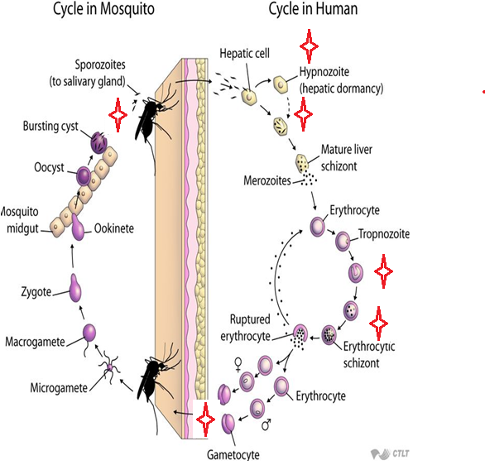
Cycle & Drugs site
of action
Causal
prophylaxis
Radical
cure
Clinical
cure
Supressive
prophylaxis
Sporozoitocides
Gametocides

Slide 7
Antimalarial drugs
Therapeutic classification:
Causal prophylaxis
Destroys parasite in liver cells & prevent invasion of erythrocytes
Primaquine
Suppressive prophylaxis
Suppresses the erythrocytic phase & thus attack of malaria fever
Chloroquine, mefloquine, doxycycline

Slide 8
Antimalarial drugs
Therapeutic classification:
Radical cure
Clinical cure (Erythrocytic schizonticide)
Used to terminate an episode of malarial fever
Eradicate all forms of vivax from the body
Suppressive drug + hypnozoitocidal
Chloroquine, quinine, mefloquine, artemisinin
Fast acting high efficacy
Destroys gametocytes & prevent transmission
Chloroquine, quinine against vivax
Gametocidal
Primaquine, all species
Pyrimethamine, proguanil, sulfonamides
Slow acting low efficacy
Destroys sporozoites
Proguanil, pyrimethamine
Sporozoitocides

Slide 9
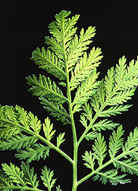
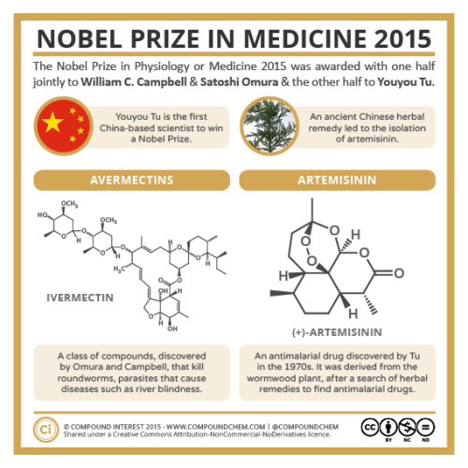
artemesinin
  Artemisinin is the active principle of the plant Artemisia annua (qinghaosu)
  Fast acting blood Schizontocide
Affect all forms including multi-drug resistant P. falciparum
  Short duration of action
  High recrudescence rate after short-course therapy
  Poorly soluble in water & oil, can only be used orally.

Slide 10
pharmakokinetics
Rapidly biotransformed in liver into di-hydroartesimininactive metabolite
Artemisinin, artesunate, artemether are prodrugs
Derivatives are rapidly absorbed orally & Widely distributed
Artemisinin t½  4 hrs
Artesunate t½ 45 min (water-soluble; oral, IV, IM, rectal administration)
Artemether t½ 4-11 hrs, (lipid-soluble; oral, IM, & rectal administration). Induce its own CYP-mediated metabolism→ ↑ clearance 5 fold.

Slide 11
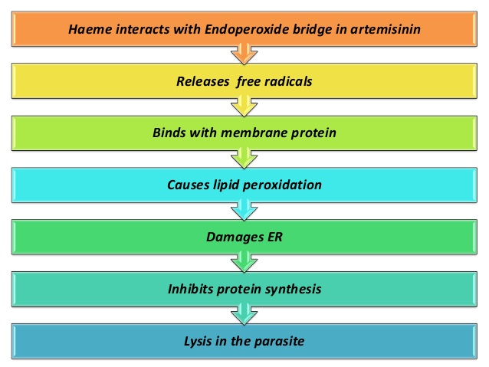
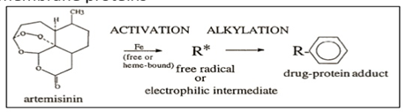
Artemesinin & its derivatives
mechanism
Artemisinin & its analogs are very rapidly acting blood schizonticides against all human malaria parasites. No effect on hepatic stages.
They have endoperoxide bridges
Haem iron cleaves this bridge to yield carbon- centered free radicals in parasite, that will
Alkylate membranes of parasite’s food vacuole & mitochondria no energy
Irreversibly bind & inhibit sarco-endoplasmic reticulum Ca²⁺-ATPase of the parasite, thereby inhibiting its growth
Inhibiting formation of transport vesicles no food vacuoles.

Slide 12
artemesinin
Clinical uses
Because artemisinin derivatives have short t½,
Monotherapy should be extended beyond disappearance of parasite to prevent recrudescence or
by combining the drug with long- acting antimalarial drugs (Ex. mefloquine)
preparations
Artesunate IV or IM preparations for severe complicated cases as cerebral malaria (24 h) followed by complete course of ACT.

Slide 13
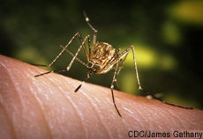
artemesinin
preparations
Artemisinin-based combination therapies (ACTs):
  Artemether + lumefantrine
  Artemether + amodiaquine
  Artemether + mefloquine
  Artemether + sulfadoxine- pyrimethamine.

Slide 14
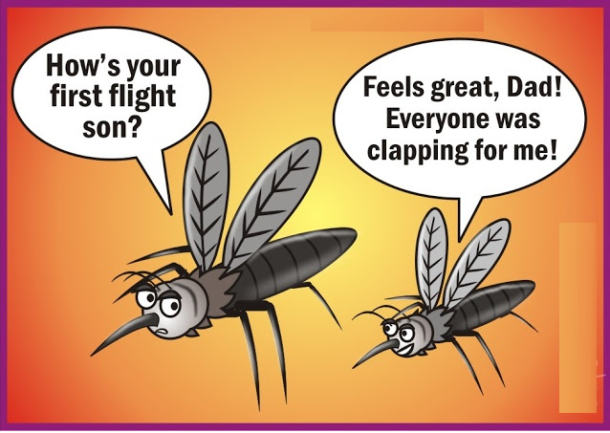
artemesinin
ADRs
Transient heart block
↓ Neutrophil count (rare)
Brief episodes of fever
Resistance  was reported recently in Cambodia- Thailand border.

Slide 15
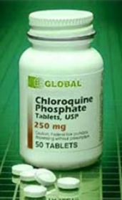
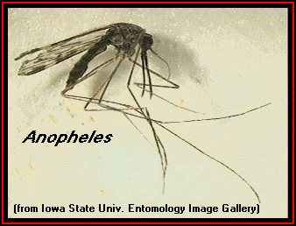
Antimalarial drugs
chloroquine
Potent blood Schizontocide
Active against all forms of the schizonts (exception is chloroquine-resistant P.f. & P.v.)
Not active against tissue shizonts
  Gametocide:-Against all species except P. falciparum.

Slide 16
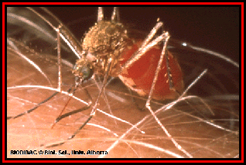
chloroquine
pharmacokinetics
  Rapidly & completely absorbed from the GIT, given po
  Has high volume of distribution (100-1000 L/kg); Released slowly from tissues & metabolized in liver
Concentrated into parasitized RBCs
  Excreted in the urine 70% unchanged
  Initial t½ = 2-3 days & terminal elimination t½=1-2 months.

Slide 17
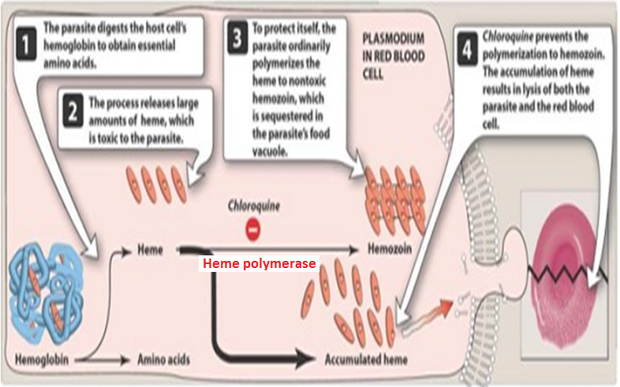
chloroquine
Mechanism of action
Malaria Parasite digest host cell’s Hb to utilize globin & obtain amino acids
Heme is released  Toxic
So parasite detoxifies it by heme polymerase  Hemozoin (NonToxic) & traps it in food vacuoles.

Slide 18
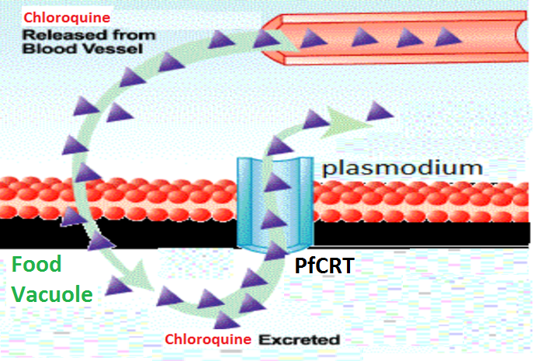
chloroquine
resistance
Resistance against the drug develops as a result of mutation of the chloroquine resistance transporter (PfCRT)
PfCRT enhances the efflux of chloroquine from the food vacuole.

Slide 19
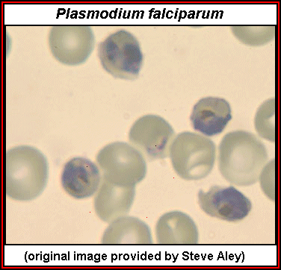
chloroquine
Therapeutic uses
Used to eradicate blood schizonts of Plasmodium. It is given in loading dose to rapidly achieve effective plasma conc.
Hepatic amebiasis
Rheumatoid arthritis.

Slide 20

chloroquine
adrs
Mild headache & visual disturbances
GIT upsets; Nausea, vomiting
Pruritus, urticaria.
Prolonged therapy & high doses:
Ocular toxicity: Loss of accommodation, lenticular opacity, retinopathy
Ototoxicity
Weight loss
Bolus injection→ hypotension & dysrrhythmias
Safe in pregnancy

Slide 21
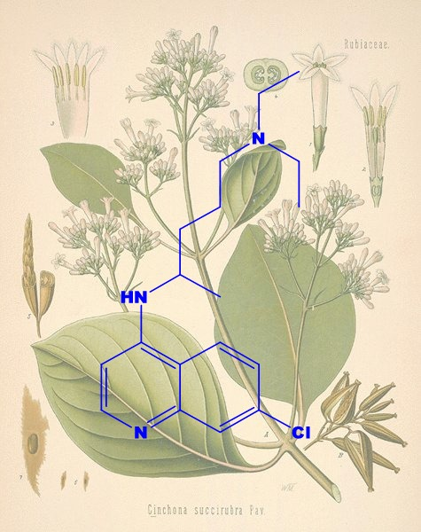
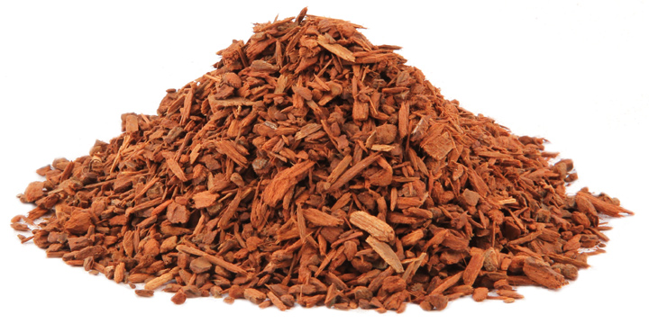
QUININE
  The main alkaloid in cinchona bark
  Potent blood Schizontocide of ALL malarial parasites & gametoside for P vivax & ovale but not falciparum. It is Not active against liver stage parasites.
  Depresses the myocardium, reduce excitability & conductivity
  Mild analgesic, antipyretic, stimulation of uterine smooth muscle, curare mimetic effect.

Slide 22
QUININE
pharmacokinetics
  Rapidly & completely absorbed from the GIT
  Peaks after 1-3 hours
  Metabolized in the liver & excreted in urine
  5-20% excreted in the urine unchanged
  t½ = 10 hrs but longer in sever falciparum infection (18 hrs)
  Administered: orally in a 7 day course or by slow IV for severe P. falciparum infection.

Slide 23
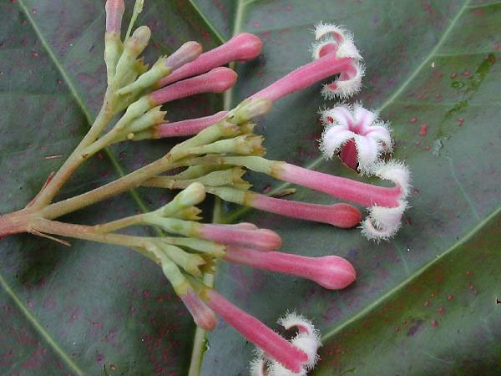
quinine
Mechanism
Same as chloroquine
Mechanism of resistance
Like chloroquine, by mutation of chloroquine resistance transporter, also increased expression of P-glycoprotein transporter.

Slide 24
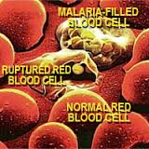
quinine
Clinical uses:
Parenteral treatment of severe falciparum malaria
Oral treatment of falciparum malaria
Nocturnal leg cramps.

Slide 25
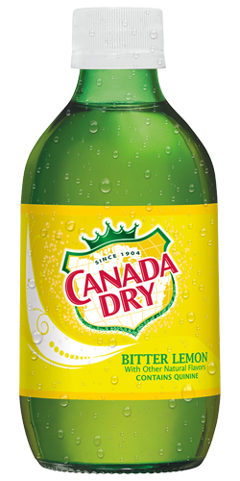
quinine
adrs
With therapeutic dose  poor compliance  bitter taste
Higher doses 
  Cinchonism  (tinnitus, deafness, headaches, nausea & visual disturbances)
  Abdominal pain & diarrhea
  Rashes, fever, hypersensitivity reactions
  Hypotension & arrhythmias, hypoglycemia
  Blood dyscarasis; anaemia, thrombocytopenic purpura & hypoprothrombinaemia (mild)
  Blackwater fever, a fatal condition in which acute haemolytic anaemia is associated with renal failure due to a hypersensitivity reaction to the drug
IV  neurotoxicity  tremor of the lips & limbs, delirium, fits, stimulation followed by depression of respiration & coma.
Safe in pregnancy

Slide 26
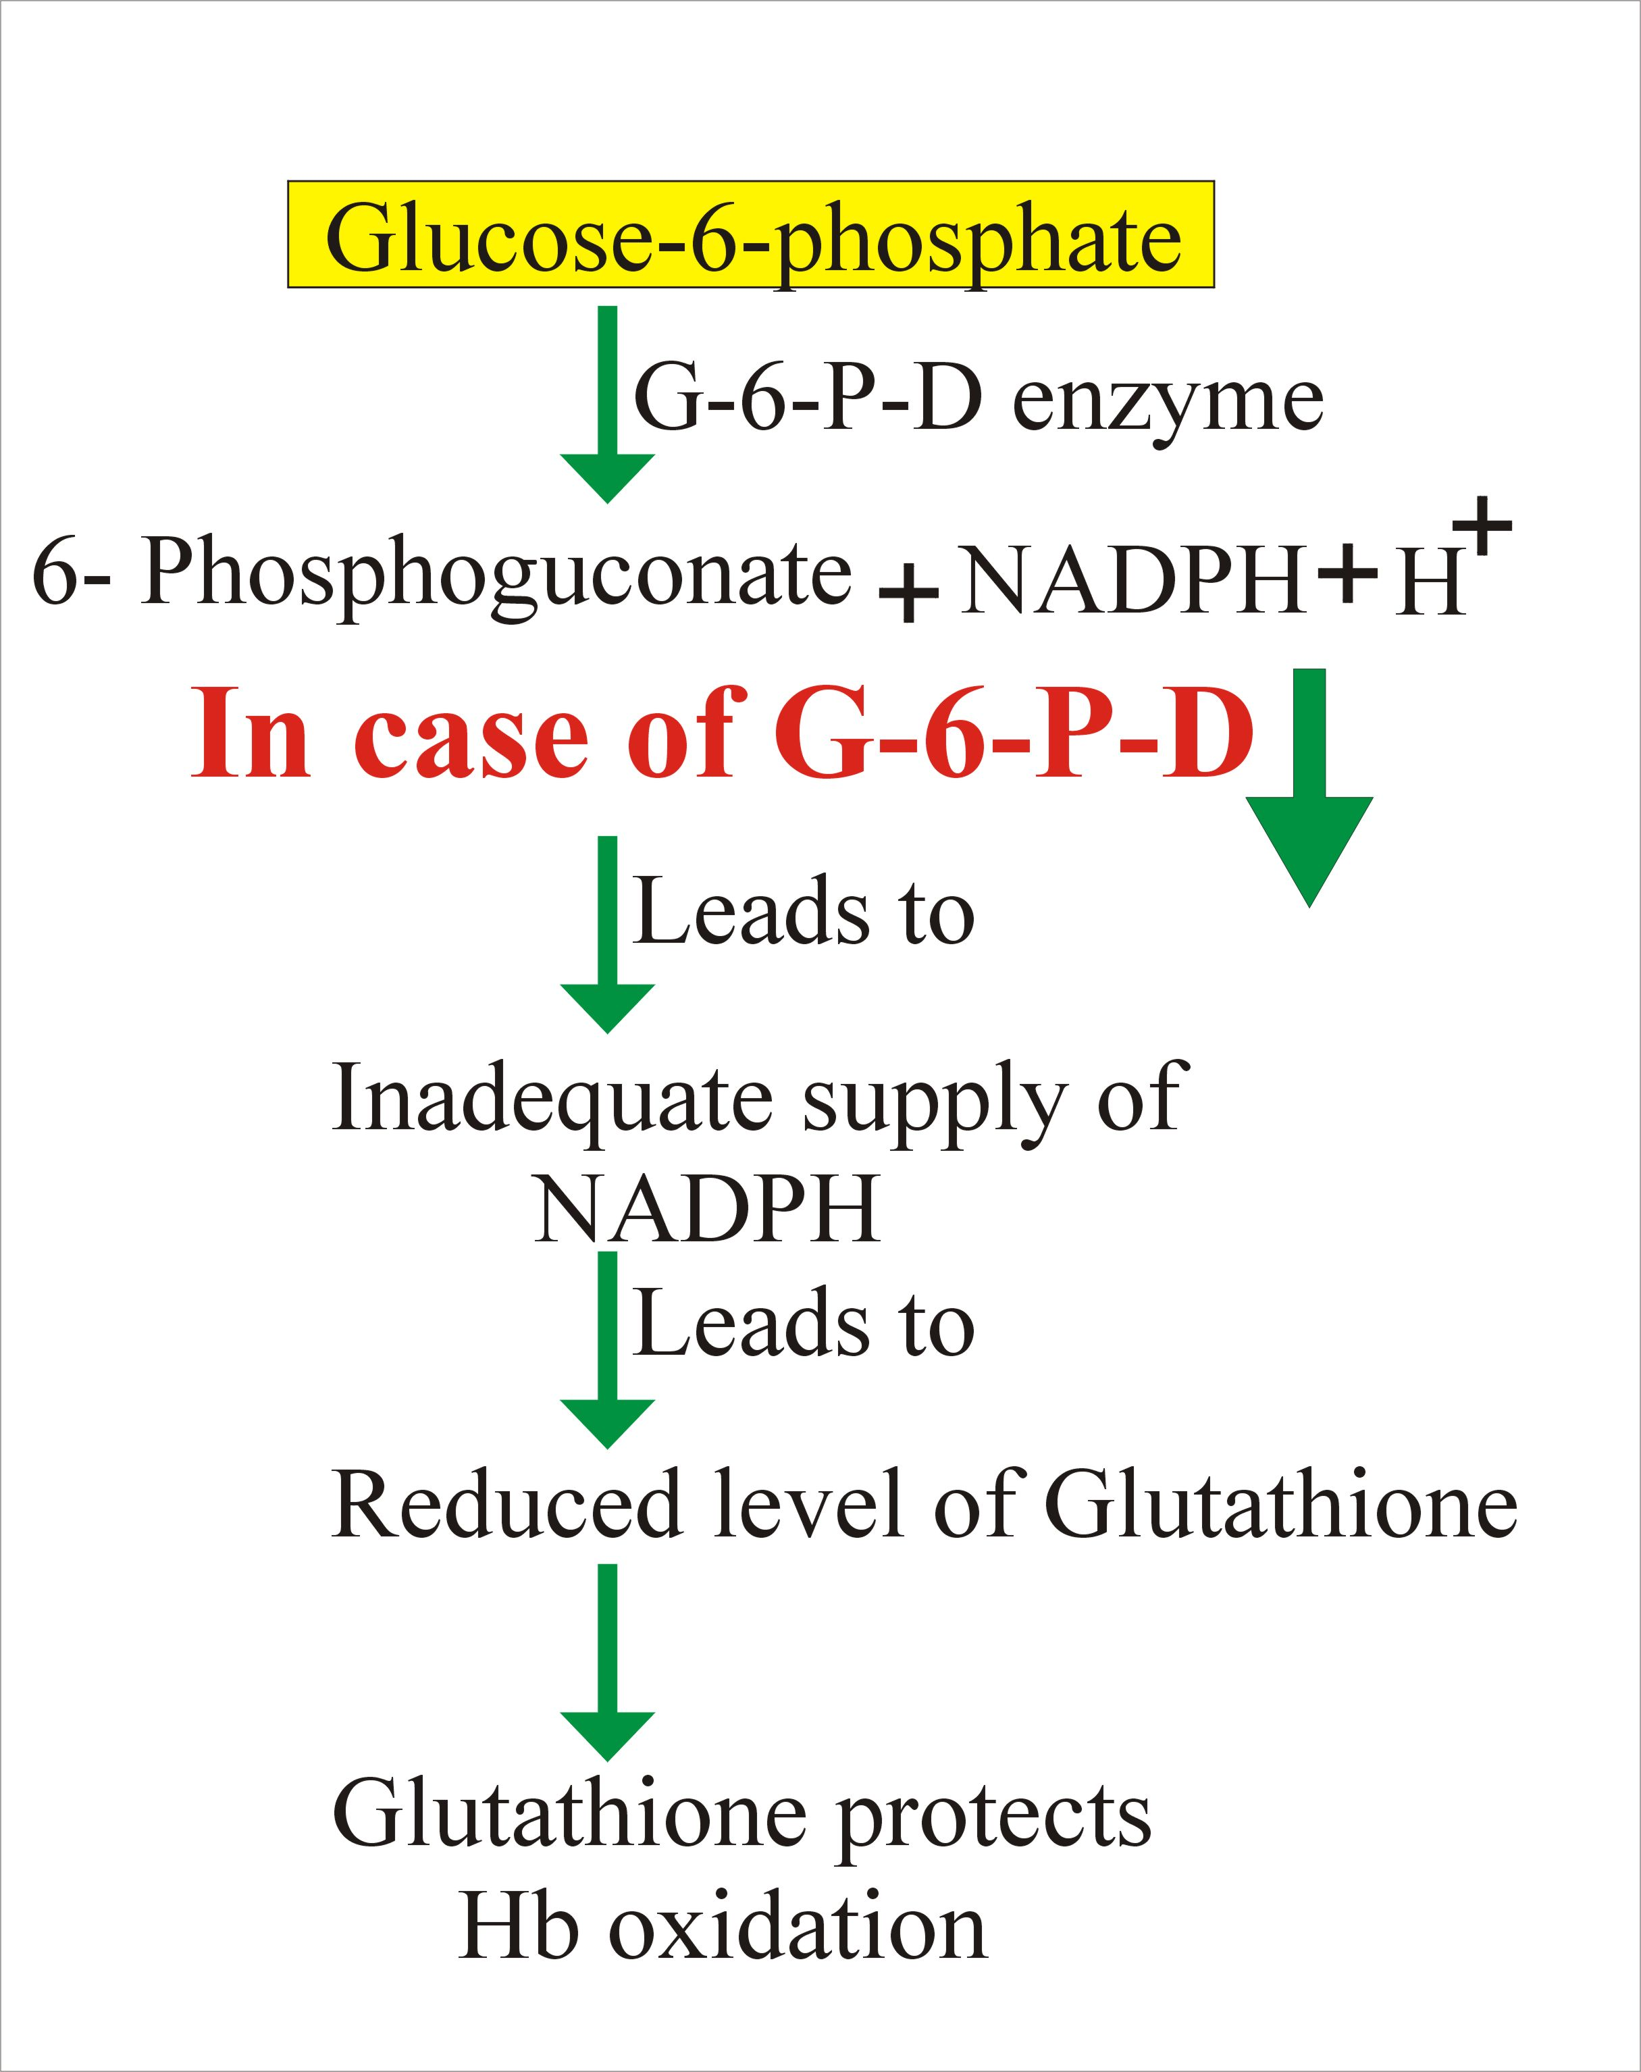
quinine
contraindications
Prolonged QT Interval
Glucose-6-Phosphate Dehydrogenase deficiency & pregnancy
Myasthenia Gravis
Hypersensitivity
Optic Neuritis, auditory problems
Dose should be reduced in renal insufficiency.

Slide 27
quinine
Drug interactions
Antacids: Antacids containing aluminum &/or magnesium may delay or decrease absorption of quinine
Mefloquine
Quinine can raise plasma levels of warfarin & digoxin.

Slide 28
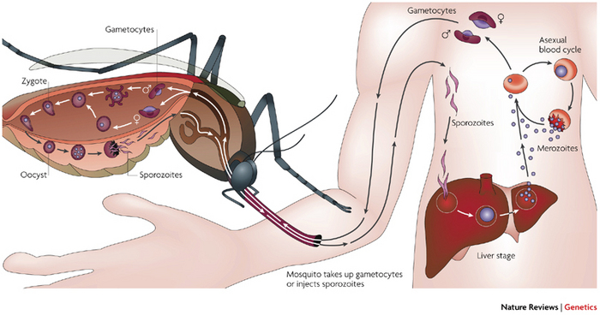
primaquine
  Hypnozoitocides against liver hypnozoites & gametocytocides against the 4 human malaria species
  Radical cure of P. ovale & P. vivax
  Prevent spread of ALL forms (chemoprophylaxis)
pharmacokinetics
  Well absorbed orally
Rapidly metabolized to etaquine & tafenoquine  more active forms
t½  3-6 h.

Slide 29
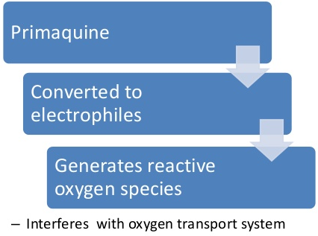
primaquine
mechanism
Not well understood, It may be acting by:-
Generating ROS  can damage lipids, proteins & nucleic acids in the parasite
Interfering with the electron transport  no energy
Inhibiting formation of transport vesicles no food vacuoles
Resistance;  Rare when primaquine & chloroquine are combined.

Slide 30
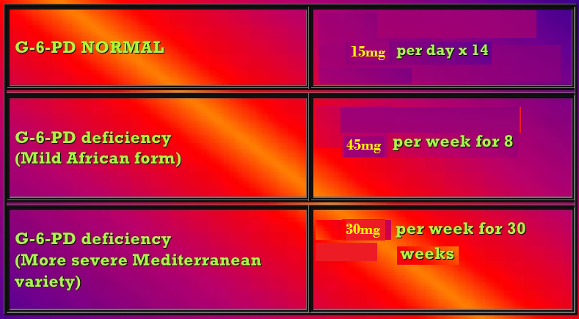
Antimalarial drugs
primaquine
Clinical uses
Radical cure of relapsing malaria, 15 mg/day for 14 days
In falciparum malaria: a single dose (45 mg) to kill gametes & cut down transmission
Should be avoided in pregnancy (the fetus is relatively G6PD-deficient & thus at risk of hemolysis) & G6PD deficiency patients

Slide 31
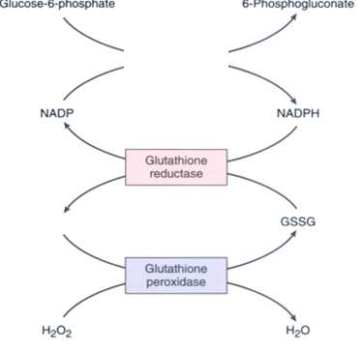
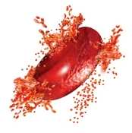
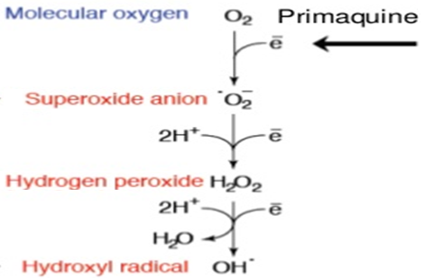
primaquine
adrs
At regular doses  patients with G-6-PD deficiency  hemolytic anemia.
Oxidation of primaqune produces free radicals
G6PD
Free radicals will cause oxidative damage of RBCs →Hemolysis
At larger doses 
Epigastric distress & abdominal cramps
H₂O₂ oxidizes GSH
Mild anemia, cyanosis & methemoglobinemia
GSH
Severe methemoglobinemia  rarely in patients with deficiency of NADPH methemoglobin reductase
Maintains integrity of RBCs
Granulocytopenia & agranulocytosis  rare.

Slide 32
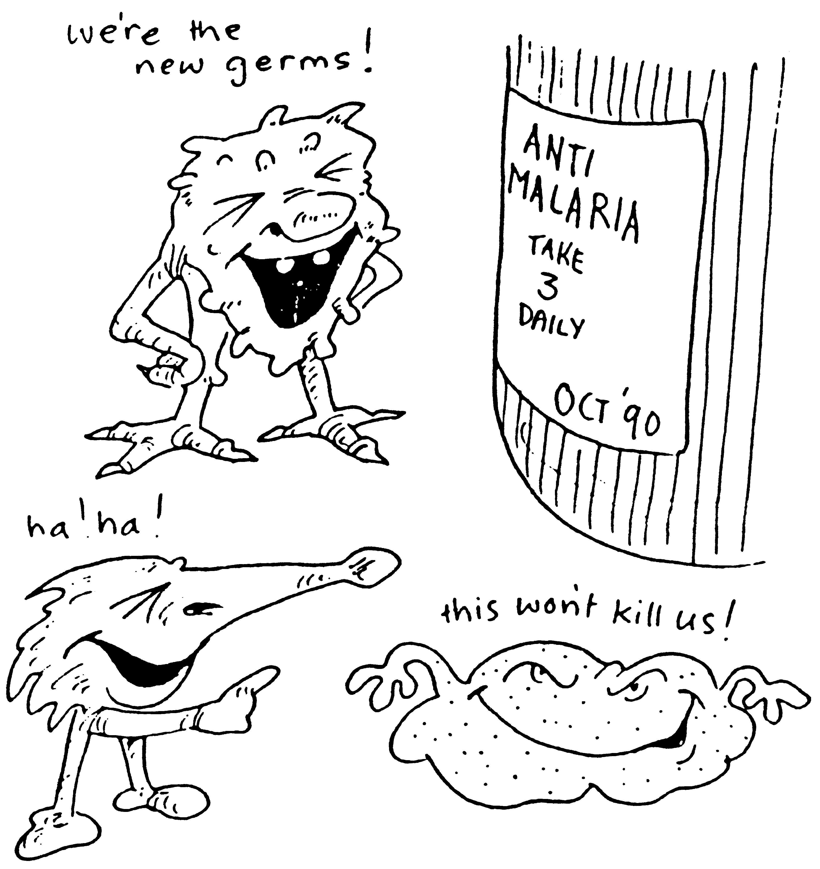
Who treatment guidelines
In P vivax
sensitive
Chloroquine for 3 days followed by Primaquine for 14 days
In P falciparum
All show Resistance
resistant
ACT / 3 days followed by Primaquine for 14 days
uncomplicated
ACT
complicated
IV Artesunate for 24 hrs followed by ACT
Or Artemether + [Clindamycin / doxycycline]
Or Quinine + [Clindamycin / doxycycline]

Slide 33
Who treatment guidelines
In falicparum
Special risk groups
Pregnancy; 1st trimester
Quinine + Clindamycin (7 days)
Pregnancy; 2nd & 3rd trimester
Lactating women
Infants & young children
ACT

Slide 34
Prophylaxis in travellers
Cdc recomendations
Chloroquine
Areas without resistant P falciparum
Mefloquine
Areas with chloroquine-resistant P falciparum
Doxycycline
Areas with multidrug-resistant P falciparum
Begin 1-2 weeks before departure (except for doxycycline 2 days) & continue for 4 weeks after leaving the endemic area.

Slide 35
