Slide 2
Objectives
By the end of this lecture the student should be able to:
Describe the anatomy of the parotid gland: position, shape, structures within it , innervation and parotid duct.
Describe the anatomy of the submandibular and sublingual salivary glands: location, shape, parts, ducts and innervation of the glands.

Slide 3
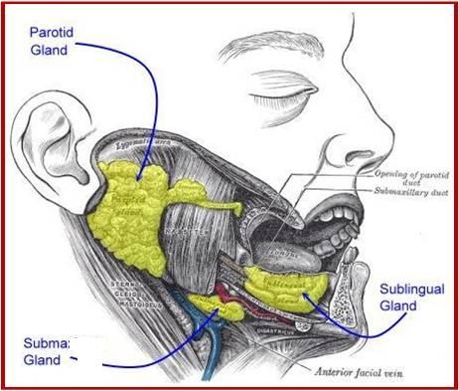
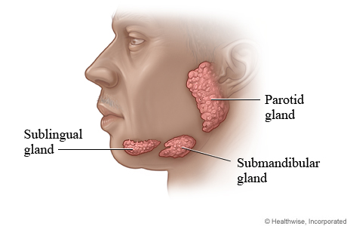
Salivary glands
Are exocrine glands, that produce saliva.
There are 3 large named pairs of salivary glands and multiple minute unnamed glands in the submucosa of the oral cavity (lips, palate & under surface of the tongue).
The three NAMED PAIRS are:
Parotid(biggest): | produces a serous watery secretion.
Submandibular: | produces a mixed serous & mucous secretion.
Sublingual: | secretes saliva that is predominantly mucous in character.
EXTRA

Slide 4
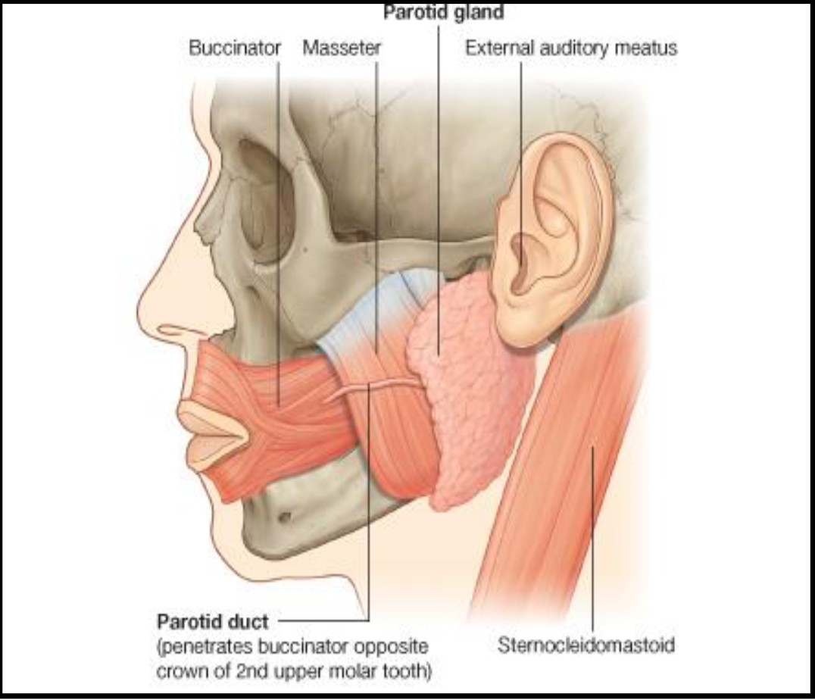
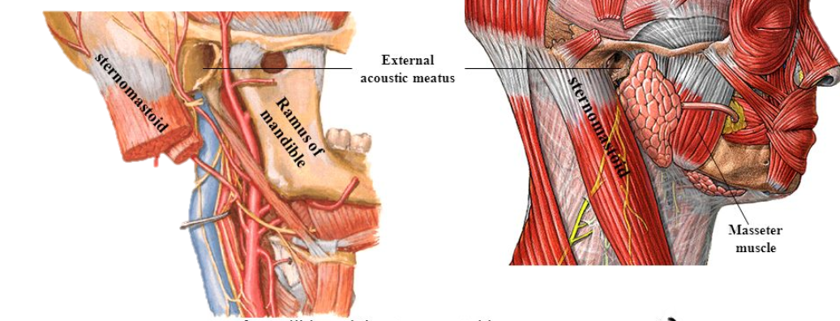
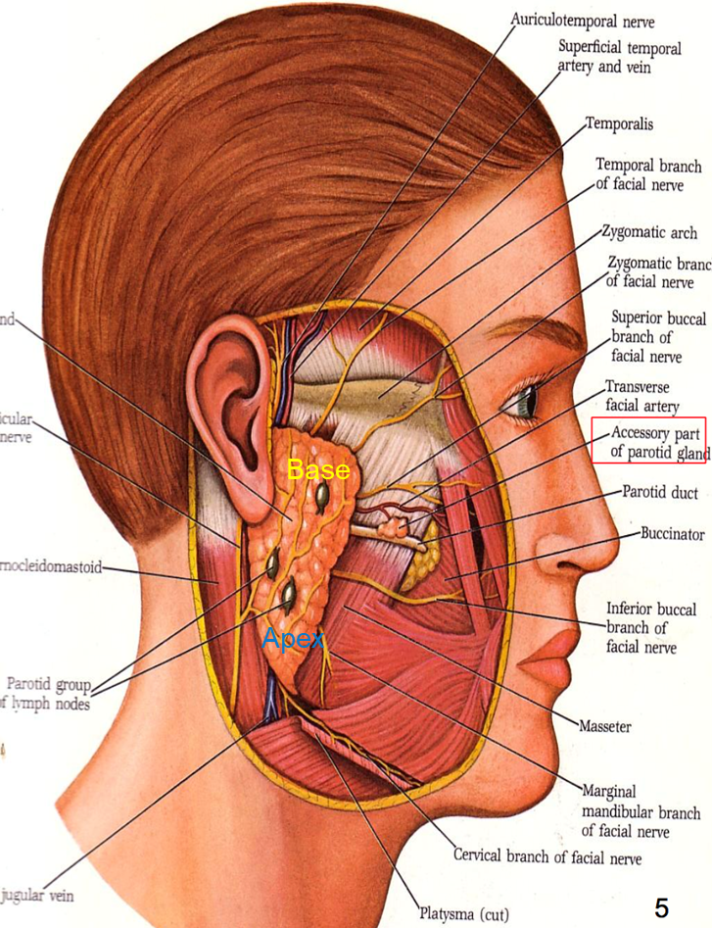
Parotid gland
Parotid Gland
It is the largest salivary gland formed entirely of serous acini.
It has 3 surfaces :
1- Superficial 2- Anteromedial 3- Posteromedial
Accessory part:
A small part that is separated from the main gland.
Capsule of the parotid gland: tight, derived from cervical fascia of the neck.
We have:
True capsule → from the fibrous tissue of the gland
False capsule → from deep cervical fascia
Position: Gland wedged between
Anteriorly: mandibular ramus & masseter + medial pterygoid (the parotid gland is behind them)
Posteriorly: Mastoid process & sternomastoid muscle + posterior belly of digastric (the parotid gland is in front of them)
هي تكون في الوسط وفوقها شيء وتحتها شيء زي السندويتس
Shape: Triangular and has:
Apex (lower end): behind angle of the mandible
Base (concave upper end): directed upward just below the
zygomatic arch, external auditory meatus &TMJ. (temporomandibular joint).

Slide 5
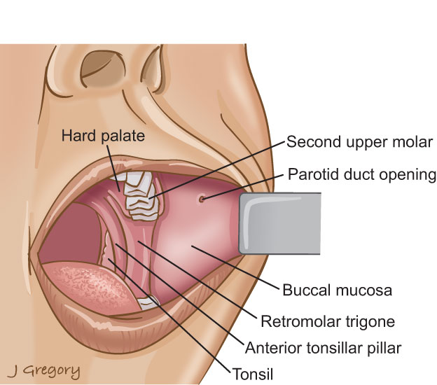
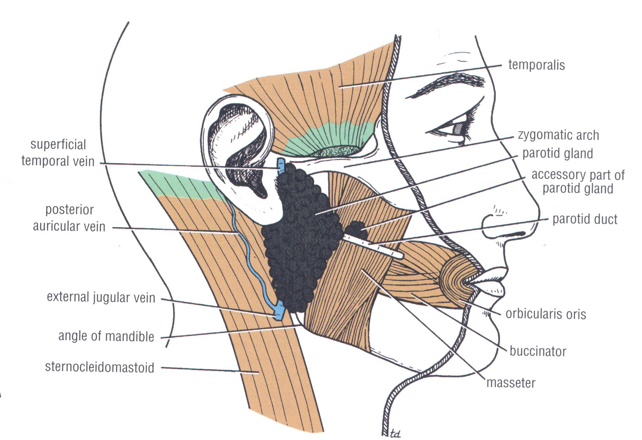
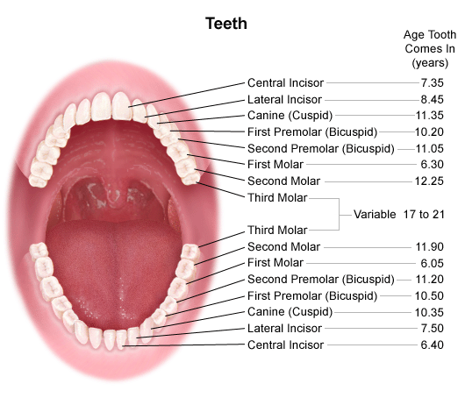
Parotid Gland Parotid Duct (of Stensen):
It opens into the vestibule of the mouth on a small papilla, opposite the upper second molar (maxillary) tooth.
Parotid duct 5 cm long, runs on the masseter muscle, then it pierces buccal pad of fat & buccinator muscle.
Extra

Slide 6
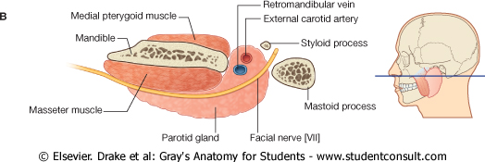
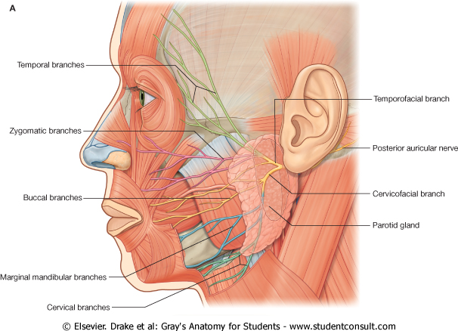
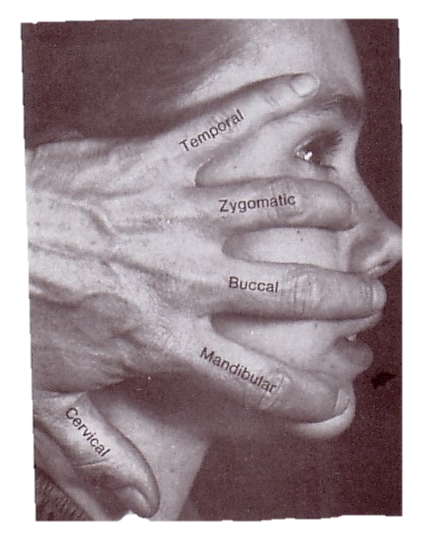
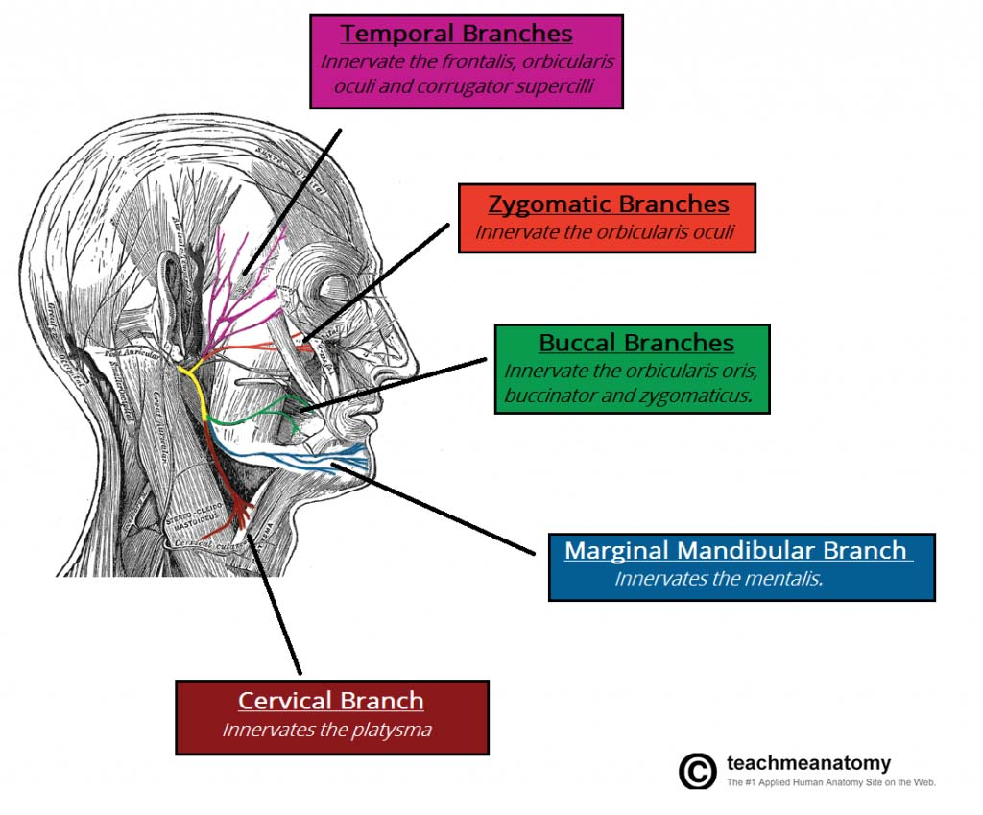
Structures within Parotid Gland
From superficial to deep OR lateral to medial (horizontal section)
(you have to know both)
1. Facial Nerve (motor supply)
most superficial structure
2. Retromandibular vein
intermediate in position
3. External Carotid artery
Most deep
Very important Note: the sequence from outside to inside is (Nerve, vein, artery)
The facial nerve it divides the gland into superficial & deep parts.
TWO Branches before it enters the gland to supply two muscles (posterior belly of digastric and stylohyoid)
In the exam you might have a question about the structures found in the gland, so it is important to know them
FIVE (terminal) Branches within the parotid which leave anteromedial suface of the gland:
1- Temporal
2- Zygomatic
3- Buccal
4- Mandibular
5- Cervical.
Muscles of the face
Extra

Slide 7
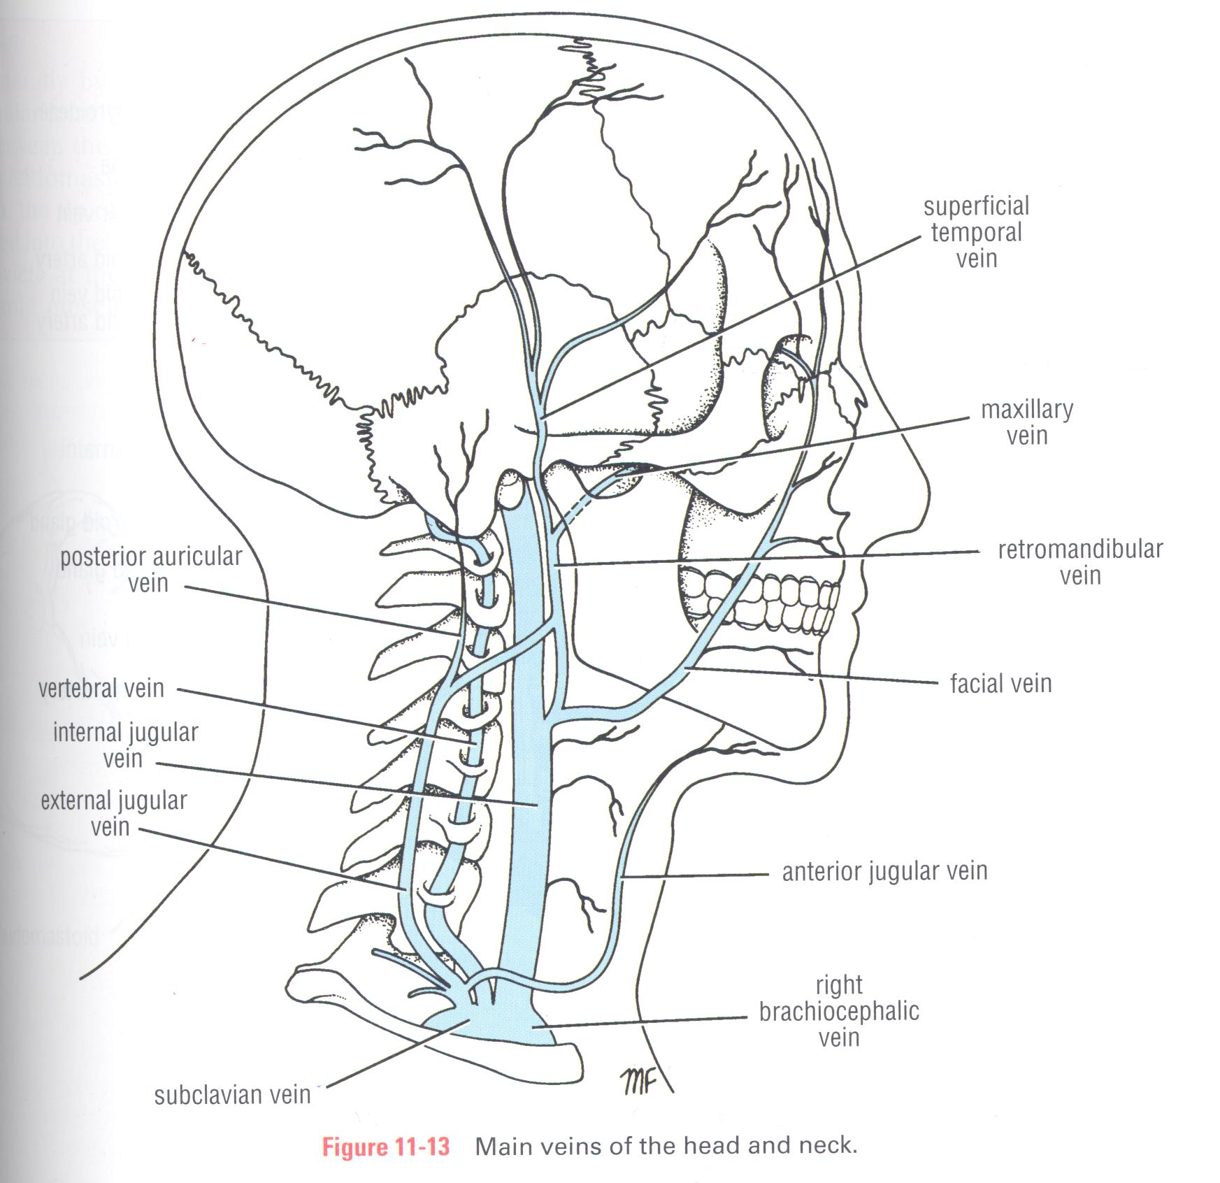
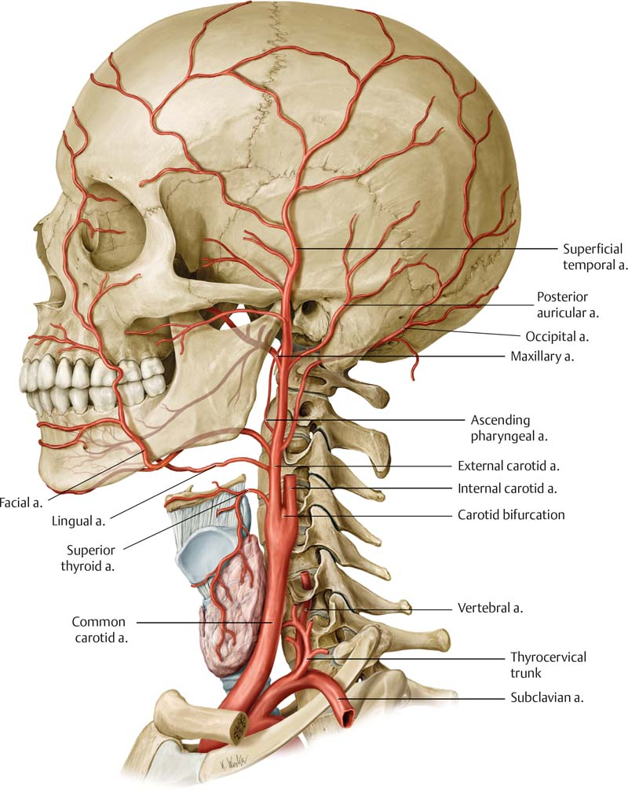
Structures within Parotid Gland
From superficial to deep OR lateral to medial (horizontal section)
(you have to know both)
1. Facial Nerve
most superficial structure
2. Retromandibular vein
intermediate in position
3. External Carotid artery
Most deep (most medial)
Formed by the union of maxillary & superficial temporal veins.
Before it leaves the gland it is divided into 2 division/branches:
anterior (join the facial vein and form the common facial vein)
Posterior (join the posterior auricular and form the external jugular )
It is divided into its 2-terminal branches maxillary and superficial temporal arteries. (within the gland)
Extra

Slide 8
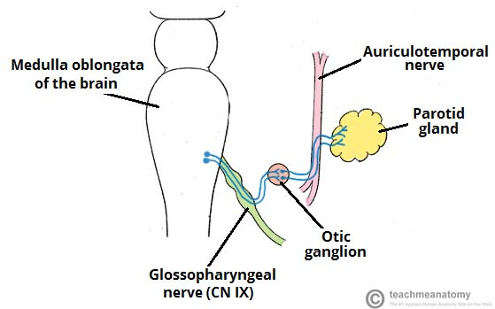
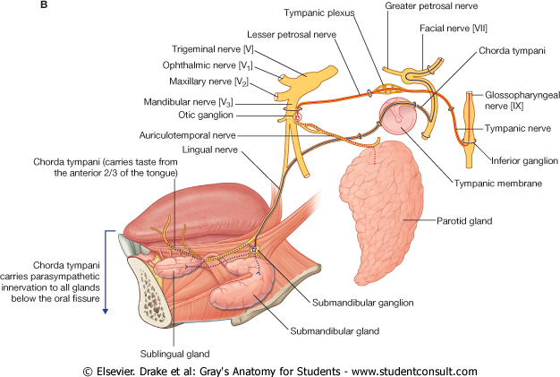
Parotid Gland Nerve supply and lymphatic drainage
Inferior salivary nucleus → to parotid gland
Superior salivary nucleus → to sublingual and submandibular
Extra
Parasympathetic (secretomotor):
from inferior salivary nucleus (of 9th cranial nerve “glossopharyngeal nerve” in medulla oblongata) → via its branch: tympanic nerve → forms tympanic plexus in middle ear → then via lesser petrosal nerve (preganglionic fibers) to otic ganglion
The postganglionic fibers running in auriculotemporal nerve supply the parotid gland.
Sympathetic:
from plexus around external carotid artery.
Lymphatic:
parotid lymph nodes which finally drain into upper group of deep cervical lymph nodes.

Slide 9
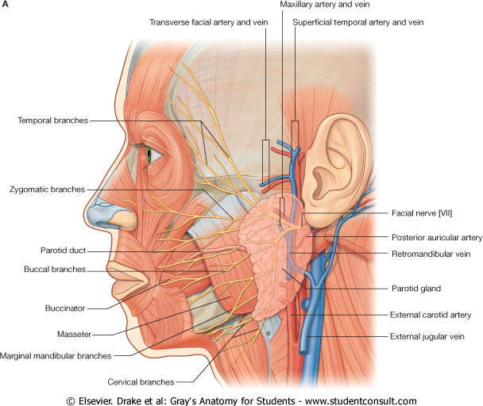
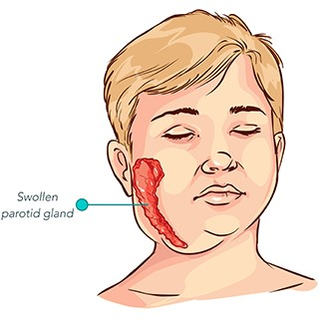
Parotid Gland Blood supply
*Arterial supply:
external carotid artery + its branches (superior temporal and maxillary)
*Venous drainage:
into the retromandibular vein.
Clinical Notes:
1- Parotid gland infection: Mumps
viral disease caused by the mumps virus.
Initial signs and symptoms often include fever, muscle pain, headache, poor appetite, and feeling tired.
This is then usually followed by painful swelling of one or both parotid salivary glands.
In adults
About two to three out of every 10 adolescent or adult men who have mumps may experience painful swelling of the testicles.
Extra

Slide 10
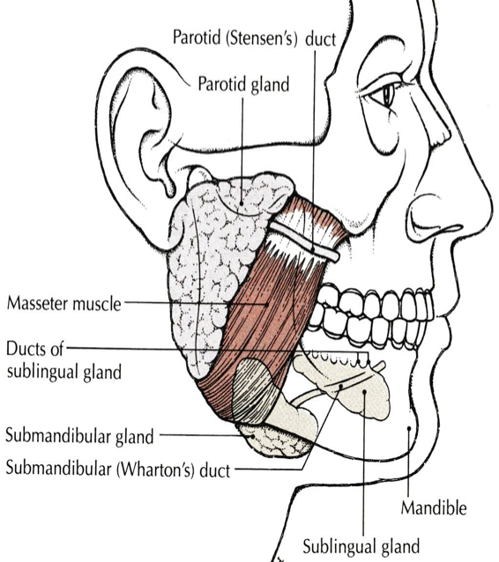
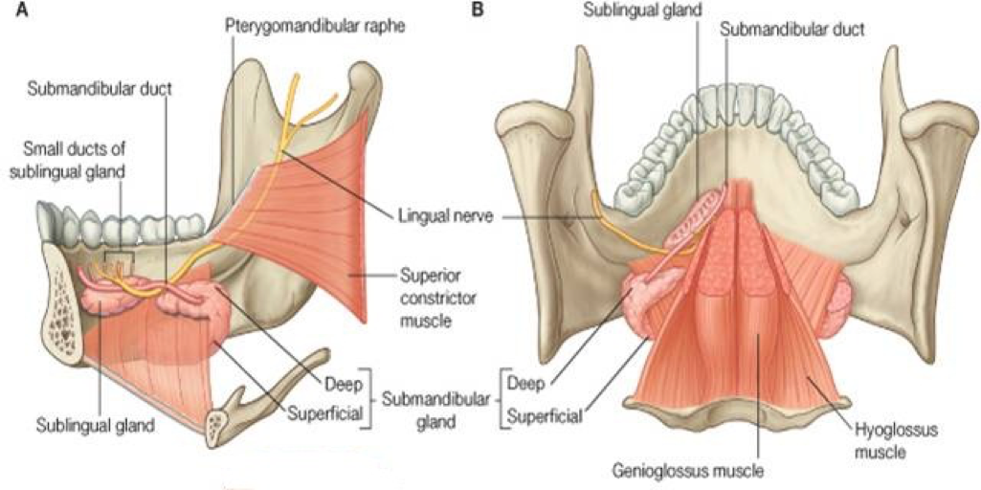
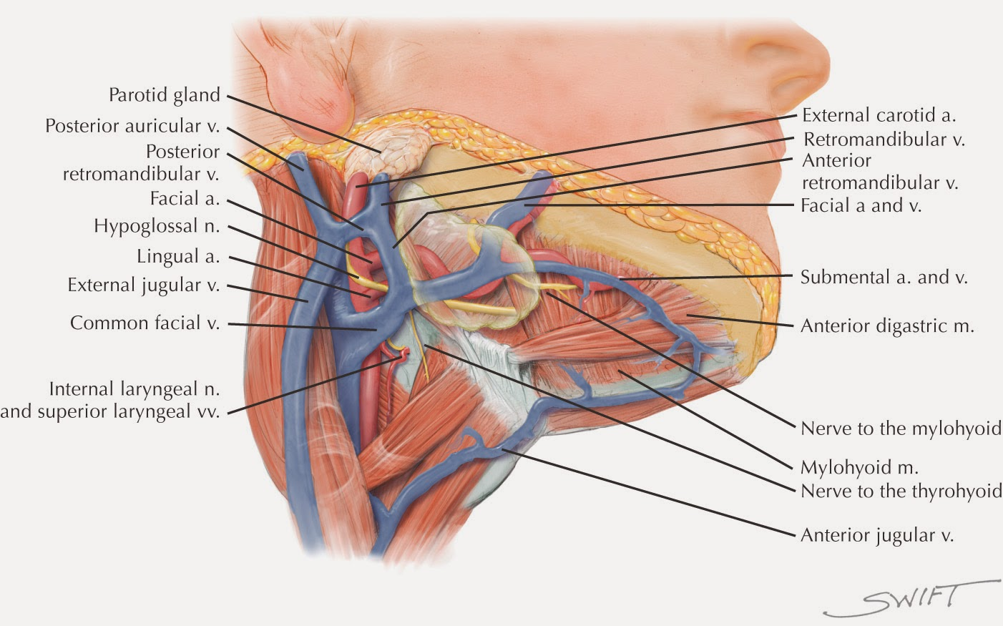
Submandibular Gland
located deep to the body of the mandible.
Formed of two parts:
Large Superficial Part
Small Deep Part
Both parts continuate around the mylohyoid muscle
Supply
Arterial supply:
Facial artery.
Venous drainage:
Facial vein.

Slide 11
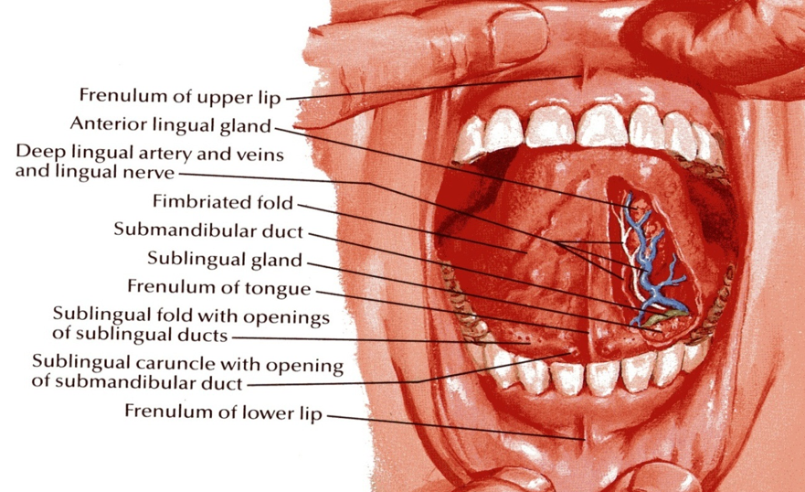
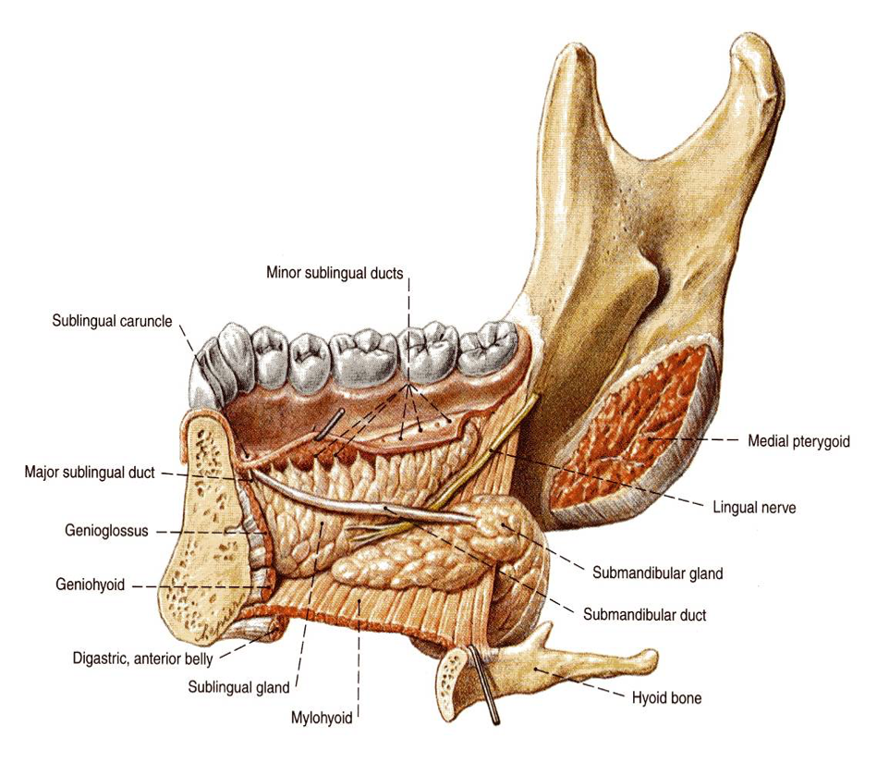
Submandibular Gland Submandibular Duct
The duct emerges from the deep part of the gland.
It passes forward along the side of the tongue, under the mucous membrane of the floor of the mouth.
It is crossed laterally by the lingual nerve.
It opens into floor of mouth on the summit (highest point) of a small sublingual papilla (the sublingual caruncle*), which lies at the side of the frenulum of the tongue.
Clinically, it is important to remember that the submandibular duct can be palpated through the floor of the mouth alongside the tongue.
Saliva can usually be seen emerging from the orifice of the duct.
* Sublingual caruncle: an eminence on either side of the frenulum of the tongue, on which the major duct of the sublingual gland and the duct of the submandibular gland open.

Slide 12
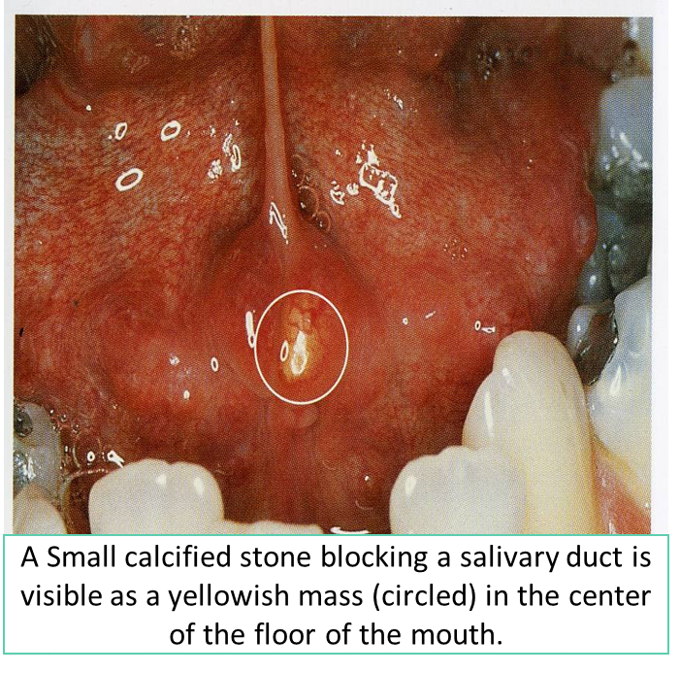
Submandibular Duct
Clinical Note
1. Calcus Formation
The submandibular duct is a common site of calculus formation.
The presence of a tense swelling below the body of the mandible, which is greatest before or during a meal and is reduced in size or absent between meals, is diagnostic of the condition.
Clinically: examination of the floor of the mouth will reveal absence of ejection of saliva from the orifice of the duct of the affected gland + Frequently, the stone can be palpated in the duct, which lies below the mucous membrane of the floor of the mouth.

Slide 13
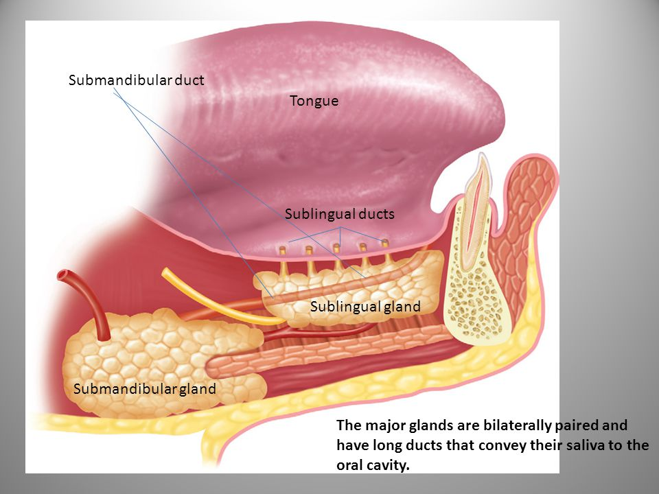
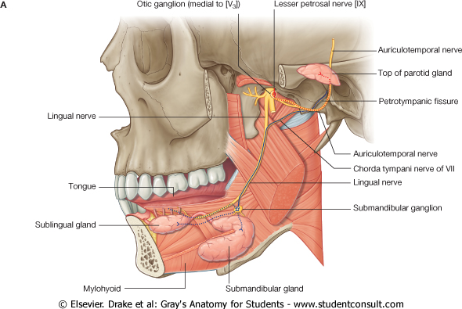
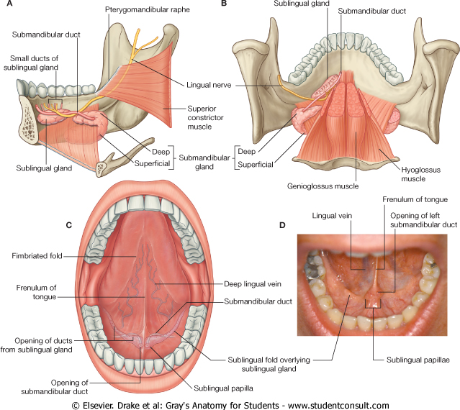
Sublingual Gland
Remember:
1- A ranula is a mucous a extravasation cyst (related to sublingual gland)
2- stones are mostly (related to submandibular)
3- Mumps is a swelling (related to the parotid)
Extra
Location:
Almond shaped
The smallest of the three main salivary glands.
It lies below the mucous membrane of the floor of mouth(between mylohyoid & side of the tongue), close to the midline.
Sublingual Ducts:
The sublingual ducts are 8 to 20 in number.
Most open into floor of mouth on the summit of the sublingual fold, but a few may open into the submandibular duct.
Clinical Note:
RANULA
It is a mucus extravasation cyst.
Involved sublingual gland
Found on the floor of the mouth.

Slide 14
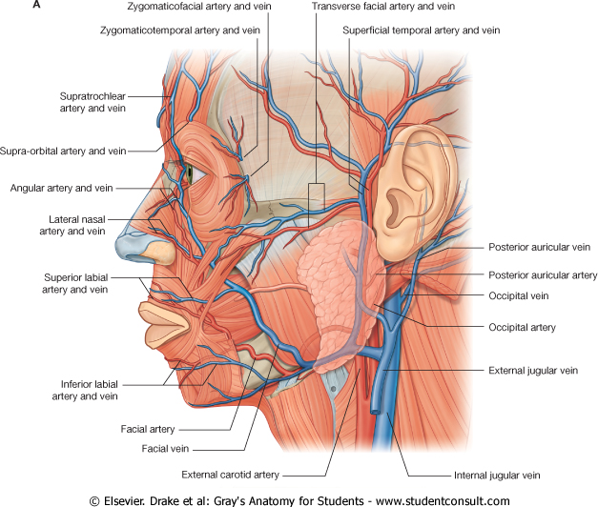
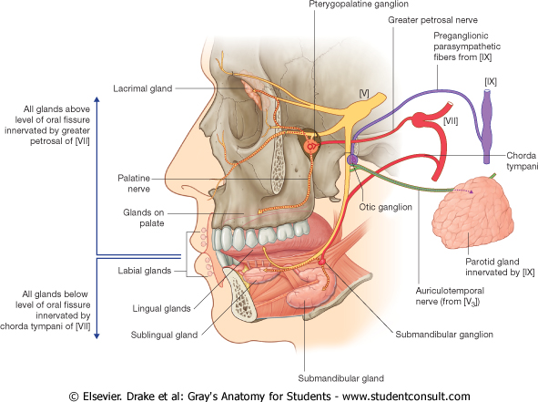
Sublingual Gland
Supply
Arterial supply:
Facial artery.(lingual branch)
Lymph drainage:
Submandibular lymph nodes.
Nerve Supply
Parasympathetic secretomotor supply is from
Preganglionic superior salivary nucleus of the facial (7th) nerve → The fibers pass to the submandibular ganglion via the chorda tympani nerve and the lingual nerve.
Postganglionic parasympathetic fibers reach the submandibular & sublingual glands either directly or along the duct.
Sympathetic: from plexus around facial artery.
Venous drainage:
Facial vein. (lingual branch)

Slide 15
Structures within the gland \Clinical application | NERVE\BLOOD SUPPLY | DUCT | GENERAL NOTES | GLANDS
Structures within the gland: 1- Facial nerve: -TWO Branches before it enters the gland -FIVE Branches within the parotid 2- Retromandibular vein. 3- External carotid artery. | Parasympathetic from inferior salivary nucleus via auriculotemporal nerve Sympathetic: from plexus around external carotid artery. Arterial: ECA & its branches. Venous drainage: retromandibular vein. Lymphatic: parotid & deep cervical lymph nodes. | It opens into the vestibule of the mouth on a small papilla, opposite the upper second molar (maxillary) tooth. | Largest Formed entirely of serous acini Triangular in shape accessory part: A small part that is separated from the main gland. Capsule: Tight, derived from deep cervical fascia of the neck.
Clinical application: -the submandibular duct can be palpated through the floor of the mouth alongside the tongue. Saliva can usually be seen emerging from the orifice of the duct. -common site of calculus formation. The presence of a tense swelling below the body of the mandible. | Arterial supply: Facial + lingual artery. Lymph drainage: Submandibular + deep cervical lymph nodes Parasympathetic secretomotor supply is from superior salivary nucleus via lingual nerve | The duct emerges from the deep part of the gland. It is crossed laterally by the lingual nerve It opens on the summit of a small sublingual papilla, which lies at the side of the frenulum of the tongue. | deep to the body of the mandible Formed of 2 parts: Large superficial part Small deep part
- | Arterial supply: Facial artery. Venous drainage: Facial vein. Lymph drainage: Submandibular lymph nodes Parasympathetic secretomotor supply is from superior salivary nucleus via lingual nerve | sublingual ducts are 8 to 20 in number. Most open into the summit of the sublingual fold, but a few may open into the submandibular duct. | The smallest
PAROTID
SUBMANDIBULAR
SUBLINGUAL

Slide 16
MCQs
5. Which of the salivary is the largest?
A.Sublingual
B.submandibular
C.Parotid
D.Buccal
6. Parotid produces a
A. mixed serous & mucous secretion.
B. serous secretion
C. mucous secretion
D. nothing
7. Structures within the Parotid gland?
A. Facial nerve
B. Retromandibular vein
C. External carotid artery
D. All of the above
1. The submandibular duct emerge from which part of the gland ? A- The superficial part
B- The deep part
C- The anterior part
D- The posterior part
2. The submandibular duct crossed laterally by which structure ?
A- The lingual nerve
B- The facial nerve C- The parotid duct
D- retromandibular vein
3. Which of the following duct is a common site for calculus formation ?
A- The thoracic duct
B- The parotid duct
C- The sublingual duct
D- The submandibular duct
4. What’s the blood supply for the sublingual gland? A- Sublingual artery
B- Facial Artery
C- External carotid artery
D- Submental Artery
8.How many branches the facial nerve gives before it enters the parotid?
A.5 B.2 C.3 D.4
9.Which of the salivary glands is capsulated by the deep cervical faciae?
A.Sublingual
B.submandibular
C.Parotid
D.Buccal
Answers: 1. B, 2. A, 3. D, 4. B, 5. C, 6. B, 7. D, 8. B, 9. C

Slide 17
SAQ
A\ What are the structures within the parotid gland ?
1-Facial nerve – most superficial structure
2- retromandibular vine - intermediate in position
3- External carotid artery – most deep structure
B\ Qhat’s the nerve supply for the parotid gland ?
Sympathetic from plexus around External carotid artery
Parasympathetic from ( inferior salivary nucleus- tympanic nerve ) through the glossopharyngeal nerve to tympanic plexus –lesser petrosal to otic ganglion which is postganglionic fiber running in auriculotemporal nerve

