Slide 2
Objectives
At the end of the lecture, students should be able to:
Location, surface anatomy, parts, relations & peritoneal reflection of the pancreas and gall bladder.
Blood supply, nerve supply and lymphatic drainage of pancreas and gall bladder.
Course of each of common hepatic, cystic and common bile duct and pancreatic ducts

Slide 3
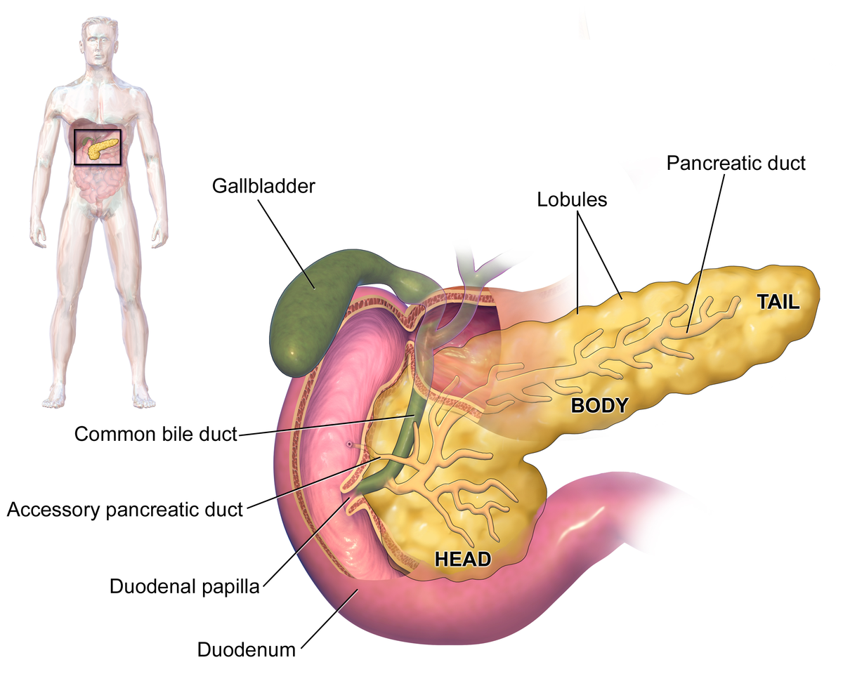
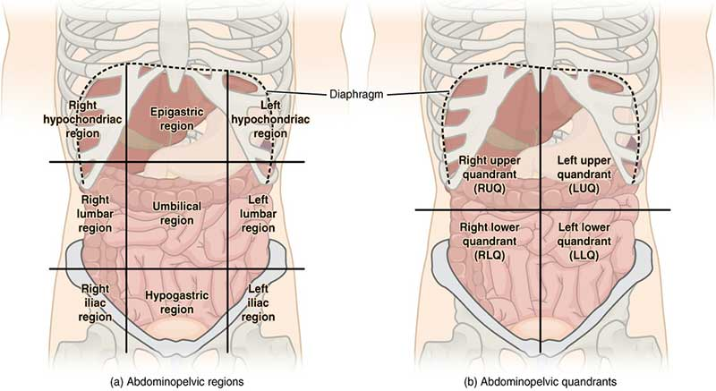
Pancreas Location
Located in Epigastrium* & Left upper quadrant of abdomen.
Pancreas is a soft, lobulated elongated gland with both exocrine (secretes pancreatic juice) and endocrine (secretes insulin) functions.
6-10 inch in length & 60-100 gram in weight.
Retro-peritoneal** in position.
Lies across the posterior abdominal wall in an oblique directions at the transpyloric plane (L1 vertebra) but the tail is at T12.
Epigastrium* : upper central region of the abdomen.
Retro-peritoneal** : behind the peritoneum (only covers anterior surface), more fixed (less movement).
3 Surfaces: Superior, inferior & anterior
3 Borders: Anterolateral, anteroinferior (with peritoneum) & posterior (without peritoneum)
Extra

Slide 4
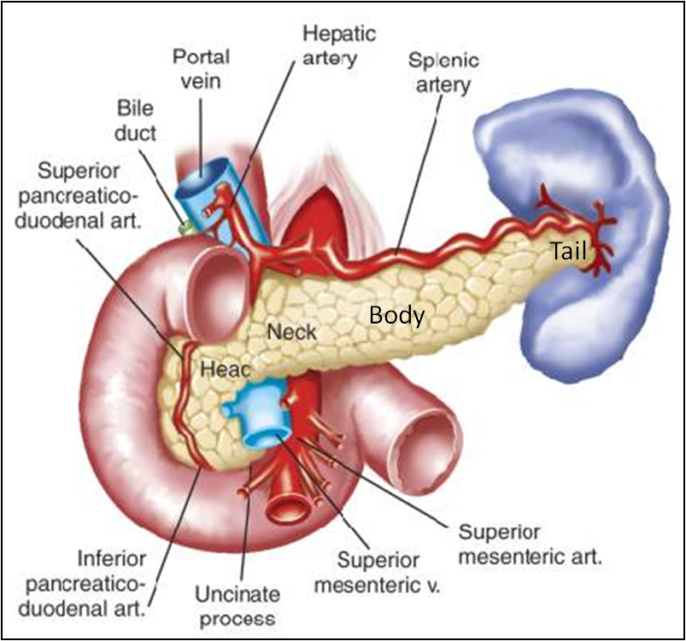
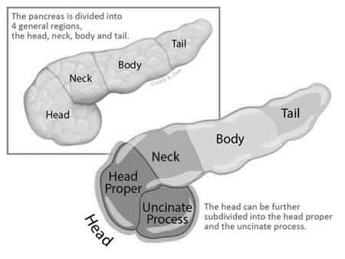
Pancreas
Head
Neck
Body
Tail
PARTS:
It is divided into:
Tail
Neck
Body
Head
uncinate process
Head
Disc shaped, lies within the concavity of the duodenum.
Related to the 2nd and 3rd parts of the duodenum on the right.
Continues with the neck on the left.
Includes uncinate process (part extending to the left behind the superior mesenteric vessels.
Neck
The constricted portion connecting the head & body of pancreas.
Lies in front of origin of superior mesenteric artery of abdominal Aorta and the beginning/confluence (origin) of the portal vein at level L1.
Its anterosuperior surface supports (يكون تحتها) the pylorus of the stomach .
The superior mesenteric vessels emerge from its inferior border.

Slide 5
Pancreas
Head
Neck
Body
Tail
PARTS:
It is divided into:
Tail
Neck
Body
Head
uncinate process
Body
It runs upward and to the left.
It is triangular in cross section.
The splenic vein is embedded in its posterior surface While splenic artery* runs along it upper border.
*One of the torches (ملتوية/متعرجة) arteries in the human body (facial & uterine arteries are the other torches arteries)
Tail
Narrow, short segment, ending at the splenic hilum & highest part
Lies in the splenorenal ligament (or lienorenal ligament)** (may get injured during splenectomy), at the level of the T12 vertebra
Anteriorly related to splenic flexure of colon.
**This ligament is attached to the helium of the spleen & front of the left kidney, its fold of peritoneum. It contain (splenic vessels “arteries” & tail of pancreas)

Slide 6
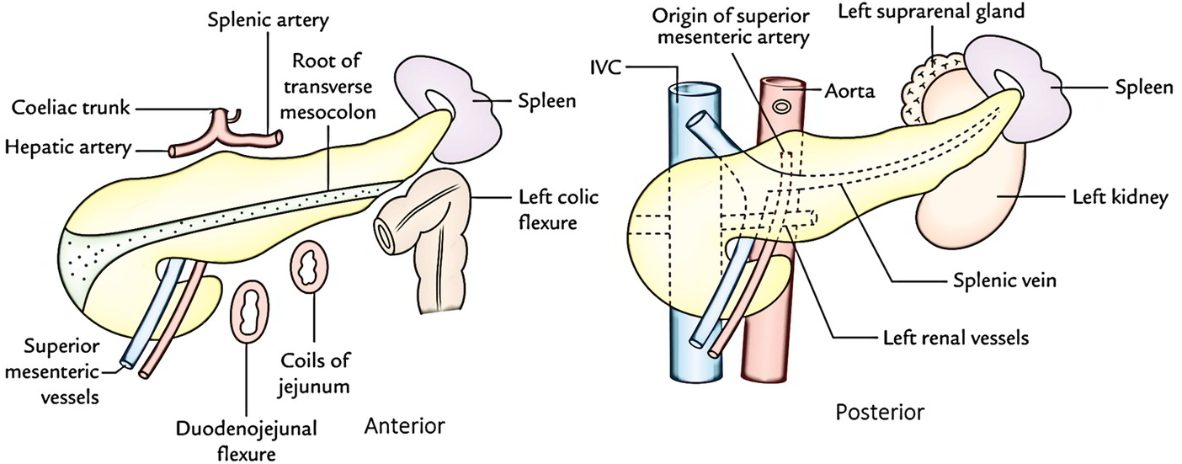
Pancreas Relations
(All relation of posterior abdominal wall)
Anterior | Posterior (IMPORTANT)
Stomach separated by lesser sac Transverse colon Transverse mesocolon (derivative of dorsal mesentery) | Common bile duct Portal & Splenic Veins, Inferior Vena Cava Aorta & Origin Of Superior Mesenteric Artery Left psoas muscle, Left Supra renal (Adrenal) Gland, Left Renal Vessels & upper 1/3rd of Left Kidney Hilum of the spleen

Slide 7
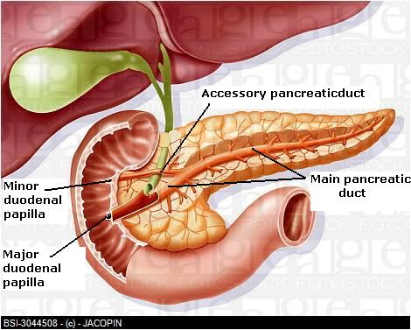
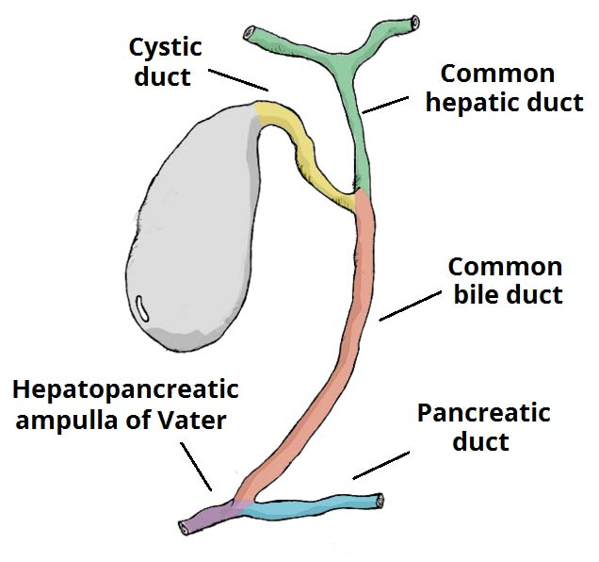
Pancreas Pancreatic Duct
Common bile duct
Ampulla of Vater
Duct of Wirsung
duct of Wirsung
Main/Major duct (duct of Wirsung):
Runs the entire length of pancreas beginning from the tail.
It receives many tributaries from tail, body, neck, inferior portion of head (NOT superior portion) & uncinate process.
Joins with common bile duct & together they open into a small hepatopancreatic ampulla (Ampulla of Vater) in the duodenal wall 2nd part.
The ampulla opens into the lumen of the duodenum by means of a small Papilla (Major duodenal papilla).
Accessory duct (of Santorini)
Drains superior portion of the head
It empties separately into 2nd part of duodenum at (minor duodenal papilla)
One inch above the major papilla

Slide 8
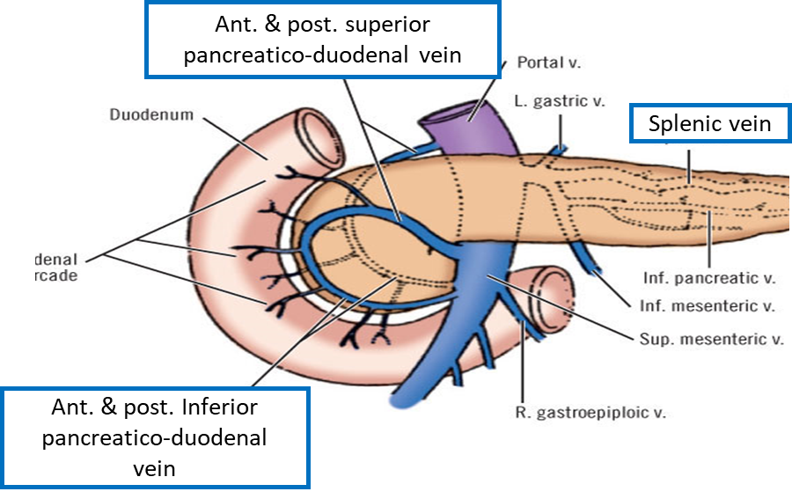
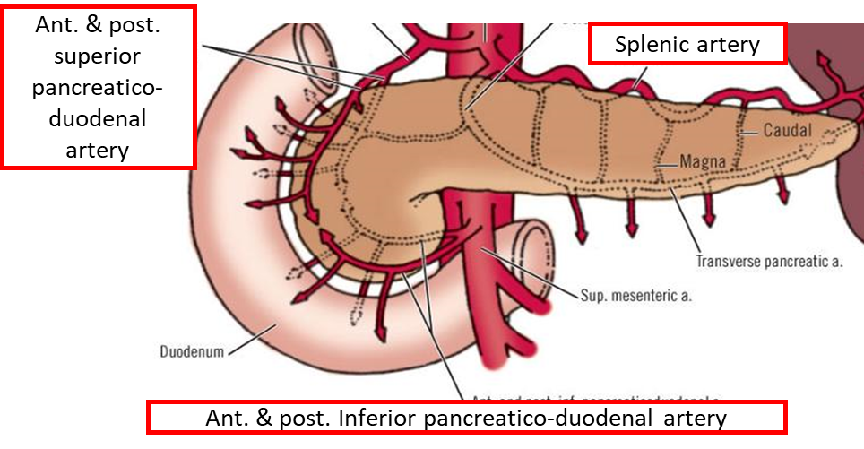
*FOR BETTER UNDERSTANDING
Abdominal Aorta
Coeliac artery
Common hepatic artery
Gastroduodenal artery
Superior artery pancreaticoduodenal
Superior mesenteric artery
Inferior artery pancreaticoduodenal
Splenic artery
pancreatic branches
Pancreas Blood Supply
Veins
Head & neck: Drained by anterior and posterior venous arcades that form the superior & inferior pancreaticoduodenal veins which follow the corresponding arteries.
Body & tail: Drained by splenic vein, which is a tributary of portal vein
Arteries
Head & neck: Supplied by branches from:
Celiac trunk through Superior artery pancreaticoduodenal
Superior mesenteric artery through Inferior artery pancreaticoduodenal
Body & tail: Supplied by Splenic artery through 8-10 pancreatic branches.

Slide 9
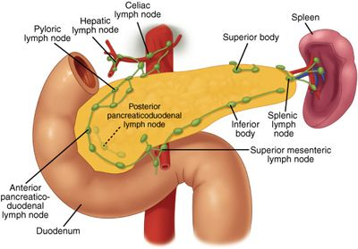
Pancreas lymphatic drainage & nerve Supply
Lymphatic Drainage
Rich network that drains into pyloric, hepatic & splenic nodes
Ultimately the efferent vessels drain into the celiac (body & tail) & superior mesenteric (head) lymph nodes.
Nerve Supply
Sympathetic fibers from the thoracic splanchnic nerves. (Sympathetic fibers have a predominantly inhibitory effect)
Parasympathetic fibers from the vagus. (Parasympathetic fibers stimulate both exocrine and endocrine secretions)

Slide 10
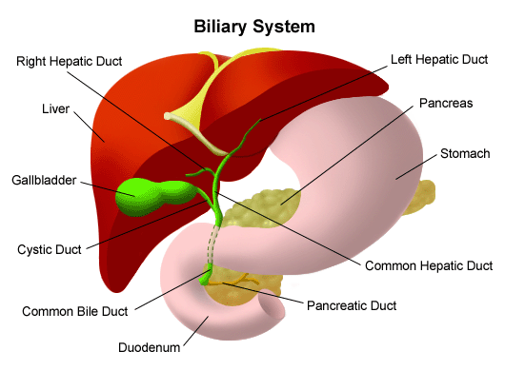
Bile canaliculi
Interlobular ducts
Intrahepatic ducts
Right hepatic ducts
Biliary system
Common hepatic duct
Common bile duct
Left hepatic ducts
Cystic duct
Bile canaliculi
Interlobular ducts
Intrahepatic ducts
The biliary system consists of the ducts and organs (liver, gallbladder & bile ducts) that are involved in the production, storage & transportation of bile respectively.
Bile is secreted by the liver cells at a constant rate of about 40 ml/hour. When digestion is not taking place, the bile is stored and concentrated in the gallbladder, later it is delivered to the duodenum.
The bile ducts consist of
Bile canaliculi (between the liver sacs)
Interlobular ducts
Intrahepatic ducts (within lobes)
Right and left hepatic ducts*
Common hepatic duct
Cystic duct (From Gallbladder)
Common bile duct (Bile duct)
Join and form larger ducts
Extra
*It comes from porta hepatis (helium: deep fissure in the inferior surface of the liver)

Slide 11
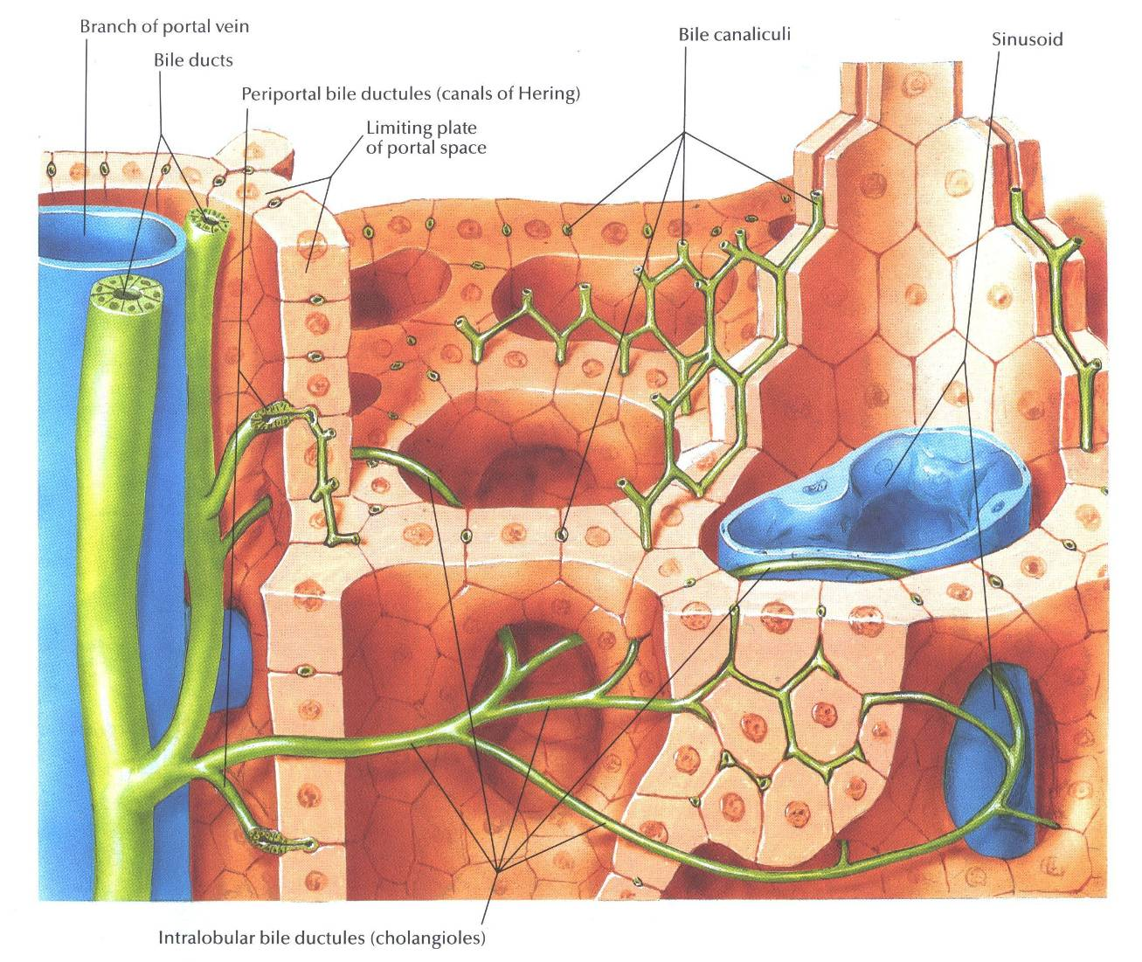
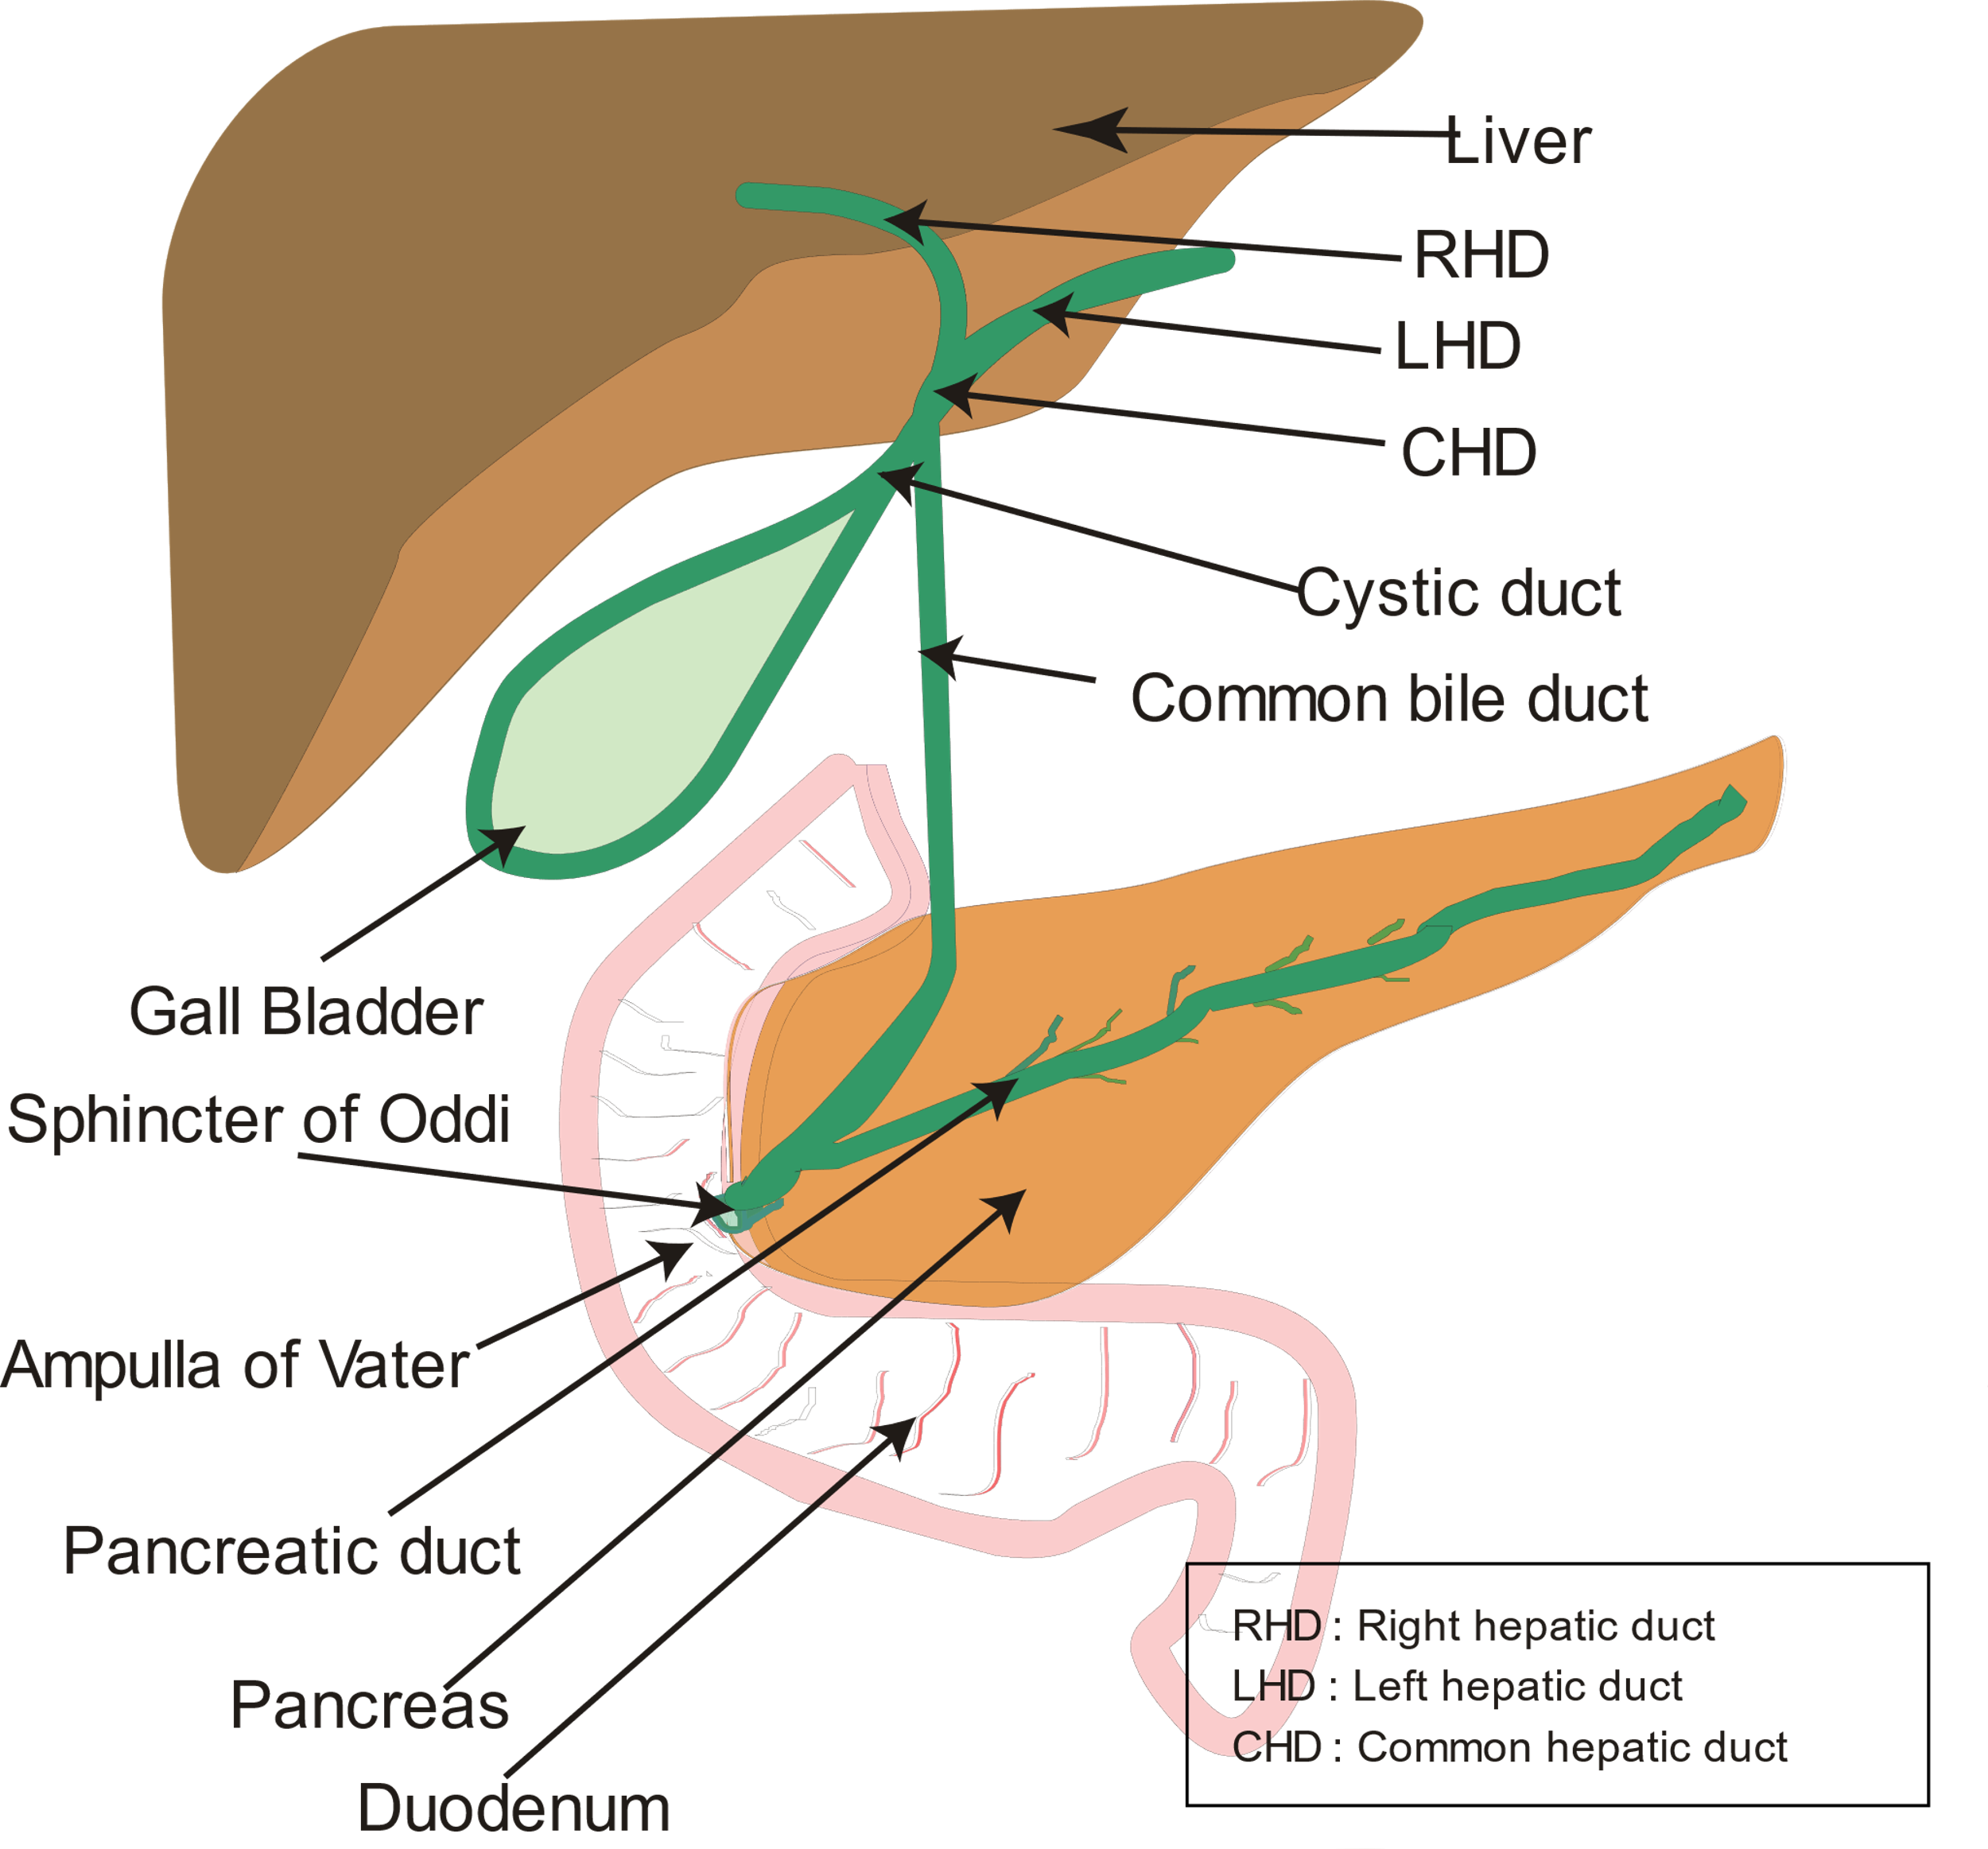
Bile canaliculi
Interlobular ducts
Intrahepatic ducts
Right hepatic ducts
Biliary system
Bile ducts
Common hepatic duct
Common bile duct
Left hepatic ducts
Cystic duct
Bile canaliculi
Interlobular ducts
Intrahepatic ducts
The smallest Interlobular tributaries of the bile ducts are situated in the portal canals of the liver; they receive the Bile canaliculi.
The interlobular ducts join one another to form progressively larger ducts and, eventually, at the porta hepatis, form the right and Right hepatic ducts.
The Left hepatic duct drains the right lobe of the liver and the left duct drains the left lobe, the caudate lobe & quadrate lobe*.
After a short course, the hepatic ducts unite to form the Common hepatic duct.
The common hepatic duct is about 1.5 inches (4 cm) long and descends within the free margin of the lesser omentum (fold of peritoneum between stomach “lesser curvature” liver “porta hepatis”)
It is joined on the right side by the Cystic duct from the gallbladder to form the Common bile duct.
Bile canaliculi
Interlobular tributaries
*Anatomically (position) related to right lobe of liver, Physiologically (function) related to left lobe of liver

Slide 12
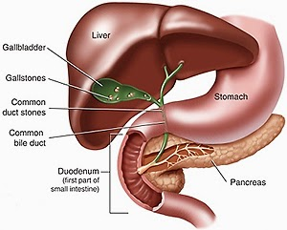
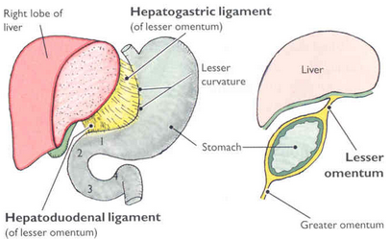
Biliary system
Common Bile Duct
*REMEMBER portal vein & hepatic artery & bile duct also lies in it
The common bile duct is about 3 inches (8 cm: 4 → cystic and 4 → common hepatic) long.
Course:
First it lies in the right free margin (border) of the lesser omentum*
Then it runs (descend) behind the first part of the duodenum.
Lastly it lies in a groove on the posterior surface of the head of the pancreas.
Here, the bile duct comes into contact with the main pancreatic duct. (cancer of the HEAD “last stage” of the pancreas will lead to obstructive jaundice due to obstruction of the bile duct)
Extra
Common Bile Duct
The bile duct ends below by piercing the medial wall of the second part of the duodenum about halfway down its length.
Joins with main pancreatic duct (duct of Wirsung) together they open into a small hepatopancreatic ampulla (Ampulla of Vater) in the duodenal wall 2nd part.
The ampulla opens into the lumen of the duodenum by means of a small Papilla (Major duodenal papilla).
The terminal parts of both ducts and the ampulla are surrounded by circular muscle, known as the sphincter of the hepatopancreatic ampulla (sphincter of Oddi). (this sphincter is constricted when we're not eating. so the bile goes back to the gallbladder)
Occasionally, the bile and pancreatic ducts open separately into the duodenum.
repeated slide 7

Slide 13
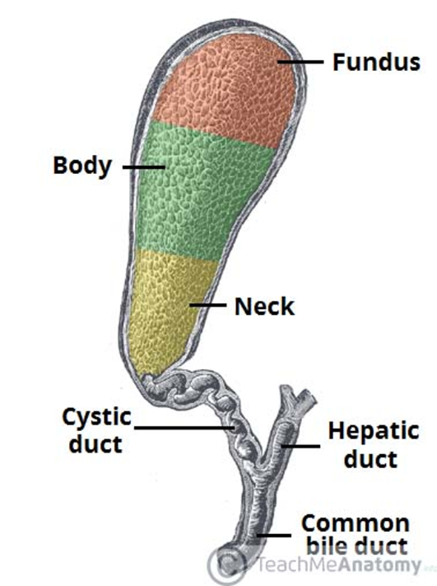
Gallbladder
REMEMBER
Bile secreted by liver cells | Bile stores by Gallbladder
A pear shaped sac lying on the undersurface of the liver.
It has a capacity of 30 to 50 ml , it stores bile, which is concentrated by absorbing water.
The gallbladder is divided into: the neck, body & fundus:
The neck becomes continuous with the cystic duct, which turns into the lesser omentum, joins the common hepatic duct, to form the common bile duct.
The body lies in contact with the visceral surface of the liver and is directed upward, backward, and to the left.
The fundus is rounded and projects below the inferior margin of the liver, the peritoneum completely surrounds it and binds the body & neck to the visceral surface of the liver, where it comes in contact with the anterior abdominal wall at the level of the tip of the right ninth right costal cartilage.
Common hepatic duct
Common bile duct
Cystic duct
Function of the Gallbladder
When digestion is not taking place, the sphincter of Oddi remains closed and bile accumulates in the gallbladder.
The gallbladder concentrates & stores bile
Selectively Absorbs bile salts & Keeps the bile acid, Excretes cholesterol & Secretes mucus
To aid in these functions, the mucous membrane (mucosa) is thrown into permanent folds that unite with each other, giving the surface a honeycombed appearance.

Slide 14
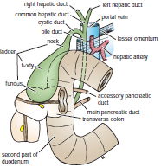
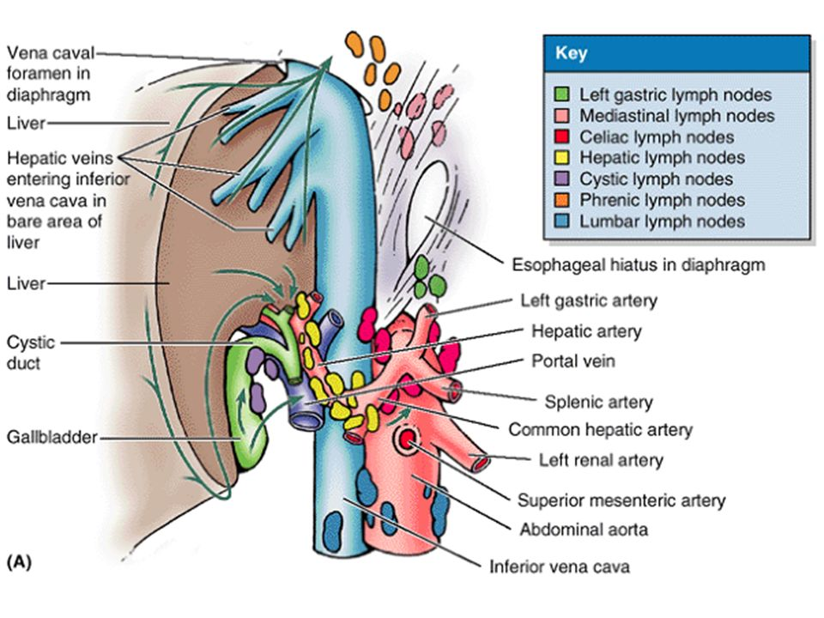
Gallbladder
Relation & Supply
Relation | Anterior | Posterior
 | The anterior abdominal wall The inferior surface of the liver | The transverse colon 1st part of the duodenum 2nd part of the duodenum
Blood supply | The cystic artery, a branch of the right hepatic artery. The cystic vein drains directly into the portal vein. Several very small arteries and veins also run between the liver & gallbladder.
Lymph drainage | The lymph drains into a cystic lymph node situated near the neck of the gallbladder, From here, the lymph vessels pass to the hepatic nodes along the course of the hepatic artery and then to the celiac nodes (lastly)
Nerve supply | Sympathetic and parasympathetic vagal fibers form the celiac plexus. The gallbladder contracts in response to the hormone cholecystokinin, which is produced by the mucous membrane of the duodenum on the arrival of fatty food from the stomach *Gallbladder NOT affected nerves, its affect by cholecystokinin hormone (secrete with fatty meal & stimulate by transportation of bile)
First part of the duodenum

Slide 15
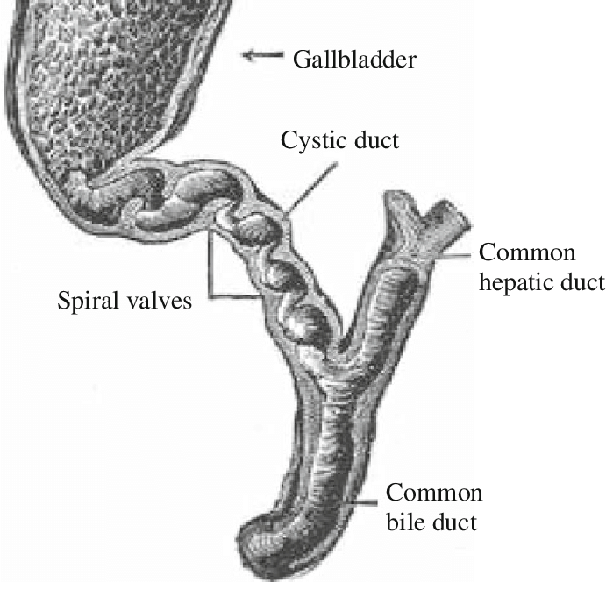
Cystic Duct
The cystic duct is about 1.5 inches (3.8-4 cm) long and connects the neck of the gallbladder to the common hepatic duct to form the common bile duct
It is usually somewhat S shaped and descends for a variable distance in the right free margin of the lesser omentum.
The mucous membrane of the cystic duct is raised to form a spiral fold (inside) that is continuous with a similar fold in the neck of the gallbladder.
The fold is commonly known as the “spiral valve” (to keep the lumen constantly open)
Common hepatic duct
Common bile duct
Cystic duct

Slide 16
SUMMARY
 |  | Pancreas | Gallbladder
Parts |  | Head, neck, body → L1 Tail → T12 | Fundus, body, and neck
Relations | Anteriorly | Stomach separated by lesser sac Transverse colon & transverse mesocolon | Anterior abdominal wall Inferior surface of the liver
 | Posteriorly | Bile duct, portal & splenic veins, inferior vena cava, aorta & origin of superior mesenteric artery Left psoas muscle, left adrenal gland, left renal vessels & upper 1/3rd of left kidney Hilum of the spleen. | Transverse colon First and second part of duodenum
Duct |  | Main Duct (of Wirsung): Joins common bile duct & together they open into a small hepatopancreatic ampulla (Ampulla of Vater) Accessory Duct (of Santorini) drains superior portion of the head | Cystic duct connects the neck of the gallbladder to the common hepatic duct to form the bile duct
Arterial supply |  | Head and neck: superior pancreatico)duodenal artery (celiac) and inferior pancreatico)duodenal artery (superior mesenteric) Body and tail: splenic artery (celiac) | Cystic artery (right hepatic artery)
Venous drainage |  | Head and neck: superior and inferior pancreatico)duodenal veins Body and tail: splenic vein → portal vein | Cystic vein → portal vein
Lymphatic drainage |  | Pyloric, hepatic and splenic nodes → celiac and superior mesenteric nodes | Cystic lymph node → hepatic nodes → celiac nodes
Nerve supply |  | Sympathetic: thoracic splanchnic nerves (inhibitory) Parasympathetic: vagus nerve (excitatory) | Sympathetic and parasympathetic vagal fibers form celiac plexus

Slide 17
(1) Which of the following is part of the Bile Ducts?
A) Interhepatic duct B) Intralobular duct
C) Interlobular duct D) Non of the them
(2) The Bile Secretion Rate is:
A) 20 ml/hour B) 40 ml/hour
C) 60 ml/hour D) 80 ml/hour
(3) Which of the following is responsible for STORAGE of bile?
A) Bile Ducts B) Liver
C) Gallbladder D) Pancreas
(4) Which part of the pancreas includes the uncinate process?
A) Head B) Neck
C) Body D) Tail
(5) The pancreas is related to the posterior abdominal wall at:
A) 9th right costal cartilage B) Transpyloric plane L1
C) 8th right costal cartilage D) Transpyloric plane C6
(6) The gallbladder contracts in response to which hormone?
A) Secretin B) Gastrin
C) Cholecystokinin D) insulin
(7) Cystic duct connects the neck of the gallbladder to the common hepatic duct to form?
A) Pancreatic duct B) Right hepatic duct
C) Left hepatic duct D) Common bile duct
(8) The right and left hepatic ducts are formed at:
A) Porta hepatis
B) Splenic flexure
C) Second part of duodenum
D) Fundus of gallbladder
(9) The fundus of the gallbladder comes in contact with the anterior abdominal wall at the level of:
A) 9th right rib
B) 8th right rib
C) Tip of the 9th right costal cartilage
D) Tip of the 8th right costal cartilage
(10) Cystic duct usually somewhat?
A) Round shape B) Pear shape C) Disc shape D) S shape

Slide 18
Answers
C
B
C
A
B
C
D
A
C
D

