Slide 2
Objectives
At the end of the lecture, students should be able to:
Stem Cell : Definition & main function within the body.
Where can we find Stem Cells (location).
Classifications of stem cells:
Embryonic Stem Cell
Adult stem cells (Tissue Specific Stem Cell)
Induced Pluripotent Stem Cell (iPS) cells
Different approaches for isolation of pluripotent stem cells.
The Promise of Stem Cell Technology.

Slide 3
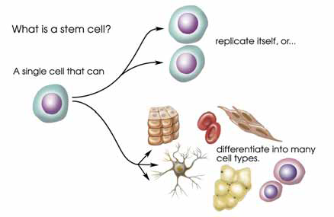
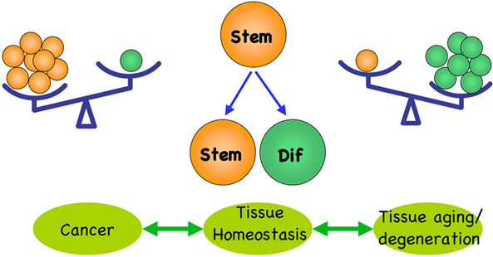
Stem cell:
-it is the first cell from fertilization
-undifferentiated
-it continues until death
Stem Cells Introduction
A cell that has the ability:
To continuously divide and give rise to new copy of itself (Unlimited self-renew)
Differentiate into various kinds of cells/tissues.
Unique Characteristics of Stem Cells:
Differentiation (eg. beating cells of the heart muscles):
Internal signals (specific genes)
External signals (GF, cytokines) 2
Main function within the body:
Continuous Repair of defective cell types and regeneration of tissues.
Self-renewal
A stem cell
Differentiation
1- It divides to give copies of itself and this is the main idea behind treating degenerative disease.
2- They amplify the microenvironment around cells
*For tissue homeostasis or health to be maintained there has to be a balance between these two characteristics. If there is imbalance:
- Too much regeneration and unlimited dividing will result in cancer
- Too much differentiation without enough regeneration will lead to aging and degeneration (die)

Slide 4
IMPORTANT
Classification of stem cells I- (potency based) potency = the ability to divide
Totipotent (Total) (morula)
1-3 days, differentiate into (intra) embryonic and extraembryonic (like placenta, amniotic fluid and umbilical cord) cell types. (this type can differentiate into anything)
Pluripotent (plural) (blastocyst)
Multipotent (multiple)
Oligopotent
Unipotent
Descendants of totipotent cells and differentiate into cells of 3 germ layers(ectoderm, mesoderm, endoderm) | Most important one that we use
Produce cells of closely related of cells (e.g. hematopoietic from bone marrow) family stem cells.
Differentiate into ONLY a few cells, such as lymphoid or myeloid stem cells
Produce ONLY one cell type (e.g. muscle stem cells)
Like the sperm, it differentiate before leaving the testis and like the cells in the ovaries
Used a lot in clinical application & treated some diseases
This cell can form the Embryo & Placenta
This cell can just form the Embryo
كل وحدة تعطي اللي تحتها
Note: in the bone marrow, we have two types of stem cells:
1- hematopoietic (multipotent) → gives us blood cells (RBCs, WBCs)
2- mesenchymal stem cells (multipotent) → give us (bone, cartilage, skin, epithelial lining)

Slide 5
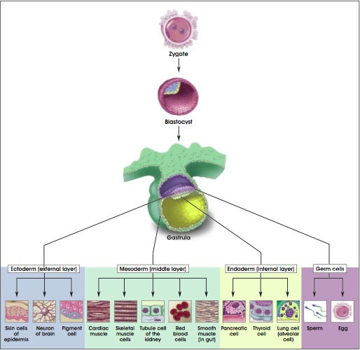
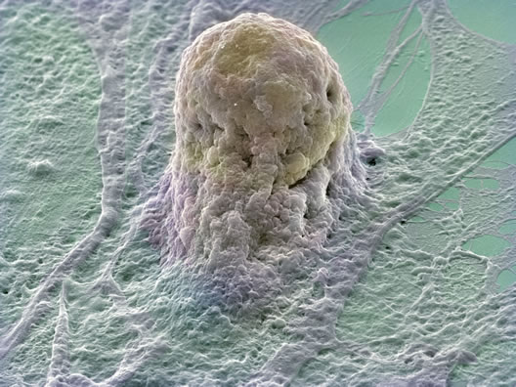
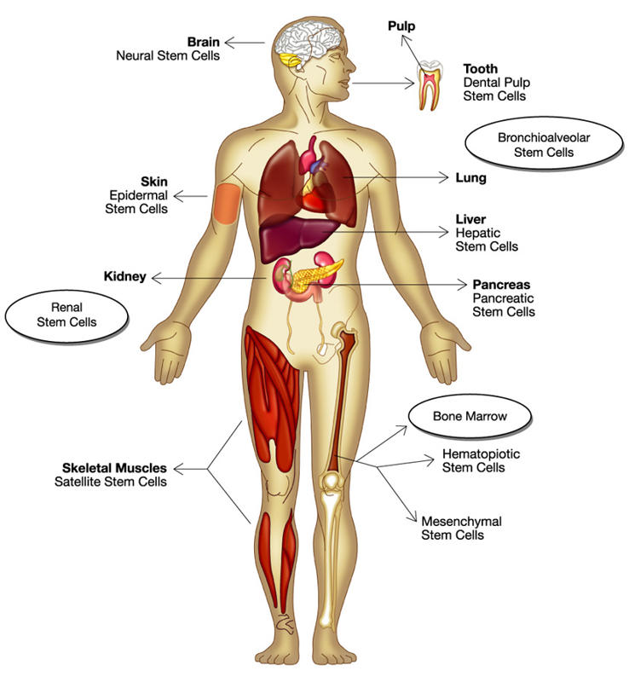
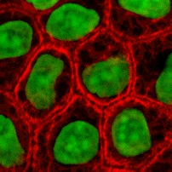
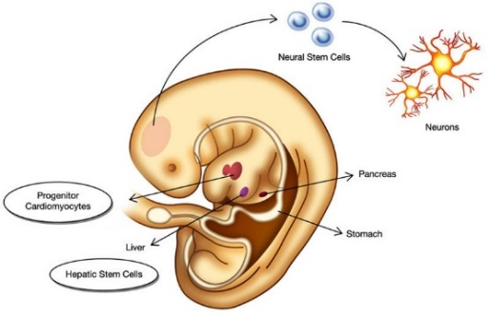
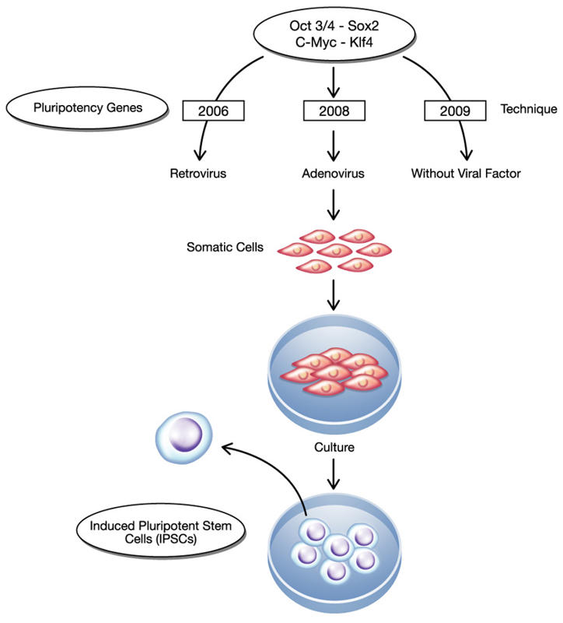
*Adult means any cell after day 14 when it becomes multipotent.
note that there is a difference between embryonic and fetus stem cells. Fetus stem cells are considered adult stem cells
Classification of stem cells II- (source based)
Totipotent: it is the fertilized egg until the 6th day where the implantation happens, after fertilization it divides into outer cell mass ( extraembryonic) and inner cells mass (embryo).
The inner cell mass is the pluripotent stem cells.
Note: if you take one pluripotent stem cell, it can give you a full fetus (without extraembryonic tissue) and this is what happens in twins , but if you did the same thing with totipotent, this will give you a full fetus with the extraembryonic tissue
Adult Stem Cells (ASC):
Induced pluripotent stem cells (IPSCs)
Sources: Bone Marrow, Placental Cord* & Mesenchymal Stem cells
Embryonic Stem Cells (ESC)
Multipotent & Limited numbers and more difficult to isolate (Disadvantage)
No immune rejection & No Ethical concerns (Advantage)
Found in specific mature body tissues as well as the umbilical cord and placenta after birth.
Slides 12 & 13
Cells which are not stem cells but converted to stem cells
Sources: IVF embryos, SCNT, Aborted embryos, cloned embryos
Pluripotent & large number can be harvested (Advantage)
May cause immune rejection & Ethical concerns (Disadvantage)
They also can be isolated of developing embryos’ different tissues
Embryonic means (totipotent and pluripotent)
Adult or tissue specific means (multipotent, oligopotent and unipotent
ما يقصد المرحلة العمرية, يقصد الخلية نفسها كبرت

Slide 6
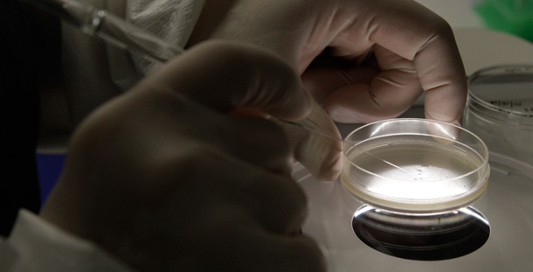
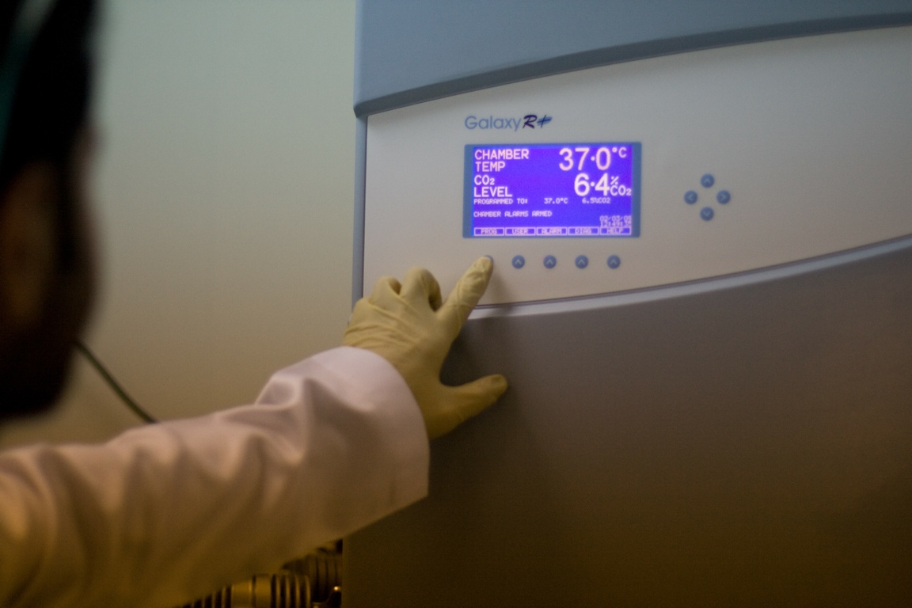
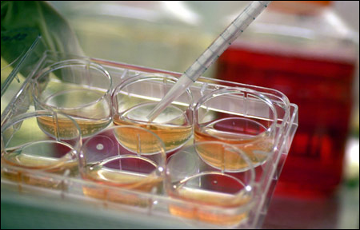
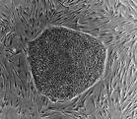
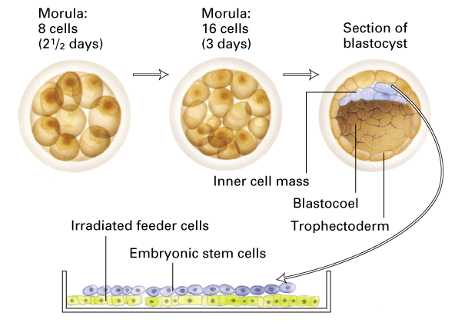
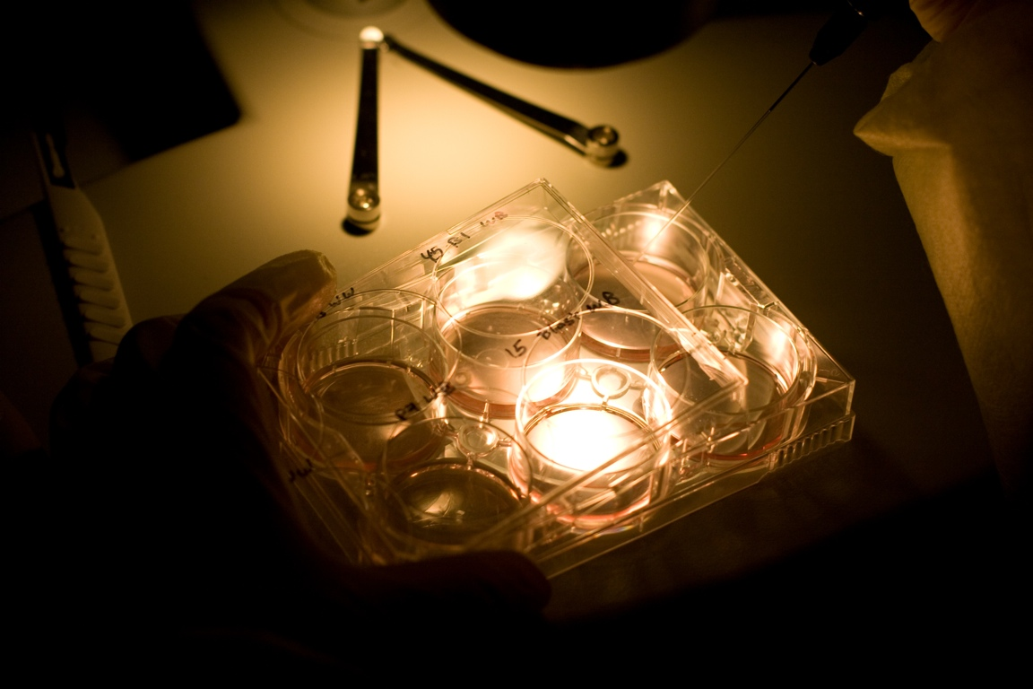
Embryonic human stem cells were first isolated in 1995 by dr. James thomson.
Inner surface of culture dish is coated with inactivated MEFs as a feeder cells:
- Provides sticky surface for attachment & Release nutrients
Derived from 4-5 day old embryo (blastocyst):
1- Trophoblast
2- Blastocoel
3- Inner Cell Mass (ICS)
Isolate and transfer of ICS into culture dish in culture media
Culture at 37c and 5% CO2
Cells divide and spread over the dish
ESCs are removed gently and plated into several different culture plates.
Generation of embryonic stem cells (ESC)
Only on the girl’s slides
Totipotent
pluripotent
MEFs = Mouse Embryonic Fibroblasts
1- totipotent: from fertilization → implantation
2- pluripotent: it is the inner cell mass after fertilization

Slide 7
Only on the girl’s slides
If there is a problem with the bone marrow, the doctors will take the mesenchymal stem cells from the umbilical cord to fix the problem.

Slide 8
Challenges with Embryonic Stem Cells (ESC)
Embryonic Stem Cells have very huge advantages: Pluripotent & unlimited ability for self-renew
Abnormalities in chromosome number and structure were found in some (three) human ESC lines. (can’t use them for clinical uses "treatment")
Stem cells need to be differentiated to the appropriate cell types before they can be used clinically (if they are inserted before they are differentiated they might multiply and form cancer)
Stem cell development or proliferation must be controlled once placed into patients (risk of teratoma formation).
The use of mouse “feeder” cells to grow ESC could result in problems due to xenotransplantation*. (the feeder layer is supposed to be removed before we use the ESC but all isolation methods don’t guarantee not having feeder layer in the sample. Now there are medias to grow without feeder layer)
Possibility of rejection of stem cell transplants as foreign tissues is very high.
*Xenotransplantation: process of transplanting tissues between organisms.

Slide 9
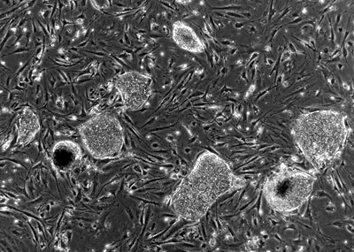
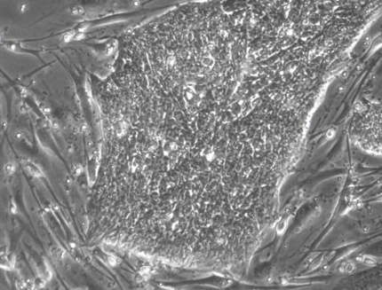
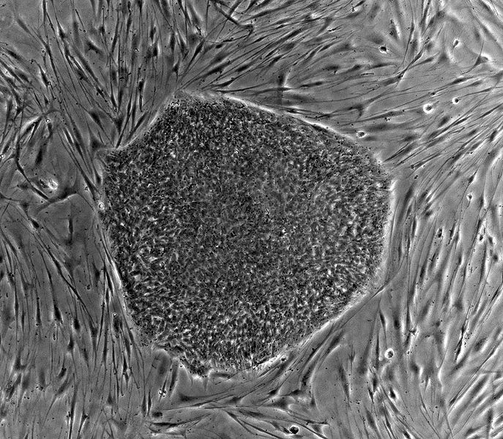
Only on the girl’s slides
Human Embryonic Stem Cell (hESC) Colony
*This is a video showing cardiac cells beating. (to view it download the ppt version)
What do cultured ESC (Embryonic Stem Cell) look like?
Beating cardiomyocytes derived from hESCs*
Mouse embryonic cells (feeder layer)
The lines around that surround ESC
Embryonic stem cell colony with distinct border
Embryonic stem cells in the dish

Slide 10
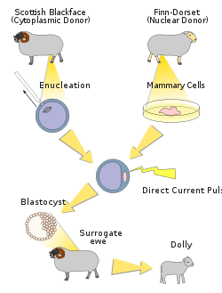
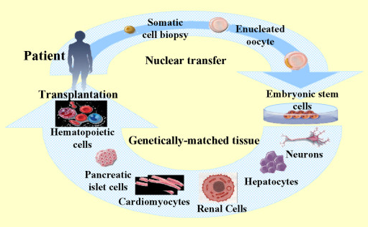
Only on the girl’s slides
Somatic Cell Nuclear Transfer (SCNT) CLONING
Nuclear transfer (cloning) can be used in 2 ways: reproductive (producing identical offspring) or therapeutic (which is the main goal)
Reproductive Cloning
Dolly is a sheep that was cloned from another sheep using the same method we discussed before. An oocyte was deprived of its nucleus and a different nucleus was inserted and the blastocyst was reinserted into a surrogate mother.
Therapeutic Cloning
Therapeutic cloning uses stem cells to correct diseases (treatment) and other health problems that someone may encounter.
Therapeutic cloning does not cloned to make full humans but rather is used for the stem cells of embryo

Slide 11
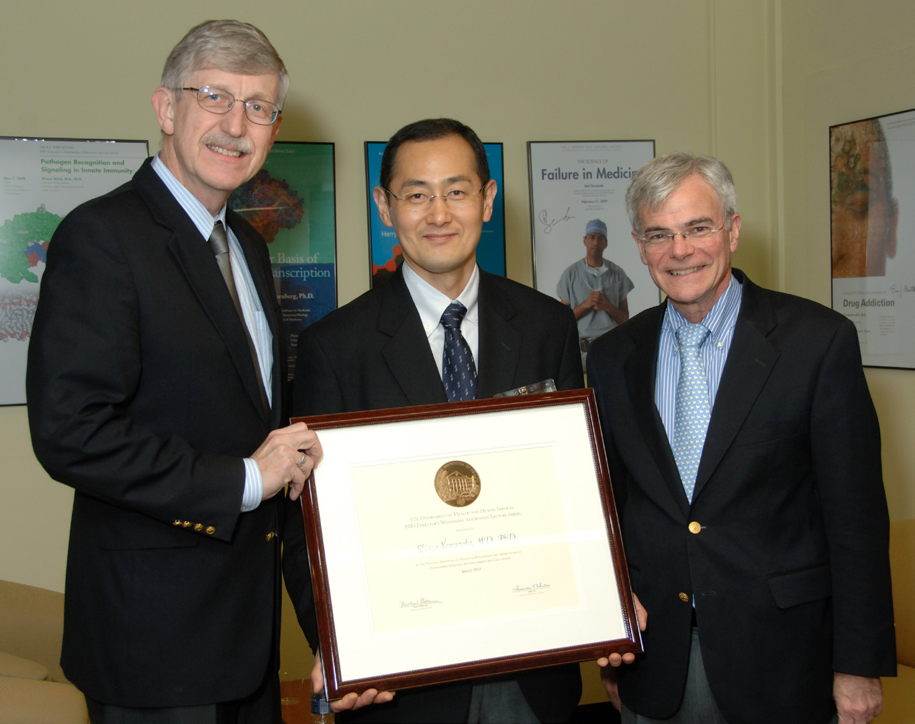
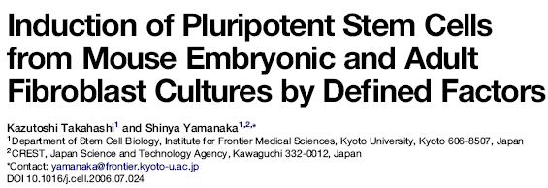
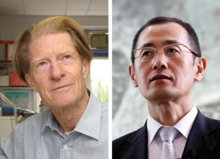
Only on the girl’s slides
The first induced pluripotent stem cells (IPSCs)
In late 2006 the group of Takahashi and Yamanaka reported the stimulation of cells of adult and embryonic origin to pluripotent stem cells called induced pluripotent stem (iPS) cells.

Slide 12
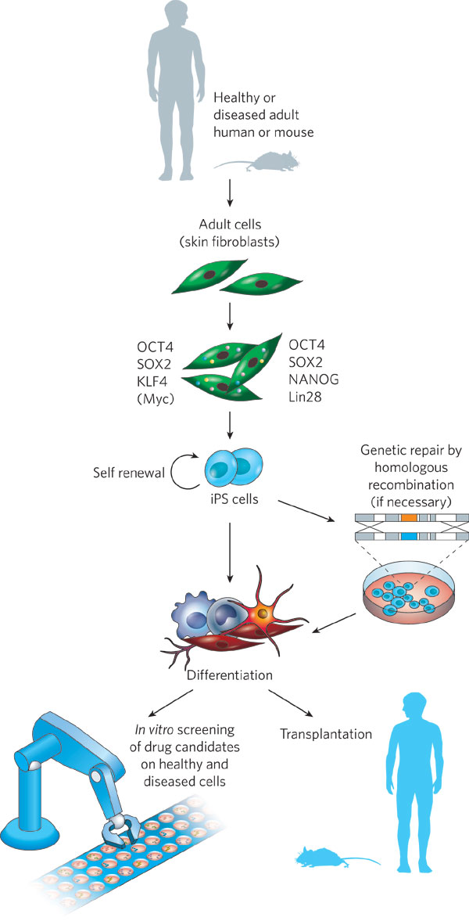
Induced pluripotent stem cells (IPSCs)
Yamanaka Factors
Thomson Factors
The method was described by Yamanaka and takahashi in which the skin cells of laboratory mice were genetically manipulated and returned back to their embryonic state.
iPS are somatic cells that have been reprogrammed to a pluripotent state (embryonic stem cell like state).
Several difficulties are to be overcome before iPS cells can be considered as a potential patient-specific cell therapy.
It will be crucial to characterize the development potential of human iPS cell line in the future.

Slide 13
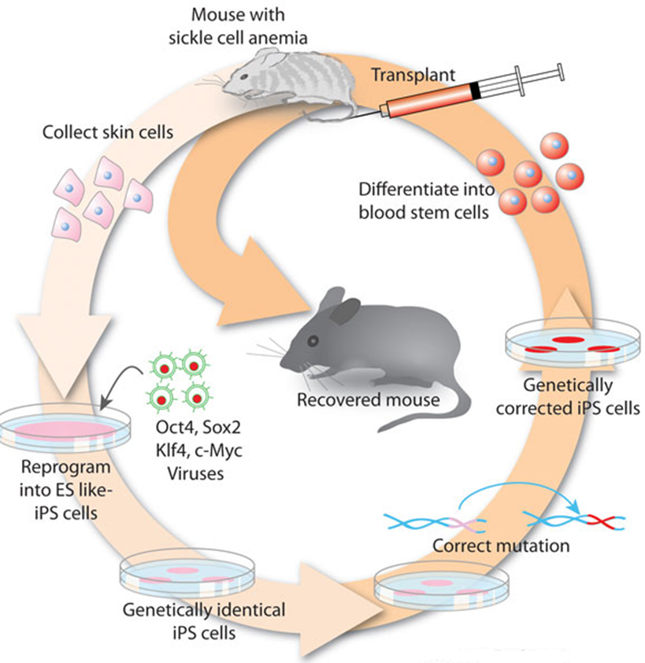
Induced pluripotent stem cells (IPSCs)
1st STEP
2nd STEP
3rd STEP
Skin cells were taken from the tail tip of a sickle-cell model mouse
Were differentiated into hematopoietic cells.
The produced cells were transfused back into the sick mouse
1st
3rd
2nd

Slide 14
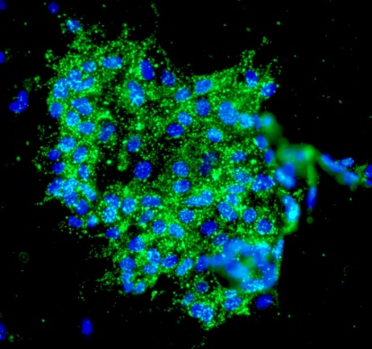
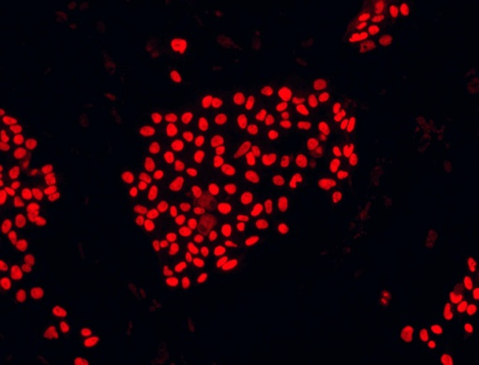
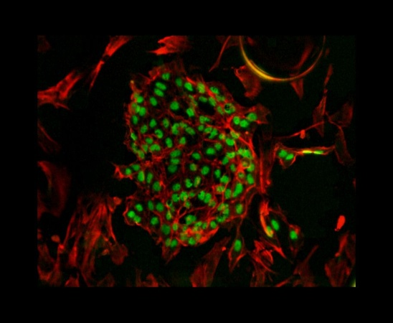
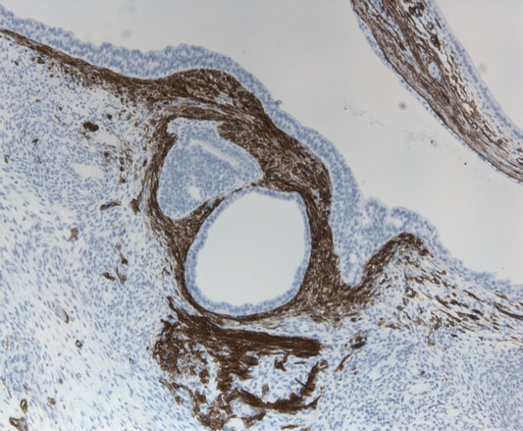
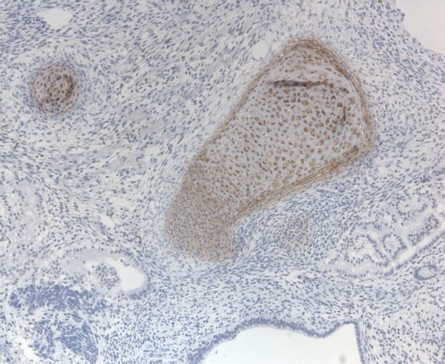
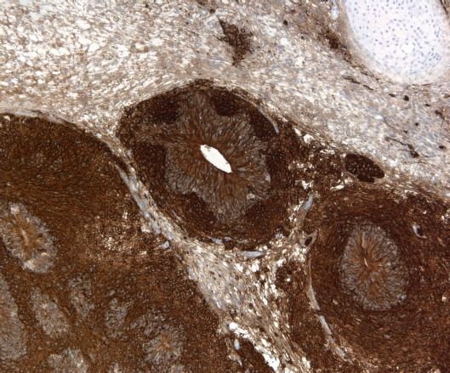
Human Pluripotent Stem cells (hPSCs)
Characterization
Specific markers for stem cells
When they put these genes in a somatic cell, it becomes a stem cell.
SSEA-4
Sox-2
ENDODREM
MESODREM
Oct-4
Sox17
Sox9
ECTODREM
Beta-III tubulin

Slide 15
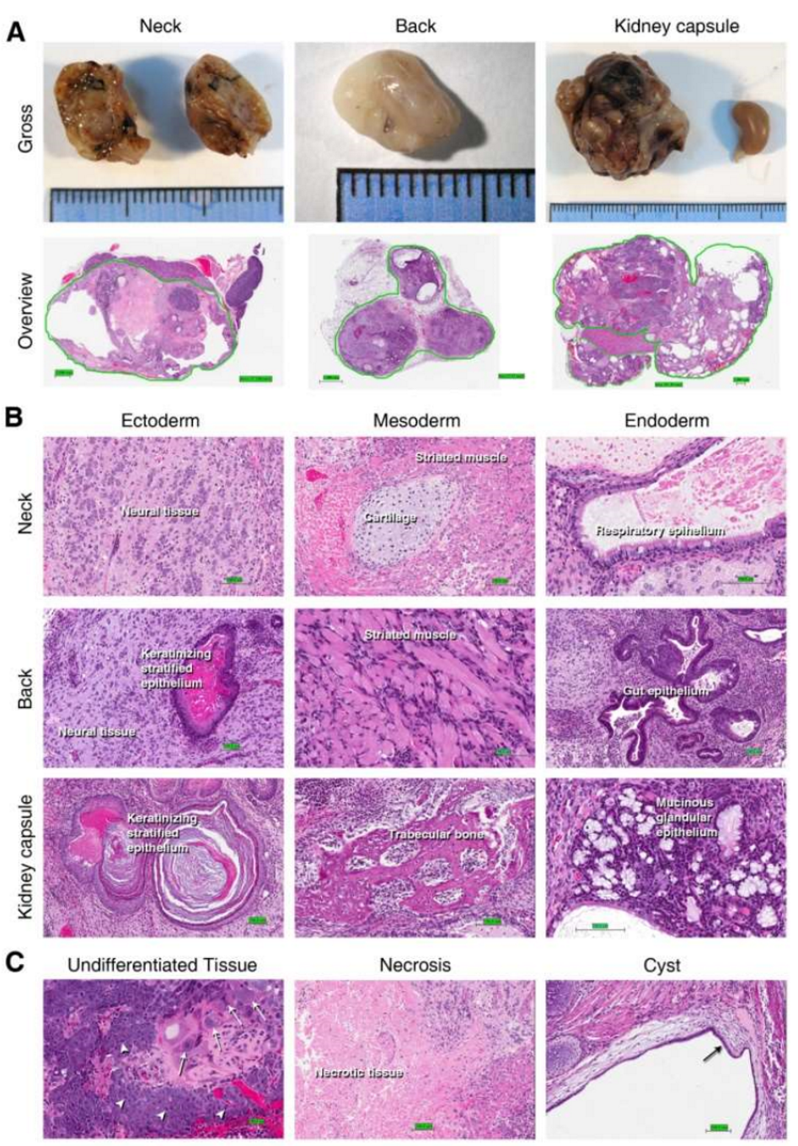
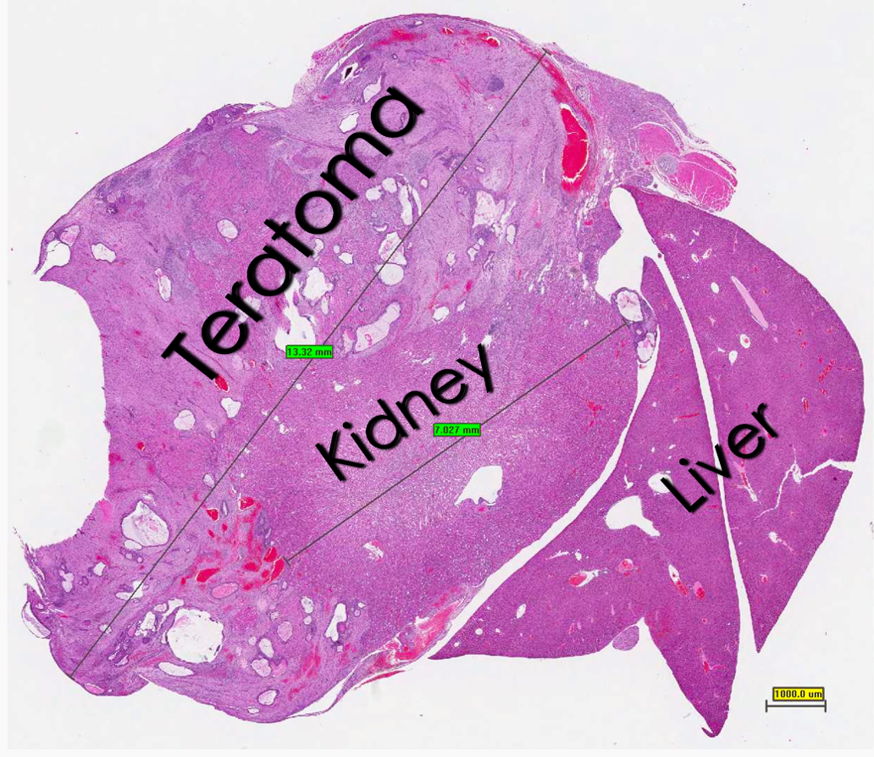
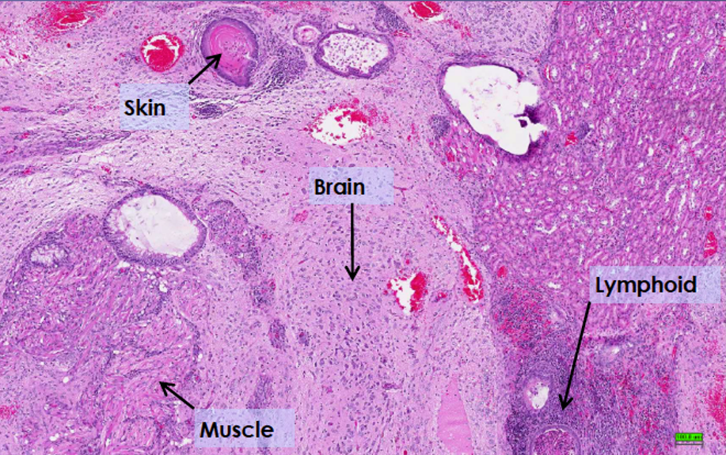
Human Pluripotent Stem cells (hPSCs)
Characterization
A large tumor mass measuring twice as the kidney is compressing it.
The teratoma was composed of mixed tissue patterns: skin with keratin, brain tissue, striated and smooth muscle, lymphoid tissue,….
Teratoma Formation in Immunocompetent Mice After Syngeneic and Allogeneic Implantation of Germline Capable Mouse Embryonic Stem Cells, 2013

Slide 16
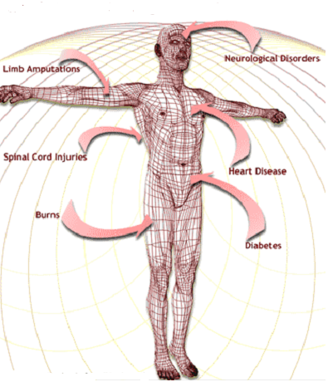
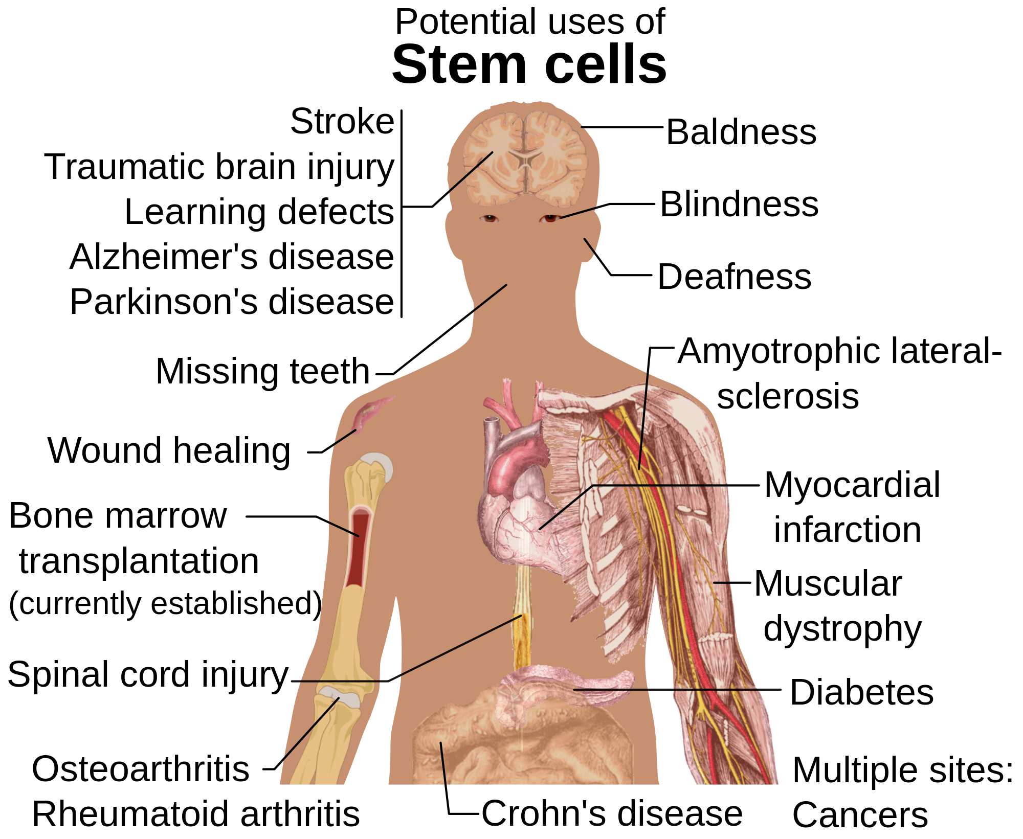
The Promise of Stem Cell Technology
Replacement of tissues/organs
Repair of defective cell types
Study cell differentiation
Toxicity testing.
Understanding prevention and treatment of birth defects.
Study of development and gene control.
Study of drugs therapeutic potential.

Slide 17
Only on the girl’s slides
Goal of Stem Cell Therapies
The goal of stem cell therapies is to promote cell replacement in organs that are damaged and do not have the ability for self repair (treat diseases)
How to find the right type of stem cells?
How to completely differentiate Stem Cells to desired cell type?
How to put the stem cells into the right place?
Will the stem cells perform the desired function in the body?
Differentiation protocols for many cell types have not been developed.
Obstacles of Stem Cell Research

Slide 18
Summary
Stem cells
Definition | Cells that have the ability to continuously divide and differentiate to other kinds of cells
Function | Repair and regeneration of tissues
Classification | 1.potency based Totipotent : from embryonic and extra embryonic cells Pluripotent : form 3 germ layers Multipotent : form related cells Oligopotent : form few cells Unipotent : form one cell type Nullpotent : terminal cell 2.Sourced based Embryonic ( pluripotent ,may cause immune reaction ) Adult (multipotent , no immune reaction ) IPSCs (no immune reaction or ethical dilemma)

Slide 19
(1) Which of the following is The Promise of Stem Cell Technology?
A) Toxicity testing
B) Understanding prevention and treatment of birth defects
C) Study of drugs therapeutic potential
D) All are true
(2) which of the following are pluripotent stem cells:
A) Cells has the potential to differentiate into any adult cell type forming an entire organism
B) Cells that has limited potential to form only multiple adult cell types
C) Cells that don’t have the ability for self-renewal
D) Cells has the Potential to form many differentiated cell types except placenta
(3) Which of the following forms embryonic and extraembryonic cell types?
A) Totipotent B) Multipotent
C) Oligopotent D) Unipotent
(4) The Blastocyst is formed of each of the following except?
A) Trophoblast B) Morula
C) Inner Cell Mass D) Blastocoel
(5) Hematopotic stem cells gives:
A) Cells of the nervous system B) Cartilage
C) Blood cells D) Connective tissue
(6) Induced Pluripotent Stem Cell (iPS) cells are?
A) Cells have limited potential to form only multiple adult cell types
B) Cells are Potential to form all differentiated cell types
C) Somatic cells that have been reprogrammed to a pluripotent state
D) Cells are potential to differentiate into any adult cell type
(7) Mesenchymal stem cells are example of?
A) Pluripotent stem cells B) Multipotent stem cells
C) Totipotent stem cells D) Induced pluripotent stem cells
(8) The goal of stem cell therapies is to:
A) Reduce the Possibility of immune rejection
B) Promote cell replacement in organs that are damaged and do not have Ability for self-repair
C) To make full humans
D) Non of them
(9) What are yamanaka factors:
A) OCT3/4, SOX2, KLF4, c-Myc B) Growth factors
C) Cytokines D) OCT3/4, SOX2, Nanog
(10) important limitation of using cloned ESCs (SCNT-ESCs) clinically:
A) Immune rejection
B) Produce limited number of cell types
C) Destruction of human embryos
D) Difficult to grow and culture in the laboratory

Slide 20
Answers
D
D
A
B
C
C
B
B
A
C

