Slide 2
Objectives
At the end of the lecture, students should be able to:
List the different parts of small intestine.
Describe the anatomy of duodenum, jejunum & ileum regarding: the shape, length, site of beginning & termination, peritoneal covering, arterial supply & lymphatic drainage.
Differentiate between each part of duodenum regarding the length, level & relations.
Differentiate between the jejunum & ileum regarding the characteristic anatomical features of each of them.

Slide 3
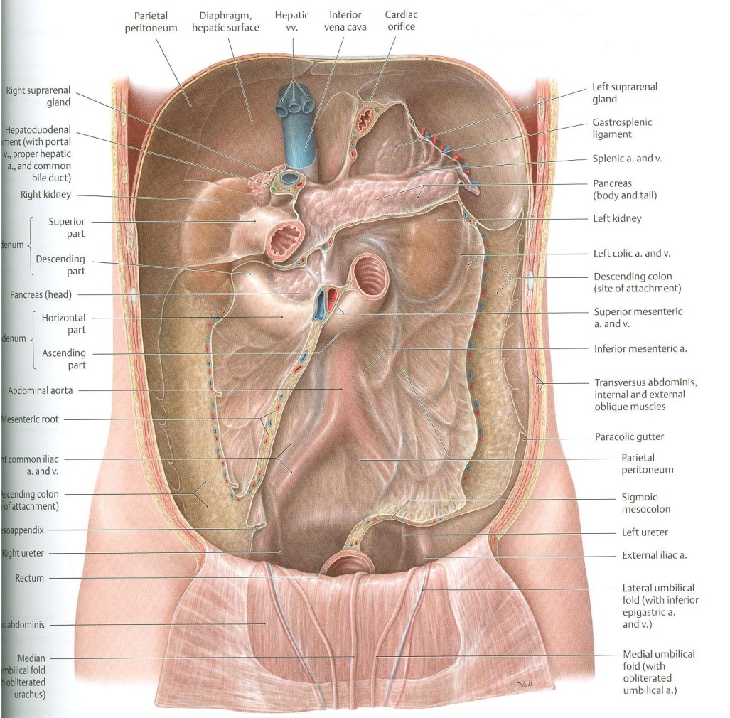
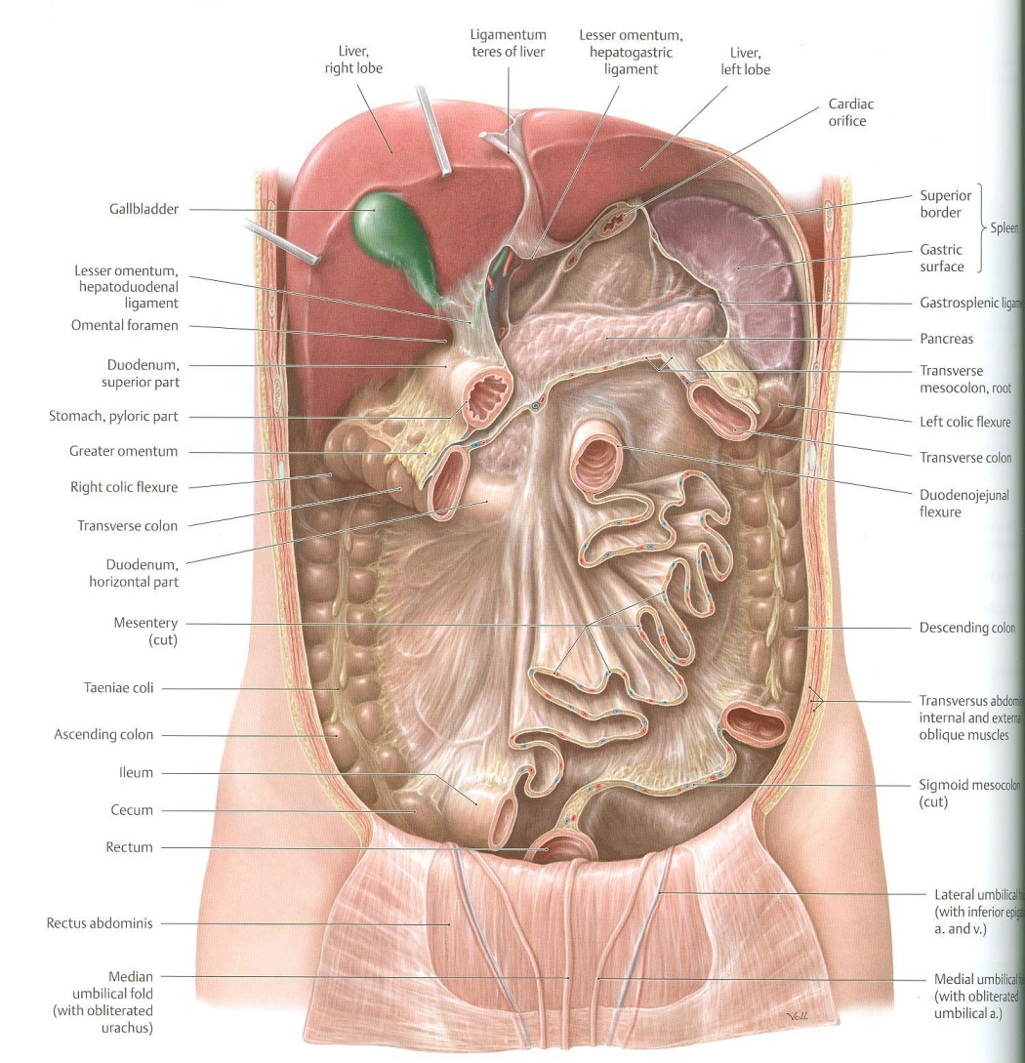
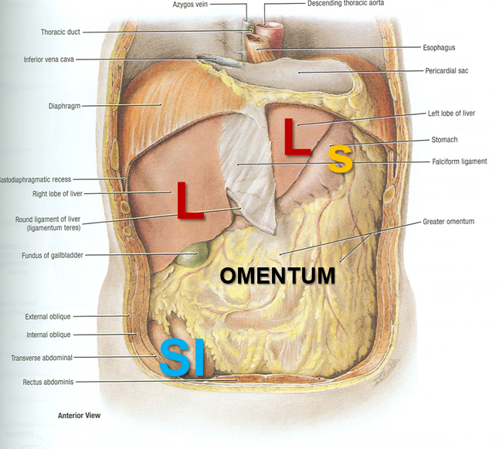
Abdomen
What is Mesentery?
It is a double layer attach the intestine to abdominal wall. If it has mesentery it is freely moveable.
The small intestines consist of two parts:
Fixed part (without mesentery) (retroperitoneal): duodenum
Free (movable) part (with mesentery): jejunum & ileum
Jejunum & ileum
Mesentery of SI
L= liver, S=Spleen, SI=Small Intestine,
AC=Ascending Colon, TC=Transverse Colon

Slide 4
Abdomen (this slide is not important)
To see the second layer you should remove the parietal peritoneum of posterior abdominal wall.
The second layer consists of:
1- ascending colon
2- cecum
3- descending colon
4- duodenum
5- pancreas
6- spleen
And behind the 2nd layer, there are the other non-GIT structures like kidney, Aorta and IVC
Dr.ahmed fathalla’s notes:
any structure invaginates the peritoneum has a certain degree of mobility
we have three levels related to abdominal structures:
1- (Part of the GIT) it is mobile and completely covered by the peritoneum, because it has invaginated the peritoneum.
2- (the rest of the GIT structures) which have lost the mesentery and covered by the peritoneum from the front and the sides
3-(Non-GIT structures) which are found in the abdominal cavity
Peritoneal folds have different names:
1- in stomach, we call them → omentum
2- In intestine → mesentery
3- colon → mesocolon
4-in the derivatives of GIT (spleen, liver, pancreas) → ligaments
We you remove the anterior abdominal wall, you will find the most superficial structures are:
1- liver
2- stomach
3- transvers colon
4- small intestine)
Jejunum & ileum
The greater omentum and small intestine are removed
Mesentery of small intestine (fan shaped)

Slide 5
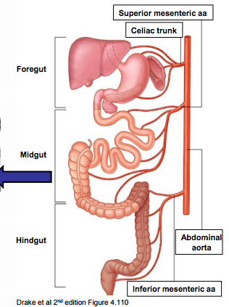
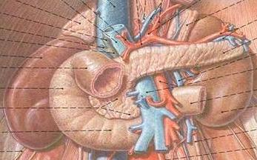
Only on the boy’s slides
Relation Between Embryological Origin & Arterial Supply
Duodenum:
Origin: foregut & midgut
Arterial supply:
Coeliac trunk (artery of foregut)
Superior mesenteric: (artery of midgut)
The duodenum has 2 arterial supply because of the double origin
The junction of foregut and midgut is at the second part of the duodenum
Jejunum & ileum:
Origin: midgut
Arterial supply:
Superior mesenteric: (artery of midgut)
Arterial supply depends on the embryological origin:
Foregut → Coeliac trunk
Midgut → Superior mesenteric artery
Hindgut → Inferior mesenteric artery
Note that the transvers colon is related to the 2nd part of duodenum

Slide 6
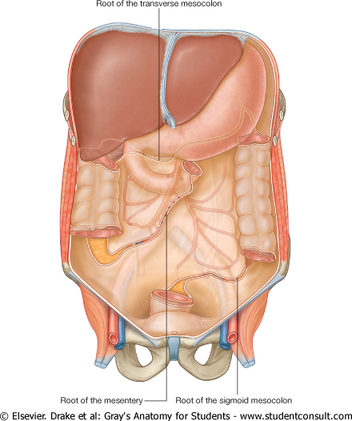
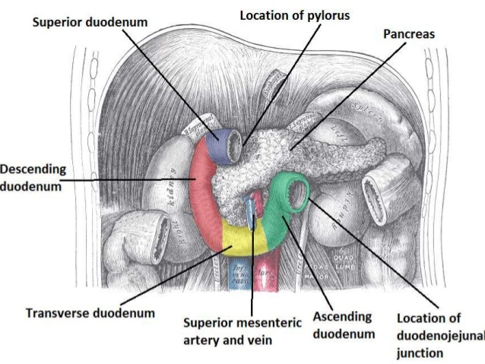
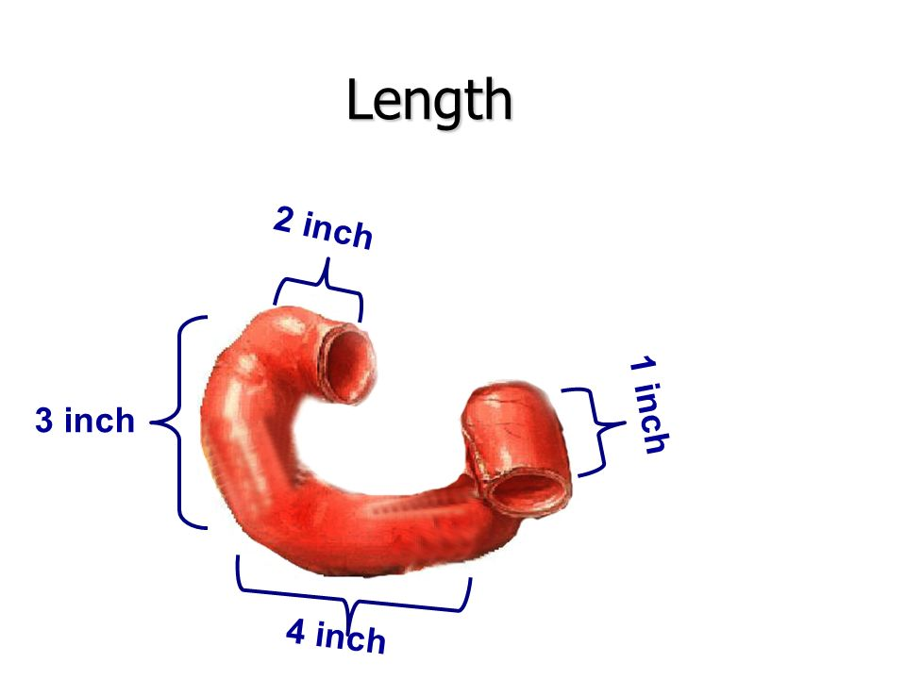
the first part of duodenum lies within the peritoneum but its other parts are retroperitoneum
Duodenum
Shape | C-shaped loop
Length | 10 inches
Beginning | At pyloro-duodenal junction
Termination | At duodeno-jejunal flexure
Peritoneal covering | Retroperitoneal {fixed movement}
Divisions | 4 parts {superior-descending-horizontal-ascending} next slide
Embryological origin | Foregut & midgut
Arterial supply | Coeliac & superior mesenteric
Venous drainage | Superior mesenteric & portal veins
Lymphatic drainage | Coeliac & superior mesenteric lymph nodes
Parts | First part (Sup./Horizontal) | Length: 2 Inches
 | Second part (Descending) | Length: 3 Inches
 | Third part (Inf./Horizontal) | Length: 4 Inches
 | Fourth part (Ascending) | Length: 1 Inches
Total length = 10 inches
Level (surface anatomy)
L1 (Transpyloric plane)
Descends from L1 TO L3
L3 (Subcostal plane)
Ascends from L3 to L2
Mnemonic:
زود واحد على اسم كل جزء عشان يطلع لك عدد الانشات
IMPORTANT

Slide 7
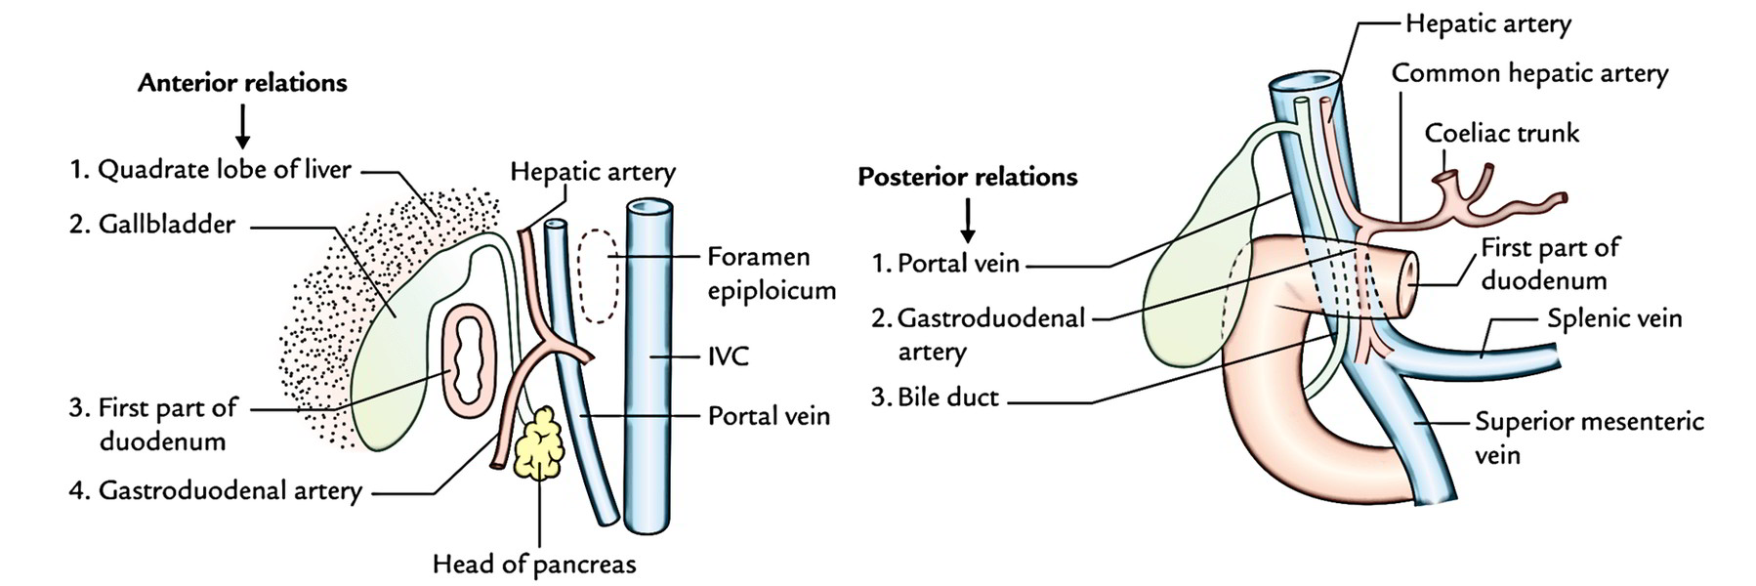
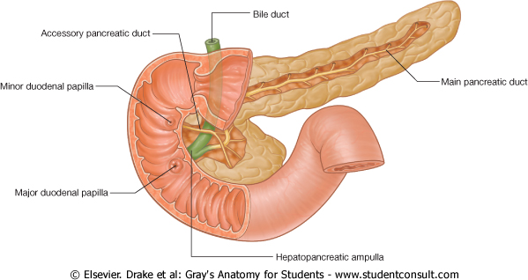
The first inch of the first part (duodenal cap) is more susceptible to duodenal ulcer.
And the gastroduodenal artery is more susceptible to get injured in case of duodenal ulcer.
Duodenum
Relations
2nd part (Medial) relation Pancreas (head)
2nd part (Lateral) relation Right colic flexure
2nd part (Openings):
Common opening of bile duct & main pancreatic duct: On summit of MAJOR duodenal papilla.
Opening of accessory pancreatic duct (one inch higher): On summit of MINOR duodenal papilla.
 | Anterior | Posterior
First part (above the transvers colon) | Liver | Gastroduodenal artery Portal vein Bile duct
Second part (at the level of the transvers colon) | Liver Transverse colon Small intestine | Right kidney
Bile duct
Accessory pancreatic duct
Minor duodenal papilla
Main pancreatic duct
Major duodenal papilla

Slide 8
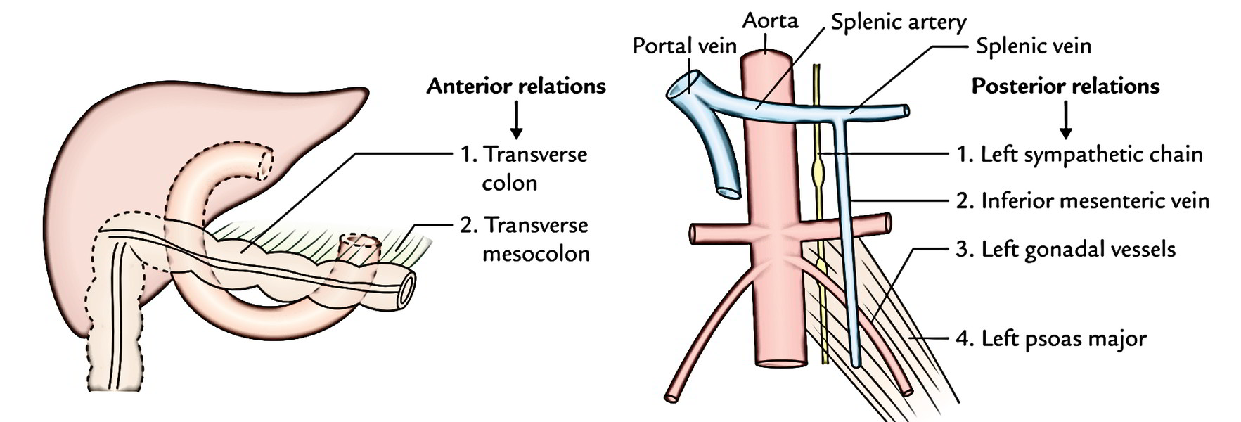
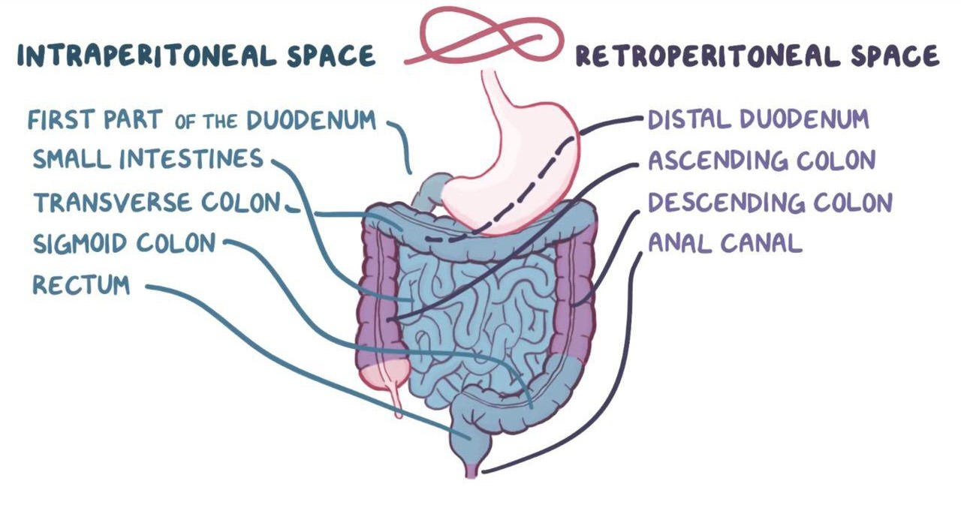
Duodenum
Relations
 | Anterior | Posterior
Third part (below the level of the transvers colon) | 1.Small Intestine (jejunum) 2.Superior Mesenteric vessels | Right psoas major Inferior vena cava Abdominal aorta Inferior mesenteric vessels (originate at L3)
Fourth part | Small Intestines | Left Psoas major
*Extra

Slide 9
Duodenum Summary
This slide is extra and summarizes the slides before
Duodenum
Part |  | Superior (1st) | Descending (2nd) | Inferior (3rd) | Ascending (4th)
Length |  | 2 Inches | 3 Inches | 4 Inches | 1 Inches
Level |  | L1 – transpyloric plane | L1 → L3 | L3 – subcotal plane | L3 → L2
Relations | Anterior | Liver | Liver Transverse colon Small intestine (J & L) | Small intestine Superior mesenteric vessels | Small intestine
 | Posterior | Bile duct Gastroduodenal artery Portal vein | Right kidney | Right psoas major Inferior vena cava Abdominal aorta Inferior mesenteric vessels | Left psoas major
 | Medial |  | Pancreas
 | Lateral |  | Right colic flexure

Slide 10
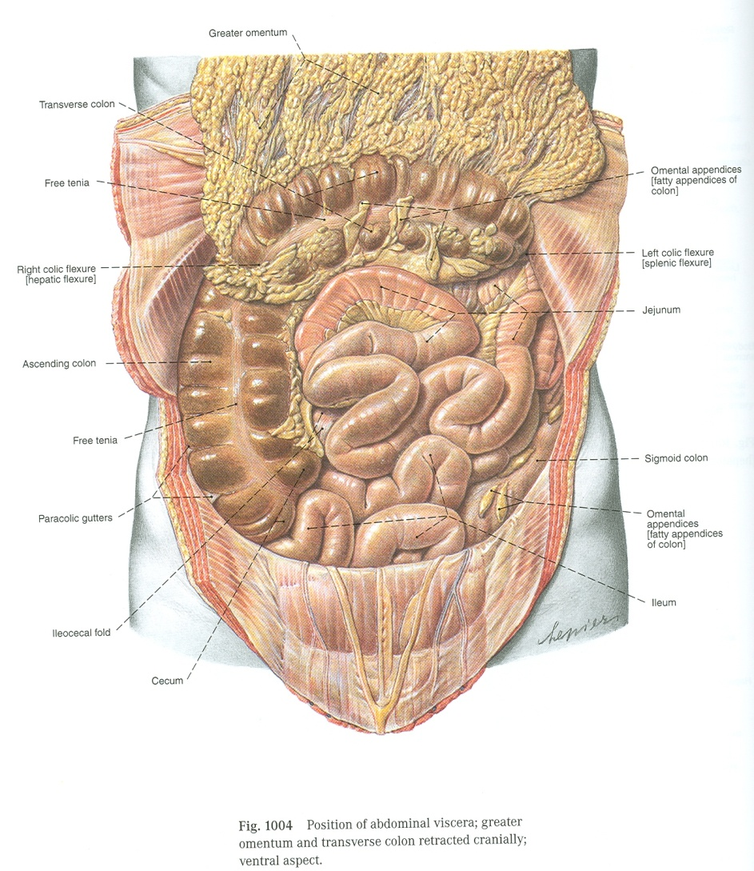
Jejunum & Ileum
Jejunum ( upper left part of abdomen)
Ilium ( lower right part of abdomen)
Shape
Coiled tube
Superior mesenteric lymph nodes
Beginning
6 meters (20 feet)
Termination
Peritoneal fold
Embyological origin
Blood supply
Lypmphatic drainage
Length
At duodeno-jejunal flexure
At ileocecal junction Or valve/orifice
Midgut
Mesentery of small intestine
Superior mesenteric Artery & Vein
Jejunum
ileum

Slide 11
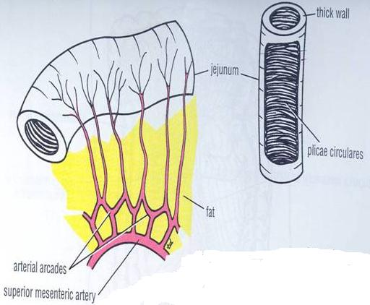
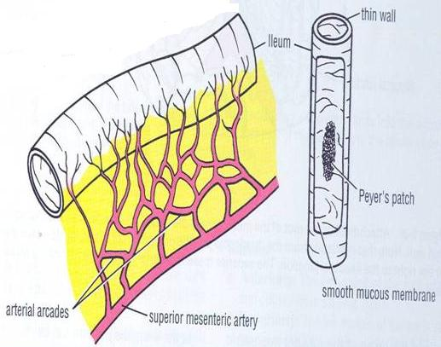
Jejunum & Ileum
Comparison
Plicae circulares: they are mucosal folds.
Arcades: Anastomosing arterial arches.
High: farther from the intestinal wall
Low: nearer intestinal wall
(Jejunum absorbs more than the ileum and needs more blood )
 | Jejunum | Ileum
Length* | Shorter (proximal 2/5) of SI | Longer (distal 3/5) of SI
Diameter | Wider | Narrower
Wall | Thicker (more plicae circulares) these are circular folds which increase the surface area for more absorption. | Thinner (less plicae circulares)
Appearance | Dark red (more vascular) | Light red (less vascular)
Vessels | High & less arcades Long terminal branches | Low & more arcades Short terminal branches كل ما تشعب الدم اكثر, الكمية اللي توصل اقل.
Mesenteric fat** | Small amount & ***Near (away from) intestinal border | Large amount & ***Near (Close to) intestinal border
Lymphoid tissue | Few aggregations | Numerous aggregations (peyer’s patches)
*In regards to the total length of jejunum and ileum. (SI = Small Intestine)
**In general, the mesentery of the jejunum has less fat than the ileum. Also, the fat in the jejunum is not near the intestinal wall (the gap in the picture).
*** We talked to Dr.Ahmed Fathallah and he said that near in both is the wright information, but in girls slides it’s different

Slide 12
Summary
 | Duodenum | Ileum | Jejunum
Shape | C-shaped | Coiled tube
Peritoneal covering | Retroperitoneal | With mesentery
Length | 10 inch | 2/5 of SI | 3/5 of SI
Beginning | Pyloro-duodenal junction | Duodeno-jejunal flexure
End | Duodeno-jejunal flexure | Ilieo-caecal junction
Embryological origin | Foregut & midgut | Midgut
Arterial Supply | Celiac & superior mesenteric arteries | Superior mesenteric artery
Venous Drainage | Superior mesenteric → portal vein | Superior mesenteric vein
Lymphatic Drainage | Celiac & superior mesenteric lymph nodes | Superior mesenteric lymph node

Slide 13
(1) The origin of the duodenum is:
A) Foregut B) Midgut
C) Hindgut D) A and B
(2) The lymphatic drainage of the duodenum is:
A) Coeliac B) superior mesenteric
C) A and B D) Inferior mesenteric
(5) The blood supply for the jejunum and ileum is from the:
A) Celiac trunk B) Superior mesenteric artery
C) Inferior mesenteric artery
(6) Which of the following has a major contribution to the thickness of the jejunum?
A) Plicae circulares B) Lymphoid tissue
C) Mesenteric fat
(7) Which of the following lies anterior to the third part of duodenum?
A) Liver B) Superior mesenteric vessels
C) Inferior mesenteric vessels D) Abdominal aorta
(8) Which one of the following structures can be injured in case of perforated duodenal ulcer?
A) Right kidney B) Right colic flexure
C) Gastroduodenal artery D) Inferior mesenteric vessels
(3) Which level lies the third part of duodenum?
A-Transpyloric plane. B) Subcotal plane
C) L1 to L3 D) L3 to L2
(4) Which of the following lies anterior to the first part of duodenum?
A) Liver B) Bile duct
C) Portal vein D) Aorta

Slide 14
Answers
D
C
B
A
B
A
B
C

