Slide 2
Objectives
At the end of the lecture, students should be able to:
List the different parts of large intestine.
List the characteristic features of colon.
Describe the anatomy of different parts of large intestine regarding: the surface anatomy, peritoneal covering, relations, arterial & nerve supply.

Slide 3
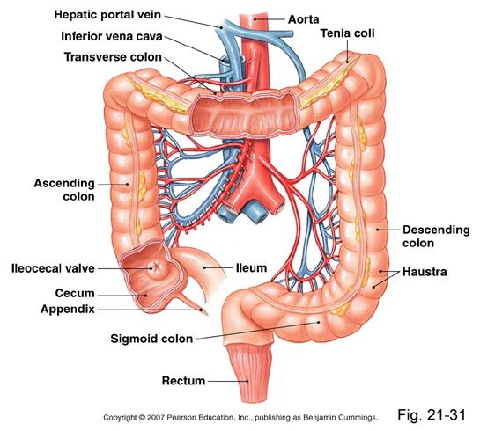
Parts of the Large Intestine
(1,2,3,4,5) are found in the abdomen
(6,7) are found in the pelvis
(8) is found in the perineum
NOT found in rectum & anal canal ONLY colon
Taeniae coli: Three longitudinal muscle bands
Sacculations (Haustra)=تكيّسات: Because the Taeniae coli are shorter than large intestine
Epiploic Appendicesزوائد=: Short peritoneal folds filled with fat (Yellowish color)
Epiploic
Appendices
Characteristics of Colon
Anus or
Anal canal

Slide 4
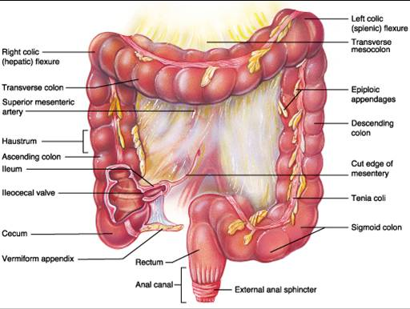
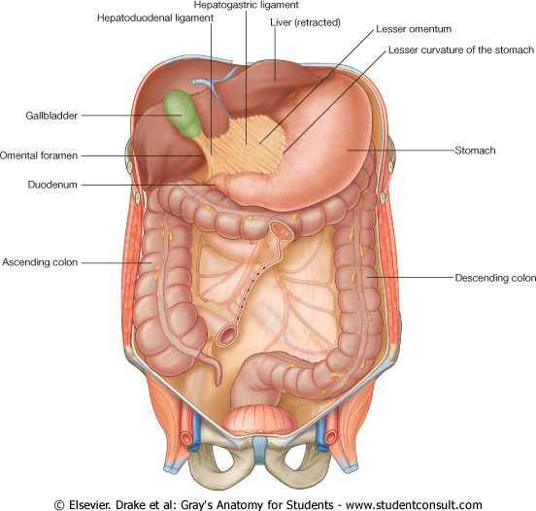
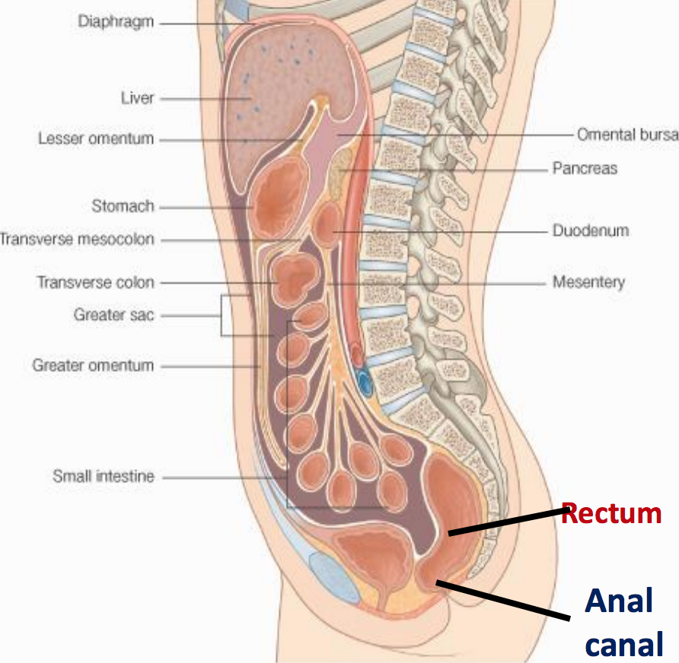
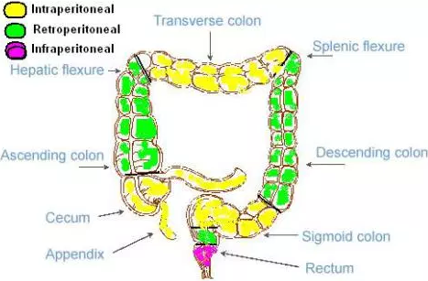
Peritoneal Covering
Parts with mesentery¹ | Parts with Retroperitoneal² | Parts devoid of (without) peritoneal covering
Transverse colon³ Sigmoid colon Appendix 4.Cecum | Ascending colon Descending colon Upper 2/3 of rectum | Lower 1/3 of rectum Anal canal
Rectum
Anal canal
1- The peritoneum covers the anterior and posterior surfaces.
2- The peritoneum only covers the anterior surface
3- First 2 inches WITHOUT mesentery

Slide 5
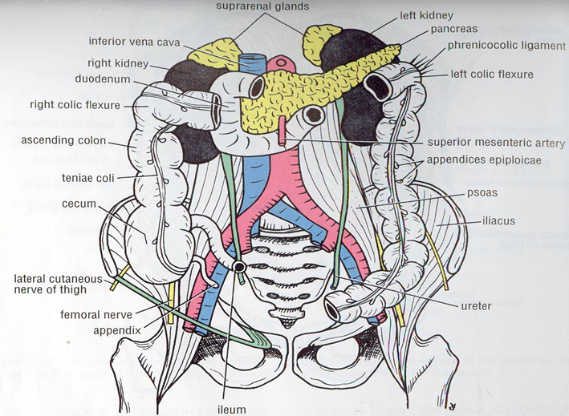
Parts of the Large Intestine
Relation
*Transverse colon full → Stomach will be Anterior
*Transverse colon empty → Stomach will be Superior
 | Anterior | Posterior
Cecum (Right) | Greater omentum Anterior abdominal wall Coils of small intestine (jejunum & ilum) | Psoas major Iliacus
Ascending colon (Right) |  | Right kidney Iliacus Quadratus lumborum
Descending colons (Left) |  | Psoas major Iliacus Quadratus lumborum Left kidney
Transverse colon | Greater omentum Anterior abdominal wall Stomach* | Superior mesenteric vessels 2nd part of duodenum Pancreas (head)
 | Superior | Inferior
 | Gallbladder Stomach Liver | Coils of small intestine (jejunum & ilum)
Quadratus lumborum

Slide 6
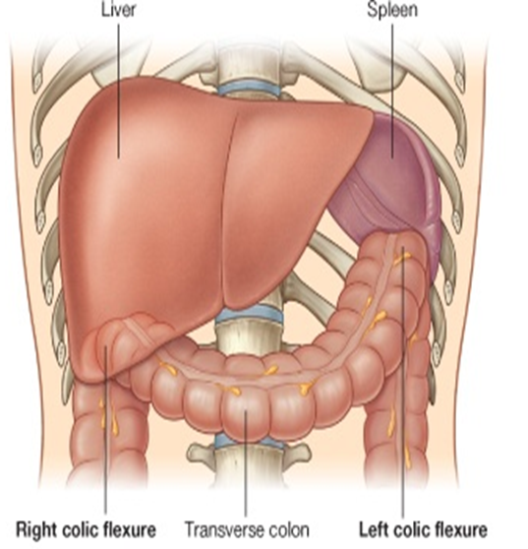
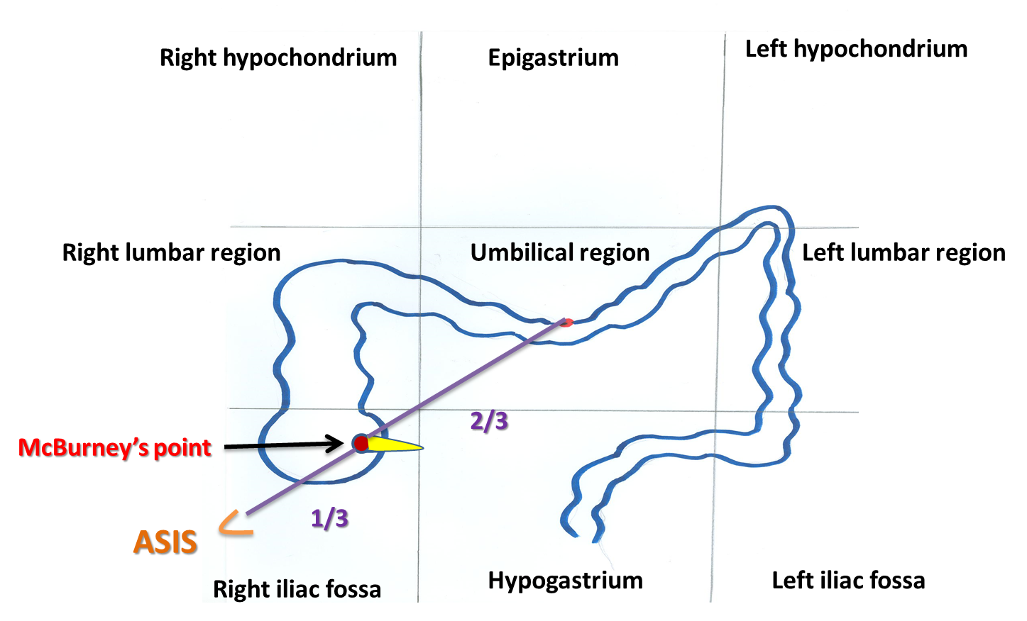
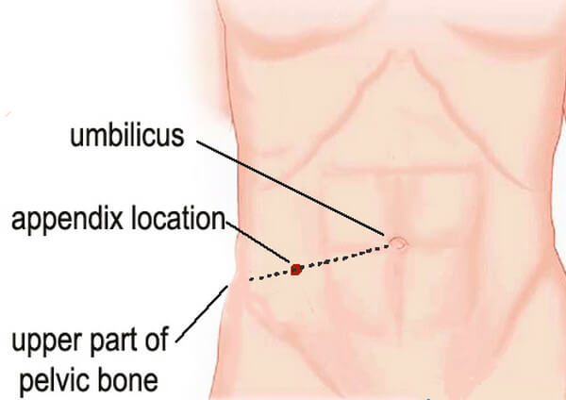
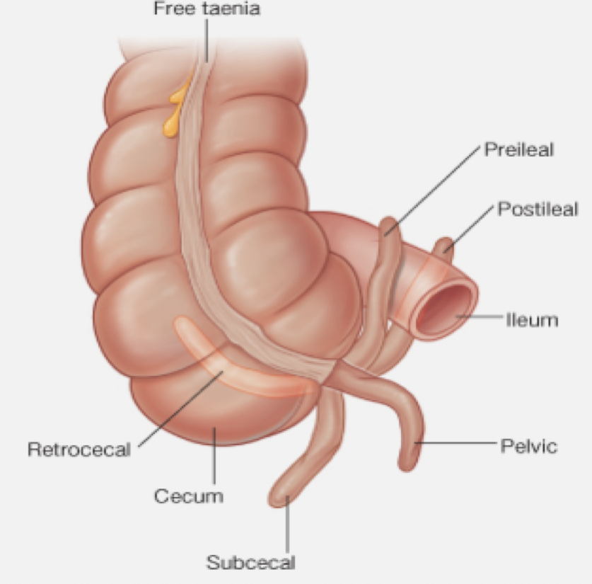
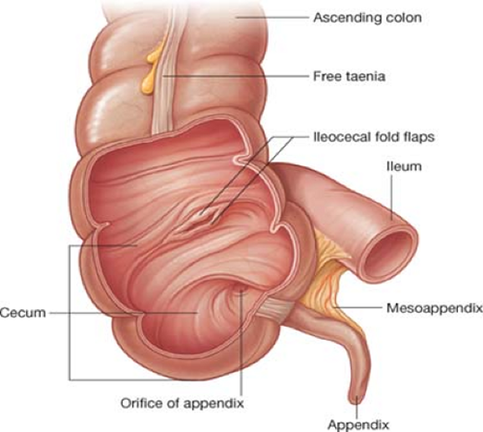
Colic flexures & Appendix
Colic flexures
Splenic flexure (Left) |  | Hepatic flexure (Right)
Between Transverse colon & Spleen Position: higher | Angle: more acute |  | Between Ascending colon & Liver Wider angle
Appendix (Anatomically related to large intestine BUT Functionally related to immunity “Lymphatic system”)
Surface Anatomy | The base of appendix is marked by McBurney’s point*: A point at the junction of lateral 1/3 & medial 2/3 of a line traced from right anterior superior iliac spine to umbilicus.
Opening | At posteromedial aspect of cecum, 1 inch below ileocecal junction
Positions | Retrocecal (most common) Pelvic Subcecal** Preiliea Postileal (least common) **Its original position but with development of the cecum, the position could change depend on equality of the developing sites of cecum, usually inequality causing shifting of appendix position
Extra
(REMEMBER! The position of base not change)
*In case of appendicitis this area will have rebound tenderness (It refers to pain upon removal of pressure rather than application of pressure to the abdomen)

Slide 7
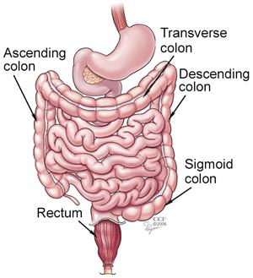
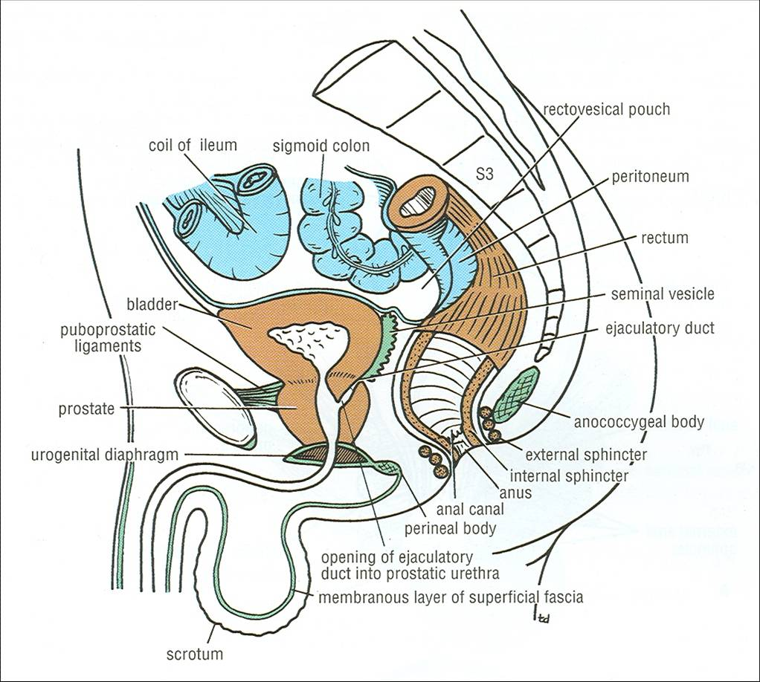
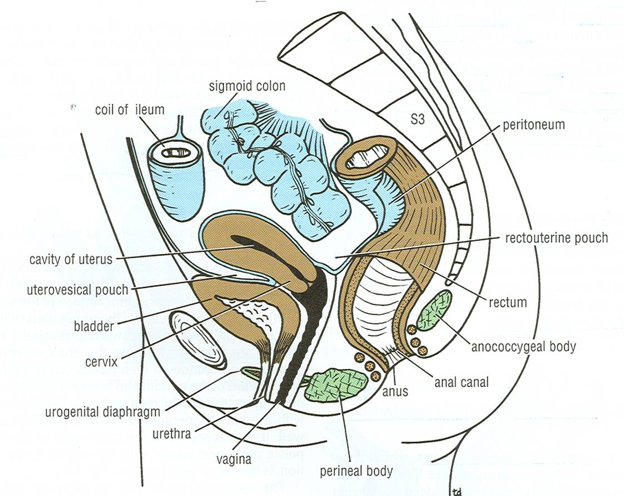
- Upper 1/3 of rectum is covered by peritoneum in front & side
- Middle 1/3 of rectum is covered by peritoneum in front ONLY
- Lower 1/3 of rectum & anal canal has no peritoneum cover
Rectum
Beginning | as a continuation of sigmoid colon at level of S3 in front | as a continuation of sigmoid colon at level of S3
Termination | Continues as anal canal, one inch below & in front of tip of coccyx. Its end is dilated to form the rectal ampulla. | Continues as anal canal, one inch below & in front of tip of coccyx Its end is dilated to form the rectal ampulla
Length | 13 cm (5 inches) | 13 cm (5 inches)
Relations of Rectum in Pelvis
 | Male pelvic |  | Male pelvic
Anterior | Posterior surfaces of urinary bladder Seminal vesicles Prostate gland |  | posterior wall of vagina
Posterior | Sacral plexus 2.Sacrum 3.Coccyx
Male pelvic
Female pelvic

Slide 8
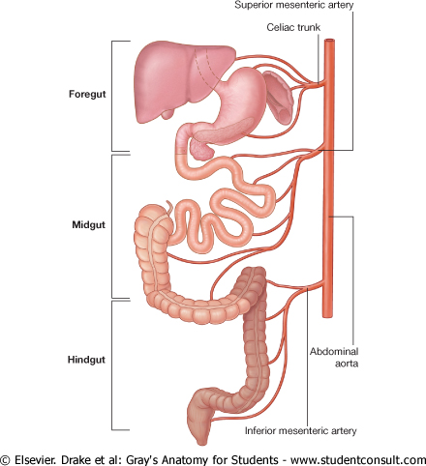
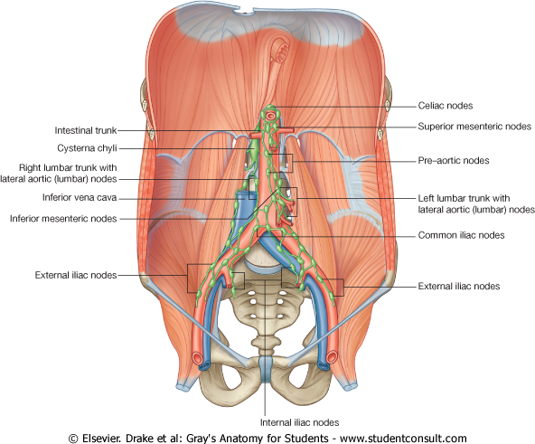
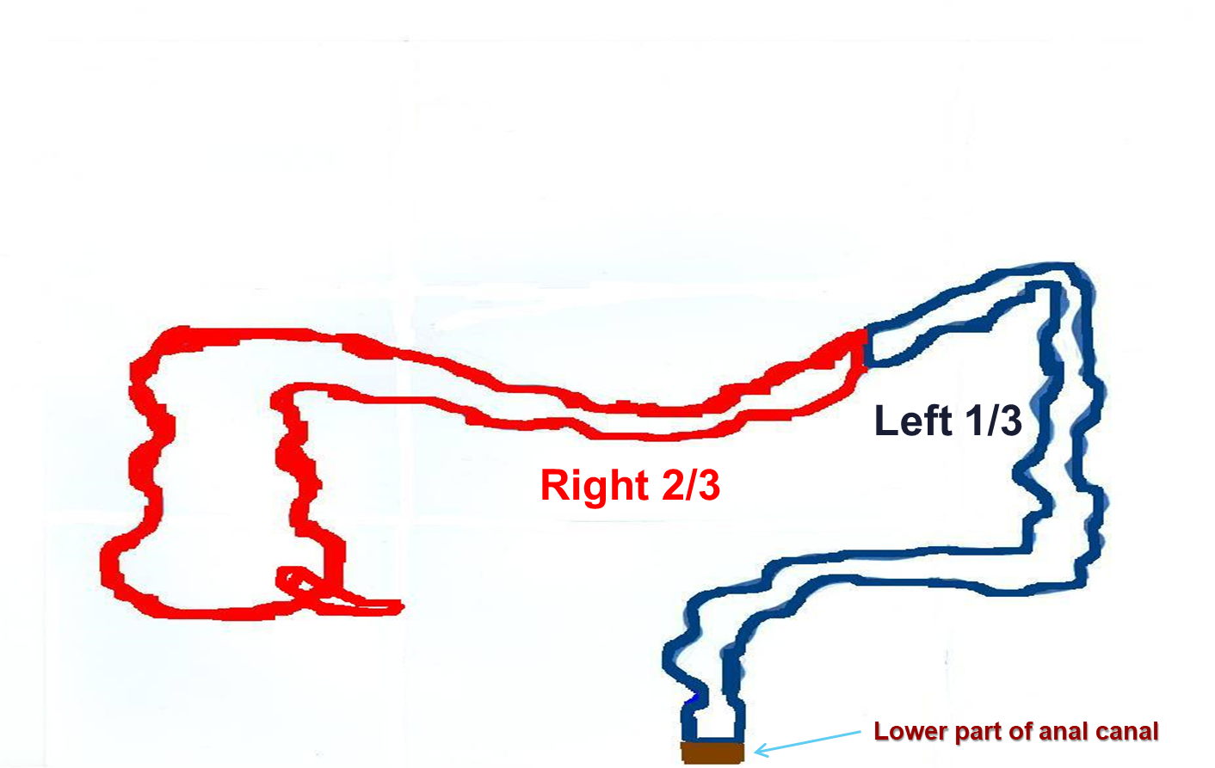
Relation between embryological origin of GIT & Supply
Arterial Supply | Foregut | from esophagus → proximal duodenum at major duodenal papilla (Celiac trunk)
 | Midgut | from distal duodenum after opening → from cecum, appendix, ascending colon & right 2/3 of transvers colon (Superior mesenteric artery)
 | Hindgut | from left 1/3 of transvers colon, Descending colon, Sigmoid colon & Upper 2/3 of anal canal (Inferior mesenteric artery)*
Venous Drainage | The veins of the gut form the tributaries of the portal vein which enters the liver and drains into the portal circulation (Portal vein → liver sinusoid → IVC)
Lymph Drainage | The lymph vessels follow the arteries. Ultimately, all the lymph is collected at the Preaortic lymph nodes (Superior & Inferior mesenteric).
Nerve Supply | Ectoderm | *lower 1/3 of anal canal | Somatic (inferior rectal from sacral plexus)
 | Midgut* | *Endoderm | (Autonomic): Sympathetic + Vagus
 | Hindgut* | *Endoderm | (Autonomic): Sympathetic + pelvic splanchnic nerves (S2&S3)
*It continues as the superior rectal artery in the root of the sigmoid mesocolon (pelvic region).

Slide 9
Peritoneal Covering | Cecum, Ascending & Descending Colons | Transverse Colon | Appendix | Rectum | Venous, Lymph & Nerve Supply
Parts with mesentery: 1. Transverse colon 2. Sigmoid colon 3. Appendix 4. Cecum Retroperitoneal parts: 1. Ascending colon 2. Descending colon 3. Upper 2/3 of rectum Parts devoid of peritoneal covering: 1. Lower 1/3 of rectum 2. Anal canal | Anterior relations: -Greater omentum -Coils of small intestine -Anterior abdominal wall Posterior relations: Cecum: 1. Psoas major 2. Iliacus Ascending colon: 1. Iliacus 2. Quadratus lumborum 3. Right kidney Descending colon: 1. Left kidney 2. Quadratus lumborum 3. Iliacus | Colic flexures: 1-Hepatic flexure 2-Splenic flexure: higher + more acute angle Relations: Anterior: -greater omentum -anterior abdominal wall Posterior: 2nd part of duodenm, pancreas & superior mesenteric vessels Superior: -liver -gall bladder -stomach Inferior: coils of small intestine | Surface anatomy: the base of appendix is marked by Mc’Burney’spoint Opening: At posteromedial aspect of cecum Positions: 1.Retrocecal most common 2.Pelvic 3.Subcecal 4.Preilieal 5.Postileal least common | Beginning: at level of S3 Termination: continues as anal canal, one inch below & in front of tip of coccyx Length: 13 cm (5 inches) Relations: Posterior: sacrum, sacral plexus & coccyx Anterior: MALE PELVIS: seminal vesicles, posterior surfaces of urinary bladder & prostate gland FEMALE PELVIS: posterior wall of vagina | Venous drainage: Portal circulation Lymph drainage: Preaortic lymph nodes Nerve supply: Origin: Midgut Nerve supply: (Autonomic): Sympathetic + Vagus Origin: Hindgut Nerve supply: (Autonomic): Sympathetic + pelvic splanchnic nerves Origin: ectoderm (lower 1/3 of anal canal) Nerve Supply: Somatic (inferior rectal)

Slide 10
1. The taeniae coli found in which of the following structure?
A- Transverse colon B- Small intestine C- Rectum D- Anal canal
2. Which of the following part is with mesentery?
A- Lower 1/3 of rectum B- Appendix C- Ascending colon
D- Upper 2/3 of rectum
3. Which of the following structure is an anterior relation of cecum?
A- Psoas major B- lliacus C- Quadratus lumborum D- Coils of small intestine
4. The superior mesenteric vessels relate to Transverse colon?
A- Anteriorly B- Posteriorly C- Superiorly D- Inferiorly
5. Which one of the following is the nerve supply of the Hindgut (endoderm):
A- Sympathetic + pelvic splanchnic nerves
B- Somatic (inferior rectal)
C- Sympathetic + Vagus
D- Non of them
6. All the lymph in the GIT is collected at the:
A- Preaorticlymph nodes (Superior & Inferior mesenteric)
B- Preaorticlymph nodes (anterior & Inferior mesenteric)
C- Postaorticlymph node
D- Non of them
7. The termination of the rectum is:
A- As a continuation of sigmoid colon at level of S3
B- Continues as anal canal, one inch below & in front of tip of coccyx
C- Sacral plexus & coccyx
D- A & C
8. Which one of the following parts of large intestine is found in the pelvis?
A- Transverse colon B- Anal canal
C- Rectum D- Cecum
9. Its surface anatomy is marked by Mc’Burney’s point:
A- Rectum
B- Colon
C- Appendix
D- Pancreas

Slide 11
Answers
A
B
D
B
A
A
B
C
C

Slide 12
1. What are the characteristics of colon?
Taeniae coli
Sacculations
Epiploic appendices
2. What are the anterior relations of (Cecum – Ascending & Descending colons):
Anterior abdominal wall
Coils of small intestine
Greater omentum
3. What are the posterior relations (Cecum – Ascending & Descending colons):
Cecum: 1. Psoas major 2. Iliacus
Ascending colon: 1. Iliacus 2. Quadratus lumborum 3. Right kidney
Descending colon: 1. Left kidney 2. Quadratus lumborum 3. Iliacus 4. Psoas major

