Slide 2
Objectives
At the end of the lecture, students should be able to:
Location, subdivisions ,relations and peritoneal reflection of liver.
Blood supply, nerve supply and lymphatic drainage of liver.
Location, subdivisions and relations and peritoneal reflection of spleen.
Blood supply, nerve supply and lymphatic drainage of spleen.

Slide 3
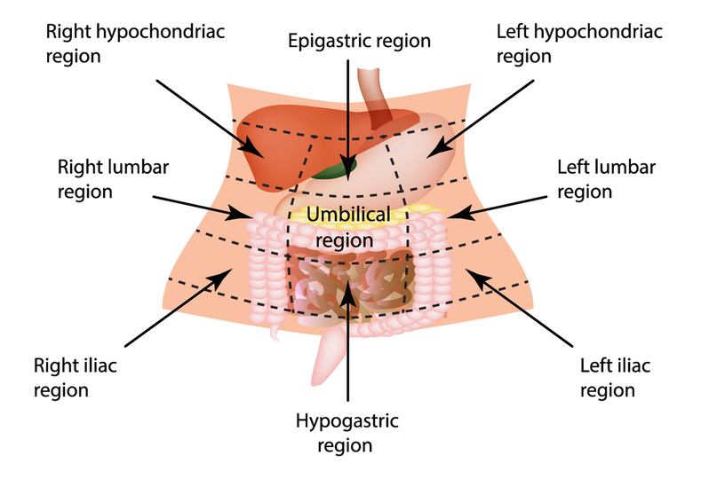
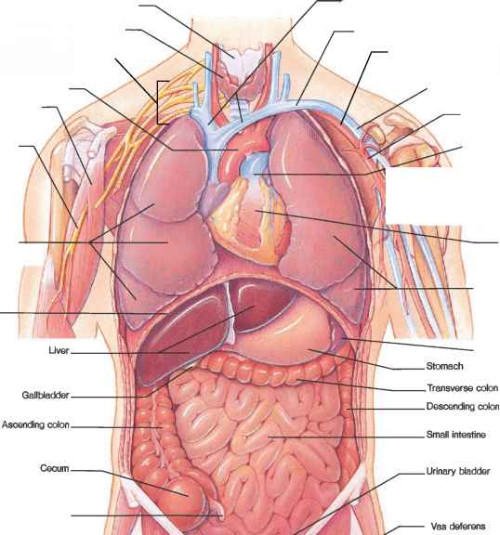
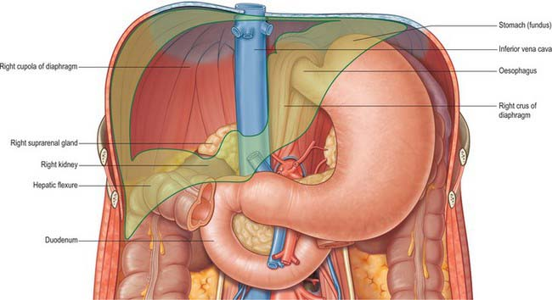
Liver
The largest gland in the body.
Weighs approximately 1500 g (approximately 2.5% of adult body weight).
Lies mainly in the right hypochondrium and epigastrium and extends into the left hypochondrium.
Protected by the thoracic cage and diaphragm, its greater part lies deep to ribs 7-11 (when taking a biopsy from the liver it’s taken from here) on the right side and crosses the midline toward the left below the nipple.
Moves with the diaphragm and is located more inferiorly when on is erect (standing) because of gravity.
10:07
Diaphragm is dome shape so it’s seen anteriorly and posteriorly.
Anterior relation | Posterior relation
Diaphragm Right & left pleura and lower margins of both lungs Right & left costal margins Xiphoid process Anterior abdominal wall in the subcostal angle | Diaphragm Inferior vena cava Right kidney and right suprarenal gland Hepatic flexure of the colon Duodenum (1st part), gallbladder, esophagus (lower part) & fundus of the stomach
IMPOETANT IN OSPE

Slide 4
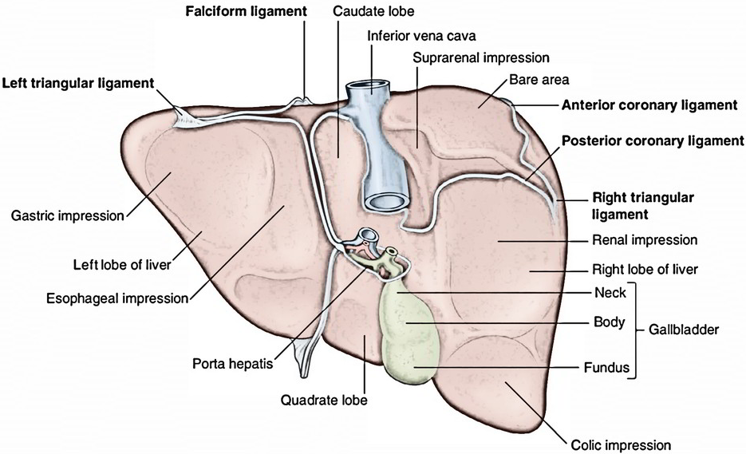
Liver
Peritoneal Reflection
The liver is completely surrounded by a fibrous capsule and completely covered by peritoneum EXCEPT the bare areas = Partially covered by peritoneum
The bare area of the liver is a triangular area on the posterior (diaphragmatic) surface of right lobe where there is NO intervening peritoneum between the liver and the diaphragm.
Boundaries of Bare area:
Anterior: superior (anterior) layer of coronary ligament.
Posterior: inferior (posterior) layer of coronary ligament.
Right: Right triangular ligaments.
Left : Groove for IVC
Other bare areas include:
Porta hepatis, fossa for gall bladder, & groove for IVC (left boundary of bare area)

Slide 5
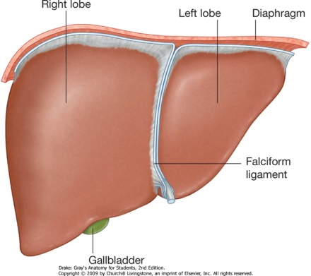
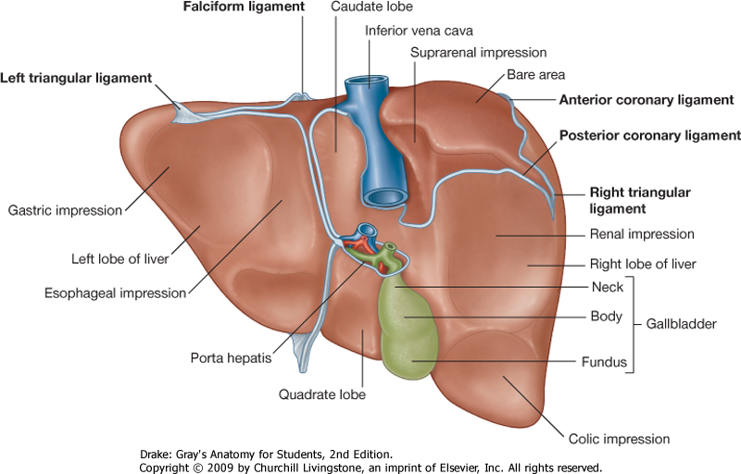
Liver
Surfaces
The liver has two surfaces:
A convex diaphragmatic surface (Antero-superior, right lateral & small area of posterior surface)
A relatively flat or even concave visceral surface (postero-inferior)
Diaphragmatic Surface
The convex upper, anterior & right lateral surface is smooth and molded to the undersurface of the domes of the diaphragm which separates it from the base of 2 pleurae & lungs, pericardium, and heart. Covered with visceral peritoneum, except posteriorly in the bare area of the liver,
where it lies in direct contact with the diaphragm.
Visceral Surface (IMPORTANT)
It is the posteroinferior surface, related to abdominal viscera.
It is covered with peritoneum, except at the fossa for the gallbladder, the porta hepatis and IVC groove.
It bears multiple fissures and impressions for contact with other organs.
The visceral surface of the liver is related to the:
1- Stomach & duodenum (lower end) 2- Esophagus (lower end) 3- Lesser omentum (along margin of porta hepatis) 4- Gallbladder 5- Right colic flexure 6- Right kidney & right suprarenal gland
Lesser omentum

Slide 6
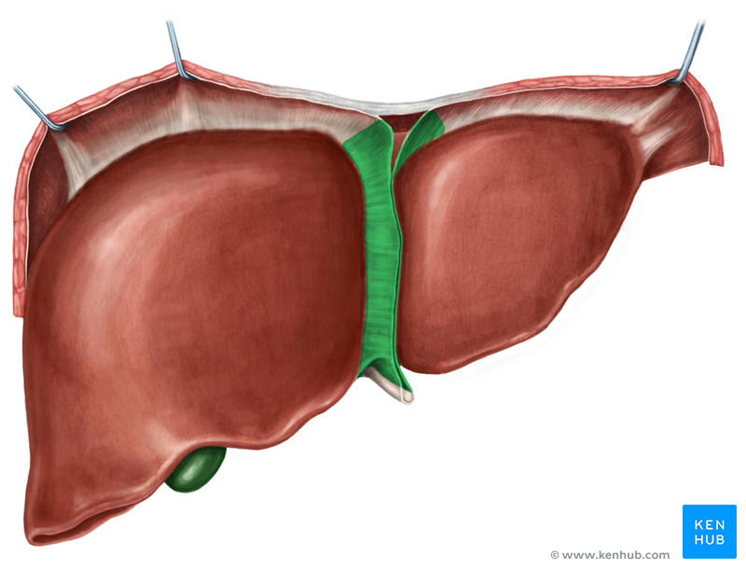
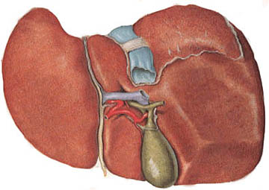
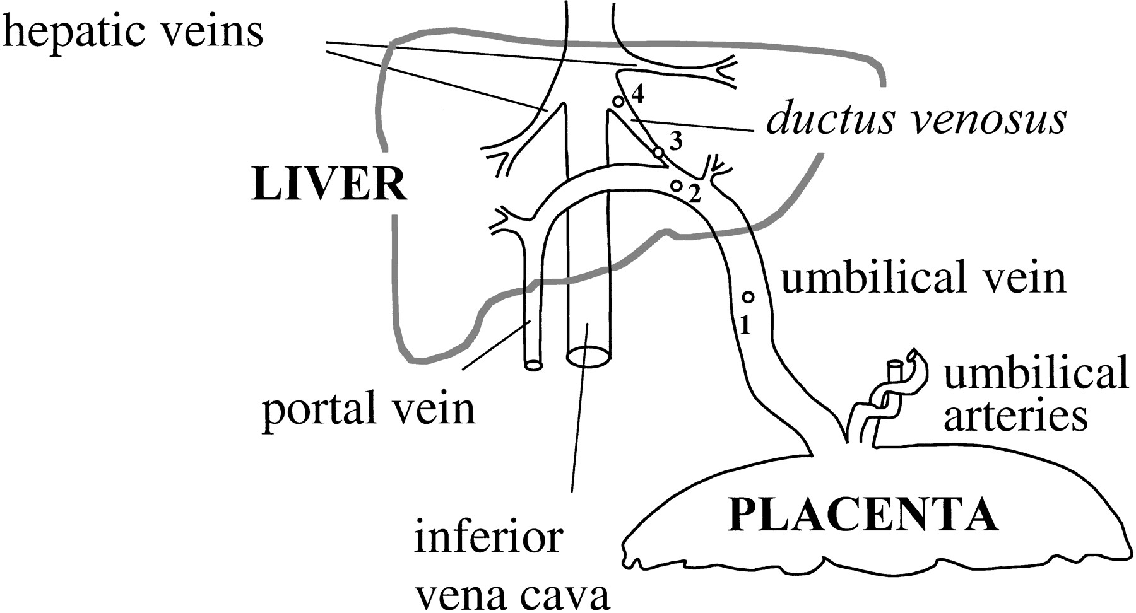
Liver
Ligaments
Falciform ligament
It is a two-layered fold of the peritoneum, ascends from the umbilicus to the liver.
It connects the liver with the diaphragm and anterior abdominal wall & umblicus.
(Attached to the anterior abdominal wall and posteriorly to the anterior & superior border of the liver)
Its sickle-shaped free margin contains the ligamentum teres (round Ligament) of liver, the remains of the umbilical vein (oblitrated umbilical vein) , which carried oxygenated blood and nutrients from the placenta to the fetus.
Ligamentum venosum
It is the fibrous remnant of the fetal ductus venosus (oblitrated ductus venosus), which shunted blood from the umbilical vein to the IVC, in intrauterine fetal life
short circuiting the liver.
In fetal circulation, 50% of the venous blood coming from the mother goes to the liver and 50% shunts directly to IVC by the ductus venosus.
ligamentum venosum
round ligament

Slide 7
Liver
Lobes
The liver is divided into a large right lobe and a small left lobe (the difference in size is only anatomically not physiologically, since the caudate and quadrate lobes are functionally a part of the left lobe) by the attachment of the falciform ligament to anterior and superior surfaces.
The right lobe is further divided into a quadrate lobe (interior) and a caudate (superior) lobe by the presence of (1) the gallbladder, (2) the fissure for the ligamentum teres, (3) the inferior vena cava, and (4) the fissure for the ligamentum venosum.
The caudate lobe is connected to the right lobe by the caudate process.(demonstrates the opening of the lesser sac from above)
The quadrate and caudate lobes are a functional part of the left lobe of the liver.
The functional anatomy divides the liver into left and right lobes based on their relation to the division of common hepatic duct, hepatic portal vein, and hepatic artery proper into right & left branches, so the areas of the liver supplied by these branches constitute the functional left or right lobes.
Caudate process

Slide 8
Liver
Fissures & Porta hepatis
Two sagittally oriented fissures, linked centrally by the transverse porta hepatis, form the letter H on the visceral surface.
Porta hepatis (Helium of the liver): A transverse fissure found on the posteroinferior surface and lies between the caudate & quadrate lobes.
The upper part of the lesser omentum is attached to its margins. (the lips)
Structures passing through the porta hepatis include:
Right and left hepatic ducts.
Right and left branches of the hepatic artery
Right and left branches of the portal vein
Sympathetic and parasympathetic nerve fibers
A few hepatic lymph nodes lie here; they drain the liver and gallbladder and send their efferent vessels to the celiac lymph nodes (final drainage).
The 2 hepatic veins open in the posterior surface on the groove for IVC
Right Fissure
Anteriorly: by the fossa for the gallbladder
Posteriorly: by the groove for the IVC. ,
Left Fissure
Anteriorly: by the fissure for the round ligament (ligamentum teres)
Posteriorly: by the fissure for the ligamentum venosum.
Sometimes the IVC runs in a tunnel inside the liver.
ligamentum venosum
IVC
IMPOETANT
round ligament
Gallbladder
Porta hepatis

Slide 9
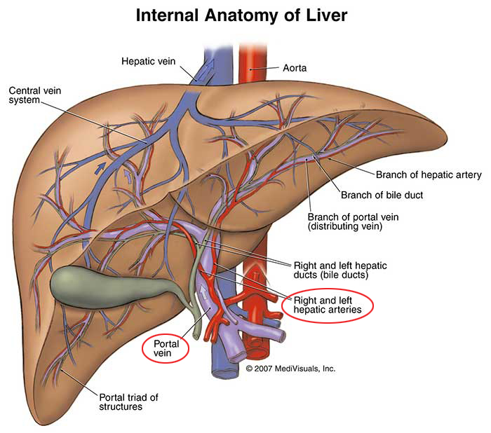
The liver is held in its position by 3 things:
Hepatic veins → main!
Peritoneal ligaments
Abdominal muscles
Liver
Blood Circulation
08:11
The blood vessels conveying blood to the liver are the hepatic artery (30%) a branch of celiac trunk, and portal vein (70%).
The hepatic artery brings oxygenated blood to the liver
The portal vein brings venous blood rich in the products of digestion, which have been absorbed from the gastrointestinal tract to the liver.
The venous blood is drained by right & left hepatic veins into the IVC
At or close to the porta hepatis, the hepatic artery and portal vein terminate by dividing into right and left primary branches which supply the right and left parts of liver, respectively.
Within the liver, the primary branches divide to give secondary and tertiary to supply the hepatic segments independently.
The hepatic veins, are intersegmental in their distribution and function, draining parts of adjacent segments, and they open in the posterior surface on the groove for IVC.
The attachment of the two hepatic veins to the IVC helps hold the liver in position. (The peritoneal ligaments and the tone of the abdominal muscles play a minor role in the support of liver).
hepatic Vein
hepatic arteries
Portal vein

Slide 10
In portal hypertension (as from cirrhosis or hepatitis) the anastomosis areas dilate causing variant effects depending on the site, for example:
Esophageal → causes esophageal varices and hematemesis (vomiting blood)
Paraumbilical → causes caput medusa
Upper anal canal → cause hemorrhoids (البواسير) when the dilation burst and bleed.
Liver
Supply
Lymph Drainage | The liver produces a large amount of lymph—about one third to one half of all body lymph. The lymph vessels leave the liver and enter several lymph nodes in the porta hepatis. The efferent vessels pass to the celiac nodes mainly. A few vessels pass from the bare area of the liver through the diaphragm to the posterior mediastinal lymph nodes.
Nerve supply | Sympathetic from the celiac plexus. Parasympathetic nerves: The anterior vagal trunk gives rise to a large hepatic branch, which passes directly to the liver.
Portal-systemic (portacaval) anstomoses IMPORTANT | It is a specific type of anastomosis that occurs between the veins of portal circulation and those of systemic circulation In portal hypertion, these anastomosis open and form venous dilatation called varices (الدوالي). Sites: -Esophagus (lower third part) (either systemic to the azygos veins or portal to the left gastric vein) -Upper Anal canal (immediately under rectum, between the superior rectal vein and the middle & inferior rectal veins) -Paraumbilical region -Retroperitoneal -Intrahepatic (Patent ductus venosus)

Slide 11
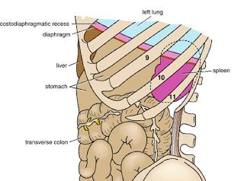
Spleen
Largest single mass of lymphoid tissue (embryologically formed by the dorsal mesogastrium by collection of scattered lymph nodes)
Located in the left hypochondrium, deep to 9, 10 & 11 ribs.
Its Long axis lies along 10th rib.
It is separated from the ribs by the diaphragm and the costodiaphragmatic recess (space in pleural cavity).
Ovoid in shape with notched anterior border, while posterior border is round
Lower pole extends forward as far as the midaxillary line.
Normal size spleen can not be palpated on clinical examination. (A healthy spleen is not palpable).

Slide 12
Spleen
Relation
REMEMBER!
Left colic flexure = splenic flexure
Right colic flexure = hepatic flexure
Anterior | Posterior
Stomach Tail of pancreas Left colic flexure Left kidney | Diaphragm, that separates it from the left pleura (left costo-diaphragmatic recess) Left lung 9, 10 & 11 ribs
Medial | Inferior
Left kidney | Left colic flexure
Left colic flexure | Right colic flexure
Higher | Lower
Away from the middle line
Develops from the hindgut | Develops from the midgut
Supplied by the inferior mesenteric | Supplied by the superior mesenteric
Acute angle (less than 90° ) | Right angle (90°)
IMPOETANT

Slide 13
Spleen
Peritoneal Reflection | Ligaments | Spleen is completely surrounded by peritoneum which passes from its hilus as: Gastrosplenic ligament to the greater curvature of stomach (carrying the short gastric and left gastroepiploic vessels) Lienorenal (splenorenal) ligament to the left kidney (carrying the splenic vessels and the tail of pancreas care not to cut it in splenectomy).
Surfaces | Diaphragmatic surface: is convexly curved to fit the concavity of the diaphragm and curved bodies of the adjacent ribs Visceral surface: related to viscera.
Borders | The superior & anterior borders are sharp. Anterior border is notched. The posterior (medial) & inferior borders are rounded.

Slide 14
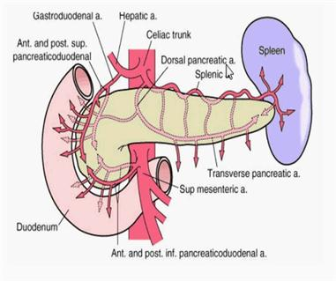
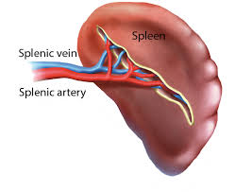
Spleen
Supply
14:28
Blood supply (Splenic artery) | Largest branch of the celiac artery Runs a tortuous (متعرج) course (so when the stomach is full it won’t collapse it will just elongate) along the upper border of the pancreas Passes within the lienorenal ligament Divides into 4-5 terminal branches, which enter the spleen at the hilus.
Venous Drainage (Splenic vein) IMPORTANT | Leaves the hilus Runs behind the tail & body of the pancreas Reaches behind the neck of pancreas, where it joins the superior mesenteric vein to form the portal vein Tributaries: Short gastric vein | left gastroepiploic vein | Pancreatic veins | Inferior mesenteric vein
Lymph Drainage | Lymphatics emerge from the hilus and drain into several nodes lying at the hilum Efferents from the hilar nodes pass along the course of splenic artery, and drain into the celiac lymph nodes
Nerve supply | Derived from the celiac plexus (Innervation is purely sympathetic). Are distributed mainly along branches of the splenic artery, and are vasomotor in function.

Slide 15
SUMMARY
 | LIVER | SPLEEN
Location | Right & left hypochondrium and epigastrium | Left hypochondrium deep to 9&10&11ribs
Surfaces | Convex diaphragmatic Concave visceral | Diaphragmatic(convex) visceral
Borders | - | Superior & anterior borders → sharp Posterior & inferior → round
Blood supply | Hepatic artery(carry oxygenated blood) Portal vein (carry venous blood rich in nutrients) R&L hepatic vein drain venous blood into IVC | Splenic artery & vein (splenic v joins superior mesenteric v to form portal v)
Nerve supply | Sympathetic →celiac plexus parasympathetic→ anterior vagal trunk | Purely sympathetic →celiac plexus
Lymphatic drainage | Celiac nodes Few vessels to posterior mediastinal lymph nodes | Celiac nodes

Slide 16
(1) Which one of the following play a major role in supporting of liver?
A) Hepatic veins
B) Hepatic artery
(6) Which of the following artery has tortuous course :-
A) Hepatic artery
B) Splenic artery
C) Superior mesenteric
D) Inferior mesenteric
C) Peritoneal ligament
D) Tone of abdominal muscle
(7) The portal vein is form by joining of :-
A) Splenic vein and superior mesenteric artery
B) Splenic vein and superior mesenteric vein
C) Hepatic vein and superior mesenteric vein
D) Superior and inferior mesenteric veins
(2) The main final lymphatic drainage of liver is :-
A) Posterior mediastinal nodes
B) Celiac nodes
C) Superior mediastinal nodes
D) Superior mesenteric nodes
(3) The spleen is located in the left side deep to :-
A) 7,8 and 9 ribs
B) 10 rib
C) 9,10 and 11 ribs
D) None of above
(8) The liver lies mainly in the :
A) Right lumber region
B) Left hypochondrium
C) Right hypogastrium
D) Right hypochondrium
(4) The ligament that attached the hilum of spleen to the greet curvature of stomach :-
A) Gastrosplenic ligament
B) Lienorenal ligament
(9) Which of the following lies posterior to the liver:
A) The body of the stomach
B) The hepatic flexure
C) Splenorenal ligament
D) Gastrohepatic ligament
C) The jejunum
D) The splenic flexure
(5) The left colic flexure is related to the spleen :-
A) Anteriorly
B) Posteriorly
(10) The lateral boundaries of the Bare area include:
A) Superior triangular ligament
B) Left coronary ligament
C) Medially
D) Inferiorly
C) Posterior triangular ligament
D) Right triangular ligament

Slide 17
Answers
A
B
C
A
D
B
B
D
B
D

Slide 18
52 years old male, emigrated from Southeast Asia about 10 years ago, and has no specific complaints except fatigue. On examination you find little of note except that his liver edge is firm, is easily felt, and extends about 6 cm below the costal margin across much of the right upper quadrant.
1) What is the liver ?
The largest gland in the body
2) Where is it located ?
Lies mainly in the right hypochondrium and epigastrium and extend into the left hypochondrium. Its gather part lies deep to 7- 11 right side ribs and crosses the midline toward the left nipple
3) What protects it ?
It is protected by the thoracic cage and the diaphragm.
4) What is the site of portal-systemic anastomoses?
Esophagus (lower part).
Upper Anal canal.
Paraumbilical region.
Retroperitoneal.
Intrahepatic (Patent ductus venosus).
5) What is the feature that enable subtotal splenectomy?
Lack of arterial anastomoses

