Slide 1
DEVELOPMENT OF
PANCREAS & SMALL INTESTINE
Color Code:
Important
Doctors Notes
Extra explanation

Slide 2
OBJECTIVES:
At the end of the lecture, the students should be able to :
Describe the development of the duodenum.
Describe the development of the pancreas.
Describe the development of the small intestine.
Identify the congenital anomalies of the small intestine :
Congenital omphalocele.
Umbilical hernia.
Meckel’s diverticulum.

Slide 3
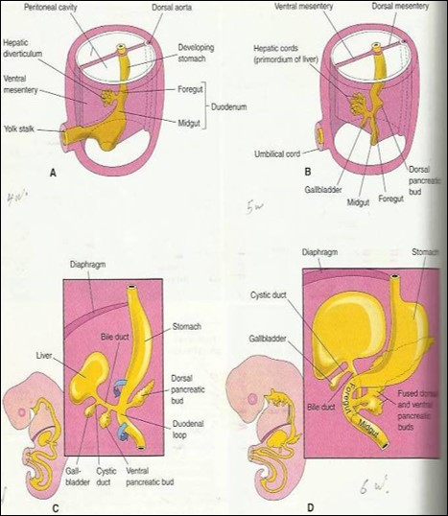
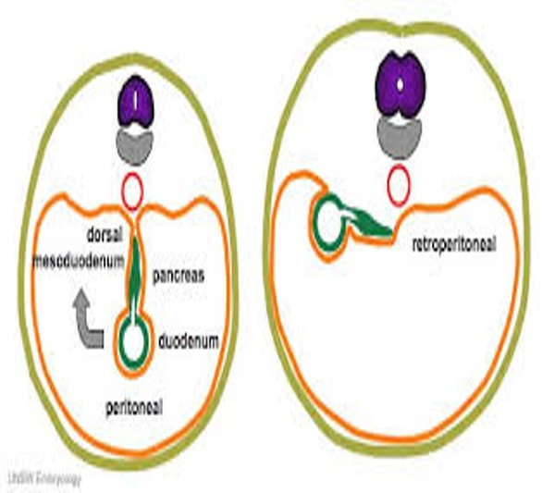
DEVELOPMENT OF THE DUODENUM:
Stages in the development of duodenum, liver, biliary ducts and pancreas (pic.A-D):
pic A > 4th week , pic B and C > 5th week , pic D > 6th week
Early in the 4th week , the duodenum develops from the endoderm of primordial gut of :
Caudal part of foregut
Cranial part of midgut
Splanchnic mesoderm.
The junction of the 2 parts of the gut lies just below or distal to the origin of bile duct (pic. C&D).
The duodenal loop:
During 5 th and 6 th weeks, the lumen of the duodenum is temporarily obliterated because of proliferation of its epithelial cells.
Normally degeneration (recanalization) of epithelial cells occurs, so the duodenum normally becomes recanalized by the end of the embryonic period ( end of 8th week)
Stomach develops from cranial part of foregut
1- The duodenal loop is formed and projected ventrally ”from anterior abdominal wall” forming a C shaped loop.
2- The duodenal loop is rotated with the stomach to the right. (90) degrees وياخذ معاه البنكرياس
3- It comes to lie on the posterior abdominal wall retroperitoneally with the developing pancreas.
Prenatal periods is consistent of two periods:
1- embryonic period: since fertilization to the end of 8th week
2- fetal period: beginning of 9th week to birth

Slide 4
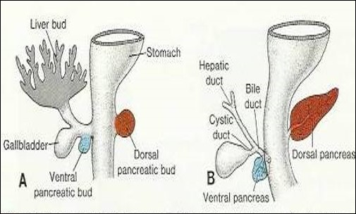
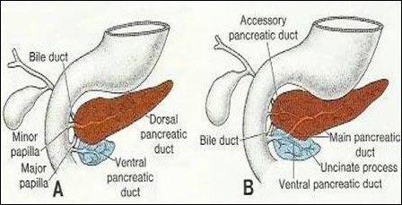
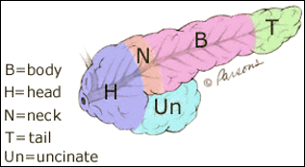
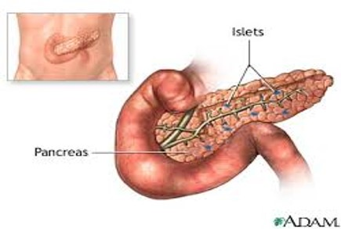
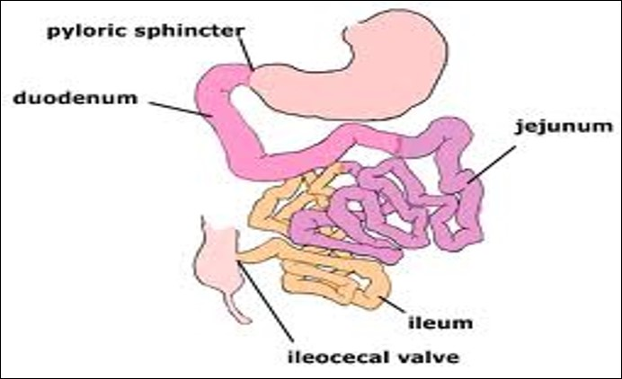
DEVELOPMENT OF PANCREAS:
The pancreas develops from 2 buds ( ventral & dorsal pancreatic buds ) arising from the endoderm of the caudal part of foregut. But Most of pancreas is derived from the dorsal pancreatic bud.
When the duodenum rotates to the right and becomes C-shaped, the ventral pancreatic bud moves dorsally to lie below and behind the dorsal bud.
Later the 2 buds fused together and lying in the dorsal mesentery.
The parenchyma (tissue) of pancreas is derived from the endoderm of pancreatic buds.”both ventral+dorsal”
Pancreatic islets (of Langerhans) more potent in the tail develops from> parenchymatous pancreatic tissue.
Insulin secretion begins at 5th month of pregnancy.
DEVELOPMENT OF SMALL INTESTINE:
 | A ventral pancreatic bud | A dorsal pancreatic bud ( larger ) forming most of the pancreas
develops from | Proximal end of hepatic diverticulum (forms the liver & gallbladder). | dorsal wall of duodenum slightly cranial to the ventral bud. Formation is induced by the notochord.
the bud forms | Uncinate process. Inferior part of head of pancreas. | Upper part of of head. Neck. Body. Tail of pancreas.
pancreatic ducts
The main pancreatic duct ( is derived from ) | The duct of the ventral bud. | The distal part of duct of dorsal bud.
The accessory pancreatic duct ( is derived from ) | — | Proximal part of duct of dorsal bud.
Important!!
Most of small intestine develop from midgut
Derivatives of cranial part of the midgut loop. | Derivatives of the caudal part of midgut loop. | Derivative of the caudal part of foregut.
Distal part of the duodenum Jejunum Upper part of the ileum. | Lower portion of ileum. Cecum , appendix, ascending colon + proximal 2/3 of transverse colon ( Large intestine ) | proximal part of duodenum
So, the small intestine ( duodenum , Jejunum & ileum ) is developed from: Caudal part of foregut and all midgut. Midgut is supplied by superior mesenteric artery (artery of midgut).

Slide 5
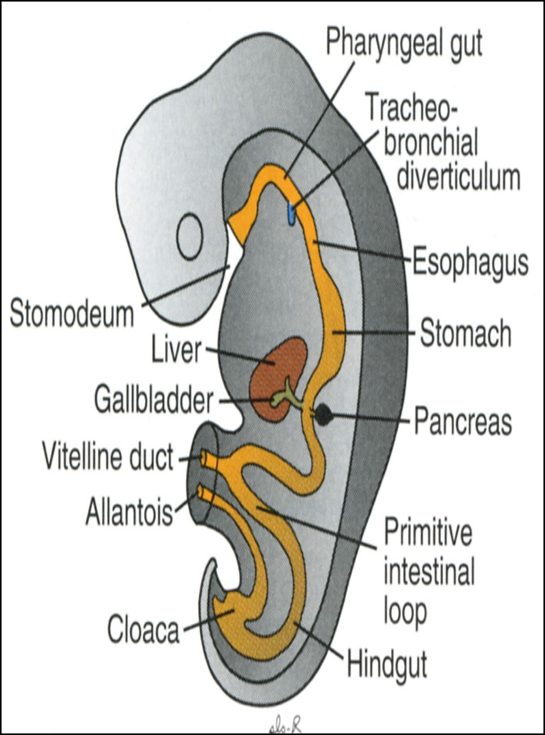
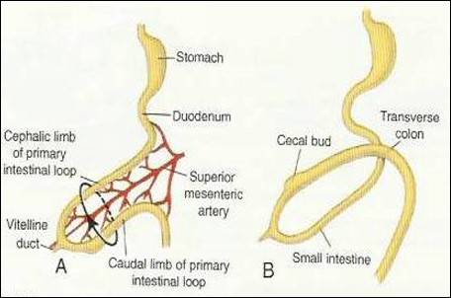
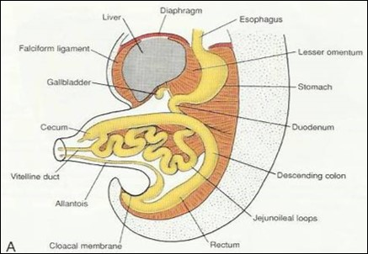
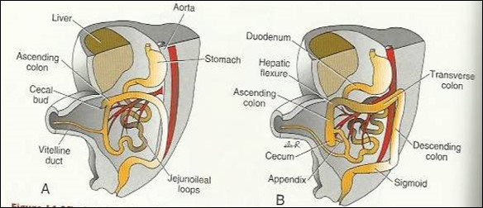
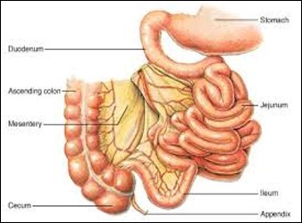
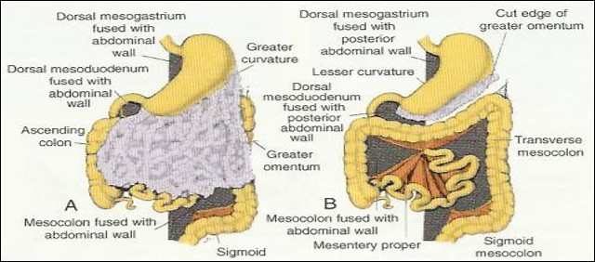
DEVELOPMENT OF SMALL INTESTINE:
➔ STAGES OF DEVELOPMENT OF SMALL INTESTINE:
Preherniation stage.
Stage of physiological umbilical hernia.
stage of rotation of midgut loop.
Stage of reduction of umbilical hernia.
Stage of fixation of various parts of intestine.
Development of midgut loop:
At the beginning of 6th week, the midgut elongates to form a ventral U-shaped midgut loop.
Midgut loop communicates with the yolk sac by vitelline duct or yolk stalk.
As a result of rapidly growing liver, kidneys & gut ,so the abdominal cavity is temporarily too small to contain the developing rapidly growing intestinal loop. So ,Midgut loop projects into the umbilical cord , this is called physiological umbilical herniation (begins at 6th w.).
Rotation of midgut loop:
Midgut loop has a cranial limb & a caudal limb.
Midgut loop rotates around the axis of the superior mesenteric artery.
Midgut loop rotates first 90 degrees to bring the cranial limb to the right and caudal limb to left during the physiological hernia.
The cranial limb of midgut loop elongates to form the intestinal coiled loops (jejunum & upper ileum).
This rotation is counterclockwise and it is completed to 270 degrees, so after reduction of physiological hernia it rotates to about 180 degrees.
Return of midgut to abdomen:
During 10th week, the intestines return to the abdomen due to regression of liver & kidneys + expansion of abdominal cavity. It is called reduction of physiological midgut hernia.
Rotation is completed and the coiled intestinal loops lie in their final position in the left side.
The caecum at first lies below the liver, but later it descends to lie in the right iliac fossa.
Fixation of various parts of intestine:
The mesentry of jejunoileal loops is at first continuous with that of the ascending colon.
When the mesentry of ascending colon fuses with the posterior abdominal wall، the mesentry of small intestine becomes fan-shaped and acquires a new line of attachment that passes from duodenojejunal junction to the ileocecal junction.
The enlarged colon presses the duodenum & pancreas against the posterior abdominal wall.
Most of duodenal mesentery is absorbed, so most of duodenum ( except for about the first 2.5 cm derived from foregut) & pancreas become retroperitoneal.
الاسبوع العاشر مهم

Slide 6
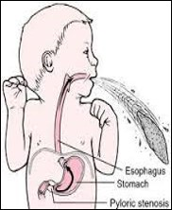
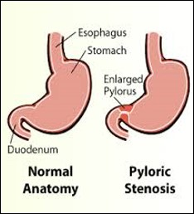
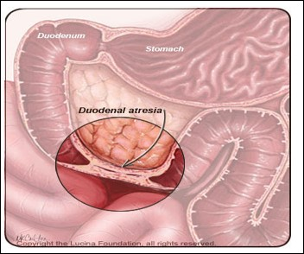
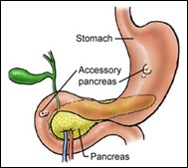
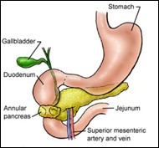
Congenital Anomalies
Organ: | Details:
Duodenum: A. Duodenal stenosis | A. results from incomplete recanalization of duodenum
Duodenum: B. Duodenal atresia | B. results from failure of recanalization leading to complete occlusion of the duodenal lumen, (autosomal recessive inheritance ).
Pancreas: A. Accessory pancreatic tissue | A. located in the wall of the stomach or duodenum.
Pancreas: B. Anular pancreas | B. A thin flat band of pancreatic tissue surrounding the second part of the duodenum, causing duodenal obstruction. (Intestinal obstruction)

Slide 7
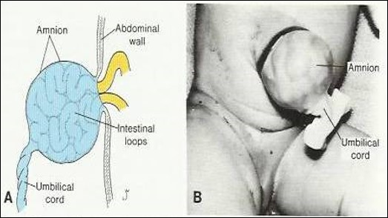
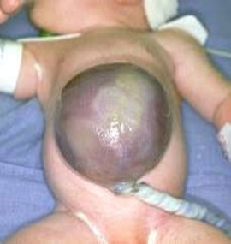
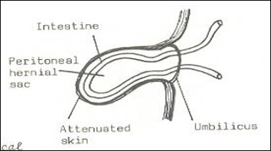
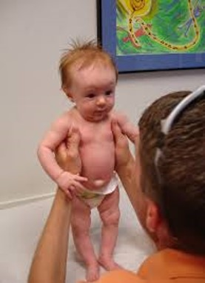
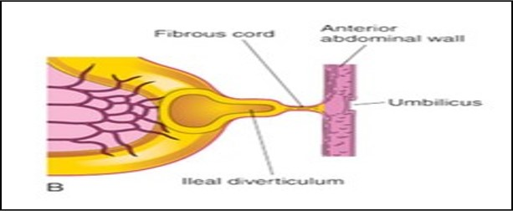
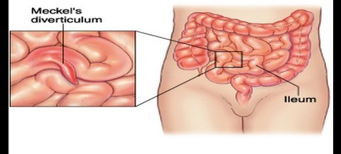
Important!!
Organ: | Details
Small intestine: A. Congenital Omphalocele | It is a persistence of herniation of abdominal contents into proximal part of umbilical cord due to failure of reduction of physiological hernia to abdominal cavity at 10th week. It is accompanied by small abdominal cavity. Herniation of intestines occurs in 1 of 5000 births – herniation of liver and intestines occurs in 1 of 10,000 births. The hernial sac is covered by the epithelium of the umbilical cord or the amnion. Immediate surgical repair is required.
Small intestine: B. Congenital Umbilical Hernia | The intestines return to abdominal cavity at 10th week, but herniate through an imperfectly closed umbilicus. It is a common type of hernia. The herniated contents are usually the greater omentum and small intestine. The hernial sac is covered by skin and subcutaneous tissue. It protrudes during crying , straining or coughing and can be easily reduced through fibrous ring at umbilicus. Surgery is performed at age of 3-5 years.
Small intestine C. ileal (Meckel’s)Diverticulum | It is one of the most common anomalies of the digestive tract, present in about 2% -4% of people, more common in males. It is a small pouch from the ileum, and may contain small patches of gastric and pancreatic tissues causing ulceration, bleeding or even perforation. It is the remnant of proximal part non-obliterated part of yolk stalk (or vitelline duct). It arises from antimesenteric border of ileum, 1/2 meter from ileocecal junction. It is sometimes becomes inflammed and causes symptoms that mimic appendicitis. 1- It may be connected to the umbilucus by a fibrous cord. 2- or the middle portion forms a cyst 3- or may remain patent forming the fistula (vitelline fistula). - so, faecal matter is carried through the duct into umbilicus.

Slide 8
Summary
Organ | Period | Event
Duodenum | 4th week | Develops from the endoderm of primordial gut.
 | 5th & 6th week | The lumen of the duodenum is temporarily obliterated. Degeneration of epithelial cells occurs.
 | End of 8th week | - Duodenum normally becomes recanalized.
Pancreas | 5th month | Insulin secretion begins.
Midgut loop | 6th week | Elongates to form a venteral U-shaped midgut loop. Communicates with the yolk sac by vitelline duct or yolk stalk. Projects into the umbilical cord (physiological umbilical herniation).
 | 10th week | Return to the abdomen (reduction of physiological midgut hernia).
Congenital anomalies | Cause and details
Duodenal stenosis | Incomplete recanalization of duodenum.
Duodenal atresia | Failure of recanalization of duodenum.
Accessory pancreatic tissue | Located in the wall of the stomach or duodenum.
Anular pancreas | A thin flat band of pancreatic tissue surrounding the second part of the duodenum, causing duodenal obstruction.
Congenital Omphalocele | Failure of reduction of physiological hernia to abdominal cavity at 10th week.
Congenital Umbilical Hernia | Imperfectly closed umbilicus.
Ileal (Meckel’s) Diverticulum | Remnant of proximal part non-obliterated part of yolk stalk (or vitelline duct). Sometimes become inflamed and can produce pain.

Slide 9
Questions
reduction of physiological midgut hernia. ( RETURN OF MIDGUT TO ABDOMEN ) occur during: |  | 2. physiological umbilical herniation occur at:
 | 6th month. |  | 6th month.
B. | 10th month. | B. | 10th month.
C. | 10th week. | C. | 10th week.
D. | 6th week. | D. | 6th week.
3.Which part of the pancreas the ventral pancreatic bud forms: |  | 4. Which artery the midgut loop rotates around its axis:
 | Upper part of the head. |  | Splenic artery.
B. | Lower part of the head. | B. | Inferior mesenteric artery.
C. | Body. | C. | Superior mesenteric artery.
D. | Tail. | D. | Celiac trunk.
5. The umbilical hernia is: |  | 6. The duodenal………… results from failure of recanalization , but duodenal………. results from incomplete recanalization.
 | Uncommon type. |  | atresia - stenosis
B. | Resulting from imperfect closed umbilicus. | B. | Stenosis- atresia
C. | Covered by the epithelium of umbilical cord. | C. | Omphalocele - Umbilical Hernia
D. | Not be easily reduced at the umbilicus. | D. | Umbilical Hernia - Omphalocele
Q | 1 | 2 | 3 | 4 | 5 | 6
Answers | C | D | B | C | B | A

Slide 10
( يَرْفَعِ اللَّهُ الَّذِينَ آمَنُوا مِنكُمْ وَالَّذِينَ أُوتُوا الْعِلْمَ دَرَجَاتٍ وَاللَّهُ بِمَا تَعْمَلُونَ خَبِير )
Team leaders
ميعاد النفيعي - فهد النهابي
Team members
عهد القرين - ليلى الصّباغ
Embryologyteam437@gmail.com
‪@embryology437
Your feedback
Editing file

