Slide 1
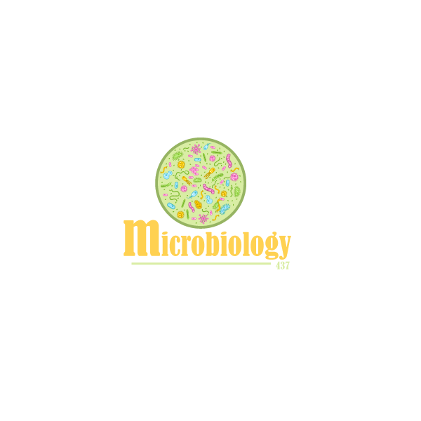

Slide 2
Introduction to normal flora:
Normal flora are microorganisms that are frequently found in various body sites in normal healthy individuals
Constituents and number vary according to the age and physiologic status
Able to colonize and multiply under the existing condition of different body sites
Inhibit competing intruders
Have symbiotic relationship that benefit the host
Can cause disease in immunocompromised patients
Normal Flora Of GIT
Oral cavity: contain high number of flora which vary from site to site of the mouth. Saliva contain mixed flora: 10⁸ organism /ml Stomach: empty stomach has no normal flora in health due to HCL and peptic enzymes Small intestine: very scanty except near colon Colon of adults: 10¹⁰ org/gm stool, >90% are Bacteriodes (anaerobic), 10% other bacteria. (the most colonized organ) Direct effect of diet composition.
Normal flora (low virulence)
Organ | Mouth | Nasopharynx | Stomach | Small intestine | Colon
The normal flora | Viridans streptococci Neisseria spp Moraxella Peptostreptococcus. | Neisseria spp Viridans sterpt. Moraxella Peptostreptococcus | Streptococci, Peptosterptococcus others from mouth | Scanty variable | Bacteriodes, Fusobacterium Eubacterium Lactobacillus Enterobacteriaceae, Clostridium Enterococcus
Potential pathogen (carrier)
Organ | Mouth | Nasopharynx | Stomach | Small intestine | Colon
The normal flora | Candida albicans | S.pneumoniae, N.meningitidis, H.infuenzae, S.pyogenes, S.aureus | None | None | B.fragilis E.coli, Pseudomonas Candida Clostridium (C. perfringens, C.difficile)

Slide 3
Role of GIT normal Flora in disease
Many are opportunistic pathogens , eg. perforation of the colon from ruptured diverticulum, feces enter into peritoneal cavity and cause peritonitis
Viridans streptococci of oral cavity enters the blood and colonize damaged heart valves.
Mouth flora play a role in dental caries.
Compromised defense systems increase the opportunity for invasion.
Death after lethal dose of radiation due to massive invasion of normal flora.
E.coli: the most common Enterobacteriaceae; a facultative flora of colon followed by Klebsiella,Proteus and Enterobacter.
Salmonella, Shigella and Yersinia are NOT normal flora of the intestinal tract.
Some strains of E.coli ,Salmonella ,Shigella and Yersinia enterocolitica are able to cause diseases in the intestinal tract.
Acute diarrheal illness and food poisoning:
Introduction:
Acute diarrheal illness is one of the most common problems evaluated by clinicians. A major cause of morbidity and mortality worldwide. Most of healthy people have mild illness but other might develop serious squeals so it is important to identify those individuals who require early treatment.
Definition of diarrhea:
Stool weight in excess of 200 gm/day or 3 or more loose or watery stools/day Alteration in normal bowel movement characterized by decreased consistency and increased frequency Less than 14 days in duration
Etiology:
Viral: 70-80% of infectious diarrhea in developed countries Bacterial:10-20% of infectious diarrhea but responsible for most cases of severe diarrhea Protozoan: less than 10%

Slide 4
Acute diarrheal illness and food poisoning:
Epidemiology
1.2 - 1.9 episodes per person annually in the general population 2.4 episodes per child <3 years old annually 5 episodes per year for children <3 years old and in daycare Seasonal peak in the winter.
Classifications
Infectious Diarrhea: caused by Viral or Bacterial infections (eg. Campylobcator, Shigella, Salmonella,Yersinia, Vibrio cholerae & E.coli). Food Poisoning: caused by Staphylococcus aureus,Clostridium perfringens, Bacillus spp. Traveler Diarrhea : caused by Enterotoxigenic E.coli. Antibiotic Associated Diarrhea: Clostridium difficile.
Risk factor
Food from restaurant Family member with gastrointestinal symptoms Recent travel to developing countries Patient underlying illness and medication, low stomach acidity, cyst, spores Abnormal peristalsis Low Immunoglobulin A (IgA). Antibiotics decrease the normal flora to less than 1012 Median infective dose (ID50)
Intestinal pathogens:
Invasive and Cytotoxic strains produce inflammatory diarrhea (Dysentery) with WBCs
and /or blood in the stool.
Enterotoxin-producing strains cause watery diarrhea with loss of fluid.
Some produce systemic illness due to spread to multiple organs such as enteric ( typhoid) fever.

Slide 5
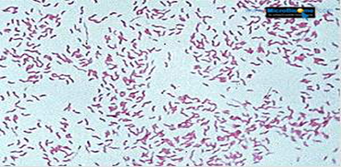
Clinical Presentation & Pathogenic Mechanism
Enterotoxin mediated: | Invasive:
Lack of pus in the stool (no gut invasion) No fever Some have rapid onset (<12 hour if due to preformed toxin ingestion) Small intestine affected. Vomiting, non-bloody diarrhea, abdominal cramps. Vibreo cholerae, Staphylococcus aureus, Clostridium perfringens and Bacillus cereus Some viral and parasitic infections. | Pus and blood in the stool Fever due to inflammation Shigella, Salmonella spp.,Campylobacter, some E.coli and Entameoba histolytica Affect colonic mucosa Extension to lymph nodes Incubation period 1-3 days Dysentery syndrome-gross blood and mucous EHEC bloody diarrhea Entameoba histolytica 1-3wk
Campylobacter
General information | Gram negative curved ( spiral or S-shape ) bacilli . world wide infection ,more common among children Common species: C.jejuni, C. coli, C fetus.
Epidemiology | Source: dog , cat, birds, poultry ,water, milk, meat, person to person transmission can occur.
Clinically | •IP: 2-6 days •Lower abdominal pain , watery or dysenteric diarrhea with pus and blood. fever in some patients,Nausea and vomiting are rare •Self limiting 2-6 Day •Chronic carrier outbreaks uncommon. Complications: May lead to autoimmune disease like Guillain- Barrie’ syndrome and extraintestinal infections eg. Reactive arthritis ,bacteremia ,lung infection and others frequently preceded by C.jejuni infection.
Laboratory diagnosis | •Use transport media •Culture on CAMPY BAP media contain antibiotics •Incubate in microaerophilic atmosphere (5%)O2 ,(10%)CO2 ,(85%)N at 42°C except C.fetus 37°C •Identification: Gram stain/culture biochemical/Serology
Treatment | •Only severe cases •Ciprofloxacin, Erythromycin

Slide 6
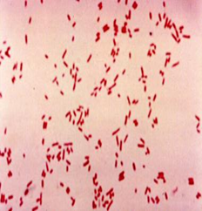
E. coli
About 10 -15% of strains of E. coli associated with diarrhea.
Other strains associated with extra-intestinal diseases ( septicemia, meningitis & UTI).
Based on virulence factors, clinical manifestation, epidemiology and different O and H serotype.
Enterotoxigenic E.coli [ETEC]
Enteropathogenic E.coli [EPEC]
Enteroinvasive E.coli [EIEC]
E.Coli diarrhea
Enterohemorrhagic E.coli [EHEC]
Enteroadherent E.coli [EAEC]
 | Enterotoxigenic E.coli | Enteroinvasive E.coli
The diseases | Major cause of traveler's diarrhea in infant and adult in developing countries from contaminated food and water | Produce dysentery (Penetration, invasion and distraction), Common in children
Infective doses | High : 10⁶ -10¹⁰ | 10⁶
Symptoms | watery diarrhea, abdominal cramps and some time vomiting | Fever, severe abdominal cramps, malaise and watery diarrhea
toxins | Has heat-labile toxin (LT) and heat-stable toxin (ST) each has two fragment (A and B). No invasion or inflammation, LT leads to accumulation of CGMP, which lead to hyper secretion of fluid with no cellular injury
diagnosis | No routine diagnostic method.
Other info | Self limiting | Similar to Shigella spp (Non motile, LNF) Transmission: Fecal oral route

Slide 7
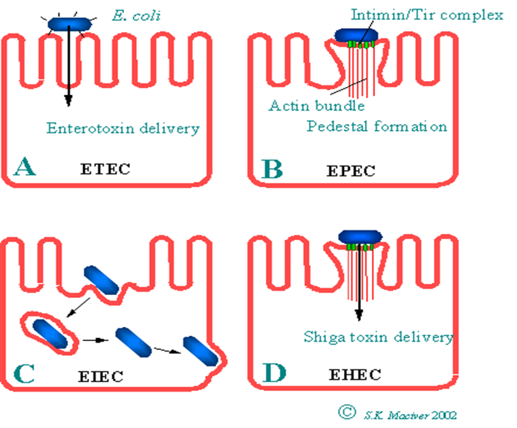
E. coli
Enterohemrrhagic E.coli
The diseases | 0157:H7 Hemorrhagic diarrhea, colitis and hemolytic uremic syndrome (HUS) manifested with low Platelet count, hemolytic anemia and kidney failure
prevalence | Fatal disease in young and elderly persons in nursing homes
Symptoms | Bloody diarrhea, low grade fever and stool has no leukocytes
toxins | Cytotoxin: Shiga-toxin I & II (verotoxin І and verotoxin ІІ) (Similar to toxin produced by Shigella dysenteriae)
diagnosis | Diagnosis by culture on SMAC(sorbitol MacConkey agar), Verotoxin detection by immunological test or nucleic acid testing (NAT).
Other info | Undercooked hamburgers, unpasteurized dairy products, Apple cider, cookie dough Management of HUS required. Antimicrobial therapy not recommended E.coli other than 0157:H7 can cause HUS.
 | Enteroaggregative Ecoli | Enteropathogenic E.coli
The diseases | Pediatric Diarrheal Disease | Causes Infantile diarrhea ( bottle fed infants)
Symptoms | Produce mucoid, Watery diarrhea, vomiting, dehydration and abdominal pain. | Low grade fever, malaise, vomiting and watery diarrhea
Other info | Adherence to surface of intestinal mucosa. Produce Aggregative stacked bricked, Resolve after 2 weeks or more | Outbreak in hospital nurseries and day-care centers Mucus in Stool but no blood. -Disrupt Microvilli and intestinal absorptive function.

Slide 8
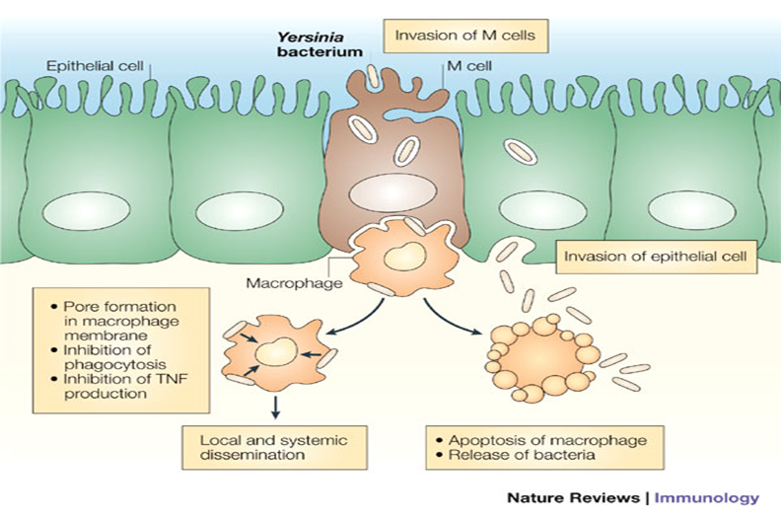
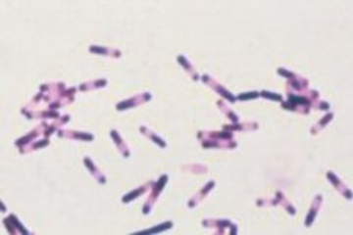
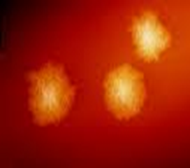
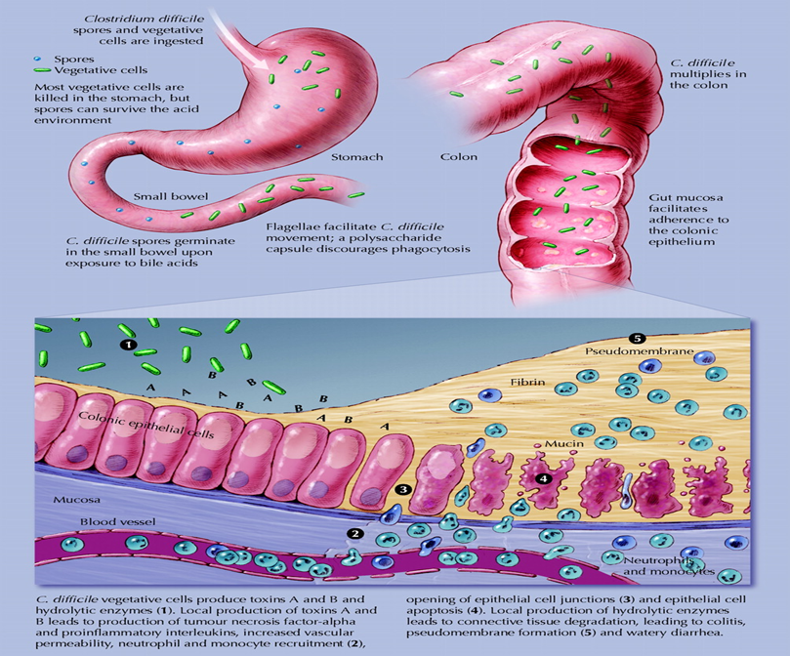
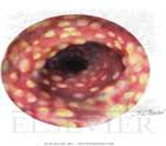
Yersinia enterocolitica
The diseases | Mesenteric lymphadenitis in children and septicemia in immunocompramised hosts
prevalence | Common in Europe, USA, Canada and cat, dog, swine (chitterlings)
Symptoms | Presented with enteritis, arthritis and erythema nodosum
Characteristics | Survive cold temperatures and associated with transfusion of packed red blood cells.
diagnosis | Growth at 25°c-30°c media Cefsulodin-Igrasan-Novabiacin (CIN)
Other info | Generalize infection in adult and children 1-5 yrs usually mild but in old children adult mimic appendicitis
Clostridium difficile
The diseases | Antibiotic associated diarrhea, (ampicillin, cephalosporins & clindamycin) Antibiotic use for the last 8 weeks (community acquired= outpatient) or hospital stay for at least 3 days (hospital acquired)
Transmission | Transmit from person to person via Fecal-Oral route.
Symptoms | Patient Presents with fever, leukocytosis, abdominal pain and diarrhea
toxins | Produce toxin A ( enterotoxic & cytotoxic effects ) and B (cytotoxic) that can bind to surface epithelial cell receptors leading to inflammation mucosal injury and diarrhea
Histological findings | Pseudomembrane can result (neutrophils, fibrin, and cellular debris in the colonic mucosa) and toxic megacolon.
diagnosis | direct toxin detection from stool by (EIA) or NAT
Treatment | Metronidazole ± oral Vancomycin and supportive treatment.
Other info | Have been cultured from inanimate hospital surfaces. Disruption of the indigenous bacterial flora of the colon

Slide 9
Selected Clinical and Epidemiologic Characteristics of Typical Illness Caused By Common Foodborne Pathogens
Pathogen | Typical Incubation Period | Duration | Typical Clinical Presentation | Assorted Foods
Bacterial
Salmonella species | 1-3 Days | 4-7 Days | Gastroenteritis | Undercooked eggs or poultry, produce
Campylobacter jejuni | 2-5 Days | 2-10 Days | Gastroenteritis | Undercooked poultry, unpasteurized dairy products
E. coli, Enterotoxigenic | 1-3 Days | 3-7 Days | Gastroenteritis | Many foods
Shigella species | 1-2 Days | 4-7 Days | Gastroenteritis | Produce, egg salad
Listeria monocytogenes | 2-6 weeks | Variable | Gastroenteritis, meningitis abortion | Deli meat, hotdogs, unpasteurized dairy products
Bacillus cereus | 1-6 hour | <24 hour | Vomiting, Gastroenteritis | Fried rice, meats
Clostridium botulinum | 12-72 hour | Days-months | Blurred vision, paralysis | Home-canned foods, fermented fish
Staphylococcus aureus | 1-6 hour | 1-2 Days | Gastroenteritis, particularly nausea | Meats, potato & pork, unpasteurized dairy products.
Yersinia enterocolitica | 1-2 Days | 1-3 weeks | Gastroenteritis, appendicitis-like syndrome | Undercooked pork, unpasteurized dairy products.
Lab diagnosis of diarrheal diseases
due to bacterial causes:
Stool specimen:
Microscopy: for the presence of polymorphs or blood may help
Culture :
on selective media for Salmonella, Shigella & Campylobacter.
Culture for Vibrio cholerae, EHEC or Yersinia if suspected.
Toxin assay: if C.difficile toxins is suspected

Slide 10
Dr notes:
Most of the normal flora are found in the colon.
Many of the Normal flora can cause a disease in immunocompromised patient and its strongly associated with antibiotics.
Dr said:just I want you to get general idea from slide 6.
Strep.viridans might cause endocarditis after dental procedure.
How does antibiotic cause infection(like in Cl.difficile)? Because antibiotic will kill some of the normal flora in the GI that will lead enhance the infection of the other Bacteria.
Diarrhea occurs mainly in children remember.
Cl.difficile infection is very common in clinical practice.
Diarrhea could be due to:1-infection ,2-non-infectious causes like in case of lactose intolerance.
Viral causes are self-limited.
Infectious Diarrhea like Campylobacter will cause diarrhea by initiation of inflammation and this will lead to invasion to the intestinal mucosa.
One of the the risk factor for diarrhea is proton pump inhibitors because it will cause decrease in acidity which is good for the infection.
very important:In case of enterotoxin bacteria(ingestion of preformed toxins in the stool) like in Staph.aureus there will be rapid onset of the infection maybe 1-6 hours!!!!.
In case of invasive bacteria like salmonella it will take days.
Chicken source indicates two bacteria:Campylobacter,salmonella
It's a hint!
Campylobacter will cause infection due to ingestion of undercooked chicken , can come in case as people doing BBQ

Slide 11
Dr notes
Campylobacter common in BBQ parties remember that very well,also it will cause other manifestations like reactive arthritis.
Diagnosis:-Gram negative curved shaped,Culture on CAMPY BAPA.
Treatment:Erythromycin,CIPROFLOXACIN.
E.coli:Enterotoxigenic e.coli is the most common cause in case of Traveler's diarrhea تصير للشخص إذا سافر لمكان جديد.
Enterohemorrhagic E.coli is the most common cause of (HUS) and cause bloody diarrhea Mainly occur after ingestion of undercooked hamburger and Has Important toxin which is Shiga toxin 1 and 2.
Diagnosis: Culture on Sorbitol MacConkey agar.
Treatment:Not recommended why? Because it will enhance the bacterial infection.
Other E.coli doctor did not focus on them.
Yersinia will cause a condition just like appendicitis also will cause Erythema nodosum.
Clostridium difficile usually associated with antibiotic. The most important toxin is Toxin B will cause Pseudomembranous Colitis.
Diagnosis:Stool specimen for Microscopy,Culture on selective media.
The doctor mentioned some cases you will find it in the next slide in the quiz.

Slide 12
Quiz:
1-Which of the following sites has the most abundant normal flora:
A-stomach
B-mouth
C-colon
D-small intestine
2-the reason behind rapid onset of staph aureus:
A-low infectious dose
B-due to the preformed toxins
C-highly virulent
D-due to invasion
3-Which of the following infections can lead to Guillain- Barrie’ syndrome ?
A-Campylobacter jejuni
B-Clostridium difficile
C-Enterohemorrhagic E.coli
D-Staphylococcus aureus
4-a 32 year old tourist came to the outpatient department complaining of abdominal pain and continuous going to the toilet, he describes his stool as ” watery’”. Which of the following is the most likely cause?
A-Enterotoxigenic E.coli
B-Enteropathogenic E.coli
C-Enterohemorrhagic E.coli
D-Enteroadherent E.coli
5-which of the following infections may cause an appendicitis like pain ?
A-Campylobacter jejuni
B-Enterohemorrhagic E.coli
C-Clostridium difficile
D-Yersinia enterocolitica
6- Antibiotic associated diarrhea is related to :
A-Campylobacter jejuni
B-Enterohemorrhagic E.coli
C-Clostridium difficile
D-Yersinia enterocolitica
7-Which of the following methods is used to diagnose Clostridium difficile ?
A-Selective culture media
B-Non-selective culture media
C-Microscopy
D-Toxin assay
Answers:
1-C 2-B 3-A 4-A 5-D 6-C 7-D

Slide 13
Case:
A 40 years old seen in the medicine department with a bloody diarrhea and has a thrombocytopenia, he usually eats hamburgers from fast food restaurants.
1-which organism can cause such symptoms ?
2-what is the syndrome related to this patient ?
3- what is the most likely source of the organism ?
4- What is the management of this patient ?
Answers:
Enterohemorrhagic E.coli
hemolytic uremic syndrome
Undercooked Hamburgers
Treating the syndrome without any antibiotic, it is contraindicated

Slide 14
ALANOUD AL-MANSOUR & KHALED AL-OQEELY
-Moath abdulghani
-Moath alhamoud
-Abdullah Alangari
-Anas abdullah alsaif
-Faisal Altahan

