Slide 2
Tip: We recommend you to start this lecture by reading the notes
Vibrio Cholera
Overview | A waterborne live threatening diarrheal disease. Caused by vibrio cholera which is a comma- shaped gram-negative rods. Found in salt and freshwater. Has many serotypes based on O-antigen. O 1 and O 139. Produce a non-invasive enterotoxin. Leads to outbreak and epidemic. Can be prevented by good sanitation system.
Discovery | John Snow discovered an outbreak in London 1854 It was related to broad street pump sewage contamination. Removal of the pump handle →end of the outbreak..
Epidemiology | V. cholera O1 and O139 serogroup organisms are the causes of epidemic cholera. O1 ( from 1817 till now) Classical: 1 case per 30-100 infections El Tor: 1 case per 2-4 infections (Seventh pandemic) O139 ( recently in 1992 in Asia only) Contained in India, Bangladesh. Seven major outbreaks. Majority in India, Sub-Saharan Africa, Southern Asia. Endemic in > 50 countries. Each year 3-5 millions cases result in 100,000 deaths.
Risk factors | Children, elderly and people with less gastric acidity are at higher risk than others Blood group O>> B > A > AB.
Transmission | Fecal- oral transmission through contaminated food or water. Common in summer grows in brackish estuaries and coastal seawaters, often in close association with copepods or other zooplankton. Sewage or infected person contaminate water supply. Not well established sewage system and water treatment. Undercooked shellfish.

Slide 3
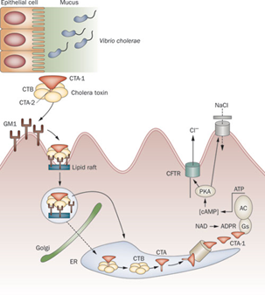
Infectivity
Period of infectivity during acute stage till recovery ( end one to three wks) Infected person can produce up to 20 L of 10⁹ CFU/ml /day Has high infectious dose NOT like Shigella Infectious dose 10⁶-10¹¹ colony-forming units (not highly virulent) Due to harsh environment of the intestine i.e. temperature and stomach acidity and Bile salts, organic acids in the intestine.
Pathogenesis (previous lecture)
Vibrio cholerae uses toxin-coregulated pili (TCP) to colonize the human intestine. Cholera results from secretory diarrhea caused by the actions of cholera toxin (Enterotoxin) on intestinal epithelial cells. CT is an adenosine diphosphate–ribosylating enzyme that leads to chloride, sodium, and water loss from intestinal epithelial cells. → leads to rice water diarrhea GM1, a glycosphingolipid on the surface of epithelial cells Enzymatic A subunit of cholera toxin mediates Nicotinamide adenine dinucleotide (NAD) → Adenosine diphosphate (ADP)-ribose → G protein → Regulates adenylyl (adenylate) cyclase activity (AC) → elevation in the intracellular cyclic adenosine monophosphate (cAMP) concentration Monosialoganglioside (GM1) receptor

Slide 4
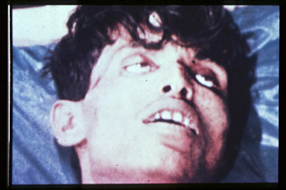
Clinical Manifestations:
Ranges from a few hours to 5 days( range 1-3 days). Depending on gastric acidity (antacids) and initial infectious dose. Majority have mild, or no symptoms at all 75% asymptomatic 20% mild disease 2-5% severe
20% mild disease | Vomiting, Cramps Watery diarrhea (1L/hour) with flecks of white mucus (rice water stool) with a fishy odor (no fever)
2-5% severe symptoms Cholera gravis: | More severe symptoms due to Rapid loss of body fluids (6 liters/hour, 10⁷⁻⁹ vibrios CFU/mL) → hypovolemic shock(severe metabolic acidosis due to inadequate O) and electrolytes imbalance(↓ Ca⁺⁺ and K can lead to ileus, muscle pain and spasm, and even tetany)→multi failure organ (Cardiac and Renal failure). Rapidly lose more than 10% of body weight Dehydration and shock Sunken eyes, and ↓skin turgor ( tenting), cold and clammy. Anuric and lactic acidosis ( Kussmaul breathing). Hypoglycemia leads to seizure or comma. Aspiration pneumonia
Prognosis | Mild disease→Death occurred in 18 hours-several days if not treated due dehydration. Severe symptoms→•Death within 2-12 hours or less. •Mortality 50-60% without treatment •Mortality <1% with redehydration.

Slide 5
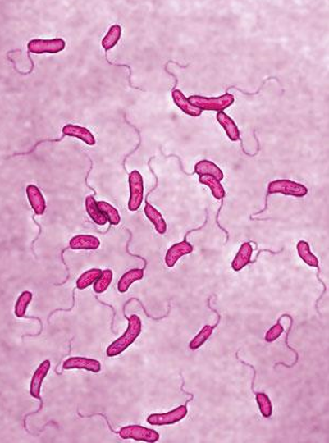
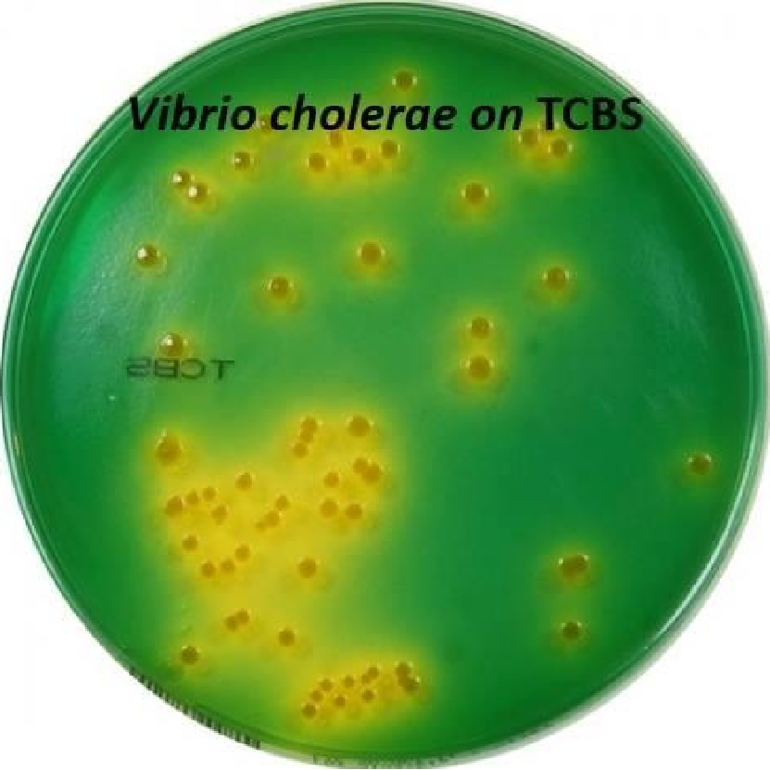
Diagnosis:
Suspect in severe diarrhea with dehydration.
Other non-invasive bacterial, ETEC and viral gastroenteritis might have similar presentation.
Complete history and physical examination.
Insert central line for IV fluid, collect blood for basic routine tests ( chemistry and hematology).
Send stool for smear and culture on special media.
Culture not routinely performed, you have to request it.
Dark field microscopy (shooting stars)
Gram stain (curve Gram Negative bacilli)
Culture on thiosulfate citrate bile sucrose (TCBS) agar-yellow colonies
Recovery of organisms can be enhanced by enrichment of stool in alkaline peptone water. (60-100%).
Diagnosis/ microbiology:
•Vibrio cholera is highly motile, gram-negative, curved or comma-shaped rods with a single polar flagellum.
String test: if the organism is growing it will be like a honey
Dont memorize these charts
Biotype O 1 antigen | Serotype | Antigen
Classical | Ogawa | A,B
 | Inaba | A,C
 | Hikojima | A,B,C
El Tor | Ogawa | A,B
 | Inaba | A,C
 | Hikojima | A,B,C
O 139 serogroup appeared in Bangladesh 1992
Has polysaccharide capsule but does not have O1 antigen
Non-O1, Non-O139 Serogroup
Most are CT (cholera toxin) negative and are not associated with epidemic disease.

Slide 6
Treatment
Basically rehydration and antimicrobial therapy. Rehydration should be started immediately before confirming the diagnosis. Either oral rehydration if the patient can tolerate it ( not vomiting or start IV rehydration). Decrease mortality from 50% to 1 %. Give 1.5 time the amount lost. Start when 10% of total body weight lost. Patients recovered within 3-6 days. Oral Rehydration Salt (ORS) by WHO and UNICEF One pack in 1 liter contain NaCl, KCl, NaHCO3, glucose IV use either Ringer’s lactate, Saline or Sugar and water. Antibiotics: Reduce the recovery time to 2-3 days. Decrease infectivity Azithromycin single-dose is often the preferred therapy especially in children. Ciprofloxacin(not for pts younger than 18,but you can use it because its life saving) Tetracycline, Doxycycline (not in patients younger than 7) Can be a bioterrorism agents: Ease of procurement Simplicity of production in large quantities at minimal expense Ease of dissemination with low technology Silent dissemination.

Slide 7
Prevention:
International Efforts:
Wash your hand frequently
Boil water and chlorination.
Cook all types of food very well.
Avoid salad, ice and iced food
Water Sanitation
Water treatment
Disrupt fecal-oral transmission if present.
WHO: Global Task Force on Cholera Control
Reduce mortality and morbidity
Provide aid for social and economic consequences of Cholera
CDC
U.N.: GEMS/Water
Global Water Quality Monitoring Project
Addresses global issues of water quality with monitoring stations on all continents
 | Killed Whole-cell Vaccines | Live Attenuated Vaccines
Adult | 50% protection for 6 months | 60% protection for 2 years
children aged 2-5 | < 25% protection | protection rapidly declines after 6 months
Doses | Multiple doses | 3 dose
Side effects | -------------------- | Mild diarrhea, abdominal cramping

Slide 8
Summary Vibrio Cholera
Description | A waterborne live threatening diarrheal disease. Caused by Vibrio Cholera which is a comma- shaped gram-negative rods. Which is found in salt and freshwater. Serotypes (O 1 and O 139). Produce a non-invasive enterotoxin.
Transmission | Fecal- oral transmission through contaminated food or water. Sewage or infected person contaminate water supply. Undercooked shellfish.
Infectivity | During acute stage till recovery ( end one to three weeks) Infected person can produce up to 20 L of 10⁹ CFU/ml /day Infectious dose 10⁶-10¹¹ colony-forming units
Pathogenesis | Vibrio cholerae uses toxin-coregulated pili (TCP) To colonize the human intestine. secretory diarrhea caused by the actions of cholera toxin (enterotoxin)
Clinical Manifestations | Ranges from a few hours to 5 days( range 1-3 days). Depending on gastric acidity and initial infectious dose. 75% asymptomatic 20% mild disease:Vomiting -Cramps -Watery diarrhea (1L/hour) with flecks of white mucus (rice water stool) with a fishy odor 2-5% severe(Cholera Gravis): More severe symptoms due to Rapid loss of body fluids Causing Hypovolemic Shock & electrolytes imbalance.
Prognosis | mild disease→ Death in 18 Hours-days if not treated due dehydration. severe symptoms→•Death within 2-12 hours or less. Mortality 50-60% without treatment DECREASE to 1% with redehydration.
Diagnosis | Complete history and physical examination. Collect blood for routine tests stool for smear and culture on special media. Dark field microscopy (shooting stars) Gram stain (curve Gram Negative bacilli) Culture on thiosulfate citrate bile sucrose (TCBS) agar-yellow colonies Recovery of organisms can be enhanced by enrichment of stool in alkaline peptone water. (60-100%).
Treatment | Rehydration Azithromycin single-dose is often the preferred therapy especially in children. Tetracycline,doxycycline(not for pts younger than 7) Ciprofloxacin(not for pts younger than 18,but you can use it because its life saving)
Prevention | General prevention:hand wash, cooking food well water cleaning...etc Killed Whole Cell Vacc:50% for adults for 6 months- 25% children -multiple doses. Live Attenuated Vacc:60% for adults for 2 years-declines after 6 months -3 doses-Side effects: mild diarrhea, abdominal cramping.

Slide 9
Dr’s Notes
introduction:
Cholera is a curved gram negative bacteria,that causes rice-watery(with mucous) diarrhea usually through contaminated water, it lives within shellfishes it prefers in salt water, It may contaminate water after an earthquake due to the mixing between sewage and water. patients may die why?Because of dehydration→renal/cardiac failure.treated by→dehydration Can be prevented by vaccines
epidemiology:
Old type O1/new type O139 in india bangladesh(O=somatic antigen)
There is an outbreak in yemen right now
Transmission: fecal-oral
Due to water contaminated by sewage
Undercooked shellfish
Infectivity: it needs a higher infectious dose than shigella and salmonella
Period of infectivity is 1-3 weeks so you have to isolate them
Pathogenesis: (he said just know the following)
They have enterotoxin and it will increase cAMP leading to increased Na+ and water secretions
Clinical manifestation:
It depends on gastric acidity and patients immunity
Most people are asymptomatic, 5% have severe symptoms
It causes rice water stool Patient will lose 1L/hour.
Death may occur due to dehydration
Cholera gravis(severe):
Death will be fast he will lose 10% of his weight
They will have signs of dehydration:sunken eye ,turgor(elastic) skin. They will be anuric and hypoglycemic) so you need to rehydrate them very fast

Slide 10
Diagnosis:
Suspected if severe diarrhea or pts(patient) is coming from an endemic area other non-invasive bacteria may produce non-invasive diarrhea but it won't be as severe is cholera
Stool smear and culture:
microscope will show shooting stars gram -ve curved bacilli
culture media is TCBS(thiosulfate citrate bile sucrose for all vibrio not just V.cholera)
string test: if organism is growing it will be like honey
Treatment :
Rehydration and antibiotics
Rehydration: more important than antibiotics we gave it IV if pts is vomiting
Antibiotics:
Azithromycin(patient younger than 7 because others are contraindicated)
Ciprofloxacin(not for pts younger than 18,but you can use it because its life saving)
tetracycline(not for pts younger than 7)
Prevention:
2 vaccines killed and live attenuated
Killed vaccine: -less efficient -less side effect -we used for travelers
Live-attenuated: -more effective -more side effects -used in outbreaks
Summary:
V.cholera: a Gram negative, motile, lactose non-fermentative bacteria
Source: shellfish
transmitted: fecal orally by drinking contaminated water
leading to: severe watery diarrhea
Diagnosis: by smear→ shooting stars
The culture media: TCBS ,results can be confirmed by string test
Treated: by rehydration and azithromycin/ciprofloxacin/tetracycline
prevented: by killed and live attenuated

Slide 11
QUIZ:
1.Which of the following is true about cholera?
A-non-motile
B-gram - curved rods
C-low infection dose
D-transmitted sexually
2.Which of the following is high risk for v.cholera infection ?
A-overcooked shellfish
B-low gastric acidity
C-low infection dose
D-good hygiene
3.In cholera gravis how many litter of the fluid is lost ?
A-6L/H
B-1L/H
C-3L/H
D-4L/H
4-A tsunami tidal wave hits the east coast of South America and the people living there are forced to drink unclean water. Within the next several days, a large number of people develop severe diarrhea and about half of these people expire. Samples of drinking water are positive for Vibrio cholerae. Which of the following types of ion channels is most likely to be irreversibly opened in the epithelial cells of the crypts of Lieberkühn in these people with severe diarrhea?
A) Calcium channels
B) Chloride channels
C) Magnesium channels
D) Potassium channels
Case:A middle-aged man returns from a trip to yemen and immediately begins passing voluminous, watery diarrhea. When he is seen in the emergency department, he is suffering from dehydration and has tachycardia but no fever. While in the emergency department, he is given ﬂuids and electrolytes.
5.What is the most likely etiology?
6.Which of the following should have been given before traveling?
A-prophylaxis antibiotics
B-live attenuated vaccine
C-killed vaccine
D-I.V. normal saline
1/B 2/B 3/B 4/B 5/V.cholera 6/C

Slide 12
ALANOUD AL-MANSOUR & KHALED AL-OQEELY
Hassan Al-oraini
Hussam Al-hajlah
Mohammed Al-dwaghri
Saif Al-meshari

