Slide 2
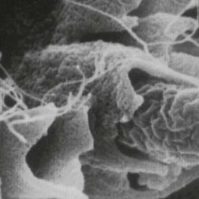
Salmonella
Introduction | Gram negative ,motile ,facultative anaerobic bacilli Non lactose fermenting colonies Highest during the rainy season in tropical climates and during the warmer months in temperate climates.
Classification | Two species of Salmonella : S.enterica (six subspecies I, II, III, IV, V, VI) S.borgori (rare) Found in cold blooded animal, birds, rodents, turtles, snakes and fish.
Virulence Factors | Fimbria - Adherence Endocytosis: SPI 1 T3SS TLR Replication in macrophage Enterotoxin
Antigenic Structures | O. Somatic antigen H. Flagellar antigen K. Capsular antigen V_{I} in Salmonella serotype typhi (virulence heat-labile capsular homopolymer of N-acetyl-galactosamino-uronic acid) vs phagocytosis Dr. Hanan said don’t memorize the long name O Antigen (Heat stable) is lipopolysaccharide in the outer membrane A,B,C1,C2,D,E H₋antigen (Heat labile)
Source | Water, food and milk contaminated with human or animal excreta. S.typhi and S.paratyphi : the source is human.
Clinical Diseases | Acute gastroenteritis (self limiting) Typhoid fever Nontyphoidal bacteremia Carrier state following Salmonella infection

Slide 3
Salmonella Gastroenteritis
Food poisoning through contaminated food S. enterica subsp. enterica the common cause Source: poultry, milk, egg & egg products and handling pets Infective dose: 10⁶ bacteria → (high infective dose means the bacteria is lowly virulent) Incubation period : 8 – 36 hrs. fever, chills, watery diarrhea and abdominal pain. Self limiting. In sickle cell ,hemolytic disorders , ulcerative colitis, elderly or very young patients; the infection may be very severe. Patients at high risk for dissemination and antimicrobial therapy is indicated.
Enteric fever (Typhoid fever)
Prolonged fever Bacteremia Involvement of the reticuloendothelial system (liver, spleen, intestines and mesentery) Dissemination to multiple organs Ingestion of contaminated food by infected or carrier individual Caused by Salmonella serotype typhi or S. paratyphi A, B and C (less severe) Common in tropical , subtropical countries, and travelers (sewage ,poor sanitation). IP : 9 – 14 days.
First week | 2nd and 3rd week
Fever, malaise, anorexia, myalgia and a continuous dull frontal headache → then the patient develops constipation Mesenteric lymph node → bloodstream liver, spleen and bone marrow Engulfment of Salmonella by mononuclear phagocytes . Bacteria released into the bloodstream again and can lead to high fever . Blood culture is positive. | Sustained fever & prolonged bacteremia. Invade gallbladder and Payer's patches Rose spots 2nd week of fever Biliary tract → GIT Organism isolated from stool .

Slide 4
Salmonella Species & Subspecies | Usual Habitat
S. enterica subsp. enterica (I) | Warm-blooded animals
S. enterica subsp. salmae(II) S. enterica subsp. arizonae (IIIa) S. enterica subsp. diarizonae (IIIb) S. enterica subsp. houtenae (IV) S. enterica subsp. indica(VI) | Cold-blooded animals and the environment*
S. bongori (V) | Cold-blooded animals and the environment*
DON’T memorize them:
S,typhi is from S.enterica & others are non-typhi
thats it
Complications
Necrotizing cholecystitis. Bowel hemorrhage and perforation. Pneumonia and thrombophlebitis. Meningitis, osteomyelitis, endocarditis and abscess (especially in kids)
Management & Antibiotics
Enteric Fever | Ceftriaxone Ciprofloxacin Trimethoprim – Sulfamethoxazole Ampicillin Azithromycin or Ceftriaxone for patients from India and SE Asia due to strains resistant to Ciprofloxacin. Ciprofloxacin can be used for patients from other areas.
Salmonella Gastroenteritis | Uncomplicated cases require fluid and electrolyte replacement only.
Start first with those two
Female Notes→

Slide 5
Shigella
Clinical Infection | Shigella is non lactose fermenting Gram negative bacteria. Cause bacillary dysentery ( blood, mucus and pus in the stool). S.sonnei (group D1) most predominant in USA ( fever, watery diarrhea) S.flexneri (group B15) 2nd most common Young adult ( man who have sex with man) S. dysenteriae (group A 6 )and S. boydii (group C 20) are most common isolates in developing countries S. dysenteriae type 1 associated with morbidity and mortality. Human is the only reservoir
Antigenic Structure | Has 4 species and 4 major O antigen groups: S.dysenteriae, S.flexneri. S.boydii & S.sonnei (most common in USA from pigs). All have O antigens some serotype has K antigen (heat labile removed by boiling) Shigella are non motile, lack H antigen
Transmission | Person to person through fecal –oral route . Flies, fingers (have a role in spread). Food and water. Young children in daycare, people in crowded area and anal oral sex in developed countries. Low infective dose < 200 bacilli most infectious more virulent than salmonella Penetrate epithelial cells ,leads to local inflammation, shedding of intestinal lining and ulcer formation.
Symptoms | High fever, chill, abdominal cramp and pain accompanied by tenesmus , bloody stool with mucus & leukocytes. Incubation period : 24 - 48 hrs Can lead to rectal prolapse in children
Complications | ileus, obstruction dilatation and toxic megacolon Bacteremia in 4 % of severely ill patient Seizures, HUS
Don't memorize just know that there are 4 species

Slide 6
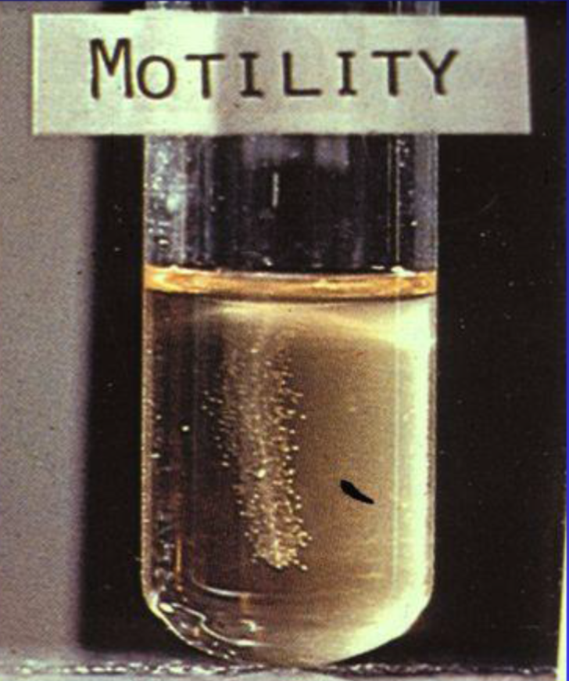
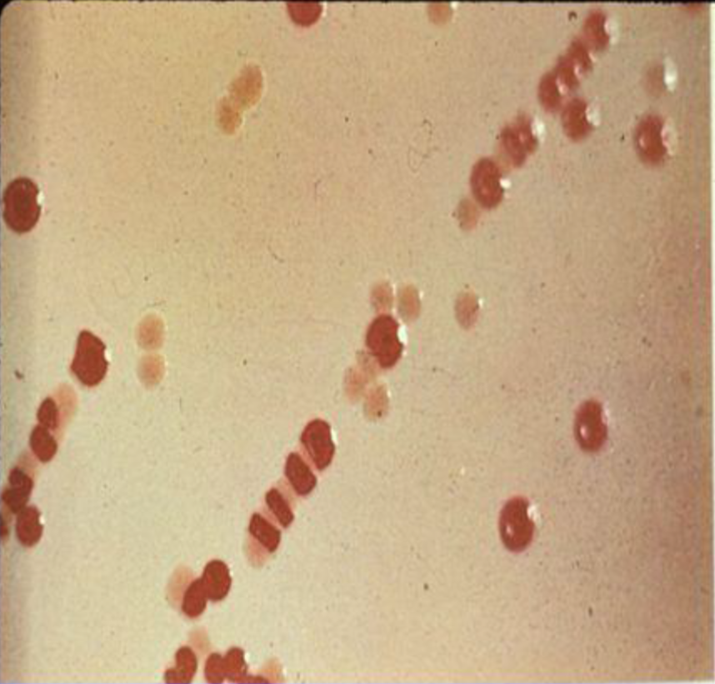
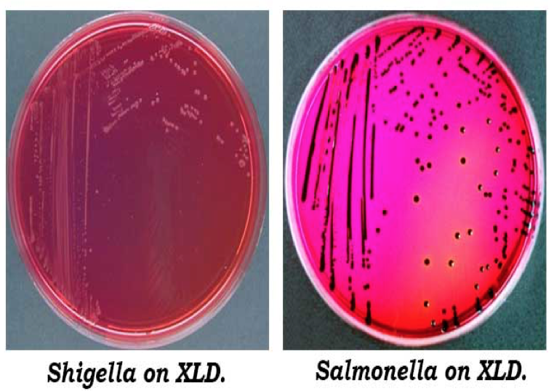
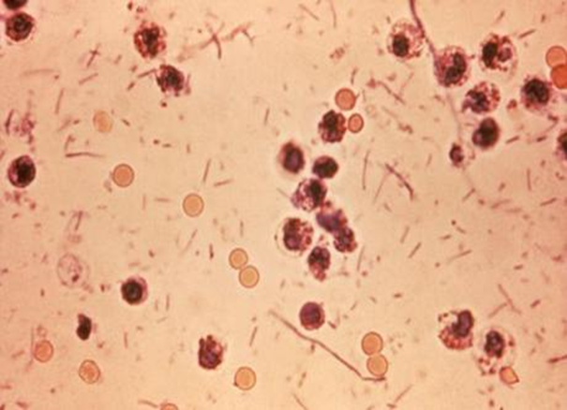
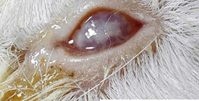
Laboratory Diagnosis of Salmonella & Shigella From Stool
Both are Gram negative bacilli Culture in selective media it produce black colonies due to H2S (selenite enrichment broth media MAC, SS and XLD,HEA BS0) Biochemical tests Motility test (we stap the media into a tube if they were motile you will see that these dots have been distributed over the tube) Serology for serotypes using agglutination Ag+Ab test (antigen-antibody reaction) Shigella in Macconkey agar: Dysentery stool:
Non motile
Non lactose fermenter
RBC + gram-ve rods Similar to E.coli but they are non lactose fermentative
Culture on selective media
Salmonella produces H2S (appears black)
Diagnosis
Stool culture on selective selenite enrichment broth media MAC, SS and XLD,HEA BS Sero-grouping based on O and H antigen Sereny test not in clinical practice
Treatment
Like salmonella but we can’t use azithromycin Antibiotic indicated if symptoms were severe and used to reduce duration of illness Antimicrobial agents depending on susceptibility testing Including: Ampicillin or IV Ceftriaxone or oral TMP-SMX or Ciprofloxacin or doxycycline

Slide 7
Summary
Salmonella
Shigella
Description
Gram negative ,motile ,facultative anaerobic bacilli Non lactose fermenting colonies Causes : Acute gastroenteritis By S.Enterica from contaminated food(poultry,egg,milk) Symptoms:fever, chills, watery diarrhea and abdominal pain. Self limiting.(except in sickle cell, hemolytic ,ulcerative colitis, elderly or very young patients) Incubation period: 8 – 36 hrs. Typhoid fever(Enteric Fever) Prolonged fever-Bacteremia-Dissemination to multiple organs Caused by S.typhi or S. paratyphi IP : 9 – 14 days. Symptoms: 1st week /2nd&3rd week Nontyphoidal bacteremia
Shigella is non lactose fermenting Gram negative bacteria. Cause: bacillary dysentery ( blood, mucus and pus in the stool). Symptoms:High fever, chill, abdominal cramp and pain accompanied by tenesmus , bloody stool with mucus & leukocytes. Incubation period : 24 - 48 hrs Can lead to rectal prolapse in children
Classification
S.enterica (six subspecies I, II, III, IV, V, VI) S.borgori (rare)
S. dysenteriae (group A 6 ) S. boydii (group C 20) Human is the only Reservoir.
Antigenic Structure.
O. Somatic antigen H. Flagellar antigen K. Capsular antigen V_{I} in Salmonella serotype typhi (virulence heat-labile capsular) O Antigen (Heat stable) H₋antigen (Heat labile)
Has 4 species and 4 major O antigen groups: S.dysenteriae, S.flexneri. S.boydii & S.sonnei (common in pigs). All have O antigens some serotype has K antigen (heat labile removed by boiling) Shigella are non motile, lack H antigen
Source, Transmission & Infective dose
Water, food and milk contaminated with human or animal excreta.(source) S.typhi & S.paratyphi : source is human. (Source) Infective dose: 10⁶ bacteria
Human is the only reservoir(source) Person to person through fecal –oral route .(transmission) Low infective dose < 200 bacilli most infectious = more virulent than salmonella
Complications
Necrotizing cholecystitis. Bowel hemorrhage and perforation. Pneumonia and thrombophlebitis. Meningitis, osteomyelitis, endocarditis and abscess
ileus, obstruction dilatation and toxic megacolon Bacteremia in 4 % of severely ill patient Seizures, HUS
Treatment.
Enteric Fever: Ceftriaxone(+ Azithromycin in ptn from India & SE Asia) Ciprofloxacin(used in ptn from other areas) Trimethoprim – Sulfamethoxazole Ampicillin Salmonella Gastroenteritis fluid and electrolyte replacement
Antibiotic indicated if symptoms were severe and used to reduce duration of illness Antimicrobial agents depending on susceptibility testing Including: Ampicillin or IV Ceftriaxone or oral TMP-SMX or Ciprofloxacin or doxycycline (same as salmonella except no Azithromycin)

Slide 8
Doctor’s Notes:
Introduction:
Infectious diarrhea is either: watery diarrhea, food poisoning or dysentery:
two causes for dysentery : amoebic(E.histolytica) and bacillus (shigella)
Some causes watery diarrhea by their enterotoxin Salmonella,cholera
Maybe caused by a preformed toxin (the bacteria might be dead)
Salmonella is the most bacteria we see in laps (the most common is actually campylobacter, but not common in the lap) because they won’t be sick.
Both Shigella and salmonella are non lactose fermentative
Salmonella is motile (like a salmon fish) while Shigella isn’t
Salmonella has vaccine shigella doesn't
Salmonella introduction:
features:Gram -ve highly motile non lactose fermentation produces H2S.
Salmonella species: They are able to go inside the cell so they can hide from phagocytosis and some of them are also capsulated
There are two genus S.enterica S.borgori
All pathological subspecies are related to S.enterica, including S.typhi

Slide 9
Salmonella non-typhi:
Features: O,H,K antigens This organism has three antigenic structure that differentiate the serotypes:-O.somatic -H.flagella -K.capsule
S.typhi has a Vi capsule(v from virulent ) when V is positive = s.typhi
reservoir: founded in cold blooded animals (birds,rodents,snakes)
transmission: chicken, milk. (it depend on how you prepare the food sometimes the ice cream can get contaminated)
Causes: gastroenteritis(self-limiting), bacteremia
Important: you treat Salmonella gastroenteritis in 5 conditions :
elderly , very young , sickle cell anemia ,HIV, immunocompromised
You have to treat why? because they have risk for bacteremia
Salmonella typhi:
Salmonella features + Has Vi capsule
Reservoir:humans only
Transmission:fecal oral from human carriers
Causes: Typhoid fever or carrier state
story:An indian nurse came in with fever not that she was treated for diarrhea before at india but not responding, then we treated her and still not cured so we increased the dose after testing for susceptibility
It has a long incubation period (9-14 days)
S.typhi is a very serious infections that cause systemic infection causing fever and dissemination, it causes diarrhea in early stages and constipation later
Initially they will have fever and flu like illness ; And then the organism goes via the macrophage and disseminate to the blood (they will have fever,rose spots and constipation) still the story will not end there the organism goes to the biliary tree(cholecystitis) and Peyer's patches causing chronic inflammation and may cause perforation and death if not treated
Enteric fever the only infection that causes bradycardia with fever

Slide 10
Clinical disease of Salmonella species:
acute gastroenteritis
mild disease mild fever and diarrhea and they will recover and its mostly from chicken, if you have a chicken without salmonella then its not a chicken
Typhoid (enteric fever)
Non typhoid bacteremia (in AIDS)
Carrier state
Story:there was an outbreak on canada and a guy who was working at a restaurant got colonized, he is a carrier, Can he cook at the restaurant?
They can't treat him. treatment increase the carriage;
Yes he can cook but he needs to clean his hands and maintain hygiene
Salmonella needs a high infective dose if someone had shigella i wouldn't allow him to work because 10 organisms can cause a disease
S.typhi complications : necrotizing cholecystitis, pneumonia. And may cause any infection because they have reached the blood
Treatment
salmonella gastroenteritis is self limiting (except in HIV,sickle cell anemia…)
Salmonella and shigella share the same treatment:
Ceftriaxone,Ciprofloxacin,TMP-SMX,ampicillin
While Azithromycin is only for salmonella

Slide 11
Shigella:
features:Non motile,doesn’t produce H2S Low infective dose <200 even 10 cause infectious
causes: dysentery which is a bloody stool with mucus accompanied by lower abdominal pain relieved after passing stool
If the question said: bloody stool with mucus its shigella
Shigella has 4 species S.sonnei is most common USA
they have K and O and no H (because they are non motile)
Human is the only reservoir and its highly infectious
transmission: person to person or by Flies ,food sewage leak
Symptoms :high fever chills abdominal cramps Accompanied by tenesmus bloody stool
complications: ileus bowel (lazy bowel),toxic megacolon ,HUS
Incubation period: all enteropathogenic bacteria are 1-3 days except
S.typhi Listeria entamoeba histolytica (longer than 3 days)
Prevention: hand hygiene and screening food handlers
Laboratory diagnosis for shigella and salmonella :
Both are gram -ve bacilli
Salmonella produce H2S (appear black)
Biochemical tests (old method)
Motility (we stap the media into a tube if they were motile you will see that these dots have been distributed over the tube)
Serology
We culture on selective media

Slide 12
QUIZ:
1.Which one of the following antigens is found in salmonella and not found in shigella?
A-H-antigen
B-O-antigen
C-K-antigen
D-A-antigen
2.Which one of the following salmonella antigen is heat stable?
A-H-antigen
B-O-antigen
C-K-antigen
D-A-antigen
3.Which of the following is the function of salmonella K-antigen?
A-prevent phagocytosis
B-promote invasion
C-adherence
D-heat stable
4.which one of the following gastroenteritis circumstances does not need to be treated by antibiotics?
A-sickle cell anemia with mild symptoms
B-a 55 years patient
C-pregnancy
D-CD4 count below 200 (HIV)
5.Which one of the following species causes enteric fever?
A-S. bongori(V)
B-S.enterica(I)
C-shigella
D-A&B
6.A 3-year-old child, who attends day care, is seen at the emergency department presenting with bloody diarrhea (“currant jelly” stools), accompanied by painful abdominal cramping. Stool specimens were plated on MacConkey and Hektoen agars. Gram stain of the resulting bacteria resembled gram negative rods. Colorless colonies grew on both MacConkey and Hektoen agars, and the organisms were nonmotile. What is the most likely etiology and infection?
The patient most likely has bacillary dysentery caused by Shigella sonnei .
MCQs Answer:
A
B
A
C
B

Slide 13
ALANOUD AL-MANSOUR & KHALED AL-OQEELY
Hassan Al-oraini
Hussam Al-hajlah
Mohammed Al-dwaghri
Saif Al-meshari

