Slide 2
Schistosoma
General Info. | A genus of trematodes; schistosoma, commonly known as blood-flukes, They are parasitic flatworms responsible for a highly significant group of infections in humans termed schistosomiasis. Schistosomiasis is considered by the World Health Organization as the second most socioeconomically devastating parasitic disease, (after malaria), with hundreds of millions infected worldwide. Adult flatworms parasitize blood capillaries of either the : Mesenteries (Schistosoma mansoni) Plexus of the bladder (Schistosoma haematobium), depending on the infecting species
Life Cycle | Cercaria (infective stage) emerge from snail in the water and penetrate the skin of the human (definitive host) → cercaria is transformed into a schistosomulae inside the host tissues → schistosomulae first enters the systemic circulation and then finds its way into: The portal circulation (S.mansoni & S.japonicum) worms mature in the mesenteric veins of the portal circulation S.haematobium worms generally remain in the systemic circulation and mature in the blood vessels of the vesical and venous plexus. The eggs (diagnostic stage) of S.mansoni & S.japonicum are passed mainly in stool and S.haematobium passed mainly in the urine. After the eggs of the human-infected with S.mansoni & S.japonicum are passed in the feces into the water or the eggs are passed during micturition from host infected with S.haematobium → The miracidium hatches out of the egg and searches for a suitable freshwater snail to act as an intermediate host . In the snail the miracidium develops to cercaria. From a single miracidium result a few thousand cercaria, every one of which is capable of infecting a human. The cercaria emerge from the snail during daylight and they actively seeking out their final host. When they recognize human skin and become schistosomula. Each schistosomule spends a few days in the skin and then enters the circulation starting at the dermal lymphatic and venles, they feed on blood. The schistosomule migrates to the lung and then moves via circulation through the left side of the heart then it develops into a sexually mature adult and the pair migrate to the mesenteric veins (S.mansoni & S.japonicum) or to urinary bladder veins (S.haematobium). The female fluke lays as many as 30 eggs per day which migrate to the lumen of the urinary bladder and ureters (S.haematobium) Each female lays 300 eggs a day the eggs move into the lumen of the host's intestines and are released into the environment with the feces (S.mansoni & S.japonicum)

Slide 3
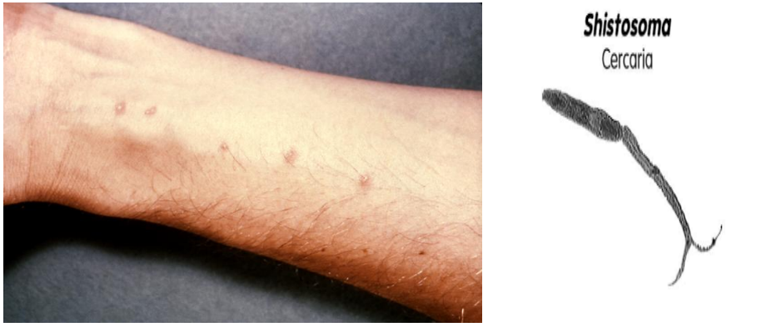
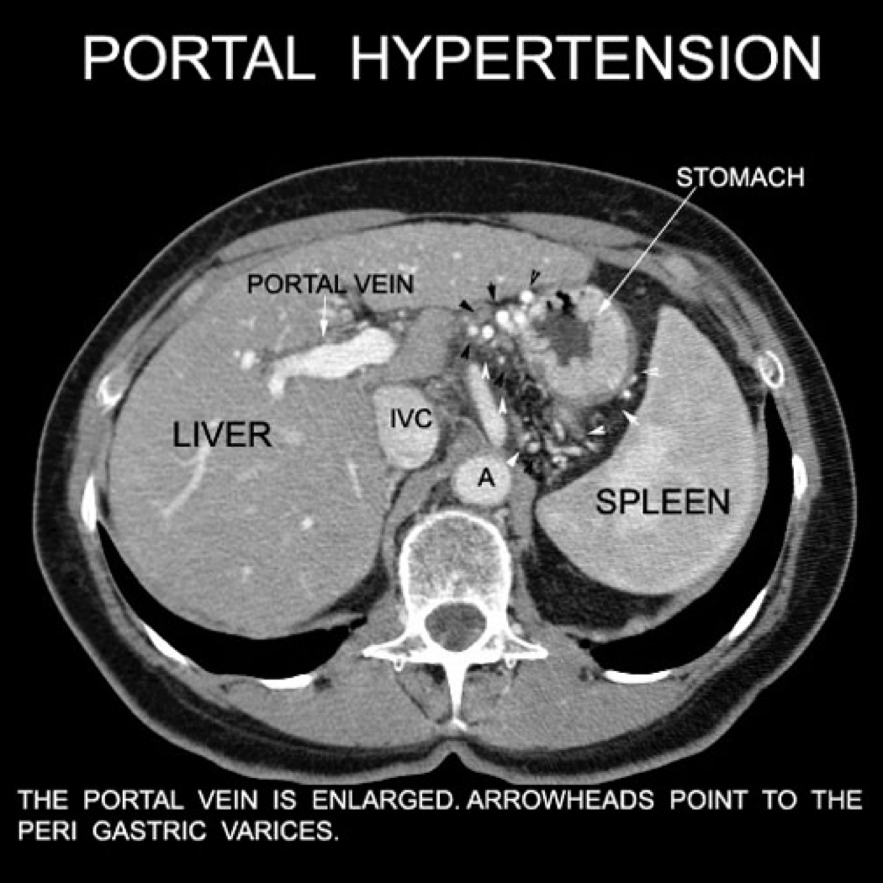
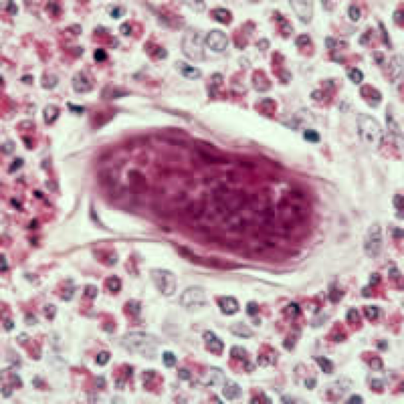
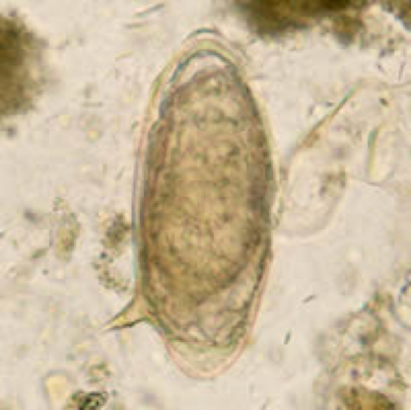
Schistosoma
Pathology | The eggs is the main cause of pathology in schistosomiasis . Many eggs become stranded in the tissues or are carried by the blood stream to other organs mainly the liver. The host reaction to the eggs may vary from small granulomas to extensive fibrosis .The extent of damage is generally related to the number of eggs present in the tissues.
Pathogenicity of Schistosomiasis
Cercarial Dermatitis | At the site of entry of cercaria.
Toxic Metabolites | liberated during the growth of schistosomulae in the circulation veins, may cause anaphylactic reaction ,fever ,urticarial rashes and eosinophilia
Terminal Spined Eggs | May erode blood vessels and cause hemorrhages. Schistosome eggs, deposited in the tissues, act as foreign protein, cause irritation leading to cell infiltration and connective tissue hyperplasia, egg granuloma around each egg (cell mediated immunity) .
Development of Schistosoma in Liver
S.mansoni and S.japonicum located mainly in mesenteric vein and its branches →the worm discharges eggs → the eggs travel in 2 directions: Some eggs find their way into the lumen of the bowel and appear in the feces Other flow with blood stream in the portal circulation and enter the liver. Most of these eggs are trapped in the liver and give rise to pathology. Some of these eggs find their way through the liver tissue → enter the systemic circulation to another organ as brain. Periportal fibrosis of the liver caused from eggs settled in the liver produce portal hypertension which may lead to hepatomegaly, splenomegaly, esophageal varices, hemorrhoids and ascites
Schistosome dermatitis, or "swimmers itch” occurs when skin is penetrated by a free-swimming, fork-tailed infective cercaria. The dermatitis often develops 24 hours after exposure and last for 2 to 3 days and then spontaneously disappears.
Hepatomegaly & splenomegaly w/ ascites
Eggs of S.mansoni in the liver and cellular reaction
Eggs of S.mansoni with lateral spine

Slide 4
S.haematobium
The worm is located in the vesical venous plexus surrounding the urinary bladder. Many eggs are trapped in the wall of the bladder where they may give rise to calcification and granuloma formation. Constriction of the orifice of the ureter may produce kidney damage, hydronephrosis and cancer of the bladder.
Pathology of Schistosomiasis
S.haematobium | S.mansoni
Cause urinary schistosomiasis | Cause intestinal schistosomiasis
Prepatent period: 10-12 wks Egg deposition and extrusion: Painless hematuria Inflammation of the bladder and burning micturition CNS involvement (rare) Tissue proliferation and repair: Fibrosis, papillomata in the bladder and lower ureter leading to obstructive uropathy Lung & CNS involvement | Prepatent period: 5-7 wks Egg deposition and extrusion: Dysentery hepatomegaly and splenomegaly CNS involvement (rare) Tissue proliferation and repair: Papillomata in intestine Periportal fibrosis Lung & CNS involvement
Diagnosis
 | S.haematobium | S.mansoni
Microscope | Examination of urine (terminal spine) | Examination of stool (lateral spine)
Immunological | Serological tests CFT, ELIZA
Indirect | Radiology Cystoscope | Radiology Endoscopy
Intradermal cyst | With cercarial antigen cause allergic reaction
Drug of choice | Praziquantel

Slide 5
Fasciola hepatica (Liver Fluke)
Transmission | By ingestion of raw, freshwater vegetation contaminated with the metacercaria. Metacercaria excyst in the duodenum → migrate through intestinal wall to the liver and settle in the biliary tract Grow into adult worm → liberate eggs in bile, through bile eggs reach the intestine → then passed in stool.
Definitive Host | Sheep, cattle, goat, and human
Intermediate Host | Snails
Infective Stage | Metacercaria ingested with contaminated grasses.
Diagnostic Stage | Egg pass in stool or in duodenal aspirate
Pathology & Clinical Picture | True Infection
 | Occur when a person ingests water plant (watercress) contaminated with metacercaria The adult worm can causes mainly biliary colic with biliary obstruction, jaundice, generalised abdominal pain ,cholecystitis and cholithiasis.
 | False Infection
 | When eggs are eaten in infected animal liver and passed in stools. It won’t lead to liver infection, only we can detect eggs in stool after eating rot cattle liver infected with Fasciola Hepatica so we can find the eggs in stool but patient is not infected.
Diagnosis | Eggs in stools or duodenal aspirate. Serological Test: CFT and skin test are also used.
Treatment | Triclabendazole is the drug of choice to treat fascioliasis and is on the WHO list of essential medicines. The correct dosage is calculated based on the person’s weight (10 mg/kg) and the tablets are given at one time.

Slide 6
Doctor’s Notes
The doctor said you don’t have to memorize the treatment
Schistosoma
Definitive host? Human
Intermediate host? Snail
Location of adult? Blood capillaries
Diagnostic & pathological stage? Eggs
Infective stage? cercaria
First the cercaria will emerge from the snail and swim in the water till it see human skin
Then it will penetrate the skin → stay in the skin for 2 days and cause dermatitis → go to the circulation as schistosomula
After it reaches the systemic circulation it has to choose one of the two destinations, which depends on the type of worm
S. Mansoni and S. Japonicum (japonicum is in japan):
They love going to the Mesenteric veins (becomes adult and give eggs)→ those eggs might go to the portal circulation → liver
The eggs might also go to the lumen of the GIT → pass eggs in the stool (the problem here is when the infected person pass their stool in a still water) → when the eggs are passed in the water they search for a snail (intermediate host) where they’ll develop to cercariae & emerges from the snail→ then when someone come to the infected water the cercaria will penetrate their skin
Eggs of S. Mansoni has lateral spine
Develop periportal fibrosis in the liver → portal hypertension
CASE: patient come to the hospital with portal hypertension after swimming in the canal what is the diagnosis? Schistosomiasis caused by S.mansoni
S. Haematobium:
Same as S. Mansoni but the only different is that it won’t go to the portal circulation
Remains in systemic circulation → they’ll become mature in the vesical & venous plexus → causes inflammation in the bladder → some would pass in the urine
Cause fibrosis in the bladder → hydronephrosis → kidney failure
Can lead to cancer bladder
The pathology is due to immunological reaction caused by cell mediated immunity

Slide 7
Summary
Schistosoma
Cycle | Egg in the water - miracidium hatches out of the egg, look for snail - Cercaria emerge from snail in the water and penetrate the skin of the human. Then it is transformed into a schistosomulae inside the host tissues, enters the systemic circulation. Goes either to: 1- the portal circulation and mature in the mesenteric veins (S.mansoni) 2- worms and mature in the vesical venous plexus surrounding the urinary bladder (S.haematobium)
Types | Schistosoma mansoni |  |  | Schistosoma haematobium
Mature in | Mesenteries blood capillary |  |  | Venous plexus of the bladder
Infective stage | Cercariae (by penetrate the skin and cause Cercarial dermatitis)
Diagnostic stage | Egg with lateral spine found in stool |  |  | Egg with terminal spine found in urine
Definitive host | Human
Intermediate host | Snails
Pathogenicity | The egg is the main cause of pathology in schistosomiasis 1-Cercarial dermatitis: at the site of entry of cercaria. 2-Toxic Metabolites: may cause anaphylactic reaction 3-Terminal spined eggs : Schistosome eggs act as foreign protein ,cause irritation leading to cell infiltration and connective tissue hyperplasia ,egg granuloma around each egg (cell mediated immunity) .
Clinically | Periportal fibrosis Lead to portal hypertension, hepatomegaly, splenomegaly, esophageal varices, hemorrhoids and ascites. |  |  | Calcification and granuloma formation in the bladder. Constriction of the orifice of the ureter may produce kidney damage, hydronephrosis and cancer of the bladder.
symptoms | Dysentery (blood and mucus in stools) |  |  | Painless haematuria
Diagnosis | Microscopical: Examination of stools |  |  | Microscopical: Examination of urine
 | Immunological Serological tests CFT,ELIZA. Indirect: Radiological - endoscopy Intradermal test : With cercarial antigen cause allergic reaction.
Fasciola hepatica
Route of infection | By ingestion of water vegetation contaminated with the metacercaria. |  | Diagnostic stage |  | Eggs pass in stool or in the duodenal aspirate or biliary tract
Intermediate host | snalis | Definitive host | Sheep ,cattle ,goat and man. | Infective stage | metacercaria
Clinically | True infection |  |  | False infection
 | Ingestion of water plant contaminated with metacercaria, lead to biliary colic with biliary obstruction, jaundice, generalised abdominal pain ,cholecystitis and cholithiasis. |  |  | when eggs are eaten in infected animal liver and passed in stools and the patient is not infected.
Diagnosis | Eggs in stools or duodenal aspirate. Serological Test :CFT and skin test are also used.

Slide 8
MCQs:
4- which of the following is the intermediate host in Fasciola hepatica?
A- Caw.
B- Dog.
C- Human.
D- Snalie.
5- Patient presented with blood in the urine, he did not report any pain. On history he said he went swimming with his friends in the lake. What type of infection could he have?
A- Urinary schistosomiasis, by S.mansoni.
B- Intestinal schistosomiasis, by S.mansoni.
C-Urinary schistosomiasis, by S. haematobium.
D- Intestinal schistosomiasis, by S. haematobium.
6- What is the diagnostic stage of Schistosoma mansoni ?
A- Eggs in the stool.
B- Cyst.
C- Egg in the urine.
D- Embryonated egg.
1- In case of schistosomiasis what is the main cause of pathology?
A- Cercaria.
B- Egg.
C- Schistosomulae.
D-Miracidium
2- Patient presented with abdominal pain and and jaundice, after taking the history you found out that he has farm and plant watercress. What is your diagnosis?
A- Schistosoma mansoni.
B- E.histolytica.
C- Fasciola hepatica .
D-C.Parvum.
3- What is the infective stage?
A- Egg.
B- Metacercaria.
C- Cyst.
D- Cercaria.
SAQ:
1-B 4-D
2-C 5-C
3-B 6-A
- A 20 years old male came to the ER. He complained of blood with stool for the past 6 days, abdominal pain. On history he mentioned traveling and swimming in lakes. Stool examination reveal the presence of egg with lateral spine.
1- What is the most likely pathogen?
Schistosoma mansoni
2- Where does this type of pathogen grow and mature?
Mesenteries blood capillary
3-What is your diagnosis ?
intestinal schistosomiasis
4- Mention the infective stage?
Cercaria
5- What further test would you order ?
Serological tests CFT,ELIZA.
Radiological - Endoscopy
Intradermal test
6-What are the complication of the disease?
portal hypertension ,which may lead to hepatomegaly, splenomegaly, esophageal varices, hemorrhoids and ascites.

Slide 9
ALANOUD AL-MANSOUR & KHALED AL-OQEELY
ALFAHDAH AL-SALEEM
DANA AL-RASHEED
LINA AL-OHALI
REEM AL-QAHTANI
SARA AL-SULTAN

