Slide 1
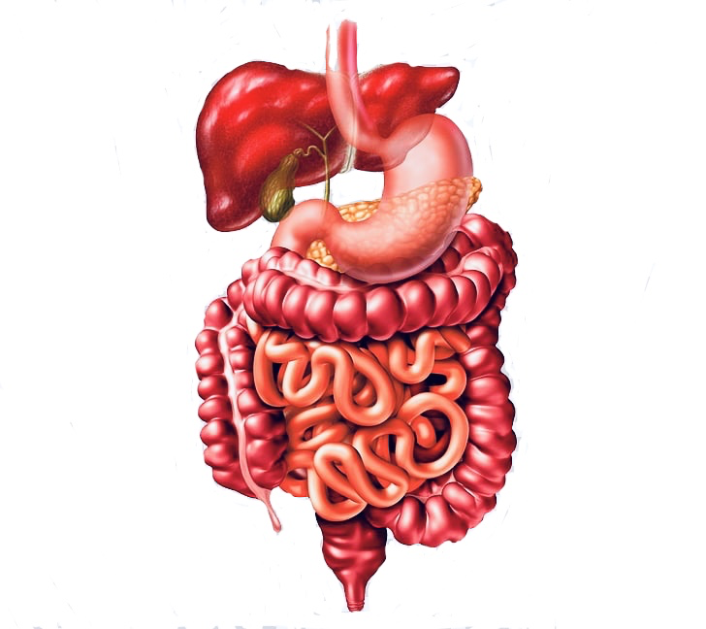
Diarrhea & Malabsorption
هذه المحاضرة هي تكريم لكل من يعمل ولا يكرّم،لكل من يعمل بالخفاء،لكل ايادي تدفعنا من ظهورنا لا نرى وجوه اصحابها
Please note:
This work is based on male slides except few points will appear pink
Content Explanation Notes Important

Slide 2
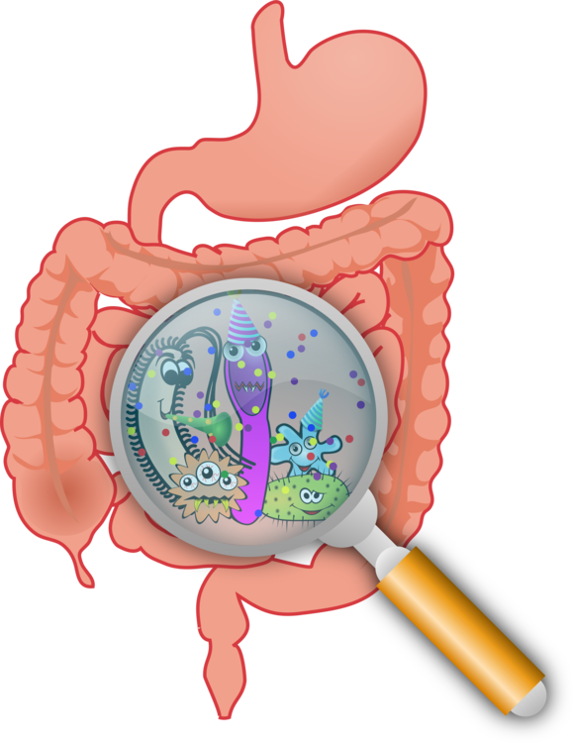
Objectives and there answers from Dr slides
Understand the physiology of fluid in small intestine
1.5 liter of fluid
7 liters secretions and reabsorbed in small intestine
1.4 reabsorbed in large intestine
Describe the pathophysiology and causes of various types of diarrhea
Secretory: Normal stool osmotic gap {bacterial toxin ( E. coli , cholera) Endocrine tumours}
osmotic: osmotic gap is high , {Malabsorption, osmotic laxatives}
Exudative: blood and pus in the stool, { inflammatory bowel diseases, and invasive infections}
Motility-related: {Irritable bowel syndrome (IBS)}
Define acute diarrhea and enumerate its common causes
Less than 2 weeks
infections (viruses, bacteria, helminths, and protozoa). Food poisoning
Define chronic diarrhea and enumerate its common causes
More than one month
Infection, post Infection malabsorption, Inflammatory bowel disease (IBD), cancer
Understand that the malabsorption is caused by either abnormal digestion or small intestinal mucosa
Know that malabsorption can affect many organ systems ( alimentary tract, hematopoietic system, musculoskeletal system, endocrine system, epidermis, nervous system)
Celiac disease
immune reaction to gliadin fraction of the wheat protein gluten.
1.villous atrophy.
2.Crypt hyperplasia
3.Increased intraepithelial lymphocytosis
Lactose Intolerance
Low or absent activity of the enzyme lactase → Lactose not absorbed Lactose accumulate in colon In colon:fermentation by bacteria → Gases

Slide 3
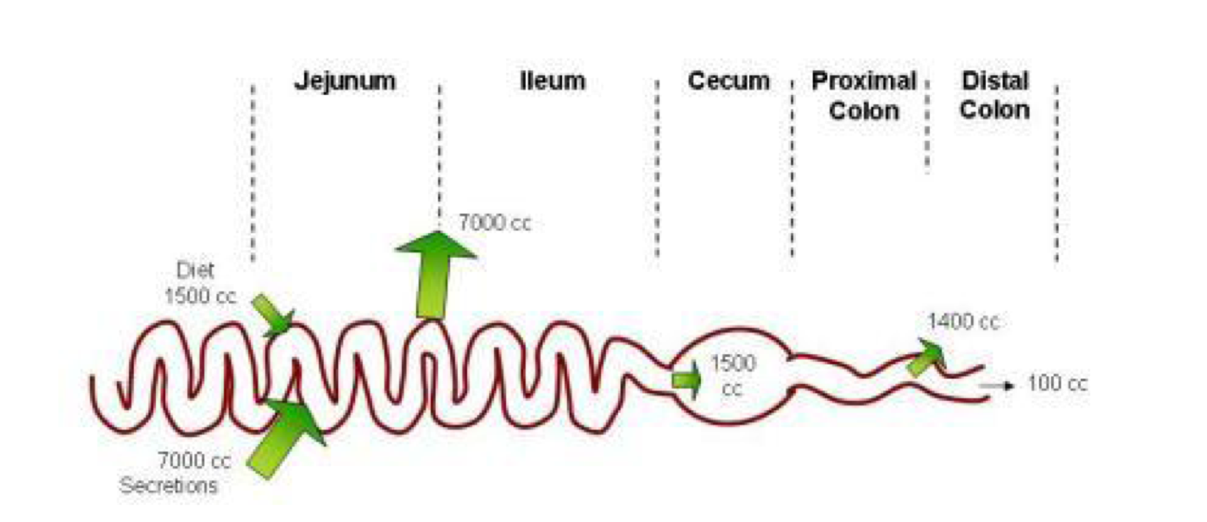
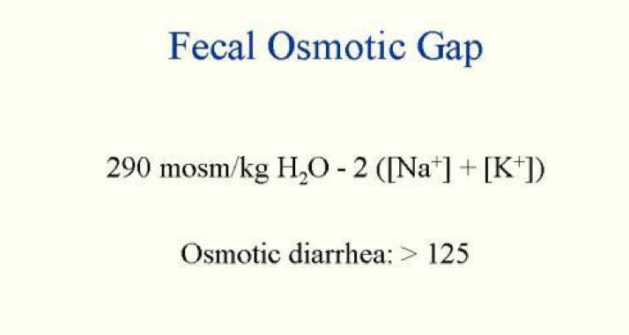
Understand the physiology of fluid in small intestine
Physiology of fluid and small intestine
*Approximately 8500 mL of fluid flow into the intestine daily :
1- from diet (1500mL).
2- Secretions (7000mL), EX (salivary, gastric, biliary, pancreatic, intestinal secretions).
3- Approximately (7000 mL) will be absorbed in the small intestines (most of the volume will be absorbed in the small intestines due to weaker tight junctions between enterocytes).
4- Approximately (1500 mL) cross the ileocecal valve.
5- The colon reabsorbed most of this fluid most of the fluid (1400 mL, but less than small intestines due to stronger tight junctions).
6- Finally, only (100mL) lost in the stool.
Fecal osmolality
As stool leaves the colon, fecal osmolality is = to the serum osmolality i.e. 290 mosm/kg. when the osmolality increase the fecal osmotic gap increase.
Under normal circumstances, the major osmoles which create the osmotic effect are Na+, K+, Cl–, and HCO3 –.
In case of osmotic diarrhea the gap will Formula used to be high due to assess the fecal abnormal increase in osmolality osmoles ** which in turn leads to osmotic diarrhea.
Notes:
باقي بظبه تضبيط هذا شغل بدائي ، good luck ❤️❤️

Slide 4
Describe the pathophysiology and causes of various types of diarrhea ( Secretory, osmotic, Exudative, Motility-related )
Introduction to diarrhea
DEFINITION |  | Based on duration! | IMPORTANCE
 |  | Acute 2 weeks | What happens | Prognosis | Mortality
 |  | Persistent 2-4 weeks | Loss of fluid through diarrhea can cause Dehydration and electrolytes imbalances and acid base imbalance | Easy to treat but if not treated may lead to death especially in children Due to dehydration
 |  | Chronic 4 Weeks We should investigate here especially in children
CLASSIFICATION
WHO:
3 or more loose or liquid stool per day increased frequency
Abnormally high fluid content of stool >200-300 gm/day
decreased consistency
More than 70% of almost 11 million child deaths every year are attributable to a 6 causes
1-diarrhea 2-malaria
3-neonatal infection
4-pneumonia
5-preterm delivery
6-lack of oxygen at birth
Types of diarrhea
Secretory |  | Osmotic | Exudative (inflammatory) | Motility-related
Normal stool osmotic gap < 100 mOsm/kg. (Isotonic stool)
 |  | Stool osmotic gap is high , > 125 mOsm/kg.
-There is an increase in the active secretion. more than 7000cc. -Also Seen in endocrine tumours |  |  | Presence of blood and pus in the stool.
High stool output. And lack of response to fasting The most common cause of this type of diarrhea is a bacterial toxin (E. coli, cholera) that stimulates the secretion of anions* not the bacteria itself but it’s toxin. Bacteria toxin will stimulate secretion of small intestine only No RBC NO inflammation |  | Stool output is not massive and fasting improve the condition Can be the result of : A. Malabsorption in which the nutrients are left in the lumen to pull in water e.g. lactose intolerance B. Osmotic laxatives. Used for constipation but then the patient starts having diarrhea |  | Irritable bowel syndrome (IBS) القولون العصبي a motor disorder that causes abdominal pain and altered bowel habits with diarrhea predominating
Pathophysiology Categories of diarrhea: (Based on pathophysiology!)
Excess amount of poorly absorbed substances that exert osmotic effect water is drawn into the bowels diarrhea.
No blood
Caused by the rapid movement of food through the intestines (hypermotility hyper-peristalsis).
Results from the outpouring of blood protein, or mucus from an inflamed or ulcerated mucosa Occurs with inflammatory bowel diseases, and invasive infections.
Persists on fasting
invasive Bacteria will invade mucosa and cause injury,inflammation, Blood.
Notes:
باقي بظبه تضبيط هذا شغل بدائي ، good luck ❤️❤️

Slide 5
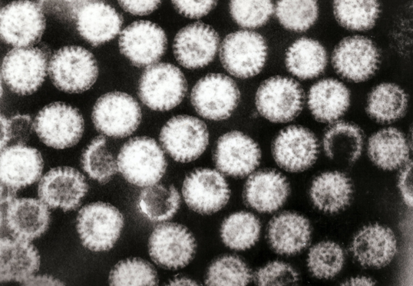
Define Acute Diarrhea And Enumerate Its Common Causes
Etiology of acute diarrhea
Infections |  | Approximately 80% of acute diarrheas are due to infections (viruses, bacteria, helminths, and protozoa).
Viruses |  | Viral gastroenteritis (viral infection of the stomach and the small intestine) is the most common cause of acute diarrhea worldwide. |  | Rotavirus the cause of nearly 40% of hospitalizations from diarrhea in children under 5
Food poisoning |  | Toxic or uncooked food like uncooked eggs, not washing hands before eating. Staph aureus toxins
Drugs |  | Antibiotic, antidepressant, antacids Once we stop the drugs, diarrhea stops.
Others
Antibiotic-Associated Diarrhea:
Acute Diarrhea occurs in 20% of patients receiving broad-spectrum antibiotics; about 20% of these diarrheas are due to Clostridium difficile. |  |  | How does Antibiotics cause Diarrhea? Antibiotic can kill Flora in gut which help in digesting & synthesising B12 & K vit, but also give a chance of Clostridium difficile to overgrowth.change in normal flora
Tests useful in the evaluation of acute diarrhea
Acute diarrhea
Fecal leukocytes
Non-Present
Present
Non-Inflammatory diarrhea
Suggests a small bowel source or colon but without mucosal injury osmotic gap نحسب
Inflammatory diarrhea
Suggests colonic mucosal damage caused by invasion
1. shigellosis, salmonellosis, Campylobacter or Yersinia infection, amebiasis)
2. toxin (C difficile, E coli).
3. Inflammatory bowel diseases
Notes:
باقي بظبه تضبيط هذا شغل بدائي ، good luck ❤️❤️

Slide 6
Define Chronic Diarrhea And Enumerate Its Common Causes
Etiology of chronic diarrhea:
Infections
like Giardia lamblia In duodenum AIDS often have chronic infections of their intestines that cause diarrhea.. not the most common cause. the most common is non infectious
Post-infectious
Following acute viral, bacterial or parasitic infections usually after traveling
Malabsorption
Colon cancer
Endocrine diseases. Carcinoid, gastrinoma
Irritable bowel syndrome
Inflammatory bowel disease (IBD)
Complications: |  | Leads to
Fluids loss |  | Dehydration.
Electrolytes loss |  | Electrolytes imbalance
Sodium bicarbonate loss |  | Metabolic acidosis.
If persistent |  | will lead to Malnutrition.
Tests useful in the evaluation of chronic diarrhea:
Stool analysis ova,parasites
+ve | -ve
Infection | Stool fat test (normal <20%)
 | -ve |  |  | +ve
 | Secretory | Non-infectious | Inflammatory | Malabsorption
Notes:
باقي بظبه تضبيط هذا شغل بدائي ، good luck ❤️❤️

Slide 7
Understand That The Malabsorption Is Caused By Either Abnormal Digestion Or Small Intestinal Mucosa
Malabsorption Syndrome
• Inability of intestine to absorb nutrients adequately into the bloodstream. • Impairment can be of single or multiple nutrients depending on the abnormality.
Physiology
The main purpose of the gastrointestinal tract is to digests and absorbs nutrients (fat, carbohydrate, and protein), micronutrients (vitamins and trace minerals), water, and electrolytes. Mechanisms and Causes of Malabsorption
Mechanisms and Causes of Malabsorption Syndromes
There are many causes:
Inadequate digestion | Deficient bile salt | Primary mucosal abnormalities | Inadequate small intestine | Lymphatic obstruction
-Post gastrectomy -Deficiency of pancreatic lipase -Chronic pancreatitis - Cystic fibrosis -Pancreatic resection -Zollinger-Ellison syndrome | - Obstructive jaundice -Bacterial overgrowth -Stasis in blind loops, diverticula -Fistulas -Hypomotility states (diabetes) -Terminal ileal resection - Crohns' disease - Precipitation of bile salts (neomycin) | Celiac disease -Tropical sprue -Whipple's disease -Amyloidosis -Radiation enteritis -Abetalipoprote-inemia Giardiasis | -Intestinal resection - Crohn's disease -Mesenteric vascular disease with infarction -Jejunoileal bypass | -Intestinal lymphangiectasia -Malignant lymphoma Macroglobulinemia
Doctor didn’t focus on this table ,the important is the next page :)
Notes:
باقي بظبه تضبيط هذا شغل بدائي
كيف الشغل مبدئيا,زين بس ابيك تحط الجدوال بالشكل اللي شفته عشان يصير كل شغل التيم نفس الشكل ، الخط حطه palatine الاحمر على المهم بس.لاتحط خط غامق او مايل او تحته خط خله عادي،الا لو الدكتور مسويه بسلايداته : بس فيه بعض الاشياء مايمديني احط جدول مثل التشخيص,فيه شغل انت سويته فوق شف انا غيرته كيف هذا قصدي
مابي ذي النقاط السودا اللي قبل الجمل حط بداله شرطات احسن،فهمت علي؟ اوك الله يوفقك
فهمت

Slide 8
Understand That The Malabsorption Is Caused By Either Abnormal Digestion Or Small Intestinal Mucosa
Pathophysiology of malabsorption syndrome
Inadequate digestion | Or | Small intestine abnormalities | = | Malabsorption
Inadequate digestion
Stomach | Postgastrectomy
Pancreas | Deficiency of pancreatic lipase usually congenital
 | Chronic pancreatitis
 | Cystic fibrosis
 | Obstructive jaundice Usually associated with steatorrhea.
 | Pancreatic resection e.g in case of pancreatic tumor
Bile | Obstructive jaundice Usually associated with steatorrhea. |  |  | Terminal ileal resection bile cycle
Small intestine abnormalities
Mucosa | Tropical sprue |  |  |  | Giardiasis | Whipple's disease type of | Celiac disease
Inadequate small intestine short small intestines | Crohn's disease fibrosis shortens the small intestine | Intestinal resection
Lymphatic obstruction | Intestinal lymphangiectasia |  |  | Malignant lymphoma

Slide 9
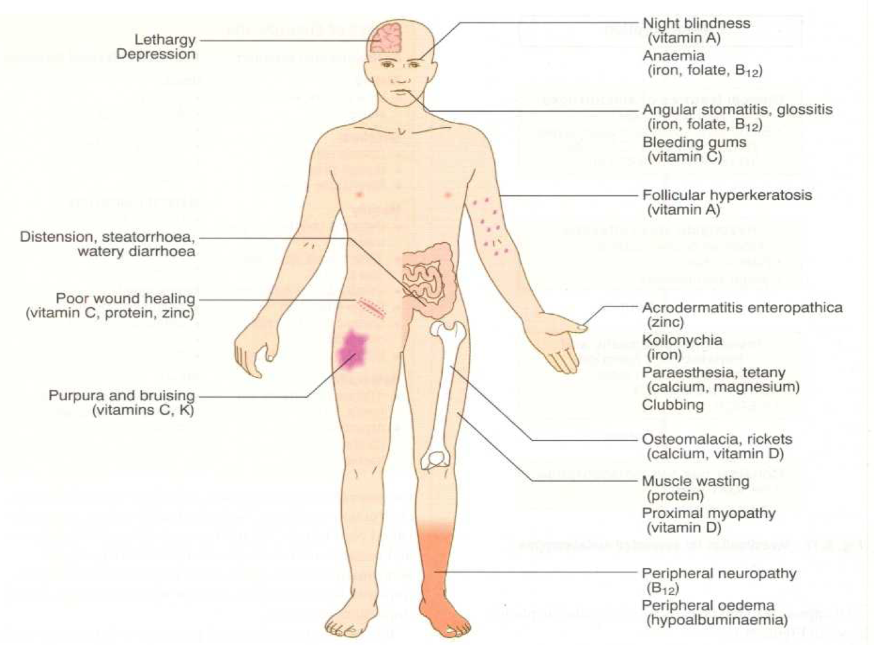
Know That Malabsorption Can Affect Many Organ Systems (Alimentary Tract, Hematopoietic System, Musculoskeletal System, Endocrine System, Epidermis, Nervous System)
Malabsorption syndrome
Clinical features Depend on the deficient nutrient
Depend on deficiencient nutrient :
Protein |  | Muscle wasting swallowing or oedema
B12, folic acid and iron deficiency |  | -Anaemia |  | -fatigue and weakness
Vitamin D and calcium |  | -Osteomalacia and osteoporosis |  | -Muscle cramp
Vitamin k and other coagulation factors |  | -Bleeding tendencies intracranial hemorrhage and bleeding under skin
Diagnosis
There is no specific test for malabsorption but we have a guideline
Investigation is guided by symptoms and signs:
Fecal fat study to diagnose steatorrhea | Blood tests iron,vitamins and albumin | Stool studies | Endoscopy
 |  |  | (Biopsy of small bowel) to exclude small intestine mucosa if normal that mean problem in bile or pancreas
There is increased fecal excretion of fat (steatorrhea) and the systemic effects of deficiency of vitamins, minerals, protein and carbohydrates.
Steatorrhea is passage of soft, yellowish, greasy = fatty stools containing an increased amount of fat. It is diarrhea with fat. usually it has bad smell.
Growth retardation, failure to thrive in children
Weight loss despite increased oral intake of nutrients. because the nutrients are unabsorbed.
For your knowledge
Notes:
باقي بظبه تضبيط هذا شغل بدائي ، good luck ❤️❤️

Slide 10
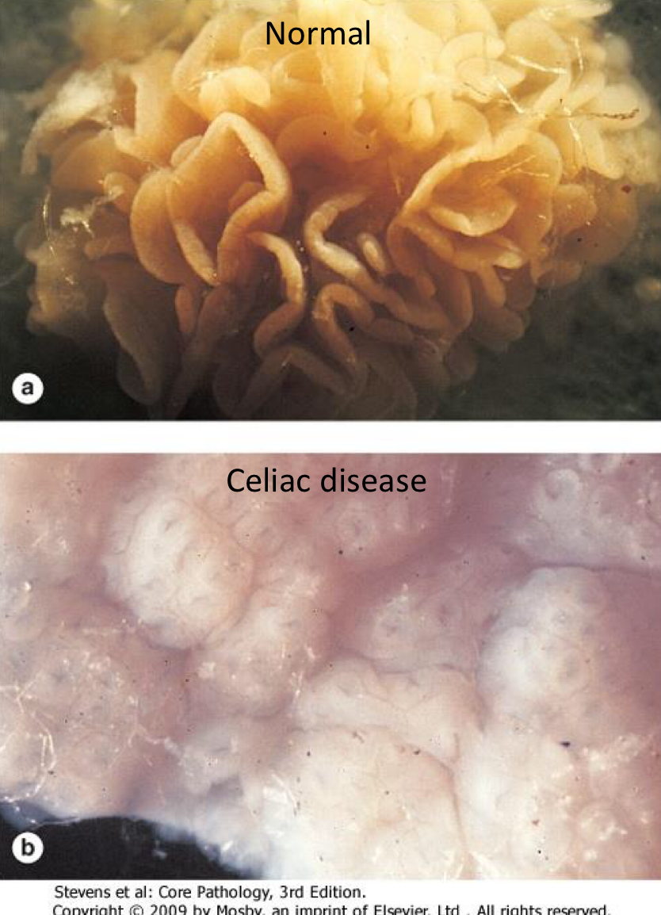
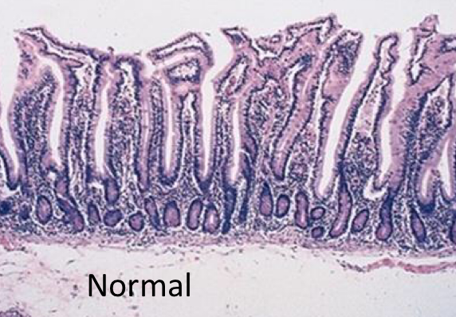
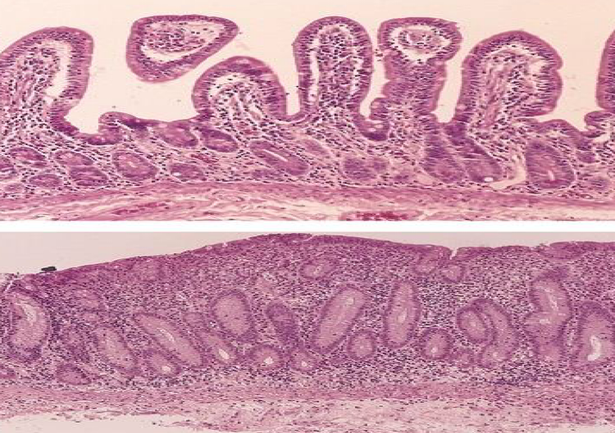
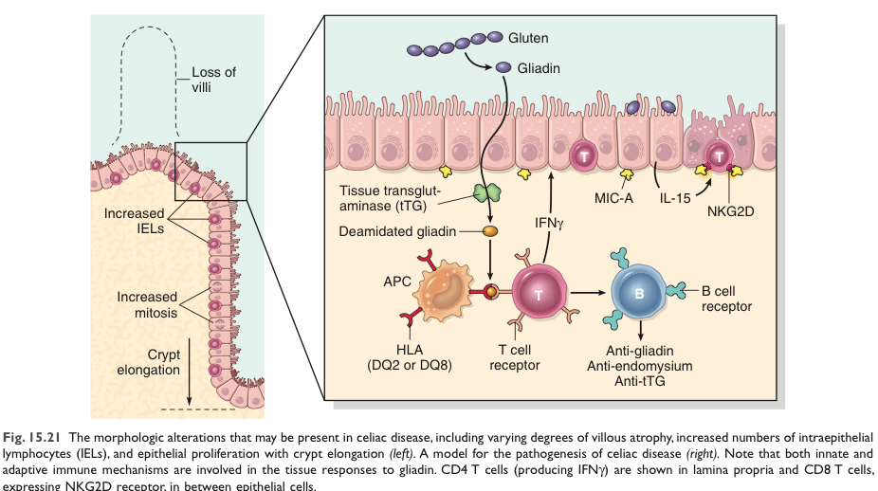
Celiac Disease(important)
What is it? (Abnormal small intestine mucosa)
An immune reaction to gliadin, which is a fraction of the wheat protein gluten. gluten جزء بسيط من الـ gliadin
Usually diagnosed in childhood-mid adult life.
Patients have raised antibodies to gluten.
Highly specific association with class II HLA (DQ2 or DQ8). And to a lesser extent, DQ8 (haplotype DR-4). HLA → Human leukocyte antigen, D → subtype of HLA and there are others (A,B,C).
Endoscopy
Histology | Mucosa is flattened with marked villous atrophy. Crypt hyperplasia. Normally crypts are short and small Increased intraepithelial lymphocytosis. This feature we use it for diagnosis, I will count for 100 enterocytes if the lymphocytes inside them ≥ 30 this is early celiac disease.
Clinical Features | GI symptoms that characteristically appear at age 9-24 months. Symptoms begin various times after the introduction of foods that contain gluten. In infants and toddlers: GI symptoms and failure to thrive. Childhood: Minor GI symptoms, inadequate rate of weight gain. Young adults: Anemia is the most common form of presentation. Adults and elderly: GI symptoms in the form of diarrhea are more prevalent
Diagnosis | Clinical documentations of malabsorption. Increased fat in stool (Steatorrhea) Serologic tests for celiac disease, namely IgA antibodies to tissue transglutaminase (Anti-TTG-IgA). Small intestine biopsy demonstrate villous atrophy. Improvement of symptoms and mucosal histology on gluten withdrawal from diet, (Wheat, barley, rye). Other grains, such as rice and corn flour, do not have such an effect. diagnosis By endoscopy and stop him from wheat and then see the mucosa if it’s better that mean he have celiac disease
Complications | Osteopenia, osteoporosis. Infertility in women. due to hypoalbuminemia. Short stature, delayed puberty, anemia. Malignancies (intestinal T-cell lymphoma), 10 to 15% risk of developing GI lymphoma.
1
2
1
Are these changes reversible? yes, they are. It means if I take a biopsy after 1 month of gluten diet I can see the villi again
2
What malignancy is associated with celiac disease? T-cell lymphoma.
Gluten is digested by brush border enzymes into gliadin. Gliadin is deamidated by tissue transglutaminase, then it’s taken by macrophages, which are antigen presenting cells. They present them through HLA-DQ2 or DQ8 to CD4+ T Cells, which in turn recognize this and produce cytokines that damage the mucosa. They also stimulate B cells to produce antibodies
against tTG and deamidated gliadin, which can be used to monitor the disease.
Pathogenesis of Celiac Disease

Slide 11
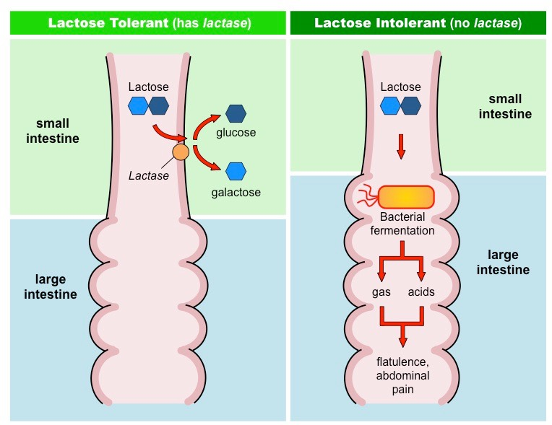
Lactose Intolerance
★ Lactose will go from small intestine → large intestine (there will be bacteria) and there will be fermentation with production of gases especially hydrogen gas which will lead to ↑ motility and irritation of the bowl and then lead to the symptoms (gases and pain).
Normally, at the brush border of enterocytes in the small intestine, Lactose is metabolized to glucose and galactose by the enzyme Lactase. Any low or absent activity of the enzyme lactase will lead to Lactose Intolerance.
Causes
Inherited lactase deficiency | Acquired lactase deficiency
Congenital lactase deficiency, extremely rare. Childhood-onset and adult-onset lactase deficiency: Genetically programmed progressive loss of the activity of the small intestinal enzyme lactase, more common than (1). Lactase enzyme will be slightly lost with time. | It is transient, Secondary lactase deficiency due to intestinal mucosal injury by an infectious, allergic, or inflammatory process. eg, Gastroenteritis: Infectious diarrhea, particularly viral acquired lactase deficiency gastroenteritis in younger children, may damage the intestinal mucosa enough to reduce the quantity of the lactase enzyme.
Clinical | One hour to a few hours after ingestion of milk products: Bloating = abdominal gases, abdominal discomfort, and flatulence.
Diagnosis | Empirical treatment with A 3-week trial of a diet that is free of milk and milk products, which results in resolution of symptoms; is a satisfactory trial to diagnose lactose intolerance. Hydrogen breath test: specific test An oral dose of lactose is administered, the sole source of H₂ is bacterial fermentation; unabsorbed lactose makes its way to colonic bacteria, resulting in excess breath H₂. Increased exhaled H₂ after lactose ingestion suggests lactose malabsorption. In our blood circulation there’s no H, so from where it will come? from the bacteria, so if there’s unabsorbed lactose this allow for the colonic bacteria to ferment the lactose and produce the H ion → circulation → breath.

Slide 12
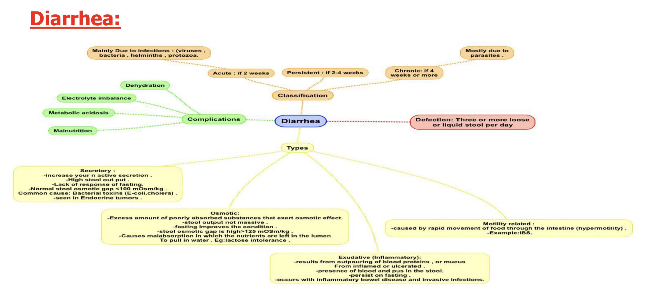
Summary
Malabsorption 1-Pathophysiology of malabsorption is inadequate digestion (BILE or PANCREAS ) OR small intestine abnormalities ( MUCOSA ) .
2-The most diagnostic feature of malabsorption is STEATORRHEA and the clinical feature depend on the deficient nutrient.
3-Celiac disease is AUTOIMMUNE DISEASE that caused by producing antibodies against the fraction of GLUTEN ( GLIADIN ) by ingestion wheat , barley or flour .
4-CELIAC DISEASE under the microscope there will be VILLOUS ATROPHY And INCREASED INTRAEPITHELIAL LYMPHOCYTOSIS .
5-The most serious complication of celiac disease is INTESTINAL T-CELL LYMPHOMA .
6-LACTOSE INTOLERANCE could be INHERITED or ACQUIRED .
7-LACTOSE INTOLERANCE is diagnosed by HYDROGEN BREATH TEST Presence of HYDROGEN indicates BACTERIAL FERMENTATION .
Lactose Intolerance
• Deficiency/absence of the enzyme lactase in the brush border of the intestinal mucosa → Maldigestion and malabsorption of lactose.
• Unabsorbed lactose draws water in the intestinal lumen
• In the colon, lactose is metabolized by bacteria to organic acid, CO2 and H2; acid is an irritant and exerts an osmotic effect
• Causes diarrhea, gaseousness, bloating and abdominal cramps.

Slide 13
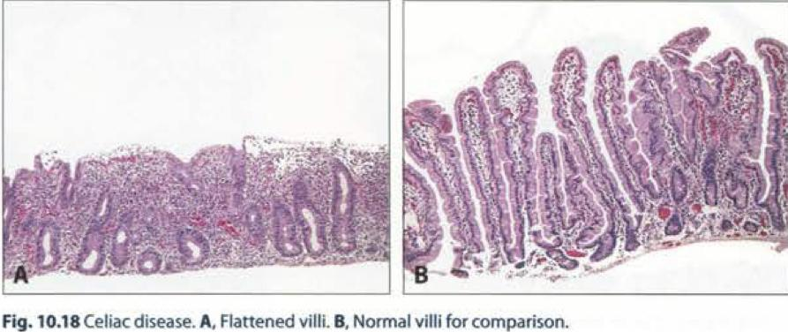
Pathoma
VI. LACTOSE INTOLERANCE A. Decreased function of the lactase enzyme found in the brush border of enterocytes 1. Lactase normally breaks down lactose into glucose and galactose.
B. Presents with abdominal distension and diarrhea upon consumption of milk products; undigested lactose is osmotically active.
C. Deficiency may be congenital (rare autosomal recessive disorder) or acquired (often develops in late childhood); temporary deficiency is seen after small bowel infection (lactase is highly susceptible to injury).
VII. CELIAC DISEASE A. Immune-mediated damage of small bowel villi due to gluten exposure; associated with HLA-DQ2 and DQS
B. Gluten is present in wheat and grains; its most pathogenic component is gliadin. 1. Once absorbed, gliadin is deamidated by tissue transglutaminase (tTG). 2. Deamidated gliadin is presented by antigen presenting cells via MHC class II. 3. Helper T cells mediate tissue damage.
C. Clinical presentation 1. Children classically present with abdominal distension, diarrhea, and failure to thrive.
2. Adults classically present with chronic diarrhea and bloating.
3. Small, herpes-like vesicles may arise on skin (dermatitis herpetiformis). Due to IgA deposition at the tips of dermal papillae; resolves with gluten-free diet D. Laboratory findings 1. IgA antibodies against endomysium, tTG, or gliadin; IgG antibodies are also present and are useful for diagnosis in individuals with IgA deficiency (increased incidence of igA deficiency is seen in celiac disease). 2. Duodenal biopsy reveals flattening of villi, hyperplasia of crypts, and increased intraepithelial lymphocytes (Fig. 10.18). Damage is most prominent in the duodenum; jejunum and ileum are less involved. E. Symptoms resolve with gluten-free diet. 1. Small bowel carcinoma and T-cell lymphoma are late complications that present as refractory disease despite good dietary control.

Slide 14
Questions
Q1 :which one of the following organisms may cause secretory diarrhea ?
Cholera
gonorrhea
s.aureus
l.monocytogenes
Q2:lactose intolerance may cause which type of diarrhea ?
osmotic
secretory
inflammatory
motility related diarrhea
Q3: If there is a patient suffers from diarrhea for the last 3 weeks , we can classify this condition as :
Chronic diarrhea
Acute diarrhea
Persistent diarrhea
Q4:A 10-month-old, previously healthy male infant develops a severe, watery diarrhea 2 days after visiting the pediatrician for a routine checkup. The most likely diagnosis is
Rotavirus infection
Enterotoxigenic
coli infection
Entamoeba histolytica infection
Q5 : all of the following are causes of acute diarrhea except:
Viral gastroenteritis
Food poisoning
Inflammatory bowel disease
Antibiotic-Associated Diarrhea
1-A 2-A 3-C 4-A 5-C

Slide 15
Questions
Q1 :malabsorption diarrhea is classified as?
(A) Chronic invasive
(B) Acute invasive
(C) Chronic osmotic
(D) Acute osmotic
Q2:which of the following is NOT a chronic malabsorptive disorder?
(A) celiac disease
(B) pancreatic insufficiency
(C) Crohn disease
(D) GERD
Q3:Which of the following is a symptom of malabsorptive disorders?
(A) they might have anemia due to pyridoxine, B12 and folate malabsorption
(B) they might have bleeding due to vit K malabsorption
(C) they might have tetany due to calcium malabsorption
(D) all of the above
Q4(from robbins) :which of the following is not a step of Celiac pathogenesis?
(A) Gluten is digested into amino acids and peptides including including “Gliadin” which will get deamidated by “tTG”
.(B) it will interact with HLA-DQ2/HLA-DQ8 of the antigen presenting cells which will present it to CD4 leading to cytokines release
(C) B-Cell activation leading to generation of antibodies against tTG , Gliadin
and CD8 will enterocytes who expresses surface MIC-A
(D) all of the above are true
Q5 A 4-year-old girl is brought to the physician because her parents noticed that she has been having pale, fatty, foul-smelling stools. The patient is at the 50th percentile for height and 10th percentile for weight. Her symptoms respond dramatically to a gluten-free diet. Which of the following is the most likely diagnosis?
(A) Celiac sprue
(B) Cystic ﬁbrosis of the pancreas
(C) Ménétrier disease
(D) Tropical sprue
1-C 2-D 3-D 4-D 5-A

Slide 16
كل الشكر والتقدير للجهود العظيمة
من قبل أعضاء فريق علم الأمراض الكرام.
قادة فريق علم الأمراض
شيرين العكيلي
فايز غياث الدرسوني
اعضاء فريق علم الأمراض
راكان محمد الغنيم
سلطان ناصر الناصر
عادل عبدالعزيز السحيباني
حسن محمد العريني
تركي عيد الشمري
عبدالجبار اليماني
عبدالله المعيذر
منصور العبرة
خالد العقيلي
تركي آل ينهار
سعد الفوزان
عبدالاله الدوسري
رزان الزهراني
لين الحكيم
عهد القرين
وجدان الشامري
غرام جليدان
ليلى الصباغ
ريناد الغريبي
نورة القاضي
مها العَمري
مجد البراك
بتول الرحيمي
منيرة المسعد
مشاعل القحطاني
رِناد الفرم
غادة الحيدري
دانة القاضي
مها بركه

