Slide 1
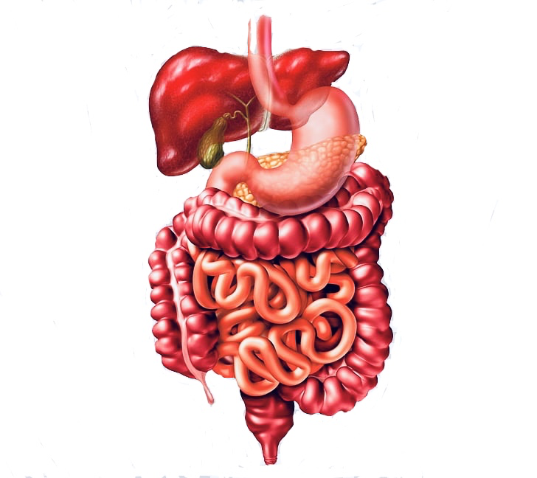
هذه المحاضرة هي تكريم لكل من يعمل ولا يكرّم،لكل من يعمل بالخفاء،لكل ايادي تدفعنا من ظهورنا لا نرى وجوه اصحابها
Review File
إن الجهد الذي تبذلونه اليوم لن يخونكم أبداً،وتذكروا دائماً بأنكم قادرون على تحقيق ما تريدون✨
Content Explanation Notes Important

Slide 2
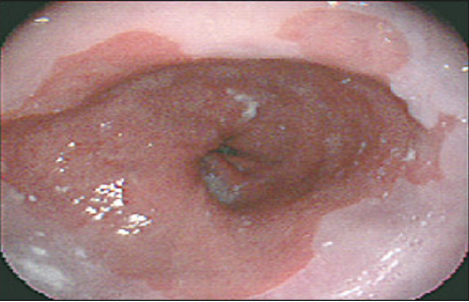
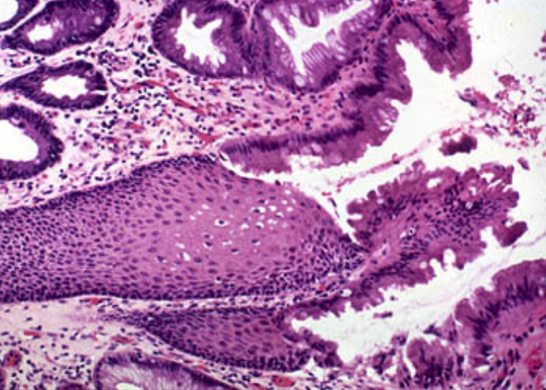
Case 1:
A 57-year-old presents with a history of a retrosternal burning sensation, particularly after large meals, and often on retiring to bed at night. Treatment with antacids has had little effect and he has been referred for endoscopy.
Upper gastrointestinal tract endoscopy reveals reddening of the lower esophageal mucosa. (Normal is white)
There is no evidence of a hiatus hernia.The proximal border of the reddened area is irregular, and this area is biopsied.
Squamous epithelium is the normal lining of the esophagus .
Here, it is replaced by columnar epithelium with some goblet cells.
The biopsy shows intestinal-type glandular mucosa.
1. What is the likely cause of the symptoms?
The symptoms of ‘heartburn’ are suggestive of gastroesophageal reflux disease (GERD), with or without the presence of a hiatus hernia. Other important causes of retrosternal pain should not be overlooked, including cardiovascular causes, especially myocardial ischaemia, as well as other rarer causes including pneumothorax and musculoskeletal pain.
2. What is the final diagnosis?
The endoscopic and biopsy appearances confirm a Barrett’s oesophagus (Intestinal metaplasia). This is a metaplastic process which develops as a result of persistent reflux of gastric contents into the esophagus, the normal squamous mucosa being replaced by glandular mucosa of intestinal type.
3. What further information do you require from the biopsy report?
It is important to look for dysplastic change in the biopsy which may herald the development of adenocarcinoma.

Slide 3
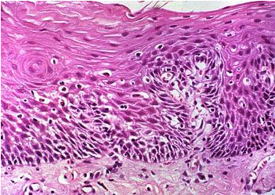
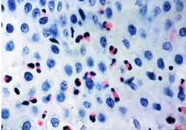
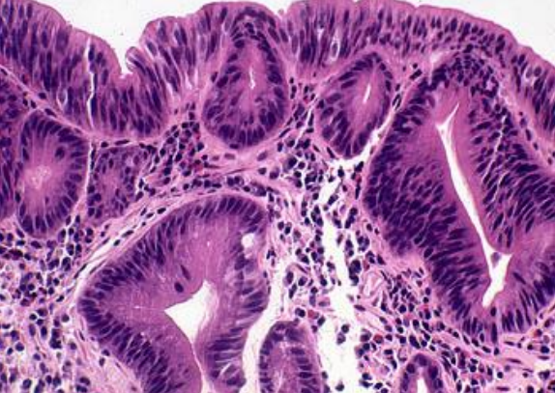
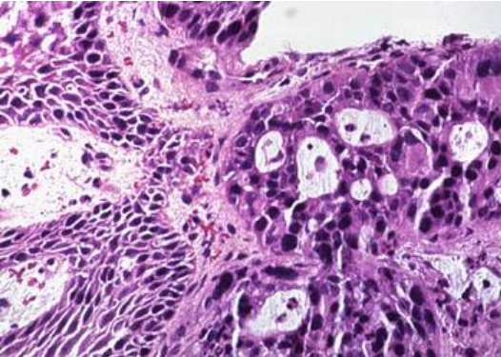
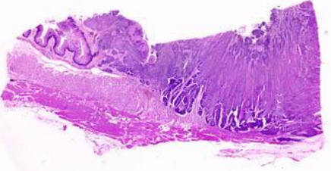
Case 2:
The patient is a 51-year-old white man who presented 10 years before surgery with a history of heartburn, regurgitation, and epigastric pain. Endoscopy was performed, and a large erythematous area involving the distal esophagus was noted. Biopsy specimens were taken.
3
Features of reflux esophagitis:
1-Basal cell hyperplasia
2-Lamina propria elongation
3- Infiltration by neutrophils and eosinophils
1
2
The patient was treated with anti-reflux drugs and given a follow-up appointment in 1 year. The patient returned 3 years later, complaining of dysphagia, heartburn, and epigastric pain. Endoscopy was performed again and revealed that the normal white squamous mucosa lining the distal esophagus was replaced by pink mucosa. Biopsy specimens were taken.
Because of the diagnosis of Barrett esophagus, the patient was enrolled in a surveillance program, and yearly endoscopic procedures were recommended. Endoscopy showed extensive Barrett esophagus 6 years before surgery, and biopsy specimens showed features of ?
Dysplasia
Features of nuclei : The nucleus becomes large and hyperchromatic (Black).
(In adenocarcinoma there is dysplasia but with invasion to the underlying structure it goes to sub muscularis propria)
He failed to return for subsequent surveillance endoscopy. The patient was admitted with increasing dysphagia 1 month before surgery. An upper GI series (radiographs) revealed distal narrowing of the esophagus. Endoscopic examination of the esophagus revealed an ulcerating mass in the distal esophagus. A biopsy specimen was obtained.
The patient was taken to surgery, where an esophagogastrectomy was performed.
Reflux esophagitis has 2 possibilities:
1- stricture formation by fibrosis
2- adenocarcinoma
Large glands with crypt form appearance with dysplasia, meaning the patient has adenocarcinoma.
however, we can not make sure until we examine a section specimen, where we should find underlying structure invasion involving the submucosa and muscularis propria
Invasion and forming gland means adenocarcinoma

Slide 4
Case 3:
A 49-year-old secretary presents to medical outpatients with a 7-month history of epigastric pain. She has been treated with antacids by her GP, but this has not controlled the symptoms. In the clinic, she complains of epigastric pains which are sharp and burning and radiate her subcostal margin to the right. The pain is worse at night and is relieved by food. On examination, there is epigastric tenderness and clinical signs of anaemia.
1. What is the possible cause of this clinical presentation?
Duodenal Peptic ulceration
2. What are the predisposing causes?
1. H.Pylori infection.
2. Acid hypersecretion
3.What are the major complications?
The major complication is perforation of a vessel with subsequent gastrointestinal haemorrhage. This can present as either hematemesis, melena or iron deficiency anemia (due to chronic blood loss). Other complications include fibrosis and adhesions.
Frank hemorrhage is a major complication
adenocarcinoma is a complication of gastric and duodenal ulcer
4.What investigations should be performed?
Endoscopy
5.What is the treatment?
1. Proton pump inhibitors.
2. H 2 receptor antagonists.
3. H. pylori eradication therapy

Slide 5
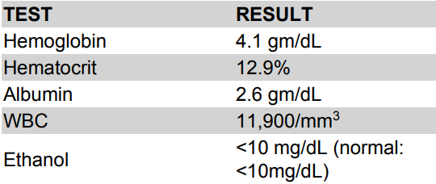
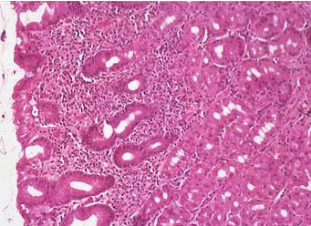
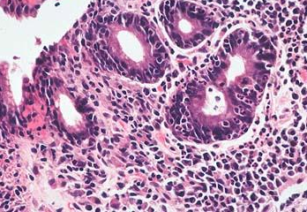
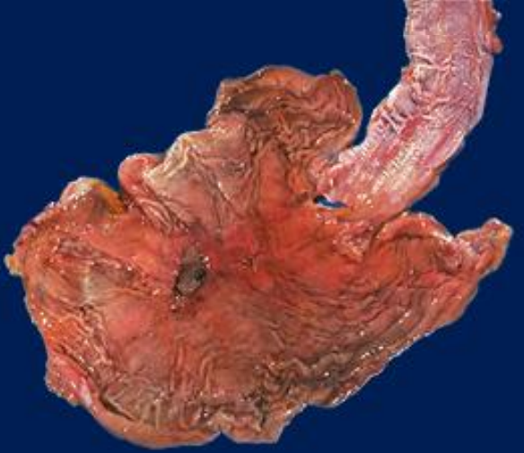
Case 4:
The patient is a 72-year-old white man with a history of homelessness, chronic obstructive pulmonary disease, chronic alcohol abuse, chronic dementia, and multiple episodes of upper GI bleeding (vomiting blood). He was admitted to the hospital with complaints of dizziness (due to loss of blood volume), syncope, and abdominal pain. The abdominal examination revealed mild epigastric pain on palpation. The rectal examination shows black stool. (Malena)
The patient was admitted to the medical intensive care unit, where a nasogastric tube lavage produced coffee-ground gastric contents that tested positive for blood.
He was transfused with 6 U of packed RBCs, which increased his hematocrit to 38% (normal 40% to 52%).
What is your next step?
An upper GI tract endoscopy was performed, which showed a large (5 _ 5 cm) gastric ulcer in the antrum along the lesser curvature. Biopsy specimens were taken of the ulcers and surrounding mucosa.
Helicobacter Pylori
Ulcer in stomach and esophagus
What do you expect to find in the surrounding mucosa?
1- gastritis
Chronic:plasma cells in lamina propria
acute:Neutrophils invading the crypts as well as inflammation
2- H.pylori

Slide 6
MCQ:
1-A 52-year-old male presents with epigastric pain that improves with meals. Endoscopy demonstrates a 2 Cm ulcerated area located 3 cm distal to the pyloric junction (So the ulceration is in the duodenum). Which of the following is most likely to have made the strongest contribution to the development of this disease?
A. Aspirin use
B. Chronic antacid use
C. Drinking alcohol
D. Helicobacter pylori infection
E. Smoking
The patient has a duodenal peptic ulcer. The strongest risk factor for duodenal peptic ulcer is Helicobacter pylori infection, which is found in almost 100% of these cases (contrast to 70% Infection rate in gastric peptic ulcer).
• Aspirin use (choice A) and ethanol use (choice C) are more strongly implicated in gastric ulcer disease than duodenal ulcer disease.
• Chronic antacid use (choice B) is seen as a result of peptic ulcer disease, not as a cause of it.
• Smoking (choice E) may also be a lesser contributing factor to the development of peptic ulcer.
2-All of the following are causes of acute peptic ulcer except?
A. Severe burns
B. Helicobacter pylori infection (Chronic)
C. Major trauma
D. Zollinger-Ellison syndrome
3-All of the following are Defensive Factors against gastric ulcer development except?
A. Mucus
B. Bicarbonate
C. Bile salts (aggressive)
D. Prostaglandins
E. Phospholipids
Ans: D
Ans: B
Ans: C

Slide 7
Which of the following is an aggressive factor, and which is a defensive factor?
1) H. pylori
2) Phospholipids
3) Drugs (NSAIDs)
4) Mucus
5) bicarbonate
6) Blood flow
7) Acid
8) pepsin
9) Bile salts
10) cell renewal
11) Prostaglandins
Aggressive Factors | defensive Factors
H.pylori Drugs (NSAIDs) Acid Pepsin Bile salts | Phospholipids Mucus Bicarbonate Blood flow Cell renewal Prostaglandins

Slide 8
Diarrhea
Q1: A 44 year-old man is admitted to the hospital with acute upper GI bleed due to several gastric and duodenal ulcers seen on an urgent upper endoscopy. One of the duodenal ulcers is in the 3rd portion of the duodenum. The patient also complains of a year history of frequent non-bloody diarrhea. (most likely secretory but could be osmotic also) A fecal osmotic gap is very low (normal therefore it is not osmotic)
1. What type of chronic diarrhea does this patient have? - Secretory (due to low osmotic gap + non-bloody diarrhea)
2. What is the most likely cause? Zollinger-Ellison syndrome due to a gastrinoma (that stimulate gastrin which lead to increase acid secretion causing hyperacidity) (will secrete gastrin which will cause gastric hyperacidity due to stimulation of parietal cells and these cells will secrete more acid and cause multiple gastric ulcers and it will stimulate secretion of small intestine and it will cause chronic diarrhea)
3. What is the mechanism to explain diarrhea? (zollinger ellison syndrome it will secrete gastrin hormone which will increase small intestinal secretion which will lead to secretory diarrhea - Acid inactivation of pancreatic enzyme and bile salts - Excess intestinal fluid
4. What blood test can you check to make the diagnosis? Gastrin level (also X-Ray or CT Scan)
Q2: A 10-month-old, previously healthy male infant develops a severe, watery diarrhea 2 days after visiting the pediatrician for a routine checkup. The most likely diagnosis is:
A) Rotavirus infection
B) Enterotoxigenic E. coli infection
C) Entamoeba histolytica infection
D) Lactase deficiency
E) Ulcerative colitis
ANS:A
Child with acute diarrhea is usually caused by virus
What are the complications of diarrhea?
Complications: If persistent it will lead to Malnutrition. |  | Leads to
Fluids loss |  | Dehydration.
Electrolytes loss |  | Electrolytes imbalance
Sodium bicarbonate loss |  | Metabolic acidosis.

Slide 9
Q4: match the correct answers
A | B
1. Fasting improve the condition (b) 2. inflammatory bowel diseases (c) 3. High stool output (a) 4. Presence of WBC in stool(c) 5. Irritable bowel syndrome(d) 6. bacterial toxin(a) if it were invasive the answer would’ve been (C) 7. Malabsorption (b) 8. High fecal osmotic gap (b) | a) Secretory b) Osmotic c) Exudative (inflammatory ) d) Motility-related
A | B
1. Irritable bowel syndrome (b) 2. Giardia lamblia (b) 3. Viral gastroenteritis (a) 4. Inflammatory bowel disease (b) 5. Food poisoning (a) 6. Antibiotic-Associated Diarrhea (a) 7. Malabsorption (b) | a) Acute Diarrhea b) chronic diarrhea
Clinical presentation of malabsorption:
Steatorrhea will indicate malabsorption only. clinical presentation depends on nutrient
Mostly abnormality in: stomach, pancreas, bile
Pathophysiology of malabsorption ?
Pathophysiology of malabsorption syndrome
Inadequate digestion | Or | Small intestine abnormalities | = | Malabsorption

Slide 10
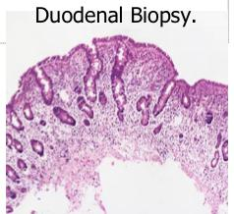
malabsorption
Case :A 44-year-old white male presented with a seven-month history of diarrhea. The frequency of his bowel movements had increased to 5-7 per day, and his stools were yellow and floated at the top of the water in the toilet. (steatorrhea) He had occasional abdominal cramping, but no tenesmus, melena, or bleeding. His appetite was good, but he had experienced gradual weight loss. His bowel movement frequency would decrease upon fasting and would increase with food intake.
Stool tests revealed a stool output of 4128 g/d (nl 100-200 g/d) with fat excretion of 17 g/d (nl <5 g/d). (increased indicates steatorrhea)
Microscopic examination for ova and parasites and cultures for bacterial pathogens and acid-fast bacilli were negative. Excludes bacterial infection
Blood tests showed mild anemia (due to malabsorption) , hypoproteinemia (4.9 mg/dl), and hypoalbuminemia (3.4 mg/dl) the would increase with food intake
1. Exposure to what dietary antigen is thought to be the cause of these changes?
Exposure to gluten (specifically, the gliadin constituent of this protein)
2. What food components contain this antigen? Wheat, barley, flour, and possibly oats contain gluten.
3. Would these histologic changes resolve with dietary modification?
Yes. histological changes and symptoms will resolve with this treatment and diagnosis
abnormal due to presence of
1- villous atrophy
2- intraepithelial lymphocytosis
3-Crypt Hyperplasia
4-what is celiac disease?
gluten will affect the small intestine mucosa so there will be malabsorption to other nutrients not like lactose intolerance which only affects lactose absorption

Slide 11
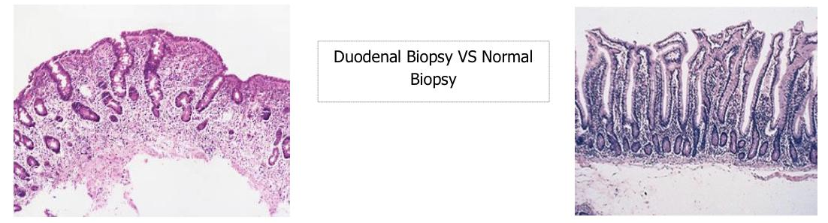
Case:A 6-year-old boy has been brought to outpatients by his mother because he has abdominal pain after some meals. This has been getting increasingly frequent and it sounds, from his description, somewhat colicky (comes and goes) in nature. You discover that he has always had very smelly, loose, pale bulky stools, which his parents have put down to the fact that he likes milk. On examination, he is pale, underweight, and of short stature. (Lactose intolerance does not cause this it only affects lactose absorption)
What are the important differential diagnoses on presentation? malabsorption (due to Pancreas, bile, stomach abnormality) 1-Celiac disease is the most likely diagnosis. Parasitic infection (e.g. giardiasis) and pancreatic insufficiency (e.g. due to chronic pancreatitis or cystic fibrosis) may give rise to a similar presentation, but these are not supported by the results of the investigations. 2-Blood tests reveal a mild macrocytic anemia. There is a low level of vitamin B12, and folate is at the lower end of normal. Autoantibody screens reveal a positive reaction to antigliadin antibodies. (not specific diagnostic test, it can be seen in normal individuals)
Do these tests help to narrow down the diagnosis? We have to perform an endoscopy and extract a biopsy, as well as, tell him to stop eating wheat for 2 to 3 months to see if he improves (if he does it confirms the presence of the disease) These results are very suggestive of celiac disease due to the low levels of vitamin B12 and the hypersensitivity reaction to α-gliadin, a component of gluten. The finding of villous atrophy would support the diagnosis, and this is achieved by endoscopic biopsy of the first part of the duodenum. The final diagnosis is celiac disease, provided the patient’s symptoms respond to a gluten-free diet and the histological changes relapse on re-challenge. Such criteria are necessary before confining a patient to a lifelong gluten-free diet.
normal
villous atrophy
1. What treatment options are available?
Treatment is by adhering to a strict gluten-free diet.

Slide 12
Pathophysiology of Lactose Intolerance: Lactose is Metabolized into Glucose + Galactose BY Lactase enzyme AT the brush border of enterocytes. Lactose Intolerance describes having low or absent activity of the lactase enzyme. In lactose Intolerance, the lactose is mixed with water in the small intestine, then the bacteria ferment this compound creating gases, organic acids & other osmotically active molecules which in turn cause irritation & increase of motility. Causes Of lactose intolerance: 1. Congenital Lactase deficiency: Extremely rare.
2. Childhood-onset and adult-onset lactase deficiency: more common and genetically programmed progressive loss of the activity of the small intestinal lactase enzyme.
3. Acquired Lactase Deficiency (especially after infection): Transient. Secondary lactase deficiency due to intestinal mucosal injury (affects the brush border) by an infectious, allergic, or inflammatory process.
Eg:, Gastroenteritis,infectious diarrhea, particularly viral gastroenteritis in younger children may damage the intestinal mucosa enough to reduce the quantity of the lactase enzyme.
Diagnosis of Lactose intolerance: Empirical treatment with a lactose-free diet, which results in resolution of symptoms.
Hydrogen breath test. (the only source of the bacteria is fermentation)
Treatment: Lactose-free diet.
Lactose intolerance

Slide 13
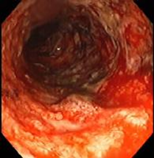
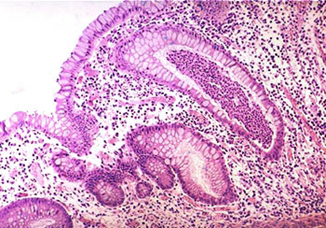
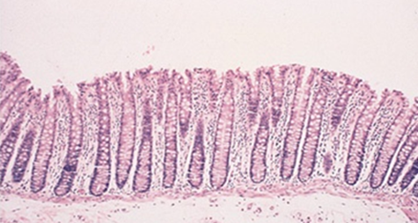
Case1
• A 25-year-old man (good age for IBD) experiences the gradual onset of intermittent diarrhea, which over years, progresses to severe diarrhea, alternating with constipation, rectal bleeding, and passage of mucus.
• On physical examination, the abdomen is tender over the colon.
• Stool examination fails to reveal no parasites or bacteria
Most likely ulcerative colitis, but could also be crohns
Colonoscopy demonstrates inflammation limited to the rectum,
1. What histologic feature is seen in Crohn disease that is not seen in ulcerative colitis?
Granulomas and transmural inflammation (only seen in resected specimen because in biopsy we take mucosa only) in the resected specimen. we can also deep ulcers and fistulas from resected specimen
2.What are the complications of ulcerative colitis?
The most serious complication is the development of carcinoma. The cancers are preceded by dysplasia, which tends to arise in multiple sites. The risk of cancer is highest in patients with pancolitis of ten or more years duration, in whom it is 20 to 30 fold higher than in a control population. Other life-threatening complications include severe diarrhea and electrolyte disturbances, severe colonic dilation (toxic megacolon) with potential for perforation and peritonitis, and massive hemorrhage. after this it might lead to cancer
Active chronic colitis.
Can be seen in both ulcerative colitis and crohn's
Crypts dilation and some branching called architure distortion which indicates chronic colitis
Presence of neutrophils
Normal

Slide 14
Case 2
A 25-year-old man presents to a rheumatologist with complaints of joint pain involving the large joints of the legs. On questioning, the patient indicates that exacerbations in the joint pain are frequently accompanied by diarrhea. Which of the following gastrointestinal diseases is most likely to be implicated as the cause of the patient's joint problems?
A. Amebic colitis
B. Chronic appendicitis
C. Diverticulosis
D. Pseudomembranous colitis
E. Ulcerative colitis can also be crohn’s disease
Mucosal ulceration is seen in both Crohn's disease and ulcerative colitis. The ulcers of Crohn's disease are generally described as linear fissures, following the longitudinal axis of the intestine. Ulcerative colitis typically produces broad, extensive areas of ulceration. Pseudopolyps are most commonly associated with ulcerative colitis, and represent the islands of spared mucosa between the broad ulcerations. Rectal involvement in inflammatory bowel disease is more typical of ulcerative colitis than of Crohn's disease. Whereas ulcerative colitis is a "pancolitis," that is usually most severe in the rectum and right colon, Crohn's disease is usually a disease of the small intestine, and may involve the small intestine alone (40%) or both the small intestine and colon (30%).
Crohn's disease is frequently associated with "skip lesions,“ discontinuous areas of active disease in the colon and small intestine with intervening segments that appear normal. This is in marked contrast to ulcerative colitis, which most commonly shows continuous mucosal involvement. Both ulcerative colitis and Crohn's disease can show mucosal atrophy. Chronic mucosal inflammation produces glandular atrophy, and a loss of mucosal folding.
Explanation: Enteropathic arthritis is a chronic, inflammatory arthritis that's associated with inflammatory bowel disease (IBD)

Slide 15
MCQ:
A patient has had years of intermittent diarrhea and abdominal pain, but has never consulted a physician. Eventually, he begins to pass fecal material in his urine and he seeks medical attention. Which of the following diseases is most likely to cause this complication?
Celiac disease
Crohn's disease
Diverticulitis
Ulcerative colitis
Whipple's disease
Passing fecal material in urine strongly suggests the possibility of a fistula (enterovesical) between the bowel and bladder. Of the diseases listed, only Crohn's disease (a type of inflammatory bowel disease) commonly produces fistulas. Fistulas are produced in Crohn's because the disease affects the entire thickness of the bowel wall, rather than being restricted to the mucosa (e.g., ulcerative colitis).
Ans: B

Slide 16
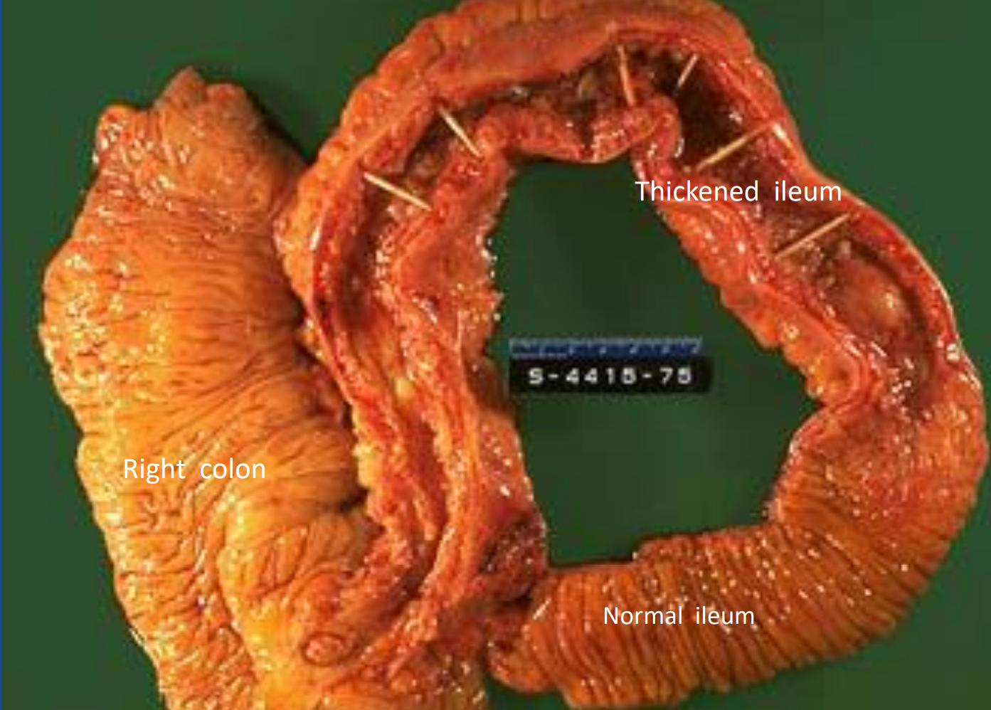
Case3:
35 y/o male , known case of inflammatory bowel disease, presented in ER with severe colicky abdominal pain. Barium enema study show features of intestinal obstruction. He was taken to OR , and Excision of terminal ileum and proximal colon was performed. (the only choice in this condition)
What are the complications of Crohn disease?
Fissures in the mucosa can extend through the wall and form sinus tracts, resulting in fistula formation to other loops of bowel, urinary bladder or vagina; there may be localized peritonitis and abdominal abscesses; Fibrosis of the gut wall may lead to strictures and obstruction. Extensive involvement of the small bowel may cause marked loss of albumin (protein-losing enteropathy) or malabsorption.
Are any other organs affected in Crohn disease? In ulcerative colitis? (skin,eyes,joints)
Both Crohn disease and ulcerative colitis are systemic diseases, associated with varied extraintestinal manifestations of immunologic origin. These include polyarthritis, sacroiliitis, ankylosing spondylitis, uveitis, sclerosing cholangitis, erythema nodosum, and clubbing of the fingertips.
The specimen is a section of normal ileum, thickened ileum, and right colon. The intestinal wall is thick, the result of edema, inflammation, fibrosis, and hypertrophy of the muscularis propria. Linear ulcers are typically present in the diseased segment of bowel. In diseased bowel segments, the serosa is thickened and fibrotic, and often the mesenteric fat wraps around the bowel surface (creeping fat)
involvement of terminal ileum excludes presence of ulcerative colitis

Slide 17
MCQ: A 39-year-old male presents with bloody diarrhea. Multiple stool examinations fail to reveal any ova or parasites. A colonoscopy reveals the rectum and sigmoid portions of the colon to be unremarkable (so it is not ulcerative colitis). A biopsy from the terminal ileum reveals numerous acute and chronic inflammatory cells within the lamina propria. Worsening of the patient’s symptoms results in emergency resection of the distal small intestines. Gross examination of this resected bowel reveals deep, long mucosal fissures extending deep into the muscle wall. Several transmural fistulas are also found. What is the best diagnosis for this patient?
Ulcerative colitis
Lymphocytic colitis
Infectious colitis
Eosinophilic colitis
Crohn’s disease
Ans: E
- CD is classically described as being a granulomatous disease, but granulomas are present in only 25 to 75% of cases. Therefore, the absence of granulomas does not rule out the diagnosis of CD.
- CD may involve any portion of the gastrointestinal tract and is characterized by focal (segmental) involvement with “skip lesions.”
- Involvement of the intestines by CD is typically transmural inflammation, which leads to the formation of fistulas and sinuses.
- The deep inflammation produces deep longitudinal, serpiginous ulcers, which impart a “cobblestone” appearance to the mucosal surface of the colon.
- Additionally in Crohn’s disease, the mesenteric fat wraps around the bowel surface, producing what is called “creeping fat,”
- the thickened wall narrows the lumen, producing a characteristic “string sign” on x-ray. This narrowing of the colon, which may produce intestinal obstruction, is grossly described as a “lead pipe” or “garden hose” colon.
- In contrast to CD, UC affects only the colon, and the disease involvement is continuous. The rectum is involved in all cases, and the inflammation extends proximally. Since UC involves the mucosa and submucosa, but not the wall, fistula formation and wall thickening are absent (but toxic megacolon may occur). Grossly, the mucosa displays diffuse hyperemia with numerous superficial ulcerations. The regenerating, nonulcerated mucosa appears as “pseudopolyps.

Slide 18
A- Crohn's disease | 1- Colon only | B
 | 2- Diffuse involvement of mucosa | B
 | 3- Superficial ulcers | B
 | 4- Any part of the GIT | A
 | 5- Skip areas of normal mucosa | A
 | 6- Mucosal inflammation only | B
B- Ulcerative Colitis | 7- Fistula formation | A
 | 8- Transmural inflammation | A
 | 9- Granulomas | A
 | 10- Deep ulcers ( fissure ) | A
 | 11- Dysplasia is common | B
 | 12- Carcinoma is more common (10%) | B
CASE:A 68-year-old (less likely to be IBD) woman presents with intermittent constipation, weight loss, and a swollen abdomen. She has had two previous polypectomies: one showed a tubular adenoma and the other was a tubulovillous adenoma. Double-contrast barium enema shows an irregular stricture 4 cm long in the ascending colon. A tumor is diagnosed and surgery is advised. The tumor is resected and is found to have invaded through the thickness of the bowel wall, but is completely excised. Three of 15 lymph nodes identified contained metastatic tumor.
What is the most likely diagnosis with this presentation?
The most likely diagnosis is colorectal adenocarcinoma.
What stage is this tumor and what is the prognosis? (no need)
This is a Dukes’ C carcinoma (T3 (involving submucosa muscularis and extend to fat layer), N1, MX
(T2-----involves propria T1----submucosa)
What is the association between adenoma and carcinoma?
multiple genetic abnormalities: APC,P53,K-RAS mutation
There is much evidence to suggest that most carcinomas of the colon arise in pre-existing adenomas (adenoma–carcinoma sequence). Patients with familial adenomatous polyposis (FAP) have a very high risk of developing colorectal carcinomas.
Where is the metastatic spread most likely?
Colorectal carcinomas metastasize mainly to regional lymph nodes and liver most commonly, less commonly developing other systemic metastases such as brain, bone and lung.

Slide 19
CASE:52 y/o female presented with fatigue and weakness. She experienced 6 kg wt loss in a 6 six months
- CBC => Hg 7.5 g/dl , hematocrit 26 % - Serum ferritin => 8 ng/dl - Iron deficiency anemia caused by: not eating enough, malabsorption, lost in RBC (bleeding) - Rx oral iron treatment
- Stool and urine analysis => blood in the stool - Colonoscopy (to see the source of RBCs) => ascending colon 6 cm mass (Right colon involvement might present with just anemia) - Biopsy => adenocarcinoma
A- Familial polyposis coli | 1- Colonic polyposis | A
 | 2- Multiple osteoma | B
B- Gardner’s syndrome | 3- Central nervous system tumors | C
 | 4- Fibromatosis | B
C- Turcot’s syndrome. | 5- 100% risk of carcinoma | A
 | 6- Cutaneous cysts | B

Slide 20
Polyps
Non-neoplastic | Neoplastic
90% | 10%
Hyperplastic polyps Hamartomatous polyps (juvenile & peutz-jeghers polyps) Inflammatory polyps Lymphoid polyps | Adenoma must have dysplasia
A 22-year-old woman has had recurrent episodes of diarrhea, crampy
abdominal pain, and slight fever over the last 2 years. Other symptoms
have included mild joint pain and sometimes red skin lesions. On at least
one occasion, her stool has been iron-positive, indicating the presence of
occult blood. Colonoscopy reveals several sharply delineated areas with
thickening of the bowel wall and mucosal ulceration. Areas adjacent to
these lesions appear normal. Biopsies (Biopsies only show mucosa so there is an error, should've been resected specimen) of the affected areas show
full-thickness inflammation of the bowel wall and several noncaseating
granulomas.
What is the most likely diagnosis?
What are the common complications of this disease?
Most likely diagnosis: Crohn disease.
Common complications of this disease:
Malabsorption and malnutrition, fibrous
strictures of the intestine, and fistulae to other organs, such as from bowel to skin or bowel to bladder.

Slide 21
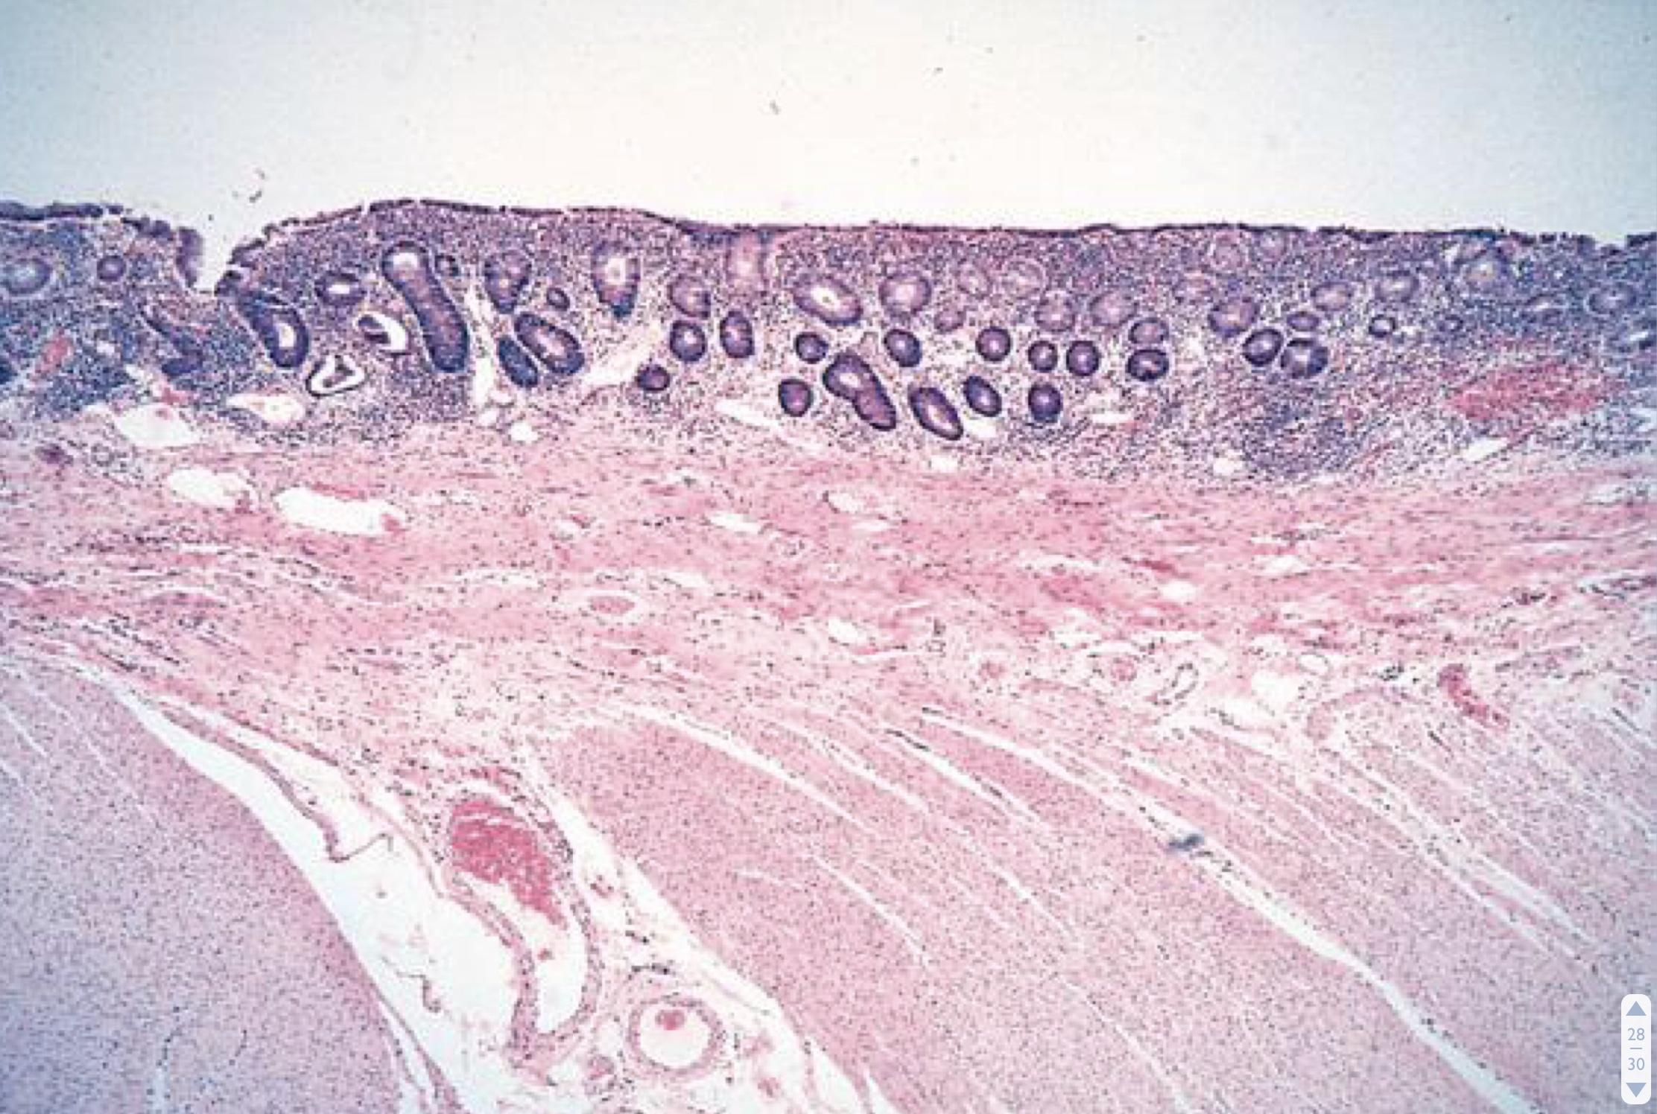
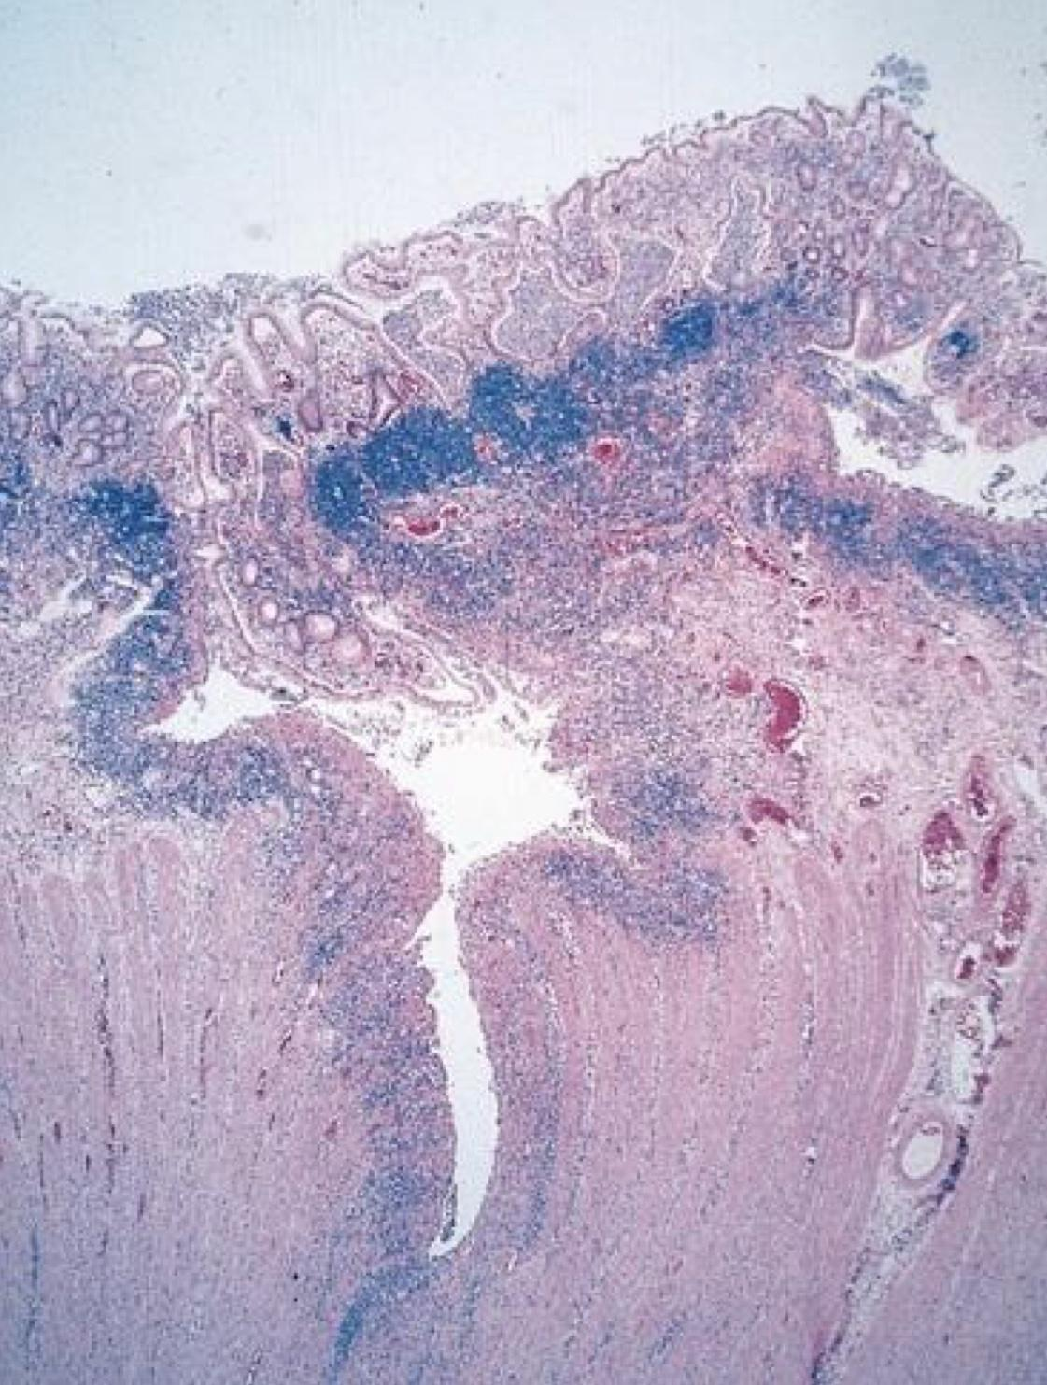
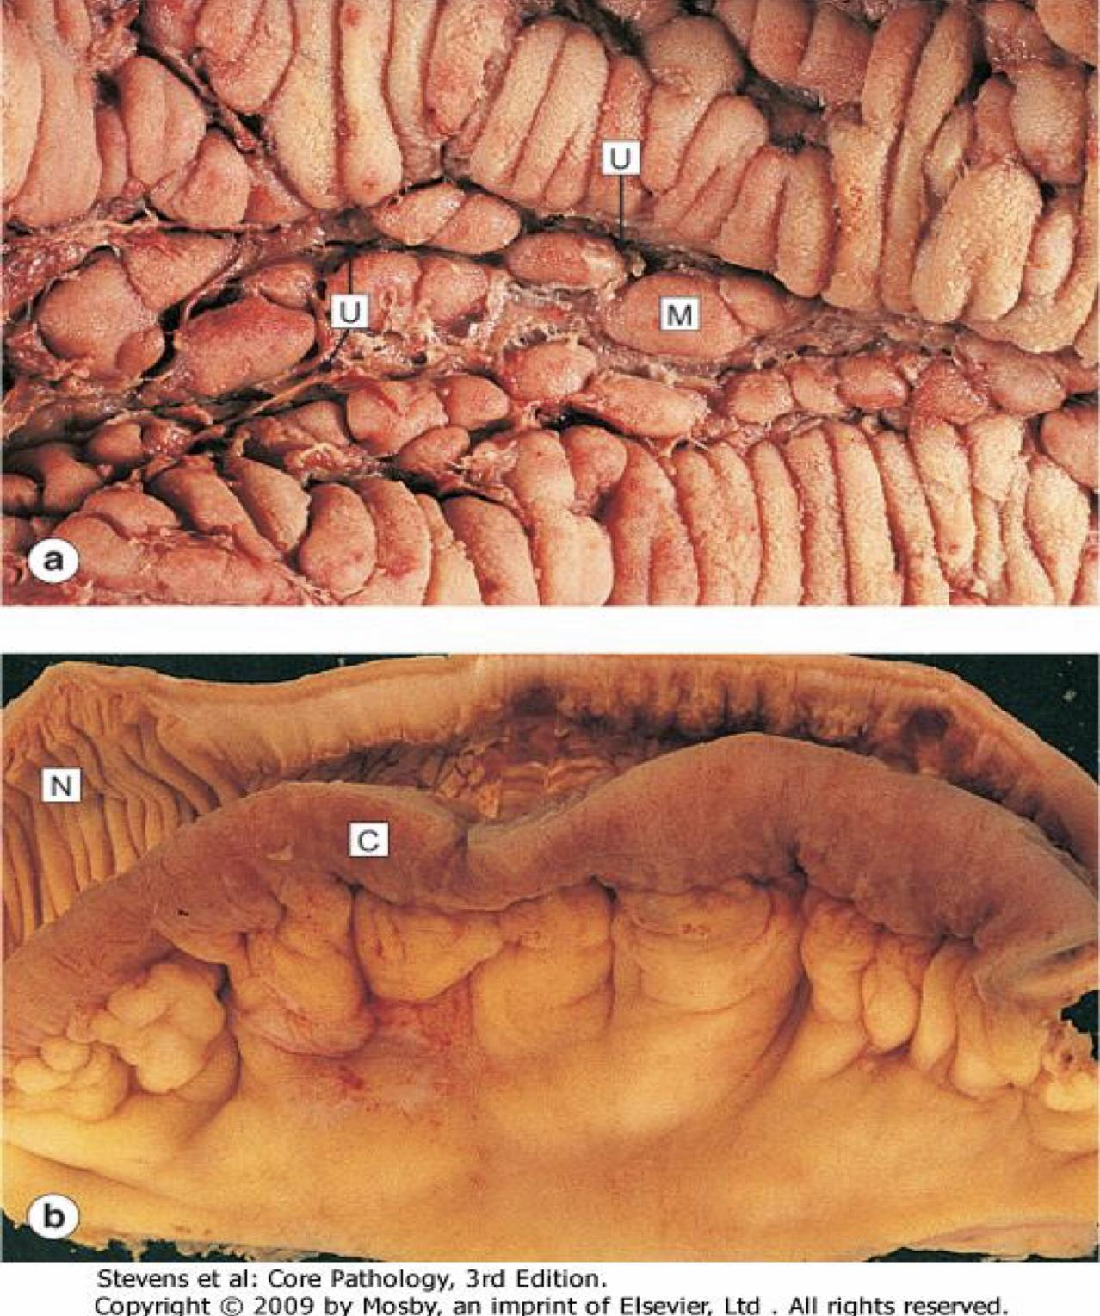
A 26-year-old man presents with intermittent crampy abdominal pain,
diarrhea without noticeable blood, and weight loss of 15 lb over 10
months. The bowel symptoms, including the diarrhea, wake him from
sleep; he resumed smoking cigarettes a year ago. His older brother has
had similar symptoms but has not yet been evaluated. Stool leukocytes are present. Results of examination with sigmoidoscopy are normal.
Which of the following is the most likely diagnosis for this patient?
Irritable bowel syndrome
Acute appendicitis
Crohn disease
Ulcerative colitis
Colon cancer
Which of the following statements regarding the
relationship between colon cancer and polyps is false?
Most colorectal cancers arise from preexisting adenomas
Adenomatous polyps, as well as juvenile polyps, hamartomas, and inflammatory polyps, progress to colorectal carcinoma
Larger polyps, especially those larger than 1 cm, are more likely to contain invasive carcinoma
On the basis of histology, villous polyps are more likely to contain invasive carcinoma than are tubular polyps
Doctor didn't do them
just inflammation
Ulcerative colitis
Crohn’s disease
1- fissure
2- Ulcer
3-transmural inflammation
Crohn’s disease
Cobblestone appearance
Creeping fat

Slide 22
كل الشكر والتقدير للجهود العظيمة
من قبل أعضاء فريق علم الأمراض الكرام.
قادة فريق علم الأمراض
شيرين العكيلي
فايز غياث الدرسوني
اعضاء فريق علم الأمراض
رزان الزهراني
لين الحكيم
عهد القرين
وجدان الشامري
غرام جليدان
ليلى الصباغ
ريناد الغريبي
نورة القاضي
مها العَمري
مجد البراك
بتول الرحيمي
منيرة المسعد
مشاعل القحطاني
رِناد الفرم
غادة الحيدري
دانة القاضي
مها بركه
سلطان ناصر الناصر
منصور العبرة
عادل ابراهيم
عبدالله السرجاني
Best of luck ✨ :)

