Slide 1
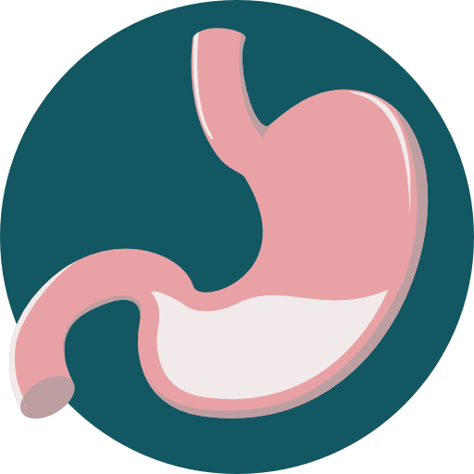
General Principles of GIT Physiology
Objectives:
Physiologic Anatomy of the Gastrointestinal Wall.
The General & Specific Characteristics of Smooth Muscle.
Neural & Hormonal Control of Gastrointestinal Function.
Types of Neurotransmitters Secreted by Enteric Neurons.
Functional Types of Movements in the GIT.
Gastrointestinal Blood Flow "Splanchnic Circulation".
Effect of Gut Activity and Metabolic Factors on GI Blood Flow.
Done by :
Team leader: Rahaf AlShammari
Team members:
Renad AlMigren, Rinad Alghoraiby
Yazeed AlKhayyal, Hesham AlShaya
Turki AlShammari, Abdullah AlZaid
Dana AlKadi, Alanoud AlEssa
Saif AlMeshari, Ahad AlGrain
Abduljabbar AlYamani
Colour index:
Important
Numbers
Extra
وَأَن لَّيْسَ لِلْإِنسَانِ إِلَّا مَا سَعَىٰ

Slide 2
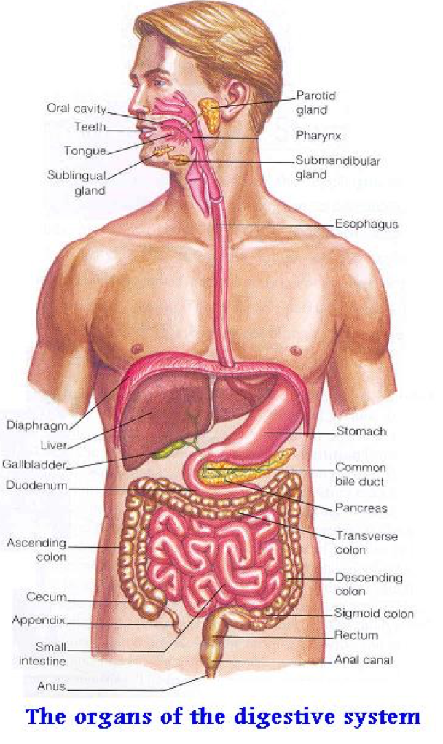
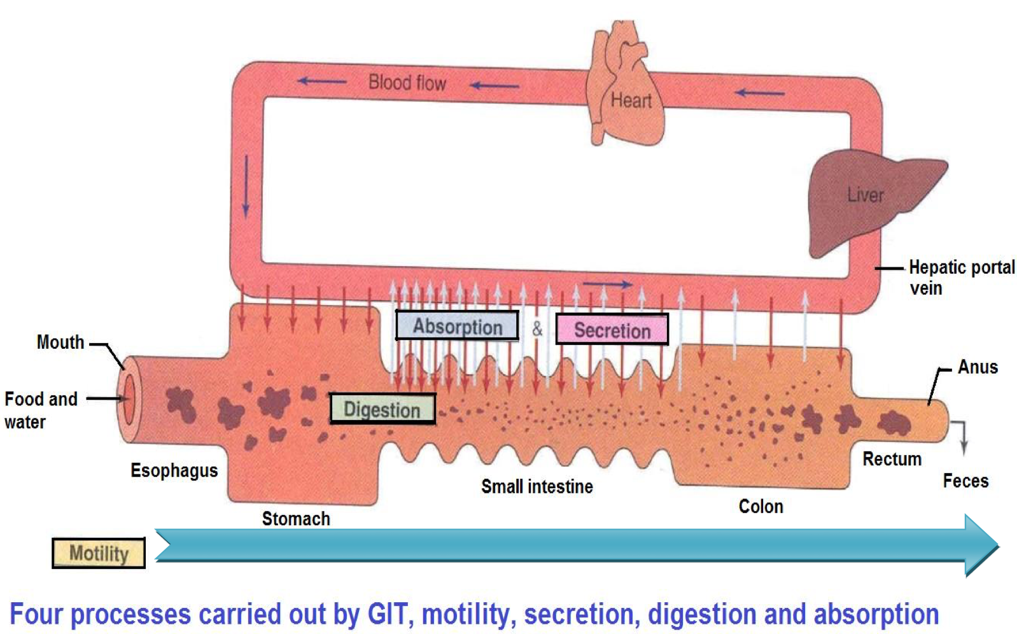
Gastrointestinal System:
GIT
Gastrointestinal System
Associated Organs
(Liver,gallbladder,pancreas,salivary gland)
Gastrointestinal Function:
The alimentary tract provides the body with a continual supply of water, electrolytes, and nutrients. To achieve this function, it requires:
1 | Movement of food through the alimentary tract (motility).
2 | Secretion of digestive juices and digestion of the food.
3 | Absorption of water, various electrolytes, and digestive products.
4 | Circulation of blood through the gastrointestinal organs to carry away the absorbed substances.
Control of all these functions is by local, nervous, and hormonal systems.
The Four Processes Carried Out by the GIT:

Slide 3
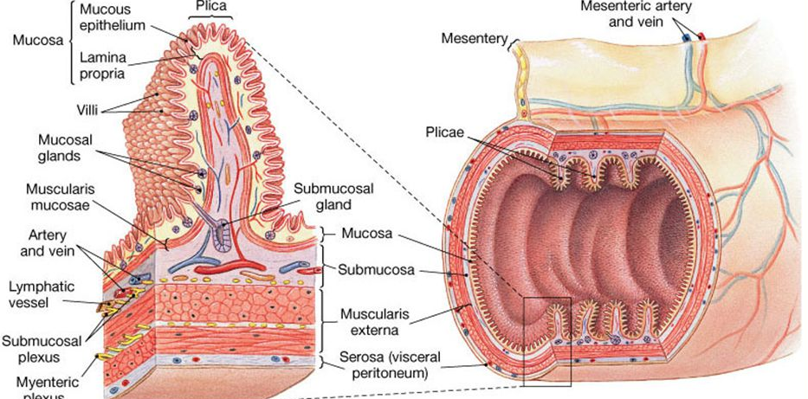
Physiologic Anatomy of the Gastrointestinal Wall
The following layers structure the GI wall from inner surface outward:
The mucosa
The submucosa
Circular muscle layer
longitudinal muscle layer
The serosa.
In addition, sparse bundles of smooth muscle fibers, the mucosal muscle, lie in the deeper layers of the mucosa.
Same layers in Histology lecture
The General Characteristics of Smooth Muscle
1- Two Smooth Muscle Classification:
Unitary type | Contracts spontaneously in response to stretch, in the absence of neural or hormonal influence. E.g: in stomach and intestine Cells are electrically coupled via gap junctions. Extra information from Guyton Chapter 8 ,13th edition: Unitary smooth muscle is also called syncytial smooth muscle or visceral smooth muscle. he term “unitary” is confusing because it does not mean single muscle fibers. Instead, it means a mass of hundreds to thousands of smooth muscle fibers that contract together as a single unit.the cell membranes are joined by many gap junctions through which ions can low freely from one muscle cell to the next so that action potentials, or simple ion low without action potentials, can travel from one fiber to the next and cause the muscle fibers to contract together.
Multi-unit type | Does not contract in response to stretch or without neural input. E.g: in esophagus & gallbladder Extra information from Guyton Chapter 8 ,13th edition: Multi­unit smooth muscle is composed of discrete, separate smooth muscle fibers. Each fiber operates independently of the others and often is innervated by a single nerve ending, as occurs for skel­etal muscle fibers. Important characteristics of multi­unit smooth muscle fibers are that each fiber can contract independently of the others, and their control is exerted mainly by nerve signals. Some examples of multi­unit smooth muscle are the ciliary muscle of the eye and the iris muscle of the eye.
Rich in gap junctions

Slide 4
The General Characteristics of Smooth Muscle Cont.
2- Two Main Smooth Muscle Layers:
Longitudinal | Circular
Thinner and less powerful. | Thicker and more powerful.
Less gap junctions. | More gap junctions.
Contraction shortens the segment of the intestine and expands the lumen. | Contraction reduces the diameter of the lumen and increases its length.
Innervated by enteric nervous system (ENS), mainly by excitatory motor neurons. | Innervated by ENS, both excitatory and inhibitory motor neurons.
Ca++ influx from outside is more important. “from extracellular fluid” | Intracellular release of Ca++ is more important. “from sarcoplasmic reticulum”
3- Types of Contraction:
Phasic contractions (rhythmical) | Tonic contractions (Maintained)
Periodic contractions followed by relaxation. Occur in esophagus, gastric antrum and small intestine. | Contraction without relaxation. Occurs in orad (mouth=proximal) region of stomach, lower esophageal, ileocecal & internal anal sphincters. Not associated with slow waves (often lasting several minutes or hours). Doctor said: if it is associated to slow waves , it will not be guaranteed to contract as slow waves cannot elicit contraction unless it peaks or reaches the threshold beside we need this segment to continually contracted. Caused by: repetitive spike potentials hormones continuous entry of Ca⁺⁺ ions not associated with changes in membrane potentials i.e. Not via voltage-gated Ca⁺⁺ channels.

Slide 5
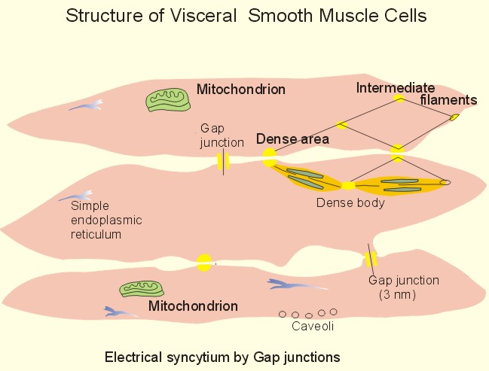
The Specific Characteristics of Smooth Muscles
1- Gastrointestinal Smooth Muscle Functions as a Syncytium:
Same as cardiac muscles
The individual smooth muscle fibers are 200 to 500 μm in length and 2 to 10 μm in diameter, and they are arranged in bundles of as many as 1000 parallel fibers.
Within each bundle, the muscle fibers are electrically connected with one another through large numbers of gap junctions.
Each muscle layer functions as a syncytium; when an action potential is elicited anywhere within the muscle mass, it generally travels in all directions in the muscle.
2- Electrical Activity of Gastrointestinal Smooth Muscle:
The smooth muscle of the gastrointestinal tract is excited by almost continual slow, intrinsic electrical activity along the membranes of the muscle fibers.
This activity has two basic types of electrical waves:
Action potential is 20 times longer than other cells action potentials why?!
To make sure or to guarantee that enough Calcium can influx..
Slow Waves
Spike Potential
The Slow Waves- Basic Electrical Rhythm
1
They are oscillating depolarization and repolarization in the resting membrane potential with unknown cause.
oscillating means :move or swing back and forth in a regular rhythm.
2
Intensity(amplitude) from 5-15 mv, frequency from 3-12/min.
Frequency change according to site in GIT
3
These waves are not action potentials and do not directly cause contraction.
4
Generated by interstitial cells of Cajal, ICC (the GI pacemaker), which are abundant in the myenteric plexuses.
5
ICC form a network and are interposed between the smooth muscle layers, with synaptic-like contacts to smooth muscle cells.
6
Parasympathetic ↑ the amplitude and frequency of slow waves. Sympathetic ↓ their amplitude and frequency.

Slide 6
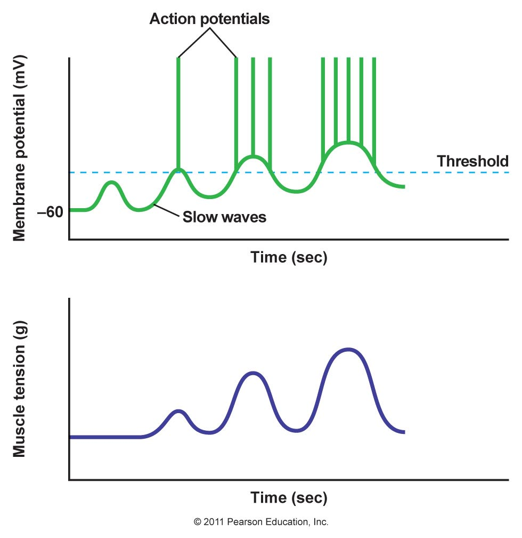
The Specific Characteristics of Smooth Muscles
Slow Waves are Generated by Interstitial Cells of Cajal
Membrane potentials in intestinal smooth muscles
Spike potential happen on top of slow waves.
Slow waves will reach a specific membrane potential (-40 mv) and then firing will happen
The Spike Potential
1
They are true action potentials that occur automatically when RMP rises above -40 mv [RMP= -(50) to (-60) mv].
2
Each spike lasts as long as 10 to 20 msec. They are 10 to 40 times the action potentials in large nerve fibers.
3
Spikes of action potential superimpose on depolarization of slow waves followed by contraction.
4
The rising phase of AP is caused by inflow of large numbers of Ca++ along with smaller numbers of Na+ (Slow Ca++-Na+ channels).
5
The higher the slow wave potential rises, the greater the frequency of the spike potentials.
6
They are usually ranging between 1 and 10 spikes per second.

Slide 7
The Specific Characteristics of Smooth Muscles
3- Changes in Voltage of the Resting Membrane Potential (-50mv to -60mv)
Factors that depolarize the membrane (become less negative and more excitable) | Factors that hyperpolarize the membrane (become more negative and less excitable)
Stretching of the muscle | Effect of norepinephrine on fiber membrane
Stimulation by Ach released from parasympathetic nerves endings | Effect of epinephrine on fiber membrane
Stimulation by several specific GI hormones | Stimulation of the sympathetic nerves that secrete norepinephrine at their endings
4- Role of Calcium in Muscle Contractions
Smooth muscle contraction occurs in response to entry of Ca++ into the muscle fiber.
Slow waves do not cause Ca++ to enter smooth muscle fiber (only sodium ions). Therefore, slow waves by themselves usually cause no muscle contraction.
During spike potentials, generated at the peaks of slow waves, significant quantities of Ca++ enter the fibers and cause most of the contraction.

Slide 8
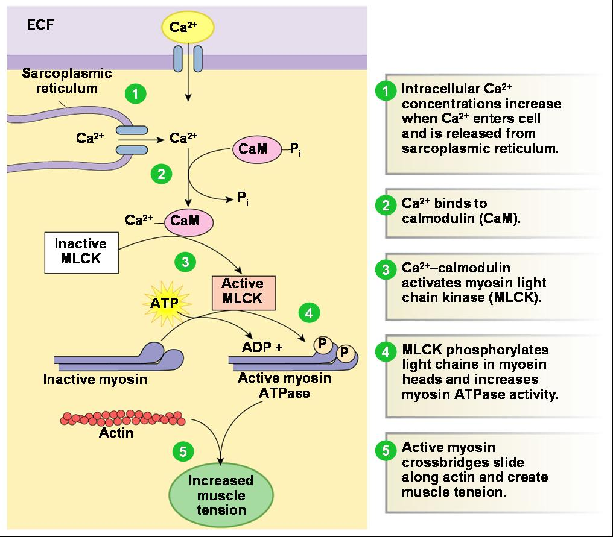
Mechanism of smooth muscle contraction:

Slide 9
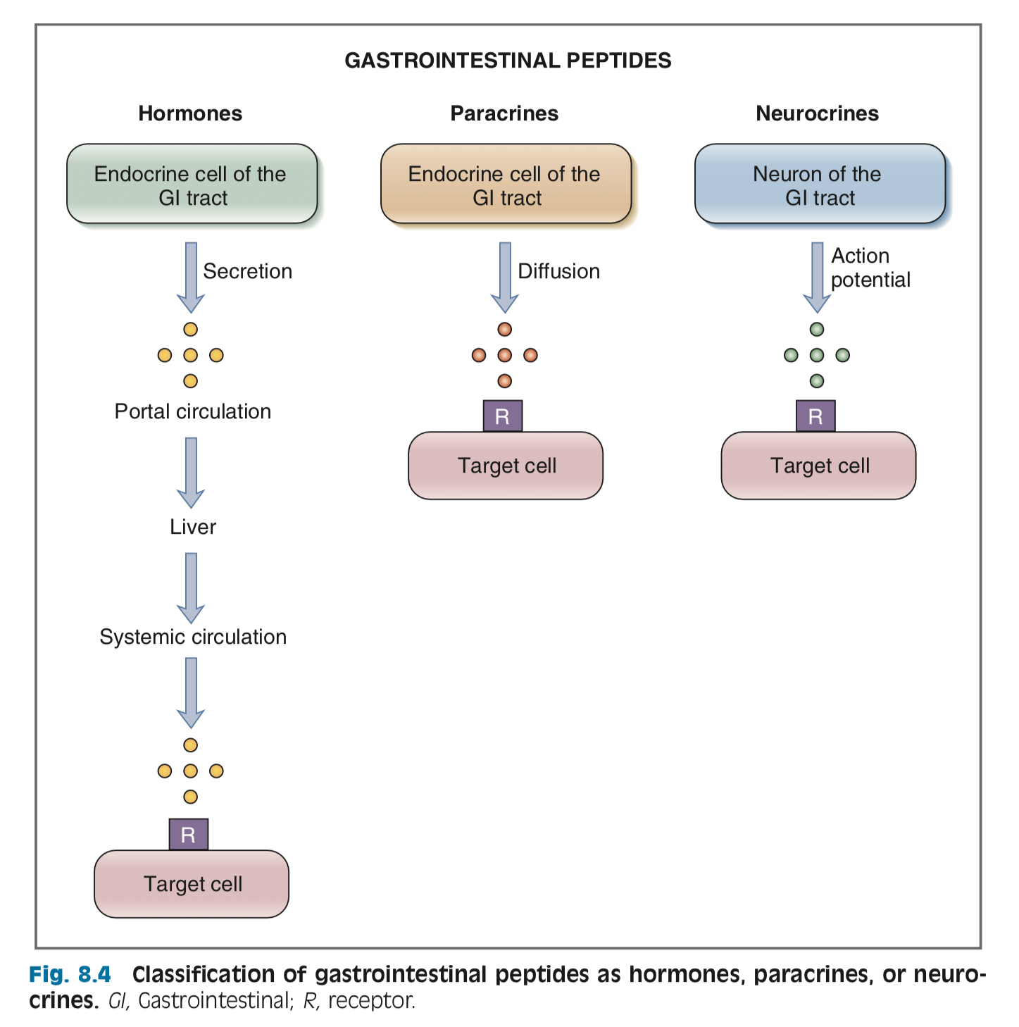
Control of GIT functions:
GIT functions are controlled by:
Neural control:
Autonomic (extrinsic) nervous system.
Enteric nervous system.
Hormonal control:
Endocrine cells are located in the pancreas, in the mucosa & submucosa of the stomach & intestine. They produce hormones that act on the secretory cells, smooth muscle cells or sphincters.
All the GI hormones are peptides such as: Gastrin, Secretin, Cholecystokinin.
Acts upon adjacent cells, does not pass through systemic circulation.
Has to pass systemic circulation to be activated.

Slide 10
Hormonal Control of Gastrointestinal Motility (GI Peptides):
Hormone | Site of secretion | Stimuli for secretion | Actions
Gastrin | “G” Cells of the stomach | -Protein -Distention of the stomach. -Vagal stimulation. -(Acid inhibits release). | ↑ Gastric H+ secretion Stimulates growth of gastric mucosa. Stimulate parietal cells to secrete hydrochloric acid HCl.
Cholecystokinin (CCK) | “I” cells of the duodenum and jejunum | -Protein -Fatty acids. -Acid. | ↑ Pancreatic enzyme secretion. ↑ Pancreatic HCO3 - secretion. Stimulates contraction of the gallbladder & relaxation of the sphincter of Oddi. Stimulates growth of the exocrine pancreas and gallbladder. Inhibits gastric emptying.
Secretin Does not like acids at all | “S” cells of the duodenum | -H+ in the duodenum. -Fatty acids in the duodenum. | ↑ Pancreatic HCO3 - secretion. ↑ Biliary HCO3 - secretion. ↓ Gastric H+ secretion. Inhibits trophic effect of gastrin on gastric mucosa.
Glucose-Dependent Insulinotropic Peptide (GIP) | “K” cells of the Duodenum and jejunum | -Fatty acids Amino acids. -Oral glucose carbohydrate. | ↑ Insulin secretion from pancreatic β cells. ↓Gastric H+ secretion.
Motilin During fasting, motilin increases | “M” cells of the duodenum and jejunum | Fat, Acid, Nerve | Stimulates: Gastric motility Intestinal motility.
*This table is important

Slide 11
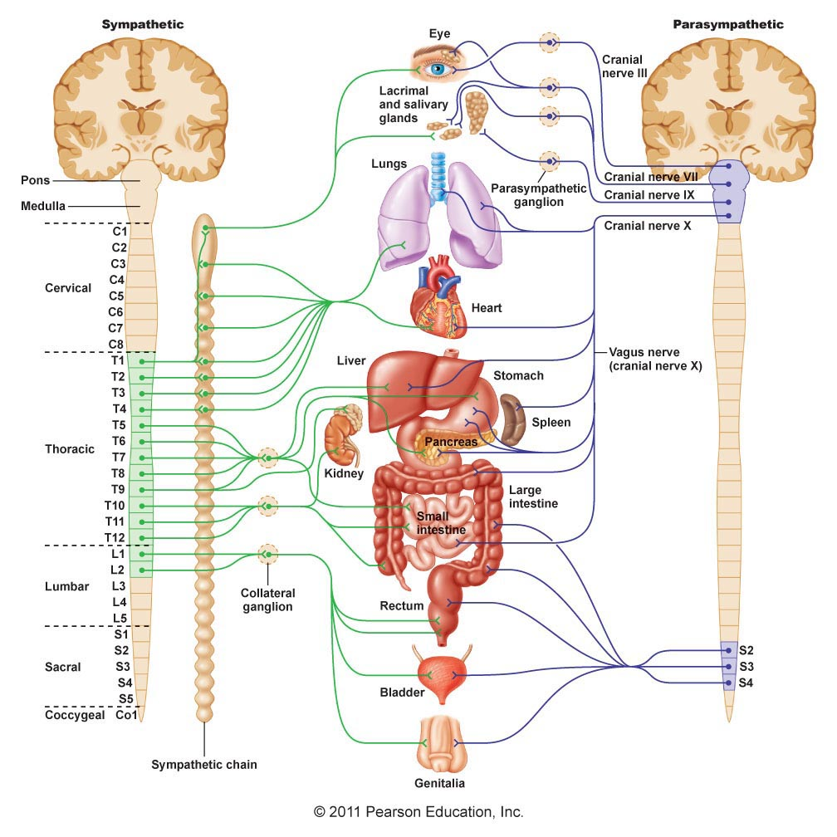
Neural control of gastrointestinal function:
Autonomic Nervous System (ANS) is divided into:
Parasympathetic
Sympathetic
Enteric Nervous system
Useful video
Sympathetic Innervation (Thoracolumbar outflow)
Parasympathetic Innervation (Cranial & Sacral outflow)
The sympathetic fibers originate in the spinal cord between segments T-5 and L2.
The sympathetics innervate essentially all of the GI tract.
The sympathetic nerve endings secrete mainly norepinephrine.
Stimulation of the sympathetic nervous system inhibits activity of the GI system.
Strong stimulation of the sympathetic system can inhibit motor movements of the gut so greatly that this literally can block movement of food through the GI tract.
The vagus nerves (cranial division) innervate the esophagus, stomach, pancreas and intestines down to the first half of the large intestine.
The pelvic nerves (sacral division) innervate the distal half of the large intestine and the anus (to execute the defecation reflexes).
The postganglionic neurons of the gastrointestinal parasympathetic system are located mainly in the myenteric and submucosal plexuses.
Stimulation of parasympathetic nerves causes general stimulation of entire activity of enteric nervous system.

Slide 12
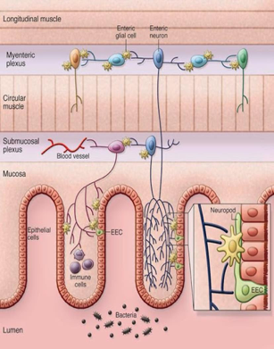
The Enteric Nervous System
Enteric Nervous System (ENS) is the nervous system of GI tract.
It lies entirely in the wall of the gut, beginning in the esophagus and extending all the way to the anus.
It has as many neurons as the spinal cord (about 100 million).
Components of The Enteric Nervous System
It is composed mainly of two plexuses:
The myenteric (Auerbach’s) plexus
Lies between the longitudinal and circular muscle layers.
Consists mostly of a linear chain of many interconnecting neurons.
The myenteric plexus has excitatory and inhibitory motor neurons.
The submucosal (Meissner's) plexus
Lies in the submucosa.
Functions of Myenteric and Submucosal Plexuses
Myenteric plexus Deals with motility | Submucosal plexus Mainly excitatory
Increase tonic contraction Increase intensity of the rhythmical contractions Increase rate of rhythm of contraction Increased excitatory waves conduction velocity along gut wall Some neurons are inhibitory (e.g . pyloric & ileocecal valves). | Controls:- Local intestinal secretion Local absorption Local blood flow Local contraction of submucosal muscle causing infolding of the gastrointestinal mucosa.

Slide 13
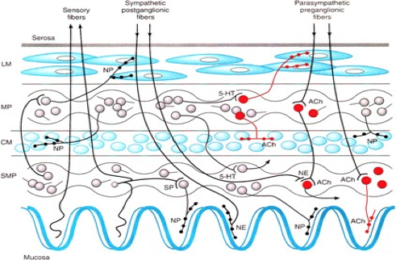
The Enteric Nervous System & the Extrinsic Nerves
The enteric nervous system can function on its own, independently of the parasympathetic and sympathetic systems, however, these extrinsic nerves can greatly enhance or inhibit gastrointestinal functions.
Sympathetic postganglionic fibers
Parasympathetic preganglionic fibers
Myenteric plexus
Submucosal plexus
Types of Neurotransmitters Secreted by Enteric Neurons
Excitatory for motor neurons:
Excitatory for secretomotor neurons:
Inhibitory for motor neurons:
1- Substance P
2- Ach
1- Ach
2- VIP
3- Histamine
1- ATP
2- NO
3- VIP

Slide 14
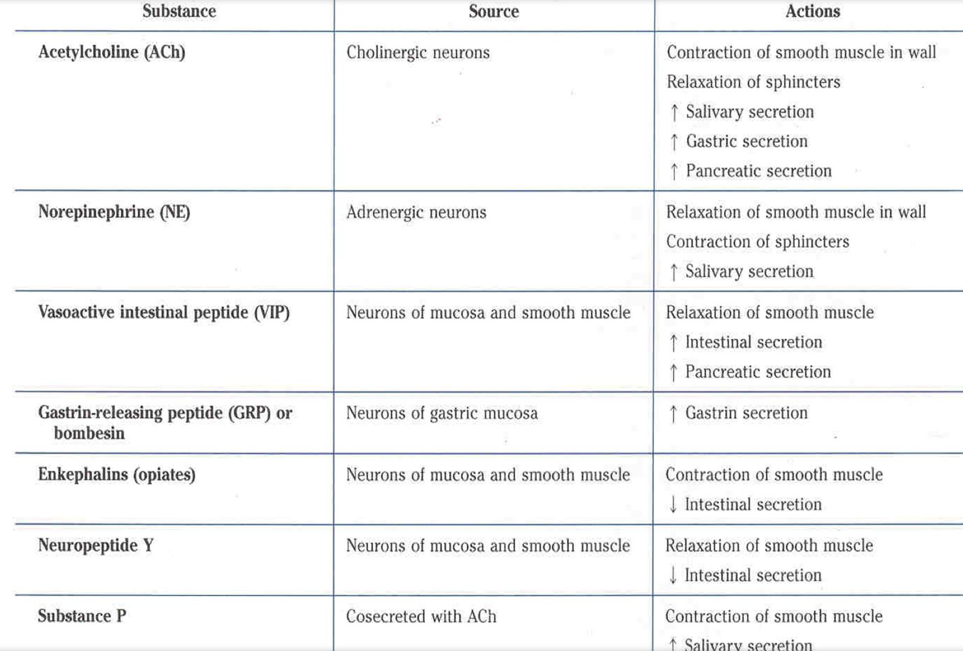
Neurotransmitters & Neuromodulators in Enteric Nervous System
Afferent Sensory Nerve Fibers from the Gut
Many afferent sensory nerve fibers innervate the gut.
Some of them have their cell bodies in the ENS and some in the dorsal root ganglia of the spinal cord.
These sensory nerves can be stimulated by:
1- irritation of the gut mucosa
2- excessive distention of the gut
3- presence of specific chemical substances in the gut.
Signals transmitted through the fibers can cause excitation or inhibition of intestinal movements or secretion.
Other sensory signals from the gut go all the way to multiple areas of the spinal cord and even the brain stem.
For example, 80% of the nerve fibers in the vagus nerves are afferent rather than efferent.
These afferent fibers transmit sensory signals from the GI tract into the medulla, which in turn initiates vagal reflex signals (vagovagal reflexes).

Slide 15
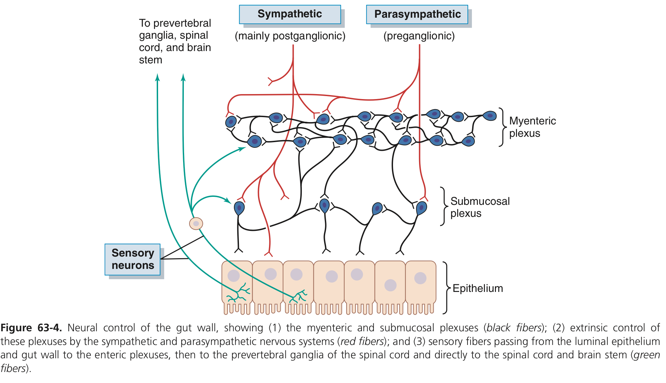
➣ Nervous Control of Gastrointestinal Blood Flow
Summary of the Neural Control of Gastrointestinal Function
1-Parasympathetic stimulation | 2-Sympathetic stimulation
Increases local blood flow at the same time that it increases glandular secretion. | Greatly decreased local blood flow. The local metabolic vasodilator mechanisms override the sympathetic vasoconstriction effects, returning normal blood flow

Slide 16
➣ Gastrointestinal Reflexes
The anatomical arrangement of the ENS and its connections with the sympathetic & parasympathetic systems support three types of GI reflexes :
1- Reflexes that are integrated entirely within the gut wall ENS. The majority of reflexes that occur in gut are among this category. Local reflexes, no ganglia or other extrinsic influences.
2- Reflexes that transmit signals long distances from the gut to the prevertebral ganglia”Sympathetic chain“and then back to the GI tract as : ➥ Gastrocolic reflex: signals from the stomach to the colon.(Excitatory) Distension of stomach lead to increase motility of colon, this applied when you eat a heavy meal you will directly rush to bathroom to defecate. ➥ Enterogastric reflexes: signals from the colon and small intestine to inhibit stomach motility and secretion.(inhibitory) Distension of small intestines or colon lead to inhibit gastric motility and secretion. ➥ Colonoileal reflex: reflex from the colon to inhibit emptying of ileal contents into the colon.(inhibitory) Distension of colon lead to inhibit ileal emptying.
3- Reflexes from the gut to the spinal cord or brain stem and then back to the GI tract as : ➥ Reflexes from stomach & duodenum to brain stem and back to the stomach (by way of the vagus nerves) to control gastric motility & secretion.Vagovagal reflexes , for sure you will activate vagus nerve to elicit these reflexes. ➥ Pain reflexes that cause general inhibition of the entire GI tract. The whole GI tract can be shut down in case of severe pain that lead constipation ➥ Defecation reflexes that travel from the colon and rectum to the spinal cord and back again to produce the powerful colonic, rectal, and abdominal contractions required for defecation.
We are expecting inhibitory action since sympathetic is involved, good guess but this isn’t applied here.

Slide 17
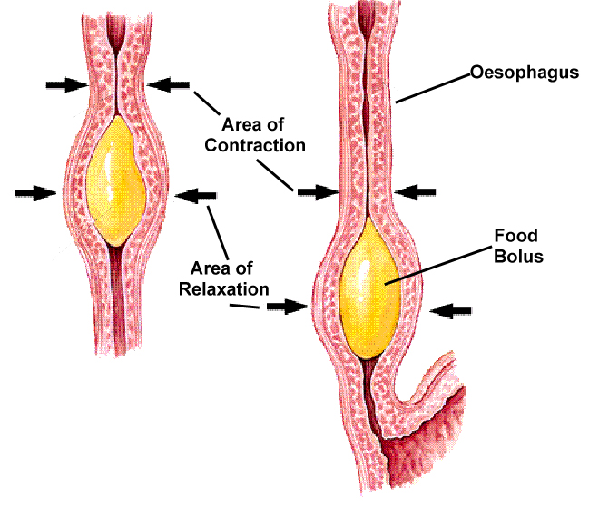
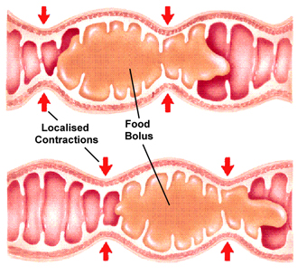
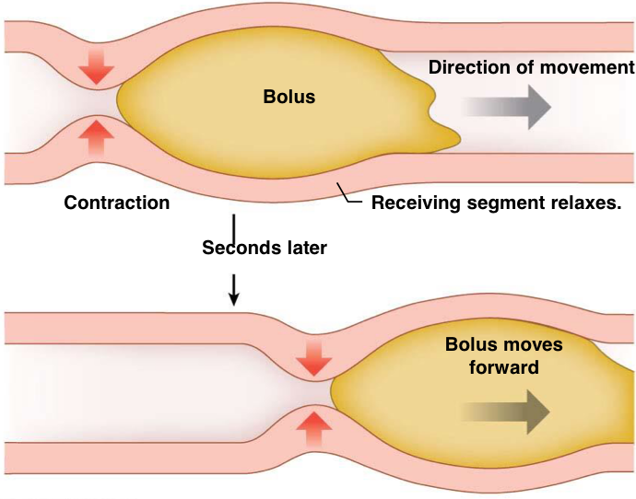
➣ Functional Types of Movements in GIT
1- Propulsive movements (peristalsis)
⚫ A contraction ring appears around gut, then moves forward. ⚫ Organizes propulsion of material over variable distances within the GI. ⚫ Lumen Stimuli include distention (mainly) &, chemical or physical irritation of the epithelial lining in the gut.
2 -Mixing movements (segmentation)
⚫ A localized circular smooth muscles contraction constricts the intestine into spaced segments, one set of segmentation contractions relaxes, a new set begins at points between the previous ones. ⚫ Blend intestinal contents & bring products of digestion in contact with absorptive surfaces ⚫ Usual stimulus is distention
Does not include mouth and pharynx.
Blending ,digesting and mixing food with juices.

Slide 18
➣ Peristaltic Reflex and the "Law of the Gut."
⚫ When a segment of the intestinal tract is distended, it initiates peristalsis.
⚫ The contractile ring normally begins on the orad side of the distended (propulsive) segment and moves toward the distended (receiving) segment, pushing the intestinal contents in the anal direction (Caudad direction) for 5 to 10 cm. before dying out.
⚫ Propulsive segment :
➥ contraction (circular M.)
➥ relaxation (longitudinal M.)
⚫ Receiving segment :
➥ contraction (longitudinal M.)
➥ relaxation (circular M.)
Contraction of muscles are indicated to move GI contents from Orad side to Cauded side. All the way to the anus.

Slide 19
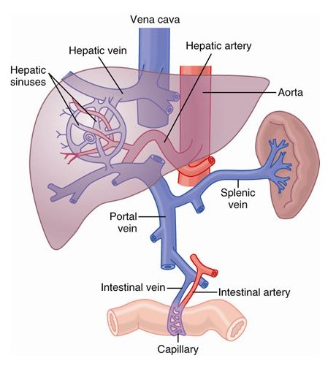
➣ Gastrointestinal Blood Flow- "Splanchnic Circulation"
⚫ It includes the blood flow through the gut itself, the spleen, pancreas, and liver.
⚫ All blood then flows into the liver by way of the portal vein.
⚫ In the liver, the blood passes through liver sinusoids and finally leaves the liver by way of hepatic veins that empty into the vena cava of the general circulation.
➣Effect of Gut Activity & Metabolic Factors on Gastrointestinal Blood Flow
Causes of the increased blood flow during GI activity :
1
Most of the peptide hormones, including cholecystokinin, vasoactive intestinal peptide”VIP”, gastrin and secretin
2
Kinins (kallidin and bradykinin) released into the gut wall from some of the GI glands. (Vasodilators)
3
Decreased oxygen concentration in the gut wall (increase blood flow 50 to 100 %).

Slide 20
Summary
Gastrointestinal Function:
-Movement of food through the alimentary tract (motility).
-Secretion of digestive juices and digestion of the food.
-Absorption of water, various electrolytes, and digestive products.
-Circulation of blood through the gastrointestinal organs to carry away the absorbed substances.
The General Characteristics of Smooth Muscle
Muscle Layers | Longitudinal | shortens the segment, expands the lumen
 | Circular | Lengthens the segment, contracts the lumen
Muscle Classification | Unitary | Contract in response to stretch Many gap junctions action potential travels in all directions
 | Multi-unit | Does not contract in response to stretch or without neural input.
Contraction | Phasic (rhythmical) | Periodic followed by relaxation
 | Tonic (Maintained) | Contraction without relaxation. Not associated with slow waves
Electrical Activity of Gastrointestinal Smooth Muscle
Slow waves | Spike potential
changes in resting membrane potential intensity: 5-15 mv Frequency: 3-12/min Use sodium ion channels Do not cause muscle contraction | TRUE action potentials Intensity: -50mv to -60mv Frequency: 1-10 spikes/sec Use calcium-sodium channels cause muscle contraction

Slide 21
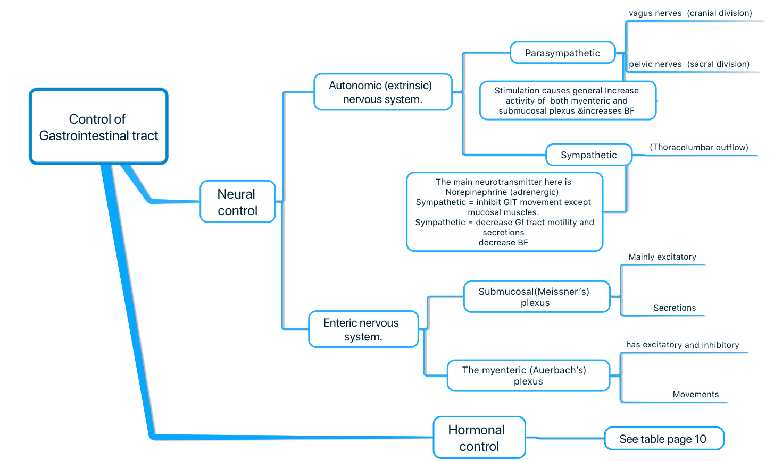
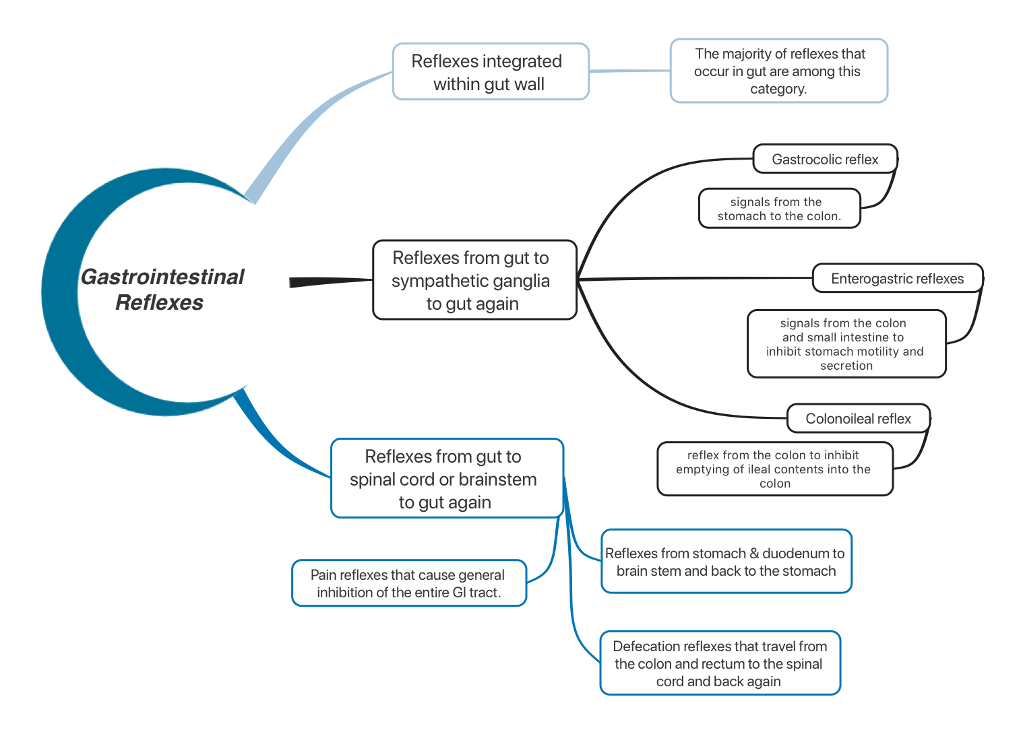
Summary

Slide 22
Questions
MCQs
1.Which one of the following happen in slow wave?
Ca influx
Na influx
Cl influx
2.Which one of the following hormones has no effect in gastric acid secretion?
Gastrin
Secretin
GIP
CCK
3.Which one of the following GI reflexes inhibit stomach motility and secretion?
Gastrocolic reflex
Enterogastric reflex
Colonoileal reflex
Intestino-intestinal reflex
4.Which one of the following increase blood flow during GI activity?
CCK
Bradykinin
Decrease oxygen concentration
All of above
5.Which one of the following hormones relax the sphincter of oddi?
Gastrin
Secretin
CCK
GIP
6.Which one of the following GI reflexes is involved with sympathetic chain?
Defecation reflex
Colonoileal reflex
Pain reflex
Vagovagal reflex
7.Which one of the following is a factor that hyperpolarize the membrane?
Stretching of the muscle
Effect of epinephrine on fiber membrane
Ach released from parasympathetic nerves
GI hormones
8.What are the causes of tonic contraction?
Repetitive spike potential
Hormones
Continuous entry of Ca ion
9.List two hormones that decrease gastric acid secretion.
GIP
Secretin
SAQ
MCQs
Answers:
B
D
B
D
C
B
B

