Slide 1
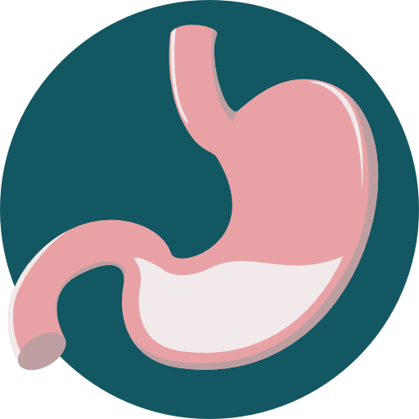
Esophageal motility
Objectives:
Mastication and chewing reflex
Swallowing process and its stages
Types of esophageal peristalsis
Esophageal sphincter
Function of lower esophageal sphincter
Achalasia
Incompetence of lower esophageal sphincter
Done by :
Team leader: Rahaf AlShammari
Team members:
Majd AlBarrak, Shahad AlZahrani
Khalid AlMutairi, Mohammed AlHassan
Abdullah AlSargani, Abdullah AlZaid
Wejdan AlBadrani, Maha AlAmri
Hadeel AlMukainzi, Shahad AlTayash
Norah AlKadi
Colour index:
Important
Numbers
Extra
وَأَن لَّيْسَ لِلْإِنسَانِ إِلَّا مَا سَعَىٰ

Slide 2
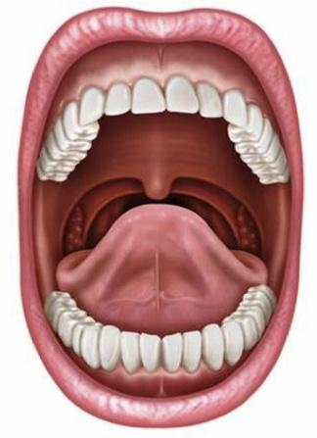
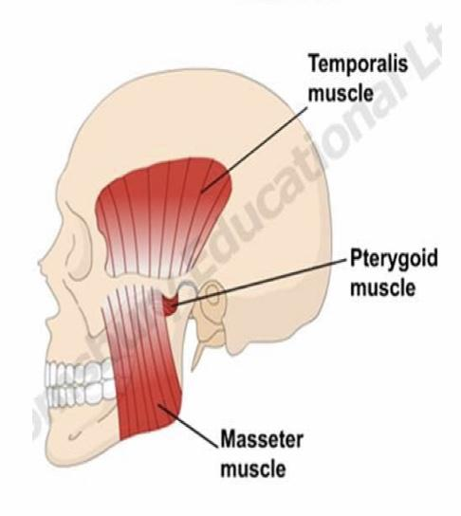
Mastication (Chewing)
Functions:
To lubricate the bolus with salivary secretion.
To breakdown the bolus to small particles.
To begin digestion of carbohydrate (by amylase).
Teeth organization:
Anterior teeth (incisors) for cutting.
Posterior teeth (molars) for grinding.
Chewing muscles are innervated by cranial nerve V (trigeminal nerve):
Masseter
Temporalis
Pterygoid (lateral & medial)
Taste center (Hypothalamus + Brainstem) ➝ rhythmical chewing movements (Chewing reflex).
Chewing (stretch) reflex:
The presence of a bolus of food in the mouth initiates reflex inhibition of the muscles of mastication ➝ the lower jaw drops ➝ stretch reflex of the jaw muscles & contraction ➝ jaw closure & compression of the bolus again against the linings of the mouth ➝ inhibits the jaw muscles once again, allowing the jaw to drop and rebound another time; this is repeated again and again.
Food in mouth stimulates
Oral & periodontal mechano- receptors
Jaw stretch reflex
Jaw opening reflex
Stimulate jaw closure & muscle spindle stretch receptors
Very useful video

Slide 3
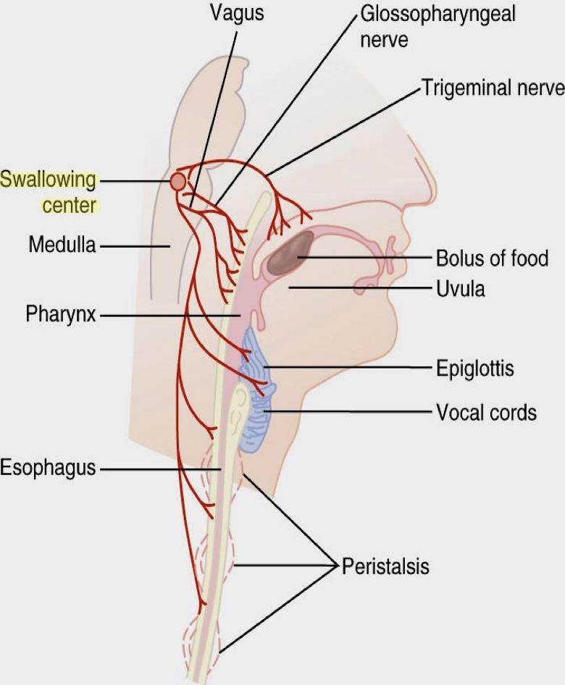
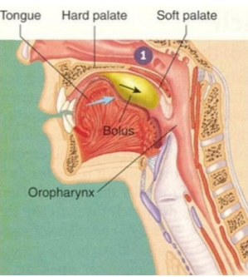
Swallowing (Deglutition)
Swallowing is The ordered sequence of events that propel food from the mouth to the stomach.
Initiatarion is voluntary, thereafter it is entirely under reflex control.
Inhibits respiration and prevents the entrance of food into the airway passages.
The reflex portion of swallowing is controlled by the swallowing center in the medulla.
Stages of Swallowing
Oral Stage (voluntary)
Pharyngeal Stage (involuntary)
Esophageal Stage (involuntary)
“Buccal stage”
I- The Oral Stage:
This stage involves the voluntary rolling of the chewed food (bolus) posteriorly into the pharynx by the upward and backward pressure applied by the tongue against the palate.
The activation of somatosensory receptors in the pharynx initiates the involuntary swallowing reflex in the medulla. From here on, swallowing becomes entirely automatic and can not be stopped.

Slide 4
II- The Pharyngeal Stage:
1
2
3
At the pharynx, the bolus stimulates epithelial swallowing receptor areas all around the pharynx opening and impulses pass to swallowing center and accordingly initiate a series of autonomic pharyngeal muscle contractions as follows:
The soft palate Is pulled upward to close the posterior nares which prevents the food from entering the nasal cavities.
.
The palatopharyngeal folds pull medially to approximate and form a sagittal slit through which food must pass into the posterior pharynx.
Form a passage for the food.
4
5
6
The vocal cords are strongly approximated and the larynx is pulled upward and anteriorly by the neck muscles. These actions cause the epiglottis to swing backward over the opening of the larynx.
The upward movement of the larynx pulls up and enlarges the opening to the esophagus. The upper esophageal sphincter relaxes and food move into the upper esophagus.
Once the larynx is raised and the pharyngoesophageal sphincter relaxes, the entire muscular wall of the pharynx contracts propelling the food by peristalsis into the esophagus.
Swallowing center inhibits the respiratory center.
عشان كذا لو تكلمنا واحنا ناكل ممكن نشرق

Slide 5
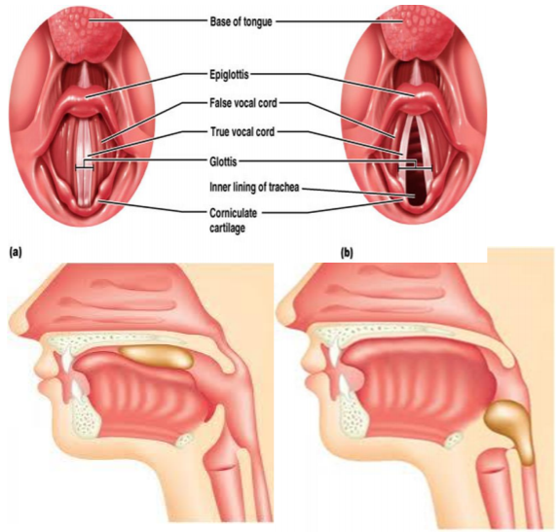
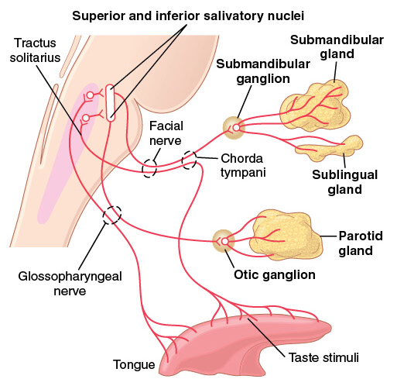
Summary of the Pharyngeal stage:
The trachea is closed.
The esophagus is opened.
A fast peristaltic wave initiated by the nervous system of the pharynx forces the bolus of food into the upper esophagus .
Time of process is < 2 second.
“Sphincter relaxed”
Nervous Initiation of the Pharyngeal Stage of Swallowing
Most sensitive areas for its initiating
Are located in a ring around the pharyngeal opening including the tonsillar pillars.
Sensory
impulses
Are received by the nucleus tractus solitarius via the medulla oblongata through the 5th & 9th cranial nerves.
Pharyngeal stage
Swallowing
center
initiates
Automatic successive stages of swallowing initiated by neuronal areas of the reticular substance of medulla & lower portion of pons.
Motor impulses to pharynx
Are transmitted from the swallowing center by the 5th, 9th, 10th, and 12th cranial nerves and few of the superior cervical nerves.

Slide 6
III- The Esophageal Stage :
The esophagus is a conduit to move food rapidly from the pharynx to the stomach.
The esophageal stage is controlled partly by the swallowing reflex and partly by the enteric nervous system (ENS). In case of vagotomy enteric nervous system takes over.
Physiologically, esophagus is divided into three functionally distinct regions:
Vagotomy: cutting of vagus nerve
Upper esophageal sphincter (UES)
Esophageal Body
Lower esophageal sphincter (UES)
The upper 1/3 of the esophagus:
Striated muscle (peristaltic waves are controlled by impulses from IX and X nerves)
The lower 2/3 of the esophagus:
Smooth muscle (controlled by the X nerve through connections with esophageal myenteric nervous system).
The swallowing reflex closes UES:
A peristaltic wave begins just below UES when bolus pass through it and traverse the entire esophagus.
The lower esophageal sphincter:
Relaxes and the bolus enters the stomach.
“Receptive relaxation”

Slide 7
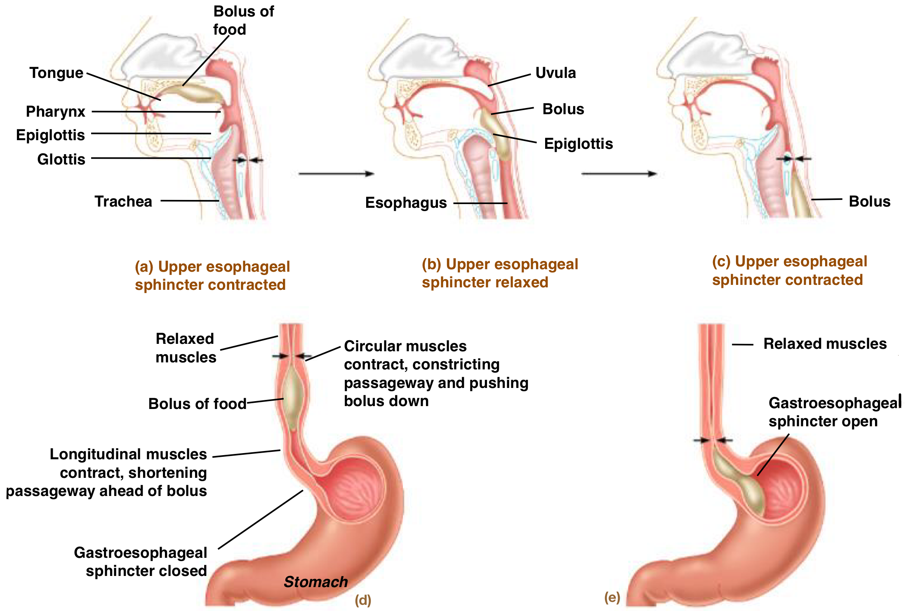
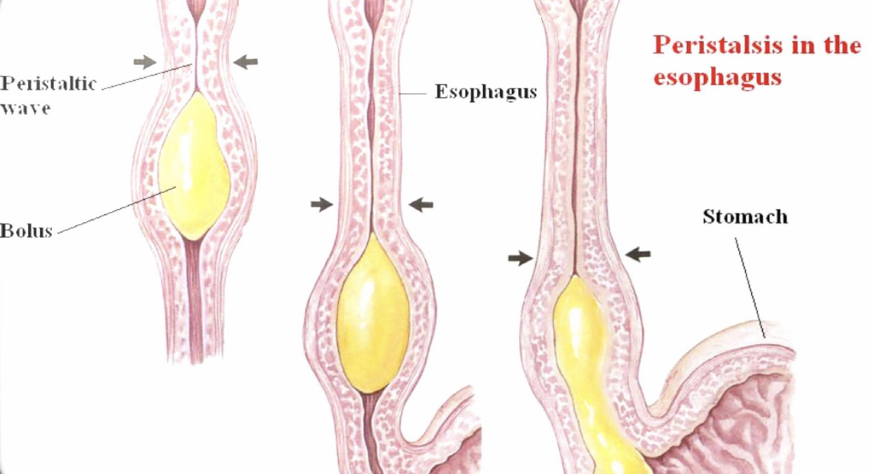
Esophageal peristalsis:
Types of Esophageal Peristalsis:
Primary
Secondary
A continuation of peristaltic wave that begins in pharynx and spreads into esophagus during the pharyngeal stage of swallowing.
This wave passes from the pharynx to the stomach in 8-10 sec.
Coordinated by swallowing center.
Bolus very big or sticky.
Occurs in response to distention and continue until all the food is emptied into the stomach.
ENS and swallowing center are both involved

Slide 8
Types of Esophageal Peristalsis:
Primary
Push bolus towards stomach
A bolus in esophagus
Pressure receptors
Swallowing center
Esophageal phase of swallowing reflex
Vagus
Primary peristalsis
Secondary
Push bolus towards stomach
A large sticky bolus in esophagus
Pressure receptors
Lubricate
Intrinsic nerves
Extrinsic nerves
(Stronger)
Salivation

Slide 9
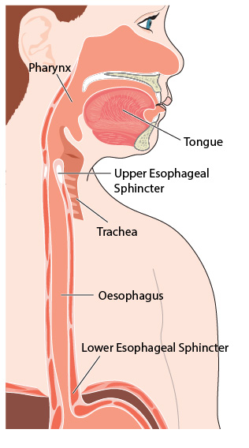
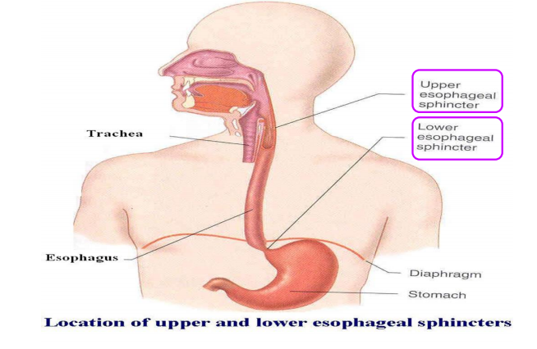
Esophageal Sphincters
The Upper Esophageal Sphincter (UES)
Where
It is formed of striated muscle but is not under voluntary control, located at the lower end of pharynx and guards the entrance into the esophagus.
Function
It prevents esophageal air insufflation during negative intrathoracic pressure events, as during inspiration.
It prevents esophagopharyngeal/laryngeal reflux during esophageal peristalsis.
When Relax
It relaxes during swallowing for about 1 second allowing the bolus to be forced through the relaxed UES
The lower Esophageal Sphincter (LES)
Where
It is formed by circular smooth muscle located in an area Where of ~ 3 cm upward of the junction with the stomach.
Function
In between swallowing, it normally remains tonically constricted to prevent reflux of gastric contents into esophagus.
During swallowing, the peristaltic wave passes down the esophagus and causes a “receptive relaxation” of LES for 7-10 sec. (mediated by vagal impulses) to allow easy propulsion of the swallowed food into the stomach.
Why
Pressure in the esophagus is mostly –ve (except for a short intra-abdominal segment).
So that pressure in the stomach is always higher than the esophagus.

Slide 10
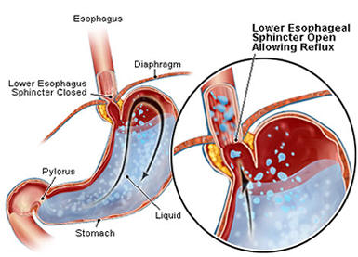
Causes of Competence and the antireflux functions of the LES
1 | Its resting pressure (15- 30 mmHg).
2 | The diaphragm wraps around the esophagus at the level of LES. Contraction of the diaphragm during inspiration helps to increase the pressure at the LES.
3 | The flutter-valve closure of the lower esophagus by the increased intra-abdominal pressure prevents the high pressure in the stomach from forcing its contents into the esophagus.
4 | Valve-like closure of the distal end of the esophagus. This involves a short portion of the esophagus that extends slightly into the stomach and caves the esophagus inward in response to increased intraabdominal P.
“Caving of esophagus inside the stomach”
Doctor said: 3 mechanisms behind competency of LES:
1-Tonic contraction of smooth muscles.
2- Diaphragm contraction and wrapping.
3-Valve-like closure.
Competence and the Antireflux Functions of the LES
Control of LES Function
Circular musculature of LES is regulated by nerves, (extrinsic & intrinsic), hormones and neuromodulators.
Contraction of LES | Relaxation of LES
Between swallows (tonic vagal cholinergic impulses) Stimulation of sympathetic nerves . Gastrin hormone. | During swallowing (efferent vagal impulses). The transmitter is NO or VIP. Secretin and cholecystokinin (CCK)

Slide 11
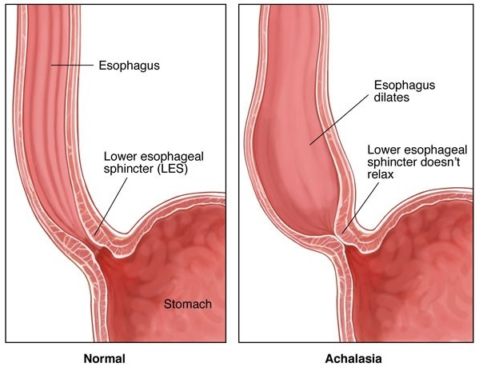
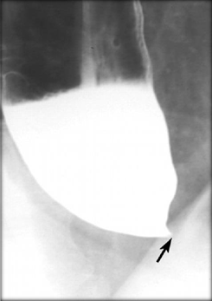
Doctor said: Failure of sphincter to relax due to absence of inhibitory neuron (vagus nerve)
Achalasia
It is due to pathology of or absence of the myenteric plexus containing VIP & NO in the lower third of esophagus (may be due to autoimmune destruction of the nerves in esophageal wall).
The musculature of the lower esophagus instead remains contracted and the myenteric plexus has lost the ability to transmit a signal to cause relaxation of the LES (high resting pressure).
Food becomes putridly infected during the long periods of esophageal stasis causing ulceration of the esophageal mucosa, severe substernal pain or even rupture & death.
Food transmission from the esophagus into the stomach is impeded or prevented. As achalasia gets worse, the esophagus gradually enlarged as food collects within it.

Slide 12
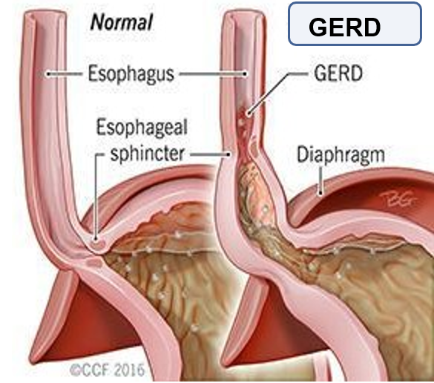
Diagnosis:
“Measure the pressure in the esophagus ”
Esophageal manometry.
X-rays of upper digestive system (barium swallow).
Upper endoscopy.
Treatment:
Surgical
Non-surgical
Myotomy
cutting the muscle at the lower end of the esophageal sphincter.
Pneumatic dilation by balloon insertion into the esophageal sphincter. .
Injecting muscle relaxant (Botox) directly into the esophageal sphincter.
Medication
as muscle relaxants, nitroglycerin before eating.
Gastroesophageal Reflux Disease (GERD) Incompetence of the LES:

Slide 13
What is it
Cause
Contributing factors
Incompetence of the lower esophageal sphincter allows reflux of gastric contents into the esophagus.
It may result from a generalized loss of intrinsic sphincter tone or from recurrent inappropriate transient relaxations triggered by gastric secretions.
Weight gain, fatty foods, caffeinated or carbonated beverages, alcohol, tobacco smoking ,and drugs (anticholinergics, antihistamines, calcium channel blockers, progesterone and nitrates).
It can lead to
Diagnosis
Treatment
Reflux esophagitis, heartburn, esophageal stricture, ulcer, dysplastic changes (cancerous) ,or Barrett esophagus (normal tissue lining the esophagus resembles tissue lining of the intestine).
Is clinical, sometimes with endoscopy, with or without 24-h pH testing.
Involves lifestyle modification, acid suppression using proton pump inhibitors, and sometimes surgical repair.

Slide 14
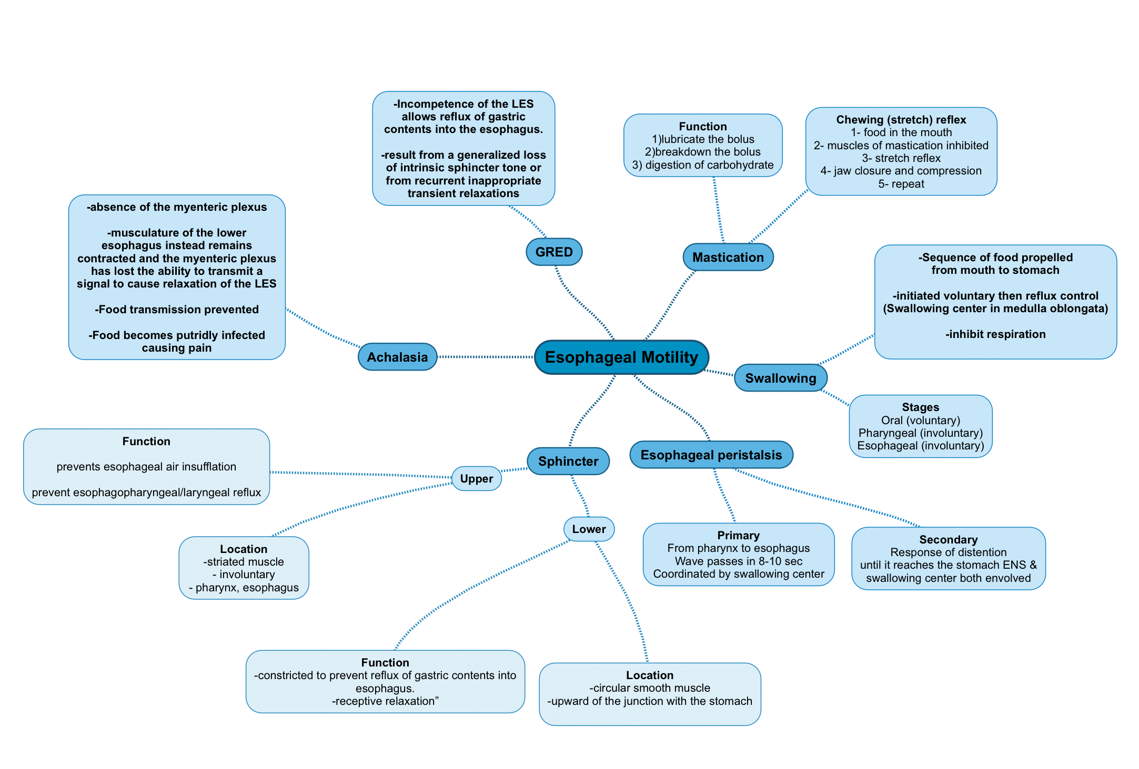
Summary
Causes of Competence and the antireflux functions of the LES
Its resting pressure (15- 30 mmHg).
The diaphragm wraps around the esophagus at the level of LES
The flutter-valve closure of the lower esophagus by the increased intra-abdominal pressure.
Valve-like closure of the distal end of the esophagus.
absence of the myenteric plexus containing VIP & NO in the lower third of esophagus
the myenteric plexus has lost the ability to transmit a signal to cause relaxation of the LES
Food transmission Is prevented
Food becomes putridly infected during the long periods of esophageal stasis

Slide 15
Questions
MCQs
1- Stages of swallowing:
Oral, pharyngeal, esophageal.
Mastication, oral, pharyngeal, esophageal.
Pharyngeal, esophageal.
Pharyngeal, esophageal, gastric.
2- In the pharyngeal stage:
palatopharyngeal folds pull medially to approximate and form a horizontal slit.
The larynx is pulled upward and anteriorly by the face muscles.
The soft palate is pulled downward to close the posterior nares.
The epiglottis swings backwards over the opening of the larynx.
3-Enlargement of the esophagus due to collection of food within it, is a complication of:
Achalasia
GERD
H Pylori infection
Heavy meal
4- One of the UES functions is:
Prevention of the reflux of gastric contents into the esophagus
Prevention of esophageal air insufflation.
Prevention of the esophagopharyngeal/laryngeal reflux
(C+B)
5- One method to diagnose GERD is
Endoscopy
Xray
Esophageal manometry
6- The esophageal stage is controlled by:
Enteric nervous system
Swallowing reflex
Swallowing reflex+ENS
7- The UES relaxes during swallowing for about:
7-10 sec
1 sec
2 sec
5 sec
8- The surgical treatment for Achalasia is:
Injecting muscle relaxant (Botox)
Pneumatic dilation by balloon
Nitroglycerin
Myotomy
9- Which of these causes LES contraction:
Secretin
CCK
Gastrin
Nitroglycerin
Answers
1- A
2- D
3- A
4- D
5- A
6- C
7- B
8- D
9- C

