Slide 1
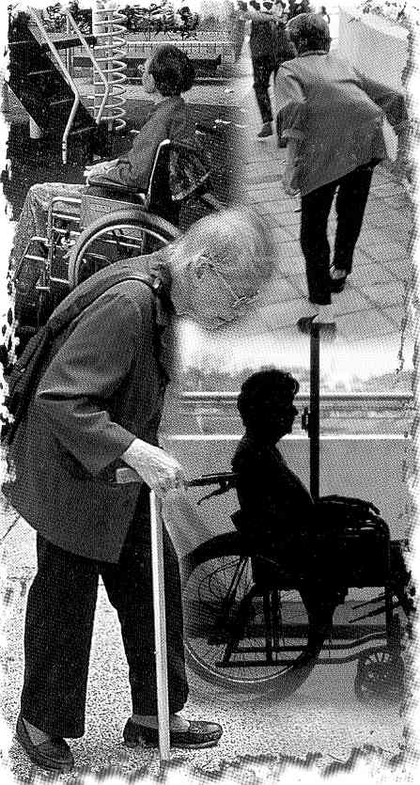
Pharmacology of drugs used in calcium & vitamin D disorders

Slide 2
Objectives
By the end of lecture, the students will be able to:
Recognize the common drugs used in calcium & vitamin D disorders
Classify them according to sources & pharmacological effects
Detail the pharmacology of each drug regarding; mechanism, clinical utility in affecting calcium & vitamin D

Slide 3
Calcium Metabolism
Calcium plays an essential role in many cellular processes, including muscle contraction, hormone secretion, cell proliferation, and gene expression.
Calcium balance is a dynamic process that reflects a balance between calcium absorption by the intestinal tract, calcium excretion by the kidney, and release and uptake of calcium by bone during bone formation and resorption.
Notes:
Calcium metabolism refers to the movements and regulation of calcium ions (Ca2+) into and out of various body compartments, such as the gastrointestinal tract, the blood plasma, the extracellular and the intracellular fluid, and bone tissue. An important aspect of calcium metabolism is plasma calcium homeostasis, the regulation of calcium ions in the blood plasma within narrow limits.[1] In this process, bone tissue acts as a calcium storage center for deposits and withdrawals as needed by the blood, via continual bone remodeling

Slide 4
Three principal hormones regulate Ca²⁺ homeostasis
Parathyroid hormone (PTH)
Vitamin D
Calcitonin
Three target tissues regulate calcium homeostasis
Bone
kidney
Intestine

Slide 5
Bone
The dominant site of calcium storage in the body is bone, which contains nearly 99.9% of body calcium.
Most body calcium is stored in bone (~1000 g), which is a very dynamic site as bone is remodeled continuously by resorption of old bone by osteoclasts & formation of new bone by osteoblasts
Although only a small fraction of total body calcium is located in the plasma, it is the plasma concentration of ionized calcium that is tightly regulated, primarily under the control of PTH and vitamin D.

Slide 6
The following are involved in calcium metabolism & bone remodeling:
Parathyroid hormone ( PTH)
Teriparatide
Vitamin D
Calcitonin
PTH and vitamin D play central roles in the regulation of bone metabolism.

Slide 7
Parathyroid Hormone
PTH: A hormone that plays a critical role in controlling calcium and phosphate
balance.
PTH is released from the parathyroid gland in response to low plasma Ca²⁺ level
Secretion of PTH is inversely related to [Ca²⁺ ].

Slide 8
PTH action
The overall action of PTH is to increase plasma Ca²⁺ levels in response to hypocalcemia:
First, PTH enhances intestinal calcium absorption in the presence of permissive amounts of vitamin D.
Second, PTH stimulates bone resorption by stimulating osteoclasts to increase the outward flux of calcium.
Third, PTH stimulates the active reabsorption of calcium from the kidney.

Slide 9
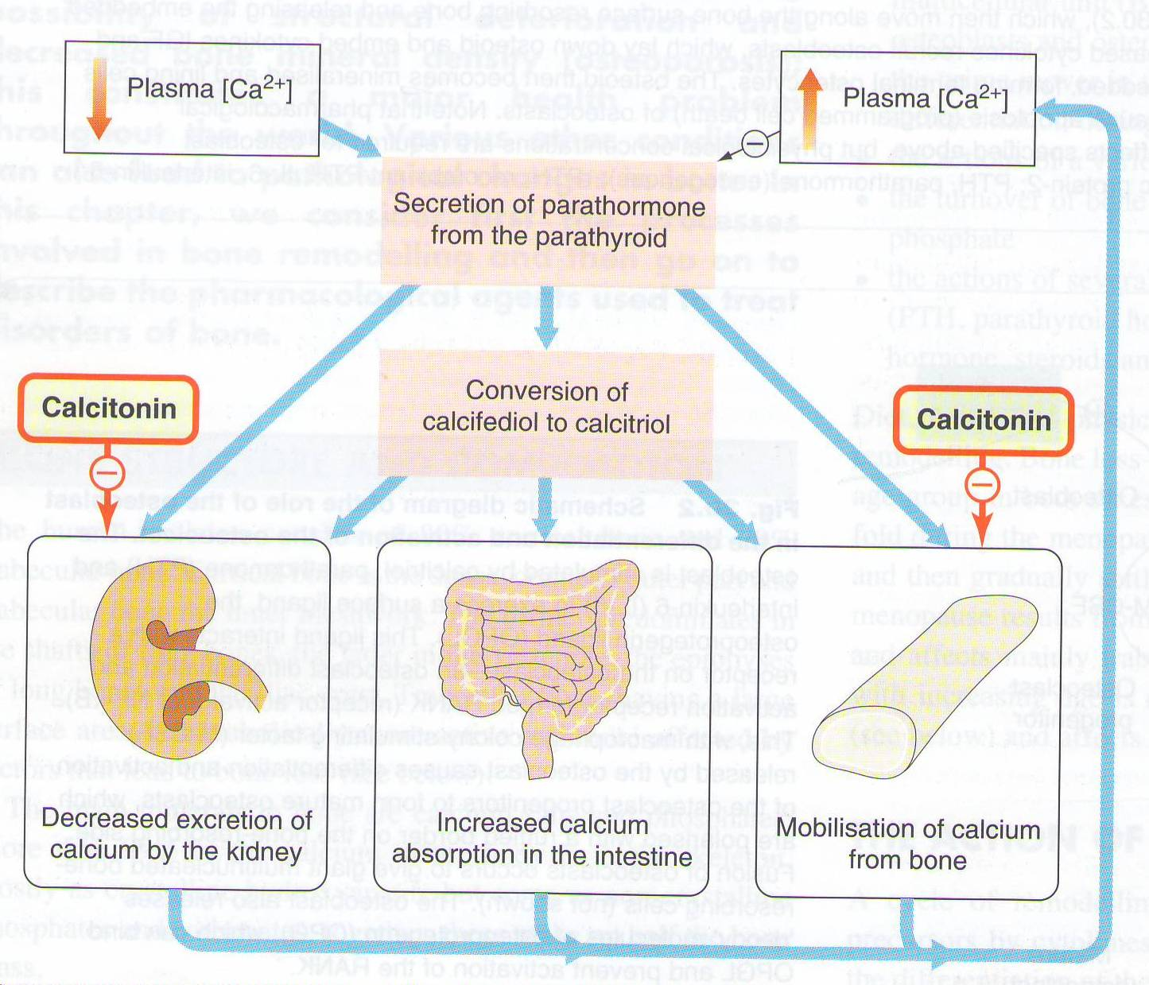
Calcitonin is a physiological antagonist to PTH with regard to Ca²⁺ homeostasis

Slide 10
Response to PTH
PTH
Intermittent
Continuous
↑ Osteoblast number/function
↑ Osteoclast
↑ Bone formation
↑ Bone resorption
↑ Bone mass/strength
↑ Serum Ca2⁺
Notes:
Intermittent PTH exerts preferential stimulation of osteoblastic activity over osteoclastic activity

Slide 11
Response to PTH
Daily, intermittent administration of recombinant human PTH, SC in the thigh (alternate thigh every day ) leads to a net stimulation of bone formation.
Continuous or chronic exposure to high serum PTH concentrations (as seen with primary or secondary hyperparathyroidism) results in bone resorption.

Slide 12
Clinical uses of PTH
Treatment of severe osteoporosis
Resistant cases failed to respond to other medications

Slide 13
Teriparatide
Synthetic polypeptide form of PTH (PTH analogue).
It belongs to a class of anti-osteoporosis drugs, the so-called “anabolic” agents.
Given, once / daily by subcutaneous injection

Slide 14
Therapeutic effects of teriparatide depend upon the pattern of systemic exposure.
Once-daily administration of teriparatide stimulates new bone formation by preferential stimulation of osteoblastic activity over osteoclastic activity.
By contrast, continuous administration of teriparatide , may be detrimental to the skeleton because bone resorption may be stimulated more than bone formation.

Slide 15
Therapeutic uses of Teriparatide
Good for postmenopausal osteoporosis.
For treatment of osteoporosis in people who have a risk of getting fracture ( increased bone mass & strength )
Used in severe osteoporosis or patients not responding to other drugs.
Should not be used routinely due to carcinogenic effects.

Slide 16
Adverse effects of Teriparatide
Carcinogenic effect (osteosarcoma)
Diarrhea, heart burn, nausea
Headache, leg cramps
Hypotension when standing (orthostatic hypotension)
Elevated serum calcium which may occur in some cases can lead to kidney stones
Notes:
instruct patient to rise slowly from a sitting/supine position while taking this drug, as drug may cause orthostatic hypotension.

Slide 17
Contraindications
Teriparatide should not be used by people with increased risk for bone tumors (osteosarcoma) including:
People with Paget's disease of bone
People who had radiation treatment involving bones
Not recommended in children

Slide 18
Vitamin D
Vitamin D is a steroid hormone that is intimately involved in the regulation of plasma calcium levels.
Its role in calcium metabolism first was recognized in the childhood disease rickets, which is characterized by hypocalcemia and various skeletal abnormalities.

Slide 19
Vitamin D Metabolism
Exposure to the ultraviolet rays in the sunlight convert 7DC to cholecalciferol. Vitamin D3 is metabolically inactive until it is hydroxylated in the liver then the kidney (by α hydroxylase) to the active form 1,25 Dihydroxycholecalciferol.
Notes:
Vitamin D is present in the diet and can be synthesized in the skin from 7-dehydrocholesterol in the presence of ultraviolet light. As this molecule passes through the liver, it is hydroxylated to 25-hydroxyvitamin D (25-hydroxycholecalciferol), the inactive form of vitamin D. 25-Hydroxyvitamin D travels by the circulation to the kidney, where proximal tubule cells contain the enzyme 1 a-hydroxylase, which converts the molecule to 1,25-dihydroxyvitamin D, the most active form of vitamin D. The activity of the 1 α-hydroxylase is tightly controlled by PTH and plasma phosphate levels.

Slide 20
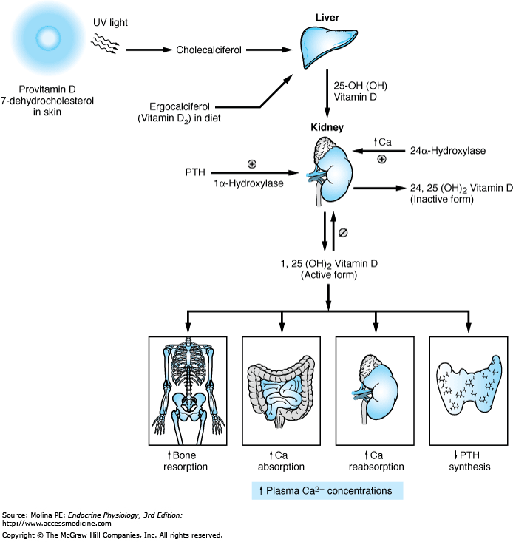
Calcium and Vitamin D
Vit D3
Vitamin D increases bone resorption, increases Ca²⁺ absorption from intestine, increases renal Ca²⁺ reabsorption, and decreases the
production of PTH by the parathyroid glands. The overall effect of
vitamin D is to increase plasma Ca²⁺ concentrations.

Slide 21
Deficiency of vitamin D leads to:
-Rickets in small children
-Osteomalacia
-Osteoporosis
Therapeutic uses of vitamin:
-Rickets & Osteomalacia
-Osteoporosis
-Psoriasis
-Cancer prevention (prostate & colorectal)

Slide 22
Remember that
1,25-dihydroxyvitamin D (calcitriol) is The most active form of vitamin D.
25-hydroxyvitamin D (calcidiol, 25-hydroxycholecalciferol): an inactive
form of vitamin D.
1alpha-hydroxylase: The enzyme that converts the inactive form of vitamin D.
.

Slide 23
Vitamin D
Cholecalciferol (Vitamin D3) in skin
Ergocalciferol (Vitamin D2) in plants
Vit D2 and Vit D3 have equal biological activities.
Vitamin D2 is the prescription form of vitamin D & is also used as food additive (milk).
Vitamin D3 is usually for vitamin D- fortified milk & foods & also available in drug combination products.
Notes:
Fortification is the process by which manufacturers add micronutrients such as vitamins and minerals to food

Slide 24
Calcitonin
Calcitonin is synthesized and secreted by the parafollicular cells (C cells) of the thyroid gland. It is released when there is a rise in plasma Ca²⁺ levels
While PTH and vitamin D act to increase plasma Ca²⁺, only calcitonin causes a decrease in plasma Ca²⁺
Calcitonin protects against development of hypercalcemia caused by a variety of conditions, including increased calcium absorption (milk-alkali syndrome) and decreased calcium excretion (thiazide use).
Notes:
(MAS) consists of hypercalcemia, various degrees of renal failure, and metabolic alkalosis due to ingestion of large amounts of calcium and absorbable alkali. This syndrome was first identified after medical treatment of peptic ulcer disease with milk and alkali

Slide 25
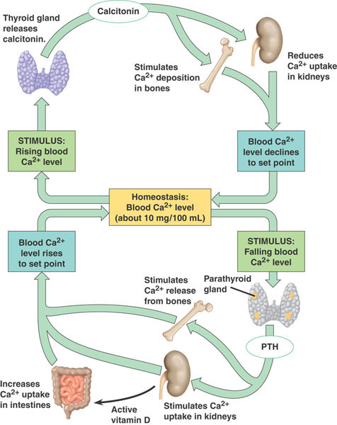
Calcitonin
Calcitonin does not appear to be critical for the regulation of calcium homeostasis even if thyroid gland is removed.

Slide 26
Effects of calcitonin
The major effect of calcitonin administration is a rapid fall in Ca²⁺ caused by:
Inhibiting bone resorption by inhibiting osteoclast activity. The osteoclast bone cells appear to be a particular target of calcitonin
Decreasing reabsorption of Ca²⁺ & PO₄ by the kidney, thus increasing their excretion

Slide 27
Clinical uses of Calcitonin
Used clinically in treatment of hypercalcemia and in certain bone diseases in which sustained reduction of osteoclastic resorption is therapeutically advantageous
Osteoporosis (major indication; alternative to other drugs).
Hypercalcemia (short-term treatment of hypercalcemia of malignancy), Paget's disease.
It has lower efficacy compared to other drugs.
Notes:
Hypercalcemia of malignancy is a common finding typically found in patients with advanced stage cancers. Several major mechanisms are responsible for the development of hypercalcemia of malignancy including parathyroid hormone-related peptide-mediated humoral hypercalcemia, osteolytic metastases-related hypercalcemia, 1,25 Vitamin D-mediated hypercalcemia, and parathyroid hormone-mediated hypercalcemia in patients with parathyroid carcinoma and extra parathyroid cancers.

Slide 28
Routes of administration S.C., Nasal spray or solution (Calcitonin Salmon ) has more affinity towards human calcitonin receptors Adverse effects -Nausea -Local inflammation at site of injection -Flushing of face & hands -Nasal irritation

