Slide 1
Pharmacology of Corticosteroids
Dr. Aliah Alshanwani
Dept. of Pharmacology
College of Medicine, KSU
Feb 2019

Slide 2
The Corticosteroids are steroid hormones produced by the adrenal cortex.
They consist of two major groups:
  1. Glucocorticoids [Major cortisol (Hydrocortisone)]
2. Mineralocorticoids (most important Aldosterone)
Notes:
The adrenal gland produce various classes of hormones/ steroids. The 2 main gps that are important for life are glucocor and mineralocor.

Slide 3
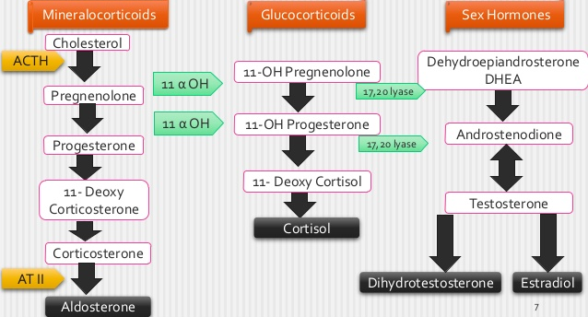
Biosynthesis of adrenal hormones
Notes:
Regulated by CRH (Corticotropin releasing hormone) by the hypothalamus, w stimulate the anterior pituitary to secrete ACTH (Adrenocorticotropic hormone) that stimulate the adrenal gland to secrete cortisol.

Slide 4
  1. Glucocorticoids:
  They have important effects on intermediary metabolism, catabolism, immune responses, growth & inflammation.
  2. Mineralocorticoids:
  They have salt-retaining activity which regulate sodium & potassium reabsorption in the collecting tubules of the kidney.
Notes:
Glucocorticoids play important role in Physiological effects
Intermediary metabolism, w describes all reactions concerned with the storage & generation of metabolic energy required for the biosynthesis of low-molecular weight compounds & energy storage compounds.

Slide 5
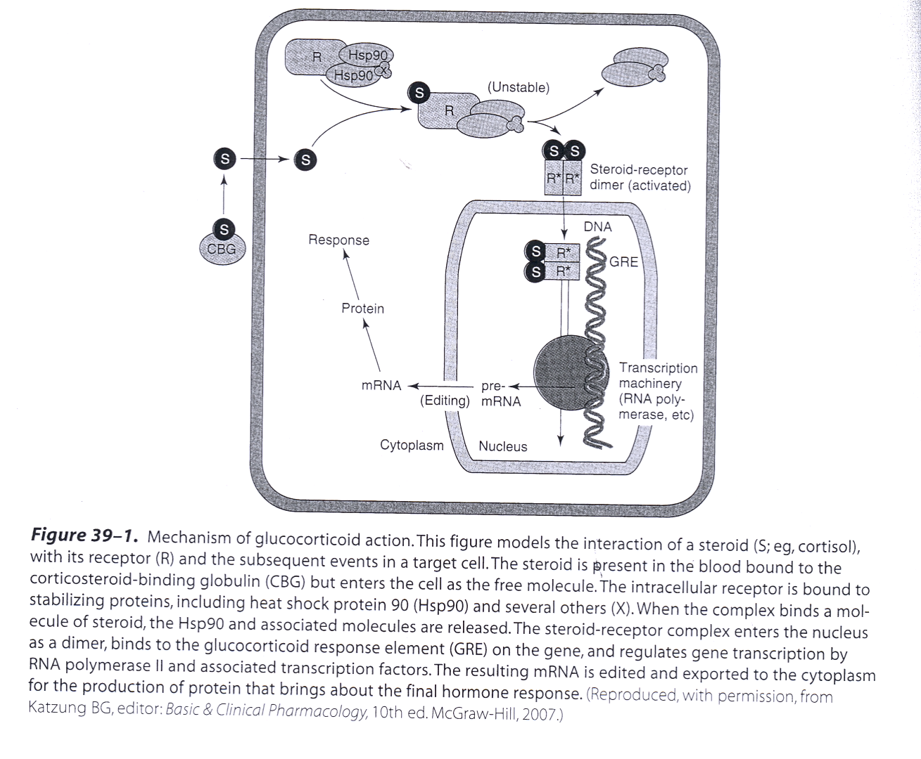

Slide 6
Pharmacodynamics
A. Mechanism of Action
Corticosteroid is present in the blood bound to the corticosteroid binding globulin (CBG) & enters the cell as the free molecule.
The intracellular receptor (R) is bound to the stabilizing proteins, including heat shock protein 90 (Hsp90) & several others(X). When the complex binds a molecule of steroid, the Hsp90 & associated molecules are released.

Slide 7
                The Steroid– R complex enters the nucleus as a dimer, binds to the glucocorticoid response element (GRE) on the gene & regulates gene transcription by RNA polymerase II & associated transcription factors.
                The resulting mRNA is edited & exported to the cytoplasm for the production of protein that brings about the final hormone response.

Slide 8
B. Metabolic effects:
Glucocorticoids stimulate gluconeogenesis, as a result:
Blood glucose rises
Insulin secretion is stimulated
Stimulate lipolysis & lipogenesis (due to increased insulin)
With a net increase of fat deposition in certain areas (e.g, the face (moon faces) & shoulder & back (buffalo hump).
These effects occur when the patient is treated with 100 mg of hydrocortisone or > for longer than 2 weeks.
Notes:
So after activating GRE and protein synthesis what are the expected response?
GCs are similar to catecholamines are called stress hormones
Stimulate lipolysis (increase release of FA in the blood)
Insulin promotes lipogenesis

Slide 9
C. Catabolic effects:
Glucocorticoids cause muscle protein catabolism ( muscle mass)
Lymphoid & connective tissue fat & skin undergo wasting
Catabolic effects on bone lead to osteoporosis
In children, growth is inhibited.
Notes:
Stimulate the conversion of protein aa to carbohydrates as glucose (gluconeogenesis) and promote the storage of carbohydrates as glycogen.

Slide 10
D. Anti – inflammatory effects:
Glucocorticoids have important inhibitory effects on the distribution, function & migration of leukocytes
Suppressive effect on the inflammatory cytokines & chemokines
  These drugs increase neutrophils & decrease lymphocytes,
eosinophils, basophils & monocytes
Inhibit phospholipase A2 & Prostaglandins synthesis.
Notes:
Neutrophils have anti-inflammatory effect
A lymphocyte is a type of WBC that is part of the immune system. There are two main types of lymphocytes: B cells and T cells.
The B cells produce antibodies that are used to attack invading bacteria, viruses, and toxins.
The T cells destroy the body's own cells that have themselves been taken over by viruses or become cancerous.
Eosinophil: A normal type of WBC that has coarse granules within its cytoplasm. Eosinophils are produced in the bone marrow and migrate to tissues throughout the body. When a foreign substance enters the body, other types of WBCs (lymphocytes and neutrophils) release substances to attract eosinophils and then release toxic substances to kill the invader. The numbers of eosinophils in blood often rise when an allergic reaction occurs. Elevated eosinophil counts are also common in some diseases, such as parasite diseases and asthma.
A basophil is a type of WBC. Basophils are the least common of the granulocytes, representing about 0.5 to 1% of circulating WBC. However, they are the largest type of granulocyte. They are responsible for inflammatory reactions during immune response, as well as in the formation of acute and chronic allergic diseases, including anaphylaxis, asthma, atopic dermatitis and hay fever. They can perform phagocytosis, produce histamine and serotonin that induce inflammation, and heparin that prevents blood clotting.
Monocytes are a type of WBC, or leukocyte. They are the largest type of leukocyte and can differentiate into macrophages and myeloid lineage dendritic cells. As a part of the vertebrate innate immune system monocytes also influence the process of adaptive immunity. There are at least three subclasses of monocytes in human blood based on their phenotypic receptors.

Slide 11
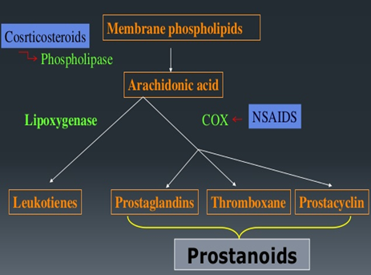

Slide 12
E. Immunosuppressive effects:
Glucocorticoids inhibit cell-mediated immunologic functions, especially dependent on lymphocytes &
decrease interleukins secretion.
Glucocorticoids do not interfere with the development of
normal acquired immunity but delay rejection reactions in patients
with organ transplants.
Notes:
B-lymphocyte (Ab-mediated)
Bec they decrease lymphocyte

Slide 13
F. Other effects:
Glucocorticoids such as cortisol are required for normal renal excretion of water loads.
CNS: When given in large doses these drugs may cause profound behavioral changes (first insomnia & euphoria then depression).
GIT: Large doses also stimulate gastric acid secretion & decrease resistance to ulcer formation.
Notes:
Physiologically GC help to control renal excretion of water

Slide 14
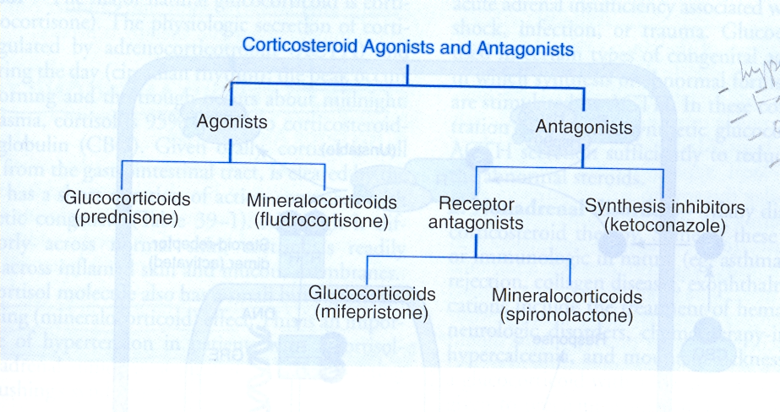

Slide 15
Important Glucocorticoids:
1- Cortisol (hydrocortisone)
The major natural glucocorticoid
The physiologic secretion of cortisol is regulated by adrenocorticotropin hormone (ACTH) & secretion rate varies during the day (circadian rhythm), peaks in the early morning & declines about midnight.
Notes:
Hydrocortisone: the pharmaceutical preparation of cortisol
circadian rhythm: internal body clock

Slide 16
Pharmacokinetics:
Given orally, cortisol is well absorbed from GIT
Cortisol in the plasma is 95% bound to CBG
It is metabolized by the liver & has short duration of
action compared with the synthetic congeners
It diffuses poorly across normal skin & mucous membranes
The cortisol molecule also has a small but significant mineralocorticoid effect. This is an important cause of hypertension in patients with cortisol secreting adrenal tumor or a pituitary ACTH secreting tumor (Cushing’s syndrome).

Slide 17
2. Synthetic Glucocorticoids
Large number are available for use:
Prednisone & its active metabolite prednisolone
Dexamethasone
Beclomethasone
Budesonide
Their properties (compared with cortisol) include:
longer half life & duration of action
reduce salt retaining effect
better penetration of lipid barriers for topical activity.

Slide 18
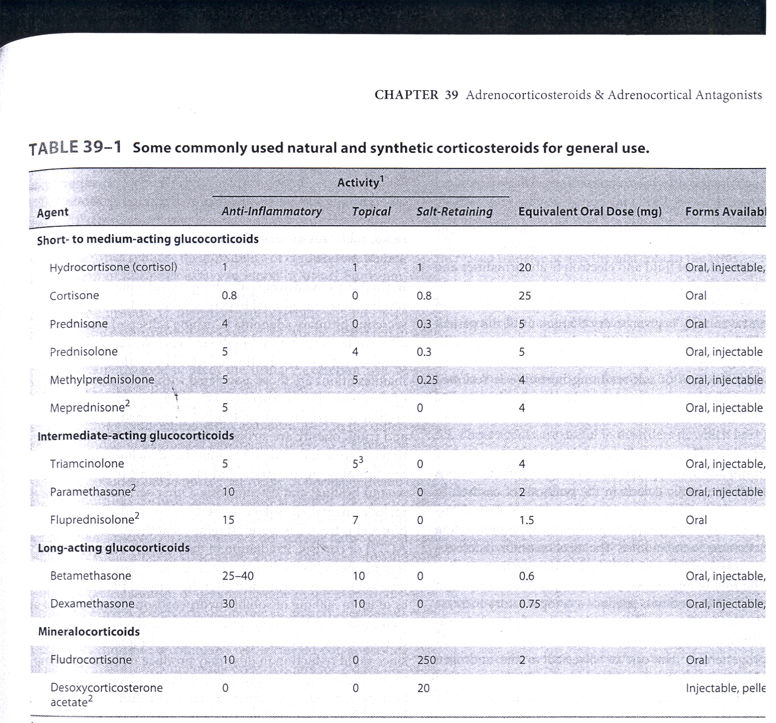
Notes:
¹ Potency relative to hydrocortisone
> 1, These drugs have Higher affinity and greater bioavailability, poorly metabolised

Slide 19
Beclomethasone & budesonide have been developed for use in asthma & other conditions in which good surface activity on mucous membrane or skin is needed & systemic effects are to be avoided.
These drugs rapidly penetrate the airway mucosa but have very short half lives after they enter the blood, so that systemic effects & toxicity are greatly reduced.

Slide 20
Clinical uses of corticosteroids
A. Adrenal disorders:
1. Addison’s disease (chronic adrenal cortical insufficiency)
2. Acute adrenal insufficiency associated with life threatening
shock, infections or trauma
3. Congenital adrenal hyperplasia (in which synthesis of
abnormal forms of corticosteroids are stimulated by ACTH).
Notes:
As a replacement for cortisol shortage
Addison’s disease : weakness, fatigue, weight loss, hypotension, inability to maintain blood glucose level during fasting.
3: defect in cortisol synthesis

Slide 21
B. Non-adrenal disorders:
1. Allergic reactions (e.g. bronchial asthma, angioneurotic edema,
drug reactions, urticaria, allergic rhinitis)
2. Collagen vascular disorder (e.g; rheumatoid arthritis,
systemic lupus erythematosus, giant cell arteritis, polymyositis, mixed connective tissue syndrome)
3. Organ transplants (prevention & treatment of rejection –
immunosuppression).
Clinical uses of corticosteroids Cont’
Notes:
Angioneurotic edema: Patients can develop recurrent attacks of swollen tissues, pain in the abdomen, & swelling of the voice box (larynx) wh can compromise breathing. Angioedema is the swelling of deep dermis, subcutaneous, or submucosal tissue due to vascular leakage.
Collagen vascular disorder: a gp of diseases that affect your connective tissue.
systemic lupus erythematosus: Autoimmune disease. In which the immune system mistakenly attacks health tissues.
mixed connective tissue syndrome: autoimmune disease

Slide 22
Clinical uses of corticosteroids Cont’
4. GI disorders such as inflammatory bowel disease
5. Hematologic disorders (leukemia, multiple myeloma, acquired hemolytic anemia, acute allergic purpura)
6. Infections (acute respiratory distress syndrome, sepsis)
7. Neurologic disorders (to minimize cerebral edema after brain surgery, multiple sclerosis).
Notes:
Leukemia: They add corticosteroids to chemotherapy. the use of a corticosteroid has the additional benefit of suppressing some related autoimmune diseases, such as immunohemolytic anemia or immune-mediated thrombocytopenia.
Multiple myeloma, also known as plasma cell myeloma, is a cancer of plasma cells, a type of WBC normally responsible for producing antibodies
Acquired hemolytic anemia: immune mediated anemia.
Allergic purpura (AP) is an allergic reaction of unknown origin causing red patches on the skin and other symptoms. "Purpura" is a bleeding disorder that occurs when capillaries rupture, allowing small amounts of blood to accumulate in the surrounding tissues. In AP, this occurs because the capillaries are blocked by protein complexes formed during an abnormal immune reaction.
ARDS: widespread inflammation in the lungs
Sepsis: immune response to infection and increased release of cytokines.
MS: dystruction of nerve cells by immune system.
IN CANCER corticosteroids are added bec they
Reduce inflammation
Reduce the immune response, for example, after a bone marrow transplant or stem cell transplant
Help to relieve sickness when having chemotherapy
Reduce cerebral edema in acute cases & infections

Slide 23
Clinical uses of corticosteroids Cont’
8. Pulmonary diseases (e.g.; aspiration pneumonia, bronchial asthma, sarcoidosis).
9. Thyroid diseases (malignant exophthalmos, subacute thyroiditis)
10. Renal disorders (nephrotic syndrome)
11. Miscellaneous (hypercalcaemia, mountain sickness).
Notes:
Aspiration pneumonia is bronchopneumonia that develops due to the entrance of foreign materials into the bronchial tree, usually oral or gastric contents.
Sarcoidosis an inflammatory disease that affects multiple organs in the body, but mostly the lungs and lymph glands. is a disease involving abnormal collections of inflammatory cells that form lumps known as granulomas
malignant exophthalmos due to hyperthyroidism and gravis disease (autoimmune disease). Protrusion of the eyeball and inflammation
Nephrotic syndrome: is nephrosis (infection) accompanied with proteinuria & edema.
HyperCa: glucocorticoids increase urinary Ca excretion and decrease intestinal Ca absorption
mountain sickness: Corticosteroids decrease swelling.

Slide 24
Toxicity (Adverse effects)
Cushing’s syndrome (iatrogenic, by higher doses > than 100 mg hydrocortisone daily for > than 2 weeks characterized by moon shape face & buffalo hump)
Increased growth of fine hair on face, thighs & trunk. Myopathy, muscle wasting, thinning of skin, Diabetes Mellitus
Osteoporosis & aseptic necrosis of the hip
Wound healing is impaired
Peptic ulcer
Acute psychosis, depression
Subcapsular cataracts
Growth suppression
Hypertension
Adrenal suppression.
Notes:
Cushing's syndrome is a collection of signs and symptoms due to prolonged exposure to cortisol. Signs and symptoms may include: high BP, abdominal obesity but with thin arms and legs, reddish stretch marks, a round red face, a fat lump between the shoulders, weak muscles, weak bones, acne, and fragile skin that heals poorly. Women may have > hair and irregular menstruation.
Aseptic necrosis is a bone condition that results from poor blood supply to an area of bone, causing localized bone death. This is a serious condition because the dead areas of bone do not function normally, are weakened, and can collapse. Aseptic necrosis is also referred to as avascular necrosis or osteonecrosis.
Acute psychosis: in overdose can produce personality changes and thought disorder
Prolonged use of glucocorticoids is a significant risk factor for the development of posterior subcapsular cataract. Cataract (Loss of lens transparency): lens epithelial cells become necrotic

Slide 25
Methods for minimizing these toxicities include
Local application (e.g, aerosol for asthma)
Alternate day therapy (to reduce pituitary suppression)
Tapering the dose soon after achieving a therapeutic response
To avoid adrenal insufficiency in patients who have had long term therapy, additional stress doses may need to be given during serious illness, or before major surgery.
Notes:
Due to adrenal suppression
Patients with a normal HPA axis who are exposed to increased levels of stress will secrete increased amounts of cortisol, while patients exposed to chronic exogenous steroids exhibit blunted responses and have traditionally been considered at risk for adrenal crisis during these periods. The original recommendation of 200 to 300 mg of hydrocortisone as a supraphysiologic dose stemmed from the idea that this would be the amount of cortisol produced by a maximally stimulated adrenal gland. There is widespread disagreement about the amount, duration, and total exposure of exogenous steroids required to cause HPA-axis dysfunction & how long the glands take to fully recover function after discontinuation of therapy.

Slide 26
Mineralocorticoids:
A. Aldosterone:
The major natural mineralocorticoid in human.
Aldosterone is the main salt-retaining hormone, promotes Na reabsorption, K excretion, in the distal convoluted tubule & thus it is very important in the regulation of blood volume & blood pressure. Its secretion is regulated by ACTH & by the renin-angiotensin system.
Aldosterone has short half life & little glucocorticoid activity.
Mechanism of action:
Same as that of glucocorticoids.
Fludrocortisone is favored for replacement therapy after adrenalectomy & in other conditions in which mineralocorticoid therapy is needed.
Notes:
Angiotensin II also stimulates the secretion of the hormone aldosterone from the adrenal cortex

Slide 27
Corticosteroid Antagonists:
A. Receptor Antagonists
Spironolactone (mineralocorticoid antagonist & K-sparing diuretic)
antagonists of aldosterone at its receptor, used in the treatment of primary aldosteronism
Mifepristone:
A competitive inhibitor of glucocorticoid receptors &
useful in the treatment of Cushing's syndrome.
Notes:
Antagonists of corticosteroids can either block corticosteroids Rs or inhibit steroid synthesis.
primary aldosteronism: Conn's syndrome, is excess production of the hormone aldosterone by the adrenal glands
Cushing’s syndrome due to ectopic ACTH production or adrenal carcinoma.

Slide 28
B. Synthesis inhibitors:
Ketoconazole (anti fungal)
Clinical uses:
Adrenal cancer, when surgical therapy is impractical or
unsuccessful because of metastasis.
Notes:
An antifungal imidazole deriv. potent nonselective inhibitor of adrenal and gonadal steroid synthesis.
At low dose : antifungal
At H dose: inhibit steroid biosynthesis.

Slide 29
Ketoconazole :
Mechanism of Action:
It inhibits the cytochrome p450 enzymes necessary for the synthesis of all steroids & is used in a no. of conditions in which reduced steroid level are desirable such as:
1. Adrenal carcinoma
2. Hirsutism
3. Breast cancer
4. Prostate cancer.
Notes:
Breast & prostate cancer: sex-hormone related cancers
Hirsutism is a condition of unwanted, male-pattern hair growth in women.

