Slide 1
Endocrinology
Dr. Hana Alzamil

Slide 2
Physiology of hypothalamo-Pituitary axis and regulatory mechanisms
Structure of pituitary gland
Anterior pituitary cell types and hormones
Posterior pituitary cell types and hormones
Hypothalamic control of pituitary gland
Hypothalamo-hypophysial portal system
Hypothalamo-hypophysial tract
Feedback mechanisms
Positive feedback
Negative feedback

Slide 3
Structure of pituitary gland
Pituitary gland consist of two lobes
Anterior (Adenohypophysis)
Posterior (Neurohypophysis)

Slide 4
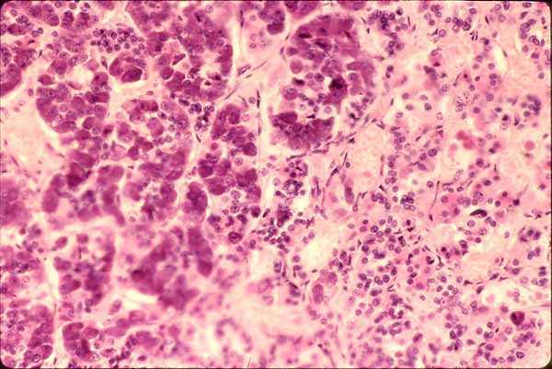
Histology of pituitary gland
Anterior pituitary originates from Rathke’s pouch (pharyngeal epithelium)
Posterior pituitary originates from hypothalamus (glial-type cells)
Anterior Pituitary
Posterior Pituitary

Slide 5
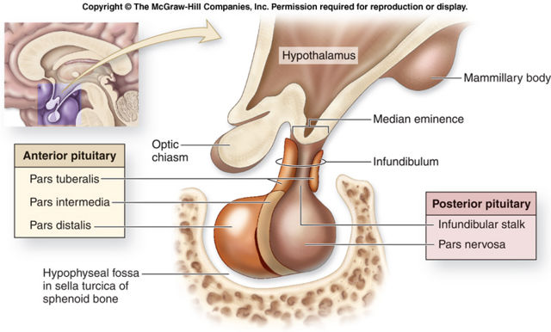
Structure of pituitary gland (relation to optic chiasm)

Slide 6
Hypothalamic control of pituitary secretions
Almost all secretions by the pituitary are controlled by either
Hormonal secretion of hypothalamus
(The anterior pituitary)
or
Nervous signals from hypothalamus
(Posterior pituitary)

Slide 7
Control of anterior pituitary by hypothalamus
Special neurons in the hypothalamus synthesize and secrete the hypothalamic releasing and inhibitory hormones that control secretion of anterior pituitary
Neurons send their nerve fibers to the median eminence (extension of hypothalamic tissue into the pituitary stalk)
Hormones are secreted to the tissue fluids, absorbed into the hypothalamic-hypophysial portal system and transported to the sinuses of the anterior pituitary

Slide 8
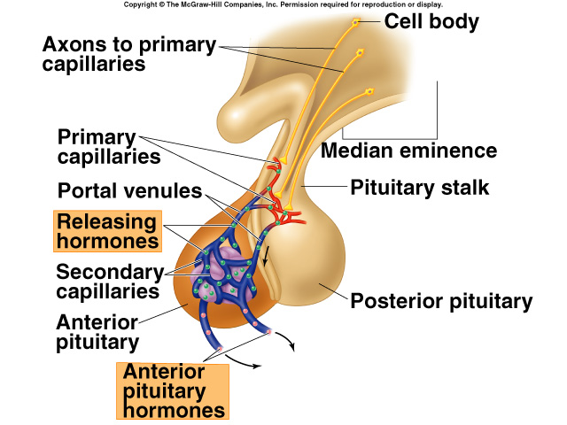
Hypothalamic Control of Anterior Pituitary Gland (adenohypophysis)
Anterior pituitary gland is connected to hypothalamus by portal system: “hypothalamic-hypophysial portal vessels”.

Slide 9
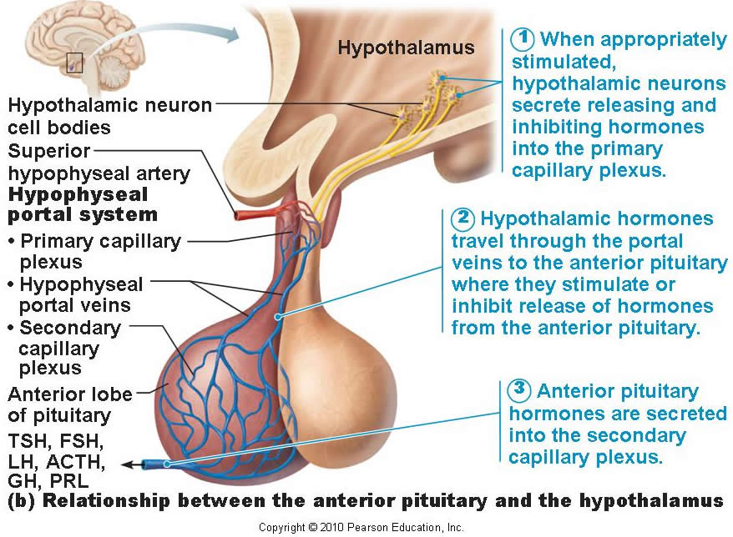
Control of anterior pituitary by hypothalamus

Slide 10
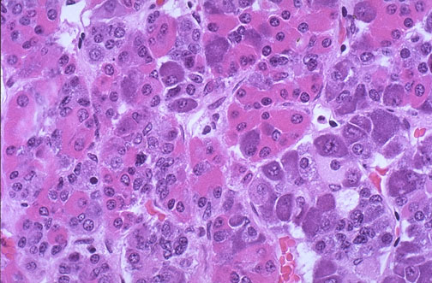
Structure of pituitary gland
Anterior pituitary contains 5 cell types:
Somatotrops: GH 40%
Corticotrops: ACTH 20%
Thyrotropes: TSH
Gonadotropes: LH & FSH
Lactotrops: PRL

Slide 11
Hypothalamic releasing and inhibiting hormones
Growth hormone releasing hormone (GHRH)
Stimulates release of growth hormone
Growth hormone inhibiting hormone (GHIH) also called Somatostatin
Inhibits release of growth hormone

Slide 12
Hypothalamic releasing and inhibiting hormones
Thyrotropin-releasing hormone (TRH)
Stimulates release of thyroid stimulating hormone (TSH)

Slide 13
Hypothalamic releasing and inhibiting hormones
Corticotropin-releasing hormone (CRH)
Stimulates release of adrenocorticotropin hormone (ACTH)

Slide 14
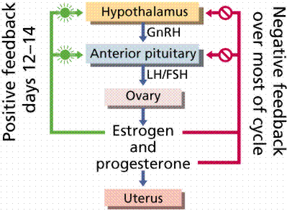
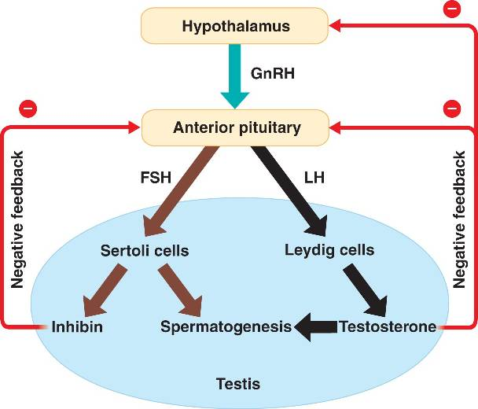
Hypothalamic releasing and inhibiting hormones
Gonadotropin releasing hormone (GnRH) –
causes release of the 2 gonadotropic hormones:
Luteinizing (LH)
Follicle-stimulating hormone FSH

Slide 15
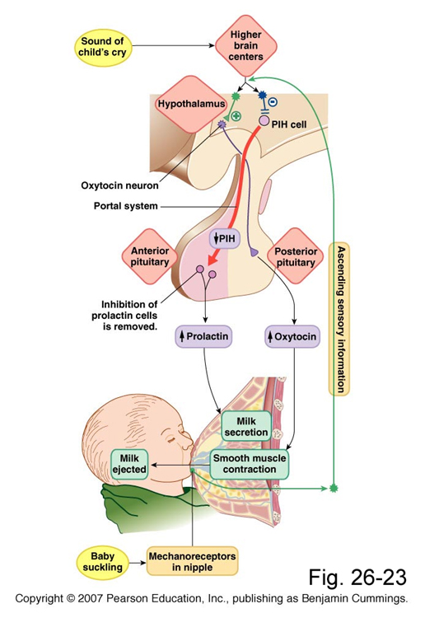
Hypothalamic releasing and inhibiting hormones
Prolactin inhibitory hormone (PIH) also known as Dopamine
Inhibits prolactin secretion

Slide 16
Clinical application
What will happen if pituitary gland is removed from its normal position and transplanted to other part of the body?
Release of all hormones will stop.
Release of some hormones will decrease to very low levels
Release of some hormones will increase.

Slide 17
Posterior pituitary gland
(Neurohypophysis)

Slide 18
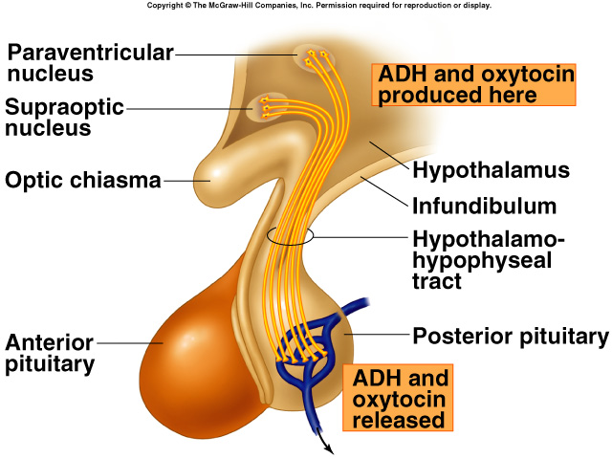
Hypothalamic Control of posterior Pituitary Gland (neurohypophysis)
Hormones synthesized in the supraoptic and paraventricular nuclei of the hypothalamus and released in posterior pituitary

Slide 19
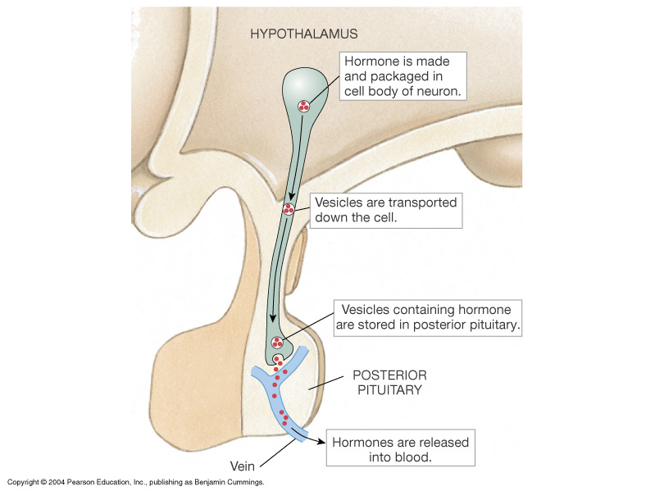
Secretion of Posterior Pituitary Hormones

Slide 20
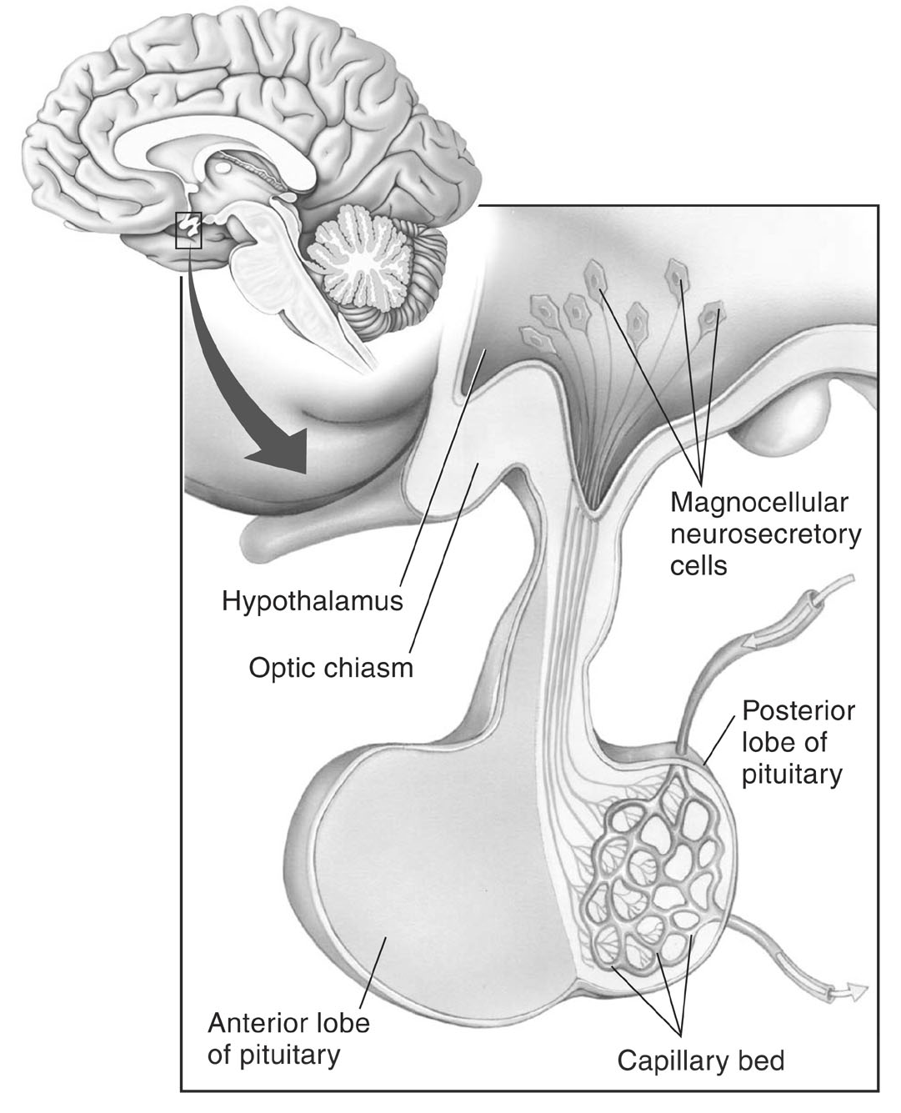
Hypothalamus and posterior pituitary
Magnocellular neurons in paraventricular and supraoptic nuclei secrete oxytocin and vasopressin directly into capillaries in the posterior lobe

Slide 21
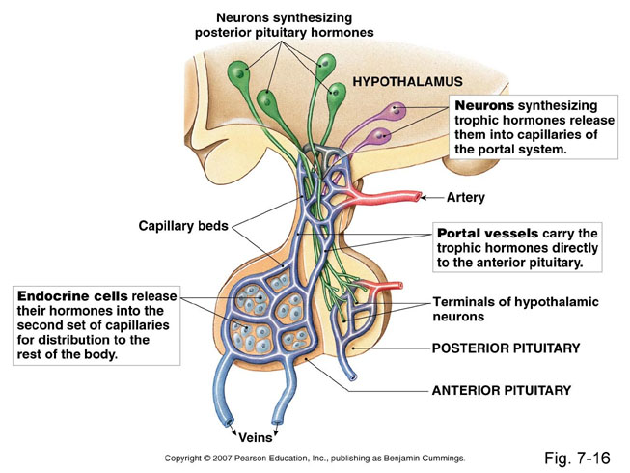
Summary of hypothalamic control of pituitary gland

Slide 22
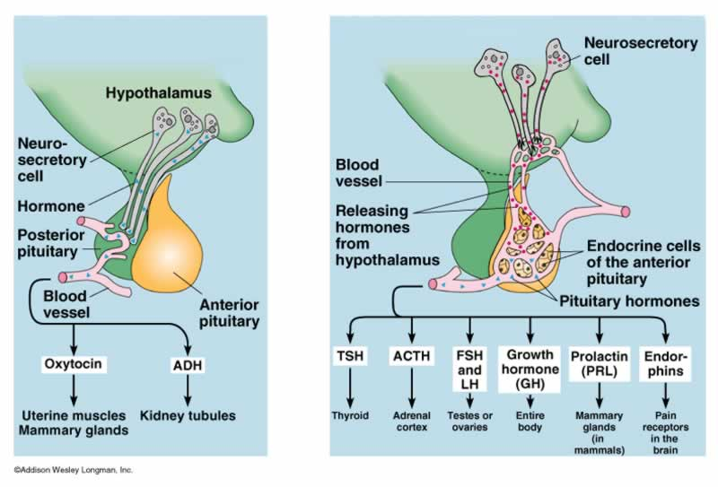

Slide 23
Feedback mechanism
Positive feedback
Negative feedback
Release of hormone A stimulates the release of hormone B
Hormone B stimulates further release of hormone A
Release of hormone A stimulates the release of hormone B
Hormone B inhibits the release of hormone A

Slide 24
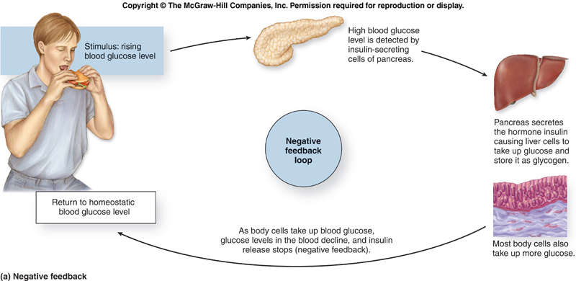
Negative feedback

Slide 25
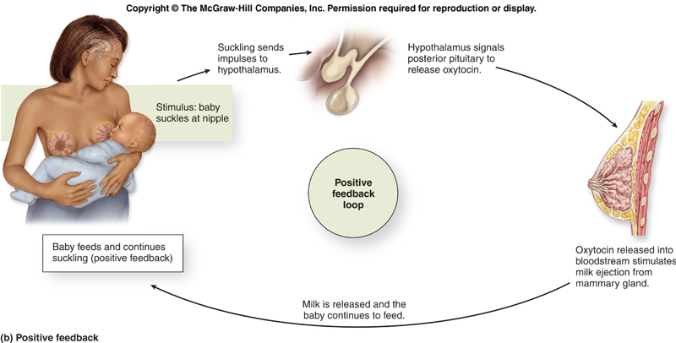
Positive feedback

Slide 26
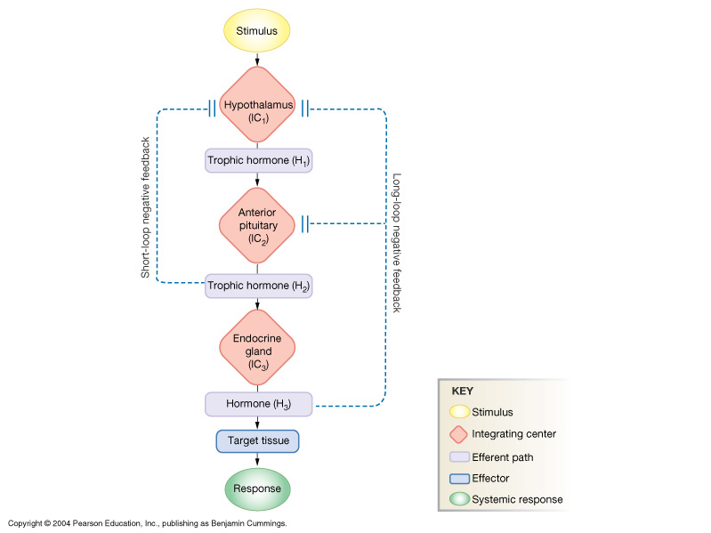
Negative Feedback mechanism: Long & Short Loop Reflexes

Slide 27
Negative Feedback mechanism Cortisol

Slide 28
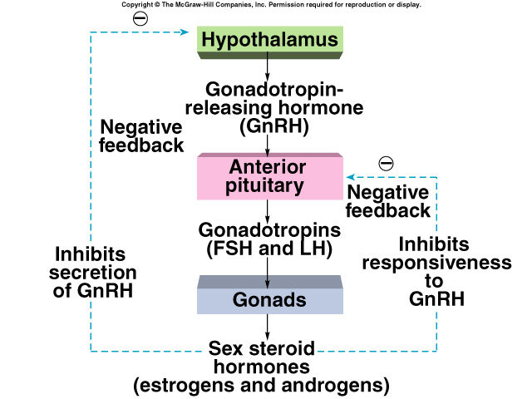
Negative Feedback mechanism Sex steroids

Slide 29
Thank you

