Slide 2
Objectives
At the end of the lecture, students should be able to:
Describe the position of the pituitary gland.
List the structures related to the pituitary gland.
Differentiate between the lobes of the gland.
Describe the blood supply of pituitary gland & the hypophyseal portal system.

Slide 3
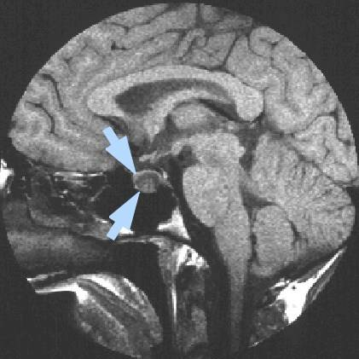
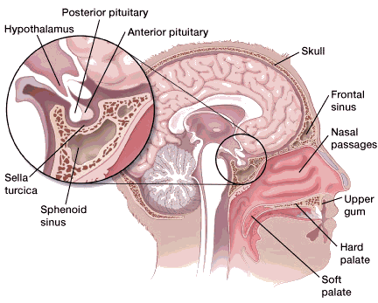
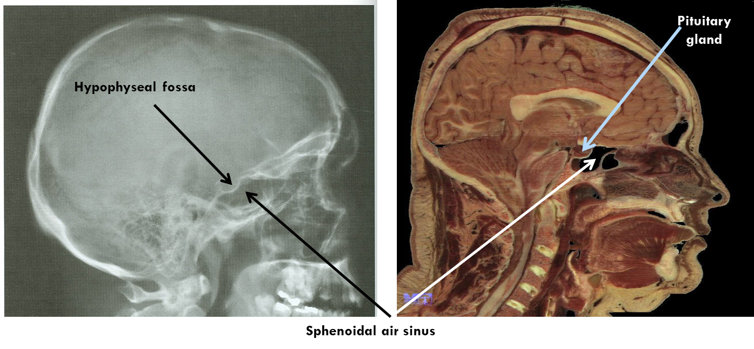
Pituitary Gland=Hypophysis Cerebri "الغدة النخامية"
It is referred to as the master of endocrine glands (CONTROL secretion of other glands)
It is a small oval structure 1 cm in diameter
It (doubles its size = STIMULATE) in women during pregnancy
In pituitary disorders the proportion between the trunk & appendicular system is not affected (unlike hypothyroidism)
X-ray skull: lateral view
Sagittal section of head & neck
Extra

Slide 4
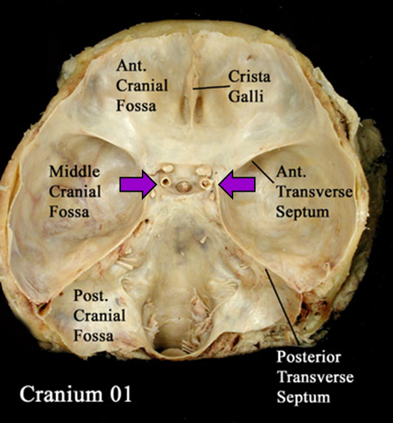
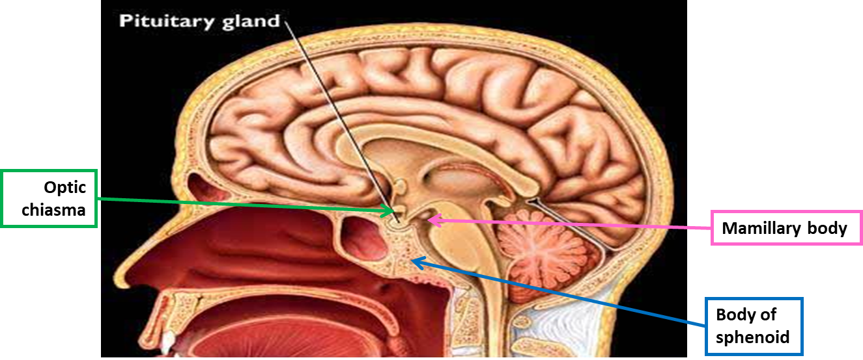
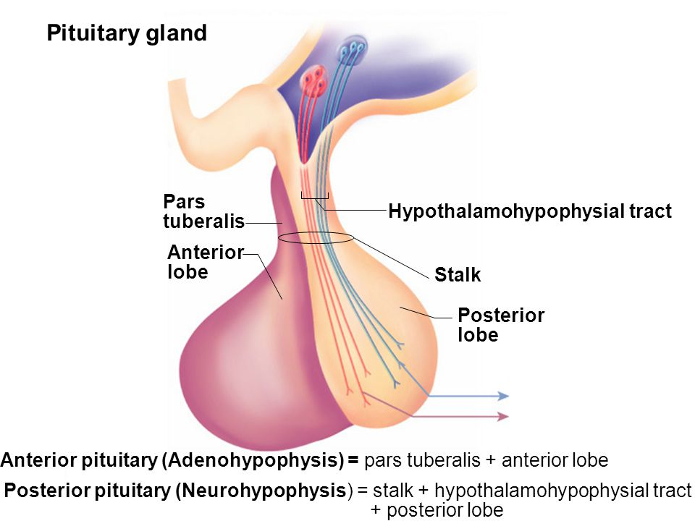
Pituitary Gland
Position & Subdivisions
It lies in the middle cranial fossa.
It is well protected in sella turcica (سرج الحصان) (hypophyseal fossa just below the hypothalamus) of the body of sphenoid
It lies between optic chiasma (anteriorly) & mamillary bodies* (posteriorly) *Part of hypothalamus
The gland is subdivided into:
Anterior Lobe (Adenohypophysis): it is the true gland, secretes hormones
Posterior Lobe (Neurohypophysis): connected to hypothalamus through hypothalamo-hypophyseal tract (which passes through the stalk or infundibulum), stores hormones secreted by hypothalamic nuclei
02:00

Slide 5
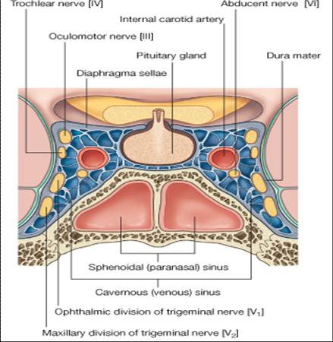
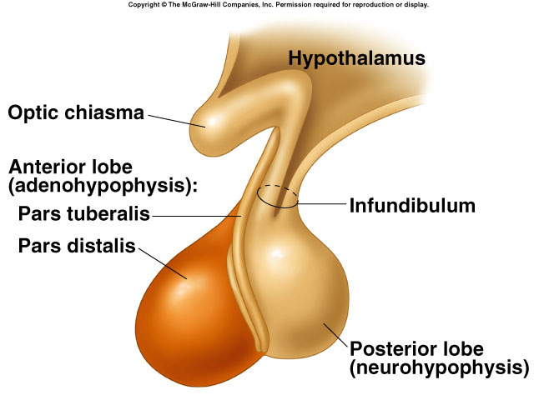
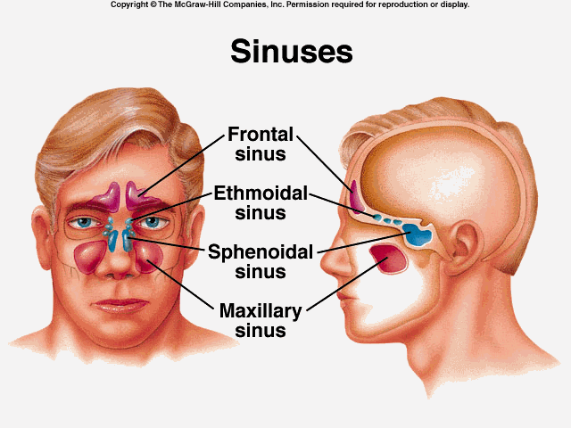
IMPORTANT
Pituitary Gland
Relations
infundibulum (pituitary\neural stalk)
Superior | Diaphragma sellae: A fold of dura mater covers the pituitary gland Has an opening for passage of infundibulum (pituitary stalk) connecting the posterior lobe of gland to hypothalamus
Inferior | Sphenoidal air sinuses
Lateral | Cavernous sinuses*
*2 structures are present in the floor of cavernous sinus: 1) Abducens nerve 2) Internal carotid artery Other cranial nerves are present in the lateral wall of cavernous sinus
Extra
Extra

Slide 6
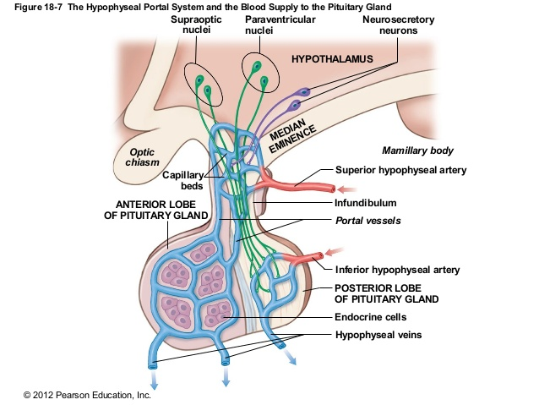
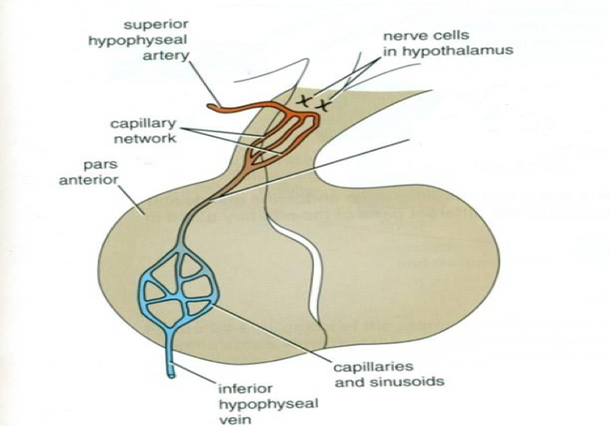
Pituitary Gland
Blood supply & Distribution of Arteries
Blood supply
Arteries | Branches from internal carotid artery: Superior hypophyseal arteries Inferior hypophyseal arteries
Veins | hypophyseal veins drain into cavernous sinuses
Distribution of Arteries
Superior Hypophyseal |  | Supplies infundibulum and anterior lobe Form a capillary network from vessels pass downward Form sinusoids* into the anterior lobe of pituitary gland “hypophyseal portal system”
Inferior Hypophyseal |  | Supplies posterior lobe of pituitary gland
a hypothalamo-hypophyseal portal vessel
*Sinusoid related to portal circulation

Slide 7
IMPORTANT
Pituitary Gland
Lobes (Explained further in physiology)
Anterior Lobe (adenohypophysis) | Hormone releasing & inhibiting factors produced by hypothalamus use Hypophyseal Portal System of vessels to reach anterior lobe of pituitary gland Example: TCH (secreted from anterior lobe) If it increase in the body, it will stimulate the inhibiting factor (produced by hypothalamus) then TCH secretion decrease
Posterior Lobe (neurohypophysis) | The Neurohypophysis receives a nerve supply from some of the hypothalamic nuclei (supraoptic & paraventricular) The axons of these nuclei convey their neuro-secretion (vasopressin and oxytocin) to the Posterior lobe of pituitary gland through Hypothalamo-Hypophyseal tract from where it passes into the blood stream.
REMEMBER!
Hypophyseal Portal System: Vascular connection between hypothalamus & anterior lobe of pituitary
Hypothalamo-Hypophyseal tract: Neural connection between hypothalamus & posterior lobe of pituitary

Slide 8
SUMMARY
PITUITARY GLAND (HYPOPHYSIS CEREBRI)
master of endocrine glands. a small oval structure 1 cm in diameter. doubles its size during pregnancy. It lies in the middle cranial fossa. It is well protected in sella turcica (hypophyseal fossa) of body of sphenoid.
ARTERIES: Superior & Inferior hypophyseal arteries - Internal Carotid artery branches Superior hypophyseal: supplies infundibulum and the anterior lobe of pituitary gland (hypophyseal portal system). Inferior hypophyseal: supplies posterior lobe of pituitary gland | Blood supply | ANTERIOR : Optic chiasma POSTERIOR : Mamillary bodies SUPERIOR: Diaphragma sellae INFERIOR: Sphenoidal air sinuses LATERAL: Cavernous sinuses | Important relations
VEINS: Hypophyseal veins drain into Cavernous Sinuses.
Anterior Lobe (Adenohypophysis): it is the True gland, Secretes hormones Hormone-releasing & inhibiting factors produced by hypothalamus use Hypophyseal Portal System of vessels to reach the Anterior lobe of pituitary gland. |  |  | Subdivisions of pituitary gland
Posterior Lobe (Neurohypophysis): connected to hypothalamus through hypothalamo-hypophyseal tract, Stores hormones secreted. It receives a nerve supply from some of the hypothalamic nuclei (supraoptic & paraventricular) -The axons of these nuclei convey their neurosecretion to the Posterior lobe of pituitary gland through Hypothalamo-Hypophyseal tract from where it passes into the blood stream.

Slide 9
1. Which part of the pituitary gland secret hormones?
A- The posterior part B- Neurohypophysis part C- Adenohypophysis part
2. Inferior hypophyseal artery branch from which of the following?
A- Internal carotid artery B- External carotid artery C- Posterior cerebral artery
3. Which of artery forms the hypophyseal portal system?
A- Inferior hypophyseal B- Superior hypophyseal C- Internal carotid
4. Which of the following nuclei supply the neurohypophysis?
A- Paraventricular B- Mammillary body C- Dentate
5. Which one of the following structures is superior to the pituitary gland?
A- Optic chiasma
B- Diaphragma sellae
C- Mammillary bodies
6. Which one of the following venous sinuses drains hypophyseal veins?
A- Superior sagittal
B- Cavernous
C- Transverse
7. Which of the following is posterior to the pituitary gland?
A- Optic chiasma
B- Diaphragma sellae
C- Mammillary bodies
8. Which part of the pituitary gland store hormones?
A- Neurohypophysis part
B- Adenohypophysis part C- The anterior part
1. C 2. A 3.B 4.A 5.B 6.B 7.C 8.A

