Slide 2
Objectives
At the end of the lecture, students should be able to:
Describe the shape, position, relations and of the thyroid gland.
List the blood supply & lymphatic drainage of the thyroid gland.
List the nerves endanger with thyroidectomy operation.
Describe the shape, position, blood supply & lymphatic drainage of the parathyroid glands.

Slide 3
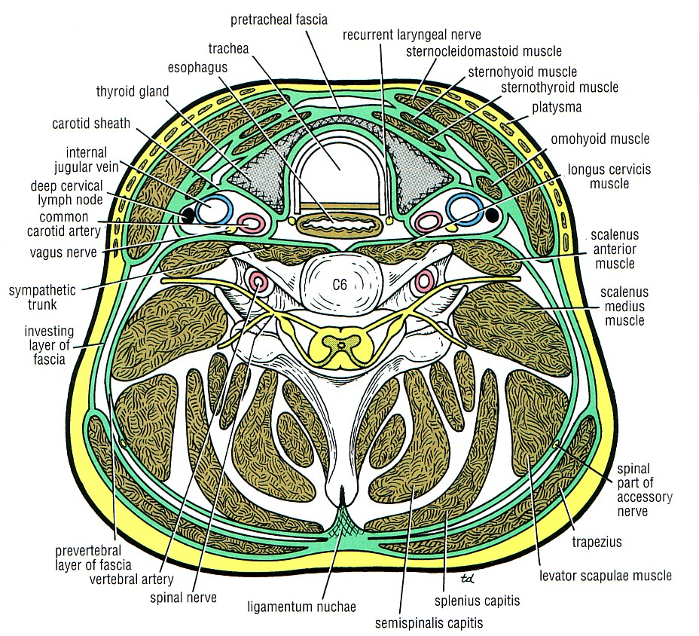
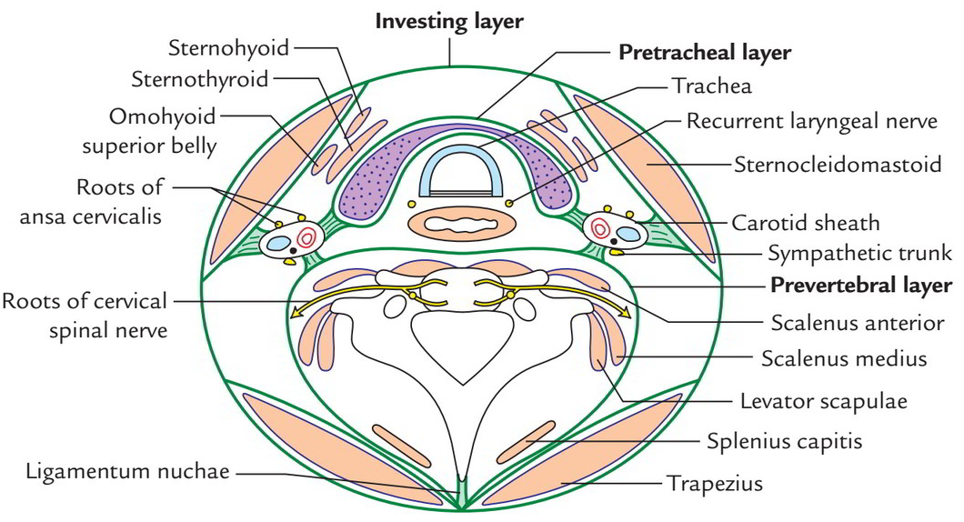
Parts of the deep cervical fascia of the neck
It is divided mainly into 3 layers (or more) important during surgeries:
Investing layer (covers neck completely)
Pretracheal layer (covers thyroid gland and trachea)
Prevertebral layer (surrounds vertebra & prevretbral muscles).
The carotid sheath is part of the deep cervical fascia of the neck
Note:
At the 4 the corners of the neck, the investing layer separates to form two layers (anterior and posterior layers) to cover the sternocleidomastoid muscle in the anterolateral corner and trapezius muscle in the posterolateral corner

Slide 4
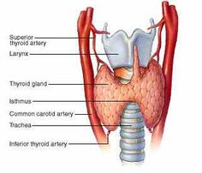
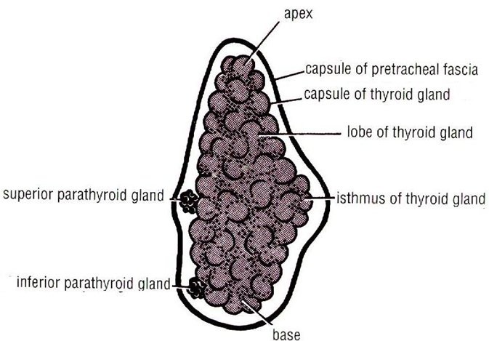
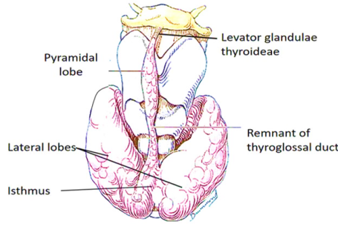
Thyroid Gland"الغدة الدرقية"
Endocrine, butterfly shaped gland, Consists of right & left lobes connected to each other by a narrow isthmus, which overlies the 2nd ,3rd & 4th tracheal rings.
The gland is surrounded by a facial sheath derived from the pretracheal layer of the deep cervical fascia, what is the clinical importance?*
Each lobe is pear- shaped, its apex reaches up to the oblique line of thyroid cartilage
Its base lies at the level of 4th or 5th tracheal rings (remember trachea has 16-20 rings)
A 3rd small pyramidal lobe is often present which projects from the upper border of the isthmus usually to left of middle line, its connected to hyoid bone by a fibrous or muscular band called levator glandulae thyroideae
This lobe represents in 50% of people the fibrosed & obliterated
thyroglossal duct It is surrounded by a facial sheath derived from the
pretracheal layer of the deep cervical fascia, inside it there is another C.T capsule
So, it s surrounded by 2 membranes
pyramidal lobe
*تقدر تعرف اذا التيومر داخل الغدة الدرقية او خارجها, تقول للمريض يبلع ريقه لو التيومر يطلع وينزل اثناء البلع معناها انه داخل الغدة ( لان اللاينركس يطلع وينزل اثناء البلع)

Slide 5
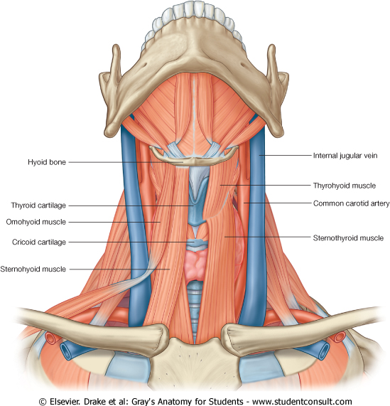
Omohyoid > the prefix “omo” means shoulder
*There are:
Superior belly of omohyoid > from hyoid bone
Inferior belly of omohyoid > from scapula
Connected to each other by a common tendon
Thyroid Gland
Relations
02:05
Anterolaterally | Posteriorly | Medially
4s Sternothyroid Sternohyoid Superior belly of omohyoid* Sternomastoid (most superficial) | Carotid sheath & its contents (common carotid artery, Internal carotid artery, internal jugular vein and vagus nerve) | Above | Below
 |  | Larynx Pharynx | Trachea Esophagus Recurrent laryngeal nerve in between trachea and esophagus Cricothyroid muscle External laryngeal nerve
Rounded posterior border
Superior parathyroid glands Anastomosis between superior thyroid arteries Inferior parathyroid glands Anastomosis between inferior thyroid arteries
Sternothyroid, sternohyoid, superior belly of omohyoid and thyrohyoid are called “strap muscles” or “infrahyoid muscles” which keep the neck structures in position.

Slide 6
Thyroid Gland
Supply
Arterial supply
Superior thyroid artery | It is the 1st branch of the external carotid artery It descends to the upper pole of the lobe, with the external laryngeal nerve It runs along the upper border of the isthmus to anastomosis with its fellow
Thyroidea ima artery | If present, it arises from aortic arch or from brachiocephalic artery, It ascends in front of the trachea to reach the isthmus. This artery might get damaged during tracheostomy tube insertion.
Inferior thyroid artery | From the thyrocervical trunk of 1st part of subclavian artery, It ascends behind the gland to the level of cricoid cartilage (C6) Then it curves medially behind the carotid sheath Then it reaches the posterior aspect of the gland & descends downwards The recurrent laryngeal nerve crosses either in front or behind it

Slide 7
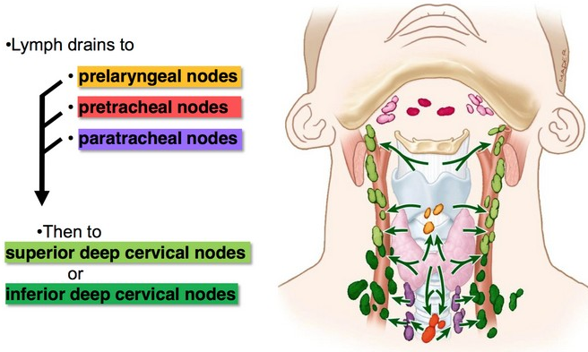
Thyroid Gland
Supply
Veins drainage
Superior thyroid vein | Drains into → Internal jugular vein
Middle thyroid vein | Drains into → Internal jugular vein
Inferior thyroid vein | Drains into → Left brachiocephalic vein
Lymph drainage
Deep cervical & paratracheal lymph nodes
Innervation(autonomic)
Sympathetic | Cervical Sympathetic Trunk
Parasympathetic | Branches of vagus nerve

Slide 8
Only in boys slides
Larynx
Supply
- All intrinsic muscles, are supplied by the recurrent laryngeal nerve of vagus nerve except cricothyroid.
The cricothyroid is supplied by external laryngeal of superior laryngeal of vagus.
Motor
Sensory
Above the vocal cords : Internal laryngeal nerve, of superior laryngeal of the vagus nerve.
- Below the vocal cords: Recurrent laryngeal nerve, of the vagus nerve.
Upper half
- Superior laryngeal artery, branch of superior thyroid artery
Lower half
- Inferior laryngeal artery, branch of inferior thyroid artery
- Accompany the corresponding arteries
- The lymph vessels drain into the deep cervical lymph nodes.

Slide 9
Clinical importance
Superior thyroid artery
The external laryngeal nerve runs close to the superior thyroid artery before turning medially to supply the cricothyroid muscle.
High ligation of the superior thyroid artery during thyroidectomy places this nerve at risk of injury.
So it should be ligated within the upper pole of the thyroid gland.
Its lesion will cause horsiness of voice.
Inferior thyroid artery
The inferior thyroid artery is closely associated with the recurrent laryngeal nerve.
This nerve can be found, in a triangle bounded laterally by the common carotid artery, medially by the trachea, and superiorly by the base of thyroid lobe.
The relationship of the recurrent laryngeal nerve and the inferior thyroid artery is highly variable in that the nerve can lie deep or superficial to the artery, or between the branches of the artery, and be different on either side of the neck.
So hight consideration of this nerve and its branches must be given during thyroidectomy as its lesion may results in impaired breathing & speech.

Slide 10
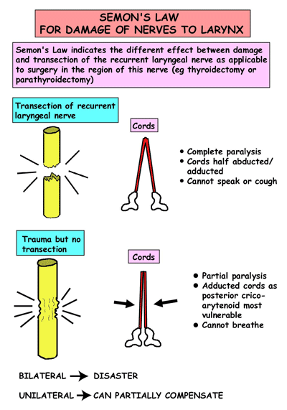
Semon’s law (damage of the laryngeal nerves)
Semon’s Law indicates the different effect between minor damage (surgical trauma) & complete transection of the recurrent laryngeal nerve due to surgery in region of the neck (e.g. thyroidectomy or parathyroidectomy)
But can breath.

Slide 11
Parathyroid Gland"الغدة الجار درقية"
4 small ovoid bodies, about 6 mm long
They lie within the facial capsule of the gland, (between the 2 membranes) (to be more specific, the are between the pretracheal fascia and the fibrous capsule)
2 superior parathyroid has a constant position at the middle of the posterior border of the thyroid gland.
2 inferior parathyroid usually at the level of the inferior pole.
They lie within the thyroid tissue or sometimes outside the facial capsule.
SUPPLY
Arterial | Superior thyroid arteries | Inferior thyroid arteries.
Veins drainage | Superior thyroid veins | Middle thyroid veins | Inferior thyroid veins
Lymph drainage | Deep cervical lymph nodes | Paratracheal lymph nodes
Nerve supply Sympathetic Trunk | Superior cervical sympathetic ganglia (vasomotor) Middle cervical sympathetic ganglia (vasomotor)
Same as thyroid gland

Slide 12
You can skip this slide:
The 1st groove gives the external acoustic meatus
The 1st pouch gives the auditory tube
Together they give the air drum
The 2nd pouch gives the palatine tonsil
The 2nd arch gives the smooth contour of the neck( an anomaly here can cause cyst or sinus)
The 3rd pouch and the 4th pouch are explained later.
The mesoderm of each arch will have a nerve and an artery and also will give derivates ( bone, muscle, cartilage)
The 1st arch gives the 4 muscles of mastication, that’s why the nerve supply for all of them is mandibular nerve.
The 2nd arch gives the muscles of the face ( nerve supply is facial nerve)
The 3rd arch gives stylopharyngeus (glossopharyngeal nerve)
The 4th arch gives cricothyroid (external laryngeal)
The 6th arch gives all the muscles of larynx except cricothyroid

Slide 13
SUMMARY
 | Thyroid Gland |  |  |  | Parathyroid Gland
Notes | Consists of 2 lobes, and each lobe has an apex and base (level of 4th or 5th tracheal rings) The 2 lobes are connected by a narrow isthmus which extends in front of 2nd , 3rd , and 4th tracheal rings. The gland is surrounded by a CT capsule and a pretracheal layer of deep cervical fascia. |  |  |  | 4 ovoid bodies lie within facial capsule between the 2 membranes
Relations | Anterolaterally | Posteriorly | Medially
 |  |  | Above | Below
 | Sternohyoid Sternothyroid Superior belly of omohyoid Sternomastoid | Carotid sheath & its contents | Larynx pharynx | Trachea Esophagus. Recurrent laryngeal nerve. Cricothyroid muscle. External laryngeal nerve.
Arterial | Superior, and inferior thyroid artery, and thyroidea ima artery |  |  |  | Superior and inferior thyroid artery
Venous | Superior, middle and inferior thyroid veins
Lymphatic | Deep cervical and paratracheal lymph nodes
Innervation | Sympathetic: cervical sympathetic trunk Parasympathetic: branches of vagus |  |  |  | Superior & middle cervical sympathetic ganglia

Slide 14
1- Which of the following arteries is crossed by the recurrent laryngeal?
A- superior thyroid
B- inferior thyroid
C- thyroidea ima artery
D- none of the above
2- Which on of the following is related to the thyroid gland medially but from above?
A- larynx
B- trachea
C- esophagus
D- sternohyoid
3- A surgeon is performing a thyroidectomy on a patient with graves disease and He accidentally ruptured the superior thyroid artery. which of the following nerves is the most susceptible to injury?
A- recurrent laryngeal
B- external laryngeal
C-phrenic nerve
D- none are susceptible
4- Which of the following is branch of the thyrocervical artery?
A-external carotid
B-thyroidea ima artery
C-superior thyroid
D-Inferior thyroid
5- Which of the following structures lies anterior to the thyroid lobe?
A- Inferior belly of omohyoid.
B- Internal jugular vein.
C- Vagus nerve.
D- Sternohyoid.
1. B 2. A 3.B 4.D 5.D

