Slide 2
Objectives
At the end of the lecture, students should be able to:
Location, shape and relations of the right and left adrenal glands.
Blood supply, lymphatic drainage and nerve supply of right and left adrenal glands.
Parts of adrenal glands and function of each part.

Slide 3
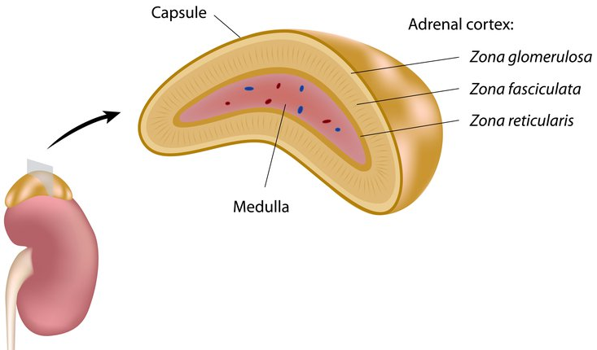
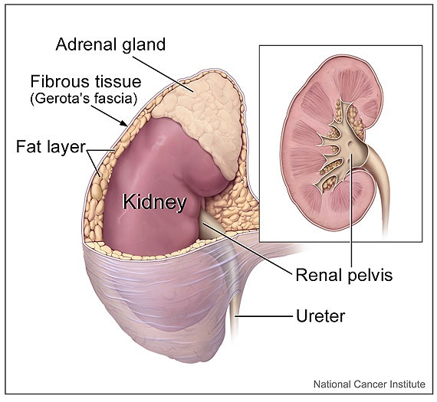
Suprarenal Gland = Adrenal gland "الغدة الكظرية"
The suprarenal (adrenal) gland is a component of the hypothalamic-pituitary-suprarenal axis also called “stressed axis” that is responsible for coordinating stress response and metabolism.
They are yellowish retroperitoneal¹ organs that lie on the upper poles of the kidneys, At the level of the last thoracic vertebra (T12) The kidney extends from T12 to L3.
Each gland has an outer yellow cortex and an inner dark brown medulla.
The suprarenal gland is enclosed within the renal fascia with the kidney but in a separate compartment, that allow the two organs to be separated easily during surgery .
It is separated from the kidney by the perirenal fat²
Cortex
1- Retroperitoneal: lying posterior to the peritoneum (covers it anteriorly only)
2- Recall the kidney is covered by 4 layers: capsule, perirenal fat, renal fascia, pararenal fat.
Renal fascia

Slide 4
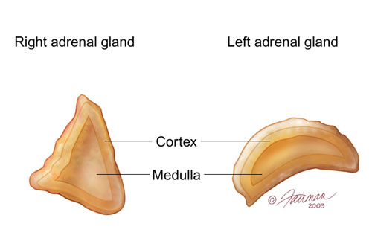
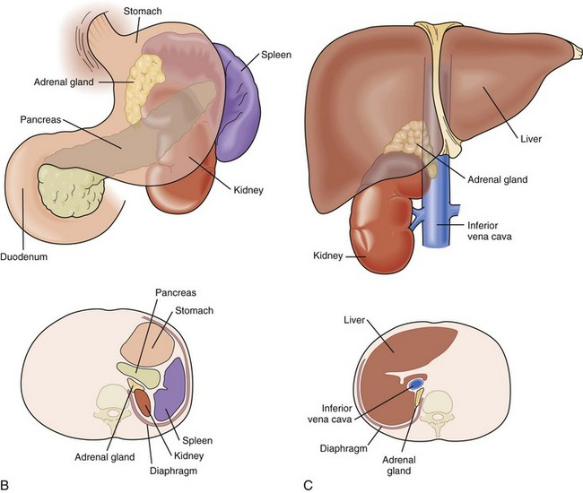
Right & left Suprarenal Gland
 |  | Right Suprarenal Gland | Left Suprarenal Gland
Shape |  | Pyramidal or triangular shape | Crescentic or semilunar shape
Location |  | Caps the upper pole of the right kidney So it is at the level of t12 | Extends along the medial border of the left kidney from the upper pole to the hilum Its level is from T12 to L2
Relations | Anterior | Right lobe of liver Inferior vena cava | Pancreas Lesser sac Stomach
 | Posterior | Diaphragm
 | Medial | Celiac plexus Ganglia .

Slide 5
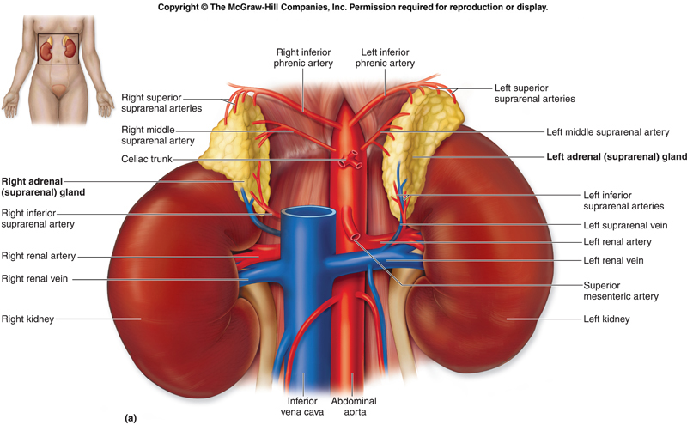
Suprarenal Gland
Supply
Arterial: The arteries supplying each gland are three in number:
Superior suprarenal from inferior phrenic artery. Middle suprarenal from abdominal aorta. Inferior suprarenal from renal artery.
Venous drainage: A single vein (adrenal vein) emerges from the hilum of each gland and drains into :
The inferior vena cava (directly¹) on the right side. The left renal vein (then to the IVC) on the left side 1- Because the IVC located to the right of the midline its directly
Nerve supply | Preganglionic sympathetic fibers derived from the splanchnic nerves supply the glands Most of the nerves (postganglionic) end in the medulla of the gland.
Lymph drainage | The lymph drains into the lateral aortic² lymph nodes. 2- Also called paraaortic or lumbar lymph nodes.
*The inferior phrenic and renal arteries are branches of the abdominal aorta.
REMEMBER!
Right adrenal vein → IVC
Left adrenal vein → left renal vein → IVC

Slide 6
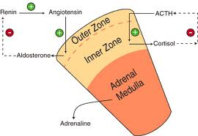
Suprarenal Gland
Function
The Cortex of the suprarenal glands secretes hormones that include: related to metabolism.
Mineral corticoids, which are concerned with the control of fluid & electrolyte balance
Glucocorticoids, which are concerned with the control of the metabolism of carbohydrates, fats, and proteins
Small amounts of Sex hormones, which probably play a role in the prepubertal development of the sex organs.
The Medulla (related to stress) of the suprarenal glands secretes the catecholamines: epinephrine & norepinephrine.

Slide 7
SUMMARY
Adrenal gland
retroperitoneal. At the level of the last thoracic vertebra (T12). Enclosed within the renal fascia.
 | Right suprarenal gland |  | Left suprarenal gland
Shape | Pyramidal |  | Crescentic
Location | Caps upper pole of the right kidney |  | Along the medial border from upper pole to hilus
Relation | Anterior | right lobe of liver IVC | Pancreas Lesser sac Stomach
 | Posterior | diaphragm
 | inferior | celiac plexus & ganglia
Blood supply | Superior suprarenal from inferior phrenic artery. Middle suprarenal from abdominal aorta Inferior suprarenal from renal artery.
Lymph drainage | Lateral aortic lymph nodes.
Venous drainage | Right adrenal vein drain into IVC |  | Left adrenal vein drain into left renal vein
Nerve supply | Preganglionic sympathetic fibers from splanchnic nerve

Slide 8
1. The hypothalamic-­‐pituitary-­‐ suprarenal axis is responsible for:
Control stress
Control stress and metabolism
Control lipid digestion
2. The suprarenal gland is:
Yellowish retroperitoneal
Reddish retroperitoneal
Brown retroperitoneal
3. The suprarenal gland is at the level of:
T11
T12
L1
4. The supra renal gland is separated from the kidney by:
Adrenal fascia
Perirenal fat
Peritoneal fat
5. The right supra renal gland is:
Crescentic in shape
Circular in shape
Pyramidal in shape
6. Which of the following is anterior to the Right supra renal :
Inferior vena cava
Diaphragm
Celiac plexus
7. Which of the following play a role in the prepubertal development of sex organs?
Mineral corticoids
Glucocorticoids
Sex hormones
8. Nerve fibers that are supplying the adrenal gland are :
Preganglionic sympathetic
Postganglionic sympathetic
Preganglionic parasympathetic
9. Superior suprarenal artery is a branch of?
Superior phrenic artery
Inferior phrenic artery
Abdominal aorta
10. A lesion in the left renal vein may affect which of the following vinous drainage :
Left suprarenal gland
Right suprarenal gland
Both
1. B 2. A 3.B 4.B 5.C 6.A 7.C 8.A 9.B 10.A

