Slide 3
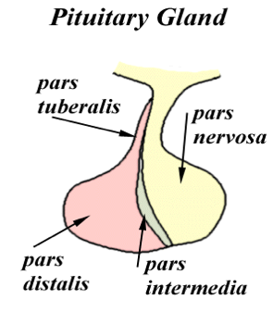
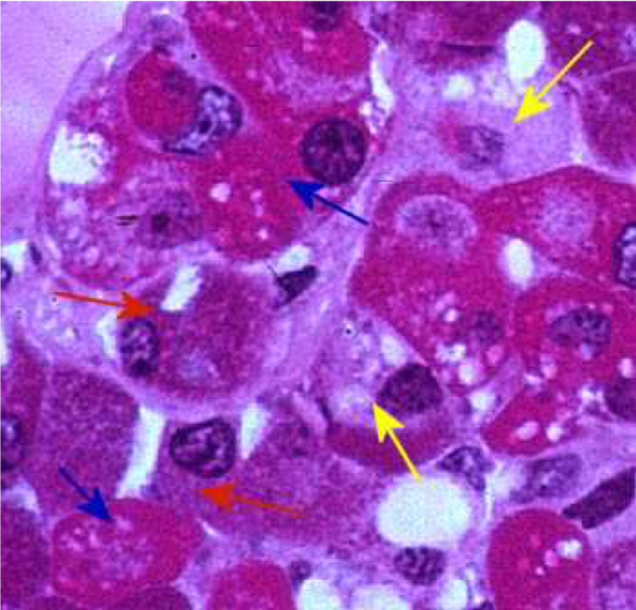
Components of pituitary gland:
I- Adenohypophysis Cerebri
1- Pars Distalis (pars anterior): Types of parenchymal cells: Chromophils: Acidophils: Somatotrophs (GH cells). Growth hormone Mammotrophs (Prolactin cells):Increase during lactation. Milk formation hormone Basophils: Thyrotrophs (TSH Cells). Thyroid stimulated hormone Corticotrophs (ACTH cells). Adrenocorticotropic hormone Gonadotrophs (Gonadotropic cells) (FSH, LH). Chromophobes, may represent: stem cells. degranulated chromophils. degenerated cells.
2- pars Tuberalis
3- Pars Intermedia
Luteinizing hormone (LH)
Follicle Stimulating Hormones (FSH)
Blue arrow: acidophils
Red arrow: basophils
Yellow arrow: chromophobes

Slide 4
II- Neurohypophysis Cerebri
1- Median eminence
2- Infundibulum: Neural (Infundibular) Stalk (stem)
3- Pars Nervosa: Components: Unmyelinated axons of secretory neurons situated in supraoptic & paraventricular nuclei (i.e. Axons of hypothalamohypophyseal tract) Function: Storage & release of: Vasopressin (ADH); by supraoptic nuclei Oxytocin; by paraventricular nuclei Fenestrated blood capillaries with diaphragm Herring bodies Are distentions of the axons in p. nervosa. Representing accumulation of neurosecretory granules at axon termini and along the length of the axons in p. nervosa. Oxytocin and ADH hormone is stored in Herring bodies Pitucytes: are glial-like cells in p. nervosa. Structure: Have numerous cytoplasmic processes. Functions: Support the axons of the p. nervosa. N.B. No secretory or neuronal cells in pars nervosa
Oxytocin work in mammary gland for milk ejection (by contraction of myoepithelial cell that located around the acini)

Slide 5
Q1: Which one of the following is Acidophils Chromophils?
a) Thyrotrophs b) Somatotrophs c) Gonadotrophs d) Corticotrophs
Q2: which of the following contains TSH cells ?
a) Thyrotrophs b) Somatotrophs c) Gonadotrophs d) Corticotrophs
Q3: Corticotrophs contains which cells ?
a) ACTH cells. b) TSH cells. c) GH cells. d) Prolactin cells
Q4: Which cells are present in pars nervosa?
a) Secretory cells b) Glial-like cells c) Neuronal cells d) All of them
Q5: The axons of hypothalamohypophyseal tract are situated in?
a) Supraoptic nucleus b)Suprachiasmatic nucleus c) Dorsomedial nucleus d) Lateral preoptic nucleus
Q6: Which of the following is the type of capillaries in pars nervosa?
a) Continuous capillaries b)Discontinuous capillaries c) Fenestrated capillaries d) Non-fenestrated capillaries
1- B
2- A
3- A
4- B
5- A
6- c

