Slide 3
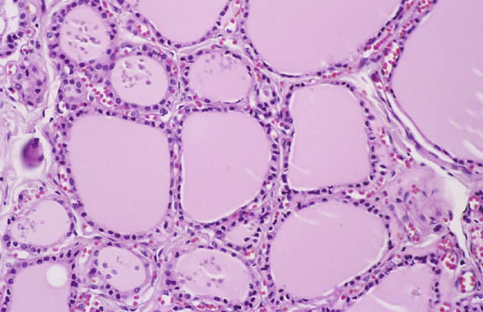
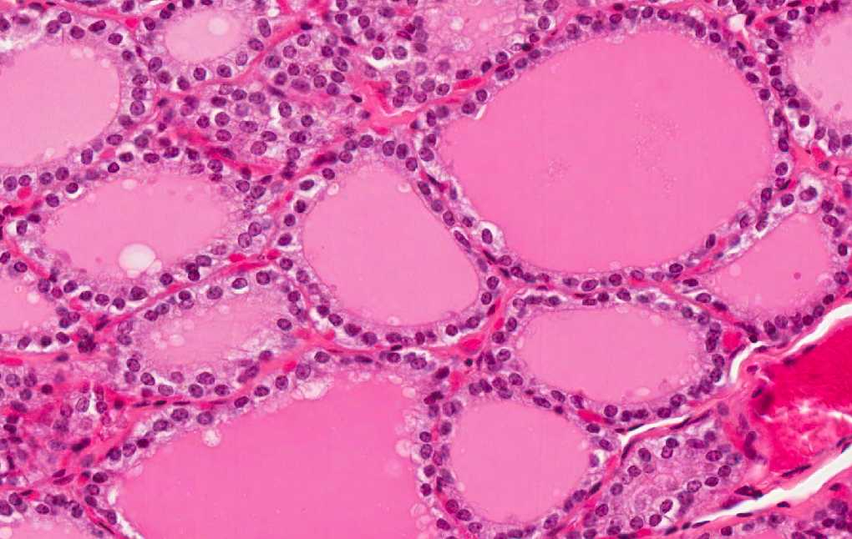
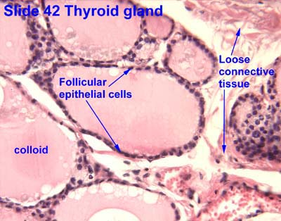
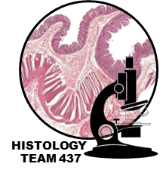
Thyroid Gland
THYROID GLAND
PARENCHYMA | STROMA
THYROID FOLLICLES: Are the structural and functional units of the thyroid gland. L/M: 1- Simple cuboidal epithelium: a- Follicular cells. b- Parafollicular cells. 2- Colloid: central colloid-filled lumen. Acidophil gel like material N.B. Each follicle is surrounded by thin basal lamina. | 1- Capsule: dense irregular collagenous C.T. 2- Septa (Interlobular septa) 3- Reticular fibers: Thin C.T., composed mostly of reticular fibers with rich capillary plexus surrounds each thyroid follicle. Highly vascular to supply the gland with amino acids and Iodine
Parafollicular cells
Follicular cells
Colloid

Slide 4
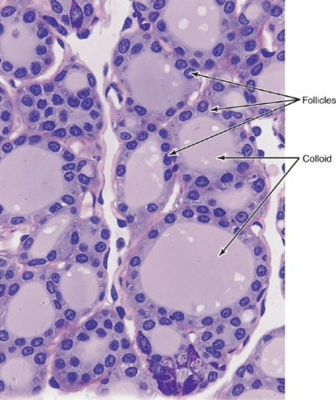
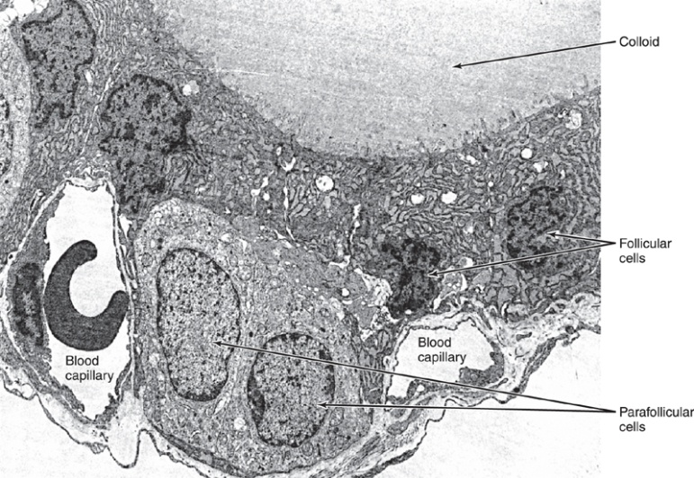
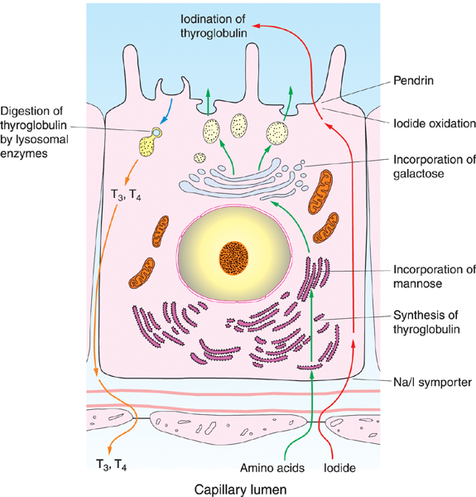
PARAFOLLICULAR CELLS (CLEAR CELLS) (C-CELLS) 0.1% of the cells | FOLLICULAR (PRINCIPAL) CELLS 99.9% of the cells
Pale-stained cells (Clear Cells). Are found singly or in clusters in between the follicular cells. Their apices do not reach the lumen of the lumen of the follicle. Are larger than follicular cells (2-3 times). Only 0.1% of the epithelial cells. Have round nucleus | -Simple cuboidal cells -Round nucleus with prominent nucleoli. -Basophilic cytoplasm. -Apical surface reaches the lumen of the thyroid follicle. | L/M
Mitochondria. RER (moderate). Well-developed Golgi. | - Mitochondria. - RER synthesis of thyroglobulin - Supranuclear Golgi Complex. - Numerous apically-located lysosomes. Numerous dispersed small vesicles: contain newly formed thyroglobulin. - Numerous apical short microvilli. | E/M
Secrete calcitonin. | Synthesis of thyroid hormones (T4 & T3) | Function
Lysosomes are important because it has peroxidase enzyme which convert reduced iodine to Iodine
The secretory vesicles are Apical in thyroid gland and basal in parathyroid
Calcitonin works with parathyroid hormone to balance the level of Ca++ in the blood

Slide 5
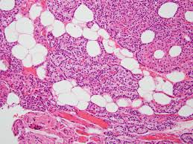
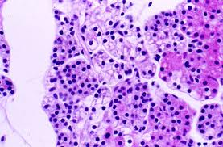
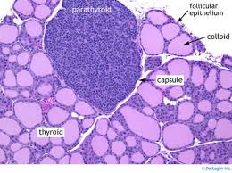
Parathyroid Glands
They are 4 glands on the posterior of thyroid gland.
Parenchyma |  | Stroma
The parenchyma is formed of cords or clusters of epithelial cells (chief cells & oxyphil cell) with blood capillaries in between. These cells are surrounded by reticular fibers. |  | 1- Capsule: Each gland has its Thin capsule. 2- Septa: thin. 3- Reticular C.T. C.T. stroma in older adults often contains many adipose cells. Adipose cells may increase with age
Oxyphil cells | Chief cells
- They are arranged in groups or clusters or as isolated cells. - They are deep eosinophilic (acidophilic) - They have more numerous mitochondria - They are less numerous but larger than chief cells. - They are of unknown function N.B. They may be inactivated chief cells. | - are slightly eosinophilic. - are rich in rER. They secrete parathyroid hormone( blood calcium).

Slide 6
QUESTIONS:
Q1: What is the epithelium of thyroid follicles?
A) Simple columnar epithelium B) Simple squamous epithelium
C) Simple cuboidal epithelium D) Simple stratified epithelium
Q2: What type of cells is responsible for the secretion of T4 & T3?
A) Clear cells B) Principal cells C) Both of them D) None of them
Q3: What is the structure whose apices do NOT reach the follicle lumen?
A) Capsule B) Follicular cells C) Parafollicular cells D) None
Q4: What are the cells that can be found singly or in clusters?
A) Clear cells B) Principal cells C) None D) All of them
Q5: Which part of thyroid gland stroma, is thin CT with rich capillary plexus?
Septa B) capsule C) reticular fibers D) none
Q6: What is the cell responsible for the secretion of Calcitonin?
A) follicular cells B) parafollicular cells C) All of them D) none
1- C
2- B
3- C
4- A
5- C
6- B

Slide 7
Q7: Which one of the following produce parathyroid hormone?
‏A) Follicular cells B) Parafollicular cell C) chief cells D) oxyphill cells
Q8: Which of the following is a Characteristic of oxyphil cells?
A) Rich in rER B) abundant mitochondria
C) smaller than chief cells D) slightly eosinophilic
Q9: Which of the following is a Characteristic of chief cells?
A) Rich in rER B) abundant mitochondria C) basophilic D) All of them
Q10: Which of the following is not a histological structure found in parathyroid gland?
A) Chief cells B) colloid C) reticular fibers D) oxyphil cells
Q11: Which cell has an un-known function and has numerous mitochondria?
A) Follicular cells B) Parafollicular cell C) chief cells D) oxyphill cells
7- C
8- B
9- A
10- B
11- D

