Slide 3
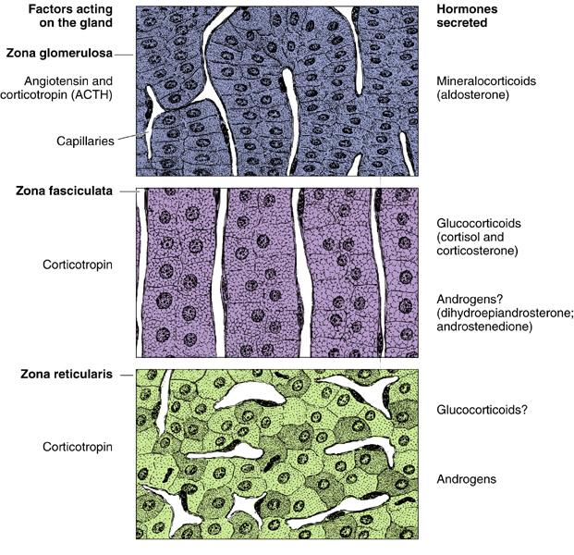
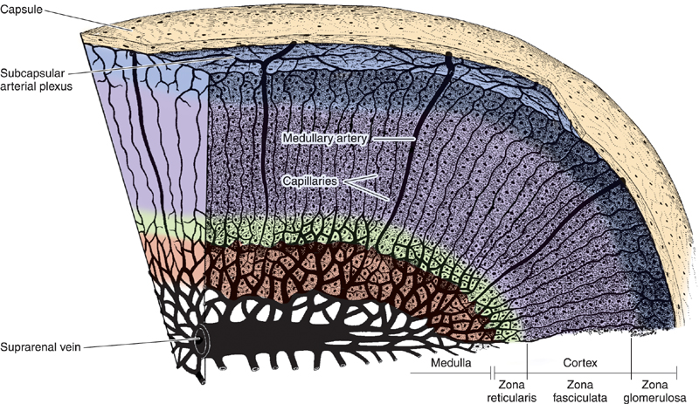
formed of:
Stroma
Parenchyma
Medulla
Cortex
Zona glomerulosa
Zona fasciculata
Zona reticularis
Adrenal gland
Outmost layer, named glomerulosa because it looks like glomerulus under the microscope.
Develop from mesoderm
Fasciculata = column
Develop from ectoderm
The adrenal cortex layers have 5 features in common:
1- Acidophilic cytoplasm
2- Abundant SER
3- Numerous mitochondria
4- Mitochondrial cristae is tubular
5- Droplet of lipids

Slide 4
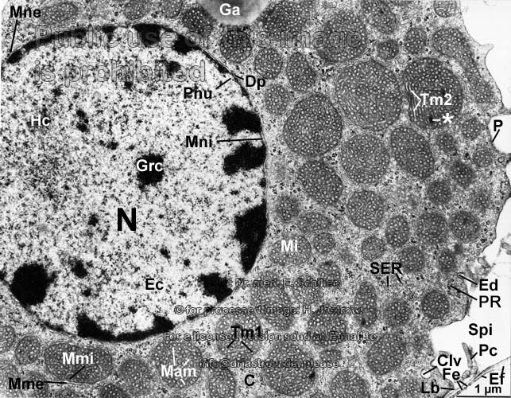
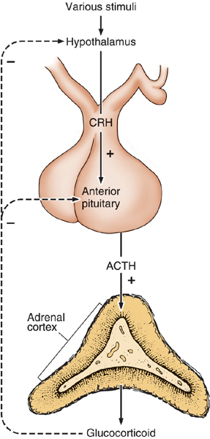
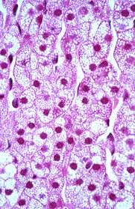
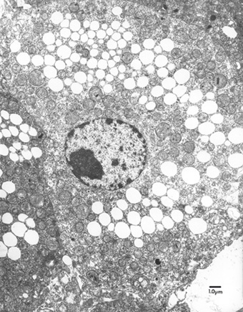
Adrenal Cortex
zona reticularis | zona fasciculata (spongiocytes) | zona glomerulosa
It is the innermost layer of adrenal cortex. It is formed of anastomosing cords of deep acidophilic cells. Its cells contains few lipofuscin and lipid droplets. The cells secrete androgens. | It is the intermediate and the largest layer of the cortex. It is formed of columns of large polyhedral cells that are separated by longitudinal sinusoidal capillaries. Its cells are rich in lipids so they appear empty in sections (spongiocytes). Its cells are rich in mitochondria (with tubular cristae),SER and lipofuscin pigments. Its cells secrete glucocoticoids. It is regulated by ACTH of pituitary. | Is formed of clusters of small columnar cells that are rich in SER and mitochondria. Produces mineralocorticoids e.g. aldosterone hormone (Reabsorb all the remaining sodium, and passively the chloride, from the lumen of the distal renal tubules into the renal interstitium. In addition, potassium and hydrogen ions are actively secreted into the lumen).
ACTH hormone act on all three layers of the adrenal cortex But does not cause an effect on the medulla
E/M of spongiocytes

Slide 5
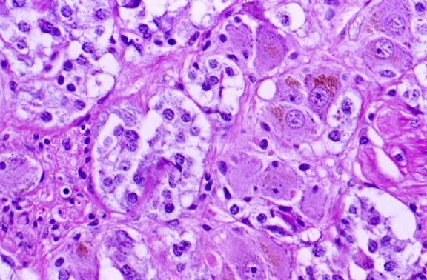
Adrenal Medulla
It is the central portion of the adrenal gland.
It is completely invested with adrenal cortex (Not separated from it by CT. septa)
It contains:
Chromaffin cells (Pheochromocytes):
- Contains granules of catecholamine as that of sympathetic nervous system.
- (They produce epinephrine and norepinephrine).
- They stain deep brown with chromic salts.
Sympathetic ganglion cells:
- Are sympathetic nerve cells
- Relay on chromaffin cells
NEURONS IN ADRENAL MEDULLA

Slide 6
QUESTIONS:
Q1: which of the following is the innermost layer of adrenal cortex?
a) Zona Glomerulosa b) Zona Fasciculata c) Zona Reticularis d) Chromaffin cells
Q2: which of the following structure separates spingiocyts from each others?
a) Adrenal capsule b) Dense connective tissue c) Sinusoidal capillaries d) It’s not separated
Q3: Which of the following is true about zona glomerulosa:
a) Clusters of small cuboidal cells, rich in SER c) Clusters of small cuboidal cells, rich in RER b) Clusters of small columnar cells, rich in SER d) Clusters of small columnar cells, rich in RER
Q4: which of the following is formed of columns of large polyhedral cells?
a) Zona Glomerulosa b) Zona Fasciculata c) Zona Reticularis d) Non of them
Q5: which of the following is produced by Chromaffin cells:
a) glucocorticoids b) Mineralocorticoids c) epinephrine d) Androgens
Q6: what is the thickest layer of adrenal cortex is:
a) Zona Glomerulosa b) Zona Fasciculata c) Zona Reticularis d) capsule
1- C
2- C
3- B
4- B
5- C
6- B

