Slide 3
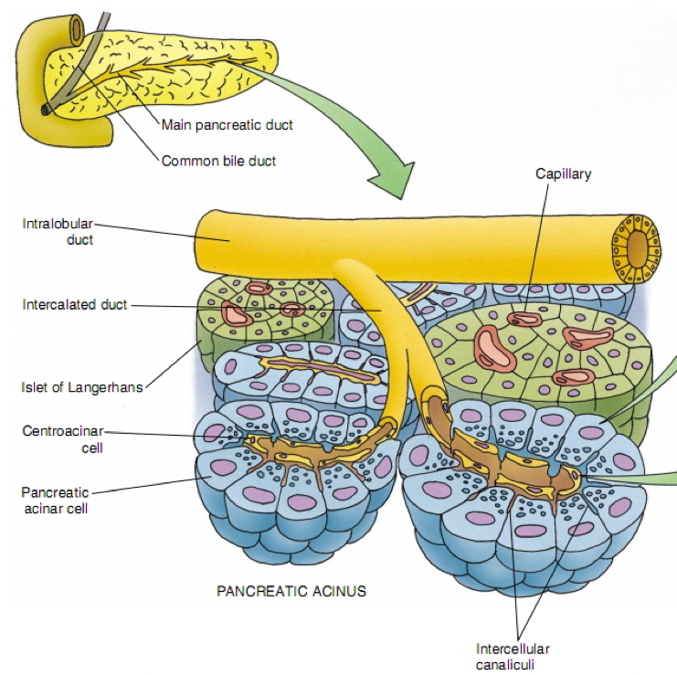
PANCREAS
Stroma
Parenchyma
capsule, septa & reticular fibers.
Pancreas is a mixed gland:
Exocrine part (acini & ducts): produces digestive pancreatic enzymes.
Endocrine part (islets of Langerhans): produces hormones.

Slide 4
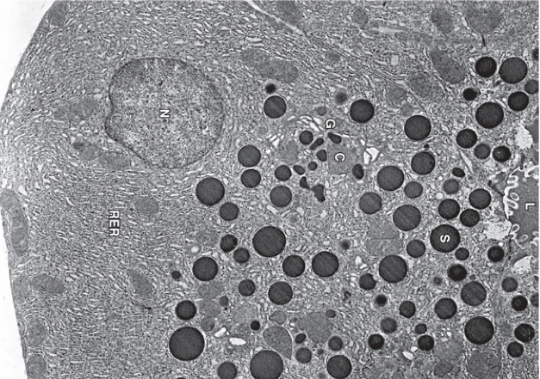
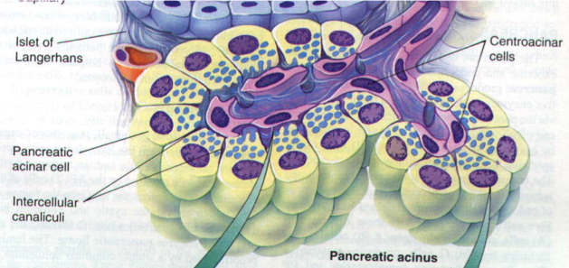
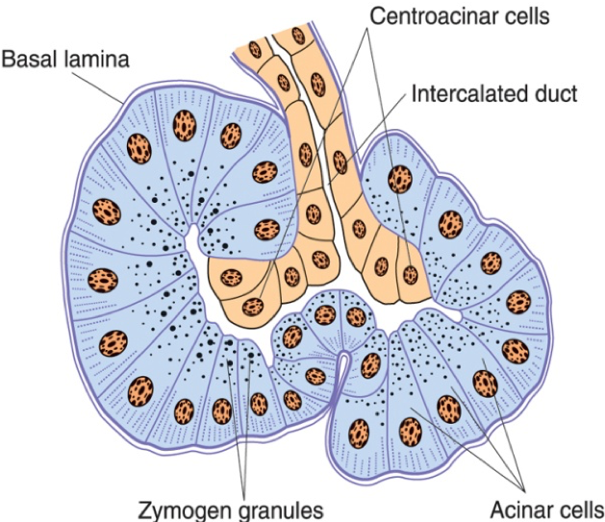
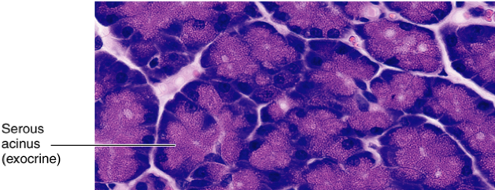
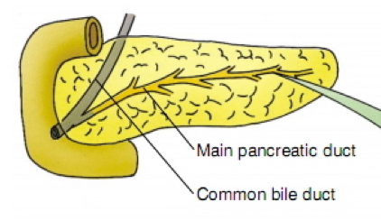
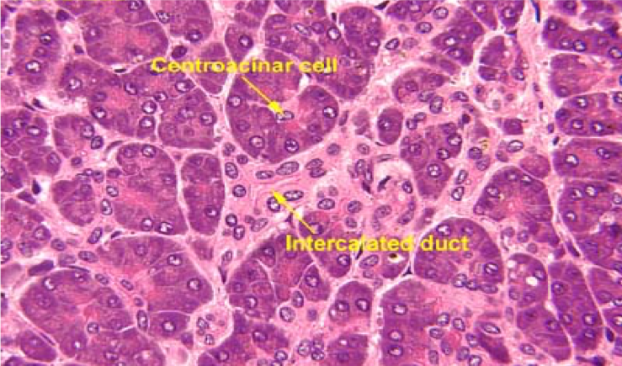
Exocrine Pancreas
Pancreatic Acini | Pancreatic Acinar Cells | Duct System
They are serous acini: secreting a thin fluid rich in digestive pancreatic enzymes. Centroacinar cells: Their nuclei appear in the center of the acini. They represent the beginning of the ducts. No myoepithelial cells around the acini. | Pyramidal in shape. Nuclei are basal. Cytoplasm: Basal part Basophilic (due to abundant rER). Apical part Acidophilic (due to secretory granules). | Centroacinar cells. Intercalated ducts (low cuboidal). Intralobular ducts (NOT prominent).in parotid gland Intralobular ducts is prominent Interlobular ducts. Main pancreatic duct.

Slide 5
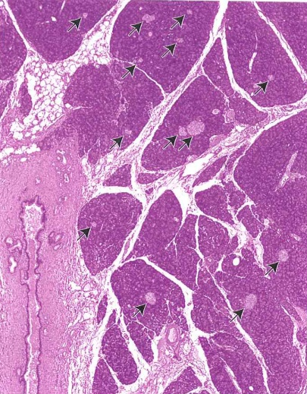
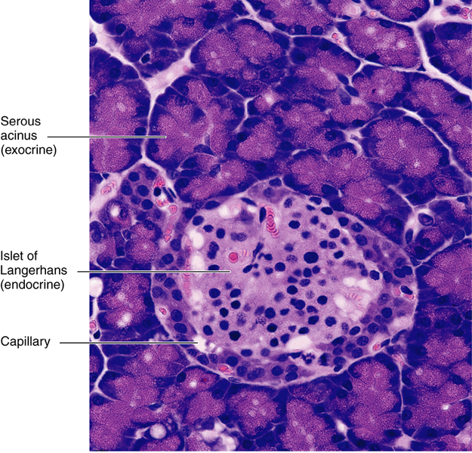
Endocrine Pancreas
Islets of Langerhans:
Pale-staining spherical collections of endocrine cells, scattered among the acini.
Richly vascularized by fenestrated capillaries.
Each islet is surrounded and supported by reticular fibers.
1 million islets in human pancreas.
Most numerous in the tail of pancreas.
Cells of the Islets:
5 types of cells in each islet
Cannot be differentiated from one another by routine stains.
We can differentiated Between 5 cell by immune stain
β (B) cells | α (A) cells | δ (D) cells | G cells | PP cells
Constitute 70% of islet cells. Concentrated in islet center. Function: secrete insulin which ↓ blood sugar. | Constitute 15-20%. Concentrated in islet periphery. Granules are much more numerous, more tightly packed, smaller, and denser than those of β cells. Function: secrete glucagon which ↑ blood sugar. | Constitute 5-10% Scattered throughout the islet. Granules are less dense than those of β and α cells. Function: secrete somatostatin which ↓ release of hormones from endocrine pancreas and enzymes from exocrine pancreas. | Constitute 1% of islet cells. Scattered throughout the islet. Function: secrete gastrin which ↑ production of HCl by parietal cells of the stomach. | Constitute 1% of islet cells. Scattered throughout the islet. Function: secrete pancreatic polypeptide which ↓ exocrine secretions of pancreas.

Slide 6
Q1:wher is the most of Islets of Langerhans located in?
A) tail B) body C) head
Q2: which cell is secrete gastrin?
Α) α B) β C) G
Q3: which hormones that secreted by δ cells ?
A) somatostatin B) insulin C) pancreatic polypeptide
Q4: Exocrine part produces.....?
A) hormones B) digestive enzymes C) mucus
Q5: which type of Acini located in pancreas?
A) serous acini B)mucus acini C) Mucoserous (Mixed) Acini
Q6: Which cell of the following is the most numerous in islets of Langerhans?
Α) α B) β C) G
1-A
2-C
3-A
4-B
5-A
6-B

