Slide 1
Hyperthyroidism
Objectives:
1- Describe different classes of drugs used in hyperthyroidism and their mechanism of action.
2- Understand their pharmacological effects, clinical uses and adverse effects.
3- Recognize treatment of special cases such as hyperthyroidism during pregnancy, Graves' disease and thyroid storm.
Color index: Important Note Extra
Editing File

Slide 2
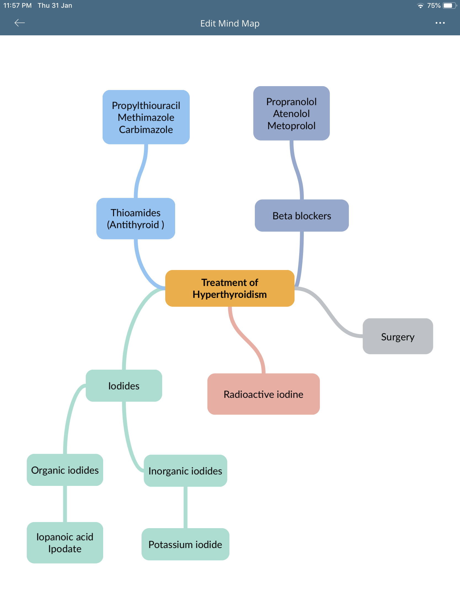
Mind Map
Introduction
Thyroid function
Normal amount of thyroid hormones are essential for normal growth and development by maintaining the level of energy metabolism in the tissue.
Either too little or too much thyroid hormones will bring disorders to the body.
-Important functions are:
Growth & development, especially in the embryo & brain
Thermoregulation: increase basal metabolic rate (BMR)
Helps maintain metabolic energy balance
CVS: increase heart rate & cardiac output which increase oxygen demand

Slide 3
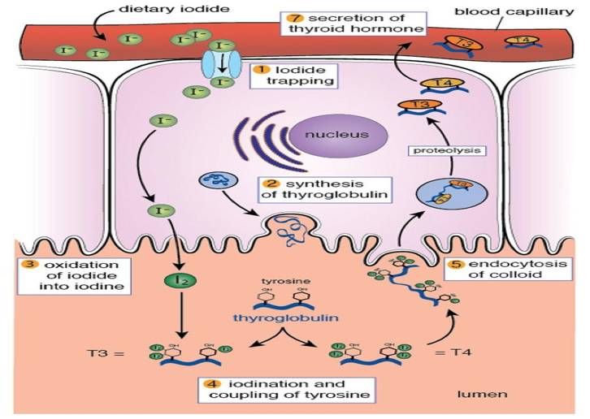
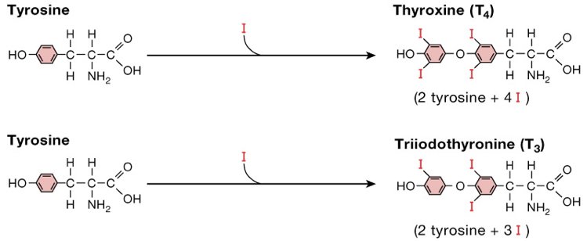
Iodine Importance\metabolism:
Thyroid hormones are unique biological molecules in that they incorporate iodine in their structure
Adequate iodine intake (diet, water) is required for normal thyroid hormone production
Major sources of iodine:- iodized salt, iodized bread, dairy products, shellfish
Minimum requirement: 75 micrograms/day
Dietary iodine is absorbed in the GI tract, then taken up by the thyroid gland (or removed from the body by the kidneys)
Iodide taken up by the thyroid gland is oxidized by peroxidase in the lumen of the follicle: I^{- H2O2} I₂ site of action of antithyroid drugs (h2o2 = peroxidase )
Oxidized iodine can then be used in production of thyroid hormones
Thyroid regulation
Hypothalamus secretes Thyrotropin- Releasing Hormone (TRH) which stimulates synthesis & release of thyrotropin (Thyroid Stimulating Hormone or( TSH) by the anterior pituitary.
TSH then stimulates the thyroid gland to uptake iodine, synthesize & release T4 & T3 , by increasing adenyl cyclase and cAMP.
T4 & T3 levels feedback to both hypothalamus & pituitary affecting the release of TRH & TSH.
Thyroid hormones exert negative feedback on TSH release at the level of the anterior pituitary:
Inhibition of TSH synthesis receptors.
Decrease in pituitary receptor for TRH.
5. TSH release is influenced by hypothalamic (TRH), and by thyroid hormones themselves.
Hypothalamus
TRH
+
Anterior
Pituitary
TSH
+
Thyroid Gland
Adenylyl Cyclase
cAMP
TSH
Receptor
-
-
T3/T4
Thyroid Hormones
Ratio 1:4
tetraiodothyronine (T4; thyroxine)
triiodothyronine (T3)

Slide 4
Thyroid Hormones Synthesis
iodine trapping: uptake of iodine by the thyroid gland
oxidation of iodine: (to its active form) thyroid peroxidase (key enzyme of the synthesis)
iodide organification: the iodination of tyrosyl groups of thyroglobulin produces : MIT and DIT
formation of T4 , T3 from MIT and DIT:
Thyroid peroxidase
Thyroid Hormones Disorders
Goiter can be with hyper or hypothyroidism*
HYPOTHYROIDISM:
Refers to disorders in which the thyroid gland secretes decreased amounts of hormones
Thyroid neoplasia:
Benign enlargement or malignancies of the gland
THYROTOXICOSIS :
Is the term for all disorders with increased levels of
circulating thyroid hormones
HYPERTHYROIDISM :
Refers to disorders in which the thyroid gland
secretes increased amounts of hormones
Differences are
very important
THYROTOXICOSIS | HYPERTHYROIDISM
Hypermetabolic state caused by thyroid hormone excess at the tissue level | Increased thyroid hormones synthesis and secretion
Not all patients with thyrotoxicosis have hyperthyroidism | All patients with hyperthyroidism have thyrotoxicosis
Causes of thyrotoxicosis
RAIU: radioactive iodine uptake
With high RAIU
Graves’ disease (60-80%)
Multinodular goitre (14%)
Adenomas / carcinomas
With low RAIU
Thyroiditis
Iodine-induced thyrotoxicosis:
-drugs (e.g. amiodarone antiarrhythmic drug )
-radiografic contrast media

Slide 5
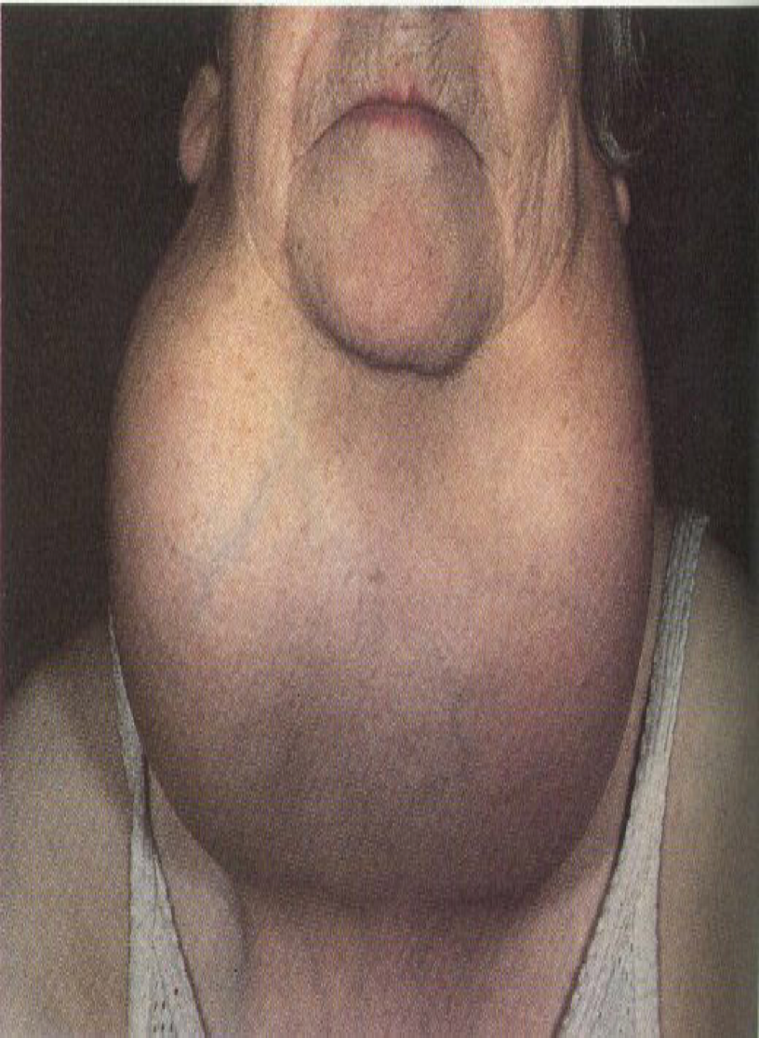
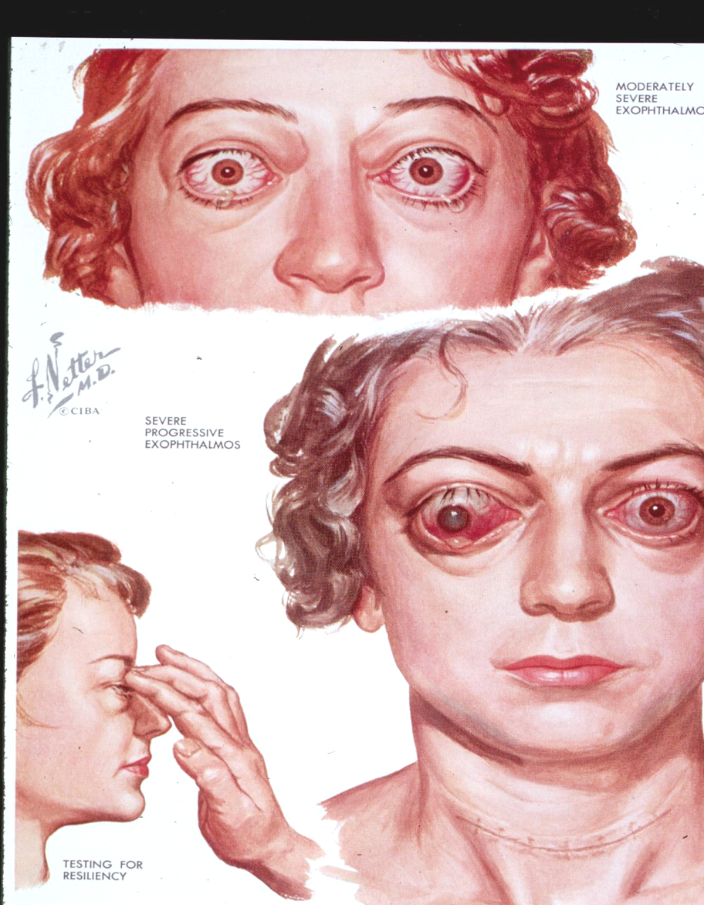
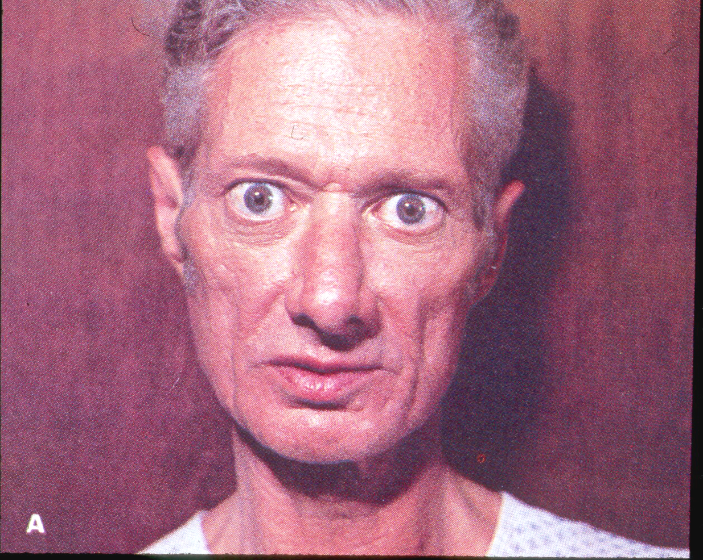
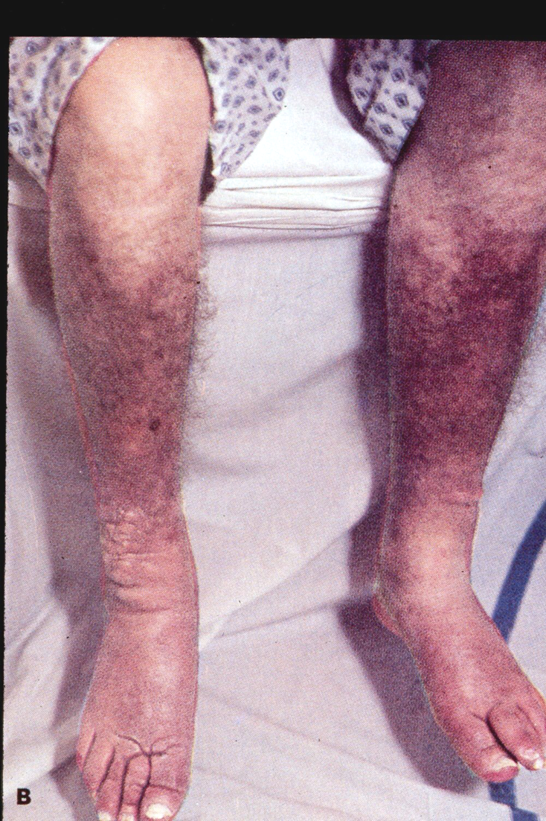
Features of Graves' Disease (Diffuse Toxic Goiter)
Caused by thyroid stimulating immunoglobulins that stimulate TSH receptor resulting in sustained thyroid over activity.
Mainly in young adults aged 20 to 50 , 5 times more frequent in women.
Swelling and soft tissues of hands and feet- Clubbing of fingers and toes.
Half of cases have Exophthalmos (not seen with other causes of hyperthyroidism)
5% have pretibial myxedema (thyroid dermopathy)
51 year old male who presented with urinary retention and proved to have Graves Disease
Pretibial myxedema and “square toes” in the same patient
Features of Toxic Multinodular Goiter
Second most common cause of hyperthyroidism
Most cases in women in 5th to 7th decades
Often have long standing goiter
Symptoms usually develop slowly
THYROTOXICOSIS
Symptoms | Signs
Irritability Dysphoria Heat intolerance & sweating Palpitations Fatigue & weakness Weight loss Diarrhea | Arrhythmias Thyroid enlargement Warm, moist skin Exophthalmos Pretibial myxedema

Slide 6
Treatment of Hyperthyroidism
Thioamides (antithyroid drugs)
Iodides
Radioactive iodine
Beta blockers
Surgery
Thioamides
Drug | Propylthiouracil (PTU) | Methimazole & Carbimazole
M.O.A | Inhibit synthesis of thyroid hormones by inhibiting the peroxidase enzyme that catalyzes the iodination of tyrosine residues.
 | PTU (but not methimazole) blocks the conversion of T4 to T3 in peripheral tissues. | Carbimazole is a prodrug converted to the active metabolite methimazole.
Absorption | Rapidly absorbed | Rapidly absorbed
Protein binding | 80-90% high | Most of the drug is free low
Accumulation | in thyroid | in thyroid
Excretion | Kidneys as inactive metabolite within 24 hrs faster | Excretion slow, 60-70% of drug is recovered in urine in 48 hrs slower
Half life | 1.5 hrs (short) | 6 hrs (long)
Administration | Every 6-8 hours | Every 8 hours
Pregnancy | Crosses placenta less. Recommended in pregnancy (Crossing placenta is less readily as it is highly protein bound) | Concentrated in Thyroid & crosses placenta. Not recommended in pregnancy
Breast feeding | Less secreted in breast milk Recommended | Secreted Not recommended

Slide 7
Thioamides cont.
Adverse Effect | Frequency | Comments
Skin reactions | 4-6% | Urticarial or macular reactions
Arthralgia | 1-5%
Polyarthritis | 1-2% | So-called anti-thyroid arthritis
GIT effects | 1-5% | Gastric distress and nausea
Immunoallergic hepatitis ** | 0.1-0.5% | Almost exclusively in patients taking propylthiouracil
Agranulocytosis Both drugs due to chronic administration | 0.1-0.5% | Seen in patients with Graves’ disease; occurs within 90 days of treatment precaution: frequent blood count should be done
ANCA-positive vasculitis (Anti-neutrophil cytoplasmic antibodies)** | Rare | With propylthiouracil
Abnormal sense of taste or smell** | Rare | With methimazole only
Warnings (male slides only)
• Agranulocytosis:
Patients on PTU or methimazole should be instructed to immediately report to their physicians any symptoms suggestive of agranulocytosis, such as fever or sore throat.
• Congenital Malformations:
Methimazole crosses the placental causing fetal harm, when administered in the first trimester of pregnancy.

Slide 8
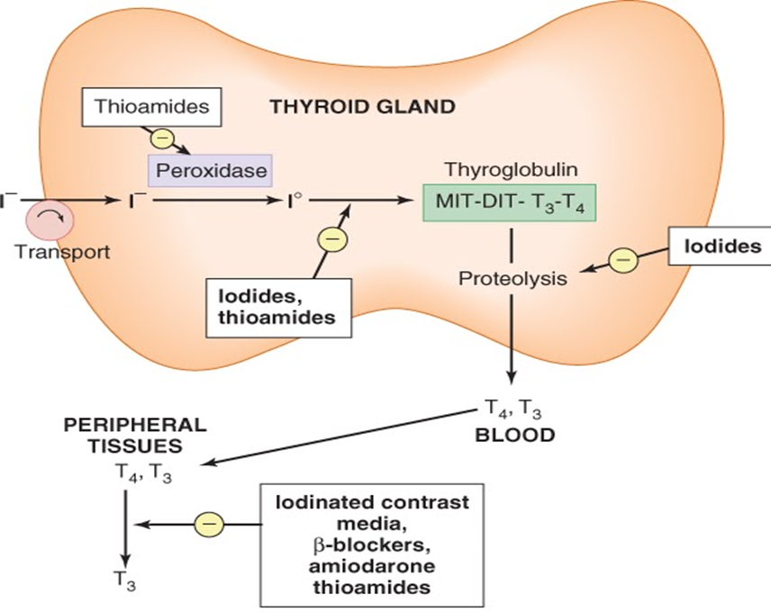
IODINE (Lugol's solution, potassium iodide)
Drug | Organic iodides as : iopanoic acid or ipodate | Potassium iodide
M.O.A | •Inhibit thyroid hormone synthesis and release •Block the peripheral conversion of T4 to T3 We give iodine in excess, and anything in excess will cause inhibition.
P.K | The effect is not sustained ( produce a temporary remission of symptoms this is why we use it before surgery ) (rapid + temporary)
Uses | •Prior to thyroid surgery to decrease vascularity & size of the gland •Following radioactive iodine therapy •Thyrotoxicosis
Precautions /toxicity | •Should not be used as a single therapy •Should not be used in pregnancy •May produce iodism ( Rare, as iodine is not much used now) Iodism Symptoms: (skin rash , hypersalivation, oral ulcers,metallic taste, bad breath). scenario : a patient with hyperthyroidism was treated with and then developed hypersalivation and bad breath. What drug was he treated with? Iodine
ADRENOCEPTOR BLOCKING AGENTS
Drug | Propranolol | Atenolol | Metoprolol
M.O.A | •Adjunctive therapy to relief the adrenergic symptoms of hyperthyroidism such as tremor, palpitation, heat intolerance and nervousness.
C.I | •Propranolol is contraindicated in asthmatic patients because propranolol is not selective and will cause bronchoconstriction

Slide 9
RADIOACTIVE IODINE ( RAI )
M.O.A | 131 I isotope ( therapeutic effect due to emission of β rays ) Accumulates in the thyroid gland and destroys parenchymal cells, producing a long-term decrease in thyroid hormone levels.
P.K | Clinical improvement may take 2-3 months. Half -life 5 days. Cross placenta & excreted in breast milk. → contraindicated during pregnancy and breastfeeding Available as a solution or in capsules.
Uses | Hyperthyroidism mainly in old patients (above 40) Graves, disease Patients with toxic nodular goiter As a diagnostic This drug is used both diagnosis and treatment.
Advantages | Easy to administer ,effective , painless and less expensive.
Disadvantages | High incidence of delayed hypothyroidism Large doses have cytotoxic actions ( necrosis of the follicular cells followed by fibrosis ) May cause genetic damage May cause leukemia & neoplasia
Thyrotoxicosis during pregnancy
• Better to start therapy before pregnancy with 131I or subtotal thyroidectomy to avoid acute exacerbation during pregnancy
• During pregnancy radioiodine is contraindicated.
• Propylthiouracil is the drug of choice during pregnancy.

Slide 10
Thyroid Storm
- A sudden acute exacerbation of all of the symptoms of thyrotoxicosis, presenting as a life threatening syndrome. - There is hypermetabolism, and excessive adrenergic activity, death may occur due to heart failure and shock. - It is a medical emergency.
Management of Thyroid Storm (IMP)**
- Should be treated in an ICU for close monitoring of vital signs and for access to invasive monitoring and inotropic support - Correct electrolyte abnormalities, Treat cardiac arrhythmia (if present) & Aggressively control hyperthermia by applying ice packs - Promptly administer antiadrenergic drugs (e.g. propranolol) to minimize sympathomimetic symptoms what is the life saving drug in thyroid storm? Propranolol ** - High-dose Propylthiouracil (PTU) is preferred because of its early onset of action (risk of severe liver injury and acute liver failure) - Administer iodine compounds (Lugol's iodine or potassium iodide) orally or via a nasogastric tube - Hydrocortisone 50 mg IV every 6 hours to prevent shock. - Rarely, plasmapheresis has been used to treat thyroid storm
Management of Hyperthyroidism due to Graves’ disease
Severe Hyperthyroidism
[ markedly elevated serum T4 or T3
very large goiter, > 4 times normal ]
Definitive therapy with radioiodine preferred in adults
Normalization of thyroid function with antithyroid drugs before surgery in elderly patients and those with heart disease

Slide 11
Management of Hyperthyroidism due to Graves’ disease
Mild/Moderate hyperthyroidism
small or moderately enlarged thyroid; children or pregnant or lactating women
Primary antithyroid drug therapy
should be considered
Start methimazole, 5–30 mg/day,
(PTU preferred in pregnant women)
Monitor thyroid function every 4–6 wk
until euthyroid state achieved
Discontinue drug therapy after 12–18 months
Monitor thyroid function every 2 months for 6 months,
then less frequently
Relapse
Remission
Definitive radioiodine (Second course of anti-thyroid
drug therapy in children)
Monitor thyroid function
therapy in adults every 12 mo indefinitely
Thyroidectomy
• Subtotal thyroidectomy is the treatment of choice in very large gland or multinodular goiter
Why do we do subtotal thyroidectomy instead of removing the whole gland? To leave a portion that can secrete hormones

Slide 12
MCQs
1- a 50 year old woman presented to the clinic complaining of weight loss, heat intolerance and excessive sweating. On examination she had an obvious goiter and bulging of her eyes.the doctor prescribed for her propylthiouracil. What is this drug’s mechanism of action?
inhibit peroxidase enzyme.
Blocks conversion of T4 to T3 in peripheral tissues.
Destroy the parenchymal cells of the thyroid.
Both A&B
2-which of the following is the drug of choice in treating a pregnant woman with hyperthyroidism?
methimazole
Carbimazole
Propylthiouracil
Radioactive iodine
3- which of the following side effects is rare but exclusive to propylthiouracil?
abnormal sense of taste and smell
Urticaria
Agranulocytosis
Immunoallergic hepatitis
4- a patient with hyperthyroidism developed vasculitis. Tests were done and her serum was positive for anti neutrophil cytoplasmic antibodies.which of the following drugs was she most likely on ?
propylthiouracil
Methimazole
Carbimazole
Potassium iodide
5- a patient was scheduled for partial thyroidectomy , which of the following drugs is used prior to the surgery to reduce the vascularity and size of the gland ?
a) Potassium iodide
B) propylthiouracil
c) methimazole
d) radioactive iodine
6- a patient with hyperthyroidism developed hypersalivation and oral ulcers. Which drug was the patient most likely on ?
Methimazole.
Carbimazole.
Potassium iodide.
Propranolol.

Slide 13
7- an asthmatic patient with hyperthyroidism is suffering from tachycardia, tremors, and palpitation. All of the following can be used to relieve his symptoms except:
Atenolol
Metolol
Propranolol
bisoprolol
8- which of the following side effects is most likely to develop in a patient with Graves’ disease after prolonged treatment with methimazole?
Immunoallergic hepatitis
Agranulocytosis.
ANCA-positive vasculitis
Hypersalivation.
9- what is the treatment of choice in multinodular goiter?
Radioactive iodine.
Propylthiouracil
Sub-total thyroidectomy.
Methimazole.
SAQ
A patient with hyperthyroidism developed a sudden acute exacerbation of all of the symptoms of thyrotoxicosis , the doctor said that it is a case of “ thyroid storm” and is life threatening if not managed properly. What is the line of treatment in this case?
1-correct electrolytes abnormalities, and control hyperthermia with ice packs.
2- administration of anti-adrenergic drugs.
3- High dose of propylthiouracil intravenously.
4- administer iodine compounds orally.
5- Hydrocortisone to prevent shock.
Mention 3 side effects of the antithyroid drug propylthiouracil.
1- polyarthritis.
2- immunoallergic hepatitis.
3- ANCA- positive vasculitis.
MCQ answers:
D
C
D
A
A
C
C
B
C

Slide 14
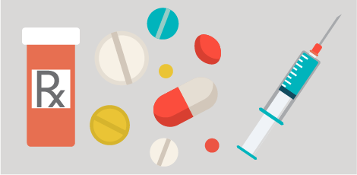
Team Leaders:
Majed Aljohani
Layan AlMana
Thanks for those who worked on the lectures :
Noura AlOthaim
Khulood AlWehaibi
Rinad Alghoraiby
Ghada AlQarni
Dana AlKadi
Dana AlRasheed
Sara AlSultan
Alanoud AlMufarrej
Ghada AlMuhanna
Munira AlHadlg
Sultan Alnasser
References:
Doctors’ slides and notes
@Pharma4370
Pharm437@gmail.com

