Slide 1
Pharmacology of drugs used in calcium & vitamin D disorders
Color index: Important Note Extra
Editing File

Slide 2
Mind map
Hormones used for osteoporosis
Calcitonin
PTH
Vitamin D
These three principal hormones regulate calcium homeostasis
Drugs used for osteoporosis
Note: PTH & Vitamin D have similar effects and calcitonin antagonizes those effects
Although PTH & Calcitonin have antagonistic effects. They can both be used for the treatment of osteoporosis
Teriparatide
Introduction
Calcium Metabolism
Calcium plays an essential role in many cellular processes, including muscle contraction, hormone secretion, cell
proliferation, and
gene expression.
Calcium balance is a dynamic process that reflects a balance between calcium absorption by the intestinal tract, calcium
excretion by the kidney, and release and uptake of calcium by bone during bone formation and resorption.
Three target tissues regulate calcium homeostasis:
1. Bone
2. Kidney
3. Intestine
The dominant site of calcium storage in the body is bone, which contains nearly 99.9% of body calcium. Most body calcium is stored in bone (~1000 g), which is a very dynamic site as bone is remodeled continuously by resorption of old bone by osteoclasts & formation of new bone by osteoblasts Although only a small fraction of total body calcium is located in the plasma, it is the plasma concentration of ionized calcium that is tightly regulated, primarily under the control of PTH and vitamin D.

Slide 3
Parathyroid Hormone (Phosphate Trashing Hormone)
Definition | PTH: A hormone that plays a critical role in controlling calcium, and phosphate balance. PTH is released from the parathyroid gland in response to low plasma Ca2+ level . The stimulus for parathyroid hormone (PTH) is hypocalcaemia . Secretion of PTH is inversely related to [Ca2+].
Action | The overall action of PTH is to increase plasma Ca2+ levels in response to hypocalcemia: 1. PTH enhances intestinal calcium absorption of calcium in the presence of permissive amounts of vitamin D. 2. PTH stimulates bone resorption by stimulating osteoclasts to increase the outward flux of calcium to restore serum calcium level. 3. PTH stimulates the active reabsorption of calcium from the kidney increase formation of calcitriol which is the active form of vitamin D
Response | -Daily, intermittent administration of recombinant human PTH, SC in the thigh (alternate thigh every day ) leads to a net stimulation of bone formation for treatment of osteoporosis. (has an anabolic effect) so Decreases osteoclast activity -Continuous or chronic exposure to high serum PTH concentrations (as seen with primary or secondary hyperparathyroidism) results in bone resorption and risk of fractures, so we can use PTH for treatment but not continuously Intermittent: Osteoblast ↑ number/function,↑ Bone formation, ↑ Bone mass/strength This is the desired effect that combats osteoporosis ( PTH is secreted intermittently, so we try to mimic the normal state) Continuous: ↑Osteoclast, ↑ Bone resorption, ↑Serum Ca2+ (this produces an effect similar to PTH secreting tumors)
Uses | Treatment of severe osteoporosis Resistant cases failed to respond to other medications

Slide 4
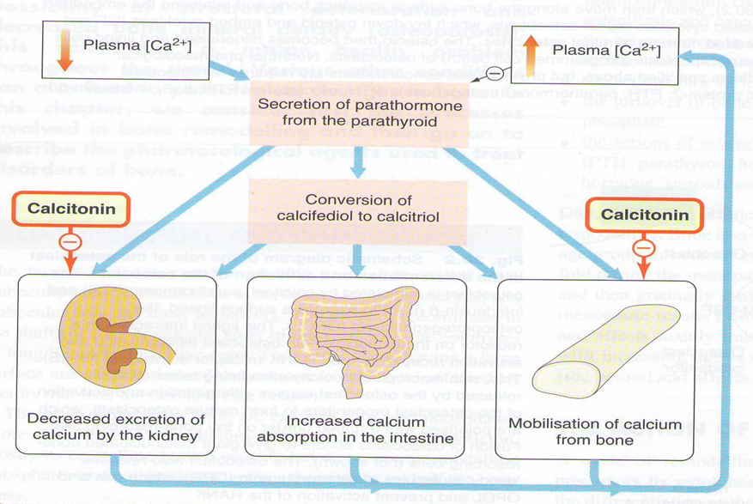
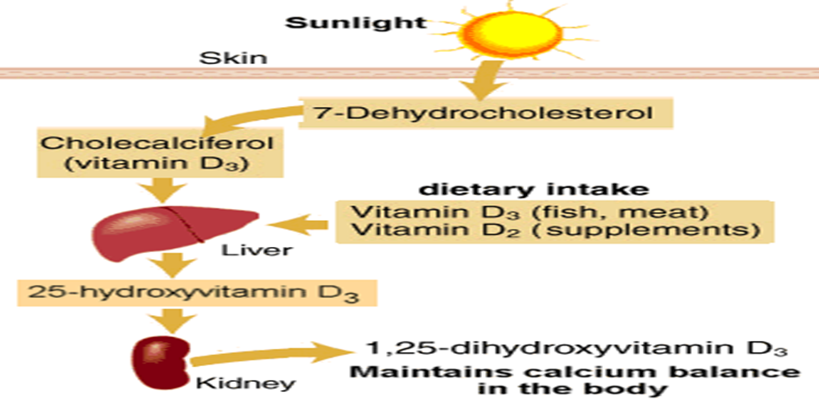
Teriparatide
MOA | Synthetic polypeptide form of PTH (PTH analogue). It belongs to a class of anti-osteoporosis drugs, the so-called “anabolic” agents. (stimulates osteoblasts) Given, once daily by subcutaneous injection
Therapeutic effects | Once-daily administration of teriparatide stimulates new bone formation by preferential stimulation of osteoblastic activity over osteoclastic activity. By contrast, continuous administration of teriparatide , may be detrimental to the skeleton because bone resorption may be stimulated more than bone formation.
Uses | Good for postmenopausal osteoporosis. For treatment of osteoporosis in people who have a risk of getting fracture (increases bone mass & strength) Used in severe osteoporosis or patients not responding to other drugs. Should not be used routinely due to carcinogenic effects.
Adverse Effects | Carcinogenic effect (osteosarcoma) Diarrhea, heartburn, nausea Headache, leg cramps Hypotension when standing (orthostatic hypotension) Elevated serum calcium which may occur in some cases can lead to kidney stones
C.I. | Teriparatide should not be used by people with increased risk for bone tumors (osteosarcoma) including: People with Paget's disease of bone People who had radiation treatment involving bones Not recommended in children

Slide 5
Vitamin D
Definition | Vitamin D is a steroid hormone that is intimately involved in the regulation of plasma calcium levels. Its role in calcium metabolism first was recognized in the childhood disease rickets, which is characterized by hypocalcemia and various skeletal abnormalities
Metabolism | Exposure to the ultraviolet rays in the sunlight convert 7DC to cholecalciferol. Vitamin D3 is metabolically inactive until it is hydroxylated in the liver then the kidney (by α hydroxylase) to the active form 1,25 Dihydroxycholecalciferol
Calcium & Vitamin D | increases bone resorption increases Ca2+ absorption from intestine increases renal Ca2+ and PO4 reabsorption decreases the production of PTH by the parathyroid glands The overall effect is increased plasma calcium concentrations
Uses | Treatment of Vitamin D deficiency diseases: Rickets Osteomalacia Osteoporosis (postmenopausal women take vitamin d + calcium) Also used for: Psoriasis Prevention of Prostate & Colorectal Cancer
Sources | Cholecalciferol (Vitamin D3) in skin Ergocalciferol (Vitamin D2) in plants Vit D2 and Vit D3 have equal biological activities. Vitamin D2 is the prescription form of vitamin D & is also used as food additive (milk). Vitamin D3 is usually for vitamin D- fortified milk & foods & also available in drug combination products.
Remember | 1,25-dihydroxyvitamin D (calcitriol) is the most active form of vitamin D. 25-hydroxyvitamin D (calcidiol, 25-hydroxycholecalciferol): an inactive form of vitamin D. 1-alpha-hydroxylase: The enzyme that converts the inactive form of vitamin D to the active form

Slide 6
Calcitonin
Definition | Calcitonin is synthesized and secreted by the parafollicular cells (C cells) of the thyroid gland. It is released when there is a rise in plasma Ca2+ levels While PTH and vitamin D act to increase plasma Ca2+, only calcitonin causes a decrease in plasma Ca2+ Calcitonin protects against development of hypercalcemia caused by a variety of conditions, including increased calcium absorption (milk-alkali syndrome) and decreased calcium excretion (thiazide use). MAS: excessive milk intake to treat peptic ulcer will lead to accumulation of calcium and alkaline→alkalosis
Action | The major effect of calcitonin administration is a rapid fall in Ca2+ (serum calcium ) caused by: Inhibiting bone resorption by inhibiting osteoclast activity. The osteoclast bone cells appear to be a particular target of calcitonin (key function of calcitonin) Decreasing reabsorption of Ca2+ & PO4 by the kidney, thus increasing their excretion. Calcitonin does not appear to be critical for the regulation of calcium homeostasis even if thyroid gland is removed.
P.K | S.C., Nasal spray or solution (Calcitonin Salmon ) has more affinity towards human calcitonin receptors
Uses | Used clinically in treatment of hypercalcemia (biggest indication) and in certain bone diseases in which sustained reduction of osteoclastic resorption is therapeutically advantageous. Osteoporosis (major indication; alternative to other drugs). Hypercalcemia (short-term treatment of hypercalcemia of malignancy), Paget's disease. It has lower efficacy compared to other drugs. (it is not very effective clinically)
ADRS | Nausea Local inflammation at site of injection (SC administration) Flushing of face & hands Nasal irritation

Slide 7
Parathyroid Hormone
Definition:
released from the parathyroid gland in
response to low plasma Ca2+ level .
Response: “given S.C”
• Intermittent: Osteoblast number/function → Bone formation→
↑Bone mass/strength
• Continuous: Osteoclast → Bone
resorption →Serum Ca2+
Use:
1-Treatment of severe osteoporosis
2-Resistant cases failed to respond to
other medications
Parathyroid Hormone
Vitamin D
Definition:
a steroid hormone involved in the
regulation of plasma calcium levels &
increase its level.
Forms:
• Cholecalciferol (Vitamin D3) in skin
• Ergocalciferol (Vitamin D2) in plants
• Calcitriol 1,25-dihydroxyvitamin D is the
active form
Deficiency leads to:
Rickets , Osteomalacia, Osteoporosis
Use:
Rickets & Osteomalacia, Osteoporosis,
Cancer prevention
Vitamin D
Teriparatide
M.O.A:
PTH analogue, anti-osteoporosis (anabolic) → stimulate new bone formation if given
intermittently
• If given continuously → bone
reabsorbtion
• Should be given intermitted not
continuous
Use:
postmenopausal osteoporosis
Should not be used routinely due to
carcinogenic effects
Contraindication:
(osteosarcoma) →Paget's disease,
radiation treatment, children
ADRs:
Carcinogenic effect, lead to kidney stones
,orthostatic hypotension
Calcitonin
Definition:
secreted by (C cells) of the thyroid gland.
released when there is a rise in plasma Ca2+
levels to ↑ its absorption
• Inhibit osteoclast activity→ inhibiting
bone reabsorption.
• It has lower efficacy compared to the
other drugs.
Routes of administration:
S.C , Nasal spray or solution → has more
affinity towards human calcitonin receptors
Use:
Osteoporosis, Hypercalcemia of malignancy
→ Paget's disease
ADRs:
1-Local inflammation at site of injection
2-Flushing of face & hands
3-Nasal irritation
Teriparatide
Calcitonin

Slide 8
Questions
Administration of parathyroid hormone must be:
Continuous
Continuous following a loading dose
Intermittent
Teriparatide is a:
PTH synthetic analogue
Calcitonin receptor antagonist
Bisphosphonate
Vitamin D’s effect on the kidney:
Decreases renal Ca2+ and PO4 reabsorption
Increases renal Ca2+ and PO4 reabsorption
increases renal Ca2+ absorption and decreases PO4 reabsorption
A common adverse effect of teriparatide:
Leukopenia
Arthropathy
Osteosarcoma
Autoimmune hepatitis
Which of the following is released in response to hypercalcemia
PTH
Vitamin D
Calcitonin
Answers:
C - A - B - C - C
A 50 year old woman visits her family physician and the physician prescribes her medication to prevent postmenopausal osteoporosis. She tells her this drug is a synthetic PTH analogue.
1-Name the drug the woman was prescribed:
Teriparatide
2-List two possible adverse effects:
Renal stones
Osteosarcoma
3-List two hormones (other than PTH) that can be used to treat osteoporosis:
Vitamin D
Calcitonin

Slide 9
Team Leader:
Majed Aljohani
Layan AlMana
Thanks for those who worked on the lectures :
Abduljabbar Alyamani
Notes by
Alanoud Almansour
Sultan Alnasser
References:
Doctors’ slides and notes
@Pharma4370
Pharm437@gmail.com

