Slide 1
Pre-Marital Counseling and Tests
Marwah Hassounah MPH-HCOM, MBBS
Community Medicine Unit Faculty
Family and Community Medicine Department- King Saud University
Reproductive System Block- 2nd year Medical Students
April 3rd, 2019 11-12 p.m.
Notes:
Salam
Introduction
Who here has been recently married, or lived the experience with her relative or close friend?
Pls come up
Did they do a pre0marital test? What did they do? Where did they go?

Slide 2
Learning Objectives
By the end of this lecture the student should be able to:
Recognize the Saudi Healthy Marriage program
Recall the program’s areas of pre-marital counseling
List diseases included in the Saudi pre-marital screening program
Identify the fate of tested individuals (case, carrier, clear)
Recognize cultural considerations for pre-marital counseling in Saudi Arabia

Slide 3
Lecture Outline
The Saudi Scene
Brief on the Saudi pre-marital screening program
Pre-marital counseling and its application in KSA
The program’s objectives
Overview video
Cultural considerations
3 minutes in-class stretching break
Scenario application for fates of tested couples
Infectious disease scenarios
Inherited blood disorders
Closing remarks
Notes:
Story form pre- program

Slide 4
The scene
The middle East is one of the regions known for high rates of sickle cell disease and beta-thalassemia.(1)
In the 80s Saudi Arabia was hyper-endemic with Hep B Virus. (2)
In Saudi Arabia, Hepatitis C persists as a problem in hemodialysis patients and IV drug users. In KKUH, Hep C prevalence was 0.58 % in 1996 and decreased to 0.08% in 2006. (2)
From the year 2000 to 2009, there were 2,956 reported Saudi cases of HIV. A rate of 1.5 cases per 100,000 Saudis.(3)
Notes:
Kkuh= king Khaled university hospital
These genetic hemoglobinopathies have no cure in most cases, and its complications are very costly and burdensome. Same goes for viral disease, you can take med to keep them under control, but on the long term (years) they are there are pose potential risk fatal complications.
Hence it makes sense to have a simple blood test done for you for free to tell you about the possibility of this happening to you or your future children\.

Slide 6
Healthy Marriage Program
Program started in 2004. It included tests for hemoglobinopathies: sickle cell and thalassemia.(1)
In 2008 the MOH added to the program testing for HIV, Hep B, Hep C.(2)
In 2013, the program changed its name from pre-marital screening فحص ما قبل الزواج to healthy marriage programبرنامج الزواج الصحي , and started electronic integration. (3)
Notes:
From 2001-2004- getting buy in form islmaic affairs, high policy decision, mandatory for Saudis, but results are not mandatory.
Islamic teachings promote
The general populations different opinion sand acceptance: http://www.alyaum.com/article/1047303

Slide 7
Healthy Marriage Program cnt’
Centers
List of MOH centers accredited to give the healthy marriage certificate:
https://www.moh.gov.sa/en/HealthAwareness/Beforemarriage/Pages/002.aspx
There are others in non-MOH institutes. Ex: PCC1 here in KKUH for KSU staff

Slide 8
Lecture Outline
The Saudi Scene
Brief on the Saudi pre-marital screening program
Pre-marital counseling and its application in KSA
The program’s objectives
Overview video
Cultural considerations
3 minutes in-class stretching break
Scenario application for fates of tested couples
Infectious disease scenarios
Inherited blood disorders
Closing remarks

Slide 9
Pre-marital counseling
Pre-marital: before marriage
Counseling: “professional guidance of the individual by utilizing psychological methods……” (1)
Notes:
So what is pre-mar. counseling?
Let’s start by defining the term.
Pre-marital is
Counseling is:

Slide 10
Pre-marital Counseling in KSA
The Saudi Healthy Marriage program, tests for genetic blood disorders (hemoglobinopathies) and infectious diseases. Then according to the results, it provides counseling on:
The odds of transferring this disease to their prospective marriage partner
The odds of transferring this disease to their future children
Solutions and how to move forward
Notes:
In our local context premarital counseling mainly happens as part of the national pre-marital screening program. برنامج فحص ما قبل الزواج

Slide 11
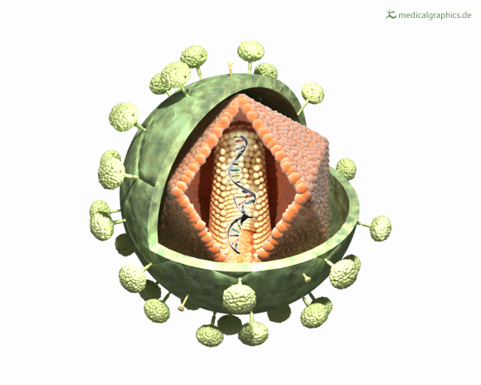
The program’s objectives
Notes:
1- decrease rates of the genetic blood disorders and infectious diseases tested like HIV and SC Anemia.
2-decrease the financial burden of treating people affected with these diseases, decrease burden on hospital and the health care system ER
3-To avoid the psychological and social problems for these future families
Source:
Premarital Screening [online webpage]. Ministry of Health. URL: https://www.moh.gov.sa/en/HealthAwareness/Beforemarriage/Pages/default.aspx. Last Update: July 1st, 2017. Accessed: April 2nd, 2018.

Slide 12
The program’s objectives
4- To make it easier for people who want to make the test to ask for it
5-To raise awareness about the concept of a comprehensive healthy marriage
Notes:
Source:

Slide 13
Notes:
2:05 minutes vid
Overview of screening program
Algorithm of fates for different scenarios
As you saw in this video, there used to be the terminology compatible. We stopped using it, because of stigma. Now we use a safe marriage certificate.
So if they wil get healthy children not diseased- we give them the certificate for marriage
If they have the chance fo ra diseased/ case child, orinfectious diseases- we require them to go to counseling clinic before handing them the certificate.

Slide 14
Certificate of healthy marriage
The certificate is issued after the test results have been done and counseling has been performed in the counseling clinic for cases that mandate it.
Examples of such cases: Having Hep C, hemoglobinopathy with chance of having diseased children
Notes:
هذه الشهادة من متطلبات المأذون لعقد النكاح

Slide 15
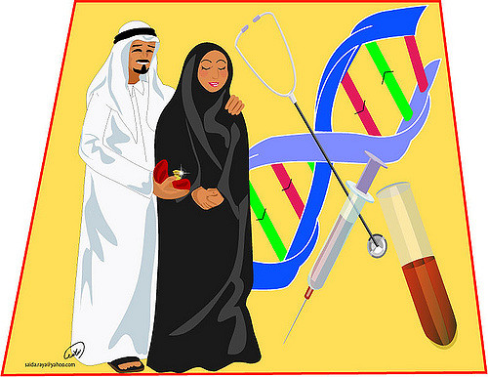
Cultural considerations
Consanguineous marriage (56% in 1995, 57.7% in 2007 in KSA)*
Respect the couple’s decisions. The test is mandatory but the results are not mandatory.
Family and tribal pressure
Taboo of certain diseases/ stigma
Privacy and confidentiality
Notes:
For pre-marital counseling our local context has some cultural considerations.
First is that consan, marriage is common. In 20--, ---% of marriages in KSA were between relatives. This plays an important role in the genetic blood disorders. SC A and thalassemia are common in certain regions like Eastern and Southern. As we saw in the video, if two cousins get married and both are carriers, they will have affected children.
Second is, National policy that put this program made it mandatory to have the test as part of the requirmeents for the sheikh , al-mimlik, to make the marriage contract. However, the test results and the certificate of compatibility are not obligatory. He decision is up to the couple to go ahead with the marriage or not, regardless of the results.
This brings me to the third point, --------Whether it is pressuring the person to marry someone from within the same family and tribe, or that they pressure them to not back out of the marriage when results come out that they are not compatible.
60 % of say they prefer to cancel at-risk marriages, but only 2% actually cancelled- mainly due to society pressure.
Source:
Memish ZA, Saeedi MY. Six-year outcome of the national premarital screening and genetic counseling program for sickle cell disease and β-thalassemia in Saudi Arabia. Annals of Saudi medicine. 2011 May;31(3):229.
Some disease like HIV have a stigma with them. We know that HIV can be transmitted via blood, during delivery, and sexual intercourse. Unfortunately, people immediately think of sexual acivity with HIV which is unfair to those that got it via blood transfusion or form their mother during delivery. Therefore, when someone tests positive for HIV in the pre-marital screening program, their file and test results are transferred to the Ministry of Internal Affairs to maintain its confidentiality. Of course if the tested is a female, imagine how bigger a stigma and taboo this will be.
Ofcourse you are doctors and privacy and confidentiality are a no brainer. You have to deal with this test discretely. Don’t go around telling other doctors, or colleagues, or family members, oh I saw this person doin ga pre-marital test and they got these results. Maybe they don’t want someone to know they’re getting married at this point, or they have results that are incompatible and don’t go throught with the marriage. ترفعوا عن القيل و القال و الكلام في عورات الناس

Slide 16
Lecture Outline
The Saudi Scene
Brief on the Saudi pre-marital screening program
Pre-marital counseling and its application in KSA
The program’s objectives
Overview video
Cultural considerations
3 minutes in-class stretching break
Scenario application for fates of tested couples
Infectious disease scenarios
Inherited blood disorders
Closing remarks

Slide 17
Notes:
3 minutes in-class stretching break

Slide 18
Lecture Outline
The Saudi Scene
Brief on the Saudi pre-marital screening program
Pre-marital counseling and its application in KSA
The program’s objectives
Overview video
Cultural considerations
3 minutes in-class stretching break
Scenario application for fates of tested couples
Infectious disease scenarios
Inherited blood disorders
Closing remarks

Slide 19
Scenario #1
Mohammed and Fatima presented to the primary care clinic for pre-marital screening. You performed the following blood tests: complete blood count, sickle cell test, hemoglobin electrophoresis, and virology tests for HIV, Hep C, and Hep B. Both were clear from any abnormalities.
Is counseling required in this situation?
Notes:
No

Slide 20
Scenario #2
Amal and Tareq performed pre-marital screening tests and it was found that Tareq is a Hep B carrier. Repeat the tests to confirm. To issue them a health marriage certificate it is mandatory that they go to the counseling clinic.
what will you counsel them about?
Transmission to wife- Hep B vaccine
Transmission to future children – Hep B vaccine
Solutions: refer to specialty clinic as needed.
Notes:
For the wife- don’t continue with it, or go ahead and go to infectious to take needed vaccination/precautions, and counseling on preventive measures. Need to sign that they received counseling and are proceeding despite knowing the risk
Source of information on this slide:
Dr. AbdulKareem Al Qowaidi
مدير إدارة مكافحة الأمراض الوراثية و المزمنة
Personal communication
April 3rd, 2018
Via whats app mobile no.########

Slide 21
What if it was Hep C or HIV?
Repeat the tests to confirm.
Counseling is mandatory as well.
Transmission to wife- no vaccines, health education
Transmission to future children
Solutions: refer to specialty clinic as needed. (antiviral therapy)
The marriage
If decided to proceed, sign that they received counseling and they are going ahead with the marriage despite counseling
Notes:
Hep C: Either don’t continue with it, or go ahead and go to infectious to take needed precautions, and counseling on preventive measures. Need to sign that they received counseling and are proceeding despite knowing the risk.
Dr. AbdulKareem Al Qowaidi
مدير إدارة مكافحة الأمراض الوراثية و المزمنة
Personal communication
April 3rd, 2018
Via whats app mobile no.########
HIV positive can marry HIV negative.
Organization publications. Marriage and reproduction pamphlets. Manaa Charity Organization caring for AIDS patients in Riyadh. n.d. URL: http://www.manaa.org.sa/versions.asp [accessed April 3 2019]

Slide 22
Lecture Outline
The Saudi Scene
Brief on the Saudi pre-marital screening program
Pre-marital counseling and its application in KSA
The program’s objectives
Overview video
Cultural considerations
3 minutes in-class stretching break
Scenario application for fates of tested couples
Infectious disease scenarios
Inherited blood disorders
Closing remarks

Slide 23
Scenario #3
Ali, from the Eastern region, presented to your clinic for pre-marital screening as he intends to marry his cousin. His prospective wife did the test and was clear from any abnormalities. Ali’s hemoglobin electrophoresis shows Hb A : 60 % , Hb SS :40% , Hb F : 2 % , meaning he is a carrier of sickle cell trait.
What would you tell them about the
odds of inheritance for their future children?
Notes:
yes

Slide 24
Scenario #3 cnt’
Notes:
The odds of transmission to partner? N/A
The odds of transmission to future children? Algorithm
(“That any given child” means: each one child when born has 50% chance to have the trait and 50% chance to be normal)
“If one parent has sickle cell trait (HbAS) and the other does not carry the sickle haemoglobin at all (HbAA) then none of the children will have sickle cell anaemia. There is a one in two (50%) chance that any given child will get one copy of the HbS gene and therefore have the sickle cell trait. It is equally likely that any given child will get two HbA genes and be completely unaffected.”

Slide 25
What if Ali’s fiancé Sara was also a sickle cell trait carrier?
Counseling:
Transmission to future children?
Solutions/alternatives?
Find another partner for marriage who doesn’t have sickle cell trait or anemia
Certificate of healthy marriage will be given after they go to the counseling clinic.
Notes:
The odds of transmission to partner? N/A
The odds of transmission to future children? Algorithm
“If both parents have sickle cell trait (HbAS) there is a one in four (25%) chance that any given child could be born with sickle cell anaemia. There is also a one in four chance that any given child could be completely unaffected. There is a one in two (50%) chance that any given child will get the sickle cell trait.”
Alternatives- consider marrying someone else
If despite that, they still insist to marry, they have to sign that they are takin gthis decision despite being counsilled.

Slide 26
What if Ali had sickle cell anemia and Sara was clear?
Odds of transmission to future children?
Is an appointment at the counseling clinic mandatory to issue the certificate?
Notes:
The odds of transmission to partner? N/A
The odds of transmission to future children? Algorithm
If one parent has sickle cell anaemia (HbSS) and the other is completely unaffected (HbAA) then all the children will have sickle cell trait. None will have sickle cell anaemia. The parent who has sickle cell anaemia (HbSS) can only pass the sickle haemoglobin gene to each of their children.
3. no
source
Inheritance of Sickle Cell Anemia [ online webpage]. Sickle Cell Society. URL: http://www.sicklecellsociety.org/resources/inheritance-of-sickle-cell-anaemia/. Published: July 13th, 2014. Accessed: April 3rd, 2018

Slide 27
What if Ali is a carrier and Sara has sickle cell anemia?
Counseling:
Odds of transmission to future children?
Alternatives/solutions?
Find another partner for marriage who doesn’t have sickle cell trait or anemia
Certificate of healthy marriage will be given after they go to the counseling clinic.
Notes:
The odds of transmission to partner? N/A
The odds of transmission to future children? Algorithm
“If one parent has sickle cell trait (HbAS) and the other has sickle cell anaemia (HbSS) there is a one in two(50%) chance that any given child will get sickle cell trait and a one in two chance that any given child will get sickle cell anaemia. No children will be completely unaffected.”
Source
Inheritance of Sickle Cell Anemia [ online webpage]. Sickle Cell Society. URL: http://www.sicklecellsociety.org/resources/inheritance-of-sickle-cell-anaemia/. Published: July 13th, 2014. Accessed: April 3rd, 2018
Alternatives- consider marrying someone else
SAME THING APPLIES TO THALASEMIA

Slide 30
Lecture Outline
The Saudi Scene
Brief on the Saudi pre-marital screening program
Pre-marital counseling and its application in KSA
The program’s objectives
Overview video
Cultural considerations
3 minutes in-class stretching break
Scenario application for fates of tested couples
Infectious disease scenarios
Inherited blood disorders
Closing remarks

Slide 31
Learning Objectives
By the end of this lecture the student should be able to:
Recognize the Saudi Healthy Marriage program
Recall the program’s areas of pre-marital counseling
List diseases included in the Saudi pre-marital screening program
Identify the fate of tested individuals (case, carrier, clear)
Recognize cultural considerations for pre-marital counseling in Saudi Arabia
Notes:
Go over each objective to sum up what we talked about for it.

Slide 32
THANK YOU mhassounah@ksu.edu.sa

