Slide 1
Female Reproductive System
Objectives:
By the end of the lecture you should be able to:
Describe the histological structure and fate of ovarian follicles.
Describe the histological structure of:
Ovary.
Oviducts (Fallopian tubes).
Uterus.
Vagina.
Resting and lactating mammary gland.

Slide 2
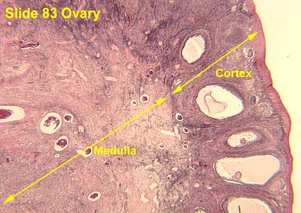
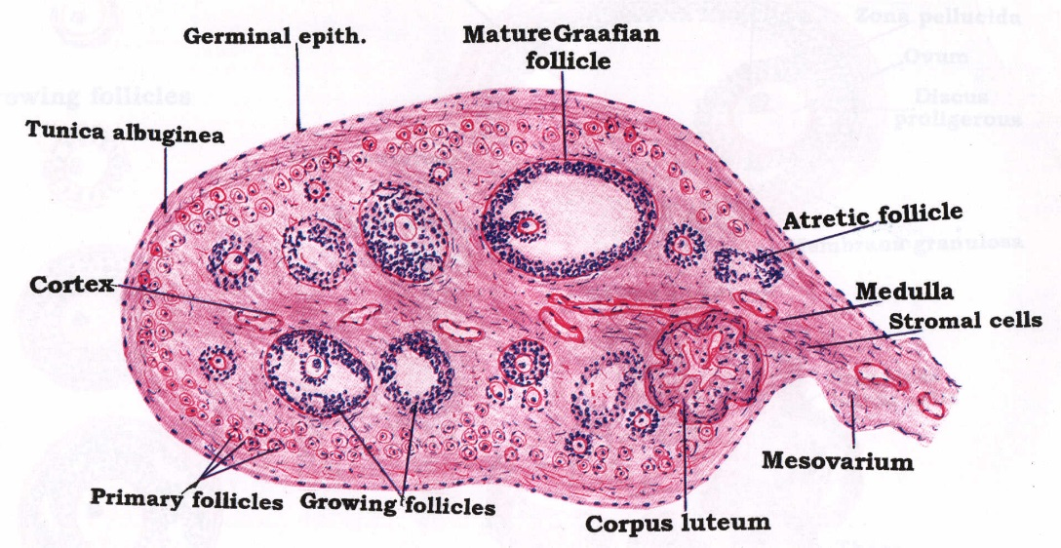
ADULT OVARY
1- Germinal epithelium: outer layer of flat cells.
2- Tunica albuginea: dense C.T layer.
3- Outer cortex: ovarian follicles and interstitial cells.
4- Inner medulla: highly vascular loose C.T.

Slide 3
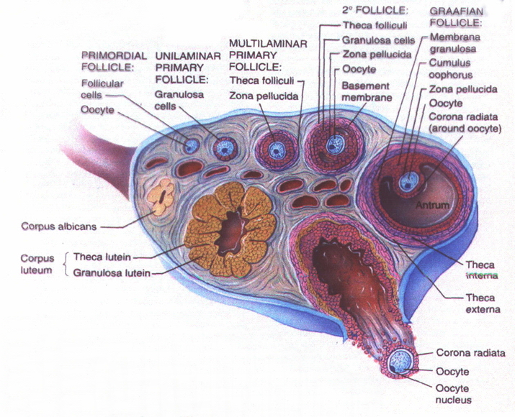
Ovarian Follicles
The cortex of the ovary in adults contains the following types (stages) of follicles:
PRIMORDIAL follicles.
PRIMARY follicles:
Unilaminar
Multilaminar
SECONDARY (ANTRAL) follicles.
MATURE Graafian follicles.

Slide 4
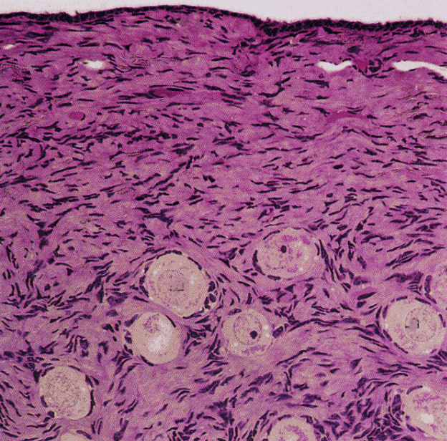
1. Primordial Follicles
The only follicles present before puberty.
The earliest and most numerous stage.
Located superficially under the tunica albuginea.
Each is formed of a primary oocyte (25 µm), surrounded by a single layer of flat follicular cells.

Slide 5
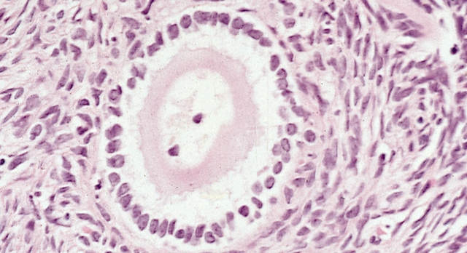
2. Primary Follicles
They develop from the primordial follicles, at puberty under the effect of FSH.
a) Unilaminar primary follicles:
are similar to primordial follicles, but:
the primary oocyte is larger (40 μm).
the follicular cells are cuboidal in shape.

Slide 6
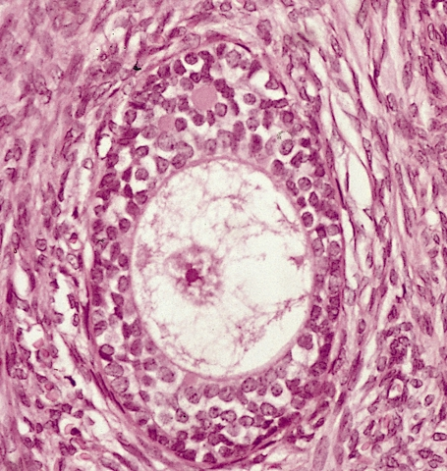
2. Primary Follicles
b) Multilaminar primary follicles:
1ry oocyte larger
corona radiata
granulosa cells
zona pellucida
theca folliculi
follicular fluid (liquor folliculi)

Slide 7
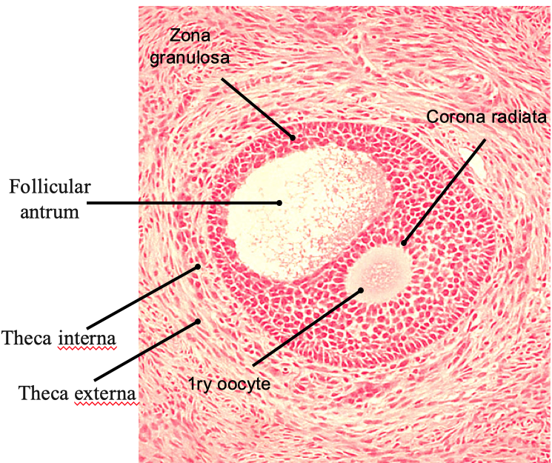
3. Secondary (Antral) Follicles
Multilaminar primary follicles become secondary follicles when a complete antrum filled with liquor folliculi is formed.
1ry oocyte is larger & pushed to one side.
Theca folliculi differentiates into theca interna and theca externa.

Slide 8
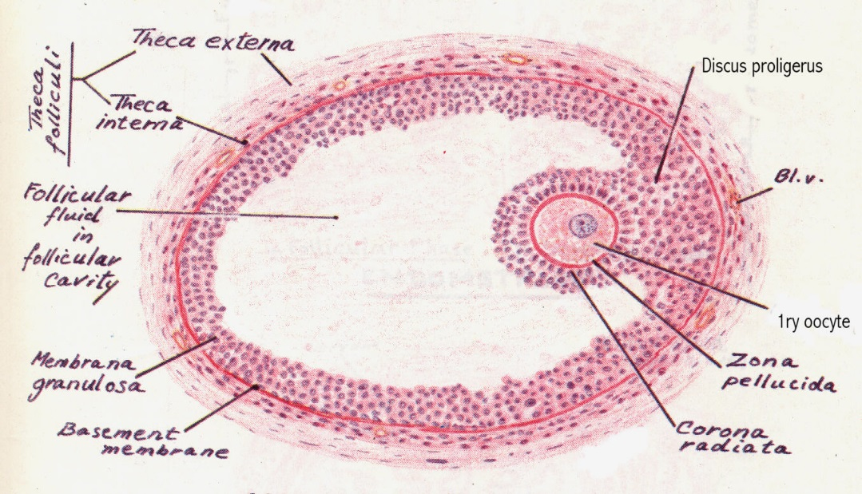
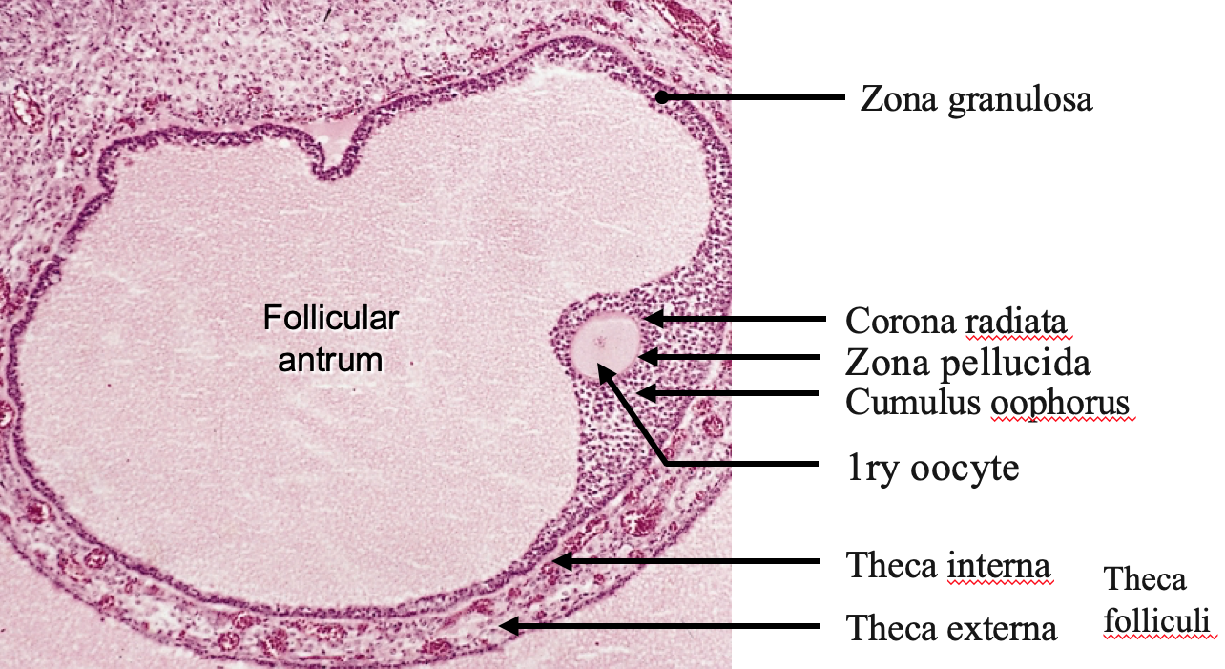
4. Mature (Graafian) Follicle
large, thin walled
wide follicular antrum
large 1ry oocyte
zona pellucida
corona radiata
cumulus oophorus
zona granulosa
basement membrane
theca folliculi: theca interna & theca externa

Slide 9
Atretic Follicles
During growth of the ovarian follicles, many of them do not reach maturation and they degenerate, and are finally replaced completely by fibrous tissue and are called atretic follicles or corpora atretica.

Slide 10
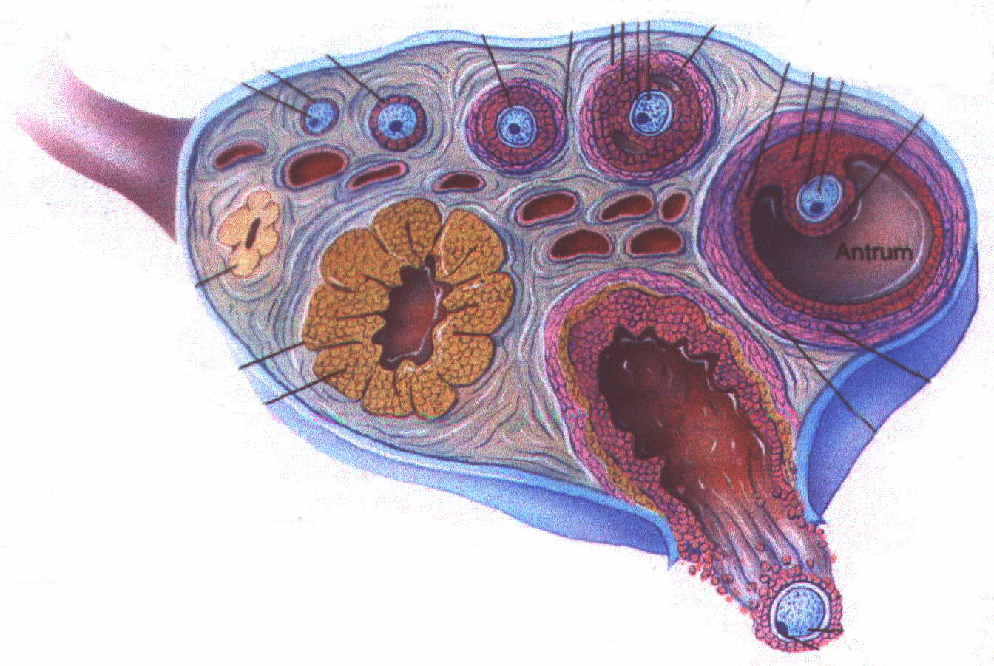
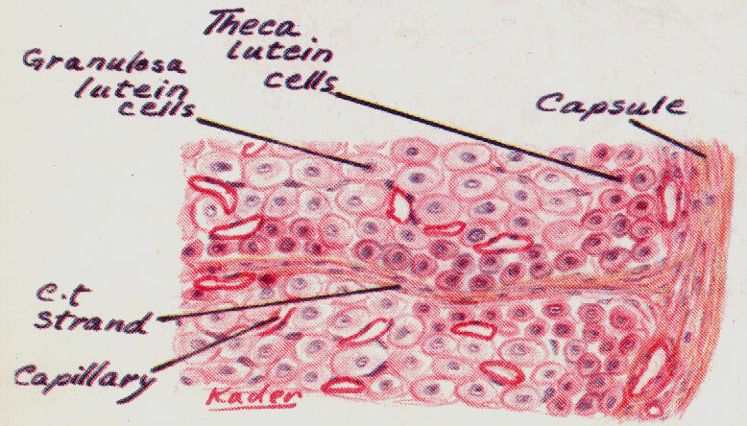
Corpus Luteum
Ovulation occurs at day 14 of the cycle, under the effect of LH.
The follicle collapses and forms a corpus luteum.
zona granulosa → granulosa lutein cells.
Theca interna → theca lutein cells.
Bleeding may occur → corpus haemorrhagicum.
Fertilization → corpus luteum of pregnancy.
No fertilization → corpus luteum of menstruation.
At the end → corpus albicans.

Slide 11
Corpus Luteum
Corpus luteum of menstruation lasts about 10 days.
Corpus luteum of pregnancy persists for six months.
Fate of corpus luteum: formation of a white degenerated fibrous body, corpus albicans.
Function of corpus luteum:
Granulosa lutein cells: secrete progesterone
Theca lutein cells: secrete estrogen.

Slide 12
Corpus Albicans
It is a white degenerated fibrous body formed by involution of corpus luteum (degenerated corpus luteum).
Secretory cells of corpus luteum degenerate and are phagocytosed by macrophages.

Slide 13
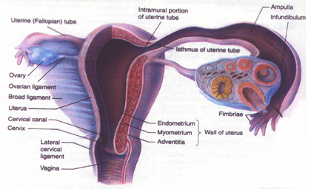
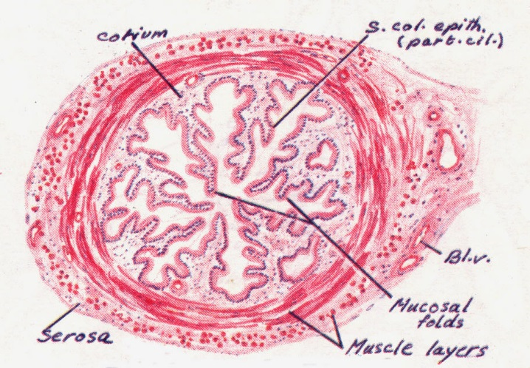
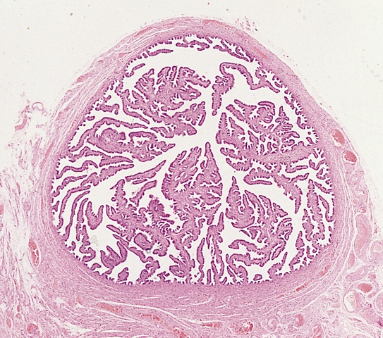
Oviducts (Fallopian Tubes)
Mucosa:
Highly folded.
Epithelium: Simple columnar partially ciliated.
Corium of C.T.
Musculosa:
Inner circular.
Outer longitudinal.
Serosa

Slide 14
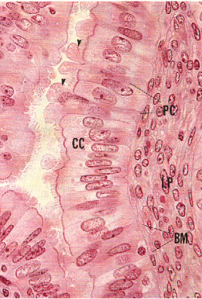
Oviducts (Fallopian Tubes)
Ciliated cells:
Non-secretory.
Cilia beat toward uterus.
Non-ciliated cells:
Thinner, also called peg cells.
Secretory cells.
Apices bulge above ciliated cells.
Their apices contain nutritive material to nourish gametes.

Slide 15
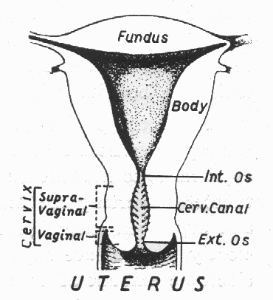
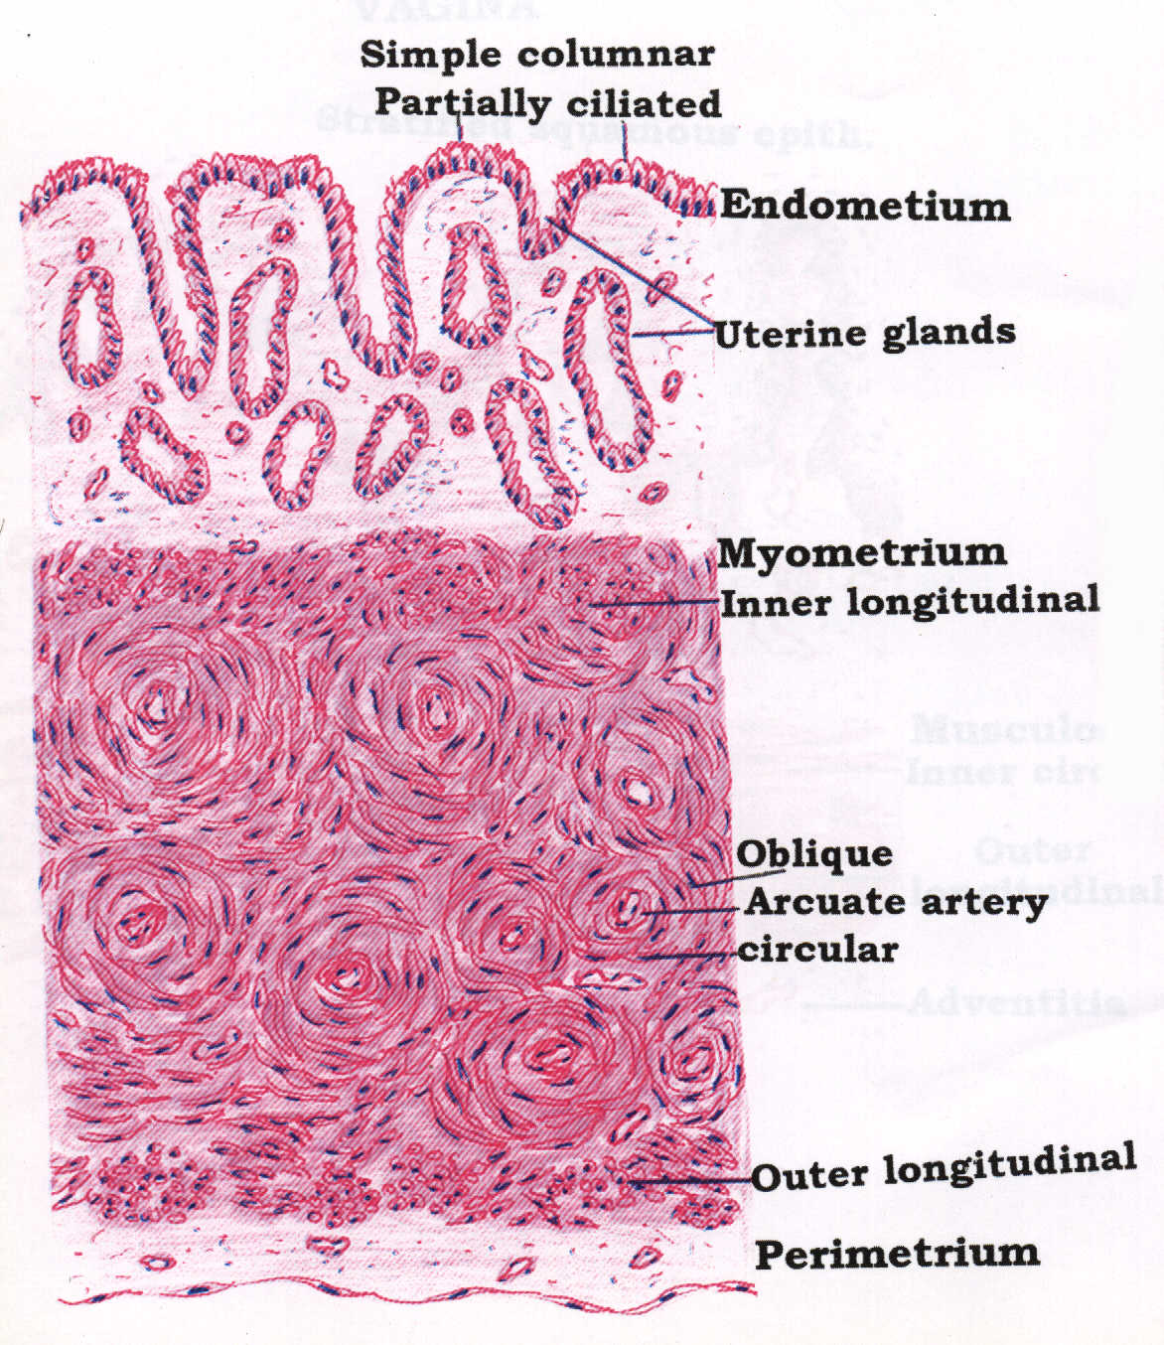
The uterus
I-Fundus & Body
Consist of:
1. Endometrium (mucosa)
2. Myometrium (musculosa)
3. Perimetrium (serosa)

Slide 16
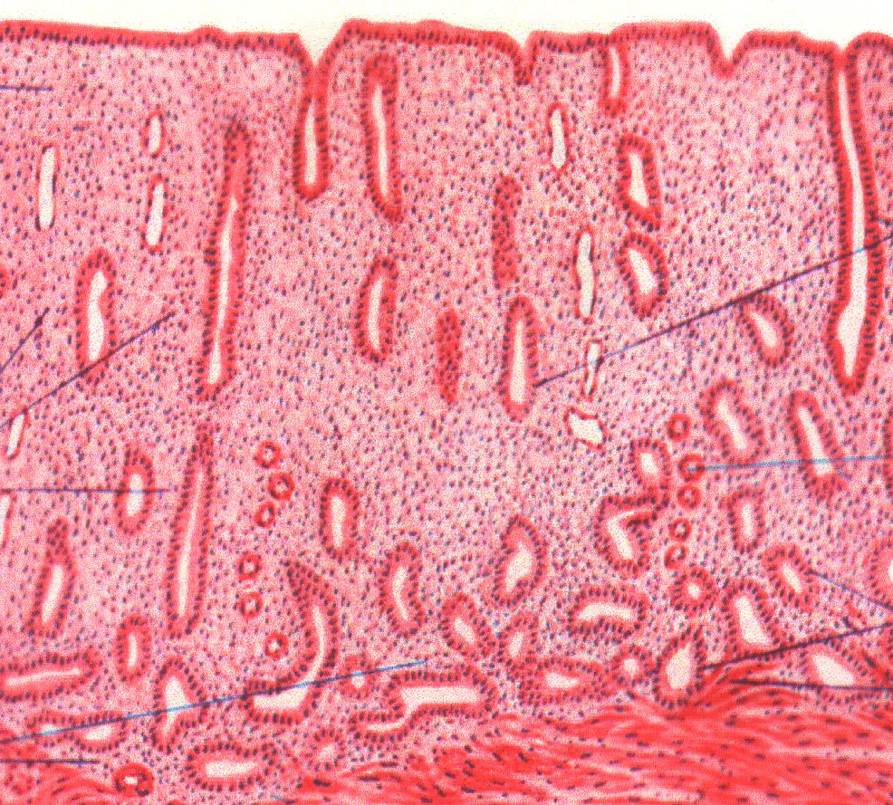
1. Endometrium
Epithelium: simple columnar partially ciliated.
Corium:
Endometrial glands: simple tubular.
Stromal cells.
Blood vessels.
Leucocytes.
Reticular fibers.

Slide 17
2.Myometrium
3 ill-defined smooth muscle layers:
Stratum submucosum: longitudinal.
Stratum vasculare: circular smooth muscle fibres in figure of 8 arrangement around large blood vessels.
Stratum supravasculare: longitudinal.
3.Perimetrium
Formed of simple squamous epithelium (mesothelium) and sub-epithelial C.T.

Slide 18
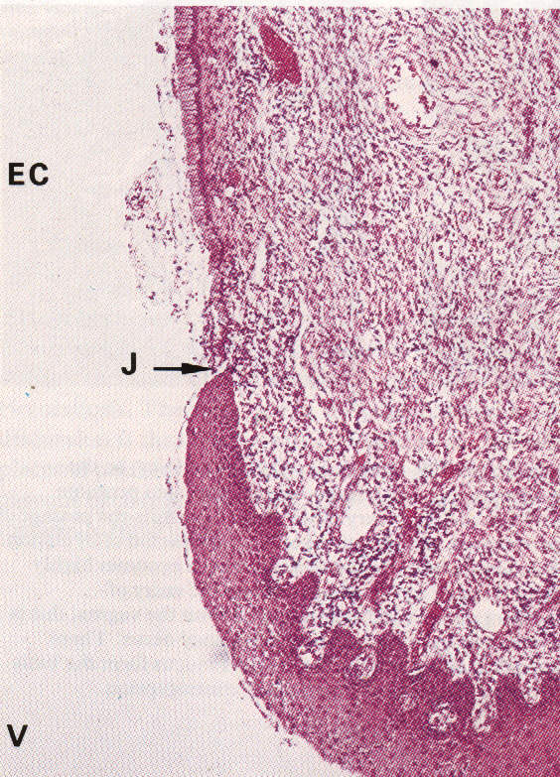
The uterus
II-Uterine Cervix
Mucosa:
Epithelium: simple columnar in the cervical canal, but it changes to stratified squamous epith. (non-keratinized) at the external os.
Corium: CT containing tubulo-alveolar glands.
Substance of the cervix: dense fibrous tissue with few smooth muscle fibers.

Slide 19
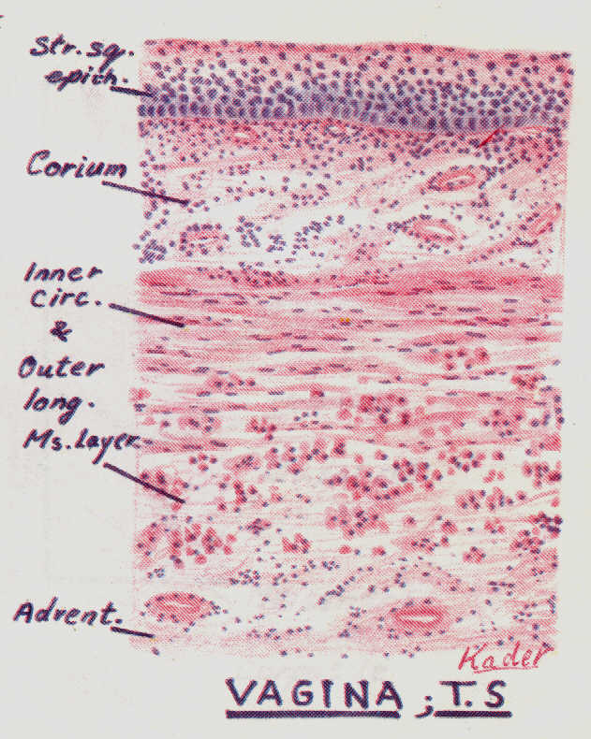
VAGINA
Mucosa: shows transverse folds and is made of:
Epithelium: stratified squamous epithelium non-keratinized, rich in glycogen.
Corium: of dense C.T., very rich in blood vessels, elastic fibres and leucocytes.
Musculosa: formed of interlacing inner circular and outer longitudinal layers of smooth muscle fibres.
Adventitia: formed of loose C.T.

Slide 20
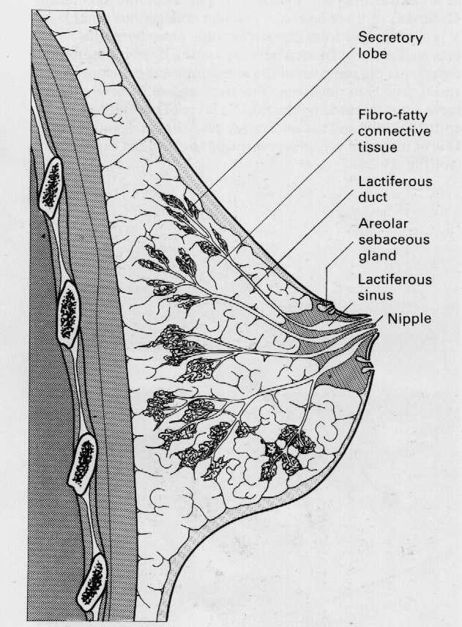
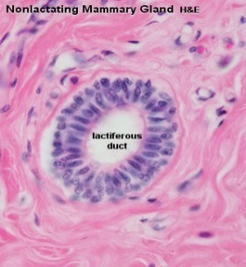
MAMMARY GLAND
At puberty they enlarge by accumulation of fat, but contain only a duct system.
Secretory units appear only during pregnancy and are functioning only during lactation.
I- Resting Mammary Gland:
It is divided into lobes and lobules.
The interlobular C.T. is dense and contains numerous fat cells.
The intralobular C.T. is loose and contains no fat cells.
Within the lobules, there are widely separated ducts lined by simple cuboidal epithelium.
Ducts collect to form lactiferous ducts lined by stratified columnar epithelium and open at the top of the nipple.

Slide 21
Mammary Gland
II-Lactating Mammary Gland:
Interlobular and intralobular C.T. become reduced.
Lobules are made of ducts and alveoli.
Alveoli are distended with milk and lined by cuboidal or flat cells surrounded by myoepithelial cells.
Milk appears acidophilic with vacuoles of dissolved fat.

Slide 22
Mammary Gland

Slide 23
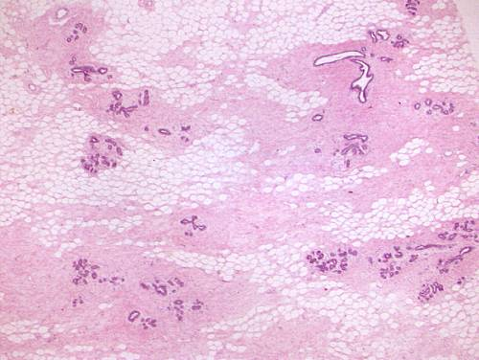
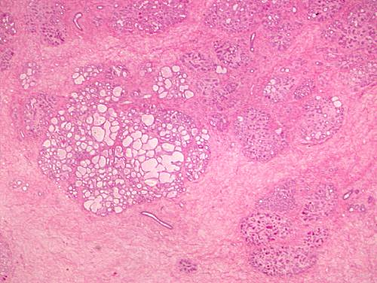
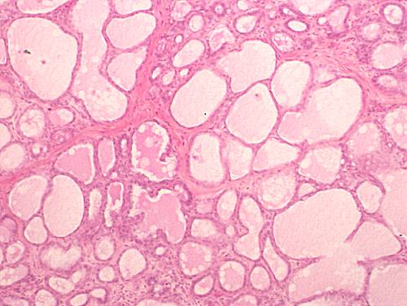
Mammary Gland
Resting (Non-Pregnant)
Lactating (Low Power)
Lactating (High Power)

