Slide 1
MALE REPRODUCTIVE SYSTEM
OBJECTIVES
At the end of this lecture, the student should be able to describe the
microscopic structure of :
Testis and epididymis.
Vas deferens.
Seminal vesicles.
Prostate.

Slide 2
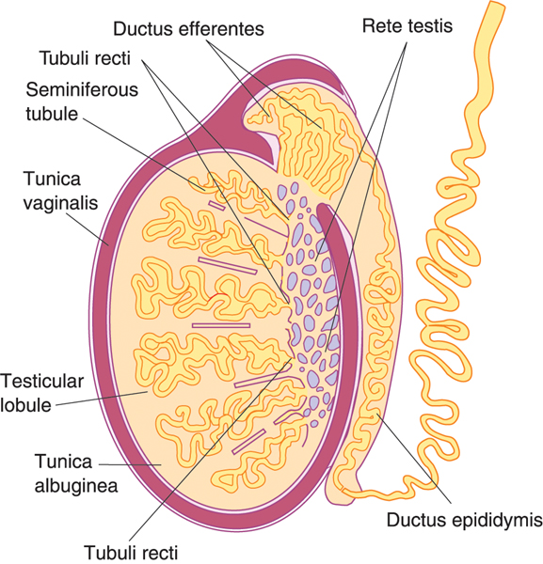
TESTIS
Stroma:
1- Tunica vaginalis.
2- Tunica albuginea.
3- Tunica vasculosa.
4- Septa.
5- Interstitial tissue.
(B) Parenchyma:
1- Seminiferous tubules.
2- Interstitial cells of Leydig.

Slide 3
STROMA OF THE TESTIS
1. TUNICA VAGINALIS It is formed of mesothelial cells. 2. TUNICA ALBUGINEA Dense irregular collagenous C.T. 3. TUNICA VASCULOSA It is formed of loose vascular C.T. lining tunica albuginea & speta from inside.

Slide 4
Septa of the Testis
Dense irregular collagenous C.T.
Divide the testis into about 250 intercommunicating compartments
(testicular lobules = lobuli testis).

Slide 5
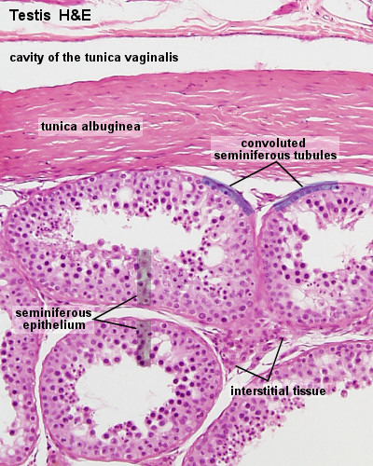
Interstitial Tissue
Loose vascular C.T. in between the seminiferous tubules.
Contents:
1- Loose vascular C.T.
2- Interstitial cells of Leydig.

Slide 6
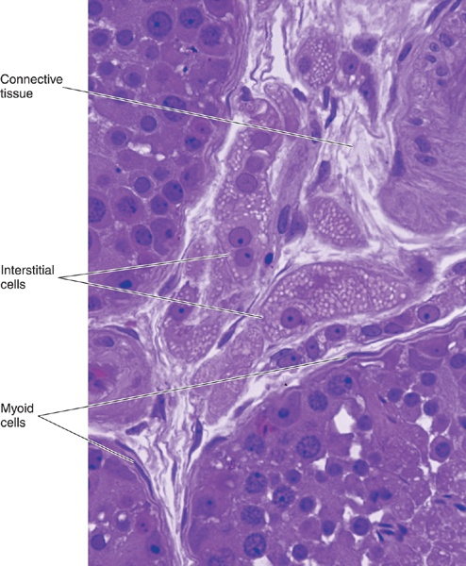
PARENCHYMA OF THE TESTIS
It is formed of:
Exocrine part: The seminiferous tubules which produce spermatozoa.
Endocrine part: interstitial cells of Leydig which produce testosterone.

Slide 7
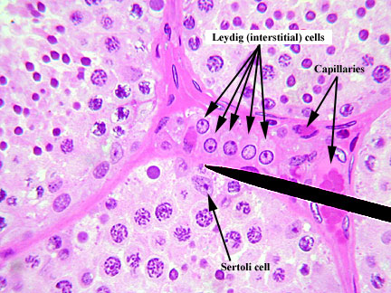
Interstitial Cells of Leydig
Are rounded or polygonal cells with central rounded nucleus.
Cytoplasm: acidophilic & vacuolated.
Function:
Secrete testosterone.

Slide 8
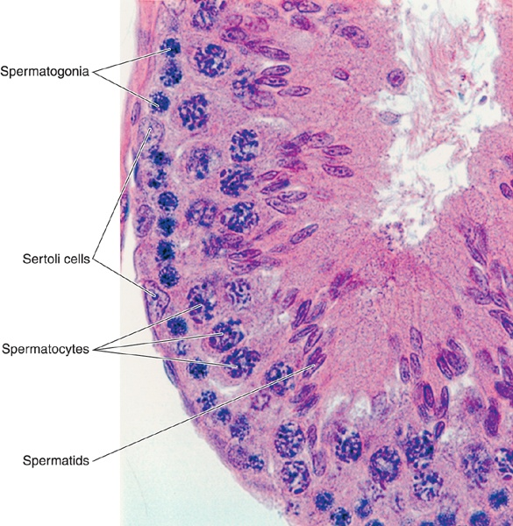
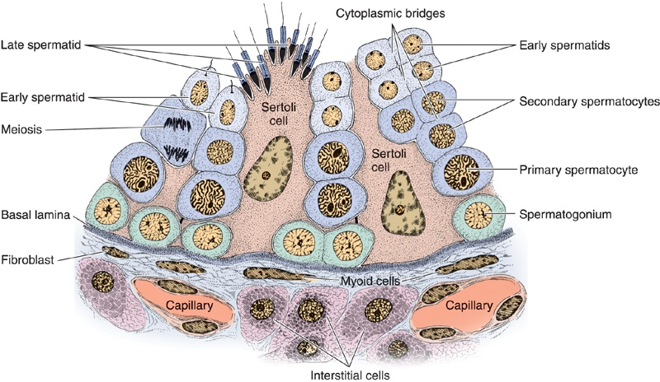
Seminiferous Tubules
Each tubule is lined with a stratified epithelium called seminiferous epithelium which is formed of 2 types of cells:
1- Spermatogenic cells.
2- Sertoli cells.
Each tubule is surrounded by a basement membrane.

Slide 9
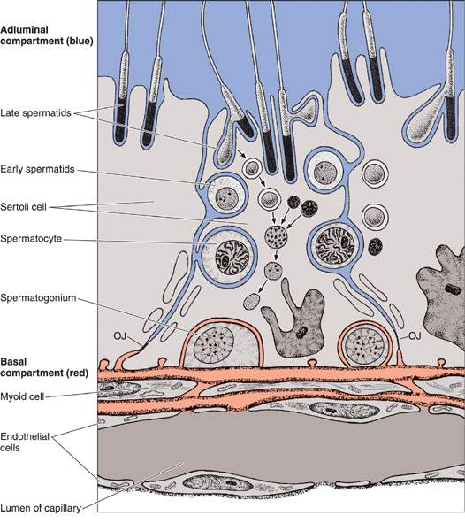
Sertoli Cell
Are columnar or pyramidal cells.
Nucleus: Basal, vesicular, irregular with prominent nucleolus.
Functions:
1- Support & Nutrition of spermatogenic cells.
2- Phagocytosis of cytoplasmic remnants of spermatogenesis.
3- Secretion: *Testicular fluid,
*Androgen Binding Protein (ABP),
*Inhibin hormone.
4- Formation of blood-testis barrier.

Slide 10
Blood-Testis Barrier
It is formed by the tight junctions between the basal parts of the lateral borders of adjacent Sertoli cells.
It divides the seminiferous tubule into 2 compartments:
1- Basal compartment: contains spermatogonia.
2- Adluminal compartment: contains the other spermatogenic cells.
Function:
1- It protects the developing spermatogenic cells from drugs and toxic materials.
2- It prevents autoimmune infertility.

Slide 11
Spermatogenic Cells
A series of cells lining the seminiferous tubules extending from the BM to the lumen.
Include:
Spermatogonia.
1ry spermatocytes.
2ry spermatocytes.
Spermatids.
Spermatozoa.

Slide 12
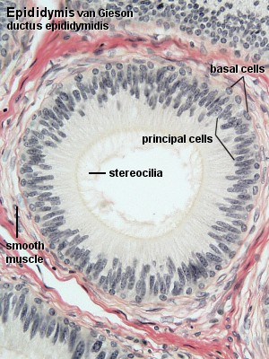
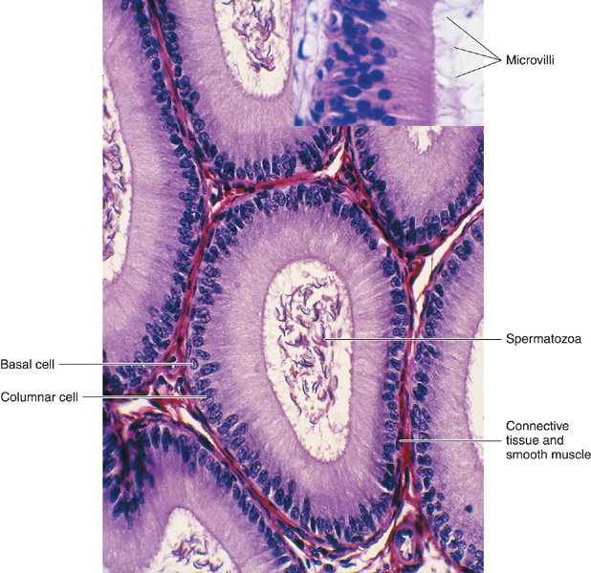
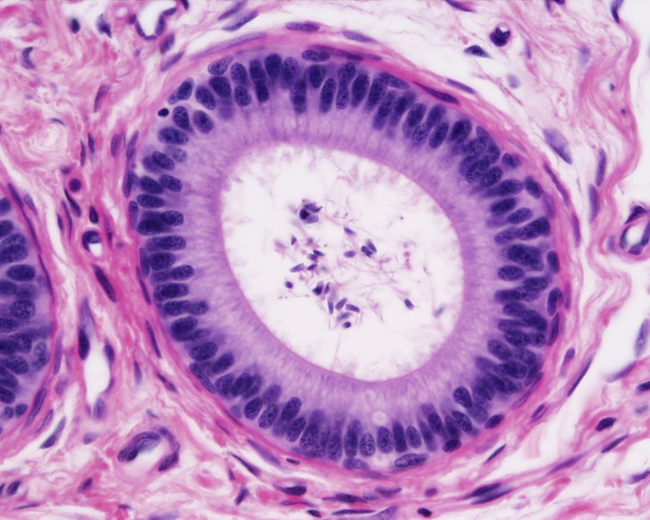
EPIDIDYMIS) DUCTUS EPIDIDYMIS)
Structure:
Epithelium:Ps. Str. Col. E. with stereocilia.
(2) Basal lamina.
(3) Loose C.T.
(4) Layer of circularly-arranged smooth muscle cells.
Functions:
a. Storage & maturation of spermatozoa.
b. Propelling spermatozoa to the vas deferens.

Slide 13
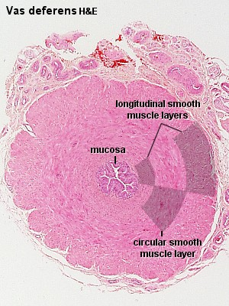
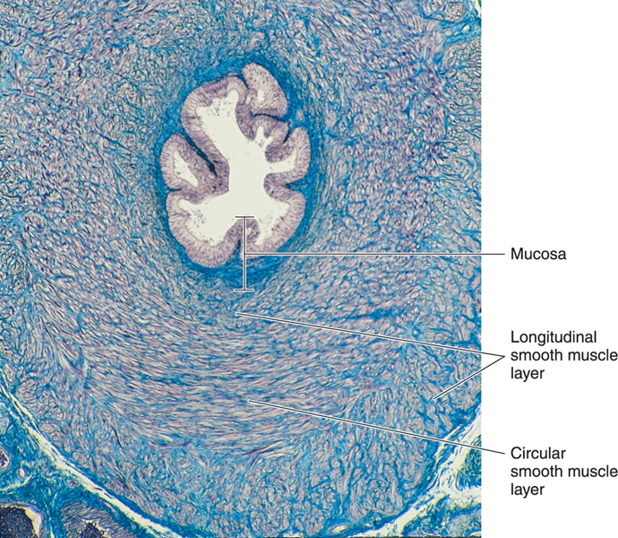
DUCTUS DEFERENS (VAS DEFERENS)
It is a muscular narrow tube with irregular lumen.
Structure:
(1) Mucosa: Ps. Str. Col. E. With stereocilia (immotile cilia) on a corium of loose C.T.
(3) Musculosa (thick; 3 layers):
Inner longitudinal muscle layer.
Middle circular “ “ .
Outer longitudinal “ “ .
Adventitia: loose C.T.
Function: Propelling of spermatozoa by strong peristalsis.

Slide 14
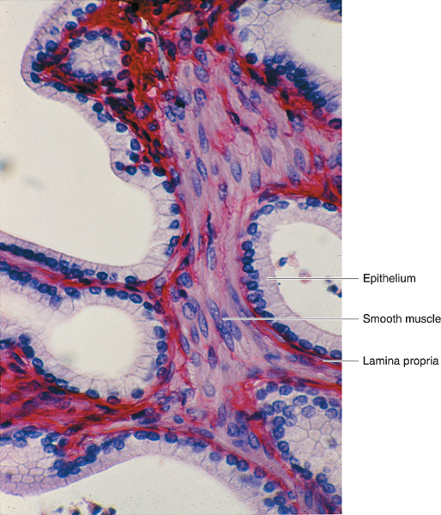
SEMINAL VESICLES
(1) Mucosa: is highly folded. - Epithelium: Ps. Str. Col. E. - Lamina propria of C.T.
(2) Musculosa:
- Inner circular layer. - Outer longitudinal layer.
(3) Adventitia: C.T.
Function:
Secretion of most of seminal fluid, rich in fructose & vit. C. which are the main nutrients for spermatozoa.

Slide 15
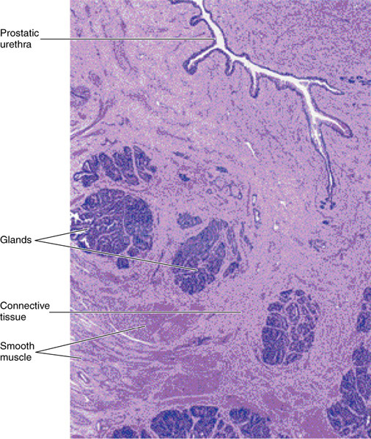
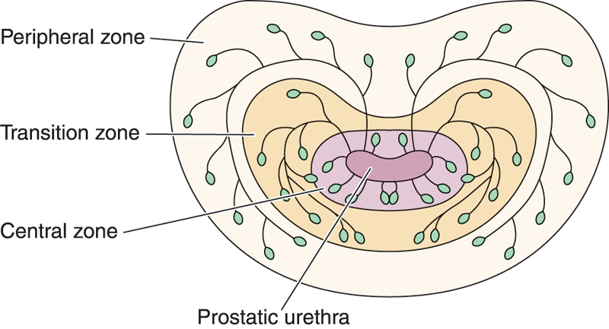
PROSTATE
Stroma: fibromuscular capsule & trabeculae.
Parenchyma: 30-50 glands in 3 concentric groups around the prostatic urethra:
Mucosal group: small.
Submucosal group: medium-sized.
Main group: Large, 70% of all glands.

Slide 16
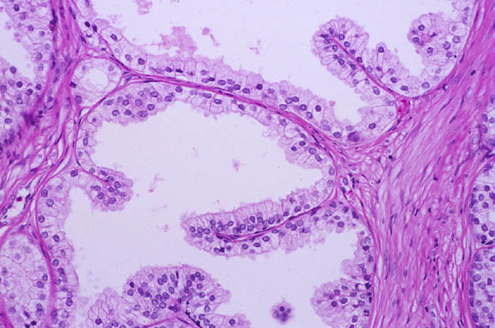
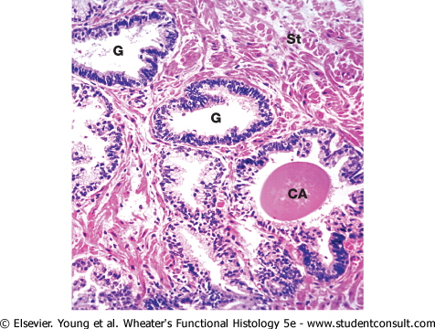
PROSTATE
Acini and ducts are lined with simple Col. or Ps. Str. Col. E. according to activity of the glands.
Prostatic concretions (corpora amylacea):
- Round or oval masses of glycoprotein in the lumen of some glands.
- Increase with advancement of age & become calcified.
Function: participates in the secretion of the seminal fluid. Its secretion is rich in acid phosphatase & proteolytic enzymes.

Slide 17
BEST WISHES

