Slide 1

Transplacental infections
( Reproductive Block , Microbiology : 2019)
By: Dr.Malak El-Hazmi

Slide 2
OBJECTIVES;
Types of infant infections.
Major transplacentaly transmitted pathogens causing congenital infections .
    Toxoplasma ,
    Treponema pallidum ,
    Parvovirus ,
    Varicella Zoster Virus,
    Rubella virus ,
    Cytomegalovirus.
Their major features & epidemiology .
Manifestations of congenital infection.
Diagnosis of congenital infection.
Their Treatment and Prevention.

Slide 3
infant infections
Classification | Timing of events | Mechanisms
Congenital | In utero | Trans placental
Perinatal | During labour and delivery | Exposure to genital secretions and blood
Neonatal | After birth | Direct contact, breast feeding or nosocomial exposure

Slide 4
Congenital infections
mostly viruses
previously known as ( TORCH) infections:
    T= Toxoplasma gondii,
    O=Others
    (Treponema pallidum ,Parvovirus &VZV),
    R=Rubella V,
    C=CMV,
    H=Herpes( Hepatitis &HIV),

Slide 5
Congenital infections
Risk of IUI & fetal damage ;
    Type of org.(teratogenic)
    Type of maternal inf.(1º,R)
    Time of inf .(1^{st ,}2nd or 3rd)
1º Maternal infection in the first half of pregnancy
poses the greatest risk to the fetus

Slide 6
Congenital infections
Common Findings
Intrauterine growth retardation(IUGR)
Hepatosplenomegaly(HSM)
Thrombocytopenia
Microcephaly
Majority of CI (“asymptomatic”) at birth
Preventative and therapeutic measures ;
possible for some of the agents

Slide 7
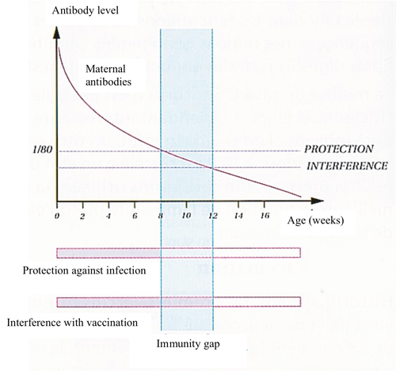
Neonatal serological Dx;
IgM antibody
Persistence of specific IgG antibody >12 ms of age
Absence of fetal IgM at birth
does not exclude infection

Slide 8
Transplacental infections
( TORCH)
T= Toxoplasma gondii
    (Treponema pallidum ,Parvovirus &VZV)
    R=Rubella V
    C=CMV

Slide 9
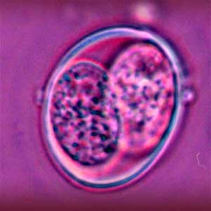
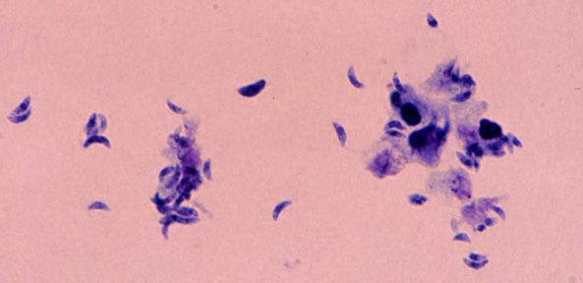
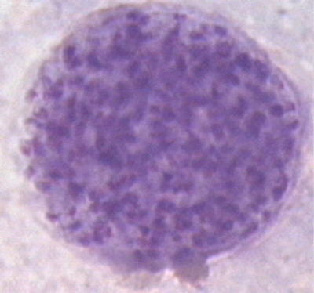
Toxoplasma Gondii
Obligate intracellular parasite
Three forms:
Oocysts;
Tachyzoites:
Bradyzoites:
Immunity +
Immunity -
Shed in cat feces
rapidly dividing forms
ACUTE PHASE
slowly dividing forms
CHRONIC PHASE

Slide 10
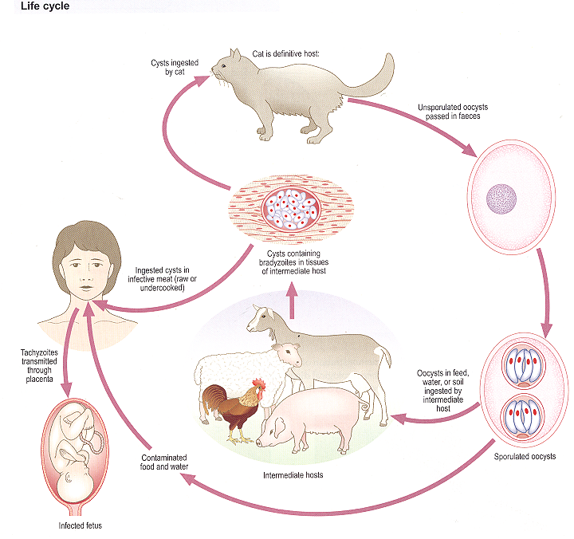
Toxoplasma gondii,
TRANSMISSION:
    Ingestion of oocyst:
    Contaminated fingers,soil,water
    Ingestion of cyst in undercooked meat.
    Blood transfusion and organ transplant

Slide 11
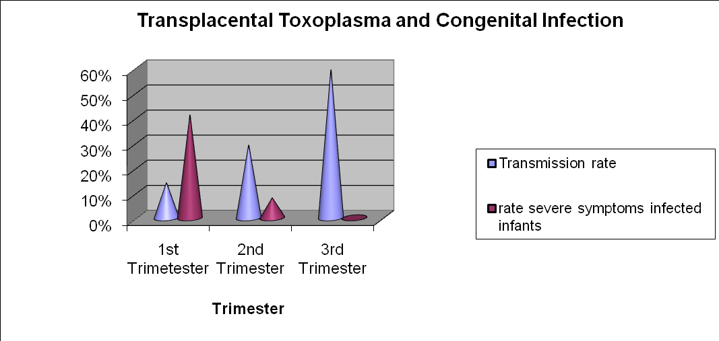
TOXO
Congenital infection ;
Most cases, due to 1⁰ maternal inf.
Rarely, reactivation of a latent inf.

Slide 12
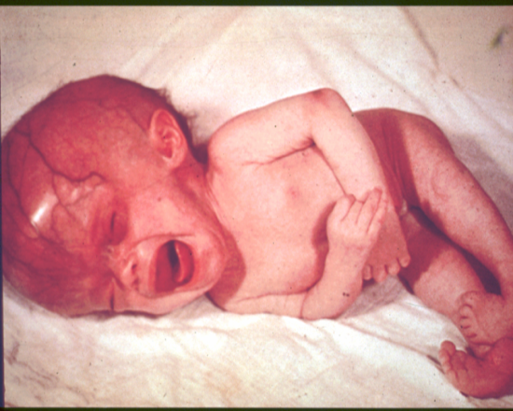
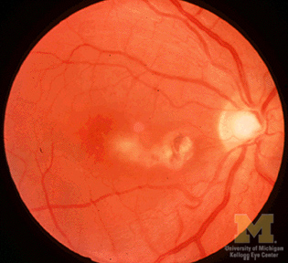
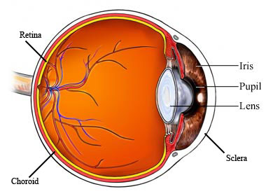
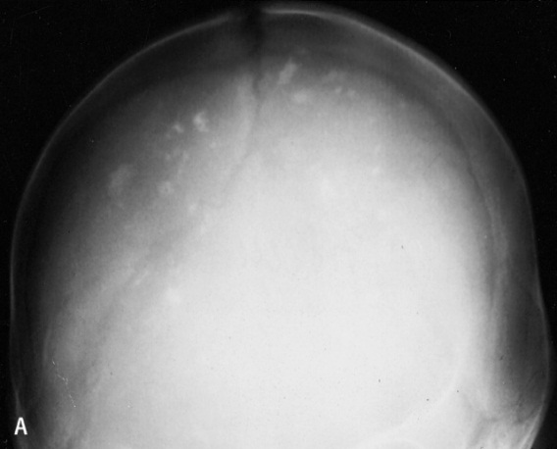
Congenital infection ;
TOXO
Most (70-90%) are asymptomatic at birth
but are still at high risk of developing abnormalities,
especially eye (chorioretinitis )/neurologic disease(MR) later.
Classic triad :
Other signs include ;
rash, HSM, jaundice, LAP, microcephaly, seizures, thrombocytopenia.
Abortion & IUD.
  Intracranial calcifications
  Chorioretinitis
Hydrocephalus

Slide 13
Dx
TOXO
  Infant
  *Prenatal Dx;
  Serial U/S
  PCR
  Culture
  *Postnatal Dx;
  Serology;
    IgM
    IgG or persistently +ve >12 ms
  PCR
  Culture
  Evalution of infant
  (ex, neuroimaging)
Pregnant mother
  Serology;
  IgM,
  IgG
  IgG avidity
  IgG seroconversion
  compared to booking blood.

Slide 14


Rx
TOXO
  Spiramycin.
  pyrimethamine& sulfadiazine.
Prevention
  Avoid exposure to cat feces;
  Wash ;- hands with soap and water
  - fruits/vegetables,
  - surfaces that touched
  fruits/vegetables/raw meat.
  Cook all meats thoroughly

Slide 15
Transplacental infections
( TORCH)
    T= Toxoplasma gondii,
    O=Other
    (Treponema pallidum ,Parvovirus &VZV),
    R=Rubella V
    C=CMV

Slide 16
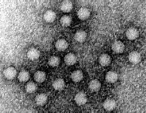
Parvovirus B19
Parvoviridae
non developed V.
Icosahedral capsid
& s.s DNA genome.
Epidemiology:
Worldwide distribution
Humans are known hosts
Transmission
  Respiratory route
  Blood transfusion
  Transplacental route

Slide 17
Clinical presentation;
Parvo
1.Acquired infection;
*Immunocompetent host *Immunocompromised pts
Erythema infectiosum
2.Congenital infection;

Slide 18
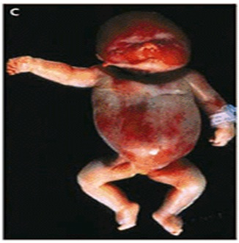
Congenital infection
Parvo
Risk of congenital infection is greatest when inf occur in 1st 20 wks
Inf in the 1st trimester IUD (Intrauterine death)
Inf in the 2nd trimester HF(Hydrops fetalis)
Inf in the 3rd trimester Lowest risk
Cause fetal loss through hydrops fetalis,severe anaemia,CHF, generalized oedema and fetal death

Slide 19
Dx
Parvo
Rx:
Intrauterine transfusion
Pregnant mother;
  Specific IgM.
  IgG seroconversion.
Prevention:
Hygiene practice
No vaccine (TRIAL)
Prenatal Dx;
  U/S (hydrops)
  Not grow in c/c.
  PCR

Slide 20
Transplacental infections
( TORCH)
    T= Toxoplasma gondii,
    O=Other
    (Treponema pallidum ,Parvovirus &VZV),
    R=Rubella V
    C=CMV

Slide 21
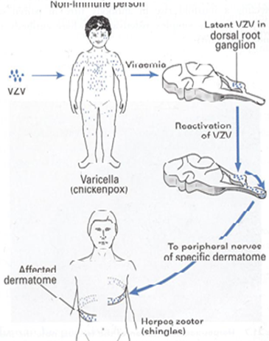
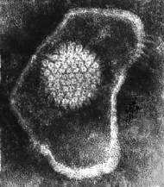
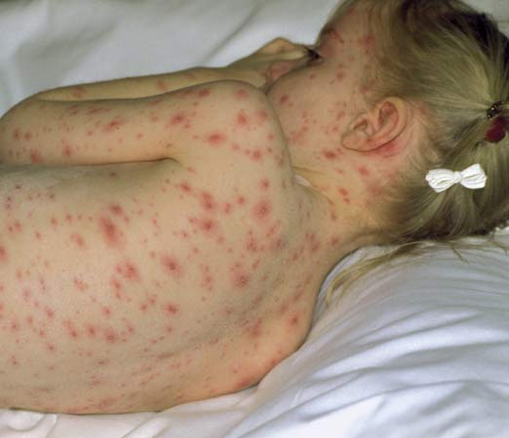
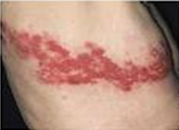
Varicella Zoster VirusVZV
Herpesviridae
    dsDNA , Enveloped , Icosahedral Virus
Transmission
  Respiratory route
  Transplacental route
Clinical presentations
  Acquired infection ;
    Varicella : Chickenpox:
      1º illness
      Generalized vesicular rash
    Zoster: Shingles:
      Recurrent inf
      Localized VR
Congenital infection ;

Slide 22
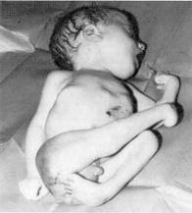
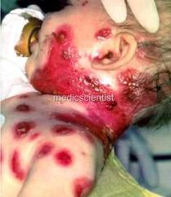
VZV infection in Pregnancy
Primary infection carries a greater risk of severe disease,
in particular pneumonia.
Intrauterine infections
congenital varicella syndrome ;
1st 20 weeks of Pregnancy
The incidence of CVS is ~ 2%
  Scarring of skin
  Hypoplasia of limbs
  CNS defects
  eye defects
Neonatal varicella ;
      < 5 days of delivery severe disease
      > 5 days before delivery mild disease

Slide 23
Diagnosis
vzv
Pregnant mother
Direct ex:
  Vesicular fluid for
  virus isolation
  Cells scraping from the base of vesicles
  ImmunoFluorescent test (Ag)
  DNA-VZV by PCR
Serological test:
    IgM AB
Infant;
Prenatal Dx
    U/S
    VZV DNA in
    FB or AF or placenta villi.
B. Postnatal Dx
    VZV IgM
    virus isolation
    VZVDNA in VF
    or CSF ( CNS inf )

Slide 24
Rx
vzv
Acyclovir
Prevention;
Pre exposure;
Varicella vaccine (LAV)
Post exposure;
VZIG
  susceptible pregnant women have been exposed to VZV.
  infants whose mothers develop V < 5 to 2 days after delivery.

Slide 25
Transplacental infections
( TORCH)
    T= Toxoplasma gondii,
    O=Other
    (Treponema pallidum,Parvovirus &VZV)
    R=Rubella V
    C=CMV

Slide 26
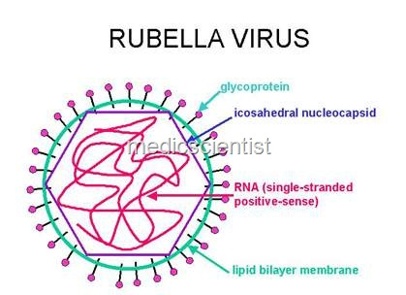
Rubella Virus
Togaviridae
SS RNA genome
Icosahedral capsid
Enveloped Virus
Epidemiology:
Humans
Transmission
  Respiratory route
  Transplacental route
A world wide distribution ed . ?

Slide 27
RV
Clinical manifestation:
Acquired infection ;
Ex. Maculopapular rash
                (Rubella = German measles)
Congenital infection;
Normal CRS IUD
Risk of acquiring congenital rubella infection varies and depends on gestational age of the fetus at the time of maternal infection.
gestational age risk to fetus
0-12 wks 70%
13-16 wks 20%
>16 wks Infrequent

Slide 28
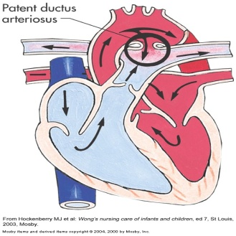
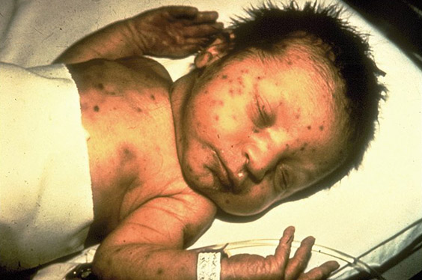
Congenital Rubella Syndrome
Triad of abnormalities
Sensorineural hearing loss*
Cataracts and glaucoma
Cardiac malformations
( patent ductus arteriosus )
Neurologic defects
Others
growth retardation,
bone disease,
HSM, thrombocytopenia,
“blueberry muffin” lesions
Affecting ears , eyes & heart
“Blueberry muffin” spots

Slide 29
RV
Dx;
Pregnant mother
Serological diagnosis
Rubella specific IgM
IgG seroconversion
  Infant
  *Prenatal Dx;
  U/S
  Culture
  PCR
  *Postnatal Dx;
  Serology;
    IgM
    Persistance of IgG >9-12 ms
  Culture
  PCR

Slide 30
RV
Prevention:
Rubella vaccine ;(LAV)
Routine antenatal screening:
Rubella specific IgG
Non-immune women vaccination
( avoid pregnancy for 3 months).

Slide 31
Transplacental infections
( TORCH)
    T= Toxoplasma gondii,
    O=Other
    (Treponema pallidum,Parvovirus &VZV),
    R=Rubella V
    C=CMV

Slide 32
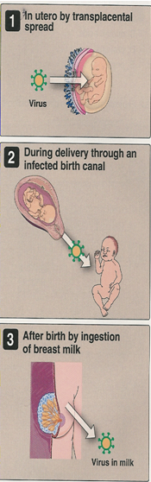
Cytomegalovirus CMV*
Herpesviridae
    dsDNA , Enveloped ,
    Icosahedral Virus.
Epidemiology
Human ,worldwide .
Transmission(tn)
  1- Horizontal tn
  Young children: saliva
  Later in life: sexual contact
  Blood transfusion
  & organ transplant
2- Vertical tn
1⁰ CMV inf . Recurrent CMV inf
(~40%) (~1%)
    Establishes in latent form
    reactivation
    Recurrent inf

Slide 33

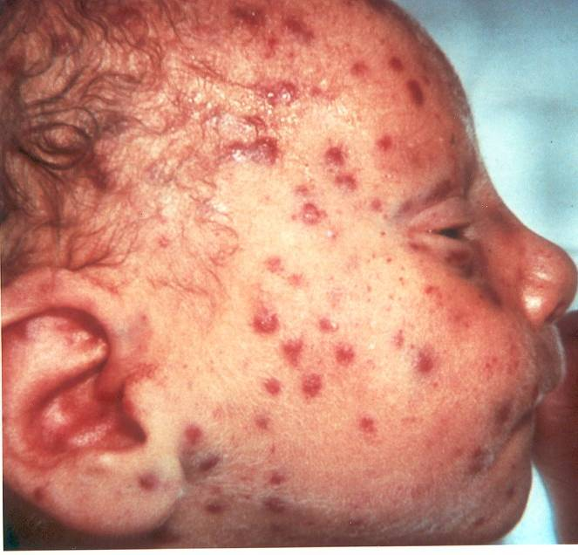
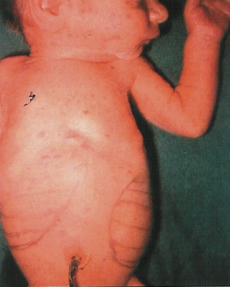
CMV
Congenital Infections:
Clinically normal
Blueberry muffin” spots
15% Hearing defect mental retardation
4% Cytomegalic inclusion disease
1% death

Slide 34
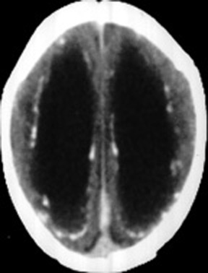
Cytomegalic Inclusion Disease;
Ventriculomegaly & calcifications
of congenital CMV
CNS abnormalities - microcephaly,
periventricular calcification.
Eye - chorioretinitis
Ear - sensorineural deafness
Liver – HSM and jaundice.
Lung - pneumonitis
Heart - myocarditis
Thrombocytopenic purpura

Slide 35
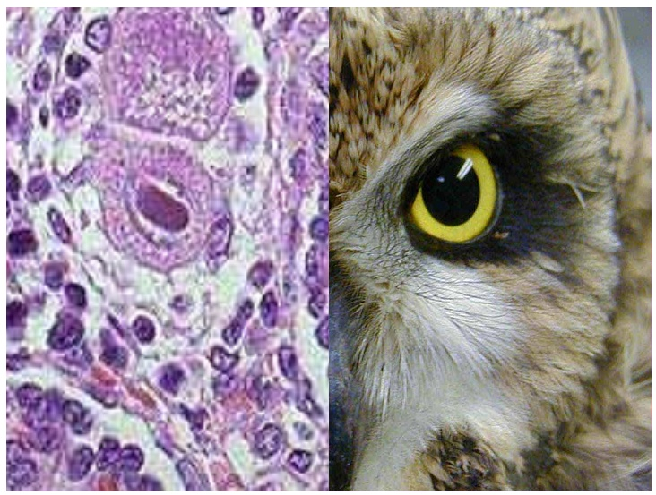
Dx.
CMV
Maternal :
  Serology ;
        CMV IgM
        CMV IgG
        CMV IgG avidity
Prenatal :
Ultrasound
  culture
  PCR
Postnatal:
by isolating CMV or detection of its genome
in first 3 wks of life.
  Body fluid : urine, saliva, blood.
  By
    Standard tube culture method
    Shell vial assay
    PCR
Histology;
Detection of Cytomegalic Inclusion
Bodies in affected tissue
Serology; CMV IgM
  Intranuclear I B [Owl’s -eye]

Slide 36
Rx
CMV
Symptomatic infants Ganciclovir .
Prevention !?
  Education about CMV
  & how to prevent it
  through hygiene;
  hand washing
  Vaccine is not available
(TRIAL)

Slide 37
OBJECTIVES;
Upon completion of this lecture, the students should be able to
To recognize the different types of infant infections.
To know major transplacentaly transmitted pathogens causing congenital infections .
(Toxoplasma , TP ,ParvoV , VZV, Rubella V & CMV.)
To describe their structures.
To know their major epidemiology features.
To describe clinical manifestations of their congenital infections
To illustrate different laboratory diagnosis of maternal and congenital infections.
To know their treatment and preventive measures.

Slide 38
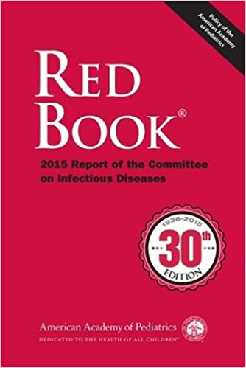
Reference books

Slide 39


